Slide 2
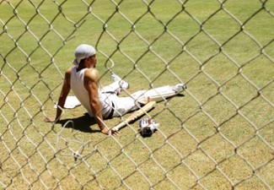
A Conversation with a Young Man in London
President Gordon B. Hinckley
“He said, ‘I’ve got to talk with someone. I’m all alone. …’
“And I said, ‘What’s your problem?’
“And he said, ‘When I joined the Church a little less than a year ago, my father told me to get out of his home and never come back. And I’ve never been back.’
“He continued, ‘A few months later the cricket club of which I was a member read me off its list, barring me from membership with the boys with whom I had grown up and with whom I had been so close and friendly.’
“Then he said, ‘Last month my boss fired me because I was a member of this church, and I have been unable to get another job. …
“‘And last night the girl with whom I have gone for a year and a half said she would never marry me because I’m a Mormon’”

Slide 3
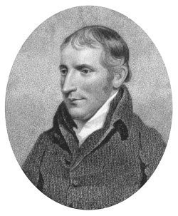
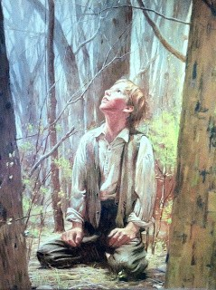
Severely Tested
After Joseph Smith’s Conversation with the Methodist Preacher
“…he treated my communication not only lightly, but with great contempt, saying it was all of the devil, that there were no such things as visions or revelations in these days; that all such things had ceased with the apostles, and that there would never be any more of them.
“…cause of great persecution, which continued to increase; and though I was an obscure boy, only between fourteen and fifteen years of age, and my circumstances in life such as to make a boy of no consequence in the world, yet men of high standing would take notice sufficient to excite the public mind against me, and create a bitter persecution; and this was common among all the sects—all united to persecute me.”
Joseph Smith –History 1:22-23

Slide 4
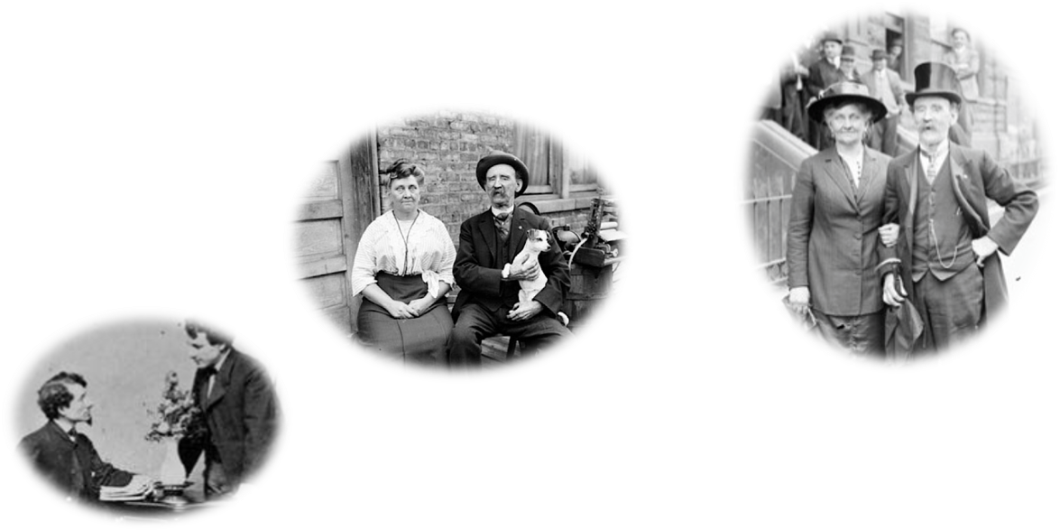
The Persecutors
People of high standing in the community who claimed to be Christians
According to Joseph Smith, why did he experience this persecution at such a young age?
Satan recognized that Joseph Smith would be
“a disturber and an annoyer of his kingdom”
Joseph Smith –History 1:22-23

Slide 5
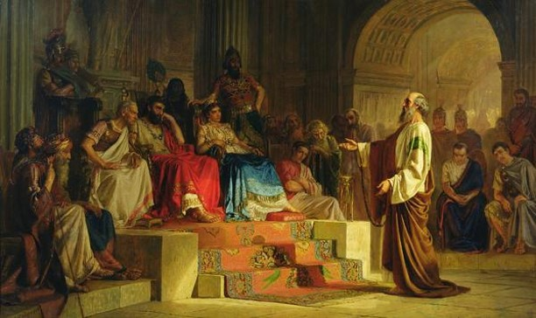
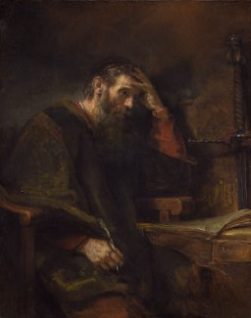
Staying True to Testimony
Joseph Smith felt like Paul in his defense to King Agrippa
Paul had been mocked for his testimony of Jesus Christ and yet remained true to it
Paul had been whipped, in prison many times, beaten with rods, stoned, three times shipwrecked, in perils of robbers, countrymen, heathen, wilderness, sea, and false teachers.
He is weary, and in pan and hungry and thirst with fasting,
naked and cold
But his testimony remains true
2 Corinthians 11:23-27
Joseph Smith –History 1:24

Slide 6
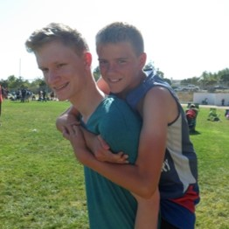
Remaining True in Difficult Times
During difficult times, we can draw strength from the examples of faithful individuals in the scriptures
When have you been strengthened by studying the experience of a faithful individual in the scriptures?
The knowledge we receive from God is true even if the world rejects it.
We should be more concerned about what God thinks of us than what men think.
Even if we are hated and persecuted for our testimonies, we must remain true to them.
Joseph Smith –History 1:25

Slide 7
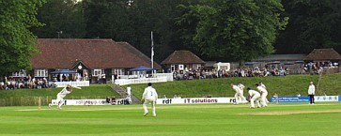
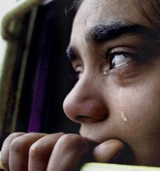
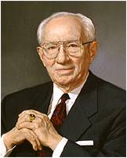
The Rest of the Story
“I said, ‘If this has cost you so much, why don’t you leave the Church and go back to your father’s home and to your cricket club and to the job that meant so much to you and to the girl you think you love?’
“He said nothing for what seemed to be a long time. Then, putting his head down in his hands, he sobbed and sobbed. Finally, he looked up through his tears and said, ‘I couldn’t do that. I know this is true, and if it were to cost me my life, I could never give it up’”
President Gordon B. Hinckley

Slide 8
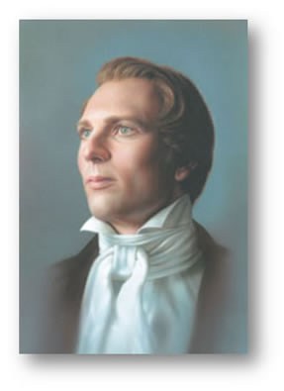
Until Further Directed
“I had now got my mind satisfied so far as the sectarian world was concerned—that it was not my duty to join with any of them, but to continue as I was until further directed. I had found the testimony of James to be true—that a man who lacked wisdom might ask of God, and obtain, and not be upbraided.”
Joseph Smith –History 1:26

Slide 9
Sources:
Video:
The Loneliness of Leadership 1:03 and 0:58
Joseph Smith and the Minister (1:57)
President Gordon B. Hinckley (“The Loneliness of Leadership” [Brigham Young University devotional address, Nov. 4, 1969], 3, speeches.byu.edu ).
Picture of Methodist Pastor—not the one Joseph talked to. The Reverend Joseph Sutcliffe, An Early Scriptural Geologist and Methodist Pastor.
Presentation by ©http://fashionsbylynda.com/blog/

