Slide 1
Lesson 8
Resisting Temptation
And Fishers of Men
Matthew 4

Slide 2
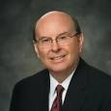
Focus
“Distractions and opposition to righteousness are not just on the Internet; they are everywhere.
They affect not just the youth but all of us.
We live in a world that is literally in commotion.”
“We are surrounded by obsessive portrayals of “fun and games” and immoral and dysfunctional lives.
[Some of] these are presented as normal conduct in much of the media.”
Were you able to focus on the words or the picture?
(1)

Slide 3
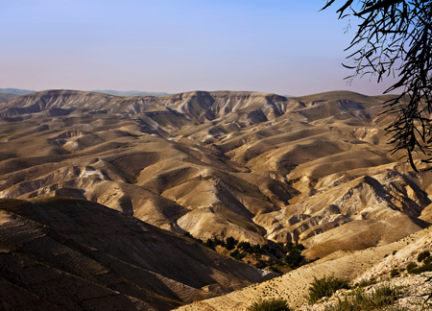
Forty Days and Forty Nights
Then was Jesus led up of the Spirit into the wilderness to be tempted of the devil.
Then Jesus was taken up into the holy city, and the Spirit setteth him on the pinnacle of the temple.
JST Matthew 4:5
To Be = To be with God
Jesus Christ did not go “into the wilderness to be tempted of the devil”, nor did the devil have power to transport Jesus Christ in order to tempt Him
And again, Jesus was in the Spirit, and it taketh him … JST Matthew 4:8
Matthew 4:1-5
(1)

Slide 4
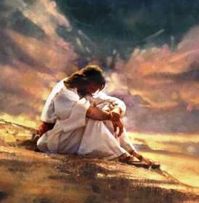
“Jesus did not go into the wilderness to be tempted of the devil; righteous men do not seek out temptation.
He went ‘to be with God.’ Probably he was visited by the Father; without question he received transcendent spiritual manifestations.
The temptations came after he ‘had communed with God,’ ‘after forty days’
Greg Olsen
Matthew 4:1-5
(2)

Slide 5
 | What Satan Tempted Jesus to Do | How Jesus Responded to the temptation
Matthew 4:3-4 | Turn the stones into bread | Physical = Hunger Man shall not live (mortality) by bread alone, but by every word (revelation) that proceedeth out of the mouth of God.
Mathew 4:5-7 | Jump ---Satan tempted Jesus to tempt the Father | Thou shalt not tempt the Lord thy God.
Matthew 4:8-11 | If you worship me you can have all | Spiritual --Thou shalt worship the Lord thy God, and him only shalt thou serve.
Matthew 4:3-11

Slide 6
Satan
Satan tries to appeal to our desires to satisfy our physical appetites
Satan promised rewards that were not his to give and that he could not provide
Satan targets our weakest or most vulnerable areas and repeatedly tempts us
(3)

Slide 7
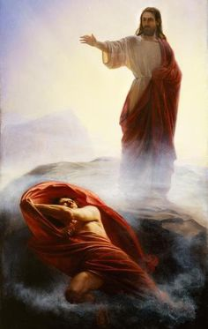
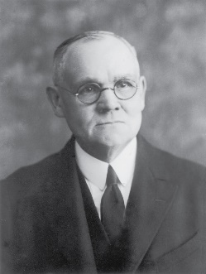
And when the devil had ended all the temptation, he departed from him for a season.
Luke 4:13
“This victory over the devil and his wiles, this triumph over the cravings of the flesh, the harassing doubts of the mind, the suggested reaching out for fame and material wealth, were great but not final successes in the struggle between Jesus, the embodied God, and Satan, the fallen angel of light.”
Matthew 4:1-5
(3)

Slide 8
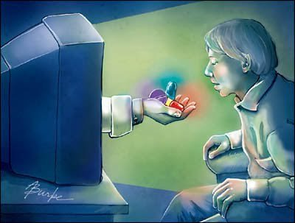
“Whatever else Satan may do, he will certainly appeal to our appetites. Far better to play on natural, acknowledged needs than struggle to plant in us artificial ones.
Here Jesus experiences the real and very understandable hunger for food by which he must sustain his mortal life.
….Why not simply turn the stones to bread and eat?
When we recall and apply truths taught in the scriptures, we can resist the devil’s temptations
“The temptation is not in the eating. He has eaten before, he will soon eat again, he must eat for the rest of his mortal life.
…But Christ will not ask selfishly for unearned bread. He will postpone gratification, indefinitely if necessary, rather than appease appetite—even ravenous appetite—with what is not his.
“Salvation comes only through discipline and sacrifice.”
(4)

Slide 9
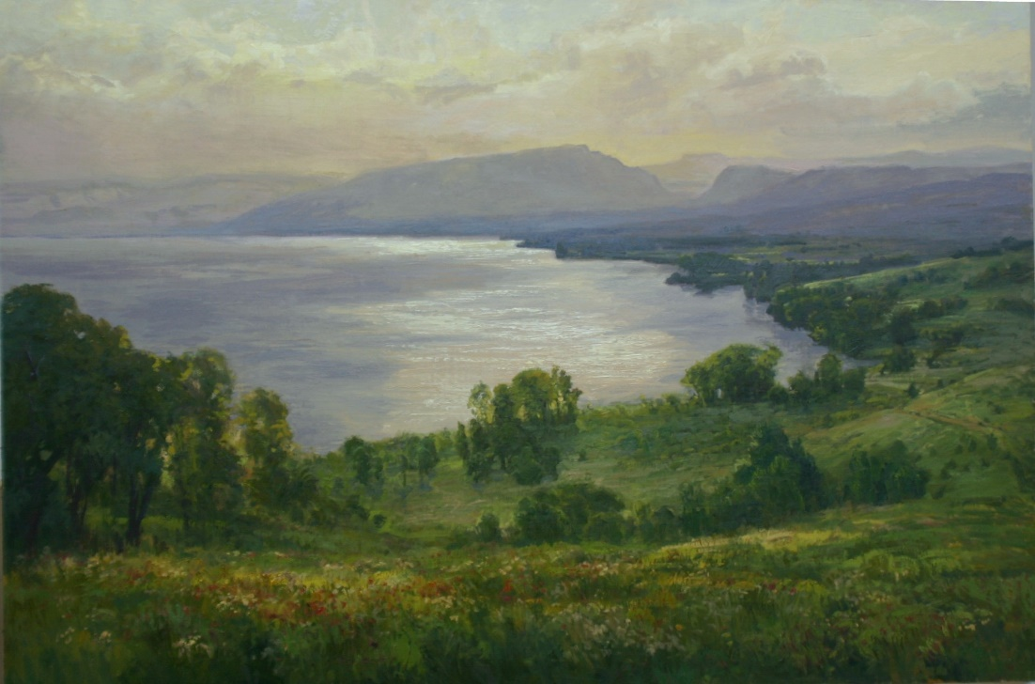
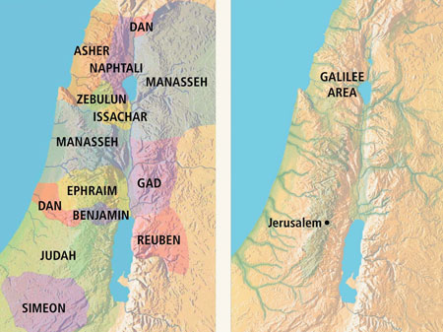
Jesus in Galilee
City of Capernaum—by the sea
Nevertheless the dimness shall not be such as was in her vexation, when at the first he lightly afflicted the land of Zebulun and the land of Naphtali, and afterward did more grievously afflict her by the way of the sea, beyond Jordan, in Galilee of the nations.
The people that walked in darkness have seen a great light: they that dwell in the land of the shadow of death, upon them hath the light shined.
The Old Testament lands of Zebulun and Naphtali became the land of Galilee in New Testament times
Matthew 4:12-17; Isaiah 9:1-2

Slide 10
Jesus Christ spent the majority of His life and ministry in the villages of Galilee—places like Capernaum, Nain, Nazareth, and Bethsaida
Jesus Christ brings light into the lives of those who are in darkness
The Savior began to preach repentance in preparation for the kingdom of heaven being established among the people.
Matthew 4:16

Slide 11
Fishers of Men
Matthew 4:19
“…Follow me and I will make you fishers of men.”
Mark 1:17
“…Come ye after me, and I will make you to become fishers of men.
Luke 5:7
“…Fear not; from henceforth thou shalt catch men.”
Matthew 4:18-22

Slide 12
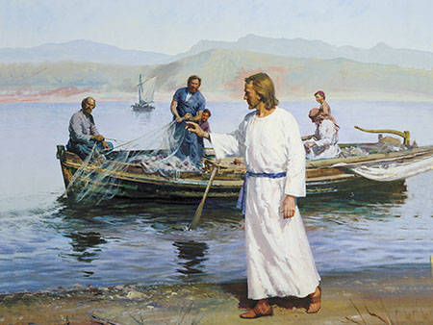
The Calling
What did the Savior call Peter, Andrew, James, and John to do?
If we immediately respond to the Savior’s invitations to follow Him, He can make more out of our lives than we can on our own.
What would these men be sacrificing to follow the Savior and assist in His work?
Matthew 4:18-22

Slide 13
Peter
He was the son of Jonah and the brother of Andrew and his name means “Rock”. He was also known as Simon. His Aramaic name, Cephas, of which Peter is the Greek equivalent, was given him by the Lord
He was originally a fisherman on the coast of Galilee
He was present at miraculous occasions and the Transfiguration
He was acting first presidency of the church in their day. However, he denied Christ three times
He was in Jerusalem at Pentecost and in prison with Cornelius and has a vision to take the gospel to the gentiles
He held the keys of the kingdom
Tradition says Peter probably died by crucifixion in Rome. (About AD 64) Head downward. (7)
In the latter days Peter, with James and John, came from heaven and literally conferred the Melchizedek Priesthood and the keys thereof upon Joseph Smith and Oliver Cowdery. This took place in May or June 1829, near Harmony, Pennsylvania.
(6)

Slide 14
James
He was the son of Zebedee, one of the Twelve, and brother of John (however there are several persons of this name)
He is also known as Jacob (Hebrew)
He was called with the other fishermen to follow Jesus.
He was given the name of Boanerges Meaning “son of Thunder”
He was baptized by John the Baptist
He was one of the three chosen to be with the Lord during special occasions: The raising of the daughter of Jairus, at the transfiguration, and at Gethsemane
He was killed by Herod in about AD 44 (Acts 12:2)
He was the first apostle martyred in early church times
(6)

Slide 15
John
He was the son of Zebedee, along with his brother James
He was one of the original 12 Apostles and a special witness to the acts and teaching of Jesus
Like Peter, he was a fisherman when Jesus called him.
He and James were two of the apostles Jesus appointed “To take the keys of Presidency.”
He was acting first presidency of the church in their day.
From Jesus he received the name Boanerges, “a son of thunder”
He was present at the raising of Jairus‘s daughter, at the Transfiguration, and present at Gethsemane.
He was banished to Patmos, there he wrote Revelation.
John did not die but has been allowed to remain on the earth as a ministering servant until the time of the Lord’s Second Coming (D&C 7; 3 Nephi 28:6)
(6)

Slide 16
Andrew
He was the son of Jonah and the elder brother of Simon Peter
He was a disciple of John the Baptist and Peter followed him 60 miles to hear the gospel
He was a fisherman along with his brother
He was one of the earliest called to be a disciple of Jesus Christ and was one of the Twelve
Andrew literally brought a young boy to Jesus, and Jesus multiplied the fish and bread to feed the multitude
Philip and Andrew went together to take the inquiring gentiles to Jesus just after the Triumphal Entry and Jesus’ end of His mortal ministry
Tradition says that Andrew was crucified at Patras, in Achaia about AD 70
(6)

Slide 17
“Men and women who turn their lives over to God will discover that He can make a lot more out of their lives than they can.
He will deepen their joys, expand their vision, quicken their minds, strengthen their muscles, lift their spirits, multiply their blessings, increase their opportunities, comfort their souls, raise up friends, and pour out peace.
Whoever will lose his life in the service of God will find eternal life.”
Matthew 4:18-22
(5)

Slide 18
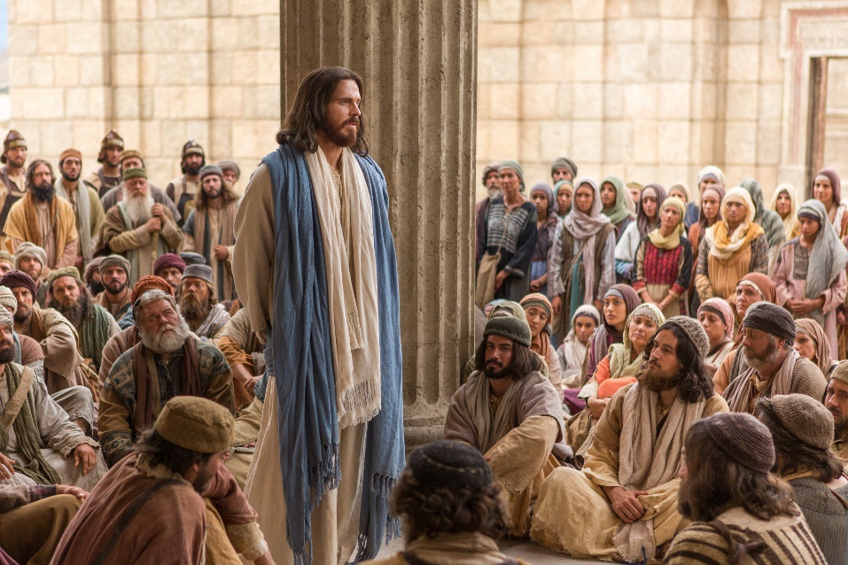
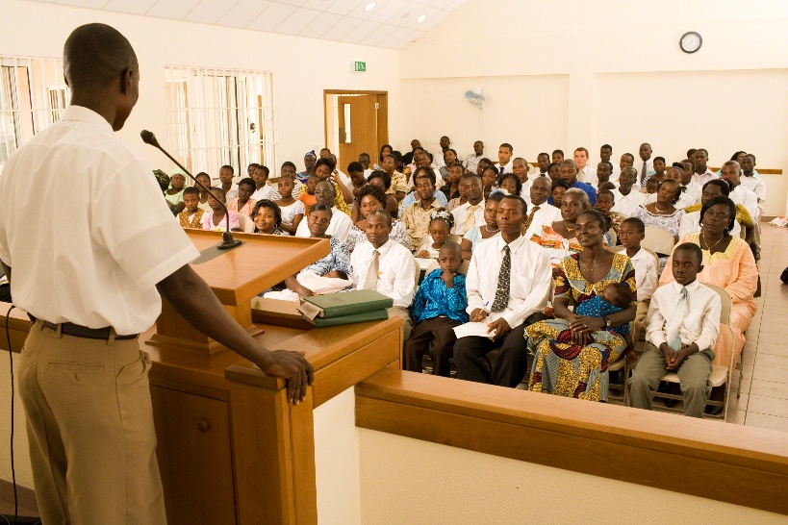
Teaching, Preaching, and Healing
“…from this earliest beginning, from the first hour, healing is mentioned almost as if it were a synonym for teaching and preaching. At least there is a clear relationship among the three. In fact, the passage that follows says more about the healing than the teaching or the preaching. …
“…our teaching can lead to healing of the spiritual kind. … As with the Master, wouldn’t it be wonderful to measure the success of our teaching by the healing that takes place in the lives of others?
(4)
Matthew 4:23-25

Slide 19
Sources:
Suggested Hymn: #220 Lord, I Would Follow Thee
Elder Quentin L. Cook Choose Wisely October 2014 General Conference
Elder Bruce R. McConkie (Doctrinal New Testament Commentary, 1:128). Joseph Smith Translation, Matthew 4:1–2; Luke 4:2]”
James E. Talmage Jesus the Christ Chapter 10
Jeffrey R. Holland, “The Inconvenient Messiah,” Ensign, Feb. 1984, 68–73.
“Teaching, Preaching, Healing,” Ensign, Jan. 2003, 33–34, 37.
President Ezra Taft Benson (“Jesus Christ—Gifts and Expectations,” Ensign, Dec. 1988, 4).
Bible Dictionary
7. Commentary on Genesis, cit. Eusebius, History 3:1 from Simon Peter By Dr. Richard Lloyd Anderson Ensign Feb. 1975
Presentation by ©http://fashionsbylynda.com/blog/

Slide 20
Opening Events in Jesus’ Ministry
Event | Matthew | Mark | Luke | John
Fast and Temptation of Jesus | 4:1-11 | 1:12, 13 | 4:1-13
Jesus Leaves Judea for Galilee | 4:12 | 1:14 | 4:14 | 4:1-3
Fast and Temptation of Jesus | 4:1-11 | 1:12, 13 | 4:1-13
Jesus Leaves Judea for Galilee | 4:12 | 1:14 | 4:14 | 4:1-3
Goes to Capernaum | 4:13-17 | 1:15
Fishers of Men: Peter, Andrew, James, and John | 4:18-22 | 1:16-20 | 5:1-11
Jesus Preaches and Heals in Galilee | 4:23-25 | 1:35-39 | 4:42-44
Source: Horizontal Harmony of the Four Gospels by Thomas M. Mumford
Peter
John
James
https://www.lds.org/ensign/1975/02/simon-peter?lang=eng
https://www.lds.org/ensign/1999/10/as-flaming-fire-and-a-ministering-angel?lang=eng
https://www.lds.org/ensign/1975/09/i-have-a-question?lang=eng

Slide 21
Matthew 4:1 Communion with God
The circumstances attending this time of exile and test must have been related by Jesus Himself, for of other human witnesses there were none. The recorded narratives deal principally with events marking the close of the forty-day period, but considered in their entirety they place beyond doubt the fact that the season was one of fasting and prayer. Christ’s realization that He was the chosen and foreordained Messiah came to Him gradually. As shown by His words to His mother on the occasion of the memorable interview with the doctors in the temple courts, He knew, when but a Boy of twelve years, that in a particular and personal sense He was the Son of God; yet it is evident that a comprehension of the full purport of His earthly mission developed within Him only as He progressed step by step in wisdom. His acknowledgment by the Father, and the continued companionship of the Holy Ghost, opened His soul to the glorious fact of His divinity. He had much to think about, much that demanded prayer and the communion with God that prayer alone could insure. Throughout the period of retirement, he ate not, but chose to fast, that His mortal body might the more completely be subjected to His divine spirit. James E Talmage Jesus the Christ Chapter 10
Fasting:
“Fasting, coupled with mighty prayer, is powerful. It can fill our minds with the revelations of the Spirit. It can strengthen us against times of temptation. Fasting and prayer can help develop within us courage and confidence. They can strengthen our character and build self-restraint and discipline. Often when we fast, our righteous prayers and petitions have greater power. Testimonies grow. We mature spiritually and emotionally and sanctify our souls. Each time we fast, we gain a little more control over our worldly appetites and passions” Elder Joseph B. Wirthlin (“The Law of the Fast,” Ensign, May 2001, 73).
Temptation:
“It is extremely difficult, if not impossible, for the devil to enter a door that is closed. He seems to have no keys for locked doors. But if a door is slightly ajar, he gets his toe in, and soon this is followed by his foot, then by his leg and his body and his head, and finally he is in all the way” (Teachings of Presidents of the Church: Spencer W. Kimball [2006], 106–7).
Matthew 4:16 Galilee:
Jesus Christ spent the majority of His life and ministry in the villages of Galilee—places like Capernaum, Nain, Nazareth, and Bethsaida. During Old Testament times this area was the inheritance of the tribes of Zebulun and Naphtali. Over the centuries, numerous battles were waged to secure control over this strategic region. Some have suggested that because so many people lost their lives in battle here, Isaiah referred to the people of this region as “them which sat in the region and shadow of death” (Matthew 4:16). Isaiah prophesied that in this death-stricken land a “great light” would spring up (Isaiah 9:2). That light is Jesus Christ, the Light of the World. Matthew wanted his readers to know that the Savior’s ministry in the land of Galilee was a fulfillment of this messianic prophecy. New Testament Student Manual Institute Chapter 2
Was Jesus Capable of Sinning?
The question as to whether He was capable of sinning. Had there been no possibility of His yielding to the lures of Satan, there would have been no real test in the temptations, no genuine victory in the result. Our Lord was sinless yet peccable (capable);
He had the capacity, the ability to sin had He willed so to do. Had He been bereft of the faculty to sin, He would have been shorn of His free agency; and it was to safeguard and insure the agency of man that He had offered Himself, before the world was, as a redeeming sacrifice. To say that He could not sin because He was the embodiment of righteousness is no denial of His agency of choice between evil and good. A thoroughly truthful man cannot culpably lie; nevertheless his insurance against falsehood is not that of external compulsion, but of internal restraint due to his cultivated companionship of the spirit of truth. A really honest man will neither take nor covet his neighbor’s goods, indeed it may be said that he cannot steal; yet he is capable of stealing should he so elect. His honesty is an armor against temptation; but the coat of mail, the helmet, the breastplate, and the greaves, are but an outward covering; the man within may be vulnerable if he can be reached.. James E Talmage Jesus the Christ Chapter 10

Slide 22
 | What Satan Tempted Jesus to Do | How Jesus Responded to the Temptation
Matthew 4:3-4
Mathew 4:5-7
Matthew 4:8-11
 | What Satan Tempted Jesus to Do | How Jesus Responded to the Temptation
Matthew 4:3-4
Mathew 4:5-7
Matthew 4:8-11
 | What Satan Tempted Jesus to Do | How Jesus Responded to the Temptation
Matthew 4:3-4
Mathew 4:5-7
Matthew 4:8-11

