Slide 1
Lesson 80 Part 1
Fishers of Men
John 21

Slide 2
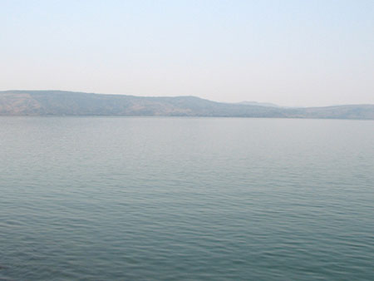
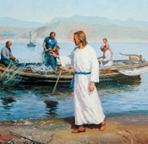
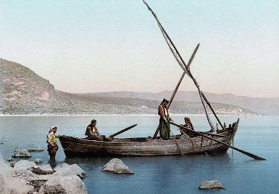
On the Sea of Galilee
North shore of the Sea of Galilee near Capernaum. John referred to the Sea of Galilee as “the sea of Tiberias”
A stranger calls out then enters a boat

Slide 3
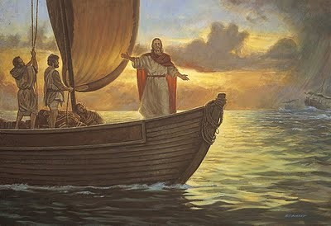
“And Simon answering said unto him, Master, we have toiled all the night, and have taken nothing…
“…nevertheless at thy word I will let down the net.”
Luke 5:5

Slide 4
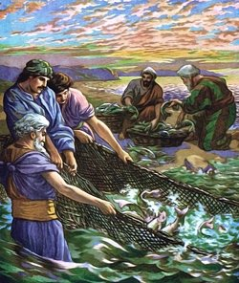
“And when they had this done, they inclosed a great multitude of fishes: and their net brake.”
Luke 5:6

Slide 5
Matthew 4:19
“…Follow me and I will make you fishers of men.”
Mark 1:17
“…Come ye after me, and I will make you to become fishers of men.
Luke 5:7
“…Fear not; from henceforth thou shalt catch men.”

Slide 6
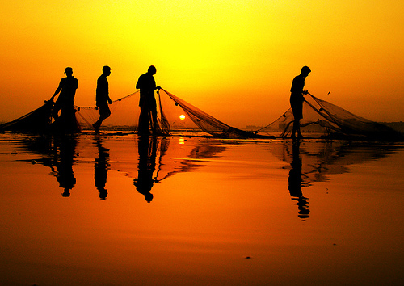
“And when they had brought their ships to land, they forsook all, and followed him.”
Luke 5:11

Slide 7
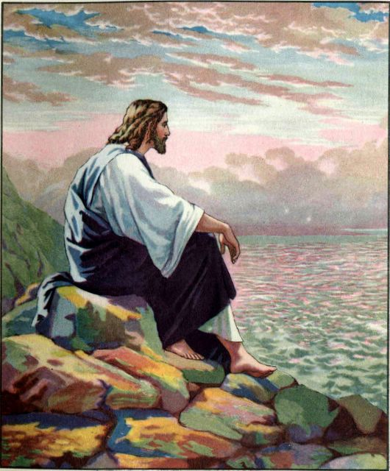
“Three years later their Lord and Master, their counselor and King, was crucified. His mortal ministry was over.”
(2)

Slide 8
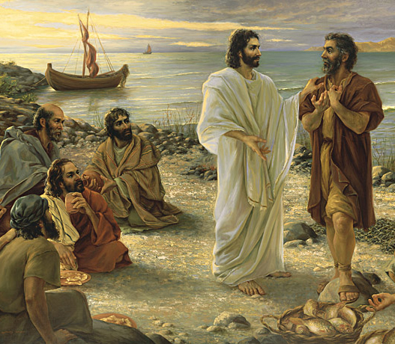
Peter wonders:
“…But that is over. He has finished His work, and He has risen from the tomb. He has worked out His salvation and ours. So you ask, ‘What do we do now?’”
Kamille Corry
(2)

Slide 9
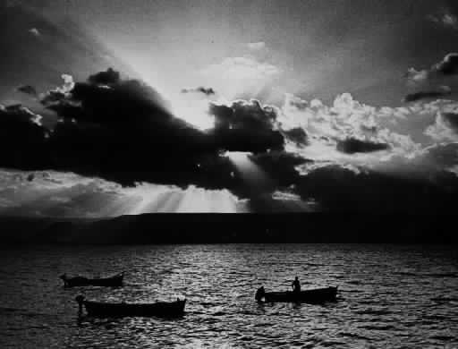
“Simon Peter saith unto them, I go a fishing. They say unto him, We also go with thee.”
At least six of the ten other remaining Apostles went with Peter. But caught nothing.
John 21:3

Slide 10
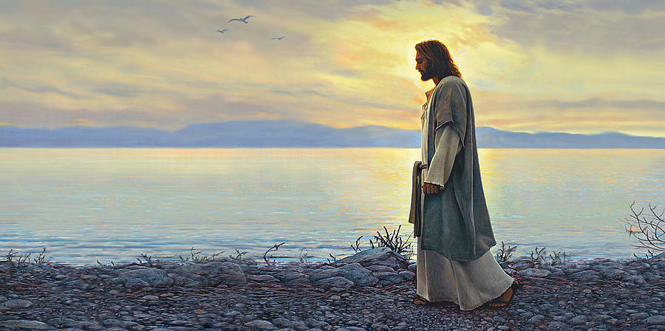
“But when the morning was now come, Jesus stood on the shore:
Greg Olsen
“…but the disciples knew not that it was Jesus.”
John 21:4

Slide 11
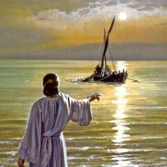
“…Children, have ye any meat?”
Children…
“Although the Apostles had been with the Savior for several years, the Savior’s use of this word may have indicated that His disciples still needed to grow and develop in their faith.
In a similar way, in 1832 the Lord told the Prophet Joseph Smith and other early members of the restored Church…
“Ye are little children, and ye have not as yet understood how great blessings the Father hath in his own hands and prepared for you; and ye cannot bear all things now; nevertheless, be of good cheer, for I will lead you along” (D&C 78:17–18).
“…They answered him, No.”
John 21:; John 4:49; John 16:215

Slide 12
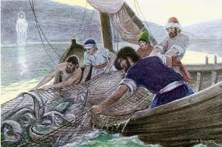
“Cast the net on the right side of the ship, and ye shall find,”
“…They cast therefore, and now they were not able to draw it for the multitude of fishes.
John 21:7

Slide 13
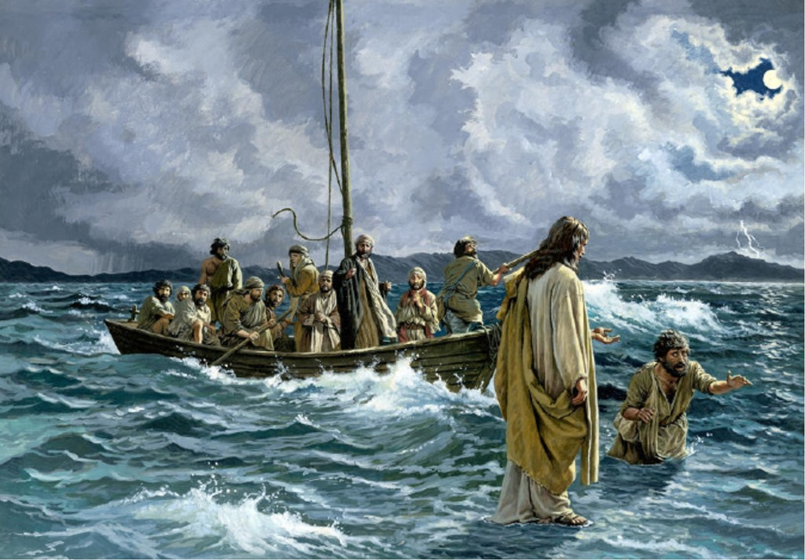
“…It is the Lord…”
When Simon Peter heard this he ‘cast himself into the sea’
John 21:7

Slide 14
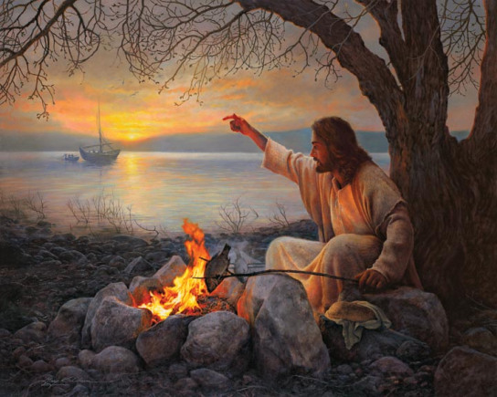
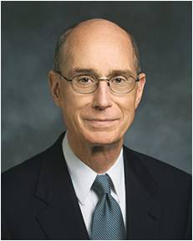
"When they came to shore they found a fire of coals with fish broiling and a supply of bread...Jesus then gave them bread and fish to eat, and although the account does not so state, he himself must also have eaten, for, as in the upper room, such would have been one of the main purposes of providing the food." (3)
… it was the Master who prepared His disciples to be fed more than fish and bread. He let them eat first. And then He taught them of spiritual feeding. And He gave a commandment to them which still stands for each of us." (4)
John 21:9-13

Slide 15
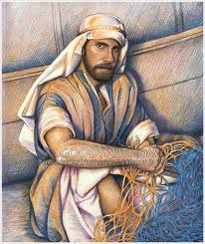
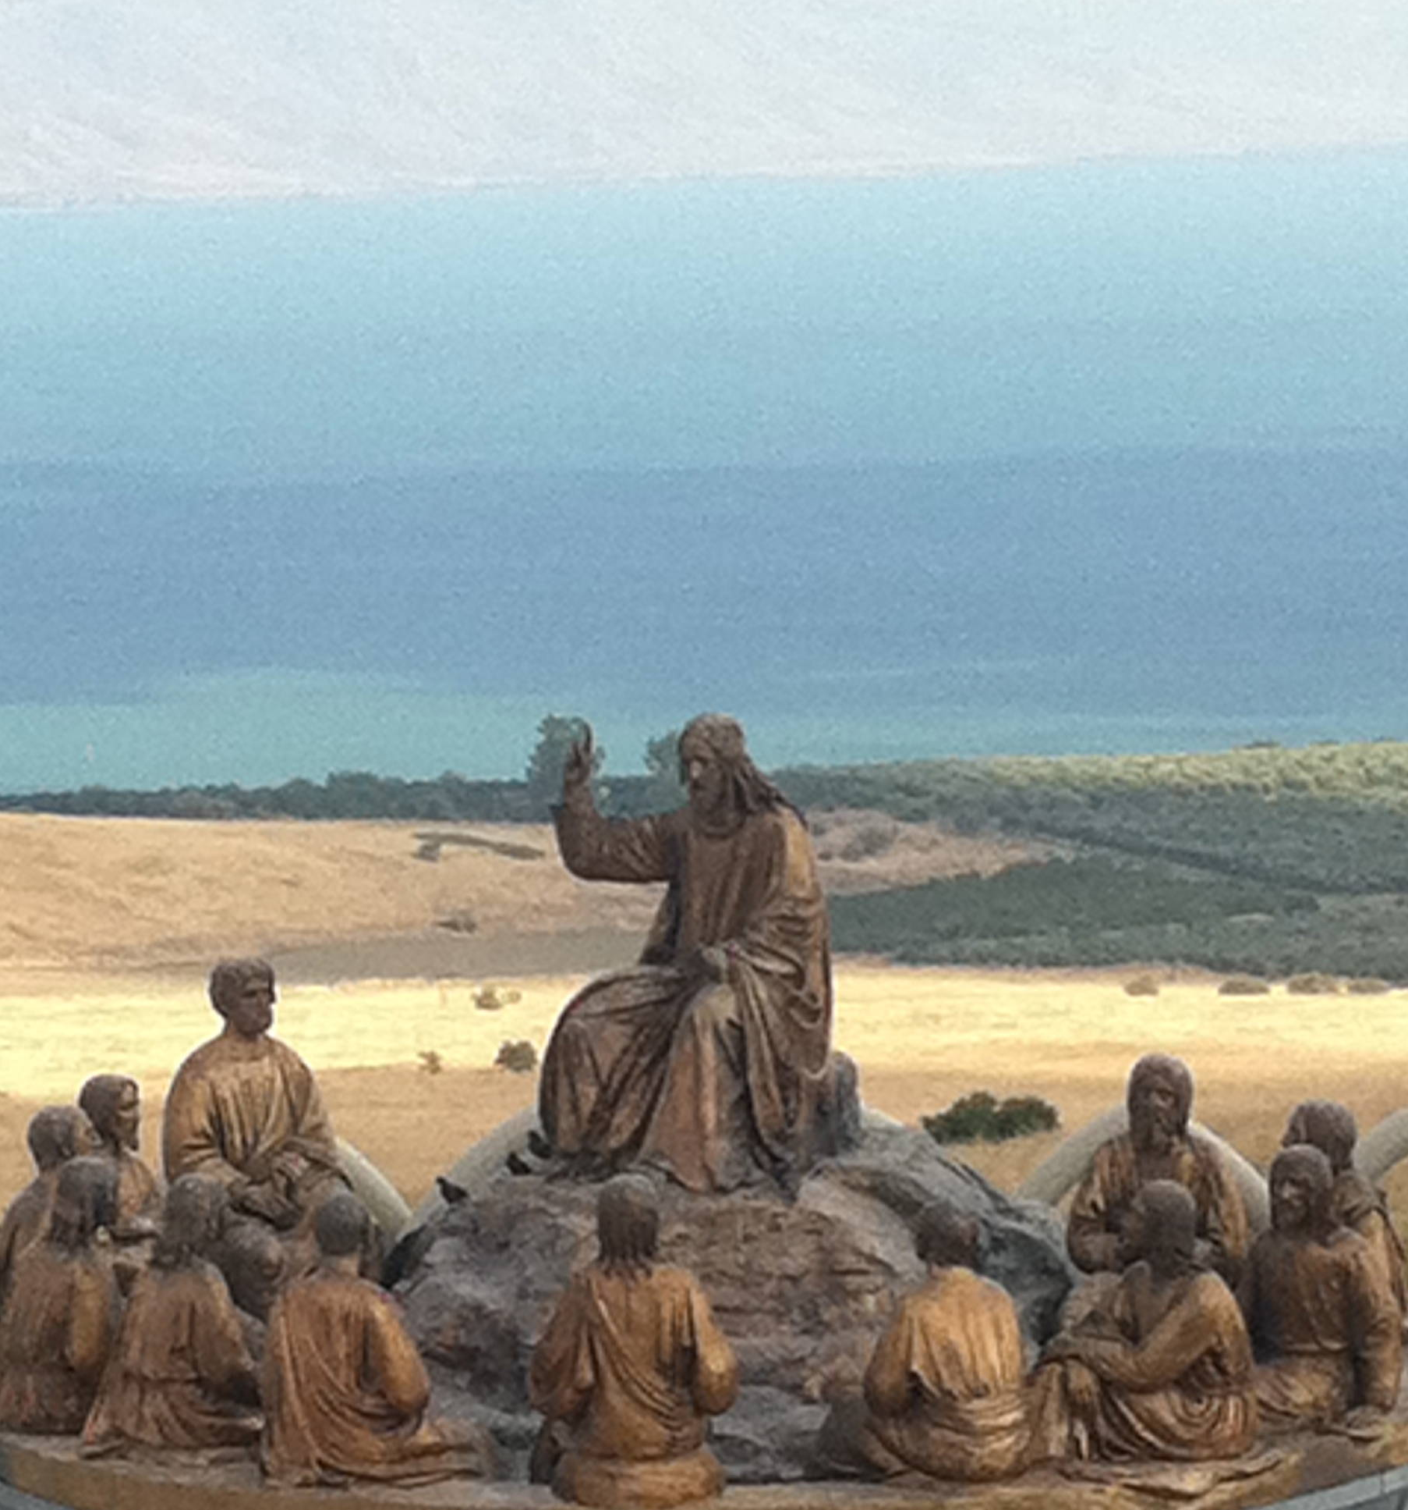
“…so when they had dined, Jesus saith to Simon Peter…
…Simon, son of Jonas, lovest thou me more than these?”
John 21:15

Slide 16
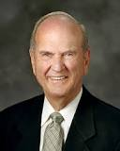
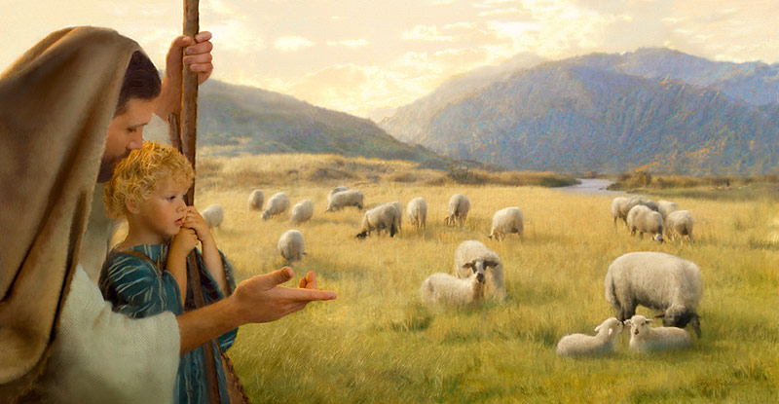
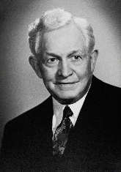
Feed my lambs
“The word feed comes from the Greek term bosko, which means ‘to nourish or to pasture.’ The word lamb comes from the diminutive term arnion, meaning ‘little lamb.’”
Jay Bryant Ward
“Anyone serving in any capacity in the Church in which he is responsible for the spiritual or temporal well-being of any of the Lord's children is a shepherd to those sheep.”
Little lambs need to be nourished in order to grow
John 21:15
(5,7)

Slide 17
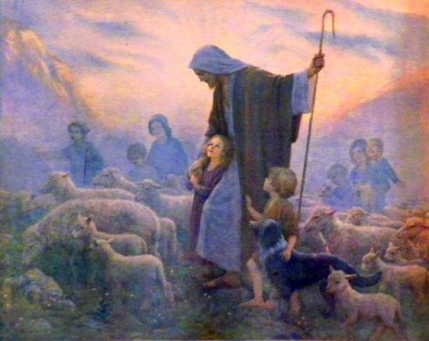
Feed my sheep
“The word feed comes from a different term, poimaino, which means ‘to shepherd, to tend, or to care.’ The word sheep comes from the term probaton, meaning ‘mature sheep.’
Sheep need to be tended
“The Lord holds his shepherds accountable for the safety [meaning the salvation] of his sheep.”
(5,7)
John 21:16

Slide 18
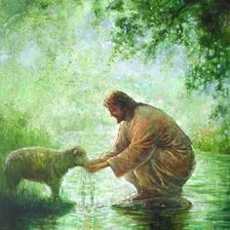
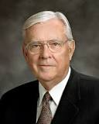
Feed my sheep
“The word feed again comes from the Greek bosko, referring to nourishment. The word sheep was again translated from the Greek term probaton, referring to adult sheep.”
Sheep need to be nourished
"Today our prophet is calling for enthusiastic and dynamic love for our Heavenly Father's children. He asks us to see the spiritual hunger around us and to respond by willingly sharing our abundance. No power on earth can accomplish as much as one righteous man or woman or boy or girl."
(6,7)
John 21:17

Slide 19
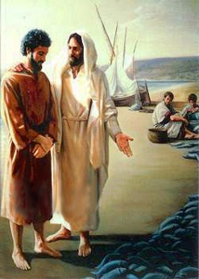
“Jesus responded…
‘Then Peter, why are you here? Why are we back on this same shore, by these same nets, having this same conversation? Wasn’t it obvious then and isn’t it obvious now that if I want fish, I can get fish? What I need, Peter, are disciples—and I need them forever.
I need someone to feed my sheep
and save my lambs. I need
someone to preach my gospel
and defend my faith….”
(2)

Slide 20
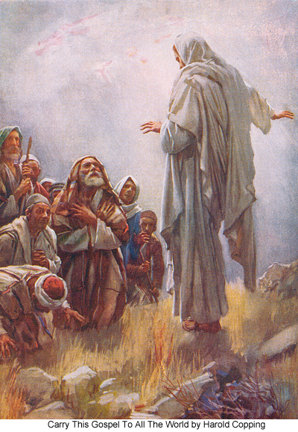
“…for the second and presumably the last time, I am asking you to leave all this and to go teach and testify, labor and serve loyally until the day in which they will do to you exactly what they did to me.”
Harold Copping
(2)

Slide 21
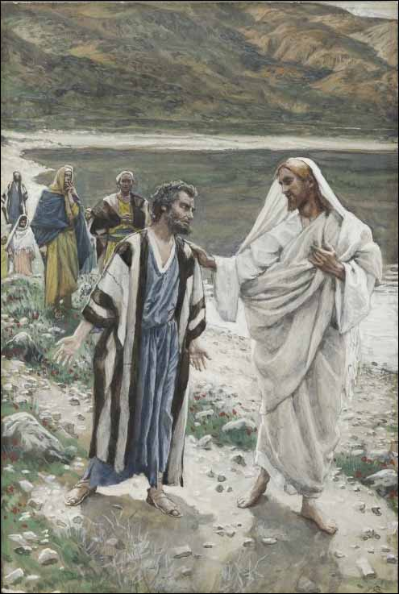
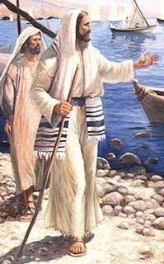
“This spake he, signifying by what death he should glorify God…
…And when he had spoken this, he saith unto him, Follow me.”
John 21:15-19

Slide 22
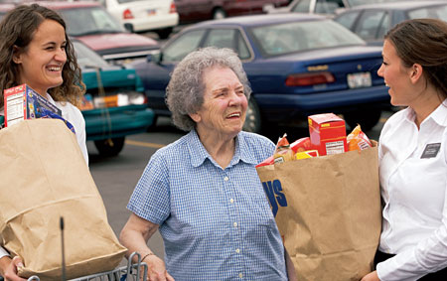
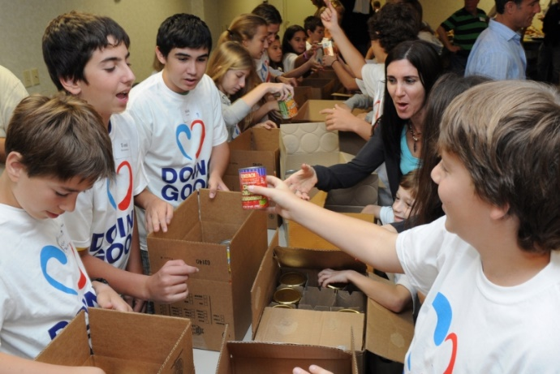
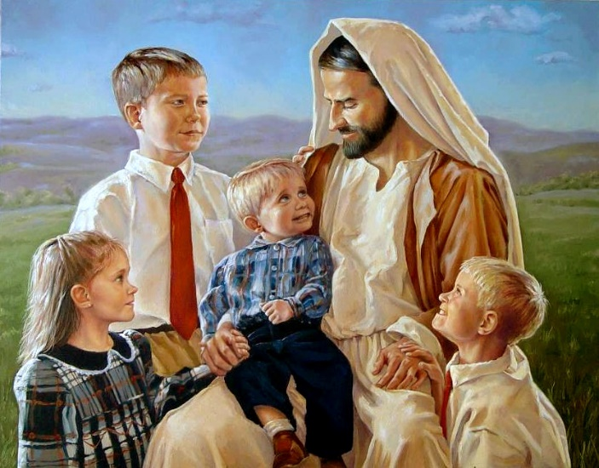
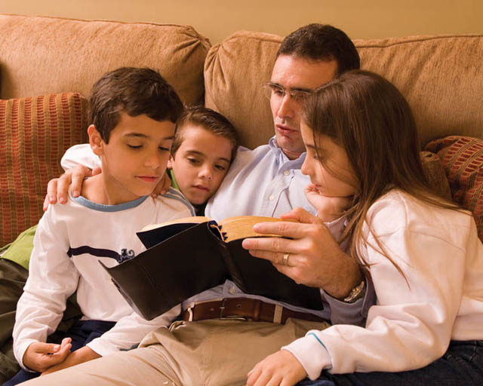
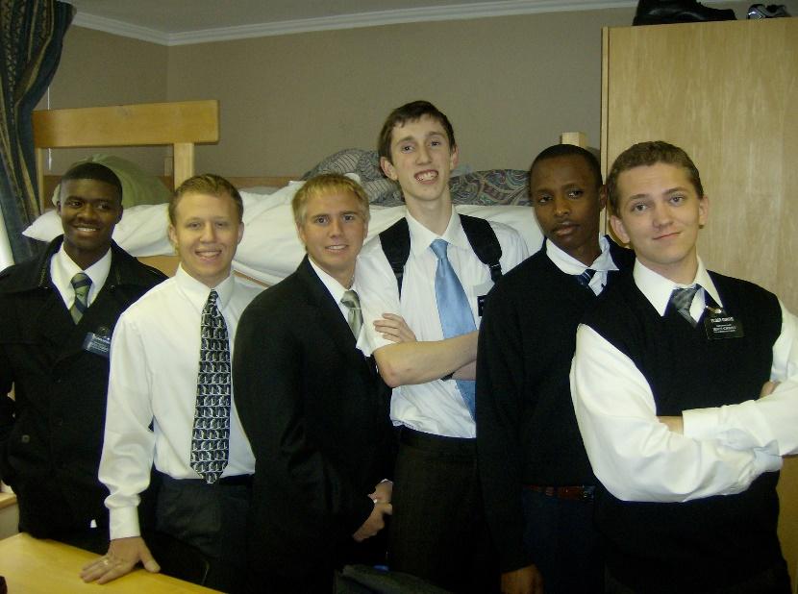
If we love the Savior and Heavenly Father more than anything else, we will feed Their sheep
Meagan Rieker

Slide 23
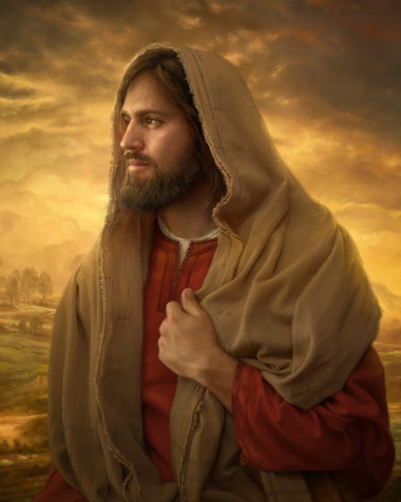
“The Crucifixion, Atonement, and Resurrection of Jesus Christ mark the beginning of a Christian life, not the end of it. It was this truth, this reality, that allowed a handful of Galilean fishermen-turned-again-Apostles without “a single synagogue or sword” to leave those nets a second time and go on to shape the history of the world in which we now live.”
Howard Lyon
(2)

Slide 24
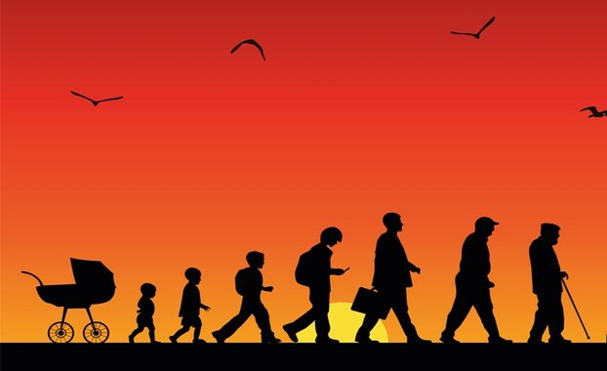
“Your Father in Heaven expects your loyalty and your love at every stage of your life.”
(2)

Slide 25
Leave those nets and follow Him
(2)

Slide 26
Sources:
Suggested Hymn: #116 Come Follow Me
Video: Feed My Sheep (5:45)
New Testament Institute Student Manual Chapter 28
Jeffrey R. Holland Oct. 2012 General Conference Report The First Great Commandment
Elder Bruce R. McConkie (The Mortal Messiah: From Bethlehem to Calvary, 4 vols. [Salt Lake City: Deseret Book Co., 1979-1981], 4: 289.)
President Henry B. Eyring ("Feed My Lambs," Ensign, Nov. 1997, 82)
President David O. McKay (Improvement Era, 1949, Vol. Lii. December, 1949. No. 12)
Elder M. Russell Ballard ("Feasting at the Lord's Table," Ensign, May 1996, 81)
Elder Russell M. Nelson (“Shepherds, Lambs, and Home Teachers,” Ensign, Aug. 1994, 16).
Presentation by ©http://fashionsbylynda.com/blog/

Slide 27
Event | Matthew | Mark | Luke | John
Jesus Visits and Eats with 7 Disciples at the Sea of Tiberias |  |  |  | 21:1-14
Peter’s Love for Jesus to Be manifest by Service |  |  |  | 21:15-17
Peter’s Death Foretold |  |  |  | 21:18, 19
Peter’s Questions Jesus About John’s Future |  |  |  | 21:20-23
John’s Concluding Testimony |  |  |  | 20:30, 31 21:24, 25
Naked: John 21:7:
The Greek term translated as “naked” in the King James Version does not always mean “nude” but can mean “lightly clad” or “without an outer garment.” When Peter recognized the Lord, he quickly put on his outer cloak and “cast himself into the sea”. This detail reveals how eager Peter was to be with the Savior. (1)
Feed My Sheep John 21:15-17:
“This is the call of Christ to every Christian today: ‘Feed my lambs. … Feed my sheep’—share my gospel with young and old, lifting, blessing, comforting, encouraging, and building them, especially those who think and believe differently than we do.” Elder Robert D. Hales (“Being a More Christian Christian,” Ensign or Liahona, Nov. 2012, 91).

