Slide 1
Lesson 80 Part 2
“ …And we know that his testimony is true.”
John 20:30-31
Matthew 28:16-20
Mark 16:15-20
Luke 24:49-53
John 21:20-31

Slide 2
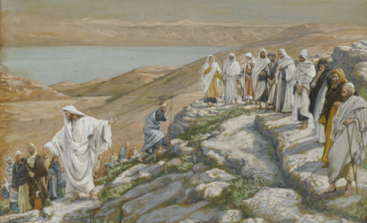
The Master’s First Message
“Then the eleven disciples went away into Galilee…
The Masters' first message to the brethren was not about a brief meeting in Jerusalem but something more important which would take place in Galilee.
A careful reading indicates that this Galilean meeting was truly something special.
It took place on a 'mountain where Jesus had appointed them'. The group was large for this is thought to be the occasion when over 500 of the brethren saw him at one time. (1)
After that, he was seen of above five hundred brethren at once; of whom the greater part remain unto this present, but some are fallen asleep. 1 Corinthians 15:6
Matthew 28:10-18

Slide 3
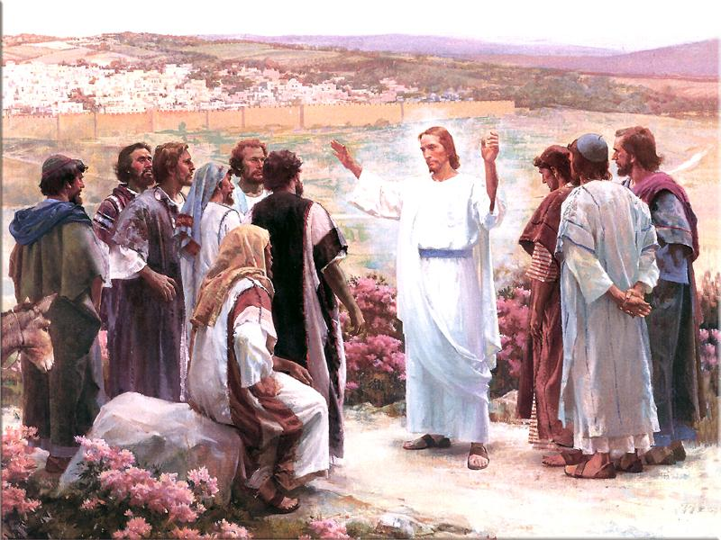
Mountain = Temple
“And Jesus came and spake unto them, saying,
All power is given unto me in heaven and in earth.
Matthew 28:18

Slide 4
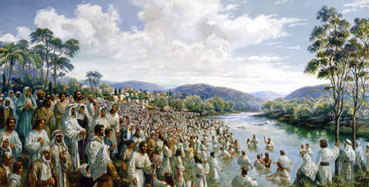
“Go ye therefore, and teach all nations, baptizing them in the name of the Father, and of the Son, and of the Holy Ghost:”
Matthew 28:18

Slide 5
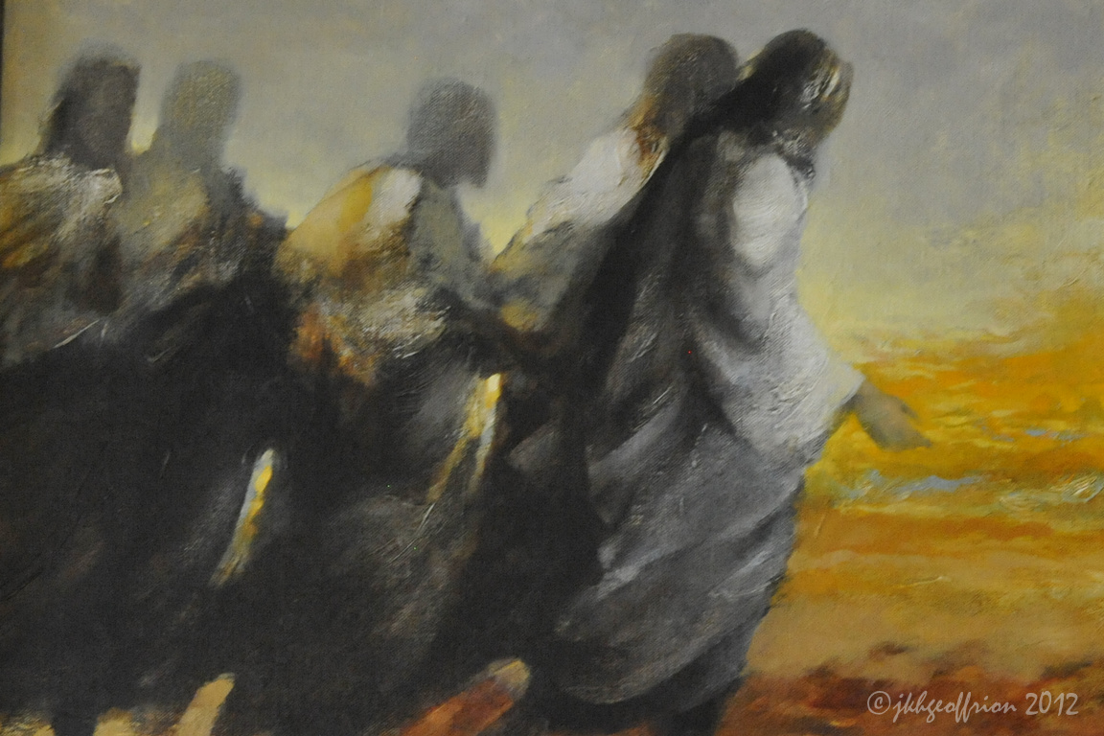
Go ye therefore, and teach all nations, baptizing them in the name of the Father, and of the Son, and of the Holy Ghost:
“And he said unto them, Go ye into all the world and preach the gospel to every creature.”
Matthew 28:19; Mark 16:15

Slide 6
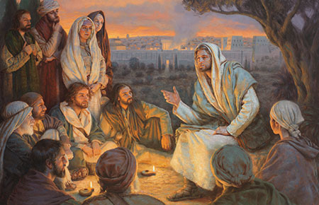
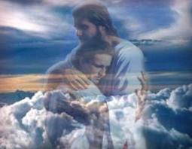
“Teaching them to observe all things whatsoever I have commanded you…
Matthew records the word of the Lord at this important meeting. Yet, he records only three verses. Did the Lord gather all these people together just to give them three verses?
Certainly, the location on a mountain and the scarcity of the record implies that this was a temple experience. (2)
…and, lo, I am with you alway, even unto the end of the world. Amen.
Matthew 28:20

Slide 7
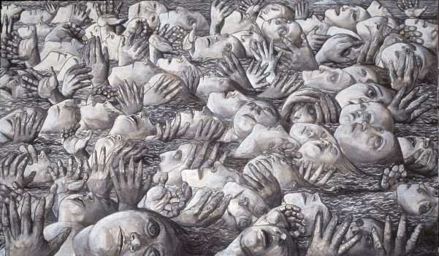
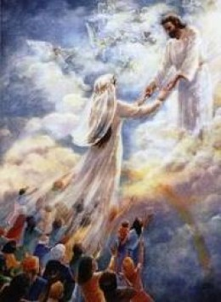
Saved VS Damned
“He that believeth and is baptized shall be saved;
“…but he that believeth not shall be damned.”
Mark 16:16

Slide 8
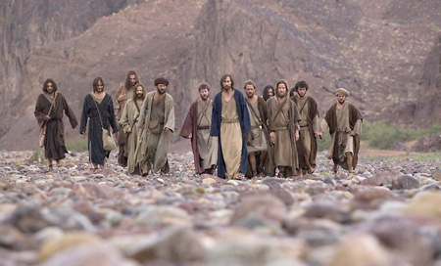
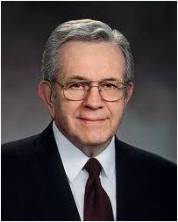
“And these signs shall follow them that believe;…
…In my name shall they cast out devils; they shall speak with new tongues:”
Such miracles have always been a witness of His church on the earth, and they are known among us-I could even say they are common among us-but they are not often talked about. We regard them with humility and with unmeasured reverence. (3)
Mark 16:17

Slide 9
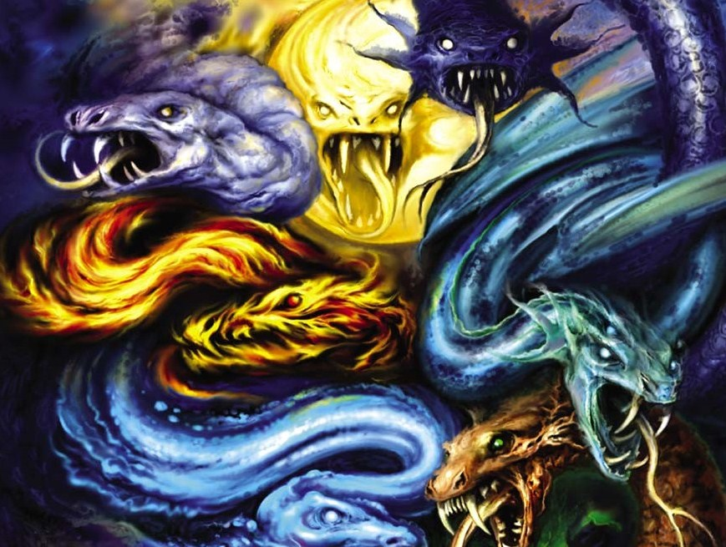
“They shall take up serpents…
…and if they drink any deadly thing, it shall not hurt them…
Mark 16:18

Slide 10
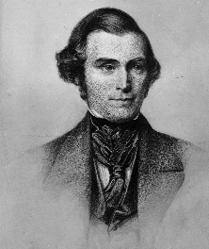
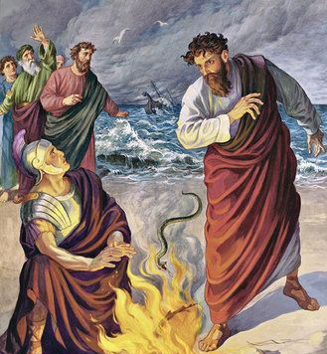
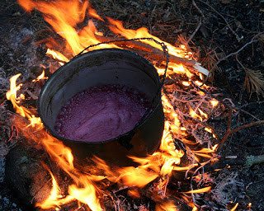
The Promise of Our Great Redeemer
“This promise of our Great Redeemer was also made to every creature in all the world who should believe the gospel.
The use of this miraculous gift was to preserve life, in case any believer should accidentally be bitten by a poisonous serpent as Paul was.
or should unintentionally swallow a deadly poison, as the sons of the prophets did…
And when Paul had gathered a bundle of sticks, and laid them on the fire, there came a viper out of the heat, and fastened on his hand. Acts 28:3
Set on the great pot, and seethe pottage for the sons of the prophets.
So they poured out for the men to eat. And it came to pass, as they were eating of the pottage, that they cried out, and said, O thou man of God, there is death in the pot. And they could not eat thereof. 2 Kings 40:38-40
Mark 16:18
(4)

Slide 11
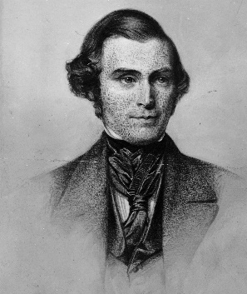
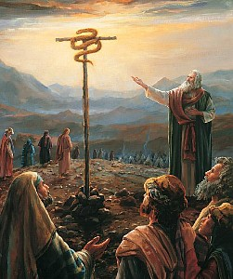
…and when the Israelites were bitten by poisonous serpents, they were healed by simply looking at a brazen serpent which the Lord commanded Moses to raise up in the wilderness; …
And the Lord said unto Moses, Make thee a fiery serpent, and set it upon a pole: and it shall come to pass, that every one that is bitten, when he looketh upon it, shall live.
And Moses made a serpent of brass, and put it upon a pole, and it came to pass, that if a serpent had bitten any man, when he beheld the serpent of brass, he lived. Number 21:8-9
…so the believers in Christ can prevail against deadly poisons by simply looking to Him in faith; for Jesus cannot fail to fulfill His promise to the believer.”
Mark 16:18
(4)

Slide 12
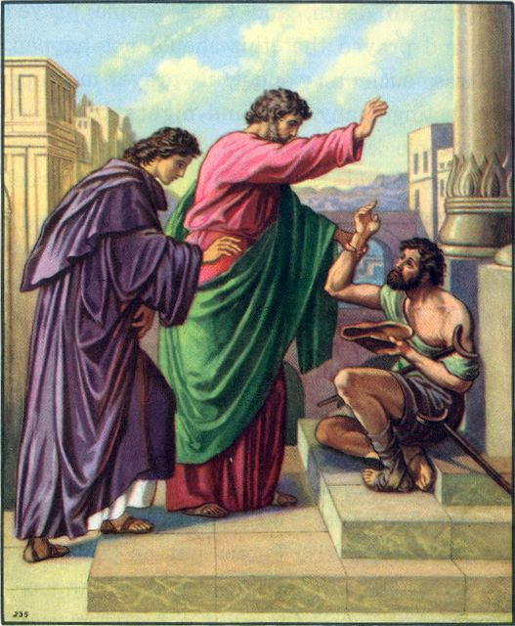
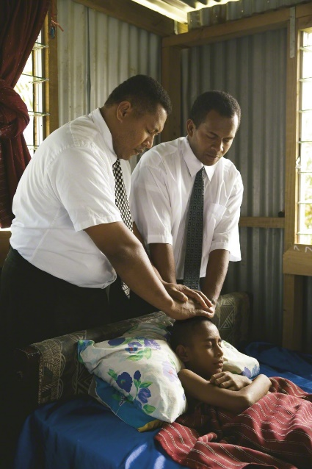
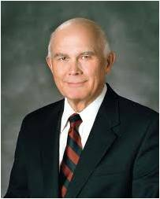
“…they shall lay hands on the sick…
…and they shall recover.”
“Miracles happen when the authority of the priesthood is used to bless the sick.
There are five parts to the use of priesthood authority to bless the sick:
the anointing,
(2) the sealing of the anointing,
(3) faith,
(4) the words of the blessing, and
(5) the will of the Lord.”
“We must always remember that faith and the healing power of the priesthood cannot produce a result contrary to the will of Him whose priesthood it is.” (5)
Mark 16:18

Slide 13
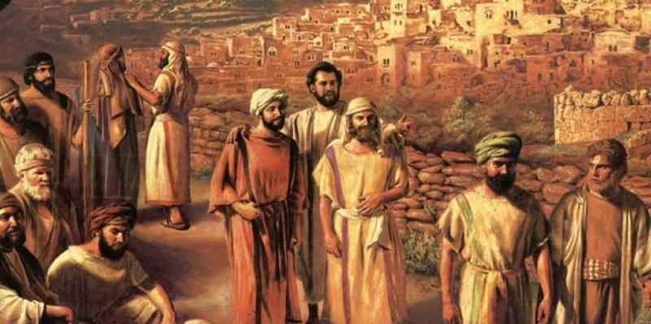
Their Eyes Were Open
"...while he was teaching them they had no realization, of the greatness of the experience that was theirs. It was only at their journey's end, when they sat to eat and Christ broke bread and blessed it, that their 'eyes were opened, and they knew him.' Only then did the one turn to the other and say, 'Did not our heart burn within us, while he talked with us by the way, and while he opened to us the scriptures?'
"As is so often the case, the spiritual hindsight of these two disciples was appreciably better than their immediate spiritual insight." (6)
Luke 24:31-32

Slide 14
The Ascension
“And, behold, I send the promise of my Father upon you…
…but tarry ye in the city of Jerusalem, until ye be endued with power from on high.”
Luke 24:49

Slide 15
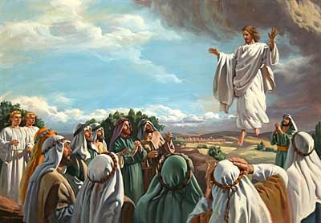
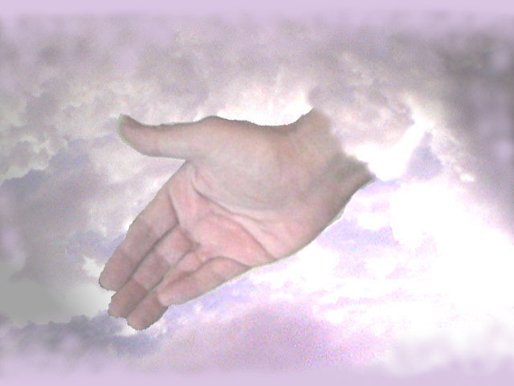
“And he led them out as far as to Bethany…
…and he lifted up his hands, and blessed them.”
Luke 24:50

Slide 16
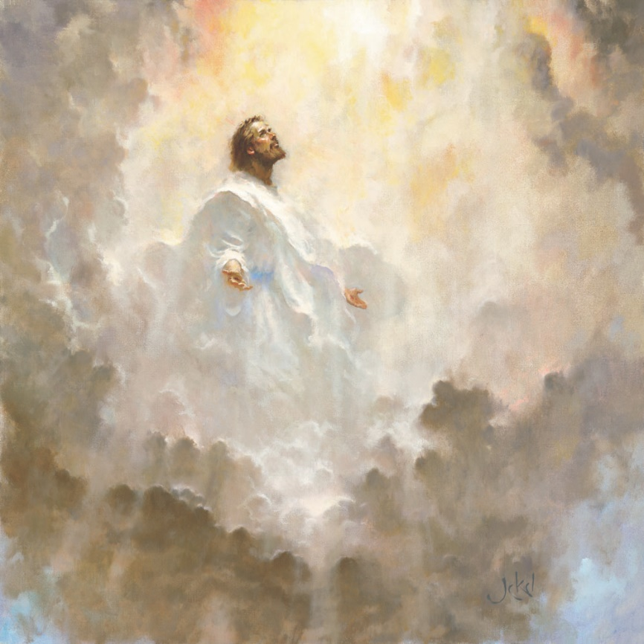
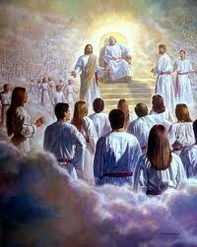
“So then after the Lord had spoken unto them, he was received up into heaven, and sat on the right hand of God.”
“And it came to pass, while he blessed them, he was parted from them, and carried up into heaven.”
Luke 24:51; Mark 16:19

Slide 17
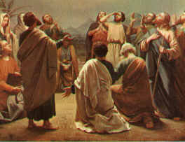
“And they worshipped him, and returned to Jerusalem with great joy:”
Luke 24:52

Slide 18
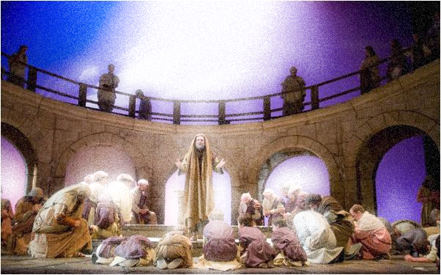
“And were continually in the temple, praising and blessing God. Amen.”
Luke 24:53

Slide 19
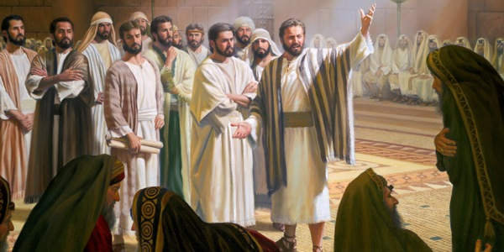
“And they went forth, and preached every where…
“…the Lord working with them, and confirming the word with signs following. Amen”
Mark 16:20

Slide 20
John’s Testimony
“And many other signs…
“…which are not written in this book.”
John 20:30

Slide 21
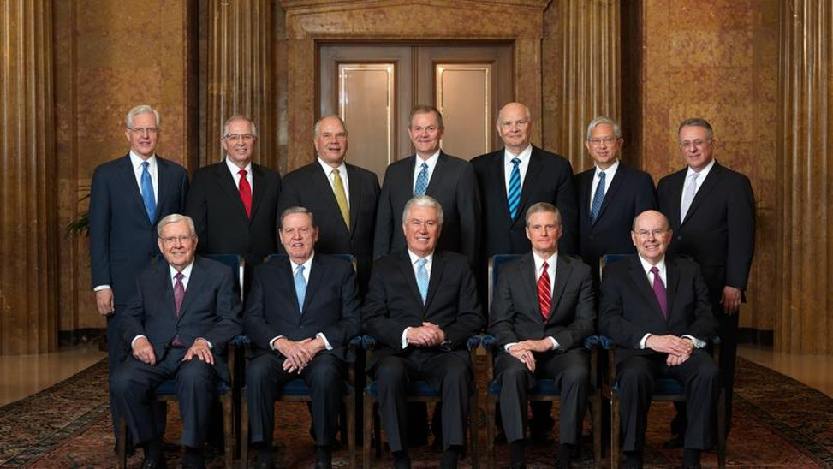
“But these are written that ye might believe that Jesus is the Christ, the Son of God…
…and that believing ye might have life through his name.”
John 20:31

Slide 22
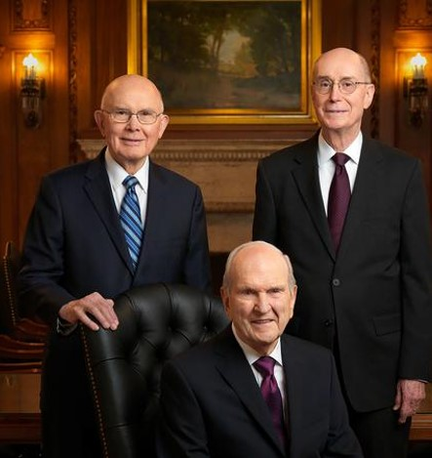
Special witnesses of Jesus--2019

Slide 23
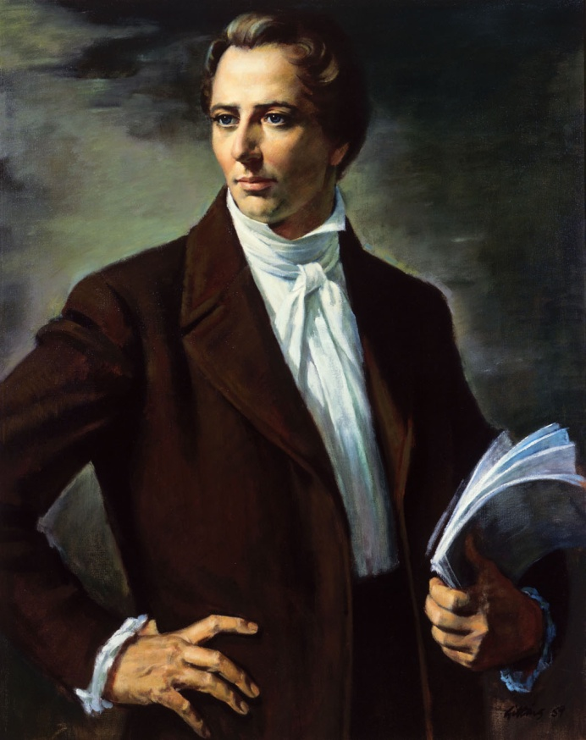
Joseph Smith
“And now, after the many testimonies which have been given of him, this is the testimony, last of all, which we give of him: That he lives!”
D&C 76:22
Read further D&C 76:22-24

Slide 24
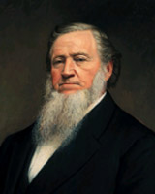
Brigham Young
“…I know that I exist and have a being, and I testify that there is a God, and that Jesus Christ lives, and that he is the Savior of the world. “
Discourses of Brigham Young 1951 ed., p. 433

Slide 25
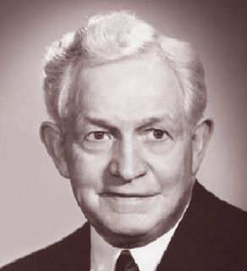
David O. McKay
“I know that his Father, our Creator, lives…I know because I have heard his voice, and I have received his guidance in matters pertaining to his kingdom here on earth.”
D&C 76:22
Read further D&C 76:22-24

Slide 26
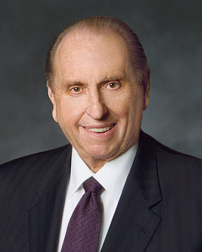
President Thomas S. Monson
“I leave with you my testimony that this work in which we are engaged is true. The Lord is at the helm. That we may ever follow Him is my sincere prayer, and I ask it in the name of Jesus Christ, amen.

Slide 27
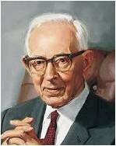
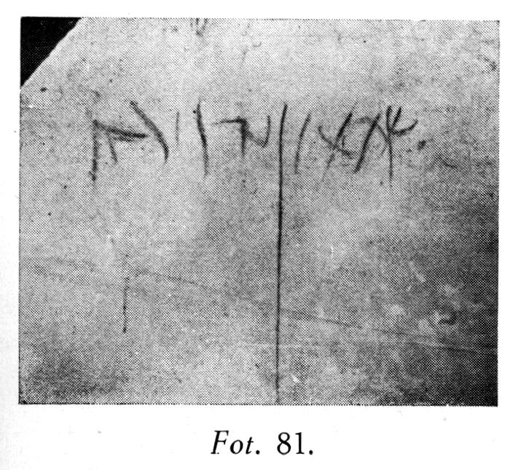
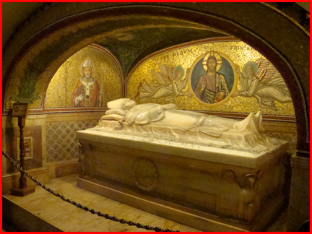
Peter’s Marytrdom
Jesus prophesied that when Peter became old he would “stretch forth [his] hands” and be carried where he did not want to go. It is traditionally believed that Peter died by crucifixion.
However, it is said (tradition) that Peter requested to be crucified upside down because he considered himself unworthy to die in the same manner as the Savior (7)
The charcoal inscription reads: "Shimon Bar Yonah" which means "Simon [Peter] son of Jonah".
Found in Jerusalem
John 21:18-25
The tomb of St. Peter in the Basilica of St. Peter in Rome

Slide 28
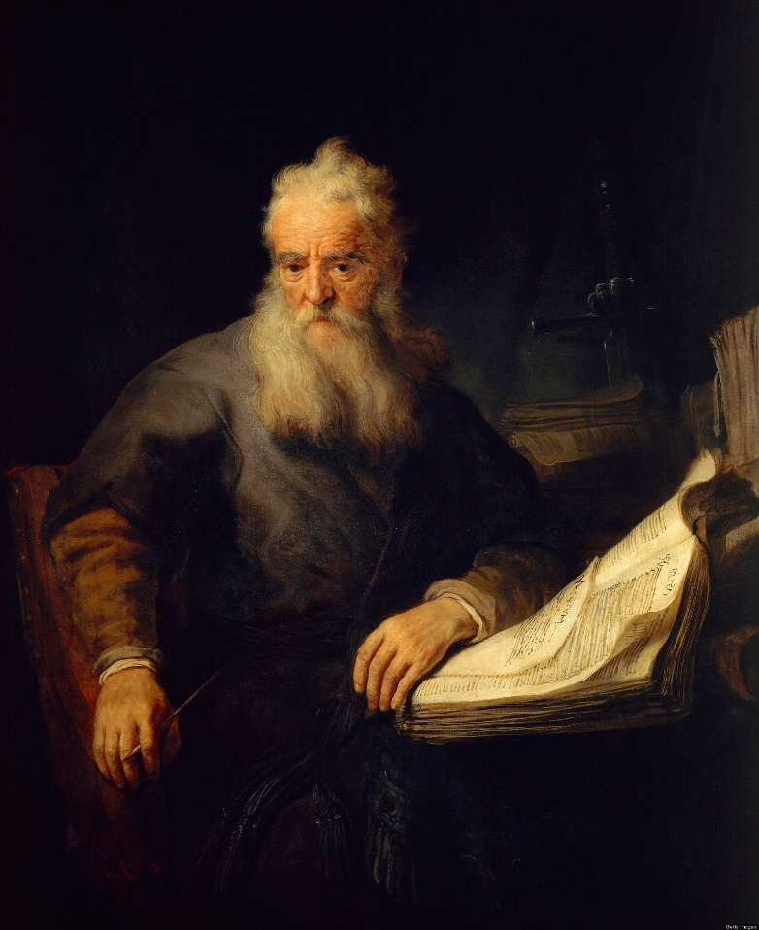
“This is the disciple which testifieth of these things, and wrote these things:
…and we know that his testimony is true.”
John 21:24

Slide 29
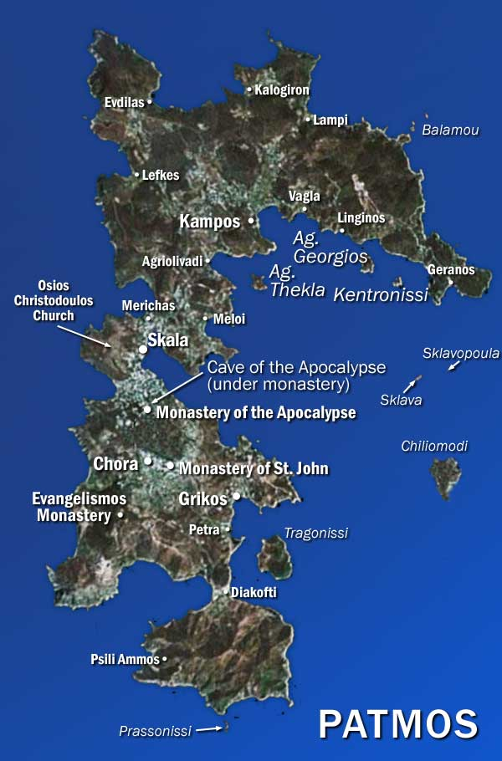
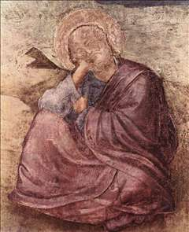
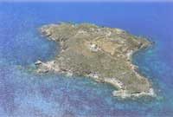
John’s Future
Tarry = to remain alive on the earth.
Thus, John would remain on the earth as a translated being until Jesus Christ’s Second Coming.
Translated beings are “persons who are changed so that they do not experience pain or death until their resurrection to immortality” (8)
Place where John wrote
The Book of Revelation
John 21:24

Slide 30
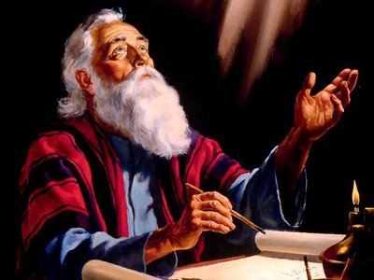
“And there are also many other things which Jesus did…
…if they should be written every one, I suppose that even the world itself could not contain the books that should be written. Amen.”
John 21:25

Slide 31
Sources:
Elder James E. Talmage Jesus the Christ p. 694
Gospeldoctrine.com
Elder Boyd K. Packer (Things of the Soul [Salt Lake City: Bookcraft, 1996], 18.)
(Orson Pratt's Works [Salt Lake City: Deseret News Press, 1945], 85.)
Elder Dallin H. Oaks Healing the Sick 2010 April Gen. Conf.
Joseph Fielding McConkie, Seeking the Spirit [Salt Lake City: Deseret Book Co., 1978], 7.
Joseph Fielding Smith, Doctrines of Salvation, comp. Bruce R. McConkie, 3 vols. [1954–56], 3:151–52).
(Guide to the Scriptures, “Translated Beings,” scriptures.lds.org).
Presentation by ©http://fashionsbylynda.com/blog/

Slide 32
Event | Matthew | Mark | Luke | John
Jesus Visits and Eats with 7 Disciples at the Sea of Tiberias |  |  |  | 21:1-14
Peter’s Love for Jesus to Be manifest by Service |  |  |  | 21:15-17
Peter’s Death Foretold |  |  |  | 21:18, 19
Peter’s Questions Jesus About John’s Future |  |  |  | 21:20-23
John’s Concluding Testimony |  |  |  | 20:30, 31 21:24, 25
Meeting on the Mountain Matthew 28:16-18:
"Of all the recorded appearances of the risen Christ to his disciples in Palestine, this one is paramount; and yet of it the present Bible preserves only a most fragmentary account. This was an appearance by appointment, by pre-arrangement, to which probably a great multitude of disciples was invited. It is likely the occasion of which, as Paul wrote later, 'he was seen of above five hundred brethren at once.' (1 Cor. 15:6.) If so, the seventies and leading brethren of the Church would have been present, as also perhaps the faithful women who are inheritors of like rewards with obedient priesthood holders.
"We may suppose that great preparation preceded this meeting; that it dealt with many things, perhaps being similar to his resurrected ministry to multitudes of Nephites; and that from it, by the months of many witnesses, the sure testimony of his divine Sonship went forth to the world.“ Elder Bruce R. McConkie (Doctrinal New Testament Commentary, 3 vols. [Salt Lake City: Bookcraft, 1965-1973], 1: 866.)
Meeting on the Mountain Matthew 28:16-18:
"Of all the recorded appearances of the risen Christ to his disciples in Palestine, this one is paramount; and yet of it the present Bible preserves only a most fragmentary account. This was an appearance by appointment, by pre-arrangement, to which probably a great multitude of disciples was invited. It is likely the occasion of which, as Paul wrote later, 'he was seen of above five hundred brethren at once.' (1 Cor. 15:6.) If so, the seventies and leading brethren of the Church would have been present, as also perhaps the faithful women who are inheritors of like rewards with obedient priesthood holders.
"We may suppose that great preparation preceded this meeting; that it dealt with many things, perhaps being similar to his resurrected ministry to multitudes of Nephites; and that from it, by the months of many witnesses, the sure testimony of his divine Sonship went forth to the world.“ Elder Bruce R. McConkie (Doctrinal New Testament Commentary, 3 vols. [Salt Lake City: Bookcraft, 1965-1973], 1: 866.)
All Power Matthew 28:18:
The time is very near when he will come to the earth again with great power and glory, accompanied by his mighty angels in flaming fire. Jesus has power over life and death and every detail of our existence. He is the light of the sun and the power by which it was made. One of the primary purposes of his life is to give us power. And more than almost any other thing, that is what we are in greatest need of both here and hereafter. We have the power of repentance, the power of excellence, the power to be like God. Emerson said, 'Do the thing and you shall have the power.' That is, we learn to do by doing. Certainly our age of power is no place for incompetents, cowards, and weaklings. But the apostle John gives us a profitable direction for attaining power when he says of us and of Christ: 'But as many as received him, to them gave he power to become the sons of God....' (John 1:12.) We need the power to build character, the power to overcome temptation, the power to destroy the weaknesses and sins in ourselves." Sterling W. Sill (Principles, Promises, and Powers [Salt Lake City: Deseret Book Co., 1973], 26.)
See Also:
Special Witnesses of Christ
April 2001 Ensign

Slide 33
They will be healed Mark 16:18:
Latter-day Saints believe in applying the best available scientific knowledge and techniques. We use nutrition, exercise, and other practices to preserve health, and we enlist the help of healing practitioners, such as physicians and surgeons, to restore health.
The use of medical science is not at odds with our prayers of faith and our reliance on priesthood blessings. When a person requested a priesthood blessing, Brigham Young would ask, “Have you used any remedies?” To those who said no because “we wish the Elders to lay hands upon us, and we have faith that we shall be healed,”
President Young replied: “That is very inconsistent according to my faith. If we are sick, and ask the Lord to heal us, and to do all for us that is necessary to be done, according to my understanding of the Gospel of salvation, I might as well ask the Lord to cause my wheat and corn to grow, without my plowing the ground and casting in the seed. It appears consistent to me to apply every remedy that comes within the range of my knowledge, and [then] to ask my Father in Heaven … to sanctify that application to the healing of my body.”¹
Of course we don’t wait until all other methods are exhausted before we pray in faith or give priesthood blessings for healing. In emergencies, prayers and blessings come first. Most often we pursue all efforts simultaneously. This follows the scriptural teachings that we should “pray always” (D&C 90:24) and that all things should be done in wisdom and order. Elder Dallin H Oaks Healing the Sick April 2010 Gen. Conf.
After the Ascension:
See Also:
The Brothers of Jesus: Loving the Unbelieving Relative
By Carlfred B. Broderick
Ensign March 1987
After the Ascension:
Following the Savior’s death, the Apostles spread the gospel, and the Church grew quickly throughout the Roman Empire. But almost immediately after the Ascension of the Savior, the Apostles began to be persecuted. James, the brother of John and one of the original Twelve Apostles, was killed by Herod (see Acts 12:1–2). Peter and Paul were also killed during New Testament times.
We don’t have records of the deaths of all the Apostles, but we do know that all but John the Beloved died and, after a time, ceased to be replaced. The keys and authority of the holy priesthood were lost with the deaths of the Church leaders. Without this authority, no new revelation, doctrine, or scripture could come.
The Apostles were killed during a time when the entire Church was being persecuted. Nero, a Roman emperor, was the first to make laws to exterminate Christians, in about A.D. 65. Under his reign, thousands were cruelly killed. A second round of persecutions began in about A.D. 93 under Emperor Domitian. Succeeding emperors continued torturing and killing Christians. As a result of these persecutions, thousands of Christians were martyred. Many others apostatized.
In about A.D. 324 Constantine became the emperor of the Roman Empire. He made Christianity a legal religion, stopping centuries of persecution. His actions linked the church to the government, and corrupt church leaders began seeking power and the honors of the world.
Teachers within the church began to adopt false religious concepts from Greek philosophy and pagan religions. False ordinances and ceremonies were also introduced. Even though the church still taught some truth, the true Church of Christ and the priesthood were no longer on the earth. And as Christianity spread to various parts of the world—including to Africa, Asia, Europe, and the Americas—new churches were formed and grew. None of these churches, however, was the true Church, since the Lord had already taken priesthood authority and priesthood keys from the earth.
What Happened to Christ’s Church?
By Shanna Butler Liahona Feb. 2005

