Slide 1
Lesson 81 and 82
Acts 1
(The Sequel)
The Acts of the Apostles forms a bridge between the record of Jesus Christ’s life and teachings in the four Gospels and the writings and labors of His Apostles.

Slide 2
Luke was the author of Acts as a sequel to his Gospel.
Acts was written after the Book of Luke, around 60 AD and 85 AD.
The Book of Acts adds the account of the Lord’s Apostles declaring this gospel message throughout all the world.
Luke directed this book to a man named Theophilus, who may have been a Roman official.
The account starts in Jerusalem and ends up in Rome.
Luke served with Paul as a companion.

Slide 3
*Background:
The events occurred over a period of about 30 years, under the rule by Rome.
The Book focuses on ministries of Peter and Paul.
Acts concludes about A.D. 62 with an account of Paul’s preaching at Rome while under house arrest.

Slide 4
In the Book of Acts:
*Lives of the early Church leaders and their lives.
*Early ministry and the operation of the Holy Spirit
* Story of how the Apostles preached the gospel and organized the Church in Jerusalem while the Lord prepared messengers to preach to an ever-widening audience.
Acts
(The
Sequel)

Slide 5
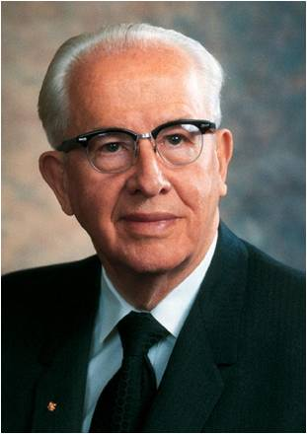
President Ezra Taft Benson
“…It is the spirit that matters most.”
The Apostles were to take up their ministry only after they had been
“endued with power from on high” Luke 24:49

Slide 6
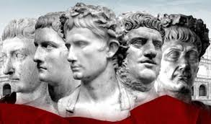
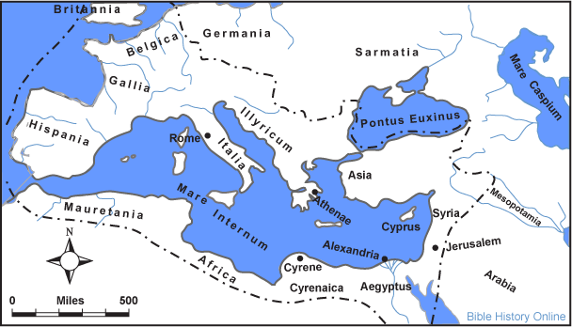
Political State At That Time
Rome ruled most of known world
Rome was the center of empire
It was composed of independent cities, states, and territories. Each was subject to an emperor and a senate.

Slide 7
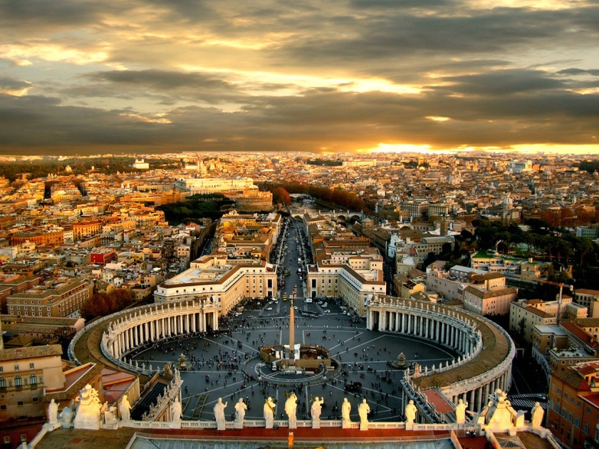
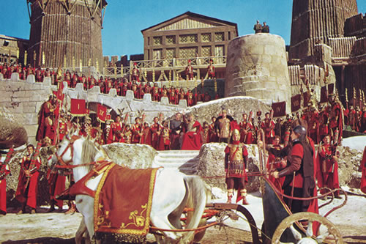
Roman Government
Provinces: Macedonia, Asia, Bithynia, Cilicia
Proconsuls: Peaceful Provinces…independent decision making but accountable to Rome. (Deputies)
Proconsuls: more turbulent
Constant Military guard and checked by emperor himself. Palestine was more violent in the days of Jesus and the Apostles. (governors and procurator)

Slide 8
King
Jewish descent under Roman rulers.
Herod the Great---monarch in Palestine at the birth of Jesus—titles: Procurator, tetrarch, and King.
Death of Herod the Great---3 sons:
Archelaeus, Antipas, and Philip
Followed by Agrippa I
Succeeded by son, Agrippa II (ruling more than 50 years)
Felix---Roman Governor (Paul tried, Acts 23:24)
Fetus—Paul appealed to Caesar
(Acts 25:8-13)

Slide 9
King Agrippa II
Festus invites King to hear Paul’s case
The King has adequate knowledge of Jewish law
The King was not committed to its religious doctrine, only ceremonial.
“this man might have been set at liberty, if he had not appealed unto Caesar.”
(Acts 26:32)

Slide 10
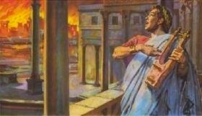
Emperor during New Testament times
Caesar (Nero)---AD 54-68---hated
Paul appears to for trial
(Acts 27:24)
Fire in Rome
More Persecutions of Christians
Peter and Paul meet death during this time period

Slide 11
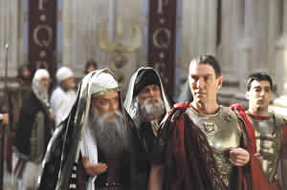
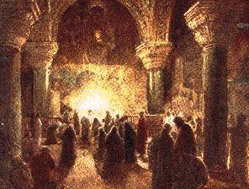
Religion
Jewish leaders openly opposed the message of Jesus in the Savior’s day.
Though His death would “crush the movement”
Jewish rulers conspire to “do away with” the Son of God.
The ‘Movement’ continues to grow despite persecution.
Faith of Christian converts were not based on a dead Savior but on a Living One. One that had risen from the dead.
(Acts 2:23, 32, 5:30-32; Corinthians 15:4-8)
Jew’s counteraction was held in check by Roman law.

Slide 12
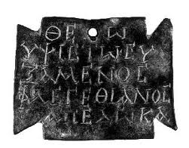
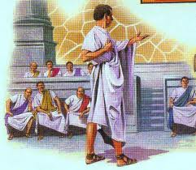
Tolerated by Rome
Political state recognized many gods
There was no interference with religious faith so long as it did not prove subversive to the state.
Judaism was tolerated.
Rome didn’t recognize Christianity as a new movement but rather another division within the Jewish order.

Slide 13
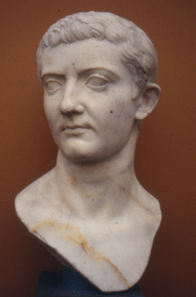
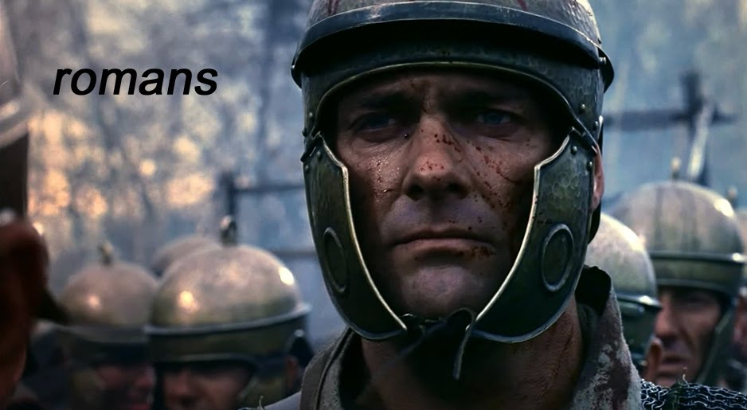
Times Change
New church expanded and grew while the tolerance changed.
The Emperor was personified as divine.
The Romans were subject to give allegiance to the Emperor as god, as well as their own deities.
Nero titles:
theos (god)
soter (savior)
Domitian (AD 81-96) title:
Dominus et Deus (Lord and God)
Greek word for Latin dominus---kurios, or Lord
Common title applied to Jesus
(700 times in New Testament)

Slide 14
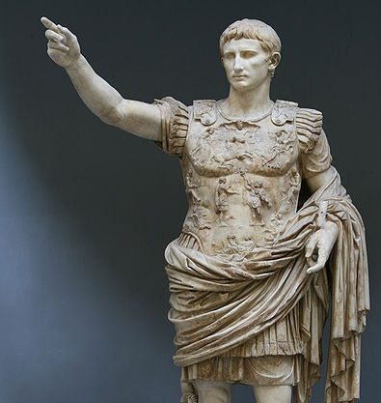
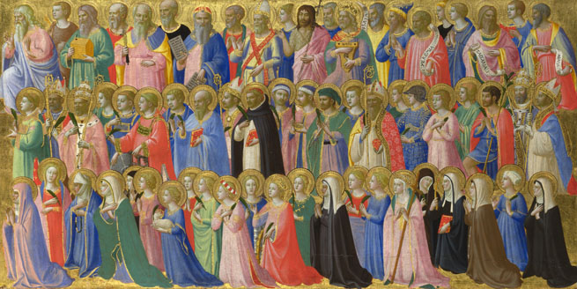
Christians Refusal to bow
Emperor was addressed as:
“God”
“The Son of God”
“the Holy One”
“Lord”
“Savior”
Central causes of Persecution was the refusal to respect the Emperor in these titles given to him, and brought on
many of the saints to
martyrdom.

Slide 15
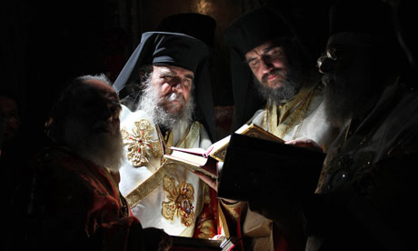
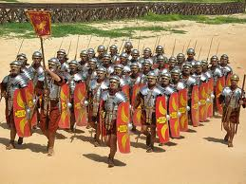
Greek influence:
Hellenism
idle witnesses to Roman domination.
Romans:
built roads
established postal system
sought for law and order
Greeks:
thinking
planning
philosophizing society
“If Rome conquered Greece with its armies, Greece conquered Rome with its ideas.”
Greek slaves were often better educated than the Roman masters whom they served.

Slide 16
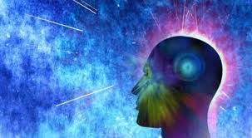
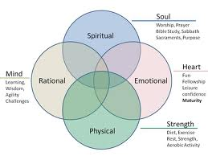
Greek religion and human existence:
Creation of men’s minds:
Power of independent thought =
Ability to examine the mysteries of the universe understanding sufficient to formulate satisfactory explanation.
“The Athenians and strangers which were there spent their time in nothing else, but either to tell, or hear some new thing.”
(Acts 17:21)

Slide 17
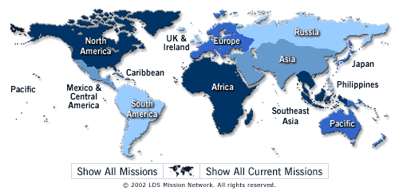
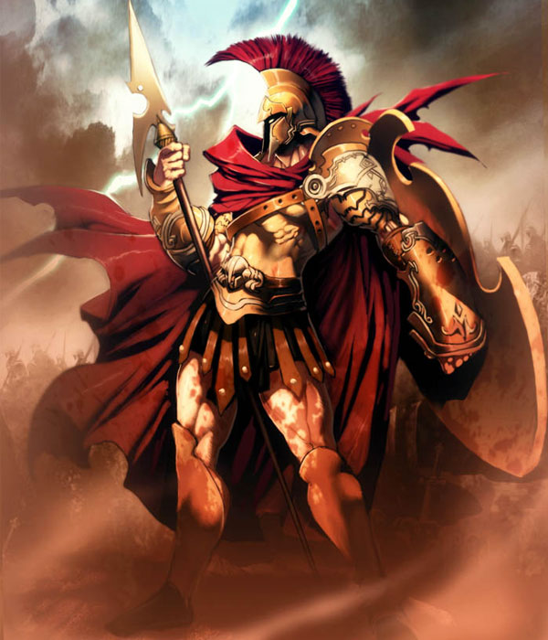
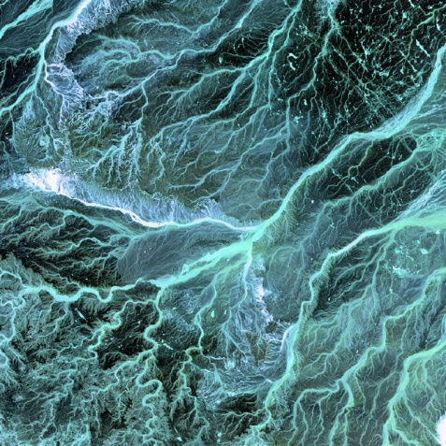
The Good, the Bad, and the Ugly Greek influence:
The Good:
Provided a medium through which the teaching of Jesus and his apostles could be spread rapidly.
The Bad:
Men could not resist the temptation to embellish the Christian revelation with their own interpretations.
The Ugly:
A new Christianity altogether. Trying to keep the gospel message pure and free from false philosophies. “The Great Apostasy”.

Slide 18
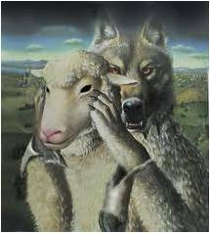
Christian Truth and pagan philosophy:
“For I know this that after my departing shall grievous wolves enter in among you, not sparing the flock.”
“Also of your own selves shall men arise, speaking perverse things, to draw away disciples after them.” (Acts 20:29, 30)

Slide 19
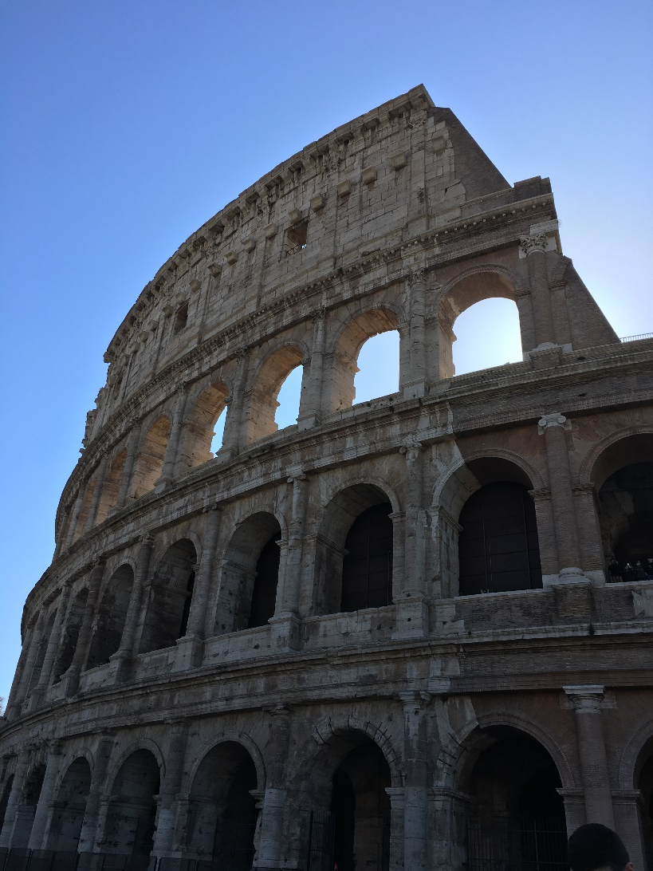
What good comes from these Societies?
Roman road literally opened avenues for Christian missionary work in the empire.
Roman toleration made it possible the practice and spread of Christianity.
The spirit of Greek rationalism and language provided opportunities where men gathered.
The Jewish dispersion made possible for Jewish-Christians to enter synagogues everywhere and preach the “good news” of Jesus Christ to all who opened their hearts and listen.

Slide 20
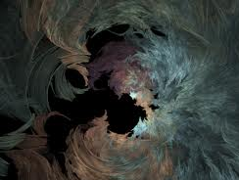
However:
Negative Attitudes:
World government-sponsored religions.
Not in total harmony.
Greeks considered doctrines of atonement and resurrection “foolishness”. (1 Corinthians 1:23)
Mocking Paul’s attempts to win their hearts to Christ. (Acts 17:32)
Jews hold it to be a threat to their
Mosaic institutions. (John 11:48)
Romans, in time, regard Christianity as an illicit cult, deserving neither sanction nor favor from the state.

Slide 21
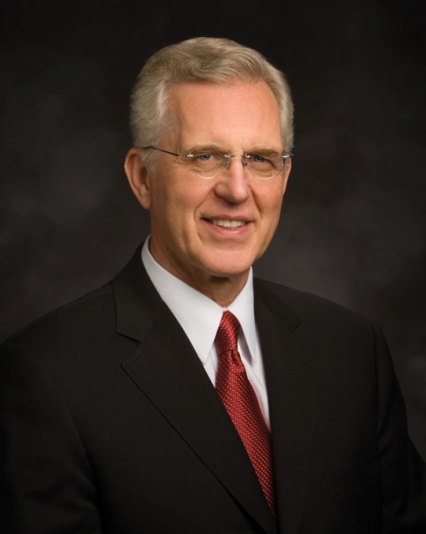
Meridian of Time
“The Savior taught His doctrine in the meridian of time, and his Apostles struggled mightily to preserve it against a barrage of false tradition and philosophy. New Testament Epistles cite numerous incidents demonstrating that serious and widespread apostasy was already under way during the Apostles ministry.”
(3)

Slide 22
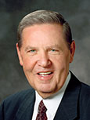
Direction Through the Holy Ghost
Jesus Christ directs His Church by revealing His will to His Apostles through the Holy Ghost
“From the first verse [of the book of Acts], the declaration is that the Church will continue to be divinely led, not mortally led. …
Indeed, a more complete title for the book of Acts could appropriately be something like ‘The Acts of the Resurrected Christ Working through the Holy Spirit in the Lives and Ministries of His Ordained Apostles.’ …
“The direction of the Church is the same. The location of the Savior has been altered, but the direction and leadership of the Church is exactly the same.”
Acts 1:1-8
(7)

Slide 23
Peter
John
Stephen
Phillip
Paul

Slide 24
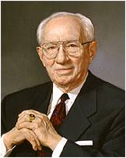
“In our day the Lord has called 15 special witnesses to testify of His divinity before all the world. Theirs is a unique calling; they are Apostles of the Lord Jesus Christ, chosen and commissioned by Him. They have been commanded to bear witness of His living reality by the power and authority of the holy apostleship in them vested.”
Acts 1:4; 2:33; Luke 24:49
(8)

Slide 25
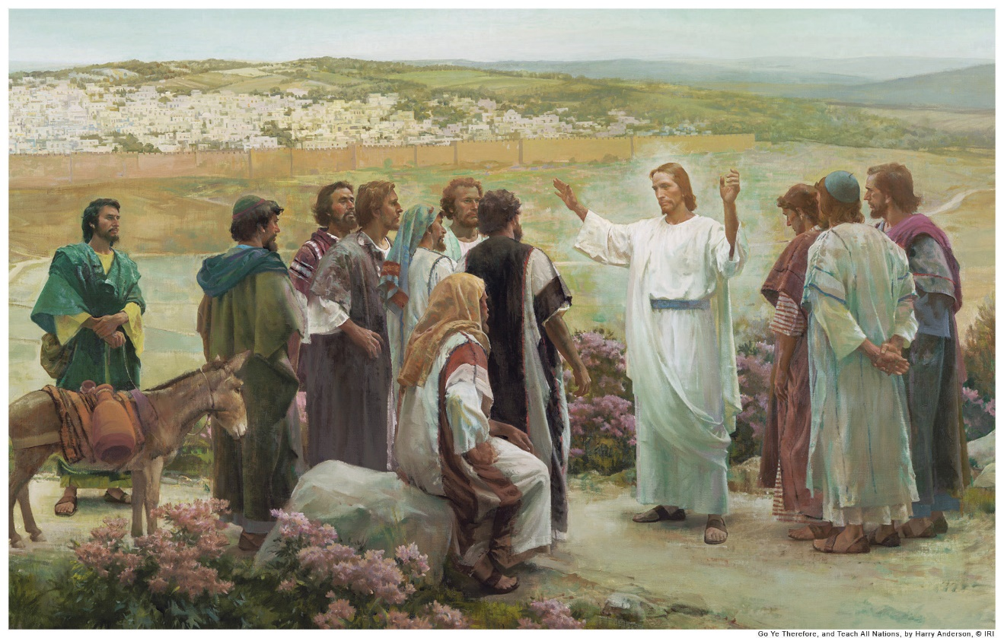
The Promise of the Father
Near the end of the Savior’s 40-day ministry with His disciples, He “commanded them that they should not depart from Jerusalem, but wait for the promise of the Father”
Harry Anderson
This referred to the gift of the Holy Ghost, which was given to the Apostles on the day of Pentecost:
(4)
Acts 1:4; 2:33; Luke 24:49

Slide 26
The Power
1 Corinthians 12:1-10
But the manifestation of the Spirit is given to every man to profit withal.
This power would have included:
The Spirit the word of wisdom
knowledge
faith
gifts of healing
Working of miracles
Prophecies
Discerning of spirts
Gift of tongues and interpretation of tongues
Acts 1:6-8 See also Moroni 10:9-17; D&C 46:13-26

Slide 27
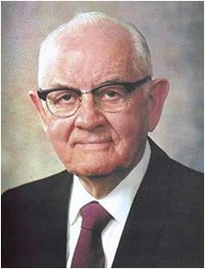
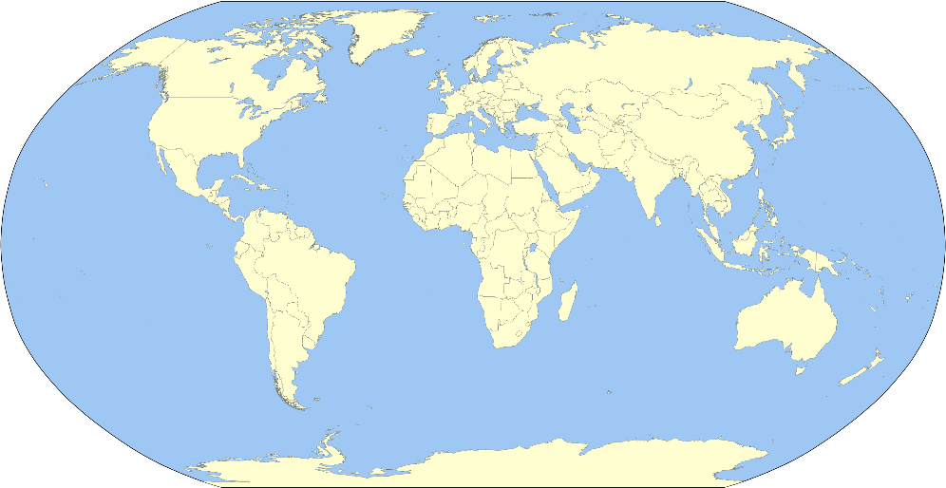
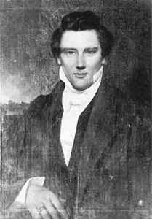
To Be A Witness—Here, There, and Everywhere
"Our work is to preach the gospel to the world. It is not self-imposed. We are under divine commandment.
The Prophet Joseph Smith preached, 'After all has been said, the greatest and most important duty is to preach the gospel.' All the other programs are extremely important but, of course, we cannot influence people much by those programs until we get them in the Church.
Acts 1:8
(6)

Slide 28
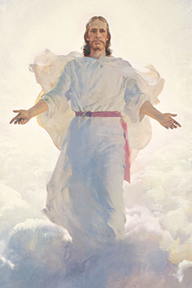
True or False?
Jesus Christ will return to the earth in the latter days.
True
And the Lord said unto Enoch: As I live, even so will I come in the last days, in the days of wickedness and vengeance, to fulfil the oath which I have made unto you concerning the children of Noah;
Moses 7:60

Slide 29
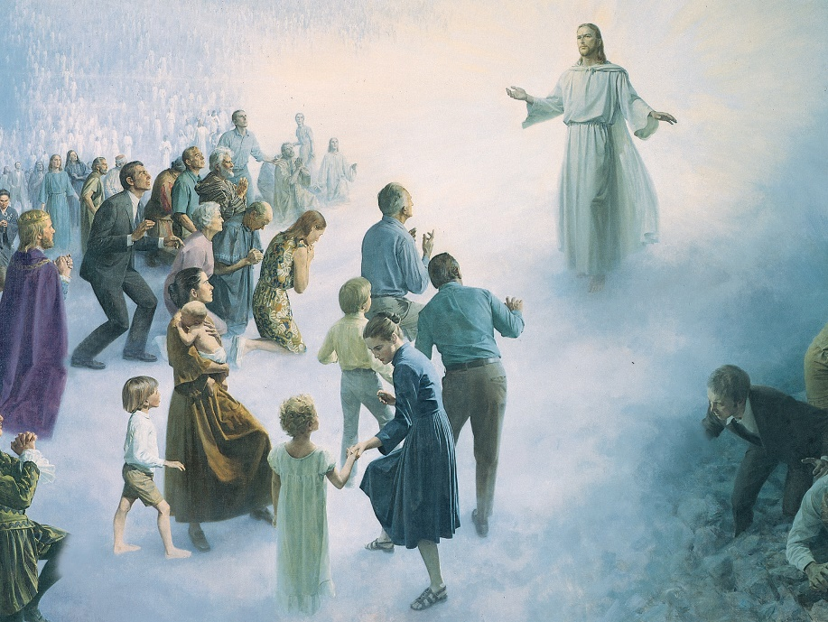
True or False?
At His Second Coming, Jesus Christ will appear only to righteous people.
False
For as the light of the morning cometh out of the east, and shineth even unto the west, and covereth the whole earth, so shall also the coming of the Son of Man be.
JST Matthew 1:26
And prepare for the revelation which is to come, when the veil of the covering of my temple, in my tabernacle, which hideth the earth, shall be taken off, and all flesh shall see me together.
D&C 101:23

Slide 30
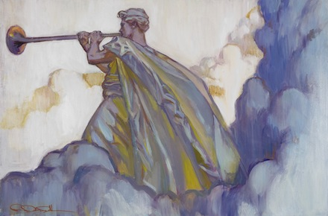
True or False?
Because Jesus Christ will be in disguise when He comes again, most people will not realize that the Second Coming has occurred.
False
And again, verily I say unto you, that the Son of Man cometh not in the form of a woman, neither of a man traveling on the earth.
Wherefore, be not deceived, but continue in steadfastness, looking forth for the heavens to be shaken, and the earth to tremble and to reel to and fro as a drunken man, and for the valleys to be exalted, and for the mountains to be made low, and for the rough places to become smooth—and all this when the angel shall sound his trumpet.
D&C 49:22-23
At His Second Coming, the Savior will descend from heaven in glory
Rose Detac Dall

Slide 31
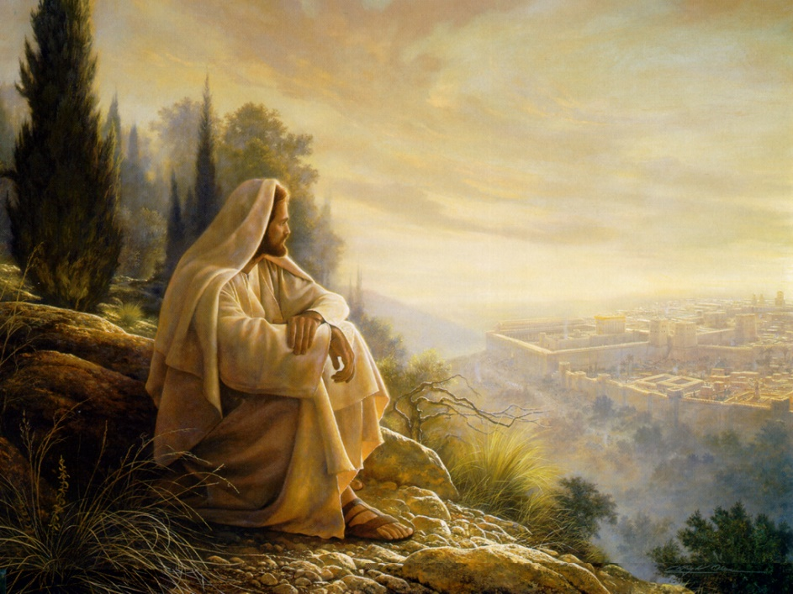
Again On Mt. Olive
The Savior’s Ascension took place on the Mount of Olives.
When the Savior comes again, one of His appearances will be when He will descend and actually stand on the Mount of Olives.
And his feet shall stand in that day upon the mount of Olives, which is before Jerusalem on the east, and the mount of Olives shall cleave in the midst thereof toward the east and toward the west, and there shall be a very great valley; and half of the mountain shall remove toward the north, and half of it toward the south.
Zechariah 14:4
This will be before His great and grand appearance to the world
And the glory of the Lord shall be revealed, and all flesh shall see it together: for the mouth of the Lord hath spoken it.
Isaiah 40:5
Acts 1:12
(6)

Slide 32
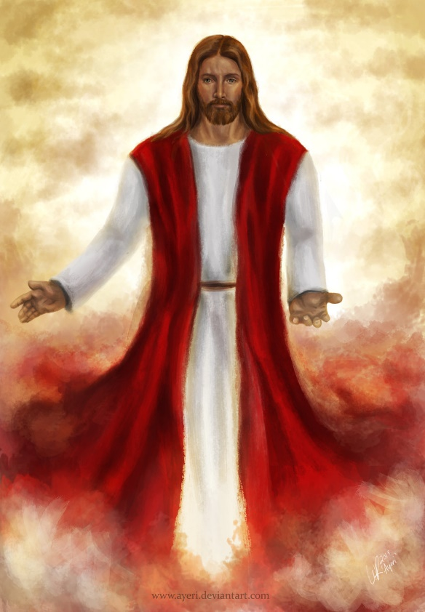
Two Holy Men
Two angels told them that Jesus Christ would return to the earth in “like manner” as He had ascended.
ayeri
This announcement makes clear to all mankind what they are to watch for in connection with the Savior’s Second Coming and protects them against deception.
Acts 1:9-10
(5)

Slide 33
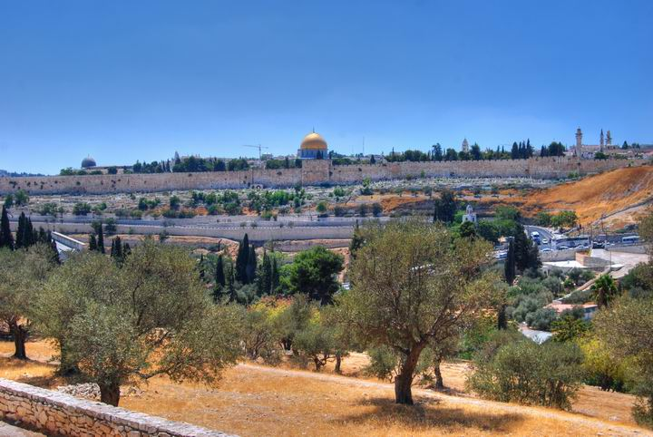
A Sabbath’s Days Journey
According to Jewish oral traditions, a Sabbath day’s journey was the distance a Jew was permitted to walk on the Sabbath.
Later rabbinic sources give this as 2,000 cubits—a distance of about 3,600 feet (about 1,100 meters).
It was about that distance from the city wall of Jerusalem to the Mount of Olives. (9)
Acts 1:12
(5)

Slide 34
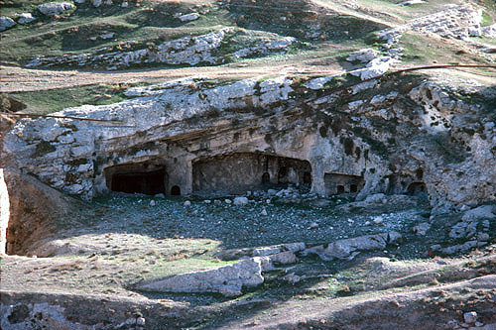
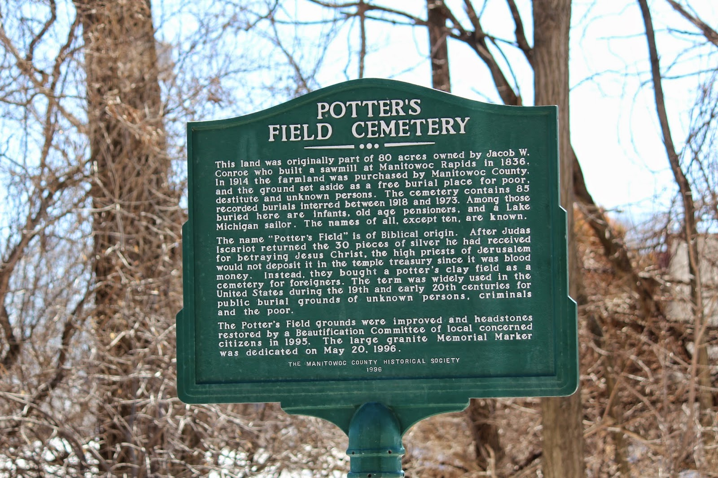
A Field of Blood
Following the suicide of Judas Iscariot (“this man”), the chief priests took the 30 pieces of silver that Judas had cast down in the temple (“the reward of iniquity”) and purchased “the potter’s field,” wherein strangers were later buried.
Field of Blood caves, tombs above the Hinnom Valley
(5)
Acts 1:13-14
Modern Day Potter’s Field

Slide 35
Matthias
Peter stood before 120 disciples and recounted the death of Judas Iscariot. Because Judas had been one of the Twelve Apostles, the disciples gathered to choose a new Apostle.
“they gave forth their lots”
casting lots was a faithful means of making a decision that showed trust in God directing the outcome
The lot is cast into the lap; but the whole disposing thereof is of the Lord.
Proverbs 16:33
Acts 1:26
(5)

Slide 36
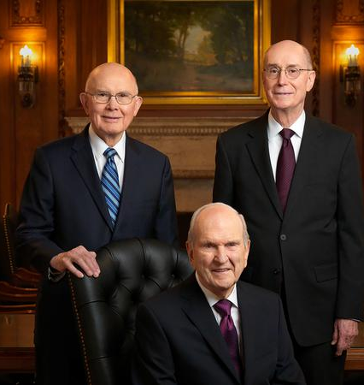
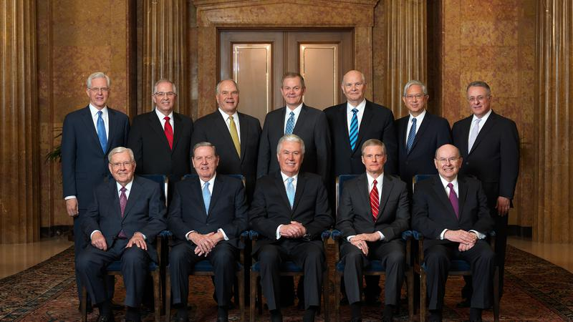
Called By Revelation
Apostles of Jesus Christ are called by God through revelation
Acts 1:21-26
(5)

Slide 37
Sources:
Suggested Hymn:
Video:
God Is at the Helm (2:28)
How Apostles Are Called (1:24)
1. The Life and Teachings of Jesus Christ and the Apostles.
2. Institute course manual 7.7
Elder D. Todd Christofferson The Doctrine of Christ 2012 April General Conference
President Boyd K. Packer (“The Cloven Tongues of Fire,” Ensign, May 2000, 7).
New Testament Institute Manual Chapter 29
President Spencer W. Kimball President Kimball Speaks Out [Salt Lake City: Deseret Book Co., 1981], 33-34.
Elder Jeffrey R. Holland (“Therefore, What?” [Church Educational System conference on the New Testament, Aug. 8, 2000], 6, si.lds.org).
President Gordon B. Hinckley (“Special Witnesses of Christ,” Ensign, Apr. 2001, 4).
D. Kelly Ogden, Where Jesus Walked: The Land and Culture of New Testament Times [Salt Lake City: Deseret Book Co., 1991], 4.
Presentation by ©http://fashionsbylynda.com/blog/

Slide 38
Place | Church Activity and Missionary Work Accounts in Acts | Scripture
Jerusalem | After Ascension | Acts 1:10-14
 | Calling of Matthias | Acts 1:15-26
 | Missionary work and Spirit on the day of Pentecost | Acts 2:1-13
 | Peter’s declaration of the Divinity of Jesus Christ | Acts 2:22-37
 | 3,000 People baptized | Acts 2:37-47
 | 2 Occasions the Sanhedrin refused to accept the Apostle’s testimonies: The arrest of Peter and John A large number of converts coming into the Church and rejection of the apostolic doctrines | Acts 3:1-4; Acts 4 Acts 5 Acts 5:17-42
Judea and Samaria | Preaching of Stephen and martyrdom—dispersion of Church members | Acts 6:8-Acts 8:2
 | The Seven Chosen to help with Church in Antioch | Acts 6
 | Philip, Peter, John, preaching | Acts 8:4-40
 | Baptism of Ethiopian eunuch | Acts 8:26-40
 | Saul of Tarsus converted | Acts 9:1-31
The Uttermost Part of the Earth | The Baptism of Cornelius at Caesarea (non-Israelite People) | Acts 9:32- Acts 11:26
 | The establishment of the church in Antioch (Gentile Members) with Saul and Barnabas | Acts 11:19-26
 | Missionary activity of Paul (Saul) travels through Asia Minor and Europe (Jew and Gentiles) | Acts 15:36- Acts 28:31
Bible Dictionary

Slide 39
Elder Jeffrey R. Holland on The Book of Acts:
“The direction of the Church is the same. The location of the Savior has been altered, but the direction and leadership of the Church is exactly the same. Then, having made that point, as if to prove in this most remarkable string of spiritual experiences all the way through the book, we get manifestations of the Lord’s power through the Holy Ghost at every turn. … The first teaching in the book of Acts from the resurrected Christ to the Twelve is that they ‘shall be baptized with the Holy Ghost not many days hence’ (Acts 1:5), and that ‘ye shall receive power, after that the Holy Ghost is come upon you’ (v. 8; italics added).
“After [Jesus] ascends to heaven before their very eyes, Peter gets the Church together—all one hundred and twenty of them. Can you see what an impact the troubles and the Crucifixion and the opposition had had on them? One hundred and twenty people gather and Peter says, ‘Men and brethren, this scripture must needs have been fulfilled, which the Holy Ghost by the mouth of David spake before concerning Judas’ (v. 16; italics added). In filling Judas’s vacancy in the Twelve, they prayed exactly the way the Quorum of the Twelve and First Presidency pray today: ‘Thou, Lord, which knowest the hearts of all men, shew whether of these … thou hast chosen’ (v. 24; italics added). … And Matthias was called.
“But that first chapter of turning heavenward, so clearly marking the divine guidance that would continue to direct the Church, is only a warm-up to chapter 2” (“Therefore, What?” [Church Educational System conference on the New Testament, Aug. 8, 2000], 6; si.lds.org).
The Day of Pentecost Acts 2:2-4:
“That power was not long in coming. On the day of Pentecost, the Twelve were assembled in a house:
“‘Suddenly there came a sound … of a rushing mighty wind, …
“‘And there appeared unto them cloven tongues like as of fire, and it sat upon each of them.
“‘And they were all filled with the Holy Ghost’ [Acts 2:2–4].
“With that the Twelve were fully empowered”
President Boyd K. Packer (“The Cloven Tongues of Fire,” Ensign, May 2000, 7).
PENTECOST also called feast of Weeks or feast of Harvest One of Three feasts everyone present Exodus 23:14-17, Deuteronomy 16:16; 1. Passover Leviticus 23:5-6; 2. Pentecost Leviticus 23:15-17; 3. Tabernacles Leviticus 23:34
The name “Pentecost,” was from the Greek language and it means “Fiftieth.” It was the fiftieth day after the Passover. Leviticus 23:15-16;. The Jews had called it the “Feast of Weeks,” “Harvest Festival” and the “Festival of the First Fruits.” It began on the Sunday the 1st day after the Sabbath which is a Saturday or 7th day, 7 weeks or 49 days after the Passover
18 Scripture n Leviticus 23:16 “Count off fifty days up to the day after the seventh Sabbath, and then present an offering of new grain to the LORD” n Numbers 28:26 “`On the day of firstfruits, when you present to the LORD an offering of new grain during the Feast of Weeks, hold a sacred assembly and do no regular work.”
The Day of Pentecost Published by Jonathon Catlow
A Witness: Acts 1: 1-8
“An eyewitness was not enough. Even the witness and testimony of the original Apostles had to be rooted in the testimony of the Holy Ghost. [President Joseph Fielding Smith] has told us that the witness of the Holy Ghost makes an impression on our soul that is more significant than ‘a visitation of an angel.’ (Joseph Fielding Smith, Doctrines of Salvation, comp. Bruce R. McConkie, Salt Lake City: Bookcraft, 1954, 1:44.) And the Bible shows that when we testify on the basis of this witness, the Holy Ghost testifies to those who hear our words.” Elder Dallin H. Oaks (“Witnesses of Christ,” Ensign, Nov. 1990, 30).
The Feast of Pentecost:
Fifty days (Lev. 23:16) after the Feast of the Passover, the Feast of Pentecost was kept. During those 50 days the harvest of wheat was being gathered in. It is called (Ex. 23:16) “the feast of harvest, the firstfruits of thy labours” and (Deut. 16:10) “the feast of weeks.” The feast lasted a single day, which was a day of holy convocation (Lev. 23:21); and the characteristic rite was the new meal offering; that is, two loaves of leavened bread made of fine flour of new wheat. Special animal sacrifices (Lev. 23:18) and freewill offerings (Deut. 16:10) were also made. The festival was prolonged in later times, and huge numbers of Jews attended it. Of this the narrative in Acts 2 is sufficient proof. It had the same evil reputation as the Feast of the Passover for tumults and massacres. We have no record of the celebration of this feast in the Old Testament. Bible Dictionary
The Gift of the Holy Ghost Acts 1:9-10
“The gift of the Holy Ghost … quickens all the intellectual faculties, increases, enlarges, expands, and purifies all the natural passions and affections, and adapts them, by the gift of wisdom, to their lawful use. It inspires, develops, cultivates, and matures all the fine-toned sympathies, joys, tastes, kindred feelings, and affections of our nature. It inspires virtue, kindness, goodness, tenderness, gentleness, and charity” Parley P. Pratt (Key to the Science of Theology [1978], 61).

Slide 40
Something of Interest:
Hugh Nibley:
"Recently I collected all the references I could find-I have twice as many now-of the forty-day mission of Christ. Whenever you find a very early Christian text, it almost always has a title referring to 'the secret teachings of the Lord to the Apostles during the forty days.' The fifty texts available to me then had four things in common.
"The first was secrets, what the Lord taught the apostles after the forty days. When he came after the resurrection, he visited them and taught them. This was the really important thing, we're told. They didn't understand anything until then, yet in the Bible we are told hardly a word of what he taught them. Why not? It was secret.
"The second point is that they all asked the Lord, 'What's going to happen to us? What's going to happen to the Church?' And he tells them that it is going to be on earth for two generations; these things are not going to be handed down; they are to be buried; they are to be kept secret. They are not to be passed on to the world. That's why we didn't get them. We are just finding them now.
"Third, he taught the strange doctrines the Christian world did not like at all, the things we have been talking about: other worlds, things like that. That was out of bounds to the Christian doctors, because it wasn't Aristotle.
"The fourth was the main thing he came to do. He took them through the temple, he taught them temple ordinances. Only the apostles and the general authorities, the seventies, were instructed in these-things to be handed down, not divulged to the public. Though they were very carefully kept from the public, we have these ordinances now as they are described here, and this I have talked about in the temple on occasion.
I just mention here these generalities, the importance of these documents, what they meant to those people. The person who receives these becomes a son. He both gives and receives...the signs and the tokens of the God of Truth while demonstrating the same to the Church, all in the hopes that these ordinances may some day become realities." (Hugh Nibley, Old Testament and Related Studies, edited by John W. Welch, Gary P. Gillum, and Don E. Norton [Salt Lake City and Provo: Deseret Book Co., Foundation for Ancient Research and Mormon Studies, 1986], 159-160.)
Casting Lots Acts 1:26:
“If they cast lots, it was an instance in which the Lord chose the result. More probably, however, ‘they gave forth their votes,’ presumably ‘sustaining votes’ to uphold him whom God had chosen to serve in the holy apostleship” (Bruce R. McConkie, Doctrinal New Testament Commentary, 3 vols. [1965–73], 2:32).
Modern Day Potter’s Field:
The land was originally part of 80 acres owned by Jacob W. Conroe who built a sawmill at Manitowoc Rapids in 1856. In 1914 the farmland was purchased by Manitowoc County and the ground set aside as a free burial place for poor destitute and unknown persons. The cemetery contains 85 recorded burials interred between 1918 and 1973. Among those buried here are infants, old age pensioners, and a Lake Michigan sailor. The names of all, except ten, are known. The name "Potter's Field" is of Biblical origin. After Judas Iscariot returned the 30 pieces of silver he had received for betraying Jesus Christ, the high priests of Jerusalem would not deposit it in the temple treasury since it was blood money. Instead, they bought a potter's clay field as a cemetery for foreigners. The term was widely used in the United States during the 19th and early 20th centuries for public burial grounds of unknown persons, criminals and the poor. The Potter's Field grounds were improved and headstones restored by a Beautification Committee of local concerned citizens in 1995. The large granite Memorial Marker was dedicated on May 20, 1996.
The marker is located on eastbound Meadow Lane, just west of its intersection with Broadway Street, near 3854 Meadow Lane, Manitowoc, Wisconsin 54220.

Slide 41
Event | Acts
Kingdom to Be Restored to Israel | 1:1–8
Mount of Olives: Christ Ascends to Heaven | 1:9–14
Jerusalem: Apostles Choose Successor to Judas | 1:15–26
The Holy Ghost and the Day of Pentecost | 2:1–21
Peter Testifies of Jesus’ Resurrection | 2:22–36
How to Gain Salvation | 2:37–40
All Things in Common | 2:41–47
Peter Heals Man Lame from Birth | 3:1–16
Age of Restoration Is Prior to Christ’s Second Coming | 3:17–24
The Children of the Covenant | 3:25, 26
Salvation Comes Only Through Christ | 4:1–12
Sadducees Seek to Silence Apostles | 4:13–22
Saints Glory in Testimony of Jesus | 4:23–31
Saints Practice United Order | 4:32–37
Fate of Deceivers | 5:1–11
Event | Acts
Apostles Continue Miracles of Jesus | 5:12–16
Angels Deliver Apostles from Prison | 5:17–26
Apostles Testify of Christ | 5:27–32
Persecution Is Not of God | 5:33–42
Seven Chosen to Assist Apostles | 6:1–6
Stephen Transfigured Before the Sanhedrin | 6:7–15
Stephen Preaches about Israel | 7:1–36
Moses—A Prototype of Christ | 7:37–40
Stephen Testifies of Apostasy in Israel | 7:41–53
Stephen Sees the Father and the Son | 7:54–60; 8:1
Saul Persecutes the Church | 8:1–4
Samaria: Philip Works Miracles, Converts Simon | 8:5–13
Apostles Confer Gift of the Holy Ghost | 8:14–17
Simon Seeks to Buy Gift of the Holy Ghost | 8:18–25
Toward Gaza: Philip Preaches Christ, Baptizes Eunuch | 8:26–40
The Acts of The Apostles, Written by Luke to Theophilus, 61-63 AD
The Events That Occurred 33-36 AD (1-8)
Life and Times of Jesus Christ Section 7 Chapter 29

