Slide 1
Lesson 86
What Would The Lord Want You to Know?
Acts 6-7
Stephen the Apostle

Slide 2
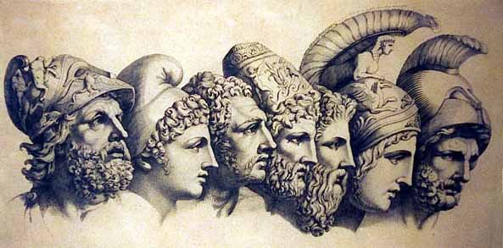
Grecians VS Hebrews
The Grecians “were Greek-speaking Jewish-Christians,”
The Hebrews “were Palestinian Jewish-Christians”
“The ancient Greek religion like many others of their time, shared some basic theological views. However, the ancient Hebrew religion differed in many ways. First of all, the Hebrews believed in one God, while the Greeks believed in a pantheon of gods. This pantheon was usually warring with each other. Humans could also thwart the plans of the Greek gods, whereas the God of the Hebrews plans could never be thwarted. Moreover, the Greeks supposed that the sacrifices they gave their gods’ strengthened the gods in some way like nourishment. Yet, Yahweh does not need the sacrifices that the Hebrews gave him. These are only some of the differences between these two religions. It is interesting to note that in the ancient era there are no other religions like the one of the Hebrews.” (3)
(2)
Acts 6:1

Slide 3
7 Men Are Called
To address the growing need to care for widows and others, seven men were called and given authority to assist the Twelve.
These men served under the direction of the Twelve with the specific task of caring for the poor and needy. It is not known what priesthood office the seven men held.
Timon
Nicanor
Prochorus
Philip
Stephen, a man full of faith and of the Holy Ghost
Nicolas a proselyte of Antioch
Parmenas
…they laid their hands on them—Setting Apart
(2)
Acts 6:2-6

Slide 4
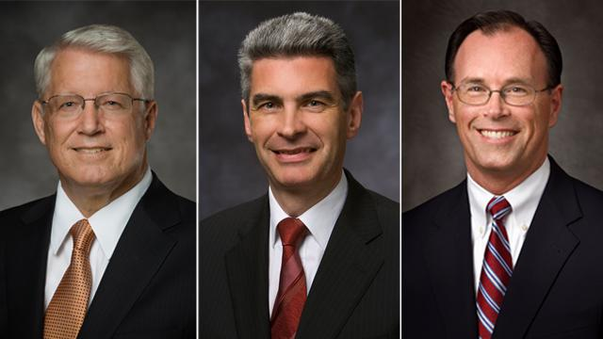
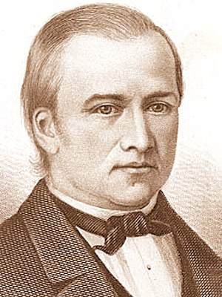
Being Called
Worthy Church members are called to help minister to the needs of others
“The bishop has a divine mandate to seek out and care for the poor.
He directs the welfare work in the ward. His goal is to help members help themselves and become self-reliant. (In branches, the branch president has these same welfare responsibilities.)
The bishop determines whom to assist, how much to give, and how long to assist.”
Presiding Bishopric of the Church (left to right):
Bishop Dean M. Davies, first counselor;
Presiding Bishop Gérald Caussé;
Bishop W. Christopher Waddell, second counselor.
2015
Each individual circumstance is different and requires inspiration and is guided by the Spirit…
“Bishops are blessed with the gift of discernment to understand how best to help those in need.
And the bishop, Newel K. Whitney, also should travel round about and among all the churches, searching after the poor to administer to their wants by humbling the rich and the proud.
D&C 84:12
(4)

Slide 5
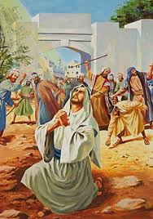
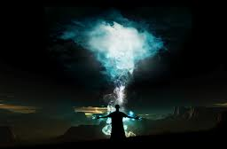
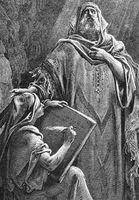
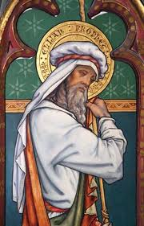
Who was Stephen?
He was a man of faith and power
He was filled with the Holy Ghost
He did great wonders and miracles
He was ordained by priesthood power
Acts 6:5-9

Slide 6
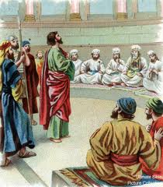
Blasphemous Words?
Those who opposed Stephen were from one or more synagogues where Jews from foreign lands worshipped:
Libertines were former slaves who had gained their freedom.
Cyrenians were Jews from Northern Africa.
Alexandrians were Jews from the Egyptian city of Alexandria.
Cilicia was a Roman province of Asia Minor.
Stephen was taken to Council for Preaching
It appears that his opponents were angered by his teachings that the coming of Jesus Christ had redefined basic Jewish concepts regarding the land of Israel, the law of Moses, and the temple of Jerusalem. Stephen’s opponents “suborned men” meaning that they persuaded men to commit perjury.
Acts 6:12-15
(1)

Slide 7
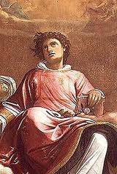
Face of an Angel
“And all that sat in the council, looking stedfastly on him, saw his face as it had been the face of an angel.”
Stephen was transfigured. This holy transfiguration was one way God showed the people that He approved of Stephen and his message.
Acts 6:15
(5)

Slide 8
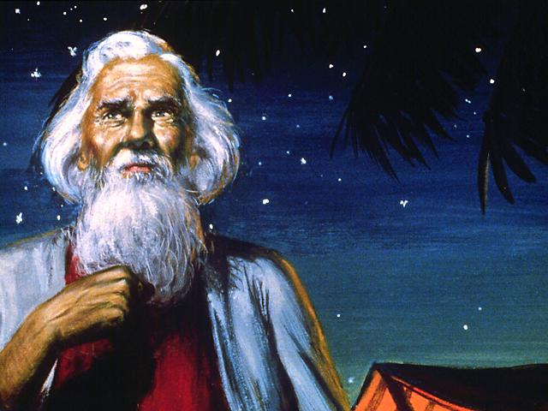
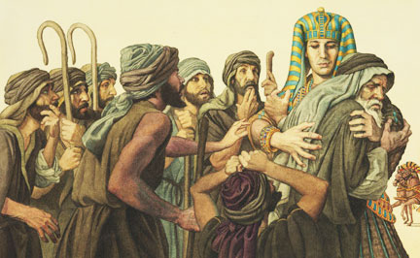
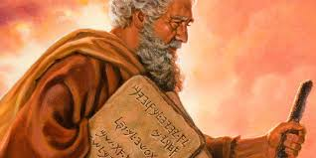
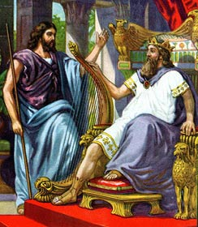
Stephen Recounts Israel’s History
Joseph in Egypt
Glory of God appearing to Abraham
Israel rejects Moses
David and Solomon
The Jews were aware of the promise that the Lord would send them a prophet like unto Moses. (1)
Acts 7:1-50

Slide 9
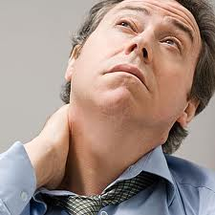
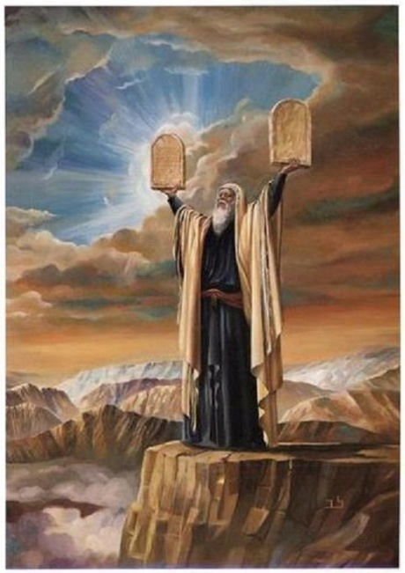
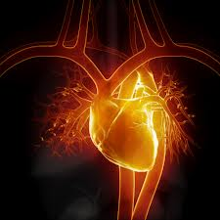
3 Accusations
“stiffnecked”
and rejected the influence of the Holy Ghost
“resist the Holy Ghost: as your fathers did, so do ye.”
“uncircumcised in heart and ears”
They rejected and slew the Just one, Jesus Christ
They received the law of Moses but didn’t live it
Acts 7:51-53

Slide 10
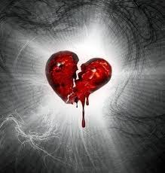
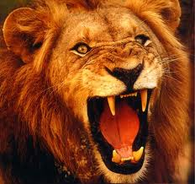
When they heard these things:
“cut to the heart”
“gnashed on him with their teeth.”
Resisting the Holy Ghost can lead to rejecting the Savior and His prophets
The Holy Ghost testifies of Jesus Christ and witnesses of the truth of His words and the words of His prophets. Therefore, resisting the Holy Ghost will weaken someone’s testimony and his or her resolve to follow the Savior and His prophets.
Acts 7:52-54

Slide 11
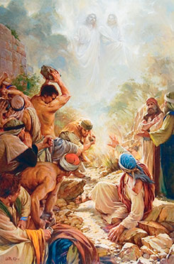
Looking to Heaven—3 Separate Beings
Stephen’s Vision
…saw the glory of God, and Jesus standing on the right hand of God,”
“But he, being full of the Holy Ghost…
Heavenly Father, Jesus Christ, and the Holy Ghost are three separate and distinct beings
“he fell asleep”
Acts 7:55-56

Slide 12
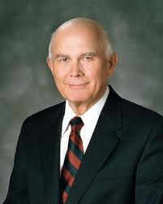
“Many Christians reject the idea of a tangible, personal God and a Godhead of three separate beings. They believe that God is a spirit and that the Godhead is only one God. In our view these concepts are evidence of the falling away we call the Great Apostasy.”
Acts 7:55-56
(6)

Slide 13
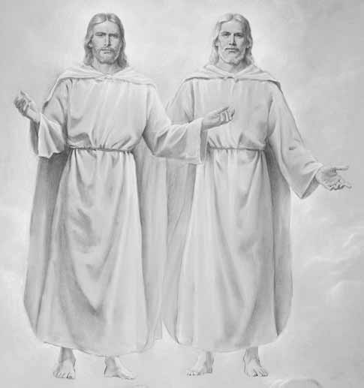
The Godhead
The Father has a body of flesh and bones as tangible as man’s
The Son also (has a body of flesh and bones)
But the Holy Ghost has not a body of Flesh and bone, but is a personage of Spirit.
D&C 130:22

Slide 14
What We Believe
“…we believe in a Godhead of Father, Son, and Holy Ghost. However, we testify that these three members of the Godhead are three separate and distinct beings. We also testify that God the Father is not just a spirit but is a glorified person with a tangible body, as is His resurrected Son, Jesus Christ”
Elder Dallin H. Oaks

Slide 15
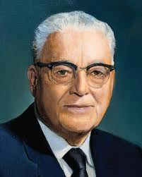
“If you want to know what the Lord would have the Saints know and to have his guidance and direction for the next six months, get a copy of the proceedings [of the last] conference, and you will have the latest word of the Lord as far as the Saints are concerned.”
(7)

Slide 16
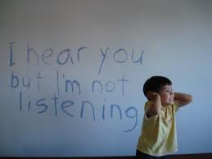
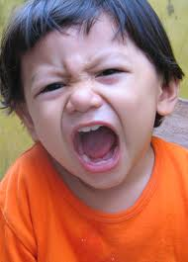
Persecution
“…cried out with a loud voice…
…stopped their ears”
…and ran upon him with one accord”
Acts 7:57

Slide 17
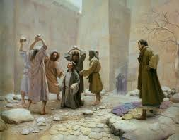
Cast out
From the city
Witnesses laid down their clothes at Saul’s feet
Acts 7:58

Slide 18
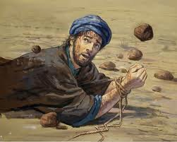
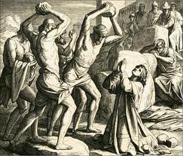
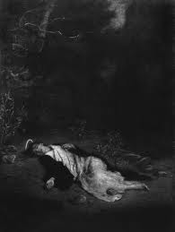
Stoning of Stephen
He calls upon God to receive his spirit
“…Lord, lay not this sin to their charge.
“…and when he had said this, he fell asleep.”
Acts 7:59-60

Slide 19
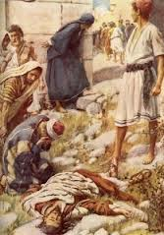
A Martyr
Stephen is generally considered the first Christian martyr.
In addition, he can be seen as a type of Christ, as both he and the Savior stood before a council to be tried, declared truths in the face of their enemies, gave their lives in a righteous cause, and even uttered similar expressions as they suffered death.

Slide 20
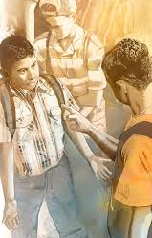
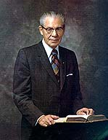
"Our Lord gave us an example of the true spirit of forgiveness when he said from the cross,
'... Father, forgive them; for they know not what they do.'
(Luke 23:34.)
We read also of that faithful disciple, Stephen, who was persecuted and stoned, 'And he kneeled down, and cried with a loud voice, Lord, lay not this sin to their charge. And when he had said this, he fell asleep.'
"How important it is for us to apply in our lives those great principles of repentance and forgiveness. Let us always remember that the one who carries a grudge or ill feelings toward a neighbor and does not forgive is the
one who is uncomfortable and unhappy and ill
at ease, and continuing in this course will
canker his soul, and in him will remain the
greater sin.
Acts 7:60
(8)

Slide 21
Sources:
Suggested Hymn: #277 As I Search the Holy Scriptures
Videos:
Seek the Lord (6:19)
Mountains to Climb (5:05)
New Testament Institute Student Manual Chapter 30
New Testament Student Manual [Church Educational System manual, 2014
Peter Bianchi (Blog) Oct. 2013
(Providing in the Lord’s Way: Summary of a Leader’s Guide to Welfare[booklet, 2009], 4–5).
Bruce R. McConkie, Doctrinal New Testament Commentary, 3 vols. (1965–73), 2:67.])
Dallin H. Oaks 1995 Apr. Conference Report or May 1995 Ensign
Harold B. Lee 1973 Oct. Conference Report or Jan 1974 Ensign
Elder N. Eldon Tanner ("The Importance of Prayer," Ensign, May 1974, 53)
Presentation by ©http://fashionsbylynda.com/blog/

Slide 22
Grecian VS Hebrew Acts 6:1
"What distinction was made in New Testament times between Greeks and Grecians?
"...Jews of the dispersion who adopted Hellenists' customs and who spoke Greek (Acts 6:1; 9:29) were called Grecians. New Testament references to Greeks refer to persons of Greek lineage." (Church News: Question of the Week, LDS Church News, 1994, 10/22/94)
"But the difference between the 'Grecians' and the 'Hebrews' was far deeper than merely of language, and extended to the whole direction of thought. There were mental influences at work in the Greek world from which, in the nature of things, it was impossible even for Jews to withdraw themselves... it was only natural that the Hellenists, placed as they were in the midst of such hostile elements, should intensely wish to be Jews, equal to their Eastern brethren. On the other hand, Pharisaism, in its pride of legal purity and of the possession of traditional lore, with all that it involved, made no secret of its contempt for the Hellenists, and openly declared the Grecian far inferior to the Babylonian 'dispersion.' That such feelings, and the suspicions which they engendered, had struck deep into the popular mind, appears from the fact, that even in the Apostolic Church, and that in her earliest days, disputes could break out between the Hellenists and the Hebrews, arising from suspicion of unkind and unfair dealings grounded on these sectional prejudices (Acts 6:1)." (Edersheim, Alfred, Life and Times of Jesus the Messiah, 5-6)
Great Company Acts 6:7
"Some scholars have recently suggested that this great company may have been such a band of holy men as we find described in the newly discovered Dead Sea Scrolls and related documents, if not a group actually named in one of them. These men were prepared by their tradition to receive the gospel when they heard it. Without that tradition and training the preaching to them might have fallen on deaf ears."
Hugh Nibley (The World and the Prophets, 3rd ed. [Salt Lake City and Provo: Deseret Book Co., Foundation for Ancient Research and Mormon Studies, 1987], 220.)
Blasphemous Words Acts 6:11-15:
"It is certain that Stephen said something about the law of Moses being fulfilled and being no longer in force, or his enemies would not have accused him of being contrary to Moses and saying that Jesus (already dead) would change the customs of the law (see Acts 6:13).
Stephen was something of an eastern Abinadi, who testified that salvation was dependent on the atonement of Jesus Christ, notwithstanding the law of Moses. And like Abinadi, he gave his life for his testimony of Jesus Christ. And like Abinadi, his face shone like an angel's." (Selected Writings of Robert J. Matthews: Gospel Scholars Series [Salt Lake City: Deseret Book Co., 1999], 286.)
Face of An Angel Acts 6:15
“Stephen was transfigured before them, visible witness thus being given that God was with him. In a lesser degree, it was with Stephen as it had been with Moses, the skin of whose face shone visibly after he had communed with the Lord for forty days on the mountain (Ex. 34:29–35.)” (Doctrinal New Testament Commentary, 2:67).
On occasion the Spirit will have such a powerful influence on the individual as to transform their being into a source of light. Like the stones that illuminated the Jaredite ship after being touched by Jehovah, the faces of the prophets become luminescent with the power of God. We remember the instance when the face of Moses shone after conversing with the Lord (Ex. 34:29). The brothers Nephi and Lehi had the same experience while conversing with angels, their 'faces...did shine exceedingly, even as the faces of angels' (Hel 5:36). And then Abinadi, whose mission was reminiscent of Stephen's, became so full of the Spirit that 'his face shone with exceeding luster' (Mosiah 13:5).
The Prophet Joseph Smith was noted to have a transcendent luminescence to his countenance when he was particularly full of the Spirit. The following are the accounts of those who witnessed this magnificent transformation:
"Emmeline B. Wells: 'The power of God rested upon him to such a degree that on many occasions he seemed transfigured. His expression was mild and almost childlike in repose; and when addressing the people, who loved him it seemed to adoration, the glory of his countenance was beyond description. At other times the great power of his manner, more than of his voice (which was sublimely eloquent to me) seemed to shake the place on which we stood and penetrate the inmost soul of his hearers, and I am sure that then they would have laid down their lives to defend him.'
"Mary Ann Winters: 'I stood close by the Prophet while he was preaching to the Indians in the Grove by the Temple. The Holy Spirit lighted up his countenance till it glowed like a halo around him, and his words penetrated the hearts of all who heard him and the Indians looked as solemn as Eternity.'" (Truman Madsen, Joseph Smith the Prophet, pp. 89-90)
Laid Their Hands On Them, Setting Apart Acts 6:6:
"The priesthood ordinance of setting apart is the formal process of giving authority to members called to labor in specific responsibilities. It involves a specific priesthood procedure, including the laying on of hands. It has been a practice of the Lord's servants since Old Testament times, even though in some scriptural references it is not clear whether the wording refers to being ordained, set apart, or both. In fact, it may be that earlier dispensations made very little distinction between these two practices.
"...In other Old Testament passages, the word separate seems to refer to the procedure of designating someone for the Lord's work. For example, 1 Chronicles 23:13 [1 Chr. 23:13], we read that 'Aaron was separated, that he should sanctify the most holy things, he and his sons for ever, to burn incense before the Lord, to minister unto him, and to bless in his name for ever.'
"In the New Testament we find clearer instances of individuals being set apart. In the ancient Church when seven men were chosen to assist the Apostles, they were 'set before the apostles: and when they had prayed, they laid their hands on them.' (Acts 6:6.) Also, when Barnabas and Saul were selected for the Lord's work, the Church leaders fasted and prayed, and 'the Holy Ghost said [to them], Separate me Barnabas and Saul for the work whereunto I have called them.' (Acts 13:2.) The Church leaders then 'laid their hands on them,' after which they sent Saul and Barnabas out to do the work. (Acts 13:3.)" (Rex Allred, "I Have a Question," Ensign, Mar. 1983, 67)

Slide 23
The History Lesson Acts 7:1-50:
"In answer to the charge, [Stephen] delivered an address, which on critical analysis appears to have been extemporaneous, nevertheless it is strikingly logical and impressive in argument. The delivery was abruptly terminated, however, by a murderous assault. In effective epitome Stephen traced the history of the covenant people from the time of Abraham down, showing that the patriarchs, and in turn Moses and the prophets, had lived and ministered in progressive preparation for the development of which those present were witnesses...It is plain to be seen that Stephen's speech was not one of vindication, and far from a plea in his own defense; it was a proclamation of the word and purposes of God by a devoted servant who had no thought for personal consequences.“ James E. Talmage (Jesus the Christ, 660.)
Cut to the Heart Acts 7:35:
"...we are told that the multitude 'were cut to the heart' when Stephen accused them of rejecting what had been brought 'by the disposition of angels' (Acts 7:53-54). But the last straw was when he had the effrontery to say, 'Behold, I see the heavens opened, and the Son of man standing on the right hand of God. Then they cried out with a loud voice, and stopped their ears, and ran upon him with one accord, and cast him out of the city, and stoned him' (Acts 7:56-58).
If Stephen had spent his life, as innumerable philosophers have, denouncing the vices and follies of the age, he might have died peacefully in bed. But those fatal words, 'I see,' were his death warrant. And what did Paul say to make the Jews cry out in utter horror: 'Away with such a fellow from the earth: for it is not fit that he should live,' as 'they . . . cast off their clothes, and threw dust into the air?' (Acts 22:22-23.) What indeed? These were the unforgivable words that made him unfit to live: 'Suddenly there shone from heaven a great light round about me. And I fell unto the ground, and heard a voice saying unto me, Saul, Saul, why persecutest thou me? And I answered, Who art thou, Lord? And he said unto me, I am Jesus of Nazareth, whom thou persecutest' (Acts 22:6-8). Paul could have won his audience over by speaking as a scholar, but when he bore witness to what he had seen and heard, he was asking for trouble." Hugh Nibley (The World and the Prophets, 3rd ed. [Salt Lake City and Provo: Deseret Book Co., Foundation for Ancient Research and Mormon Studies, 1987], 14 - 15.)
Israel’s Inheritance Acts 7:5:
"The promise of Israel's inheritance reaches into eternity when the earth is to be cleansed and made fit for the habitation of the righteous, otherwise the promise to Abraham and Israel would have failed, for, as pointed out by the martyr, Stephen, the Lord gave this land of Palestine to Abraham for him and his posterity forever, and yet in his lifetime Abraham received 'not so much as to set his foot on: yet he promised that he would give it to him for a possession, and his seed after him, when as yet he had no child.'-Acts 7:5.“ Joseph Fielding Smith (The Restoration of All Things [Salt Lake City: Deseret News Press, 1945], 138 - 139.)
Stephen Gives More Information on Moses Acts 7:20-30:
In recounting Jewish history, Stephen gives us bits of information about Moses which are not contained in the Exodus account. Like Josephus, the ancient historian, Stephen was privy to more complete records. His record tells us about:
Moses' natural good looks (v. 20),
his education among the Egyptians (v. 22),
his mighty deeds and words while amongst the Egyptians (v. 22),
his age of 40 at the time he left Egypt (v. 23),
his understanding of his mission to deliver Israel long before his epiphany on Sinai (v. 25), and
his age of 80 when the Lord appeared to him on Sinai (v. 30).
Josephus is a good source for some of this complimentary information.
"Clearly, Stephen and Paul had more information about Moses than we have in our present Old Testament. From them we learn, among other things, that Moses, years before being called at the burning bush, knew of his own identity and of his mission." (Robert J. Matthews, A Bible! A Bible! [Salt Lake City: Bookcraft, 1990], 58 - 59.)
Gospeldoctrine.com
Heavens Open Acts 7:56:
"The gateway of death may not be governed by a door as heavy and shut as it seems. It may be softly veiled by a billowy curtain or a delicate drape. The Prophet Joseph Smith referred to the 'veil of death.' Certainly communication through the gateway between this world and the next is not closed. Prophets and apostles treat such transfer of intelligence as a very sacred matter, and rarely speak openly about it.“ Elder Russell M. Nelson (The Gateway We Call Death [Salt Lake City: Deseret Book Co., 1995], 94.)
Godhead Acts 7:56:
"Clement of Rome wrote about A.D. 96 and said that God formed man in the 'likeness of his own image.' In the opening of Hebrews Christ is clearly distinct from God, standing 'on the right hand of the Majesty on high' (Heb. 1:3). Commentators too smugly say that 'no literal location is intended.' Yet the mother of James and John had a location in mind when she wanted them to sit at Christ's right and left hand in eternity (Matt. 20:21-23). But Christian scholars believe that 'God has no physical right hand or material throne where the ascended Christ sits beside Him.' They interpret the 'right hand' as merely descriptive of status or power, but how do they draw the line between explaining and explaining away? Stephen saw Christ at the right hand of God (Acts 7:55-56), as did Joseph Smith in 1820 in the First Vision. A half dozen times Paul speaks of Christ at the right hand of the Father and never hints at less than literalism." (Richard Lloyd Anderson, Understanding Paul [Salt Lake City: Deseret Book Co., 1983], 202.)

Slide 24
Event | Acts
Kingdom to Be Restored to Israel | 1:1–8
Mount of Olives: Christ Ascends to Heaven | 1:9–14
Jerusalem: Apostles Choose Successor to Judas | 1:15–26
The Holy Ghost and the Day of Pentecost | 2:1–21
Peter Testifies of Jesus’ Resurrection | 2:22–36
How to Gain Salvation | 2:37–40
All Things in Common | 2:41–47
Peter Heals Man Lame from Birth | 3:1–16
Age of Restoration Is Prior to Christ’s Second Coming | 3:17–24
The Children of the Covenant | 3:25, 26
Salvation Comes Only Through Christ | 4:1–12
Sadducees Seek to Silence Apostles | 4:13–22
Saints Glory in Testimony of Jesus | 4:23–31
Saints Practice United Order | 4:32–37
Fate of Deceivers | 5:1–11
Event | Acts
Apostles Continue Miracles of Jesus | 5:12–16
Angels Deliver Apostles from Prison | 5:17–26
Apostles Testify of Christ | 5:27–32
Persecution Is Not of God | 5:33–42
Seven Chosen to Assist Apostles | 6:1–6
Stephen Transfigured Before the Sanhedrin | 6:7–15
Stephen Preaches about Israel | 7:1–36
Moses—A Prototype of Christ | 7:37–40
Stephen Testifies of Apostasy in Israel | 7:41–53
Stephen Sees the Father and the Son | 7:54–60; 8:1
Saul Persecutes the Church | 8:1–4
Samaria: Philip Works Miracles, Converts Simon | 8:5–13
Apostles Confer Gift of the Holy Ghost | 8:14–17
Simon Seeks to Buy Gift of the Holy Ghost | 8:18–25
Toward Gaza: Philip Preaches Christ, Baptizes Eunuch | 8:26–40
The Acts of The Apostles, Written by Luke to Theophilus, 61-63 AD
The Events That Occurred 33-36 AD (1-8)
Life and Times of Jesus Christ Section 7 Chapter 29

Slide 25
Similarities Between Moses and Jesus Christ
MOSES | JESUS CHRIST
Acts 7:18–21. Moses was saved from slaughter in Egypt while he was an infant. | Matthew 2:13–16. Jesus’s family fled to Egypt so that He would not be slain as an infant.
Acts 7:22. Moses was “learned in all the wisdom of the Egyptians, and was mighty in words and in deeds.” | Mark 6:2. Many were astonished at Christ’s teachings in the synagogue.
Acts 7:25. Moses “supposed his brethren would have understood … but they understood not.” | John 1:10–11; John 6:66. “The world knew him not. … His own received him not.”
Acts 7:29. Moses fled to the wilderness of Midian before delivering the people. | Matthew 4:1–11. Jesus retired to the wilderness to be with God before His mortal ministry.
Acts 7:30–34. Moses returned to his people after those who sought his life were dead. | Matthew 2:20. Jesus Christ’s family returned to the land of Israel following Herod’s death.
Acts 7:34. Ancient Israel was in bondage to the Egyptians; Moses was sent to deliver them. | John 8:33–36. The Jews were in bondage to sin; Jesus came to deliver them.
Acts 7:35. “This Moses whom they refused, … the same did God send to be a ruler.” | Matthew 21:33–39. Jesus Christ, who was the “heir” of the Father, was rejected by the Jews (see also Mark 15:1–2).
Acts 7:36. Moses “shewed wonders and signs in the land of Egypt.” | Matthew 4:23. “Jesus went about … healing all manner of sickness.”
Acts 7:39. “In their hearts,” the people “turned back again into Egypt.” | John 6:66. “From that time many of his disciples went back, and walked no more with him.”
New Testament Institute Manual Chapter 30

