Slide 1
Lesson 87
The Gospel is Spread Beyond Jerusalem
Acts 8
Including:
Philip’s Mission
Simon, the Sorcerer

Slide 2
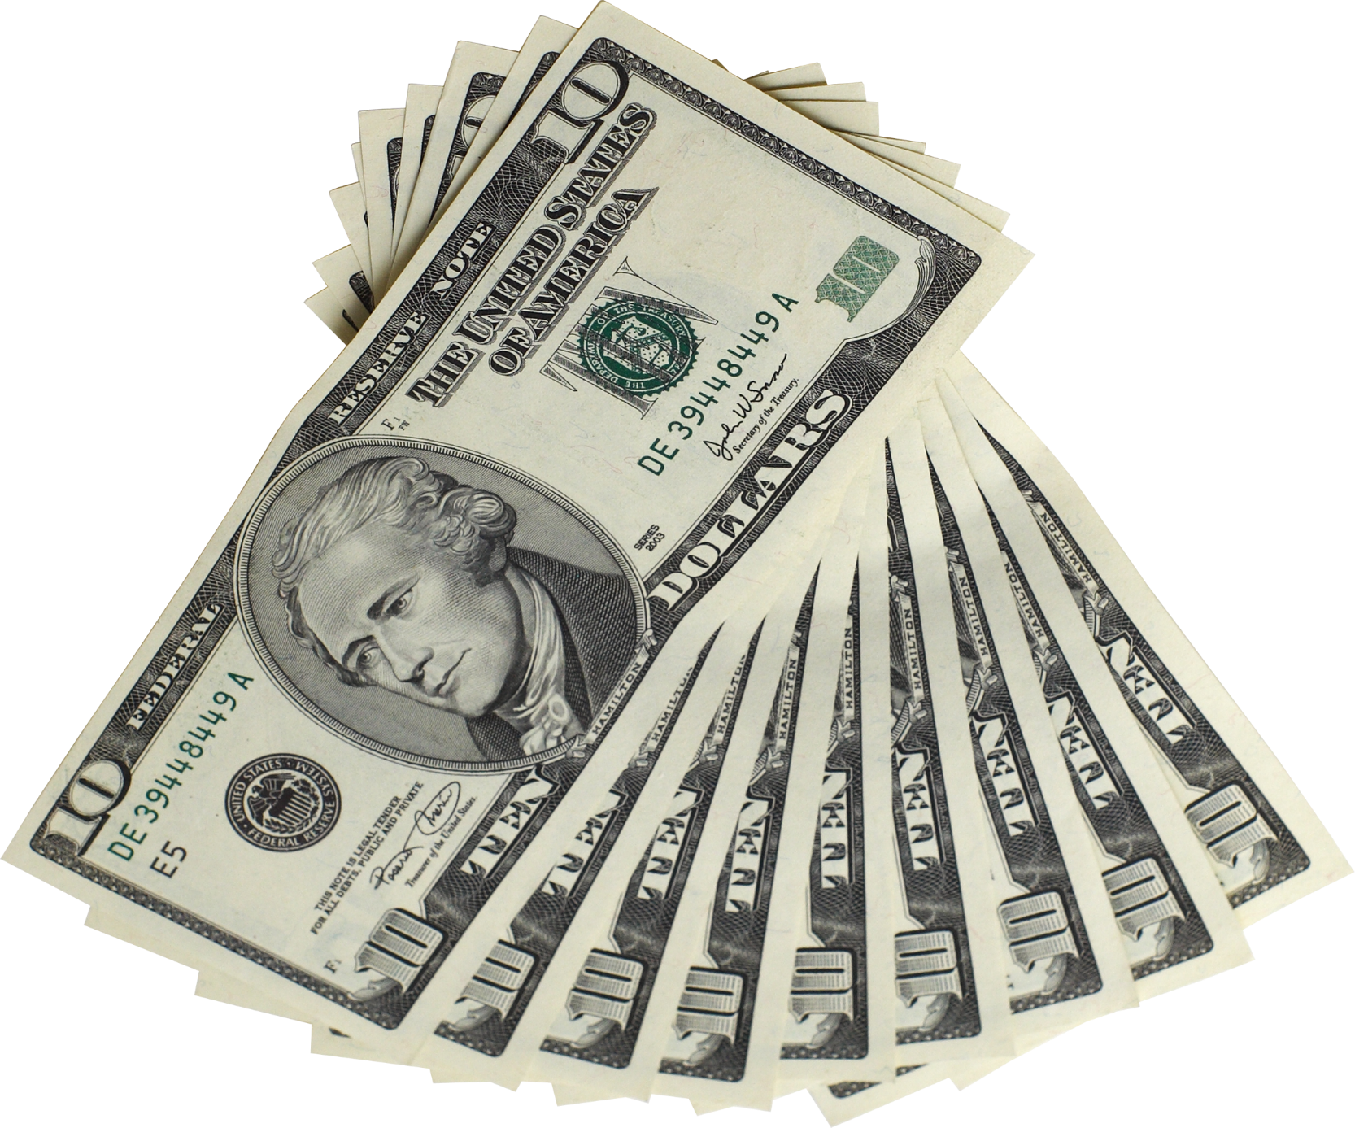
What is something you would purchase with the money?
Some people believe that money can buy anything.
However, some of the most valuable things in life cannot be purchased.

Slide 3
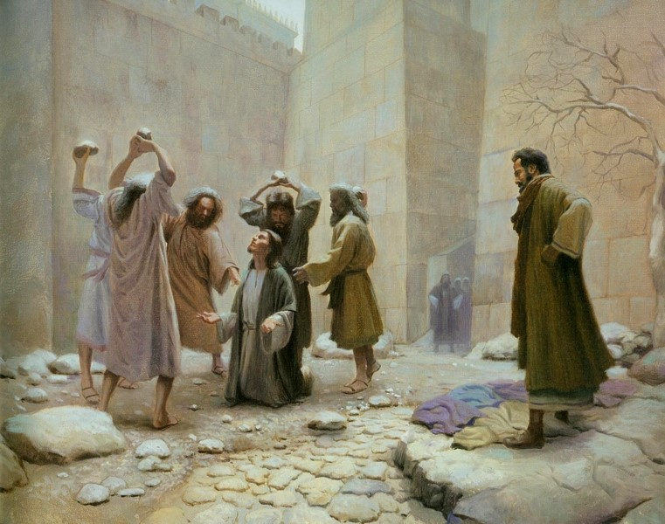
Persecutions For the Members Of the Church
Saul watches as Stephen is stoned.
Saul causes havoc for the Church Members…
Therefore the members were scattered.
Acts 8:1-4
(1)

Slide 4
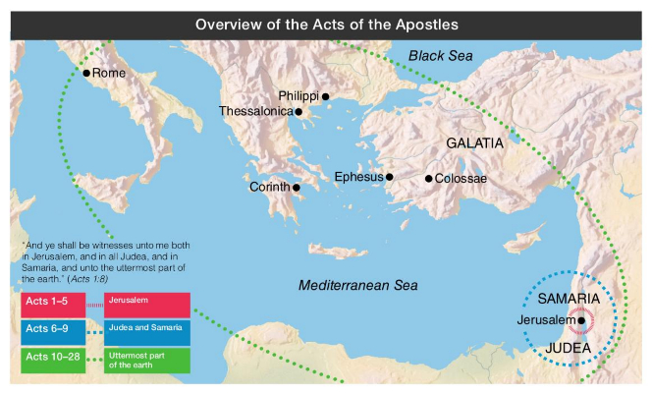
The Gospel Went Forth From Jerusalem
A Silver Lining in the Darkest Storm Clouds
Behold, he that keepeth Israel shall neither slumber nor sleep. Psalm 121:4
Because of this persecution, many of the followers of Jesus Christ traveled beyond Judea for safety, where they continued to preach the gospel and accelerate its expansion.
Acts 8:5
(1)

Slide 5
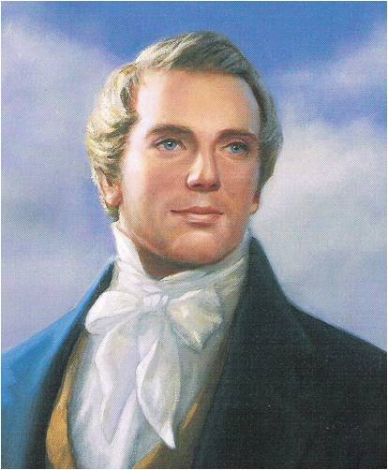
“The Standard of Truth has been erected; no unhallowed hand can stop the work from progressing; persecutions may rage, mobs may combine, armies may assemble, calumny may defame, but the truth of God will go forth boldly, nobly, and independent, till it has penetrated every continent, visited every clime, swept every country, and sounded in every ear, till the purposes of God shall be accomplished, and the Great Jehovah shall say the work is done.”
(3)

Slide 6
Philip
He was one of the “seven chosen” to care for the needs of the widows and perform other works of service
He was visited by an angel
He preached in Samaria, baptized an Ethiopian eunuch, and ended up in Caesarea
He preached, baptized, cast out unclean spirits, and performed other miracles
Philip appears to have ministered as a holder of the Aaronic Priesthood—he had the authority to baptize but did not have the authority to give the gift of the Holy Ghost . Those whom Philip baptized had to wait for the arrival of Peter and John, holders of the Melchizedek Priesthood, to receive the gift of the Holy Ghost. (1)
Had 4 unmarried daughters who had the gift of prophecy (Acts 21:9)
Later Paul stayed with Philip in Caesarea
(2)

Slide 7
Sorcery of Simon
Sorcery = use of power gained from the assistance or control of evil spirits
Simon, a Samaritan sorcerer who had been baptized by Philip, saw Peter and John exercising priesthood authority and supposed that he could purchase this authority.
“We believe that a man must be called of God, by prophecy, and by the laying on of hands by those who are in authority, to preach the Gospel and administer in the ordinances thereof.” (5th Article of Faith)
Acts 8:12-24

Slide 8
Deception
“Simon the sorcerer so convincingly portrayed his satanic powers as divine that many people, 'from the least to the greatest, [said], This man is the great power of God.'
In 1830, Hiram Page, one of the eight witnesses of the Book of Mormon, claimed to receive 'revelations' for the Church from a certain stone he had obtained.
Although these 'revelations' contradicted those Joseph Smith had received from the Lord, his manner of receiving them deceived several members of the Church, including Oliver Cowdery.
The Lord commanded Oliver to tell Brother Page 'that those things which he hath written from that stone are not of me and that Satan deceiveth him.‘
Eight years later, Hiram Page left the Church.
Obviously in these cases, Satan gave men mighty power so similar to that manifested by true servants of God that many were deceived."
Acts 8:10; D&C 28:11
(4)

Slide 9
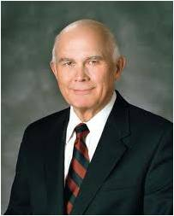
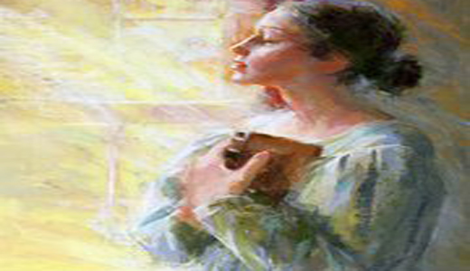
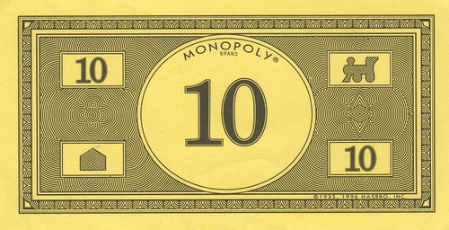
“To avoid being deceived, we must also follow the promptings of that Spirit.
“That which the Spirit testifies unto you even so I would that ye should do in all holiness of heart, walking uprightly before me, considering the end of your salvation, doing all things with prayer and thanksgiving, that ye may not be seduced by evil spirits, or doctrines of devils, or the commandments of men. …
“Wherefore, beware lest ye are deceived; and that ye may not be deceived seek ye earnestly the best gifts, always remembering for what they are given” (D&C 46:7–8).
The Holy Ghost will protect us against being deceived, but to realize that wonderful blessing we must always do the things necessary to retain that Spirit. We must keep the commandments, pray for guidance, and attend church and partake of the sacrament each Sunday. And we must never do anything to drive away that Spirit.
Monopoly is a game of deception, loopholes, and no court hearings. If the other player doesn't know the rules all you need to do is convince them that you are right even though you are lying
(5)

Slide 10
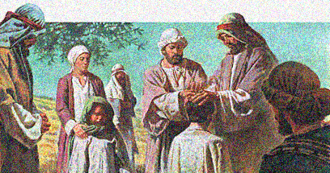
Apostles Hear of Success
Peter and John came to Samaria after hearing that the people there had accepted the word of God.
They prayed that the converted Samaritans would receive the gift of the Holy Ghost.
The gift of the Holy Ghost is bestowed after baptism through the laying on of hands by authorized priesthood holders
Acts 8:14-17

Slide 11
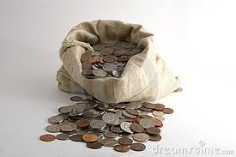
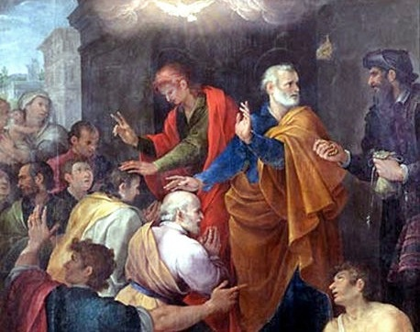
The Sorcerer’s Heart
“…Thy money perish with thee, because thou hast thought that the gift of God may be purchased with money.”
Offers money for the Priesthood
What did Peter teach Simon about the priesthood?
The priesthood is bestowed according to God’s will and standard of worthiness
Acts 8:18-20

Slide 12
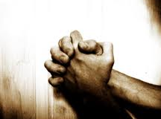
Repentance Of Simon
“…for thy heart is not right in the sight of God.”
Simon:
“…Pray ye to the Lord for me, that none of these things which ye have spoken come upon me.”
Acts 8:21-24

Slide 13
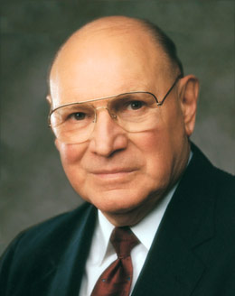
“The gift of the Holy Ghost, which is the right to receive the Holy Ghost as a constant companion, is obtained only upon condition of faith in Christ, repentance, baptism by immersion, and the laying on of hands by authorized servants endowed with the Melchizedek Priesthood.
It is a most precious gift available only to worthy members of the Lord’s Church.”
Acts 8:21-24
(6)

Slide 14
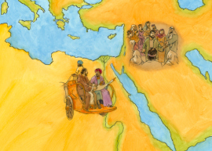
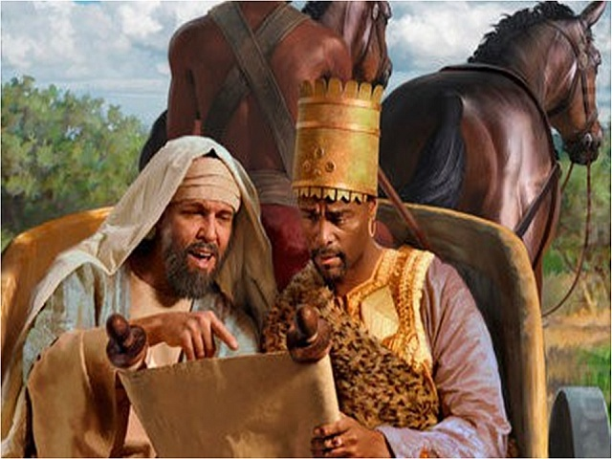
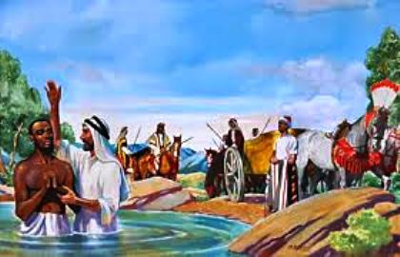
Philip Goes South to Gaza
Man from Ethiopia (an eunuch)
And hears man reading Esaias (Isaiah)
Philip taught about Jesus
and baptized the man from Ethiopia
Philip continued on to preach in all cities
Acts 8:26-40

Slide 15
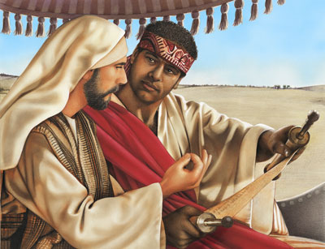
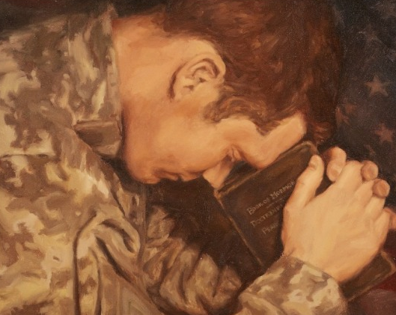
‘No greater responsibility can rest upon any man [or woman] than to be a teacher of God’s children.’
“We are, in fact, all somewhat like the man of Ethiopia to whom Philip was sent. Like him, we may know enough to reach out for religion.
We may invest ourselves in the scriptures.
We may even give up our earthly treasures, but without sufficient instruction we may miss the meaning of all this and the requirements that still lie before us.
So we cry with this man of great authority, ‘How can [we understand,] except some [teacher] should guide [us]?’”
(7)
Kalisha Dawn Harmon, Age: 18, Utah

Slide 16
Sources:
Suggested Hymn: #101 Guide Me To Thee
Video: Power of God (3:24)
New Testament Institute Student Manual Chapter 31
Who’s Who in the New Testament by Richard J. Allen p. 143-144
Teachings of Presidents of the Church: Joseph Smith [2007], 142.
William E. Berrett, "I Have a Question," Ensign, Oct. 1979, 30
Elder Dallin H. Oaks Be Not Deceived Oct. 2004 Gen. Conf.
Elder Joseph B. Wirthlin (“The Unspeakable Gift,” Ensign or Liahona, May 2003, 26; see also D&C 20:38, 41).
Elder Jeffrey R. Holland (“A Teacher Come from God,” Ensign, May 1998, 25). And quoting David O. McKay [in Conference Report, Oct. 1916, 57
Presentation by ©http://fashionsbylynda.com/blog/

Slide 17
Saul Acts 8:1-4:
"Among the disputants who, when defeated in discussion, conspired against Stephen and brought about his death, were Jews from Cilicia. Associated with them was a young man named Saul, a native of the Cilician city of Tarsus. This man was an able scholar, a forceful controversialist, an ardent defender of what he regarded as the right, and a vigorous assailant of what to him was wrong. Though born in Tarsus he had been brought to Jerusalem in early youth and had there grown up a strict Pharisee and an aggressive supporter of Judaism. He was a student of the law under the tutelage of Gamaliel, one of the most eminent masters of the time; and had the confidence of the high priest. His father, or perhaps an earlier progenitor, had acquired the rank of Roman citizenship, and Saul was a born heir to that distinction. Saul was a violent opponent of the apostles and the Church, and had made himself a party to the death of Stephen by openly consenting thereunto and by holding in personal custody the garments of the false witnesses while they stoned the martyr.“ elder James E. Talmage (Jesus the Christ, 661
One With Authority Acts 8:14-15:
"The laying on of hands is the divinely-authorized method of administering spirit baptism...The laying on of hands for the gift of the Holy Ghost was an ordinance in the Christian church for centuries. The ordinance remained with the church much longer than did the Holy Ghost. Cyprian mentions it in the third century; Augustine in the fourth. Gradually, however, it began to be neglected, until finally some of the sects repudiated it, while others, retaining the 'form of godliness,' denied 'the power thereof.'" Orson F. Whitney (Gospel Themes[Salt Lake City: n.p., 1914], 63.)
Philip eagerly Joins the Others and Preaches the Gospel Acts 8:29-30:
"We can be of so much service to others in many 'thou shalt' ways. Of course, the problem is that rendering such service takes time and we are all so busy. Some situations may call for service that somehow seems to be beneath us. Besides, we have other things to do. The 'thou shalts' are so convenient to put off. Who will notice the procrastination anyway? After all, we are not robbing a bank. Or are there forms of withholding which constitute stealing? (quotes Acts 8:26-21)
"...How many times are we too busy to 'come up and sit' (v. 31) with someone who needs conversation? You and I have divine promptings all the time encouraging us to do good, but we often deflect them instead of doing like Philip, who 'ran thither.'" Elder Neal A. Maxwell ("The Pathway of Discipleship," Ensign, Sept. 1998, 10)
Saul’s part in the Death of Stephen Acts 8:1-4:
The angry mob dropped their cloaks at Saul’s feet. Cursing and yelling, they began to hurl stones at Stephen for preaching about Jesus. The rocks bruised and cut Stephen’s body. Wounded, he knelt on the ground and cried with a loud voice, “Lord, lay not this sin to their charge,” and died.
Saul was unmoved by the innocent man’s dying words of forgiveness. He thought Christians were wicked, and he worked hard to rid the empire of them. He searched the towns and homes, and when he found any men or women who believed in Christ, they were put into prison.
So great was Saul’s vengeance that he went to the high priest and obtained letters to take to the synagogues in Damascus. The letters gave Saul the authority to take prisoner any Christian he found on his journey.
Carrying the letters, Saul started for Damascus, determined to destroy the Christians.
Scriptural Giants: Saul Becomes Paul
By Sherrie Johnson found in Friend (Sept. 1986)
Eunuch:
A class of emasculated men attached to the courts of eastern rulers. They were employed to watch over the harems and also were often given positions as trusted officials. Eunuchs are mentioned in 2 Kgs. 20:18; Isa. 39:7; 56:4; Jer. 38:7–13; 41:16; Matt. 19:12; Acts 8:27–38. Bible Dictionary
"Philip-saintly, valiant, a powerful preacher, a mighty worker of miracles-held only the Aaronic Priesthood! Peter and John must yet come from Jerusalem to Samaria to confer the Holy Ghost upon his baptized converts. (Acts 8:14-17.) And yet Philip, magnifying his calling, casts out devils, commands the lame to leap and the sick to rise from their beds of affliction. Miracles are wrought by the power of faith, and a righteous man need not hold the Melchizedek Priesthood to have power and influence with his Creator. As Joseph Smith said, 'If a priest understands his duty, his calling, and ministry, and preaches by the Holy Ghost, his enjoyment is as great as if he were one of the Presidency.‘ Elder Bruce R. McConkie (Teachings, p. 112.)" (Doctrinal New Testament Commentary, 3 vols. [Salt Lake City: Bookcraft, 1965-1973], 2: 81.)

Slide 18
Event | Acts
Kingdom to Be Restored to Israel | 1:1–8
Mount of Olives: Christ Ascends to Heaven | 1:9–14
Jerusalem: Apostles Choose Successor to Judas | 1:15–26
The Holy Ghost and the Day of Pentecost | 2:1–21
Peter Testifies of Jesus’ Resurrection | 2:22–36
How to Gain Salvation | 2:37–40
All Things in Common | 2:41–47
Peter Heals Man Lame from Birth | 3:1–16
Age of Restoration Is Prior to Christ’s Second Coming | 3:17–24
The Children of the Covenant | 3:25, 26
Salvation Comes Only Through Christ | 4:1–12
Sadducees Seek to Silence Apostles | 4:13–22
Saints Glory in Testimony of Jesus | 4:23–31
Saints Practice United Order | 4:32–37
Fate of Deceivers | 5:1–11
Event | Acts
Apostles Continue Miracles of Jesus | 5:12–16
Angels Deliver Apostles from Prison | 5:17–26
Apostles Testify of Christ | 5:27–32
Persecution Is Not of God | 5:33–42
Seven Chosen to Assist Apostles | 6:1–6
Stephen Transfigured Before the Sanhedrin | 6:7–15
Stephen Preaches about Israel | 7:1–36
Moses—A Prototype of Christ | 7:37–40
Stephen Testifies of Apostasy in Israel | 7:41–53
Stephen Sees the Father and the Son | 7:54–60; 8:1
Saul Persecutes the Church | 8:1–4
Samaria: Philip Works Miracles, Converts Simon | 8:5–13
Apostles Confer Gift of the Holy Ghost | 8:14–17
Simon Seeks to Buy Gift of the Holy Ghost | 8:18–25
Toward Gaza: Philip Preaches Christ, Baptizes Eunuch | 8:26–40
The Acts of The Apostles, Written by Luke to Theophilus, 61-63 AD
The Events That Occurred 33-36 AD (1-8)
Life and Times of Jesus Christ Section 7 Chapter 29

