Slide 1
Lesson 88
A Chosen Vessel
Acts 9
Go thy way: for he is a chosen vessel unto me, to bear my name before the Gentiles, and kings, and the children of Israel
Acts 9:15

Slide 3
Saul—Paul (Latin)
He was born in 1-3 AD, the son of Tarsus, and born a free Roman citizen
He was brought up a Jew and trained as a Pharisee under the study of Gamaliel in Jerusalem
He was from the Tribe of Benjamin (Philemon 3:5)
His father was a tentmaker, so more than likely he was too
He was a persecutor of the Saints, took part in the martyrdom of Stephen, then on his way to Damascus was visited by the Lord Jesus and was ‘reborn’
He lived in Arabia for 3 years and came back to begin his mission for the Savior
He traveled to the east and north of the Mediterranean and wrote many letters (Epistles) to specific cities
He died after his 5th missionary journey in 65-68 AD-- tradition says he was beheaded in Rome by emperor Nero (The New Testament does not say when and how he died)
2,3,4

Slide 4
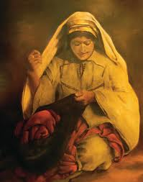
Other family members of Saul
Saul had a sister, and her son saves the Apostle’s life (Acts 23:16)

Slide 5
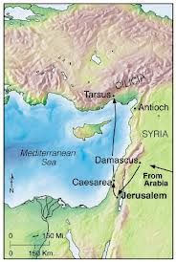
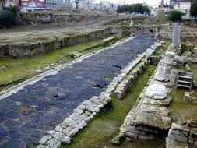
Tarsus
Capital of Cilicia
One of 3 greatest centers of learning during Saul’s days.

Slide 6
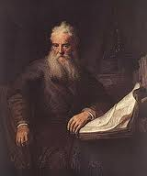
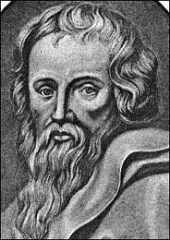
Training and Education of Saul
Learned in the Sacred Law
Jewish upbringing with Greek influence. Hebrew tongue (Aramaic), and Greek
Taught by Gamaliel…a celebrated Jewish teacher
It was an honor to study in the “Beth Hammidrash” or “House of Interpretation”
(3)

Slide 7
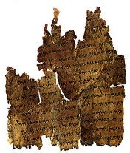
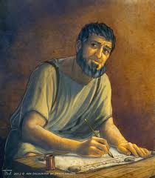
Studies
Halachah---Precepts of the law---legal code
Haggada---historical events of the scriptures, using parables and allegories
Possibly trained as a Rabbi
(3)

Slide 8
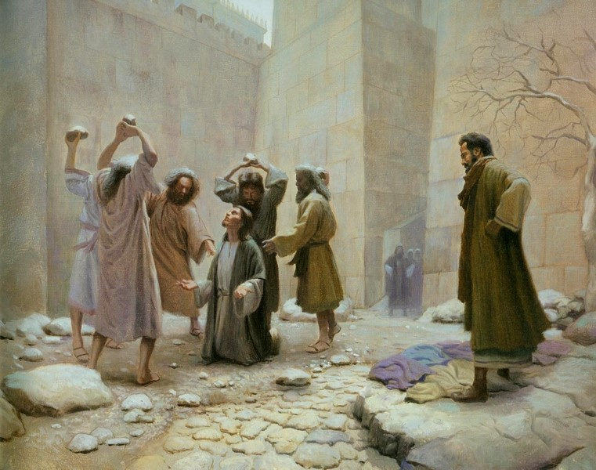
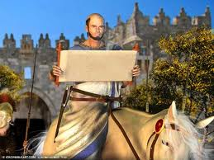
Meeting Saul---Luke Records
The young man present at the stoning of Stephen
“…and a witnesses laid down their clothes at a young man’s feet, whose name was Saul.”
Acts 7:58

Slide 9
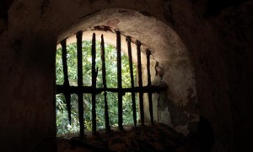
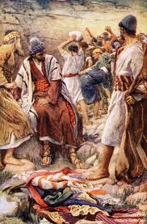
Persecution of the Church Members
“And Saul was consenting unto his (Stephen’s) death.”
“As for Saul, he made havock of the church, entering into every house, and haling men and women committed them to prison.”
Acts 8:1-4

Slide 10
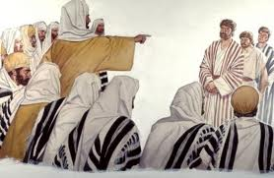
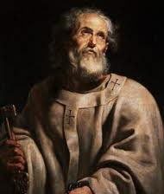
Confession of Saul
“…and many of the saints did I shut up in prison, having received authority from the chief priests; and when they were put to death, I gave my voice against them.”
“And I punished them oft in every synagogue…I persecuted them even unto strange cities.”
Acts 26:10-11

Slide 11
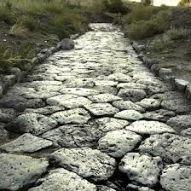
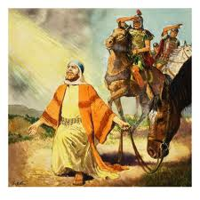
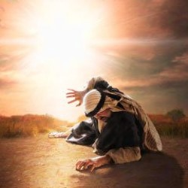
On the Road to Damascus
Light from Heaven
Falls to the earth
“…Saul, Saul, why persecutest thou me?”
Acts 9:3-4

Slide 12
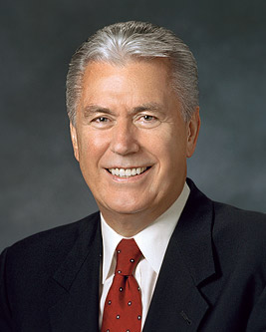
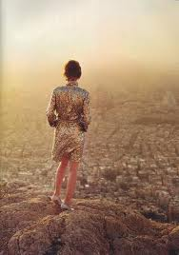
Are we waiting on the road to Damascus?
“…They stand at the waters of baptism but do not enter.
They wait at the threshold of testimony but cannot bring themselves to acknowledge the truth.
Instead of taking small steps of faith on the path of discipleship, they want some dramatic event to compel them to believe.”
(5)

Slide 13
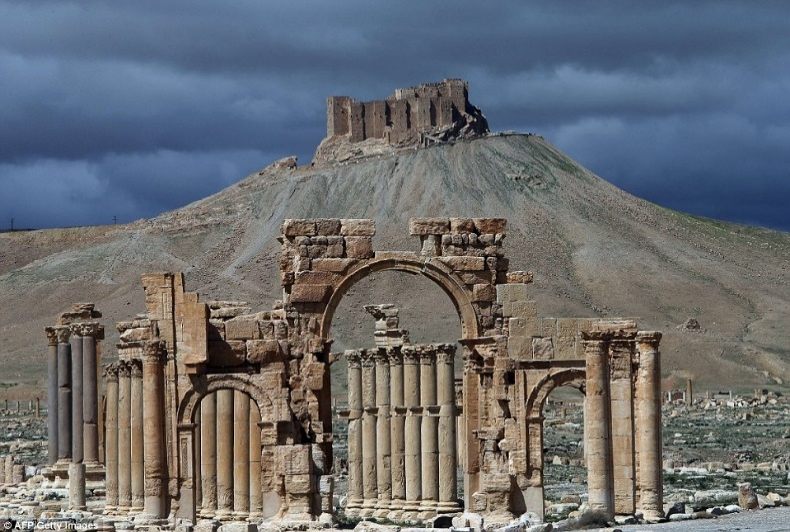
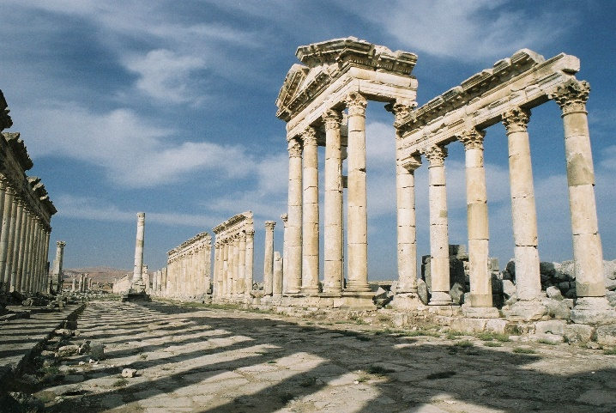
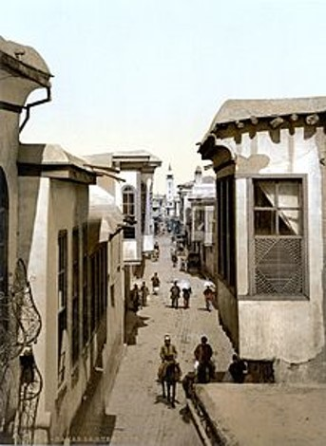
Damascus
Present Day capital of Syria
A Roman Province of Syria in days of Apostles
Terminating points for trade in the Near East
By prophecy (Isaiah) it was destroyed and then rebuilt
Present day…Christian quarter located on street named “Straight”
Northeast of Damascus
(6)

Slide 14
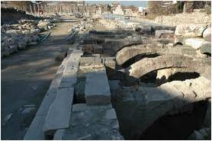
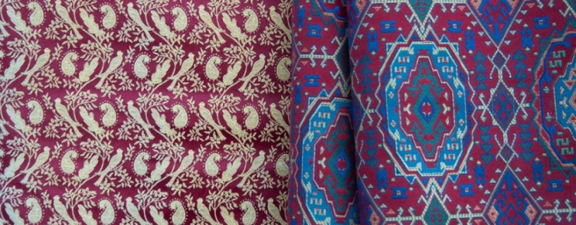
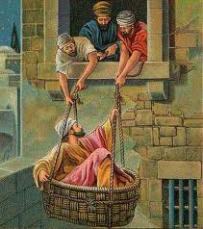
Damascus--City
Street bazaars
Damascus Steel
Famous treasured cloth “damask”
City wall surrounding City where Paul escapes in a basket (Acts 9:23-25)
Saul was on his way to Damascus to persecute the saints
(6)

Slide 15
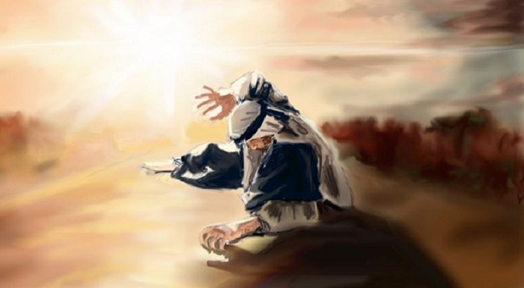
Who Art Thou, Lord?
“And the Lord said, I am Jesus whom thou persecutest…
Acts 9:5

Slide 16
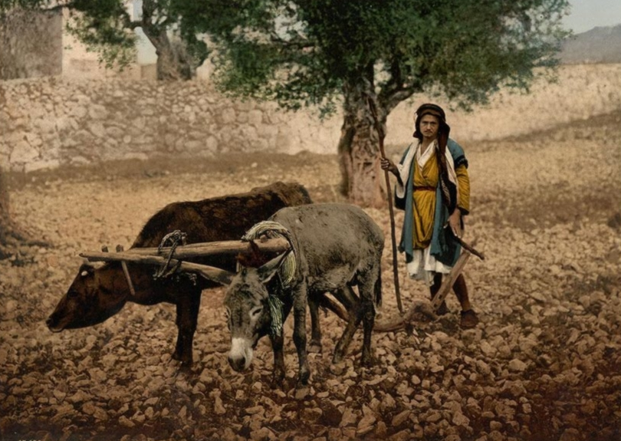
Kick against the pricks
During the time of Jesus, many people were farmers and used oxen to till the soil. A prick, or goad, was a pointed shaft sharpened to a point on one end, much like a metalwork prick. This was held up to an ox by the driver in such a way that if the ox turned in the wrong direction, it would get pricked. Sometimes an ox would attempt to kick the irritant away, which would only drive it in deeper.
“Goud”
A sharp spear used to prick the hides of animals to make them move ahead
The tendency when kicked is to “Kick back”, to retaliate
Acts 9:5
(6)

Slide 17
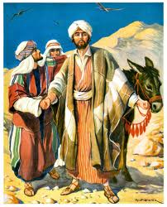
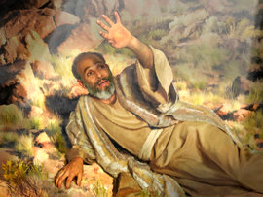
What wilt thou have me to do?
“…Arise, and go into the city, and it shall be told thee what thou must do.”
Men with him are speechless
Acts 9:6

Slide 18
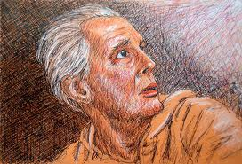
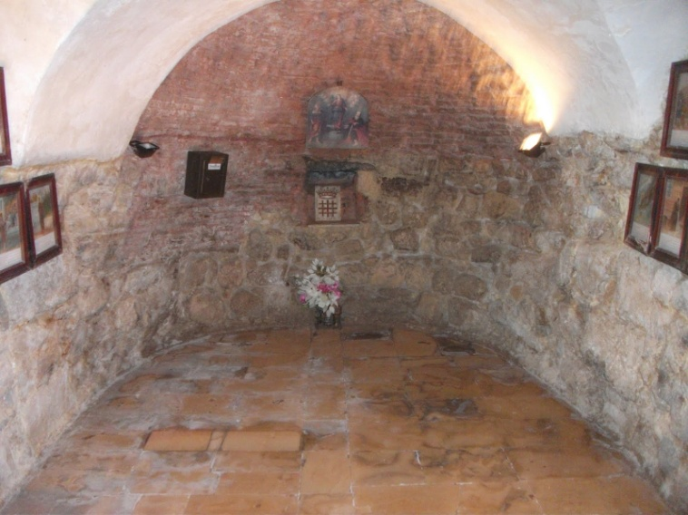
Ananias a Disciple
Has a vision
“Behold, I am here, Lord.”
“…Go into the street which is called Straight, and enquire in the house of Judas for one called Saul…”
Acts 9:10-11

Slide 19
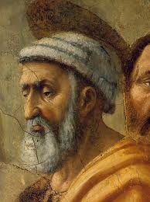
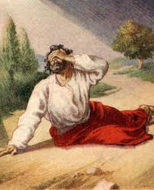
A Chosen Vessel
Ananias has heard about the persecution by this man, Saul
“…Go thy way; for he is a chosen vessel unto me, to bear my name before the Gentiles, and kings, and the children of Israel:”
Acts 9:13-15

Slide 20
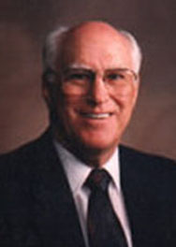
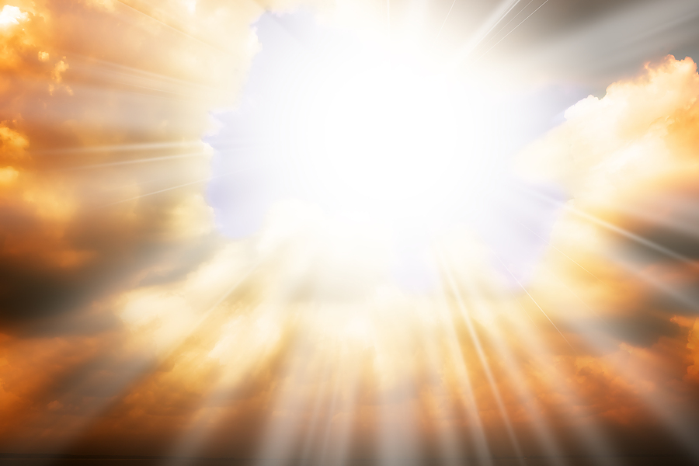
Saul’s Companions
In this account, we are told that Paul's associates heard the voice of Jesus.
However, a later account of Paul's conversion conflicts with this version. Paul stated that they 'saw indeed the light, and were afraid; but they heard not the voice of him that spake to me‘.
…surely the voice and message of the Lord was for Paul alone, although his companions in travel might be permitted to see the light and thereby be assured of the unusual event that was taking place."
Acts 9:9; Acts 22:9
(7)

Slide 21
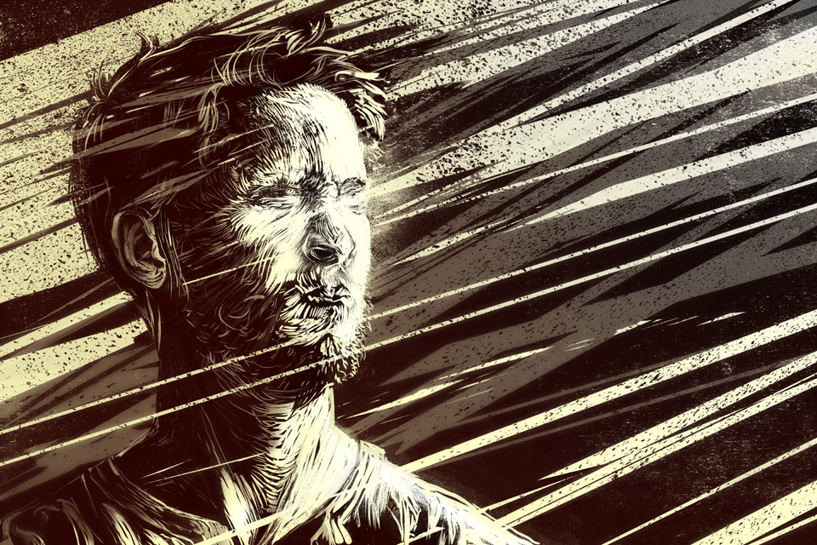
Saul is Blinded—3 Days
We are taught by latter-day scriptures that the impure cannot withstand the presence of God.
Moses declared, 'mine own eyes have beheld God; but not my natural, but my spiritual eyes, for my natural eyes could not have beheld; for I should have withered and died in his presence' (Moses 1:11).
Furthermore, the scriptures declare that the priesthood is necessary in order for a man to see God the Father.
Yet remarkably, Saul was allowed to see the Son without being destroyed-even though his actions had been wicked and he held no priesthood.
But Saul could not withstand the presence of the Son unscathed-there had to be an effect upon his physical body.
Acts 9:9; D&C 84:21-22
(9)

Slide 22
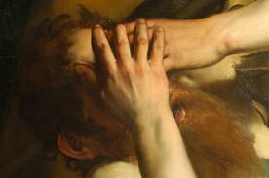
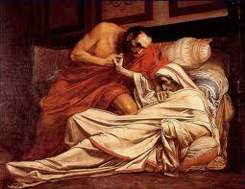
Using Priesthood Authority
“…Brother Saul, the Lord, even Jesus, that appeared unto thee in the way as thou camest, hath sent me, that thou mightest receive thy sight, and be filled with the Holy Ghost.”
Acts 9:12

Slide 23
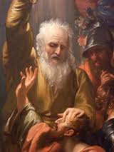
Sight Restored
“And immediately there fell from his eyes as it had been scales…
If we submit to the Lord’s will, then we can change and can fulfill the potential He sees in us
“and he received sight forthwith, and arose, and was baptized.”
Acts 9:18

Slide 24
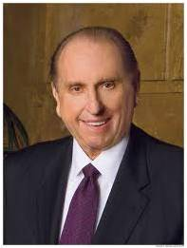
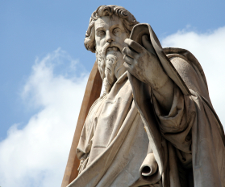
“When the Savior was to choose a missionary of zeal and power, He found him not among His advocates but amidst His adversaries.
The experience of Damascus’s way changed Saul.
Of him the Lord declared, ‘He is a chosen vessel unto me, to bear my name before the Gentiles, and kings, and the children of Israel.
Saul the persecutor became Paul the proselyter.”
(8)

Slide 25
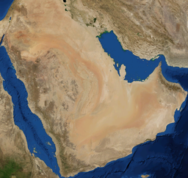
Saul Leaves For Arabia
We learn in Galatians that after Saul’s conversion he left Damascus and journeyed to Arabia.
It is not recorded why Saul went there, but he may have gone for study and reflection.
or he may have fled there for safety
He sojourned in Arabia for as long as three years. While there, Saul likely deepened his understanding of how Jesus Christ fulfilled many Old Testament prophecies. After his time in Arabia, he returned to Damascus for a short period of time before journeying to Jerusalem to see Peter and other Church leaders.
Galatians 1:17; Acts 9:23-25
(1)

Slide 26
Barnabas—Tribe of Levi
He sold property to the church.
He welcomed Paul, the former persecutor of the Saints.
He was sent to Antioch
Church leaders in Jerusalem sent him to minister in Antioch (in Syria) because a large number of people there had been converted to the gospel.
These conversions occurred because Church members who were persecuted in Jerusalem after Stephen’s death fled to Antioch and preached there.
* Note that Acts includes references to two different Antiochs—Antioch in Syria and Antioch in Pisidia. Both Antiochs lie within present-day Turkey.
Acts 9:26–31; 11:22–30
(1)

Slide 27
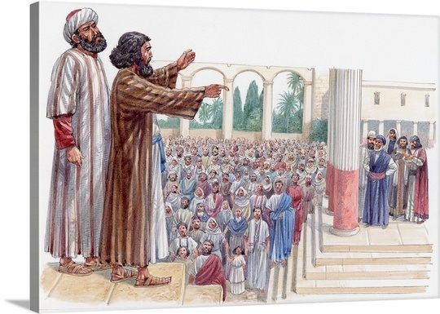
Barnabas Seeks Saul
From Antioch, Barnabas traveled to Tarsus to seek Saul, for Saul had fled there to escape persecution in Jerusalem, and the two men returned to Antioch to teach the gospel.
They were chosen to take donations from the Saints in Antioch to members of the Church in Judea, who were suffering during a famine.
Barnabas later became Saul’s missionary companion during his first mission.
Acts 9:26–31; 11:22–30
(1)

Slide 28
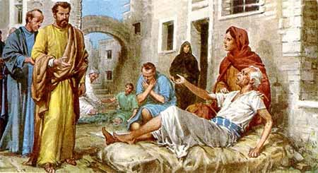
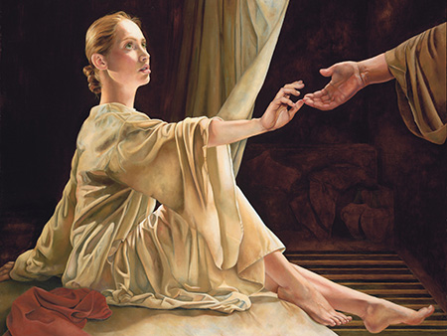
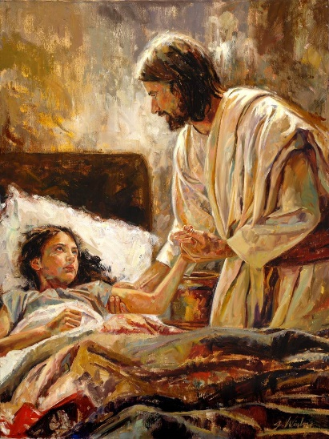
Peter Heals
While ministering in Lydda and Joppa, Peter healed Aeneas and Tabitha (also called Dorcas)
Luke’s care in recording these similar events reflects one of his purposes: to affirm continuity between Jesus Christ and the Church and show a continuation of Jesus Christ’s power and authority in Peter.
The raising of Tabitha parallels the Savior’s raising of Jairus’s daughter
By ministering to others, we can help people turn to the Lord and believe in Him
Giclee
Sandra F. Gagon
Acts 9:32-43
(1)

Slide 29
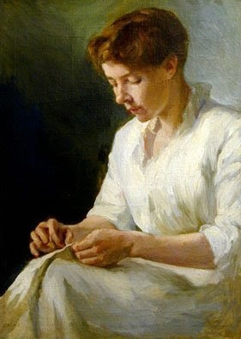
Tabitha’s “good works and almsdeeds” likely included the sewing of clothing for the poor.
“To me the scriptural reference to Tabitha, which describes her as a woman ‘full of good works and almsdeeds,’ defines some of the fundamental responsibilities of Relief Society; namely, the relief of suffering, the caring for the poor, and all which that implies.”
Caroline Augusta Lord
Acts 9:32-43
(8)

Slide 30
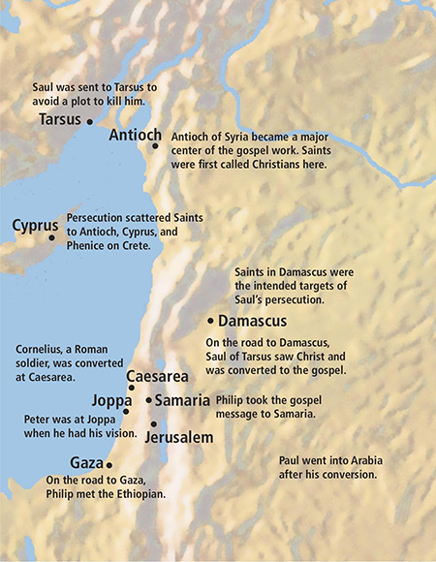
Acts 8-11 Events
Acts 8:5-25
Acts 9:30
Acts 8:28-38
Acts 10:9-18
Acts 8:1-3;
Acts 9:1-2
Acts 10:24-33
Acts 9:3-19
Acts 11
Galatians 1:17
Acts 11:19

Slide 31
Sources:
Suggested Hymn: #101 Guide Me To Thee
Videos:
The Road to Damascus (5:22)
The Healing Ointment of Forgiveness (1:13)
New Testament Institute Student Manual Chapter 31
Who’s Who in the New Testament by Richard J. Allen pp. 134-136
Paul’s Life and Letters by Dr. Sidney B. Sperry
Bible Dictionary
Dieter F. Uchtdorf “Waiting on the Road to Damascus” April 2011 General Conference
The Life and Teachings of Jesus and his Apostles pg. 246-247, 256-258
Robert J. Matthews, Joseph Smith Memorial Sermons, p. 10
8. President Thomas S. Monson (“Choose You This Day,” Ensign or Liahona, Nov. 2004, 69). ” (“Be Thou an Example,” Ensign, Nov. 2001, 99).
9. Gospeldoctrine.com
Presentation by ©http://fashionsbylynda.com/blog/

Slide 32
CHRONOLOGY OF EVENTS IN PAUL’S LIFE AND MINISTRY
About A.D. 1–3 | Born in Tarsus of the tribe of Benjamin—a Pharisee and a Roman citizen by birth | Acts 9:11; 22:3, 27–28; Philippians 3:5
About A.D.19–29 | Taught by Gamaliel in Jerusalem | Acts 22:3
A.D. 33 | Witnessed the martyrdom of Stephen and persecuted Christians in the Jerusalem area | Acts 7:54–8:4; Philippians 3:6
A.D. 33 | On the road to Damascus, saw a vision of Jesus Christ, was converted, and preached of Christ in Damascus | Acts 9:1–25
A.D.33–35 | Fled Damascus to Arabia | Galatians 1:17
A.D. 35 | Returned to Damascus and briefly preached the gospel | Galatians 1:17
A.D. 35 | After three years visited Jerusalem and spoke with Peter and James, the Lord’s brother | Acts 9:26–29; Galatians 1:18–19
A.D.35–49 | Spent 14 years in Syria-Cilicia (part of that time on his mission with Barnabas). Tarsus, Paul’s hometown, was located in Cilicia. | Acts 9:30; 11:19–26; Galatians 2:1, 21
A.D.46–49 | First missionary journey (with Barnabas) | Acts 13:1–14:28
A.D. 49 | Attended the Jerusalem Conference | Acts 15:12; Galatians 2:1–2
A.D.49–53 | Second missionary journey | Acts 15:36–18:20
A.D. 53 | Visited Jerusalem | Acts 18:21–22
About A.D.54–58 | Third and final mission | Acts 18:23; 19:1–20:38
About A.D. 58 | Farewell visit to Greece; traveled to Jerusalem to deliver offerings for the poor | Acts 21:1–16
Spring A.D. 58 | Reported to presiding Brethren in Jerusalem, had misunderstandings at the temple, and was arrested | Acts 21:17–23:22
Spring A.D.58–60 | Imprisoned in Caesarea | Acts 23:23–26:3
Fall A.D.60–Spring A.D. 61 | While under arrest, traveled by sea to Rome. Shipwrecked and spent winter months on the island of Melita (Malta) just south of Sicily. | Acts 27:1–28:1
About A.D.61–63 | Under house arrest in Rome | Acts 28:16–3
A.D.63–66 | Possible ministry in Rome and other locations in Italy | Acts 28:30–3
 | Second Imprisonment in Rome
About A.D. 68 | Died
New Testament Institute Manual Chapter 31

Slide 33
Damascus:
"Claiming to be the world's oldest city having continuous habitation, Damascus, present-day capital of Syria, was also in the Roman province of Syria in the days of the apostles. Situated some 130 miles northeast of Jerusalem and approximately 65 miles from the Mediterranean Sea, Damascus lies in the heart of a fertile plain.
"The supremacy of Damascus among ancient cities is clearly found in the fact of its location. It was the terminus point for three principal trade routes of the ancient Near East. Its close proximity to Jerusalem made Damascus a city of great importance to ancient Israel and Judah." (The Life and Teachings of Jesus & His Apostles, (1979 Institute Manual), p. 257)
The Roman ruins in the desert oasis of Palmyra to the towering Crusader castle known as the Crac des Chevaliers near the Mediterranean coast. The nation's capital, Damascus, is also one of the oldest continually inhabited cities in the world.
An enemy to the Church:
“Saul was foreordained; nothing he had done on earth qualified him for what was ahead; but his native spiritual endowment, nurtured and earned in pre-existence, prepared him for the coming ministry.” Elder Bruce R. McConkie (Doctrinal New Testament Commentary, 2:91).
The Chosen Vessel Acts 9:15:
"It is given to but few to wield a more powerful influence over Christian history than to Saul of Tarsus, the persecutor who became a prophet, the Pharisee who became the apostle to the Gentiles. The life and teachings of the Apostle Paul stand as bright reminders of the power of Christ to transform the souls of men and women, to remake the human heart, and to refocus one's misdirected zeal into the way of the Master. When the risen Lord appeared in vision to Ananias of Damascus and instructed him to send for the stricken and blinded Saul, Ananias answered: 'Lord, I have heard by many of this man, how much evil he hath done to thy saints at Jerusalem: and here he hath authority from the chief priests to bind all that call on thy name.' The response that followed bespeaks the Redeemer's insight into the wonders that would be done at Paul's hand: 'Go thy way: for he is a chosen vessel unto me, to bear my name before the Gentiles, and kings, and the children of Israel' (Acts 9:11-15; emphasis added)....[Paul] taught with a power, a persuasion, and a holy zeal known only to those who, like Alma and the sons of Mosiah, have gone from darkness to light and whose whole soul yearns to lead others to that same light." (Selected Writings of Robert L. Millet: Gospel Scholars Series, p. 69.)
“Kick Against the Pricks” Acts 9:5:
We must remember that the King James Version of the Bible was written in 17th century English. Hence, the meaning of certain phrases requires some explanation. 'To kick against the pricks' is an expression meaning to persecute the Church (see DC 121:38). That it was 'hard for [Saul]' doesn't mean that he lacked the tendency or the natural ability, but that his efforts were hard on him in ways he did not yet understand. In essence, Saul's efforts were destroying himself more than they were destroying the Church.
' . . Those who kick at the goad, that stifle and smother the convictions of conscience, that rebel against God's truths laws, that quarrel with His providences, that persecute and oppose His ministers, because they reprove them . . . and fly in the face of their reprovers, they kick against the pricks, and will have a great deal to answer for.' (Commentaries by Henry M. Scott.)
"A goad is defined as a spear or a sharp pointed stick used to sting or prig. The burro who kicks the sharp instrument with which he is being prodded is kicking at the pricks. His retaliation does little damage to the sharp stick or to him who wields it but brings distress to the foot that kicks it.
"I well remember in my youth a neighbor who moved about some days on crutches. He was evasive when asked the cause of his misfortune, but an ear witness told me, as he chuckled: 'John stubbed his toe on a chair in the night and in his quick, fierce anger, he kicked the chair and broke his toe.' The rocking chair rocked on and on, and perhaps smiled at the stupidity of man.“ Spencer W. Kimball (Conference Report, April 1955, p. 94.)
"In this figure of speech is captured the essence of rebellion against God; we can only hurt ourselves. If one is pricked by a goad and angered by the pain, he may foolishly strike out at the source of irritation, only to suffer even more." (Faith Precedes the Miracle, p. 305.)
Saul's’ Physical Appearance by Joseph Smith:
“[Paul] is about five feet high; very dark hair; dark complexion; dark skin; large Roman nose; sharp face; small black eyes, penetrating as eternity; round shoulders; a whining voice, except when elevated, and then it almost resembles the roaring of a lion. He was a good orator” (in “Extracts from William Clayton’s Private Book,” p. 4, Journals of L. John Nuttall, 1857–1904, L. Tom Perry Special Collections, Brigham Young University; copy in Church History Library, Salt Lake City).

