Slide 1

Lesson 89
Preach to the Gentiles
Acts 10-11
“Of a truth I perceive that God is no respecter of persons: But in every nation he that feareth him, and worketh righteousness, is accepted with him.” Acts 10:34-35

Slide 2
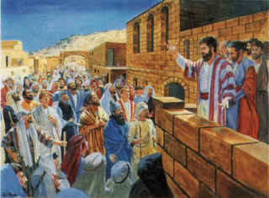
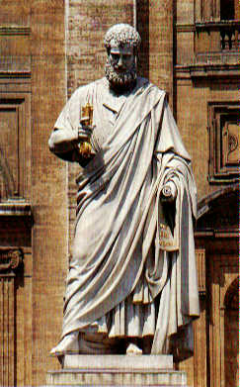
Changes
Up to this point in New Testament times, the gospel had been preached, with a few exceptions, exclusively to Jews as directed by the Savior.
These twelve Jesus sent forth, and commanded them, saying, Go not into the way of the Gentiles, and into any city of the Samaritans enter ye not:
But go rather to the lost sheep of the house of Israel.
Matthew 10:5-6
However…
The Savior also told His disciples that after the Holy Ghost came upon them they would preach the gospel “unto the uttermost part of the earth” Acts 1:18

Slide 3
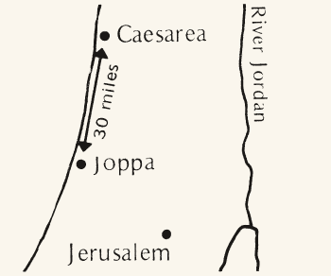
Up on the Housetop…
The word is to be preached among the Gentiles
Acts 10

Slide 4
A certain man in Caesarea called Cornelius
Cornelius was a Roman centurion (the leader of one hundred men), living in Caesarea.
He was a Gentile, who was described as being God-fearing, devout, generous, and prayerful.
Cornelius was viewed as a just man...and of good report among all the nation of the Jews…
Yet, by Jewish tradition, a Gentile could not join Christ’s Church without first converting to Judaism, since the gospel was only taken to the Jews.
Acts 10:1-2
(2)

Slide 5
Had an angel come to him in the 9th hour
Acts 10:3-7

Slide 6
Declaring what Cornelius had seen, he sends three to Joppa
Acts 10:7

Slide 7
The 6th hour
It has often been remarked that the houses in Judea were builded with flat roofs, on which people walked, conversed, meditated, prayed, etc. The house-top was the place of retirement; and thither Peter went for the purpose of praying to God. In Bengal, some of the rich Hindoos have a room on the top of the house, in which they perform worship daily. (3)
Acts 10:9-10

Slide 8
Peter sees the heaven’s open
Symbolism
The Lord did not send down the food in a great vessel or basket. He did not offer it on a banquet table, but on a 'great sheet knit at the four corners', symbolizing the four corners of the earth from which the Gentiles would come to receive the gospel.
Acts 10:11-12
(2)

Slide 9
“Letting Down the Sheet”
Three times Peter is asked to preach to the Gentiles
Acts 10:13-17

Slide 10
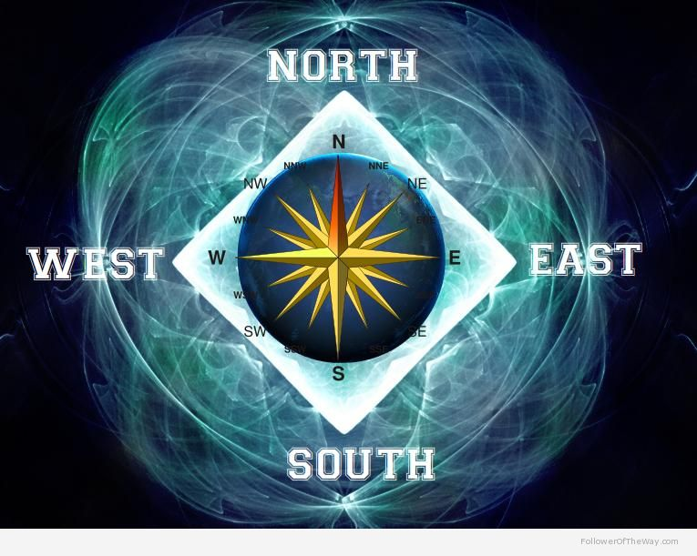
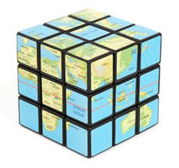
Four Corners of the Earth
'I saw four angels standing on the four corners of the earth, holding the four winds of the earth, that the wind should not blow on the earth, nor on the sea nor on any tree...
'After this I beheld, and, lo, a great multitude, which no man could number of all nations, and kindreds, and people, and tongues, stood before the throne, and before the Lamb, clothed with white robes, and palms in their hands.' (Rev 7:1,9)

Slide 11
Peter Doubts
Men come to Simon’s house
Acts 10:17-20

Slide 12
A Warning From God
They tell Peter about Cornelius
Acts 10:21-23

Slide 13
A Meeting With Cornelius
Peter goes with them to Caesarea
Cornelius told Peter about his vision. Cornelius had also gathered his family and friends so Peter could teach them.
Acts 10:23-33

Slide 14
Peter Testifies of Jesus Christ
The gift of the Holy Ghost is poured out to the Gentiles
Acts 10:44-48

Slide 15
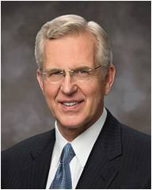
We may receive revelation and understanding gradually as we obey the Lord
God directs His Church by revelation to His prophet, the senior Apostle
God may change or add to instructions He has given in the past according to His wisdom and the needs of His children
“By this experience and revelation to Peter, the Lord modified the practice of the Church and revealed a more complete doctrinal understanding to His disciples. And so the preaching of the gospel expanded to encompass all mankind.”
(6)

Slide 16
“…and he inviteth them all to come unto him and partake of his goodness; and he denieth none that come unto him, black and white, bond and free, male and female; and he rememberth the heathen; and all are alike unto God,
both Jew and Gentile.”
(2 Nephi 26:33)

Slide 17
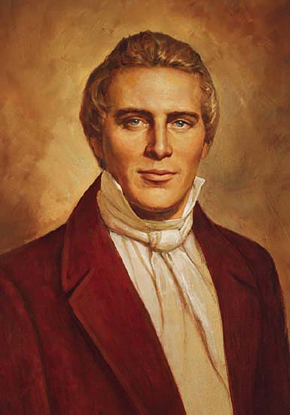
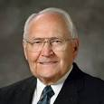
“There is order in the way the Lord reveals His will to mankind.
We all have the right to petition the Lord and receive inspiration through His Spirit within the realm of our own stewardship.
Parents can receive revelation for their own family, a bishop for his assigned congregation, and on up to the First Presidency for the entire Church.
However, we cannot receive revelation for someone else’s stewardship.”
O
R
D
E
R
Prophet Joseph Smith declared:
“‘It is contrary to the economy of God for any member of the Church, or any one, to receive instructions for those in authority, higher than themselves’ (4)
“‘Revelations of the mind and will of God to the Church, are to come through the [First] Presidency.
This is the order of heaven.’
(5)

Slide 18
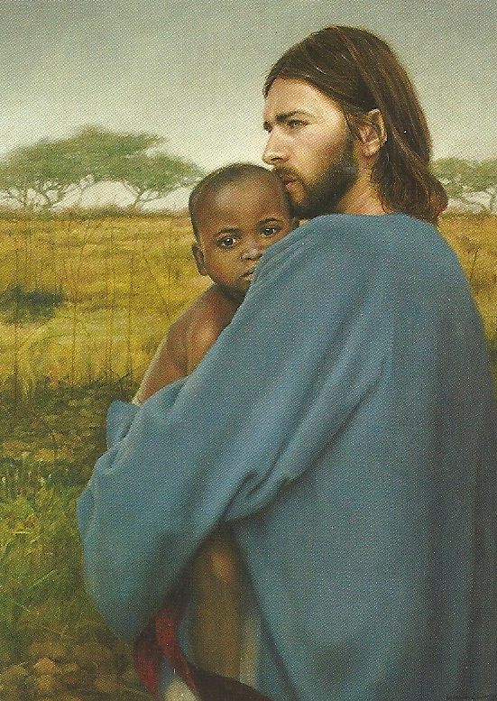
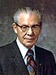
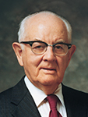
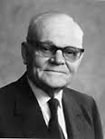
Recognizing Spencer W. Kimball as the prophet, seer, and revelator, and president of The Church of Jesus Christ of Latter-day Saints, it is proposed that we as a constituent assembly accept this revelation as the word and will of the Lord. All in favor please signify by raising your right hand. Any opposed by the same sign.
The vote to sustain the foregoing motion was unanimous in the affirmative.
Salt Lake City, Utah, September 30, 1978.
(7)

Slide 19
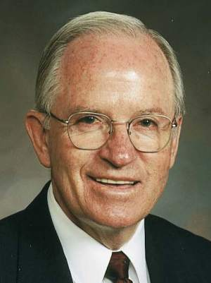
Accepting Change
Peter’s interaction with a Gentile was a major change from past practice, and some members had difficulty accepting this change
“…there are some barriers to creating a greater unity amid our diversity. These barriers include racial and cultural discrimination and attitudes of separatism.
The gospel is marvelously sufficient to create the desired unity, but people are imperfect.
Discomfort because of language barriers, fear of accepting those with differences in skin color, alienation of singles—all have created barriers to unity.
Usually, this mistreatment, isolation, and discrimination is self-justified by the use of labels. Labeling a fellow Church member an intellectual, a less-active member, a feminist, a South African, an Armenian, a Utah Mormon, or a Mexican, for example, seemingly provides an excuse to mistreat or ignore that person.
These problems and many more need to be addressed if we are to create a society such as that which Enoch created.
Change
Acts 11:1-18
(8)

Slide 20
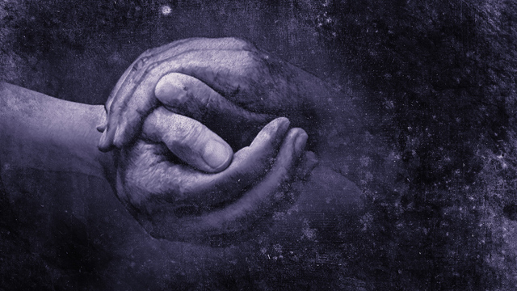
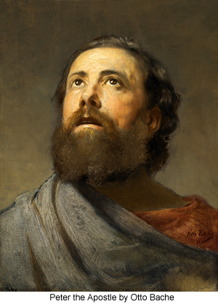
Becoming One With God
“As we become one with God, we will become one with each other. As we become one with each other, we will become one with God.”
What was I, that I could withstand God?”
Peter would not oppose God’s will of giving the Gentiles the opportunity to receive the gospel, repent, and be baptized.
When we know that those who preside over the Church are led by God, we can confidently sustain and follow them
For I have given him the keys of the mysteries, and the revelations which are sealed, until I shall appoint unto them another in his stead.
D&C 28:7
Otto Bache
Acts 11:1-18
(8)

Slide 21
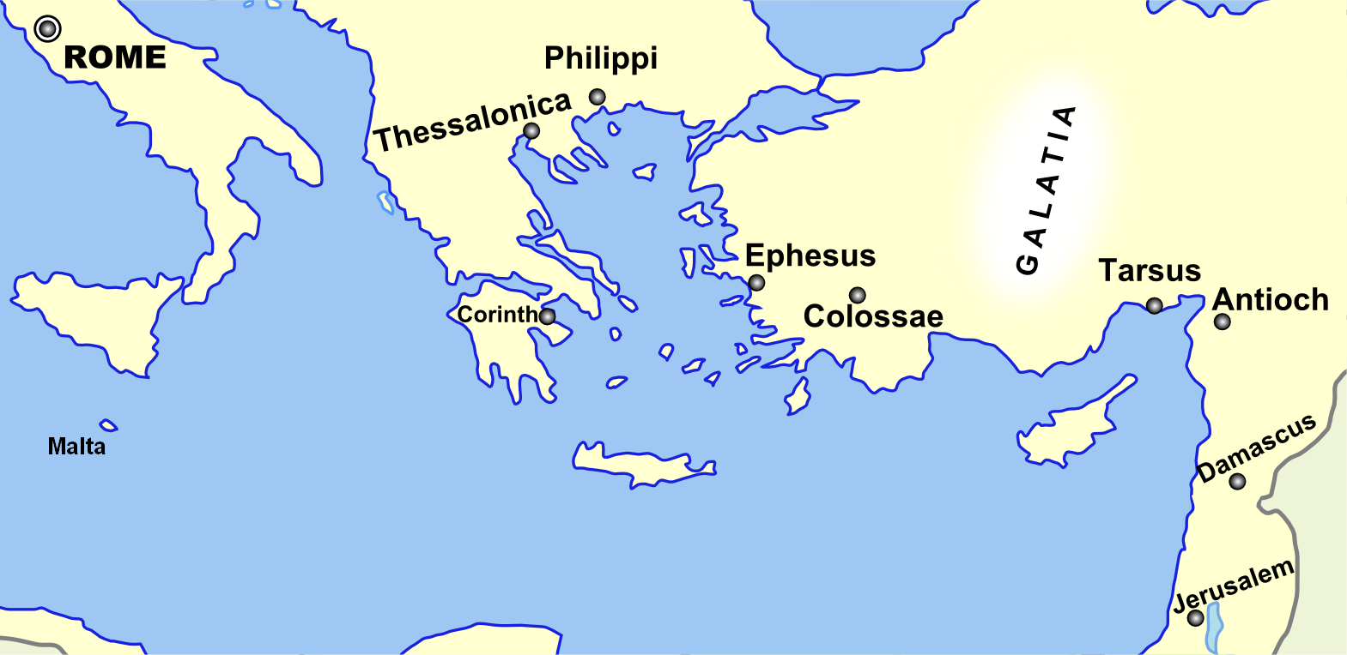
Disciples Scatter
Because of persecution, several disciples were scattered throughout the region but faithfully preached the gospel of Jesus Christ wherever they went.
And it came to pass, that a whole year they assembled themselves with the church, and taught much people. And the disciples were called Christians first in Antioch.
Acts 11:19-26

Slide 22
Christians In The Land of Zarahemla
It is interesting to note that as early as 73 B.C., all Nephites who belonged to the church of Jesus Christ in the land of Zarahemla were known as Christians.
And those who did belong to the church were faithful; yea, all those who were true believers in Christ took upon them, gladly, the name of Christ, or Christians as they were called, because of their belief in Christ who should come. Alma 46:15
In fact, the name of Jesus Christ had been revealed to Jacob and Nephi some five hundred years before his birth, thus leaving the Nephites, at least, in little doubt as to the identity of the Messiah who should save them from their sins.
Read 2 Nephi 10:3 and 25:19
Acts 11:19-26
(9)

Slide 23
Sources:
Suggested Hymn: #8 Arise and Awake
Video:
Peter’s Revelation to Take the Gospel to the Gentiles
Testing Revelation (1:23)
New Testament Institute Student Manual Chapter 31
Gospeldoctrine.com
Adam Clarke Commentary
Teachings of Presidents of the Church: Joseph Smith (2007), 197–98.
Elder L. Tom Perry [Teachings: Joseph Smith, 197]” (“We Believe All That God Has Revealed,” Ensign or Liahona, Nov. 2003, 85–86).
Elder D. Todd Christofferson (“The Doctrine of Christ,” Ensign or Liahona, May 2012, 88).
Official Declaration 2
Unity in Diversity By Elder John K. Carmack March 1991 Ensign
The Life and Teaching of Jesus and His Apostles Course Manual Rel. 211-215 Section 7 Chapter 30
Presentation by ©http://fashionsbylynda.com/blog/

Slide 24
Official Declaration 2
The Book of Mormon teaches that “all are alike unto God,” including “black and white, bond and free, male and female” (2 Nephi 26:33). Throughout the history of the Church, people of every race and ethnicity in many countries have been baptized and have lived as faithful members of the Church. During Joseph Smith’s lifetime, a few black male members of the Church were ordained to the priesthood. Early in its history, Church leaders stopped conferring the priesthood on black males of African descent. Church records offer no clear insights into the origins of this practice. Church leaders believed that a revelation from God was needed to alter this practice and prayerfully sought guidance. The revelation came to Church President Spencer W. Kimball and was affirmed to other Church leaders in the Salt Lake Temple on June 1, 1978. The revelation removed all restrictions with regard to race that once applied to the priesthood.
To Whom It May Concern:
On September 30, 1978, at the 148th Semiannual General Conference of The Church of Jesus Christ of Latter-day Saints, the following was presented by President N. Eldon Tanner, First Counselor in the First Presidency of the Church:
In early June of this year, the First Presidency announced that a revelation had been received by President Spencer W. Kimball extending priesthood and temple blessings to all worthy male members of the Church. President Kimball has asked that I advise the conference that after he had received this revelation, which came to him after extended meditation and prayer in the sacred rooms of the holy temple, he presented it to his counselors, who accepted it and approved it. It was then presented to the Quorum of the Twelve Apostles, who unanimously approved it, and was subsequently presented to all other General Authorities, who likewise approved it unanimously.
President Kimball has asked that I now read this letter:
June 8, 1978
To all general and local priesthood officers of The Church of Jesus Christ of Latter-day Saints throughout the world:
Dear Brethren:
As we have witnessed the expansion of the work of the Lord over the earth, we have been grateful that people of many nations have responded to the message of the restored gospel, and have joined the Church in ever-increasing numbers. This, in turn, has inspired us with a desire to extend to every worthy member of the Church all of the privileges and blessings which the gospel affords.
Aware of the promises made by the prophets and presidents of the Church who have preceded us that at some time, in God’s eternal plan, all of our brethren who are worthy may receive the priesthood, and witnessing the faithfulness of those from whom the priesthood has been withheld, we have pleaded long and earnestly in behalf of these, our faithful brethren, spending many hours in the Upper Room of the Temple supplicating the Lord for divine guidance.
He has heard our prayers, and by revelation has confirmed that the long-promised day has come when every faithful, worthy man in the Church may receive the holy priesthood, with power to exercise its divine authority, and enjoy with his loved ones every blessing that flows therefrom, including the blessings of the temple. Accordingly, all worthy male members of the Church may be ordained to the priesthood without regard for race or color. Priesthood leaders are instructed to follow the policy of carefully interviewing all candidates for ordination to either the Aaronic or the Melchizedek Priesthood to insure that they meet the established standards for worthiness.
We declare with soberness that the Lord has now made known his will for the blessing of all his children throughout the earth who will hearken to the voice of his authorized servants, and prepare themselves to receive every blessing of the gospel.
Sincerely yours,
Spencer W. Kimball
N. Eldon Tanner
Marion G. Romney
The First Presidency

Slide 25
Discrimination in Prayers Acts 10:4:
…God hears and answers prayers. The second is that he hears and answers the prayers of all of his children-even Gentiles. Today, we are occasionally guilty of the same narrow-mindedness. Do we really believe that the Lord is just as willing to answer the prayers of non-members as he is for Church members? If not, then we imply that God is a respecter of persons, an unjust judge, and a bigot. The words of the angel, 'Thy prayers and thine alms are come up for a memorial before God,' prove that prejudice and bigotry are exclusively mortal attributes.
Through the years, discrimination based on ethnic or religious identity has led to senseless slaughter, vicious pogroms, and countless acts of cruelty. The face of history is pocked by the ugly scars of intolerance." (Russell M. Nelson, Perfection Pending, and Other Favorite Discourses, 67.)
Cornelius and the Gift of the Holy Ghost Acts 10:45:
Luke records that the Gentiles received "the gift of the Holy Ghost" prior to their baptism or confirmation by the laying on of hands. But they did not receive "the gift of the Holy Ghost" in the same sense as the term is used today. Rather, the power of the Holy Ghost temporarily came upon them in a manner reminiscent of the way it had come upon the disciples on the day of Pentecost (Acts 2). Such a powerful bestowal of the Holy Ghost was necessary to show the Jews then present that the Gentiles were worthy of the greatest blessings of the gospel. Yet, the gift which would give them the privilege of constant companionship had not yet been bestowed upon them, for they had neither been baptized, nor had they received the laying on of hands. (2)
"There is a difference between the Holy Ghost and the gift of the Holy Ghost. Cornelius received the Holy Ghost before he was baptized, which was the convincing power of God unto him of the truth of the gospel. But he could not receive the gift of the Holy Ghost until after he was baptized. And had he not taken this sign [or] ordinances upon him, the Holy Ghost, which convinced him of the truth of God, would have left him until he obeyed those ordinances and received the gift of the Holy Ghost by the laying on of hands, according to the order of God.“ Joseph Smith (Kent P. Jackson, comp. and ed., Joseph Smith's Commentary on the Bible, p. 150.)
Hunger and Trance Acts 10:10:
The dinner among the ancients was a very slight meal; and they had no breakfast: their supper was their principal meal. And, in very ancient times, they ate only once in the day. Supper was the meal at which they saw their friends, the business of the day being then finished.
At first he felt keen hunger; but, being earnestly engaged with God, all natural appetites became absorbed in the intense application of his soul to his Maker. While every passion and appetite was under this Divine influence, and the soul, without let or hinderance, freely conversing with God, then the visionary and symbolical representation mentioned here took place. (3)
Revelation Given to Those in Authority Acts 11:
“The gradual increase of light radiating from the rising sun is like receiving a message from God ‘line upon line, precept upon precept’ (2 Nephi 28:30). Most frequently, revelation comes in small increments over time and is granted according to our desire, worthiness, and preparation. Such communications from Heavenly Father gradually and gently ‘distil upon [our souls] as the dews from heaven’ (D&C 121:45). This pattern of revelation tends to be more common than rare” (“The Spirit of Revelation,” Ensign or Liahona, May 2011, 88).
Prejudices Acts 10:13-15:
"The prejudices were deep rooted in Peter, and it took a vision from heaven to help him cast off his bias. The voice had commanded: 'Rise, Peter; kill, and eat,' when the vessel descended from the heaven containing all manner of beasts, reptiles, and fowls. Punctilious Peter expressed his lifelong prejudices and habits in saying, 'Not so, Lord; for I have never eaten anything that is common or unclean.' Then the heavenly voice made clear that the program was for all. 'What God hath cleansed,' it said, 'that call not thou common.' Peter's long sustained prejudices finally gave way under the power of the thrice-repeated command. When the devout gentile Cornelius immediately thereafter appealed to him for the gospel, the full meaning of the vision burst upon Peter and he exclaimed, '. . . God hath shewed me that I should not call any man common or unclean.' (Acts 10:13-15, 28.)“
President Spencer W. Kimball (Faith Precedes the Miracle, 294.)
The Name Christians Acts 11:26:
“Christians is an obvious name for the followers of Christ, for those who believe he is the Son of God and that salvation of all degrees comes because of him and his atoning sacrifice. Since there have been followers of Christ in successive gospel dispensations from Adam to the present, these all would have been known as Christians or some equivalent, synonymous term. By saying the saints were called Christians first in Antioch means that for the first time in the meridian dispensation there was a sufficient church membership so that nonmembers recognized the saints as a separate and distinct organization, one severed and apart from the Jewish synagogue and community.” (McConkie, DNTC, 2:112.)

Slide 26
Events in Acts 10 and 11
Event | Acts
Caesarea, Judea The Vision of Cornelius | 10:1–8
Peter: A Vision of the Unclean | 10:9–20
The Gospel Is Sent to the Gentiles | 10:21–35
Teachings of Witnesses | 10:36–43
The Holy Ghost Poured Out on the Gentiles | 10:44–48
Jerusalem, Judea Peter’s Report | 11:1–18
Antioch, Syria Disciples are Called Christians | 11:19–26
Agabus Prophecies of Famine | 11:27–30
The Life and Teachings of Jesus and His Apostles Chapter 30

