Slide 1
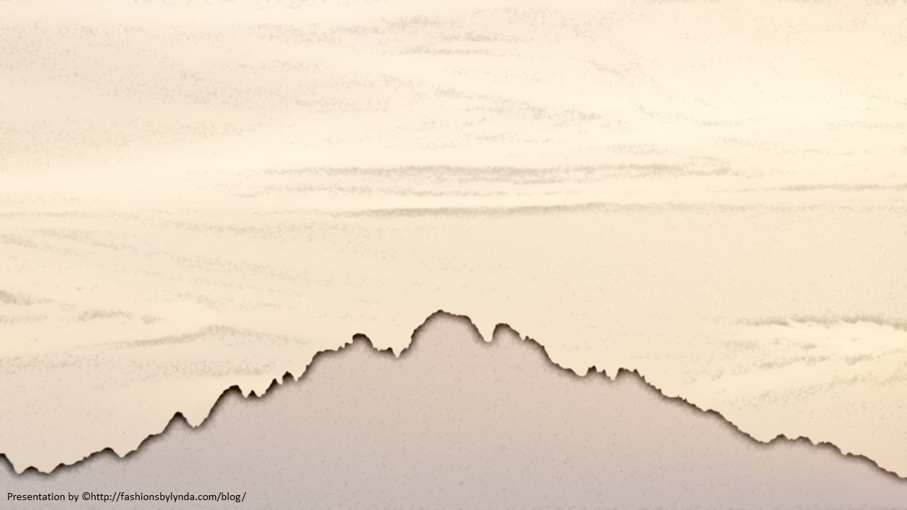
Lesson 9
Sermon on the Mount
The Beatitudes
Matthew 5:1-16
“the kingdom of heaven is at hand” Matthew 4:17

Slide 2
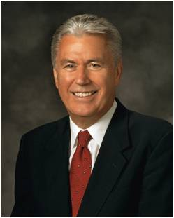
“So often we get caught up in the illusion that there is something just beyond our reach that would bring us happiness: a better family situation, a better financial situation, or the end of a challenging trial.
“… External circumstances don’t really matter or determine our happiness.
“… We determine our happiness.”
Are you happy?
(1)

Slide 3
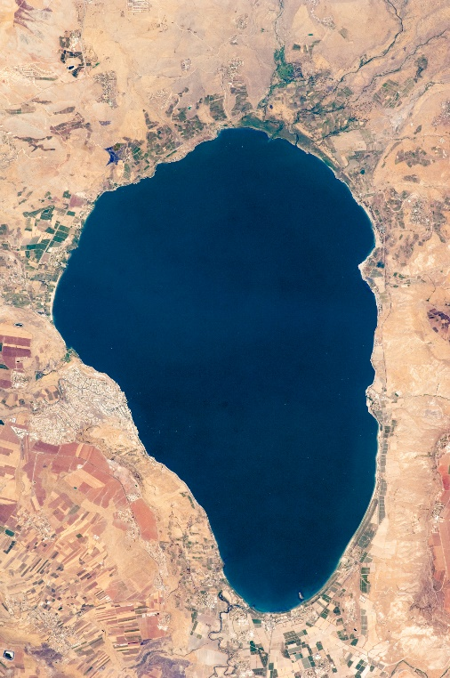
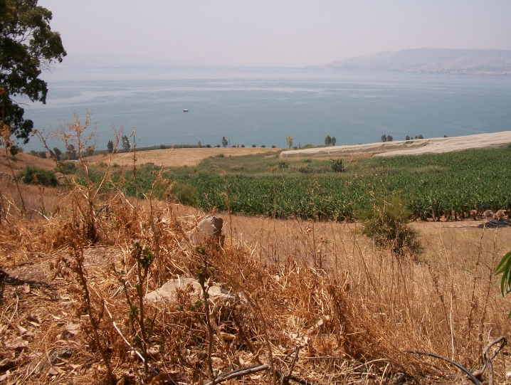
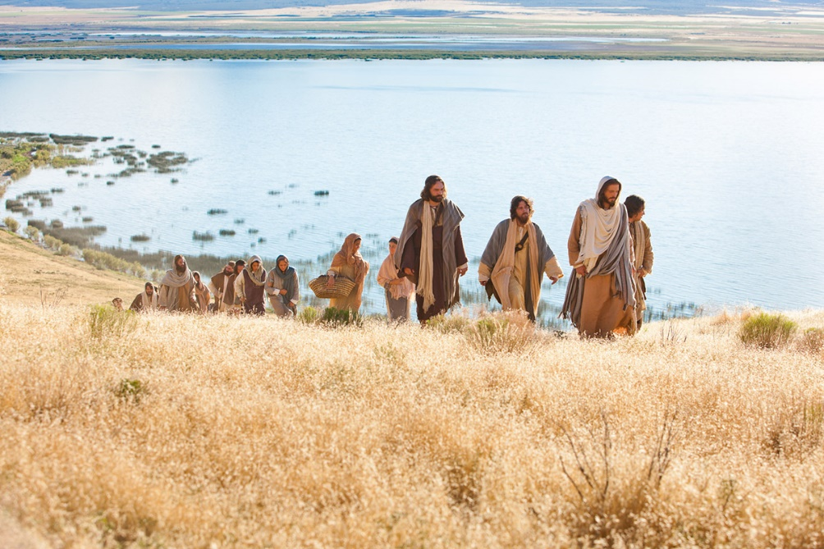
Sermon on the Mount
As the Savior began His ministry, He gave a sermon near the Sea of Galilee
The Savior explained what we can do to be truly happy, regardless of our external circumstances.

Slide 4
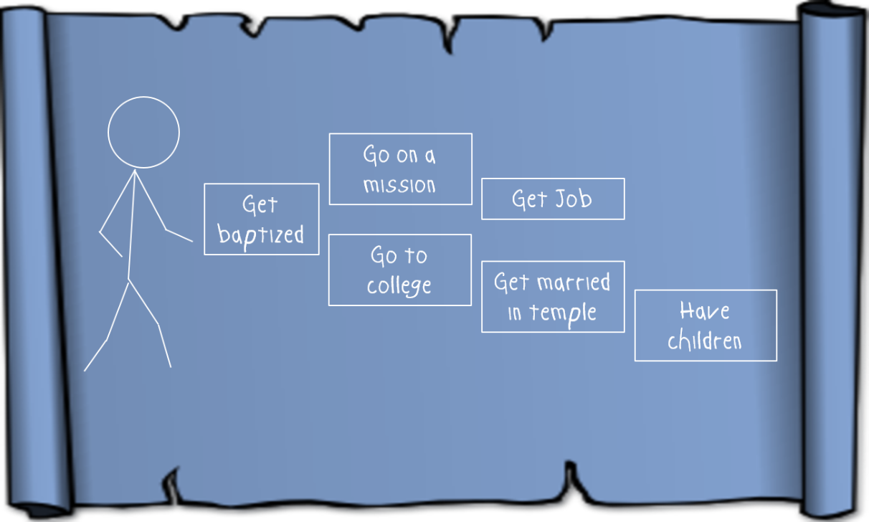
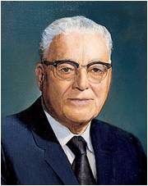
“In his Sermon on the Mount the Master has given us somewhat of a revelation of his own character, which was perfect, … and in so doing has given us a blueprint for our own lives. …
In that matchless Sermon on the Mount, Jesus has given us eight distinct ways by which we might receive [real] joy. Each of his declarations is begun by the word ‘Blessed.’ …
“These declarations of the Master are known in the literature of the Christian world as the Beatitudes. … They embody in fact the constitution for a perfect life.”
(1)

Slide 5
Blessed Are the Poor in Spirit
To be humble and “to recognize gratefully [our] dependence on the Lord—to understand that [we] have constant need for His support.
Humility is an acknowledgment that [our] talents and abilities are gifts from God.” (3)
3 Nephi 12:3
Matthew 5:3

Slide 6
Blessed Are They That Mourn
To feel or express sorrow.
A person may mourn over the difficulties and trials of mortality, including the death of loved ones.
Likewise, a person may also mourn because of sorrow for sin.
And again, more blessed are they who shall believe in your words because that ye shall testify that ye have seen me, and that ye know that I am. Yea, blessed are they who shall believe in your words, and come down into the depths of humility and be baptized, for they shall be visited with fire and with the Holy Ghost, and shall receive a remission of their sins.
3 Nephi 12:2
Yea, and are willing to mourn with those that mourn; yea, and comfort those that stand in need of comfort, and to stand as witnesses of God at all times and in all things, and in all places that ye may be in, even until death, that ye may be redeemed of God, and be numbered with those of the first resurrection, that ye may have eternal life—Mosiah 18:9
3 Nephi 12:4
Matthew 5:4

Slide 7
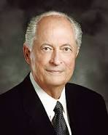
Blessed Are the Meek
“To be meek, as defined in Webster’s dictionary, is ‘manifesting patience and longsuffering: enduring injury without resentment’ (4)
To be “meek” means to be “God fearing, righteous, humble, teachable, and patient under suffering. The meek are willing to follow gospel teachings” (9)
Meekness is not weakness. It is a badge of Christian courage” (5)
But the meek shall inherit the earth; and shall delight themselves in the abundance of peace. Psalms 37:11
3 Nephi 12:5
Matthew 5:5

Slide 8
Blessed are They which do Hunger and Thirst
The Lord will feed them spiritually until they are completely satisfied.
The account of the sermon in 3 Nephi adds:
To hunger and thirst after righteousness implies a great desire to know and do the will of God.
…for they shall be filled with the Holy Ghost.
3 Nephi 12:6
Matthew 5:3

Slide 9
Blessed Are the Merciful
The Savior taught that the way we treat others affects how God will treat us
“Mercy is the compassionate treatment of a person greater than what is deserved” (6)
We are able to receive Heavenly Father’s mercy because of the Atonement of Jesus Christ.
And thou didst hear me because of mine afflictions and my sincerity; and it is because of thy Son that thou hast been thus merciful unto me, therefore I will cry unto thee in all mine afflictions, for in thee is my joy; for thou hast turned thy judgments away from me, because of thy Son.
Alma 33:11
3 Nephi 12:7
Matthew 5:6

Slide 10
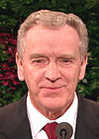
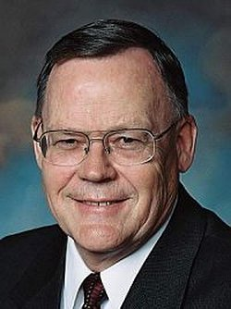
Blessed are the Pure in Heart
The pure in heart are those who love the Lord, who seek to follow Him and keep His commandments, who are striving to live virtuous lives and endure faithfully to the end.
The pure in heart are those who control their thoughts to keep themselves free from immoral fantasies and deeds” (7)
“If something is pure, it is not polluted or tainted by things which do not belong to it. Purity of heart is certainly one of the most important qualifications for receiving inspiration from God.
While none of our hearts are perfect, the more diligently we strive to eliminate impurity, or push out things which do not belong there, the more we open our hearts to the Holy Spirit” (10)
3 Nephi 12:8
Matthew 5:8

Slide 11
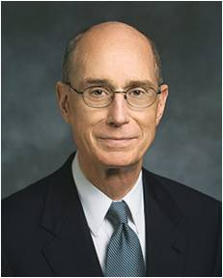
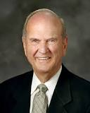
Blessed Are the Peacemakers
As a Church, we must “renounce war and proclaim peace.” As individuals, we should “follow after the things which make for peace.”
We should be personal peacemakers. We should live peacefully—as couples, families, and neighbors.(11)
“[Peacemaking] is the gift to help people find common ground when others are seeing differences” (8)
But I say unto you, Love your enemies, bless them that curse you, do good to them that hate you, and pray for them which despitefully use you, and persecute you;
Matthew 5:44
Yes
No
3 Nephi 12:9
Matthew 5:9

Slide 12
Blessed Are they which are persecuted for righteousness’ sake
Our choice to heed those who mock sacred things will distance us from the saving and life-giving light of the Savior. John 8:12 recorded: “Then spake Jesus again unto them, saying, I am the light of the world: he that followeth me shall not walk in darkness, but shall have the light of life.”
Remember, those who truly love us can help us build our faith. (14)
To be “persecuted for righteousness’ sake” means to be willing to obey and defend Jesus Christ and His teachings, even when we may be mocked or mistreated for doing so.
For those who have been persecuted by others:
I, the Lord, will forgive whom I will forgive, but of you it is required to forgive all men. D&C 64:10
3 Nephi 12:10-12
Matthew 5:10-12

Slide 13
As we develop Christlike attributes, we will find increased happiness

Slide 14
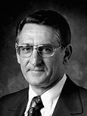
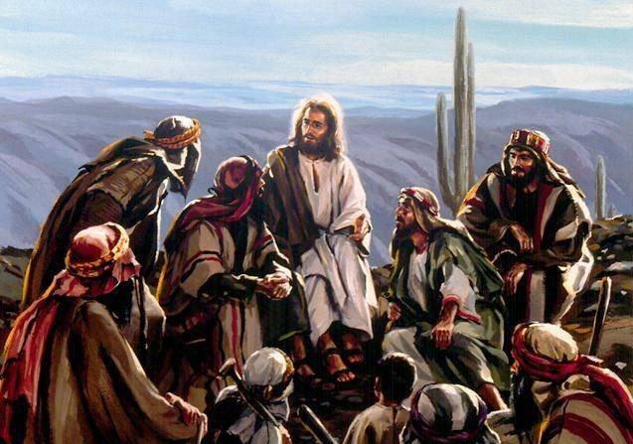
Setting a Righteous Example
Salt of the Earth = salt was added to sacrificial offerings under the law of Moses. Thus salt was associated with joy, permanence, and covenant making.
To whom did the Savior liken salt?
His disciples
“[Good salt] … is clean, pure, uncontaminated, and useful. In this state or condition, salt will preserve, flavor, heal, and perform other useful functions.”(12)
Matthew 5:13

Slide 15
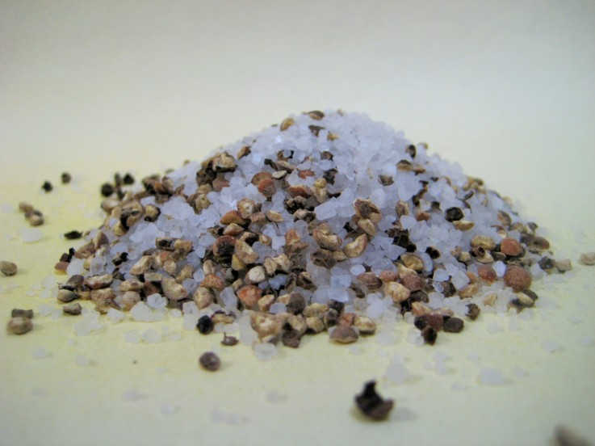
What Causes Salt to Lose Its Savor?
Salt loses its savor when it mixes with other materials and becomes contaminated.
How useful is salt when it is mixed with other materials?
Becoming contaminated by the sins of the world can prevent us from being a blessing to others.
Matthew 5:13

Slide 16
The Light of the World
What are Christ’s disciples asked to do with their light?
What does it mean to let your light shine?
Therefore, hold up your light that it may shine unto the world. Behold I am the light which ye shall hold up—that which ye have seen me do. Behold ye see that I have prayed unto the Father, and ye all have witnessed. 3 Nephi 18:24
“to glorify your Father which is in Heaven” = to give praise and honor to God through word or action.
Our righteous example can encourage others to draw nearer to Heavenly Father.
What will our good works lead others to do?
Matthew 5:14-16

Slide 17
Doctrinal Mastery
Ye are the light of the world. A city that is set on an hill cannot be hid.
Neither do men light a candle, and put it under a bushel, but on a candlestick; and it giveth light unto all that are in the house.
Let your light so shine before men, that they may see your good works, and glorify your Father which is in heaven.
Matthew 5:14-16

Slide 18
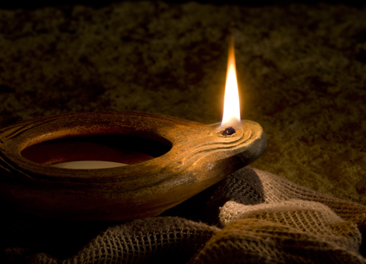
“Wouldn’t it be pleasing to Jesus if we could let our light so shine that those who followed us would be following the Savior? …
“Have you ever stopped to think that perhaps you are the light sent by Heavenly Father to lead another safely home or to be a beacon from a distance to show the way back to the straight and narrow path that leads to eternal life?
Your light is a beacon and should never stop burning or mislead those who are looking for a way home.” (13)
The “candle” in Matthew 5:15 refers to a ceramic oil lamp; the “candlestick” refers to a lamp stand.
Matthew 5:14-16

Slide 19
Sources:
Suggested Hymn: #273 Truth Reflects Upon Our Senses
Videos:
Salt Losing Its Savor (1:41)
Joy—for Us and Others—Comes by Following the Savior (3:56)
President Dieter F. Uchtdorf (“Of Regrets and Resolutions,” Ensign or Liahona, Nov. 2012, 23).
Teachings of Presidents of the Church: Harold B. Lee [2000], 200).
True to the Faith: A Gospel Reference [2004], 86.
[Webster’s Third New International Dictionary (1976 ‘meek,’ 1403].
Robert D. Hales, “Christian Courage: The Price of Discipleship,” Ensign or Liahona, Nov. 2008, 73
(Gospel Topics, “Mercy,” lds.org/topics).
(Sheldon F. Child, “Words of Jesus: Chastity,” Ensign, Jan. 2003, 44).
(Henry B. Eyring, “Learning in the Priesthood,” Ensign or Liahona, May 2011, 63).
Guide to the Scriptures “Meek”
Elder Gerald N. Lund “Opening Our Hearts,” Ensign or Liahona, May 2008, 33.
11. Russell M. Nelson “Blessed Are the Peacemakers” Oct. 2002 Gen. Conf.
12. Elder Carlos E. Asay (“Salt of the Earth: Savor of Men and Saviors of Men,” Ensign, May 1980, 42).
13. Elder Robert D. Hales (“That Ye May Be the Children of Light” [Brigham Young University fireside, Nov. 3, 1996], 8–9;speeches.byu.edu).
14. New Testament Student Institute Manual
For further study of the Beatitudes, you may want to refer to an article by Elder Robert E. Wells of the Seventy titled “The Beatitudes: Pattern for Coming unto Christ,” (Ensign, Dec. 1987, 8–11).
Presentation by ©http://fashionsbylynda.com/blog/

Slide 20
Mourn:
“‘And again, blessed are all they that mourn’ (3 Nephi 12:4; see also Matthew 5:4). … He is talking about repentance. He is talking about the promise that will come to whom? All who would ‘come down into the depths of humility’ and have been baptized and have received the gift of the Holy Ghost (see 3 Nephi 12:2)” (The Teachings of Harold B. Lee, ed. Clyde J. Williams [1996], 112).
Event | Matthew | Mark | Luke | John
The Sermon on the Mount | 5, 6, 7 |  | 6:17-49
Meek:
When Jesus promised that the meek would inherit the earth, He was quoting from Psalm 37:11. To “inherit the earth” (Matthew 5:5) means to inherit the celestial kingdom. This earth will one day be “sanctified from all unrighteousness, that it may be prepared for the celestial glory” (D&C 88:18), and “the meek of the earth shall inherit it” (D&C 88:17). Bishop H. David Burton (“More Holiness Give Me,” Ensign or Liahona, Nov. 2004, 99
Source: Horizontal Harmony of the Four Gospels by Thomas M. Mumford
Merciful and Forgiveness:
“I plead for a stronger spirit of compassion in all of our relationships, a stronger element of mercy, for if we are merciful we shall obtain mercy from the Ultimate Judge. … It is impressive to watch those who with a compelling spirit of kindness reach out to those in distress, to help and assist, to feed and provide for, to nurture and to bless. As these extend mercy, I am confident that the God of Heaven will bless them, and their posterity after them, with His own mercy. … One cannot be merciful to others without receiving a harvest of mercy in return [see Matthew 5:7]” President Gordon B. Hinckley (Standing for Something [2000], 75, 77).
Prophet Joseph Smith Said: “Ever keep in exercise the principle of mercy, and be ready to forgive our brother on the first intimations of repentance, and asking forgiveness; and should we even forgive our brother, or even our enemy, before he repent or ask forgiveness, our heavenly Father would be equally as merciful unto us” (Teachings of Presidents of the Church: Joseph Smith [2007], 392–93).
“Purity of heart is a figure for purity of soul. They are the ones who received a remission of their sins in the waters of baptism; who, after baptism, have so lived as to retain a remission of sins; who have had their sins burned out of their souls as though by fire by the power of the Holy Ghost. They are God-fearing and righteous souls; and being pure, they qualify to see and associate with other pure beings, the chief of whom is the Lord of Purity” Elder Bruce R. McConkie(A New Witness for the Articles of Faith [1985], 492).

Slide 21
Something of Interest
Those who are persecuted: I have a question June 1994 Ensign
Am I in error to avoid all contact with a family member who has seriously wronged me and continues to emotionally abuse me? I harbor no bitterness toward this person, yet my spouse wonders if I am nevertheless being unforgiving.
Maxine Murdock, retired member of the Brigham Young University Psychology Department. Emotional abuse and mistreatment that occur over an extended period of time can be devastating. Those so wronged have the right and responsibility to protect themselves.
If a perpetrator is not a family member, avoiding all contact might be easy. But terminating contact with an abusive family member is difficult, particularly for Latter-day Saints, because of the emphasis we place on the importance of family ties. Nevertheless, victims of abuse must protect themselves from family members and others who freely choose to mistreat them.
Avoiding contact, for a while at least, may sometimes be the only way to achieve that end. When the time is right and if a perpetrator has repented and abandoned abusive behavior, minimal contact might be initiated, perhaps through cards or letters on holidays. Later, a phone call might be appropriate. It may help to make such contact impersonal at first. When renewing personal visits, those who have been wronged should consider doing so in group situations that provide a safe atmosphere and an opportunity to gauge the offender’s behavior and reaction toward renewed contact.
Visits should be brief at first. One of the best ways to determine how, when, and whether to proceed is to appeal for heavenly help through prayer. Those who have been abused, not their well-meaning friends or relatives, must determine when to reinitiate contact.
The ability to discard bitterness is a big step toward reconciliation and forgiveness. Many individuals who have been abused express frustration over their inability to grant forgiveness. The offended often receive great pressure from others to forgive their offender. They are told, “You can’t heal until you forgive.”
Forgiveness is a personal and often lengthy process. Condemning those who have difficulty forgiving places an additional burden on them. Sometimes, under pressure, they will say, “Yes, I forgive,” while deep inside, the hurt not only remains but is compounded by guilt because they do not really believe their own words. On the other hand, those who have been abused should remember that forgiveness is a gospel principle that eventually brings peace of mind. Forgiveness is not only possible but is an essential part of healing, though in some cases it may take years to forgive.
“You cannot erase what has been done, but you can forgive,” said Elder Richard G. Scott of the Quorum of the Twelve. “Forgiveness heals terrible, tragic wounds, for it allows the love of God to purge your heart and mind of the poison of hate. It cleanses your consciousness of the desire for revenge. It makes place for the purifying, healing, restoring love of the Lord” (Ensign, May 1992, p. 33).
The Savior said, “Love your enemies, bless them that curse you, do good to them that hate you, and pray for them which despitefully use you, and persecute you; that ye may be the children of your Father which is in heaven” (Matt. 5:44–45). Although we do not have the same degree of knowledge that the Lord has, we do have his counsel. While he will forgive whom he will forgive, it is required of us, no matter how arduous the task, “to forgive all men” (D&C 64:10).
Small offenses may be fairly easy to forgive—especially those resulting from accidents, carelessness, or insensitivity. But offenses that are long lasting or that cause deep wounds to the soul are much more difficult to forgive, particularly when an offender does not care, feel sorry, apologize, or even recognize the offense.
Elder Scott further taught, “Forgiveness … can be hard to understand, even more difficult to give. Begin by withholding judgment. … Leave the handling of aggressors to others. As you experience an easing of your own pain, full forgiveness will come more easily” (Ensign, May 1992, pp. 32–33).
True forgiveness often develops slowly, a little at a time, perhaps even unconsciously at first. No one can predict how long it should take to forgive. As friends, family, priesthood leaders, or professional helpers, we must be patient with those seeking to forgive. Few of us can see or feel the invisible wounds they have suffered.
Forgiveness does not require acceptance of abuse or acceptance of an abusive person. But when hurt has healed, when victims have realized that the abuse is not something they caused or deserved, when they have tried sincerely to understand the offender, and when they have prayed for charity and spiritual guidance, then peace of mind and true forgiveness will come.

