Slide 1
Lesson 90
Making Right Decisions
Acts 12
N
Hearken unto me, ye that know righteousness, the people in whose heart is my law; fear ye not the reproach of men, neither be ye afraid of their revilings.
Isaiah 51:7
W
E
S

Slide 2
A compass always points north
How would this magnet influence the behavior of the compass needle?
N
W
E
The needle will point to the nearby magnet because it interferes with magnetic north.
S
How would this magnet affect your ability to make the right choice about what direction you should go?

Slide 3
King Herod Agrippa I
He was the grandson of the Herod the Great who was king at the time of the Messiah's birth; and he was the nephew of the Herod who killed John the Baptist (Luke 9:9)
It is revealed that Herod Agrippa's wickedness was not unlike his predecessors.
Herod the Great
Aristobulus
Archelaus
Herod Antipas
Philip
Herod Agrippa l
Herodias
Wife of Philip Who became Antipas wife
(Matthew 14:1-6)
Herod Agrippa II
Bernice
Drusilla
Wife of Agrippa II
Acts 25:13; 23;
26:30
Wife of Gov. Felix
Acts 24:24

Slide 4
King Herod Agrippa II
He was the son of Herod Agrippa I, and the seventh and last king of the Herodian dynasty.
Herod the Great
Aristobulus
Archelaus
Herod Antipas
Philip
Herod Agrippa l
Herodias
Wife of Philip Who became Antipas wife
(Matthew 14:1-6)
Herod Agrippa II
Bernice
Drusilla
Wife of Agrippa II
Acts 25:13; 23;
26:30
Wife of Gov. Felix
Acts 24:24

Slide 5
Vexing the Church
About 44 AD
King Herod Agrippa I kills James, brother of John the beloved, with a sword
King Agrippa I puts Peter into prison
James was killed by Herod’s order, but Peter was rescued from prison by an angel sent from God
four quaternions of soldiers = 4 soldiers
Acts 12:1-4

Slide 6
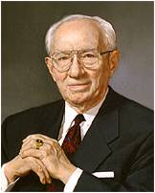
Herod’s Desire to Please Others
How did Herod’s desire to please others rather than God affect Herod’s direction in life?
Herod planned to publicly put Peter to death.
If we seek to please others rather than God, then we can be led further into sin
“One who seeks to please his Heavenly Father will serve the needs of our Father’s kingdom.
If each of us is to please our Father in Heaven, we must be responsive to the needs of His kingdom.”
Acts 12:1-4
(2)

Slide 7
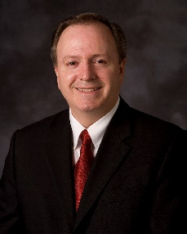
Putting God First
Peter and James put God first in their lives, regardless of the punishment they might receive.
“Trying to please others before pleasing God is inverting the first and second great commandments. It is forgetting which way we face. And yet, we have all made that mistake because of the fear of men.
Jacob quotes Isaiah
…and they were in the attitude of mocking and pointing their fingers towards those who had come at and were partaking of the fruit.
And after they had tasted of the fruit they were ashamed, because of those that were scoffing at them; and they fell away into forbidden paths and were lost.
Nephi 8:27-28
Hearken unto me, ye that know righteousness, the people in whose heart I have written my law, fear ye not the reproach of men, neither be ye afraid of their revilings.
2 Nephi 8:7

Slide 8
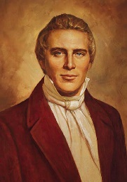
Prayer Without Ceasing
"The greatest temporal and spiritual blessings...always come from faithfulness and concerted effort, [not from] individual exertion or enterprise." (4)
The power of united prayer of the entire church is a power unequalled in the world. The Lord will not be slow to answer the prayers of his saints unless they have been disobedient.
Yet, we often underestimate this great power because we underestimate the Lord's willingness to bless us according to our desires.
Abinadi to King Noah
And it shall come to pass that except this people repent and turn unto the Lord their God, they shall be brought into bondage; and none shall deliver them, except it be the Lord the Almighty God.
Yea, and it shall come to pass that when they shall cry unto me I will be slow to hear their cries; yea, and I will suffer them that they be smitten by their enemies.
Mosiah 11:23-24
Acts 12:5

Slide 9
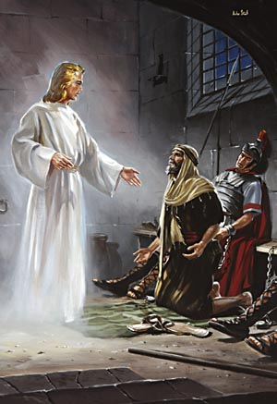
Peter Chained To Two Soldiers
And, behold, the angel of the Lord came upon him, and a light shined in the prison: and he smote Peter on the side, and raised him up, saying, Arise up quickly. And his chains fell off from his hands.
And the angel said unto him, Gird thyself, and bind on thy sandals. And so he did. And he saith unto him, Cast thy garment about thee, and follow me.
When they were past the first and the second ward, they came unto the iron gate that leadeth unto the city; which opened to them of his own accord: and they went out, and passed on through one street; and forthwith the angel departed from him.
And he went out, and followed him; and wist not that it was true which was done by the angel; but thought he saw a vision.
Acts 12:7-10

Slide 10
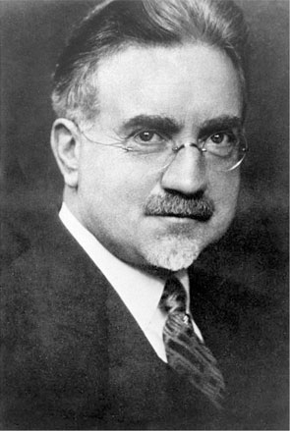
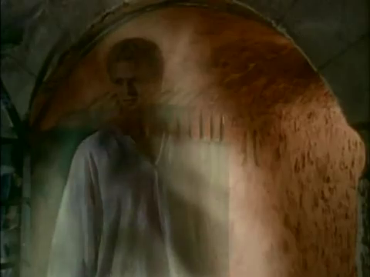
"Undoubtedly angels often guard us from accidents and harm, from temptation and sin.
They may properly be spoken of as guardian angels.
Many people have borne and may bear testimony to the guidance and protection that they have received from sources beyond their natural vision.
Without the help that we receive from the constant presence of the Holy Spirit, and from possible holy angels, the difficulties of life would be greatly multiplied.”
Acts 12:5
(6)

Slide 11
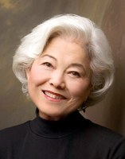
Mary’s House
John Mark, commonly known as Mark, is probably the author of the Gospel According to St. Mark.
He was the son of a woman named Mary, one of the leading women in the early Church in Jerusalem.
Believers assembled at her home, and Peter returned there after being freed from prison.
“To actually accept the miracle by looking at it was the last thing they did, and then they were so overwhelmed with their own reactions that they couldn't even welcome Peter properly. Their prayer of faith brought the miracle to their doorstep, but for a long, suspenseful moment they lacked the final ounce of faith to open the door and let the miracle enter."
Acts 12:11-15, 25; Acts 13:5
(1,7)

Slide 12
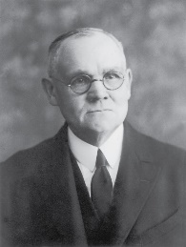
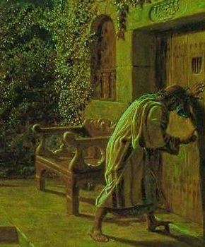
"Peter kept knocking, and at last they opened the door, and were astonished to find him safe.
Why should they be so surprised, when they had been praying for that very blessing? One might think that their hearts would be so full of thanksgiving that there would be no room for astonishment.
"Yet we to-day feel surprised when the Lord manifests His power to us in any strong or otherwise remarkable manner; our greatest cause for wonderment would seem to lie in the contemplation of His mercy, that He will interpose in behalf of such weak and sinful mortals as many of us are.
He is as willing to-day as ever in the past to assist His servants, and that too, by what we call miraculous means should it be necessary."
Acts 12:16
(8)

Slide 13
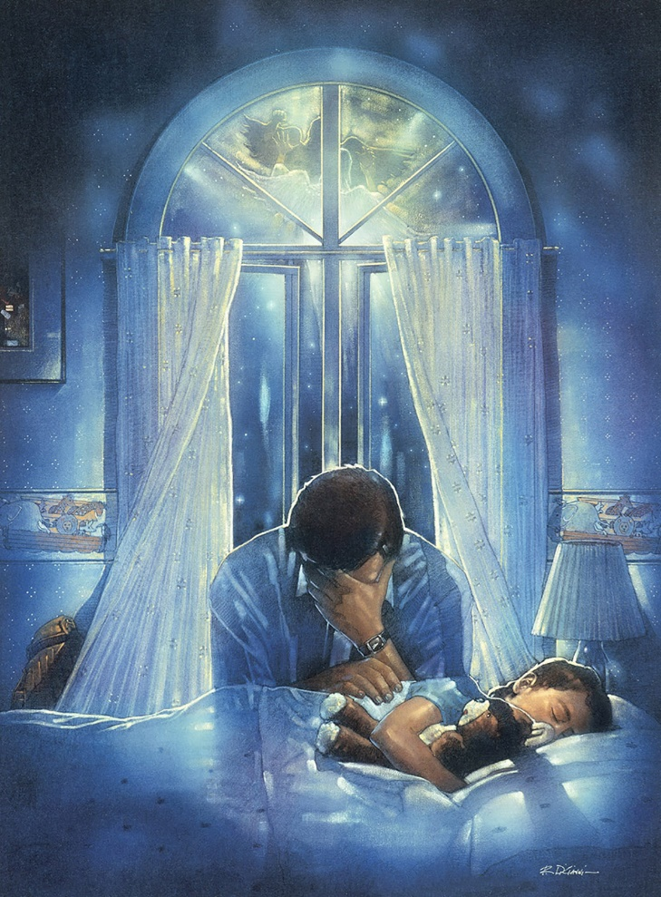
Our sincere and fervent prayers invite God’s miracles and blessings into our lives and the lives of others
“Prayer is the act by which the will of the Father and the will of the child are brought into correspondence with each other.
The object of prayer is not to change the will of God but to secure for ourselves and for others blessings that God is already willing to grant but that are made conditional on our asking for them.
Blessings require some work or effort on our part before we can obtain them. Prayer is a form of work and is an appointed means for obtaining the highest of all blessings.”
Ron DiCianni
Acts 12:16
(9)

Slide 14
Herod’s Fate
Agrippa died at the age of 54, in A.D. 44, the same year James was martyred.
Luke saw Agrippa’s sudden death as divine retribution, administered by an angel of the Lord.
And immediately the angel of the Lord smote him, because he gave not God the glory: and he was eaten of worms, and gave up the ghost.
Acts 12:18-25
(1)

Slide 15
Sources:
Suggested Hymn: #239 Choose the Rigth
Video:
Which Way Do You Face? (1:30)
New Testament Institute Student Manual Chapter 31
President Gordon B. Hinckley To Please Our Heavenly Father April 1985 Gen. Conf.
Elder Lynn G. Robbins (“Which Way Do You Face?” Ensign or Liahona, Nov. 2014, 9).
Joseph Smith (Teachings, p. 183)
Gospeldoctrine.com
John A. Widstoe (Evidences and Reconciliations, p. 402.)
Chieko Okazaki, Sanctuary, 34
James E. Talmage (Brian H. Stuy, ed., Collected Discourses, 5 vols. [Burbank, Calif., and Woodland Hills, Ut.: B.H.S. Publishing, 1987-1992], 3: June 25, 1893.)
Bible Dictionary
Presentation by ©http://fashionsbylynda.com/blog/

Slide 16
THE ACTS OF THE APOSTLES—EVENTS OCCURRED CA. A.D. 40–44 (10–13:1–5)
Jerusalem, Judea Peter is Freed from Prison | 12:1–19
Caesarea: Herod Dies of Disease | 12:20–23
Antioch, Syria Saul and Barnabas Called to the Ministry | 12:24, 25; 13:1–5
Jerusalem, Judea Peter is Freed from Prison | 12:1–19
Caesarea: Herod Dies of Disease | 12:20–23
Antioch, Syria Saul and Barnabas Called to the Ministry | 12:24, 25; 13:1–5
Death of James The Apostle Acts 12:1-2:
"This martyrdom of James is one of the strongest testimonies to his prominence and importance among the Apostles, and does much to correct the impression naturally formed by the lack of prominent mention of him by the evangelists. Surely, since Herod undertook this persecution for the sake of gaining the favor of the Jews, and since, no doubt, he could choose the victim, he would surely select one of the most influential and prominent of the Apostles. His selection of James, therefore, is a high tribute to the Apostle's worth and dignity." (Willard Done, "Lives of the Apostles", Improvement Era, 1899, Vol. ii. February, 1899. No. 4. .)
Easter Acts 12:4:
"The term Easter as used here by King James translators is an anachronism, for there was no Easter celebration as such for many, many years following the Savior's death and resurrection. The Greek word pascha, equivalent to the Hebrew Payach, translates itself as Passover. Early Christians changed the Hebrew custom of celebrating Passover into their own commemoration of the resurrection of Jesus, whom they regarded as the true Paschal lamb of God and the first fruits of the resurrection." (Institute Manual, The Life and Teachings of Jesus & his Apostles, 2nd ed., p. 253)
"The word Easter is from Eastre, a Norse goddess whose pagan festival was observed at the spring equinox. The association of this pagan goddess with the celebration of the resurrection of Jesus Christ was only by adaptation and synthesis. There is no real connection. Jesus being the Lamb of God, was crucified at the Passover time and is the true Passover (see 1 Cor. 5:7).“ Bible Dictionary
Life and Teachings of Jesus and His Apostles Section 7 Chapter 30
Peter Chained to Two Soldiers Acts 12:7-10
"The fisherman apostle lay in the dungeon, the last night before he was to be brought before the people, and probably to be put to death. He was sleeping peacefully; why should he not rest when his conscience was void of offense? What was death to him? it meant an escape from the cruel persecutions of his enemies, and a reunion with the Master who had died so bravely on the cross, and whom he had learned to love so well. He was chained to two soldiers, one lying on either side of him as he slept; he could not move without disturbing his guards. The door of the prison was fastened, and before it other guards were stationed, and beyond these again was the great gate that divided the prison grounds from the city. The guards were vigilant, for it was in accordance with Roman law, that if a soldier ever allowed a prisoner to escape from his custody, the soldier should be subject to the extreme penalty that the prisoner would have received." James E. Talmage (Brian H. Stuy, ed., Collected Discourses, 5 vols. [Burbank, Calif., and Woodland Hills, Ut.: B.H.S. Publishing, 1987-1992], 3: June 25, 1893.)
Who Was John Mark? Acts 12:12:
According to early Christian sources, Mark was not among the original disciples of Jesus Christ, but he later converted, became an assistant to the Apostle Peter, and wrote his Gospel based on what he learned from Peter.
Mark (also called John Mark) and his mother, Mary, lived in Jerusalem; their home was a gathering place for some of the earliest Christians. New Testament Institute Manual Chapter 11
Death of Herod Acts 12:18-25: "The Roman Emperor Claudius had obtained great victories in Great Britain. On his return to Rome there was great rejoicing. Herod thought he would gain great favor with the emperor by a grand festival in his honor in Caesarea, to which he hastened from Jerusalem. On the morning of the second day the theatre was filled with a mass of human beings to witness the inhuman exhibition of gladiators who fought one another for public amusement. Herod appeared in a magnificent robe, sparkling with silver. As the rays of the early morning sun fell upon him, the eyes of the beholders were dazzled by the brilliant robe. Flattered by their foolish cries of admiration he made an oration to the people who gave a shout, crying, 'It is the voice of a God and not of a man.' He was willing to be so called, though this was blasphemy, giving to a man what belongs to God alone. 'Immediately the angel of the Lord smote him because he gave not God the glory.' This was very different from the experience of Peter in prison when the angel of the Lord came upon him, and smote him upon the side; and led him from death.
"The smiting of Herod by the angel was with a dreadful disease such as had caused the death of his grandfather. He was carried from the theatre to his palace where he, lingered five days in agony until death closed his life in the fifty-fourth year of his age. It was the fourth year of his reign over the region where had ruled his grandfather, whose wicked example he had followed to a like inglorious end.
"When in the theatre the scene was suddenly changed from the gladiatorial and other wicked amusements to the judgment on the king, the multitude fled, rending their clothes according to the custom in horror." (Ancient Apostles, 158-9.)

Slide 17
Herodian Family
The Herodian family were Idumeans by birth but had become converts to the Jewish faith. Their object was to found, under the protection of Rome, a semi-independent kingdom. By his marriage with Mariamne, Herod the Great allied himself with the family of the Maccabees, who had been for several generations the leaders of the patriotic party among the Jews.
Herod (The Great) was a successful ruler and was on terms of friendship with Augustus, the Roman Emperor. In order to gain favor with his subjects, with whom he was most unpopular, he rebuilt the temple at an immense cost
His reign was disgraced by many acts of cruelty. In a fit of jealousy he had his wife, whom he dearly loved, put to death; later on he had her two sons, Alexander and Aristobulus, also murdered. In the same year in which he gave the order for the massacre of the infants at Bethlehem, he had Antipater, another of his own sons, put to death. A few months later Herod himself died. His kingdom was then divided between three of his sons: Archelaus, who received Judea, Idumea, and Samaria; Antipas, who had Galilee and Perea; and Philip, who had the northeast districts of Palestine.
Herod Agrippa II:
Herod Agrippa I’s son (Agrippa II), was allowed by the Emperor Claudius to succeed to only a small part of his father’s dominions. He never ruled Jerusalem. He was the 7th king and last king of the Herodian Dynasty. He is mentioned in Acts 25:13.
He was only seventeen when his father died. Claudius kept him in Rome, and sent Cuspius Fadus to govern the Roman province of Judea. While in Rome, he voiced support for the Jews to Claudius, and spoke against the Samaritans.
The Jews only came in contact with him because he supervised the temple and appointed the high priests. In the New Testament he is mentioned as having paid a visit to Festus, the procurator, at Caesarea, where Paul delivered a speech before him in 60 A.D.
His sister, Berenice became Emperor Titus’ mistress. His sister Drusilla, married Roman procurator Felix, and also heard Paul speak (Acts 24:24).
Between 52 and 60 A.D., he arbitrarily appointed several high priests, which angered the Jews. The Jews also hated him for adopting heathen emblems on his coins.
The Apostle Paul pleaded his case at Caesarea Maritima before Herod Agrippa II and his sister Berenice, possibly in 59 A.D. The Roman procurator, Festus, was also present. Paul presented his salvation testimony. He also gave an impassioned plea for his audience to consider the Lordship of Jesus Christ. Herod Agrippa II mocked Paul for trying to make him a Christian, but he rejected his personal need for salvation.
According to Photius, Agrippa died, childless, at the age of seventy.
Dr. Merrill's Seminary Papers and other Reflections
Herod (Antipas) After a reign of nine years Archelaus was deposed by Augustus, and Judea was attached to the Roman province of Syria, being governed by a prefect. Antipas (called in the New Testament “Herod the tetrarch”) built as his capital Tiberias on the Sea of Galilee; he is frequently mentioned in the Gospels.
He took as his wife Herodias, the wife of his half-brother Philip. He was deposed by the Emperor Caligula and banished to Lugdunum in Gaul, A.D. 39. Philip made Caesarea Philippi (previously called Panias) his capital and remained in possession of his tetrarchy until his death in A.D. 33. His territory then became part of the province of Syria, but in A.D. 37 it was given by Caligula, along with Abilene (the tetrarchy of Lysanias), to Agrippa, who was allowed to assume the title of king.
Herod Agrippa I:
On the deposition of Antipas he obtained the tetrarchy of Galilee, and in A.D. 41, on the accession of the Emperor Claudius, he received Judea and Samaria as well, and so became ruler of the whole territory governed by his grandfather. He lived in Jerusalem and was anxious to be regarded as an orthodox Jew. He began a persecution of the Church and put James to death, Peter escaping by a miracle (Acts 12:1–23). His death is described in Acts 12:20–23.
Bible Dictionary

