Slide 1
Lesson 91
Missionary Life
Yesterday and Today
Acts 13-14
And he shall come into the world to redeem his people; and he shall take upon him the transgressions of those who believe on his name; and these are they that shall have eternal life, and salvation cometh to none else.
Alma 11:40

Slide 2
The Beginning of Missionary Life
Set Apart by Peter to Preach (Acts 2, 3)
Set Apart by Stake Presidents
Training—a year in Antioch
(Acts 11:26)
Training—MTC
Transportation—walking, biking, car
Transportation—walking, sailing (Acts 13:4)
Preaches---in homes, and on the streets, door to door
Preaches first to the Jews in the Synagogues
(Acts 13:5)

Slide 3
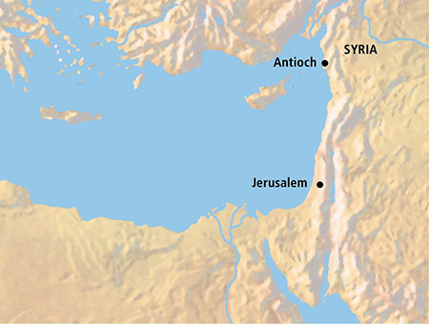
First Journey
After they were set apart, Saul and Barnabas traveled from Antioch to the island of Cyprus and preached in a synagogue in the city Salamis.
Cyprus
Paphos
From there they traveled to the other side of the island to the city Paphos.
Acts 13:1-6

Slide 4
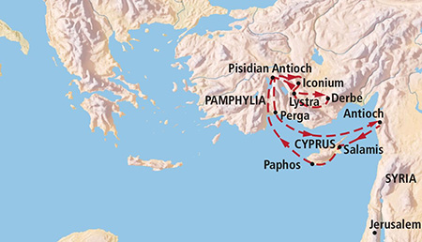
John Mark, Mark, or Marcus
He was the cousin of Barnabas and he accompanied Saul and Barnabas at the beginning of their first missionary journey.
John Mark’s unexpected departure from the other missionaries at Perga caused a later disagreement between Saul and Barnabas as they prepared to leave on their second mission.
The scriptures do not mention the reason Mark left the mission field. But he later accompanied Barnabas to Cyprus, was with Timothy at Ephesus, and is probably the Marcus whom Peter spoke of as “my son”.
Thus, Mark became a powerful force for good in the early Church. (1)
Acts 13:13; Acts 15:37-40; Colossians 4:10

Slide 5
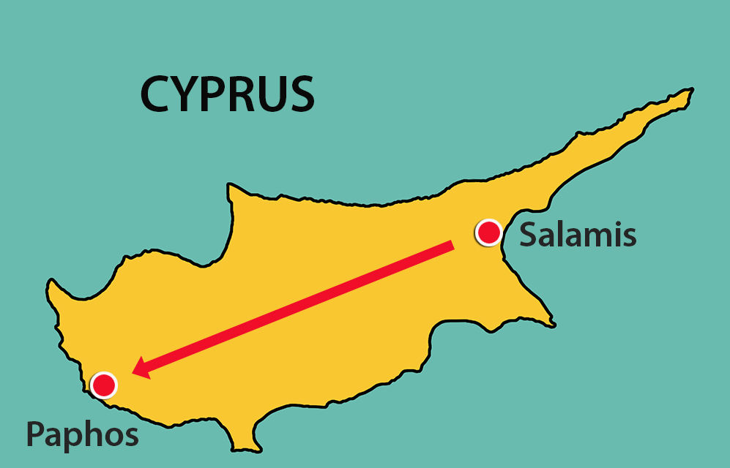
Finding Sergius Paulus
Sergius Paulus, who was the Roman deputy of the country
“Desired to hear the word of God”
False Prophet--Elymas the sorcerer, seeks to turn away the faith of Sergious Paulus
Paul (Saul) used harsh words because Elymas was attempting to keep another person from receiving salvation.
Saul cursed him with blindness
Acts 13:7-11

Slide 6
“Cursings as well as blessings may be administered by the power and authority of the priesthood … , but the Lord’s earthly agents are sent forth primarily to bless and not to curse, and no curse should ever be decreed except by direct revelation from the Lord commanding such to be done.”
And whosoever shall not receive you, nor hear your words, when ye depart out of that house or city, shake off the dust of your feet.
Matthew 10:14
The power of God is far greater than the power of the devil
From Verse 9 Saul is now referred to as Paul
Acts 13:7-11
(2)

Slide 7
Challenges of Missionary Life
Finding false prophets (Acts 13:6)
Coming across antagonists
Spake against those things and contradicting them
(Acts 13:45)
Arguing against doctrine
Others who have heard only the negative things about the church
Stirring up devout men and women in persecution
(Acts 13:50)
Slamming of doors
Being kicked out of their cities (Acts 13:50)

Slide 8
In Antioch
In Antioch in Pisidia (not to be confused with Antioch in Syria, where Church members were first called Christians), Paul preached both to Jews and to others who “feared God”
God-fearers were Gentiles who accepted Jehovah as their God and lived various aspects of Judaism but did not fully convert to Judaism by undergoing the rite of circumcision.
Many of Paul’s Gentile converts were God-fearers who worshipped in synagogues, knew the Jewish scriptures (the Old Testament), and were in a state of readiness to accept the gospel message.
Acts 13:13
(1)

Slide 9
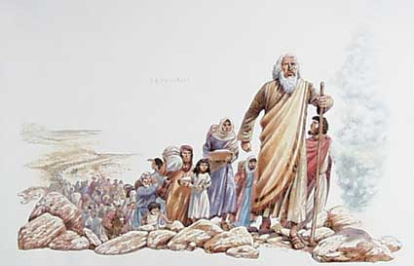
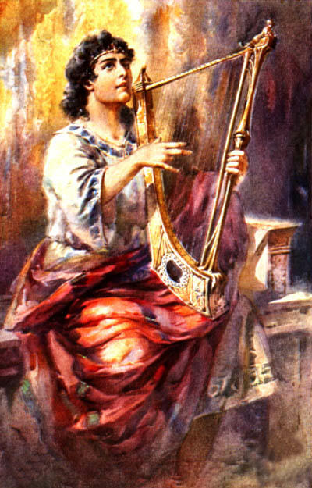
History of the Israelites
The God of this people of Israel chose our fathers, and exalted the people when they dwelt as strangers in the land of Egypt, and with an high arm brought he them out of it.
…he raised up unto them David to be their king; to whom also he gave testimony, and said, I have found David the son of Jesse, a man after mine own heart, which shall fulfil all my will.
David
Bathsheba
Nathan
“The sure mercies of David” = refer to the promises God made to David of the resurrection
41 Generations
Mary
Jesus
Acts 13:14-37
(1)

Slide 10
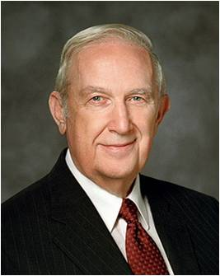
Repentance and Remission of Sins
Paul taught that “forgiveness of sins” comes only through Jesus Christ
“Whether the violation be great or small, the solution is the same: full repentance through faith in Jesus Christ and His Atonement with obedience to His commandments. …
“I testify that of all the necessary steps to repentance, the most critically important is for you to have a conviction that forgiveness comes in and through Jesus Christ. It is essential to know that only on His terms can you be forgiven. You will be helped as you exercise faith in Christ.
That means you trust Him and His teachings.”
Acts 13:38-39; 2 Nephi 9:22-24; Alma 11:40
(4)

Slide 11
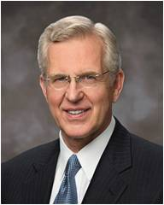
Justified and Found Guiltless, Receive Joy
justified, = “to be pardoned [or forgiven] from punishment for sin and declared guiltless”
We can be forgiven of our sins and justified through the Atonement of Jesus Christ
“Jesus suffered and gave His life to atone for sin. The power of His Atonement can erase the effects of sin in us. When we repent, His atoning grace justifies and cleanses us (see 3 Nephi 27:16–20). It is as if we had not succumbed, as if we had not yielded to temptation.”
Acts 13:38-39
(5)

Slide 12
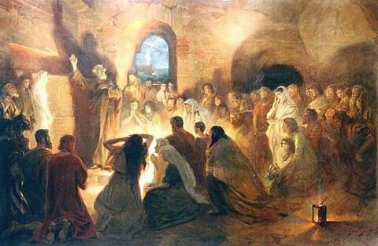
Blasphemy
Blasphemy as “contemptuous speech concerning God or concerning something that stands in a sacred relation toward God, such as His temple, His law, or His prophet.”
“Turn to the Gentiles”
This moment foreshadowed what would increasingly happen in the missionary work of the Church as many Jews opposed the gospel and Gentile conversions. After this event, as Paul traveled to other areas, he typically continued to teach the gospel “to the Jew first, and also to the Greek” (Romans 1:16),
…but when Jews rejected his message, Paul readily “turned to” the Gentiles, finding many ready to receive the gospel.
Acts 13:45-46
(6)

Slide 13
The Joys of Missionary Life
Having some Jews and Gentiles believe
(Acts 13:48)
Having converts believe and join the church
The Word of the Lord was “published” (witnessed) throughout the region
(Acts 13:49)
Being a witness of Christ through testimony
The joy of knowing a person will come unto the Lord
Disciples filled with joy, and the Holy Ghost
(Acts 13:52)

Slide 14
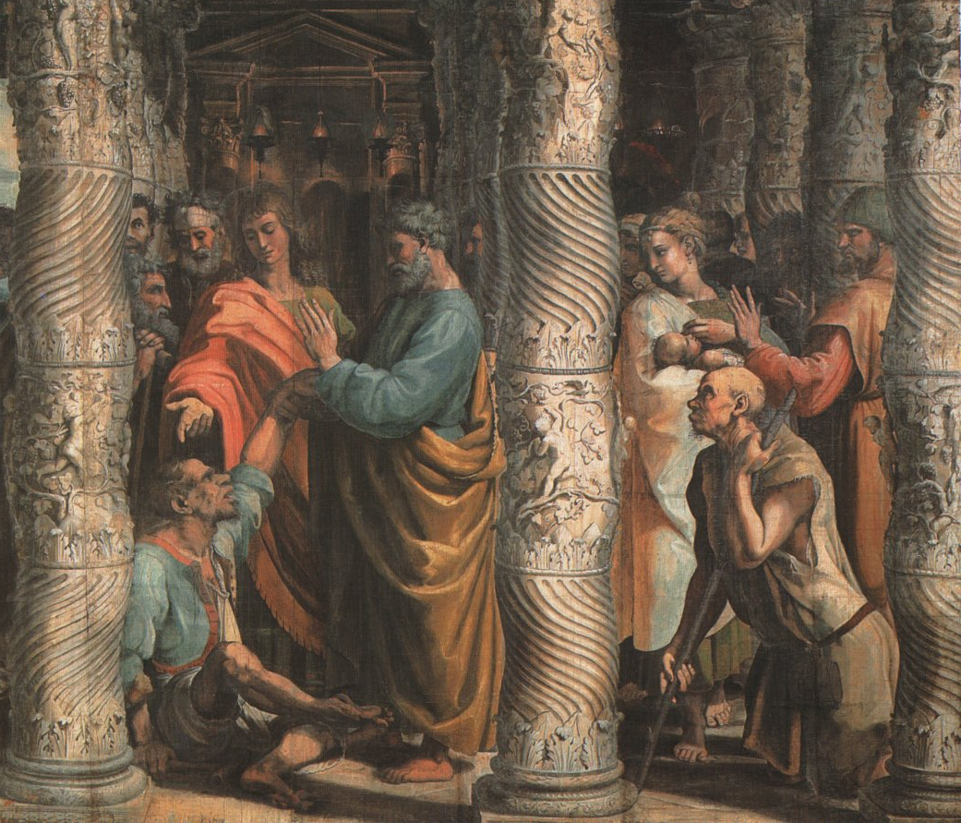
Persecution and Miracles
When Paul and Barnabas learned of a plot against their lives in Iconium, they departed to Lystra and Derbe.
In Lystra, they met a man who had been crippled from birth. Perceiving that the man “had faith to be healed,” Paul commanded the man to walk, which he did.
Unbelieving Jews stir up the Gentiles against Paul and Barnabas.
After Paul heals a crippled man, the people in Lystra think Paul and Barnabas are Greek gods and attempt to offer sacrifice to them
Acts 14:1-19
(1)

Slide 15
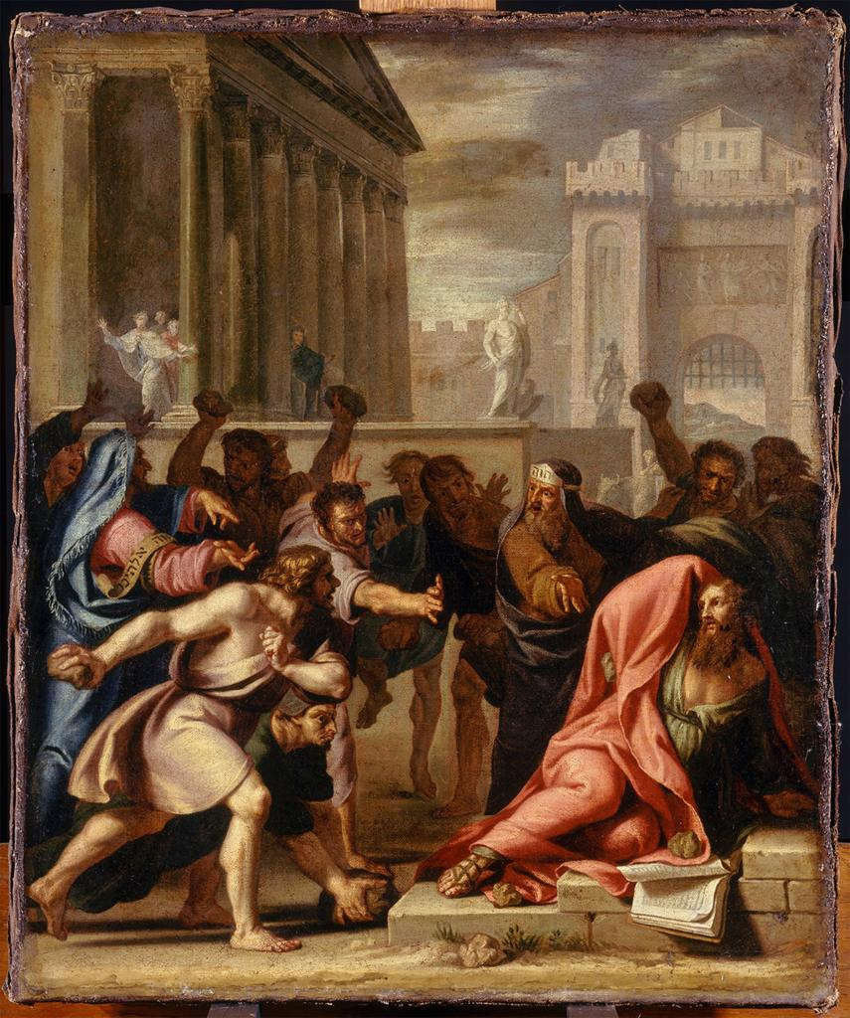
Persecution and Miracles
Paul is stoned and revived
Why does the Lord allow good people to experience difficult trials?
As we faithfully pass through tribulation, we will be prepared to enter the celestial kingdom
Acts 14:19

Slide 16
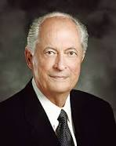
“There is meaning and purpose in our earthly challenges. Consider the Prophet Joseph Smith: throughout his life he faced daunting opposition—illness, accident, poverty, misunderstanding, false accusation, and even persecution.
One might be tempted to ask, ‘Why didn’t the Lord protect His prophet from such obstacles, provide him with unlimited resources, and stop up the mouths of his accusers?’
The answer is, Each of us must go through certain experiences to become more like our Savior. In the school of mortality, the tutor is often pain and tribulation, but the lessons are meant to refine and bless us and strengthen us, not to destroy us.”
Acts 14:19
(7)

Slide 17
The Miracles of Missionary Life
A man crippled is healed
(Acts 14:8-10)
Priesthood healings and anointings
Paul was stoned but revived
(Acts 14:19)
Blessings of Health
Having the doors open for the gospel to be spread
Opening the doors of faith with the Gentiles

Slide 18
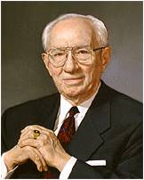
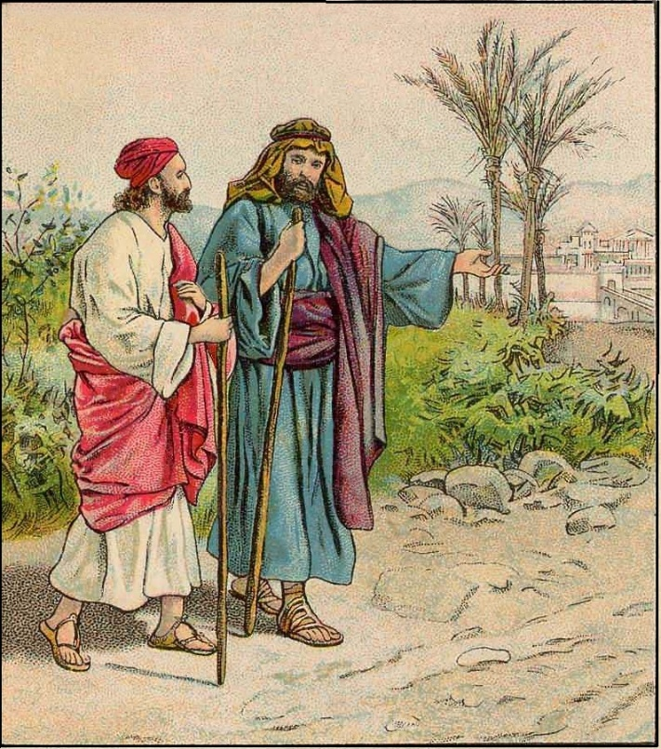
Confirming Souls and Establishing Branches
When Paul and Barnabas returned to Lystra, Iconium, and Antioch, they were following their general pattern of returning to cities where they had established branches of the Church, “confirming the souls of the disciples, and exhorting them to continue in the faith.” (1)
“With the ever-increasing number of converts, we must make an increasingly substantial effort to assist them as they find their way.
Every one of them needs three things: a friend, a responsibility, and nurturing with ‘the good word of God’ (Moro. 6:4).
It is our duty and opportunity to provide these things. …
This is a work for everyone. It is a work for home teachers and visiting teachers. It is a work for the bishopric, for the priesthood quorums, for the Relief Society, the young men and young women, even the Primary.”
Acts 14:19
(8)

Slide 19
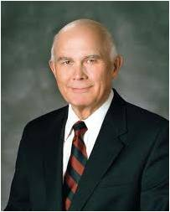
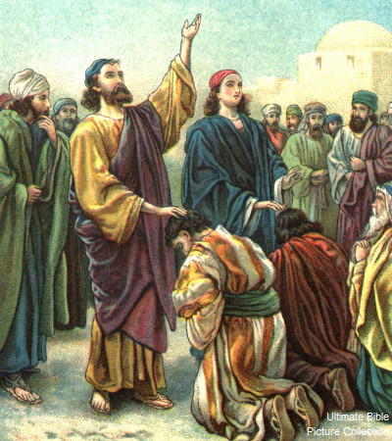
Ordained Many
Paul and his companions called and set apart faithful men to lead the Church in the various cities where branches of the Church were established and then “commended them to the Lord” Paul later exhorted Church members to honor and respect their local leaders. (1)
“The Lord told the early members of His Church that the voice of His servants is the voice of the Lord, and that the hand of His servants is the hand of the Lord.
I testify to the truthfulness of that principle, which imposes a solemn duty upon the members of this Church to be loyal to their leaders and faithful in following their direction. I affirm that the Lord will bless us for doing so.”
Acts 14:22-23; D&C 1:38, 36:2)
(9)

Slide 20
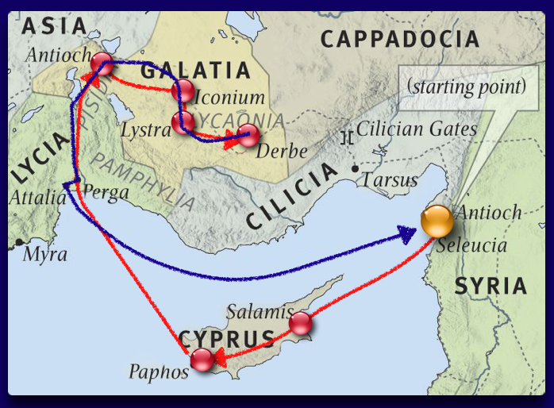
Last Part of Their First Mission
Paul and Barnabas continued their first missionary journey by visiting several additional cities that lie within present-day Turkey and Cyprus.
They concluded this journey by returning to Antioch in Syria, where they had begun their mission over two years earlier.
Acts 14:26-27
(1)

Slide 21
After the Mission
Prayed for those who had received the Word of God (Acts 14:26)
Pray for those people whom they had touched
Report to Stake President and to his ward the testimony he/she received
Gathered together with the church and rehearsed all that God had done with them.
(Acts 14:27)
Going home into the world
Rested from their labors
(Acts 14:28)

Slide 22
Sources:
Suggested Hymn: #193 I Stand All Amazed
Video: The Refiner’s Fire (5:02)
New Testament Institute Student Manual Chapter 32
Elder Bruce R. McConkie (Mormon Doctrine, 2nd ed. [1966], 175–76.
Gospeldoctrine.com
Elder Richard G. Scott (“Peace of Conscience and Peace of Mind,” Ensign or Liahona, Nov. 2004, 16–17).
Elder D. Todd Christofferson (“That They May Be One in Us,” Ensign or Liahona, Nov. 2002, 71).
Bible Dictionary
Elder Robert D. Hales (“Faith through Tribulation Brings Peace and Joy,” Ensign or Liahona, May 2003, 17).
President Gordon B. Hinckley (“Converts and Young Men,” Ensign, May 1997, 47–48).
Elder Dallin H. Oaks (“Bishop, Help!” Ensign, May 1997, 23).
Presentation by ©http://fashionsbylynda.com/blog/

Slide 23
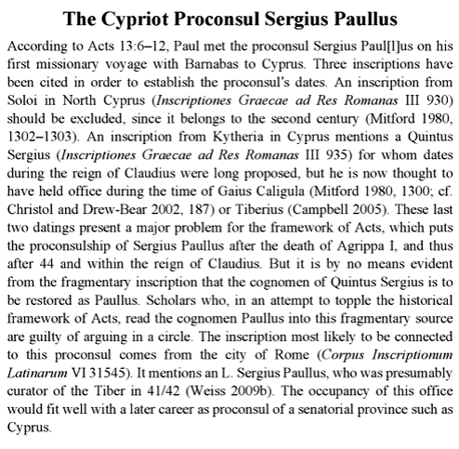
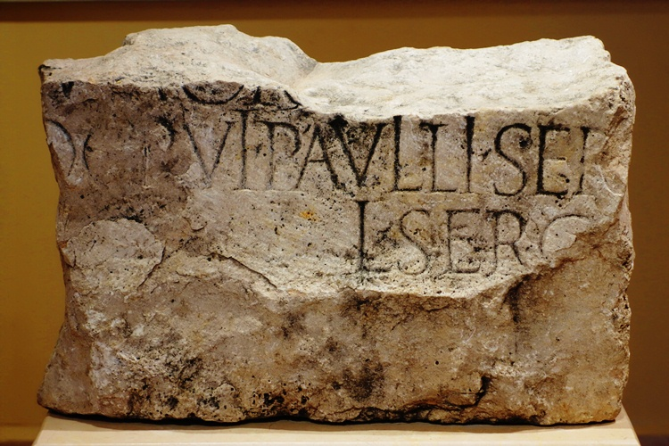
To Curse Someone Acts 13:10-11:
“To ceremonially shake the dust from one’s feet as a testimony against another was understood by the Jews to symbolize a cessation of fellowship and a renunciation of all responsibility for consequences that might follow. It became an ordinance of accusation and testimony by the Lord’s instructions to His apostles as cited in [Matthew 10:14]. In the current dispensation, the Lord has similarly directed His authorized servants to so testify against those who wilfully and maliciously oppose the truth when authoritatively presented” James E. Talmage (Jesus the Christ, 345; see also D&C 24:15; 75:18–22; 84:92–96).
Because of its serious nature, however, this should never be done except under the direction of the First Presidency and Quorum of the Twelve Apostles.(1)
Setting Apart Acts 13:3-4:
“The setting apart is an established practice in the Church and men and women are ‘set apart’ to special responsibility, in ecclesiastical, quorum, and auxiliary positions. …
“To some folk the setting apart seems a perfunctory act while others anticipate it eagerly, absorb every word of it, and let their lives be lifted thereby.
“The setting apart may be taken literally; it is a setting apart from sin, apart from the carnal; apart from everything which is crude, low, vicious, cheap, or vulgar; set apart from the world to a higher plane of thought and activity. The blessing is conditional upon faithful performance. …
“In my experience there have been numerous people who like Saul … have, through the setting apart, received ‘largeness of heart,’ extended influence, increased wisdom, enlarged vision, and new powers.” President Spencer W. Kimball (in Conference Report, Oct. 1958, 57).
Facing Opposition:
Many missionaries have had discussions with those who would teach false doctrine for their own benefit. These discussions are rarely amicable. At times, one might feel like cursing those who are contentious-as Saul cursed Elymas. Yet, how does one know when to say something like, 'Thou child of the devil...thou shalt be blind'? Obviously Saul was acting according to the Spirit for he was 'filled with the Holy Ghost.' Furthermore, the cursing came from God, not because Saul was angry or frustrated, but because it served the purposes of the Lord. The Lord does not curse these anti-Christs or false prophets out of maliciousness, but so that others may believe. Notice verse 12, 'Then the deputy, when he saw what was done, believed, being astonished at the doctrine of the Lord.'
From the Book of Mormon, we see the same pattern. Korihor was struck dumb while contending with Alma, but the result was that 'they were all convinced of the wickedness of Korhior; therefore they were all converted again unto the Lord' (Alma 30:58). Similarly, Sherem was smitten by the Lord while contending with Jacob. But the Lord did not smite him for Jacob's benefit but so that the people would not be deceived. After hearing Sherem's confession, 'the multitude...were overcome that they fell to the earth...And it came to pass that peace and the love of God was restored again among the people; and they searched the scriptures, and hearkened no more to the words of this wicked man' (Jacob 7:21-23). (3)

Slide 24
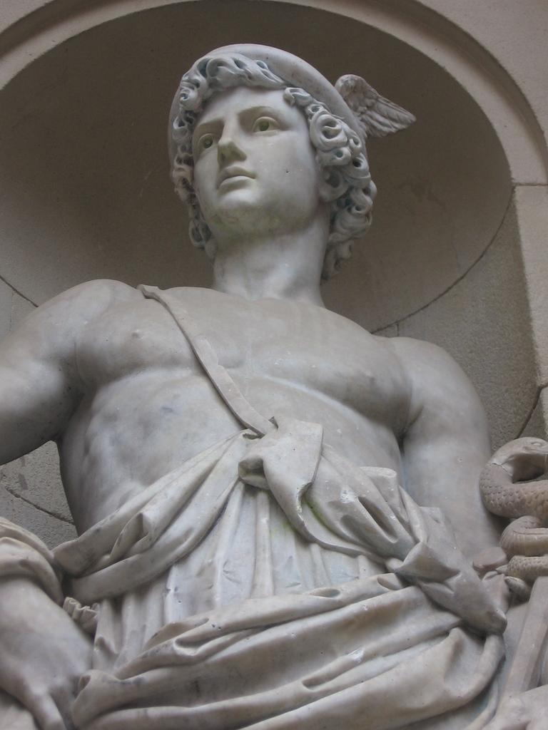
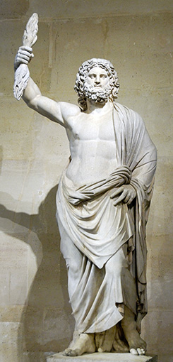
Justification Acts 13:38-39:
Justification is a gift from the Savior. He declares that a person is guiltless, free from the full demands of justice, being put back into a right relationship with God so that progress toward perfection can continue. (1)
A brief review of Greek and Roman mythology is in order.
The Romans adopted much of Greek culture, including their gods. Their mythology and powers remained the same but their names were changed. Jupiter was the Roman god of the sky who ruled the other gods. He is the Roman equivalent of the Greek god Zeus. Mercury, or the Greek god, Hermes, was the god of commerce and acted as the messenger of the gods. Barnabas was probably larger in stature than Paul (Joseph Smith taught that Paul was only five feet tall) and was therefore was assumed to be Jupiter. Paul, it seems, did most of the talking-making him "the messenger of the gods.“
From a latter-day perspective, the idea that these apostles were Greek gods is absurd. But the influence of Greek culture, Hellenism, on the people of Asia Minor cannot be overemphasized. While the theocracy of Hellenism as adopted by the Roman world seems to us like a polytheistic caricature, much of the rest of Greek culture has withstood the test of time. Of the powerful influence of Hellenism, Alfred Edersheim noted:
"Jews of the West are known by the term Hellenists...it was, in the nature of things, impossible that the Jewish communities in the West should remain unaffected by Grecian culture and modes of thought...Witness here the many converts to Judaism among the Gentiles; witness also the evident preparedness of the lands of this 'dispersion' for the new doctrine which was to come from Judaea...That restless, searching subtle Greek intellect would penetrate everywhere, and flash its light into the innermost recesses of his home and Synagogue...when the Jew stepped out of the narrow circle which he had drawn around him, he was confronted on every side by Grecianism. It was in the forum, in the market, in the counting-house, in the street; in all that he saw and in all to whom he spoke. It was refined; it was elegant; it was profound; it was supremely attractive."
(Alfred Edersheim, The Life and Times of Jesus the Messiah, 12-14)
Paul and Barnabas were Apostles Acts 14:1-6, 14:
Paul was an ordained apostle, and without question he took the place of one of the other brethren in [the Council of the Twelve]” Joseph Fielding Smith (Doctrines of Salvation, comp. Bruce R. McConkie, 3 vols. [1954–56], 3:153).
A vacancy in the Council of the Twelve was probably created because one of the other Apostles had been put to death. (1)
Acts 14:12
Mercurius
Jupter
This ancient statue of the Greek god Zeus (the chief Greek deity and equivalent of the Roman god Jupiter) was discovered in 1680 at Smyrna.

Slide 25
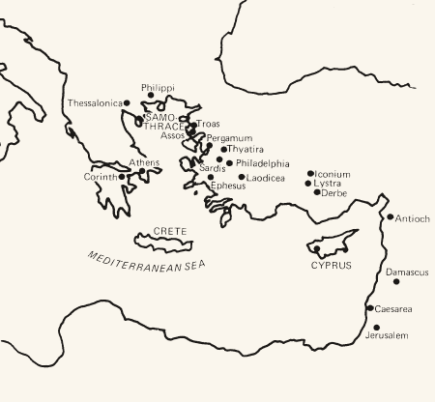
THE ACTS OF THE APOSTLES—EVENTS OCCURRED CA. A.D. 45–51 (13:6–18:23) PAUL’S FIRST AND SECOND MISSIONARY JOURNEYS
Paphos, Cyprus Paul Curses a False Prophet | 13:6–12
Anitoch, Pisidia The Savior Was of the Lineage of David | 13:13–25
The Gospel Is Offered to Israel | 13:26–41
Paul and Barnabas Teach the Gentiles | 13:42–49
Iconium, Galatia Jews Persecute Paul and Barnabas | 13:50–52; 14:1–7
Paphos, Cyprus Paul Curses a False Prophet | 13:6–12
Anitoch, Pisidia The Savior Was of the Lineage of David | 13:13–25
The Gospel Is Offered to Israel | 13:26–41
Paul and Barnabas Teach the Gentiles | 13:42–49
Iconium, Galatia Jews Persecute Paul and Barnabas | 13:50–52; 14:1–7
Lystra, Galatia Paul and Barnabas Hailed as Gods | 14:8–18
Paul Stoned, Revived, Preaches | 14:19–28
Life and Teachings of Jesus and His Apostles Chapter 33

