Slide 1
Lesson 92
Jerusalem Conference
and the Priesthood in the Church
Acts 15

Slide 2
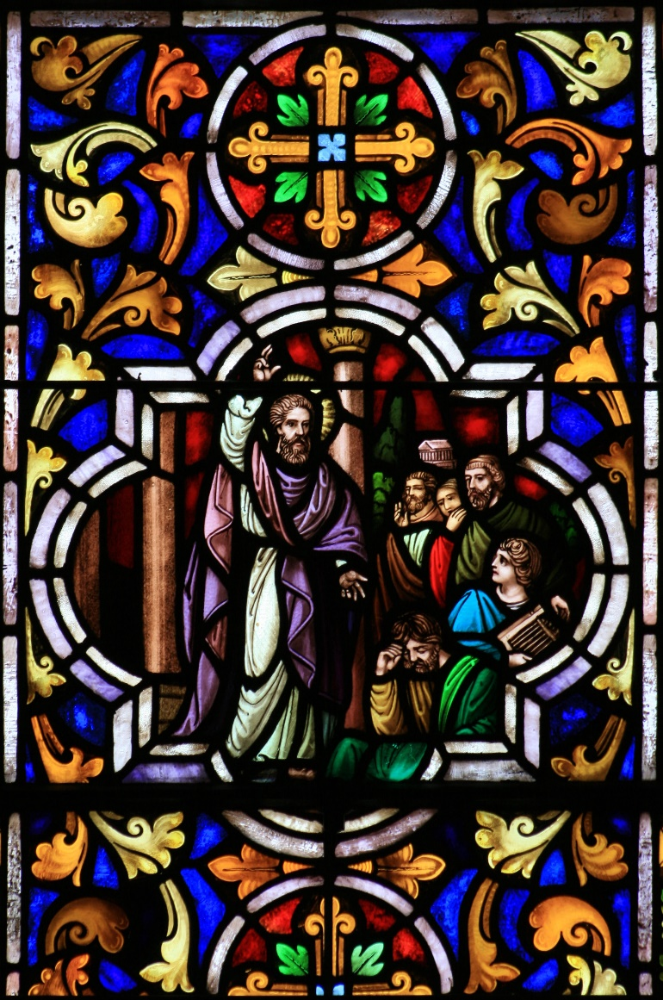
An Issue is decided in Jerusalem by the apostles
Apostles and elders come together to consider the matter of circumcision and keeping the Law of Moses
Jehovah instituted the practice of circumcision among Abraham and his descendants as a token of their covenant with Jehovah. The token reminded them of their obligations and of the sacred and eternal blessings given to all who served the Lord in righteousness
Acts 15:2-6; Abraham 2:8–11; Genesis 17

Slide 3
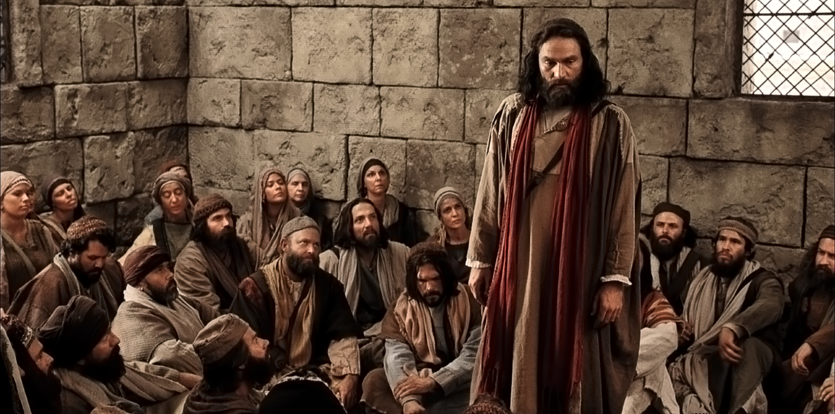
The Debate
In the new covenant instituted by Jesus Christ, the token of circumcision was replaced by the ordinance of baptism. In a revelation given to Mormon and recorded in the Book of Mormon, Jesus Christ said:
“The law of circumcision is done away in me”
(Moroni 8:8)
The debate over circumcision concerned not only the interpretation and application of doctrine, but also the accepting of new revelation through Church leaders.
Acts 15:6-11

Slide 4
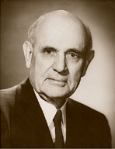
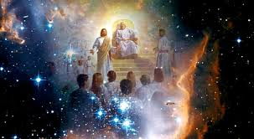
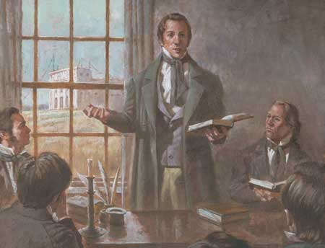
Jerusalem Conference
“put no difference between us [the converted Jews] and them [the converted Gentiles]”
“‘I have no hesitancy in giving you the assurance, if you will confer in council as you are expected to do, God will give you solutions to the problems that confront you’
“God called a grand council in the premortal world to present His glorious plan for our eternal welfare. The Lord’s church is organized with councils at every level, beginning with the Council of the First Presidency and the Quorum of the Twelve Apostles and extending to stake, ward, quorum, auxiliary, and family councils.
Acts 15:9

Slide 5
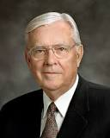
A United Effort
“… When we act in a united effort, we create spiritual synergism, which is increased effectiveness or achievement as a result of combined action or cooperation, the result of which is greater than the sum of the individual parts.”
We can know the will of the Lord through His living prophets and apostles
(3)
Acts 15:9

Slide 6
No Disputations
No doctrinal principle is important enough to argue over. When a doctrinal debate leads to an argument with the spirit of contention, both sides are at fault, and the Spirit of the Lord is grieved. Understandably, the ancient apostles let their zeal for the truth preempt their love of peace and harmony, but the Lord has said:
…'there shall be no disputations among you, as there have hitherto been; neither shall there be disputations among you concerning the points of my doctrine, as there have hitherto been.
'For verily, verily I say unto you, he that hath the spirit of contention is not of me, but is of the devil, who is the father of contention, and he stirreth up the hearts of men to contend with anger, one with another.
'Behold, this is not my doctrine, to stir up the hearts of men with anger, one against another; but this is my doctrine, that such things should be done away.'
(3 Ne 11:28-30)
The
Book
of
Mormon
ANOTHER TESTAMENT
OF JESUS CHRIST
Acts 15:9

Slide 7
James of the Jerusalem Council
"In A.D. 44, the first Herod Agrippa 'stretched forth his hands to vex certain of the church.' (Acts 12:1.) He imprisoned Peter and 'killed James the brother of John with the sword.' (Acts 12:2.)
This vacancy in the leading three was soon filled by another James, whom Paul, in writing to the Galatians about A.D. 56, said was the brother of Jesus...
John is prominent with Peter in the first half of Acts, but afterward James the brother of the Lord is the prominent leader at Jerusalem, where he is mentioned often in association with Peter. When the angel released Peter from prison, the chief Apostle sent word to 'James, and to the brethren.' (Acts 12:17.)
Because of James's leading position, later Christian writers titled him Bishop of Jerusalem, but they wrote in an era that knew no higher authority than bishop. James's specific responsibility included decisions on doctrine for the whole Church, which went far beyond the calling of any New Testament bishop.
This is apparent in the prominent role James played at the Jerusalem Council, the meeting of the Apostles and elders to determine whether gentile converts needed circumcision as well as baptism. Peter spoke first in favor of the gentiles, Paul and Barnabas supported him, and James proposed the details of the solution."
Acts 15:13
(4)

Slide 8
Trouble Them Not…
…or not make living the gospel harder for the converted Gentiles, and not require them to perform the rituals of the law of Moses before joining the Church.
James was supporting the decision given earlier by Peter.
The Apostles decided to send an epistle to the Church members declaring that circumcision was not required for salvation.
By counseling together and seeking revelation from God, Church leaders receive inspiration about difficult problems
Acts 15:22-27
(4)

Slide 9
Revelation and Order
“Behold, mine house is a house of order, saith the Lord God, and not a house of confusion.”
All things are done in order
Acts 20:68
Acts 15:9; D&C 132:8

Slide 10
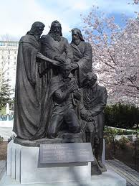
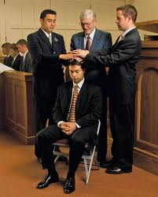
Order of the Priesthood
“And when they had ordained them elders in every church…” (Acts 14:23)
“Every elder, priest, teacher, or deacon is to be ordained…”
D&C 20

Slide 11
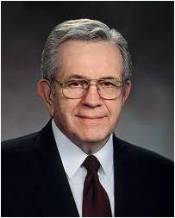
“When we officiate in the priesthood, we always do it in the name of the Lord. When we act according to proper order of things, we act for the Lord…”
(4)

Slide 12
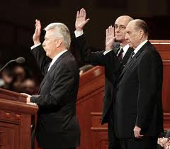
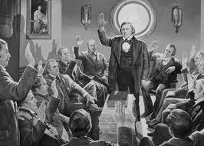
United
“…by vote of the church…”
D&C 20:63-64

Slide 13
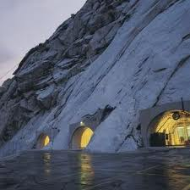
Order of Keeping Proper Records
D&C 20:64 D&C 85:1

Slide 14
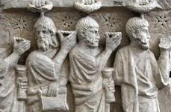
Uniting as One Unto the Lord
“Wherefore, now let every man learn his duty, and to act in the office in which he is appointed, in all diligence.”
D&C 107:99

Slide 15
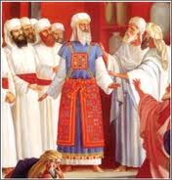
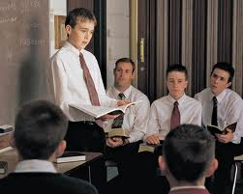
“It seemed good unto us, being assembled with one accord, to send chosen men unto you with our beloved Barnabas and Paul.”
“And again, the elders, priests and teachers of this church shall teach the principle of my gospel…”
Acts 15:25 D&C 42:11

Slide 16
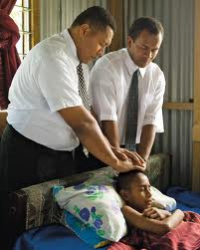
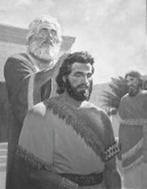
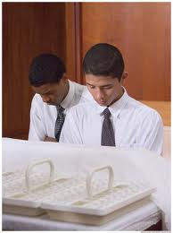
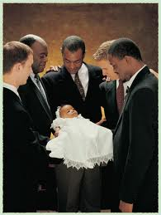
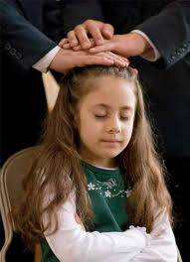
“The Priesthood, which is always associated with God’s work…

Slide 17
The Message Delivered to Antioch
“being prophets also themselves,”
Judas, surname Barsabas
Silas
Antioch
Silas was probably the “Silvanus” mentioned by Paul in several of his letters. (2 Corinthians 1:19; 1 Thessalonians 1:1; 2 Thessalonians 1:1)
Silas was apparently the scribe for the book of 1 Peter
(1 Peter 5:12).
D&C 84:35-40
(1)

Slide 18
Companions
Silas and Paul
Barnabas and Mark, surname John
Cilicia
Syria
Antioch
Cyprus
D&C 84:36-41
(1)

Slide 19
Sources:
Suggested Hymn: #262 Thy Servants Are Prepared
Videos:
The Jerusalem Conference (3:32)
We Need Living Prophets (2:45)
The Doctrine of Christ (2:39)—
New Testament Institute Student Manual Chapter 32
Stephen L. Richards (in Conference Report, Oct. 1953, p. 86)
Elder M. Russell Ballard (“Strength in Counsel,” Ensign, Nov. 1993, 76–77).
Richard Lloyd Anderson, "The First Presidency of the Early Church: Their Lives and Epistles," Ensign, Aug. 1988, 16
President Boyd K. Packer “What Every Elder Should Know…and Every Sister as Well”: A Primer on Principles of Priesthood Government” Feb. 1993 Ensign
Presentation by ©http://fashionsbylynda.com/blog/

Slide 20
Principles used by Effective Councils in Acts 15
Verse 7 | Members of the council were free to voice their opinions. (“There had been much disputing.”)
Verses 7–11 | The presiding authority explained his thoughts and referred to previous revelation. (Peter, the chief Apostle, presided over the council and, by referring to revelation he had already received, clarified that Gentiles need not be circumcised.)
Verses 13–21 | Council members expressed their opinions. (James expressed his support of Peter’s counsel not to require circumcision of Gentile converts and offered his opinions about related problems.)
Verses 22, 28 | The council came to a united decision, which was confirmed by the Holy Ghost. (The council’s decisions “seemed good to the Holy Ghost, and to us.”)
Verses 22–30 | The decision was communicated to those involved. (The decree was sent to the Gentiles in Antioch, Syria, and Cilicia.)
Verses 13–21 | Council members expressed their opinions. (James expressed his support of Peter’s counsel not to require circumcision of Gentile converts and offered his opinions about related problems.)
“The action of the Jerusalem council involved a significant policy decision. … Peter’s unmistakable experience with Cornelius makes it clear that the Brethren understood that the law of Moses was fulfilled in Christ, but evidently many members of the church did not understand. It was a matter of doctrine, tradition, culture, and emotion. Even though the Brethren had settled the matter doctrinally a decade before, considerable time passed before the matter was settled culturally and emotionally in the minds of some Jewish Christians. Furthermore, at least ten years after the council, many Jewish Christians in Jerusalem were still following the law of Moses. (Acts 21:17–25.)
“The decision of the Jerusalem council was not definitive and did not forthrightly say that the law of Moses should be discontinued. Although it declared that Gentiles did not need circumcision for salvation, it did not say that Jewish members of the church need not circumcise their sons.”
(“Unto All Nations,” in Studies in Scripture, Volume Six: Acts to Revelation, ed. Robert L. Millet [1987], 39).
New Testament Institute Manual Chapter 32

Slide 21
Circumcision Acts 15:1, 5, 24:
The law of Moses directed that every male child was to be circumcised when he was eight days old (see Leviticus 12:3) “that thou mayest know forever that children are not accountable before me [the Lord] until they are eight years old” (Joseph Smith Translation, Genesis 17:11 [in the Bible appendix]). In New Testament times it was common to refer to Jews as being of the circumcision and to Gentiles as being of the uncircumcision (see Acts 10:45; Romans 3:30; Galatians 2:7–9; Ephesians 2:11).(1)
"This problem would always plague Paul and be a topic in many letters...The problem was not salvation by faith alone; it was not a question of freedom from gospel requirements and ordinances. Instead, it was a question of whether Gentile converts to Christianity had also to obey the law of Moses.
As we have seen, the Gentile 'disciples' had already been baptized and taught strictly to 'continue in the faith' as a condition of salvation (Acts 14:22). But this did not satisfy Jewish Christians strictly observing the Law of Moses. Circumcision symbolized this issue, but Judaizers were talking about hundreds of obligations beyond circumcision. The orthodox Jews count 613 commandments in the five books of Moses, and the Rabbinical rules of the Mishnah multiply the commandments to thousands. So it is a gross simplification to see Paul advocating a gospel without rules.
Instead, he opposed a tradition of too many rules." (Richard Lloyd Anderson, Understanding Paul [Salt Lake City: Deseret Book Co., 1983], 51)
The importance of this council, often referred to as the Jerusalem Council, cannot be overstated. A living church is capable of inspired change; a dead church is only capable of decay. "Similar problems today in most churches have no solution-only an uncomfortable truce between conservatives and liberals or a split into two churches. The solution of the Early Church was to take the question to the inspired general authorities for an answer." (Richard Lloyd Anderson, Understanding Paul, 52)
This assembly of major figures in the Early Church is a rare and important event. We get a rare glimpse into the doctrinal considerations and policy making procedures of the early Apostles. Furthermore, this account of the Jerusalem Council demonstrates many different elements of appropriate church councils. They will be emphasized throughout the rest of the chapter as they are important principles for us to learn and apply today. Gosepldoctrine.com
"...there is a great need in the Church for leaders, particularly stake presidents, bishops, and parents, to understand and harvest the spiritual power of the council system. There is no problem in the family, ward, or stake that cannot be solved if we look for solutions in the Lord's way by counseling-really counseling-with one another...God, the Master Organizer, has inspired the creation of a system of committees and councils. If understood and carefully implemented and utilized, that system will lessen the burden on any one individual leader and extend the reach and impact of his or her ministry by bringing together the judgment, talents, and wisdom of many leaders who are entitled to the guidance and inspiration of the Holy Spirit." M. Russell Ballard (Counseling with Our Councils: Learning to Minister Together in the Church and in the Family [Salt Lake City: Deseret Book Co., 1997], 8-9.)
James Acts 15:13:
Likely, he took the martyred James' place as one of the three leading apostles. (The "First Presidency" of the Early Church acted within the quorum of the twelve apostles and was not separate from it as it is today.) Nevertheless, Peter's preeminent role as the leader of the church is not overshadowed by James. Notably, Peter's comments put an end to the disputations and were so powerful that the council was silent thereafter (v. 6-12). It is apparent that James final decision closely reflected the ideas that Peter put forth. From a latter-day standpoint, we would say that Peter presided over the Jerusalem Council and James conducted the meeting.
"Uninspired commentators and others who are unaware of the true system of apostolic succession falsely assume that James was making a decision in the case and therefore was head of the Church in Jerusalem, having some pre-eminence over Peter. Some Protestants have argued that Peter could not have fathered a church in Rome because James and not Peter is in fact here shown to be the chief officer of the Christian kingdom. Interesting as this may be, the fact is Peter was the presiding officer in the Church and had in fact rendered and announced judgment on the issue of circumcision. (Verses 7-11.) James is simply proposing the detailed instructions to put in force the decision already announced by Peter." Elder Bruce R. McConkie (Doctrinal New Testament Commentary, 2:143)
Unity: "My brethren and sisters, above all things, therefore, we should seek for this spirit of union and love. It should be sought for in our councils, and we should not contend. Now, suppose that I should take it into my head to say that a certain doctrine is true, and I contend for it, determined to have it so; does my contention make it true? Suppose that I should contend from now until the Savior came that it is true, would my contention make it true? Certainly not. I cannot change a principle of truth. Then why contend or dispute, or argue about it?...There can be no change wrought in doctrine and in truth by our contention. But I will tell you where there is room for differences of opinion--in regard to the policy to be pursued. There ought to be no contention, however. God speaks against it. We have no right to be a disputing, contentious people. And whenever I dispute with my brother I am likely to grieve the Spirit of the Lord and darken my own mind. Therefore, let us avoid contention, in our councils and in all our intercourse one with another." (Collected Discourses 1886-1898, ed. by Brian Stuy, vol. 4, George Q. Cannon, Apr. 7, 1895)

Slide 22
Holding Councils Acts 15:22-27:
“These same patterns are followed today in the restored Church of Jesus Christ. The President of the Church may announce or interpret doctrines based on revelation to him (see, for example, D&C 138). Doctrinal exposition may also come through the combined council of the First Presidency and Quorum of the Twelve Apostles (see, for example, Official Declaration 2). Council deliberations will often include a weighing of canonized scriptures, the teachings of Church leaders, and past practice. But in the end, just as in the New Testament Church, the objective is not simply consensus among council members but revelation from God. It is a process involving both reason and faith for obtaining the mind and will of the Lord” Elder D. Todd Christofferson (“The Doctrine of Christ,” Ensign or Liahona, May 2012, 88).
Paul and Barnabas were chosen to travel to Antioch and report on the Jerusalem council’s decision. Acts 15:32-39:
They took with them two Church leaders, Judas and Silas, “being prophets also themselves,” who helped preach and strengthen Church members in Antioch (Acts 15:32). After some time, Paul suggested to Barnabas that they return to the cities they had preached in during their first missionary journey in order to visit their converts “and see how they do” (Acts 15:36).
However, a disagreement between Paul and Barnabas began when Barnabas suggested that John Mark join them. John Mark, Barnabas’s cousin (or nephew), had accompanied Paul and Barnabas on their first mission but had departed from them early on (see Acts 13:13). Though little is known about why John Mark left or what impact it had on the other missionaries, apparently Paul was still apprehensive about him. Ultimately Paul and Barnabas separated, with Paul choosing Silas as his new missionary companion and Barnabas choosing John Mark. Paul and John Mark were later reconciled, as evidenced in 2 Timothy 4:11 and in Colossians 4:10. Barnabas took John Mark and sailed to Cyprus (see Acts 15:39), and Paul and Silas journeyed to cities on the mainland.
(1)

Slide 23
L.D.S. Church Organization
The First Presidency
President of Church
1st Counselor-----2nd Counselor
The Quorum of
Twelve Apostles
First Quorum of the Seventy
Presiding Bishopric
Presiding Bishop
1st Counselor-----2nd Counselor
(General Authorities)
Full-time positions
(serve part-time still working reg. job)
Area Authorities
Seventies
Stake Presidency
Stake President
1st Counselor----2nd Counselor
High Council
Stake Patriarch
High Priest’s Quorum
Ward Bishopric
Bishop
1st Counselor----2nd Counselor
Priest’s Quorum
Elder’s Quorum
Teacher’s Quorum
Deacon’s Quorum

Slide 24
