Slide 1
Lesson 94
Ready to Receive
Acts 17
Black Sea
Thessalonica
Berea
And those who receive it in faith, and work righteousness, shall receive a crown of eternal life;
D&C 20:14
Athens
Cyprus
Mediterranean Sea
Israel
Jerusalem

Slide 2
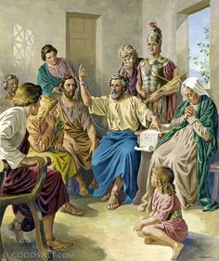
“Opening and Alleging”
To show or declare
Paul used scriptural passages to declare or show that Jesus is the Christ.
He alleged that Christ had died and risen from the dead
Acts 17:1-3

Slide 3
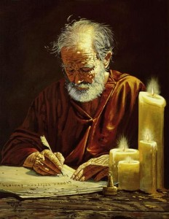
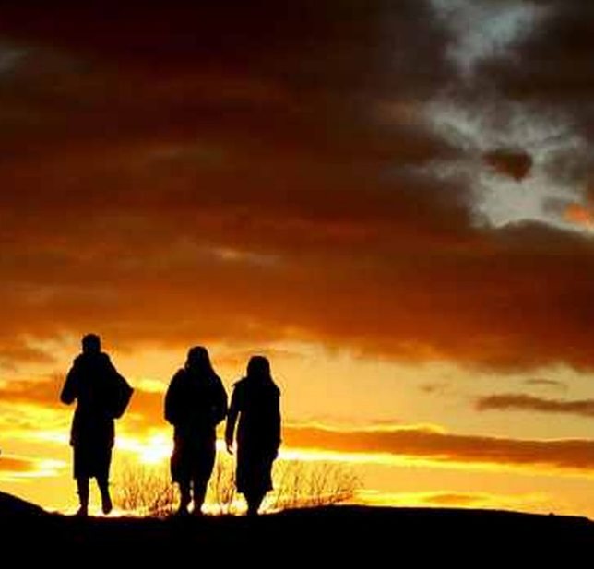
Consorted and Lewd
Consorted = Gathered with or joined
Lewd = evil
Paul and Silas left Thessalonica at night because they were being persecuted by the Jews.
A mob of unbelievers tried to find Paul and Silas. When they could not find them, the mob went to the rulers of Thessalonica and claimed that Paul’s teachings threatened Caesar’s authority.
Later Paul wrote letters which are in 1 and 2 Thessalonians
Acts 17:5-13

Slide 4
Are You Ready to Receive?
The people in Berea received Paul’s words with all readiness of mind—They had searched the Scriptures
If we receive the words of God’s servants with all readiness of mind and search the scriptures daily, then our belief in their words will be strengthened
Acts 17:5-13

Slide 5
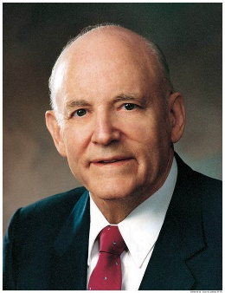
Study Time
“It is certain that one who studies the scriptures every day accomplishes far more than one who devotes considerable time one day and then lets days go by before continuing.
Not only should we study each day, but there should be a regular time set aside when we can concentrate without interference. …
It would be ideal if an hour could be spent each day; but if that much cannot be had, a half hour on a regular basis would result in substantial accomplishment.
A quarter of an hour is little time, but it is surprising how much enlightenment and knowledge can be acquired in a subject so meaningful.” (2)
Acts 17:5-13
(2)

Slide 6
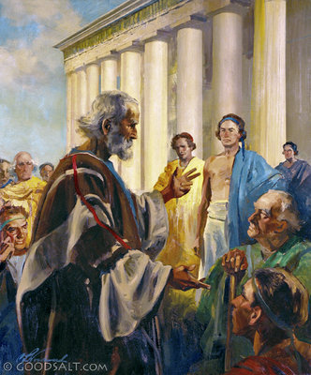
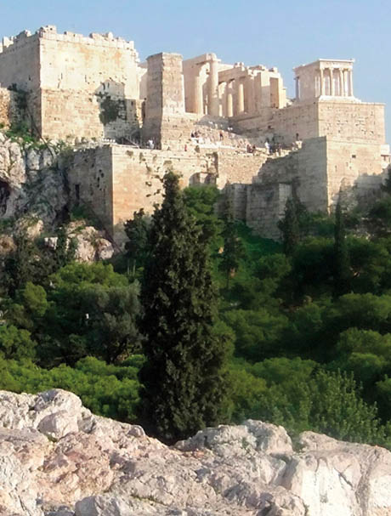
Paul Flees to Athens
The temples in Athens were used for worshipping false gods.
Inside the temples were man-made statues of gods.
Outside were altars on which sacrifices to false gods were offered.
By New Testament times, Athens had lost much of its former greatness and glory, but still contained statues and monuments to many gods and goddesses, including the “Unknown God”
Acts 17:16

Slide 7
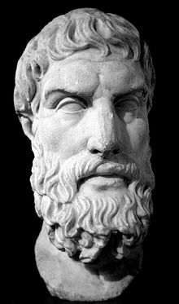
Epicureans
Epicureanism was named for Epicurus (341–270 B.C.).
According to his philosophy, the world came into existence by chance and was without purpose or design.
Epicureans believed that the gods, if they did exist, did not involve themselves in the lives of humans and that happiness was to be found in the absence of cares and pain and the enjoyment of pleasures in moderation.
Acts 17:18

Slide 8
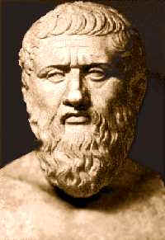
Stoicks--Stoics
“Stoicism began with the teachings of a man named Zeno (333–264 B.C.). Stoicism held that all things were created, ordered, and set in motion by divine reason.
Stoics believed that man was endowed with a spark of reason and should seek harmony with the divine order of things, overcome passions, and live a moral and upright life.”
Acts 17:18

Slide 9
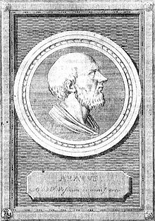
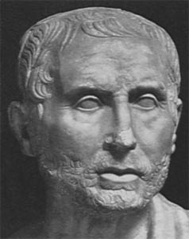
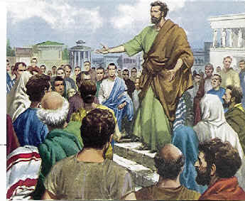
Mars Hill
In his famous address on Mars Hill, Paul quoted from the “Phaenomena,” a work by Aratus, a Cilician poet:
“As certain also of your own poets have said, For we are also his [i.e., God’s] offspring.” Almost these identical words occur in the “Hymn to Zeus” written by Cleanthes.
Both men were Stoics. In citing such poets, Paul was probably not attempting to impress his audience with his intellect and training; no doubt he was trying to place himself on a common footing with his listeners in order to gain their confidence and thus win a listening ear for his message.
Acts 17:28
(3)

Slide 10
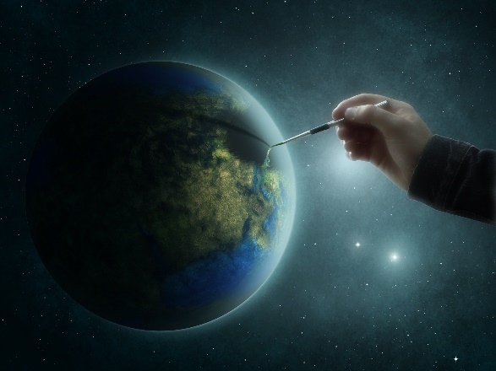
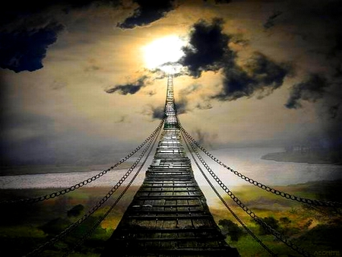
Paul’s Sermon
If we are willing to seek God, we will find that He is not far from us
God Created the World
God gives life to all things
God governs all life
We are God’s offspring
We were created in God’s image
God commands everyone to repent
God will judge us; God will raise all people from the dead
Acts 17:24-31

Slide 11
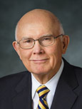
Who Are You?
“Be careful how you characterize yourself. Don’t characterize or define yourself by some temporary quality.
The only single quality that should characterize us is that we are a son or daughter of God.
That fact transcends all other characteristics, including race, occupation, physical characteristics, honors, or even religious affiliation.”
(4)

Slide 12
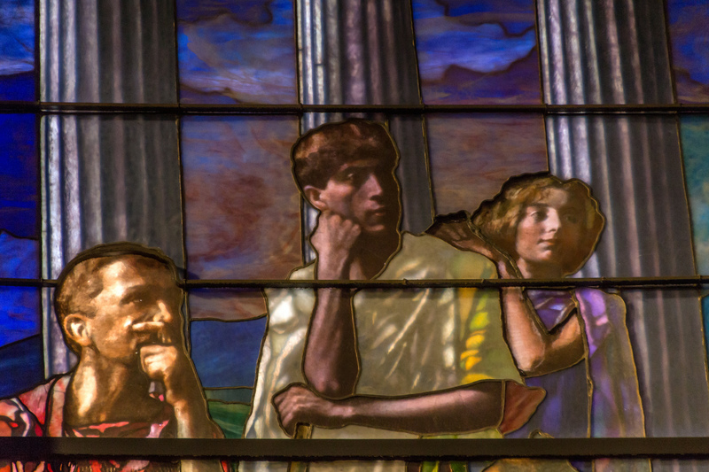
Greeks Mock Paul
After Paul finished his address on Mars Hill, some Greeks mocked his teaching about the resurrection of the dead.
During the first century A.D., popular Greek philosophy held that the physical body was part of what made the soul of man impure. According to Platonic dualism, the soul of man was imprisoned in a body of flesh.
John La Farge
The teaching that Jesus Christ had a resurrected physical body would have seemed foolish to many Greeks because they believed God to be pure and perfect
Acts 17:32; 1 Corinthians 1:23
(1)

Slide 13
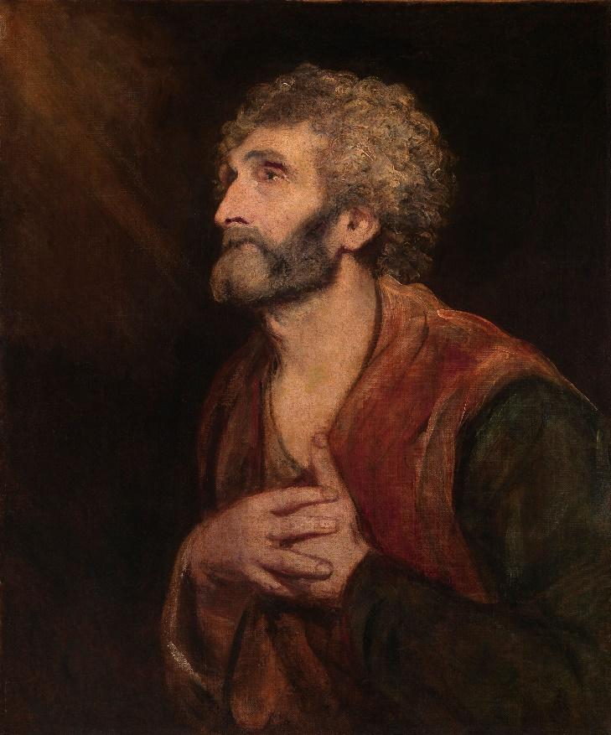
Dionysius
Dionysius was one of those who believed Paul’s teaching.
He was called “the Areopagite,” probably meaning that he was a member of the Areopagus, the judicial council that met at Mars Hill.
According to tradition, he became a bishop in the Church in Athens.
In later years a church named after Dionysius was built on the north slope of the hill, remains of which can be seen today.
Sir Joshua Reynolds
Acts 17:34
(1)

Slide 14
Sources:
Suggested Hymn: #292 Oh, My Father
Video:
We are the Offspring of God (4:25)
Prophets and Revelation—Hearing His Voice (3:56)
I Am a Child of God (2:01)
New Testament Institute Student Manual Chapter 33
President Howard W. Hunter (“Reading the Scriptures,” Ensign, Nov. 1979, 64).
New Testament Student Manual [Church Educational System manual, 2014], 315–16; see also Bible Dictionary, “Epicureans,” “Stoics”).
Elder Dallin H. Oaks (“How to Define Yourself,” New Era, June 2013, 48).
For Extra Reading:
Paul and the Athenian Intellectuals By Richard Lloyd Anderson Feb. 1972 Ensign
Presentation by ©http://fashionsbylynda.com/blog/

Slide 15
Cities of Paul’s 2nd Mission
Cities | Description | Scriptures | More About…
Thessalonica | The second-largest city in Greece and the capital of Greek Macedonia. It was a major transportation hub for the rest of southeastern Europe. The city was founded in 315 BC by Cassander of Macedon. The name of the city came from a princess, Thessalonike, a half sister of Alexander the Great, and princess of Macedon as daughter of Philip II. | Acts 17: 1,11,13 Acts 27:2 2 Timothy 4:10 Philippian 4:16 | Paul, Silas, and Timothy fled for their lives and went to Berea. There are two books of the Thessalonians in the New Testament. They were originally letters that Paul wrote to the Thessalonians while he was in Corinth during his first visit to Europe around A.D. 50. His work in Thessalonica is described in Acts 17. Paul wanted to return to Thessalonica.
Berea | It was a city of the Hellenic and Roman era now known as Veria (or Veroia) in Macedonia, northern Greece. The city was also the first city of the Macedonian region to fall to the Roman Empire, following the Battle of Pydna in 168 B.C. | Acts 17: 10,13 Acts 20:4 | Paul, Silas and Timothy travelled to Berea by night after fleeing from Thessalonica. went to the synagogue of the Jews to preach, and the Bereans were very accepting. They administered there around 54-55 AD Thessalonians stirred up trouble for the disciples and Paul fled to Athens. They administered there around 54-55 AD. Onesimus, formerly Philemon's slave, was its first bishop according to the Apostolic Constitutions (see Colossians 4:9 and Philemon 1:10)
Athens | It is one of the oldest named cities in the world, having been continuously inhabited for at least 5000 years. The name of Athens, connected to the name of its patron goddess Athena | Acts 17:15,16,22 Acts 18:1 1 Thessalonians 3:1 | Athena (Greek Mythology) created the olive tree, symbolizing peace and prosperity Damaris is a woman mentioned in the New Testament, living around 55 AD in Athens, Greece. According to the Acts of the Apostles she embraced the Christian faith following the speech of Paul of Tarsus. It was a center of literature, philosophy (Greek philosophy), and the arts (Greek theatre). In Athens at this time, the political satire of the Comic poets at the theaters had a remarkable influence on public opinion
Wikipedia and Bible Dictionary

Slide 16
THE ACTS OF THE APOSTLES—EVENTS OCCURRED CA. A.D. 45–51 (13:6–18:23) PAUL’S FIRST AND SECOND MISSIONARY JOURNEYS
Thessalonica, Macedonia Paul and Silas Flee Persecution | 17:1–14
Athens, Greece Paul Preaches the Unknown God | 17:15–34
Offspring of God Acts 17:29:
“The Apostle Paul told the Athenians on Mars’ Hill that ‘we are the offspring of God’ [Acts 17:29]. Since we know that our physical bodies are the offspring of our mortal parents, we must probe for the meaning of Paul’s statement. The Lord has declared that ‘the spirit and the body are the soul of man’ [D&C 88:15]. Thus it is the spirit which is the offspring of God. The writer of Hebrews refers to Him as ‘the Father of spirits’ [Hebrews 12:9]” President Thomas S. Monson (“The Race of Life,” Ensign or Liahona, May 2012, 91).
What Was the Significance of Paul’s Visit to Athens?
The city of Athens, capital of Greece, was one of the wonders of the ancient world. Although in a state of general decline by the time of Paul’s visit, Athens had formerly been the proud possessor of more intellectual genius, more philosophical inquiry, and more architectural splendor than any other city of ancient times. Its inhabitants, even during the period of decline, prided themselves on their brilliant heritage. Vigorous attempts were made to preserve and restore Athens to its former grandeur.
By the time of the first century A.D., Athens was literally a free city-state, privileged to enjoy the protection of Rome. Many of its most noted buildings were still standing. Famed among them was the Agora, or Marketplace. The chief men of the city gathered there each day to hear debates, to conduct the city’s business, to learn, if possible, something new (Acts 17:21). Since Paul’s message was new, he was assured of a crowd from the very first. At length, Paul was conducted to the famed Areopagus [i.e., Mars Hill], with his escorts saying, “May we know what this new doctrine, whereof thou speakest, is?” (Acts 17:19.) Although Paul’s message was largely rejected, at least one member of the High Court, Dionysius the Areopagite, and Damaris, a local woman, with others unidentified, believed (Acts 17:34). (Life and Teachings of Jesus and His Apostles Chapter 32)
Life and Teachings of Jesus and His Apostles Chapter 32
Jason of Tarsus Acts 17:5 was a Jewish convert and early Christian believer mentioned in the New Testament in Acts 17:5-9 and Romans 16:21. In Acts 17 his house in Thessalonica was used as a refuge by the apostles Paul, Silas, and Timothy. Non-believing Jews in Thessalonica stirred up a riot and Jason was arrested when the city authorities could locate neither Paul nor Silas, and was made to post bail.
Paul referred to Jason, Lucius and Sosipater as his 'countrymen' (Greek: οι συγγενεις μου) in Romans 16:21, and Jason is therefore referred to as 'Jason of Tarsus'. Both references to Jason point 'very probably' to the same person. Jason is venerated as a saint in Catholic and Orthodox traditions. … wikipedia
…with the help of some ruffians in the market-places they formed a mob and set the city in an uproar. While they were searching for Paul and Silas to bring them out to the assembly, they attacked Jason’s house.
Ready to Receive:
President Dieter F. Uchtdorf of the First Presidency taught:
“The more we incline our hearts and minds toward God, the more heavenly light distills upon our souls. And each time we willingly and earnestly seek that light, we indicate to God our readiness to receive more light. Gradually, things that before seemed hazy, dark, and remote become clear, bright, and familiar to us” (“Receiving a Testimony of Light and Truth,” Ensign or Liahona, Nov. 2014, 22).
Who are You?
“… may I ask each of you again the question, ‘Who are you?’ You are all the sons and daughters of God. Your spirits were created and lived as organized intelligences before the world was. You have been blessed to have a physical body because of your obedience to certain commandments in that premortal state. You are now born into a family to which you have come, into the nations through which you have come, as a reward for the kind of lives you lived before you came here and at a time in the world’s history, as the Apostle Paul taught the men of Athens and as the Lord revealed to Moses, determined by the faithfulness of each of those who lived before this world was created.” President Harold B. Lee (CR, Oct. 1973, p. 7.)

Slide 17
Something of Interest
The Phaenomena appears to be based on two prose works—Phaenomena and Enoptron (Ἔνοπτρον "Mirror", presumably a descriptive image of the heavens)—by Eudoxus of Cnidus, written about a century earlier. We are told by the biographers of Aratus that it was the desire of Antigonus to have them turned into verse, which gave rise to the Phaenomena of Aratus; and it appears from the fragments of them preserved by Hipparchus, that Aratus has in fact versified, or closely imitated parts of them both, but especially of the first.
The purpose of the Phaenomena is to give an introduction to the constellations, with the rules for their risings and settings; and of the circles of the sphere, amongst which the Milky Way is reckoned. The positions of the constellations, north of the ecliptic, are described by reference to the principal groups surrounding the north pole (Ursa Major, Ursa Minor, Draco, and Cepheus), whilst Orion serves as a point of departure for those to the south. The immobility of the earth, and the revolution of the sky about a fixed axis are maintained; the path of the sun in the zodiac is described; but the planets are introduced merely as bodies having a motion of their own, without any attempt to define their periods; nor is anything said about the moon's orbit. The opening of the poem asserts the dependence of all things upon Zeus. From the lack of precision in the descriptions, it would seem that Aratus was neither a mathematician nor observer or, at any rate, that in this work he did not aim at scientific accuracy. He not only represents the configurations of particular groups incorrectly, but describes some phenomena which are inconsistent with any one supposed latitude of the spectator, and others which could not coexist at any one epoch. These errors are partly to be attributed to Eudoxus himself, and partly to the way in which Aratus has used the materials supplied by him. Hipparchus (about a century later), who was a scientific astronomer and observer, has left a commentary upon the Phaenomena of Eudoxus and Aratus, accompanied by the discrepancies which he had noticed between his own observations and their descriptions.
Wikipedia

