Slide 2
Third Mission
Macedonia
Black Sea
Rome
Italy
Adriatic Sea
During Paul’s third missionary journey, he spent time in Macedonia,
Greece,
and Asia Minor.
Greece
Asia Minor
Troas
Ephesus
Cilicia
Sicily
Antioch
Syria
Crete
Cyprus
Mediterranean Sea
Jerusalem
He felt impressed to return to Jerusalem– For Pentecost
Acts 20:1-6

Slide 3
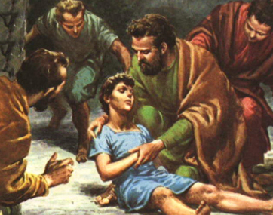
Young Man in the Window
The night before his departure from Troas, on the new Sabbath (Sunday), Paul and the disciples came together to partake of the sacrament.
Paul then spoke with the Saints long into the night.
A young man named Eutychus after he fell asleep during Paul’s sermon.
The young man fell down from the third loft and was taken up dead.
And Paul went down, and fell on him, and embracing him said, Trouble not yourselves; for his life is in him.
Acts 20:7-12

Slide 4
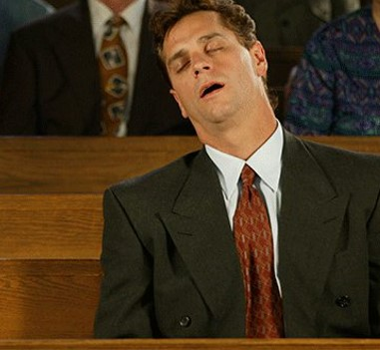
Have you ever felt to complain because church meetings last for three hours?
Have you ever been frustrated with a speaker whose talk inconsiderately rambled on for 20 or 30 minutes longer than scheduled?
Have your eyelids ever been heavy during an early morning meeting?
If you have experienced any of these feelings, then you can relate-in the smallest degree-to the situation of poor Eutychus.
The young man, like many of our Aaronic Priesthood brethren, lost interest in Paul's talk. If Paul's talks were anything like his epistles, then the content was likely too complex for the younger crowd. Besides, Paul could talk for a long time… (2)
…and as Paul was long preaching
Acts 20:7-12

Slide 5
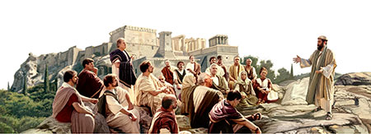
Paul’s Farewell to Elders in Ephesus
He knew he put his life in danger by returning to Jerusalem
He bore his testimony of the Holy Spirit
And now, behold, I go bound in the spirit unto Jerusalem, not knowing the things that shall befall me there:
Knowing of the Apostasy that would soon begin among the Ephesian Saints, Paul admonished Church leaders to “feed the church of God”
True servants of the Lord faithfully perform their duty, and in doing so they feel joy
Acts 20:13-27

Slide 6
“Most people don’t come to church looking merely for a few new gospel facts or to see old friends, though all of that is important.
They come seeking a spiritual experience.
They want peace.
They want their faith fortified and their hope renewed.
They want, in short, to be nourished by the good word of God, to be strengthened by the powers of heaven.
Those of us who are called upon to speak or teach or lead have an obligation to help provide that, as best we possibly can.”
(3)

Slide 7
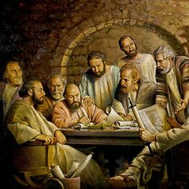
Paul’s Warning
Grievous Wolves and Perverse Things
Apostasy—both inside (our own selves) and outside the Church
Apostasia = Greek for “Falling Away”
Or “rebellion, revolution” (2 Thessalonians 2:3)
Church members themselves contributed to the Great Apostasy by rebelling against Church leaders and doctrine
Priestcraft was an important element of this internal rebellion.
Acts 20:28-31
(1)

Slide 8
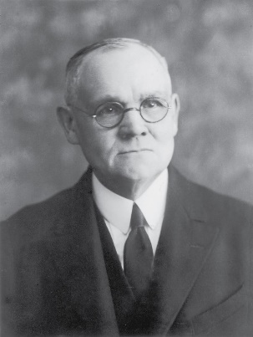
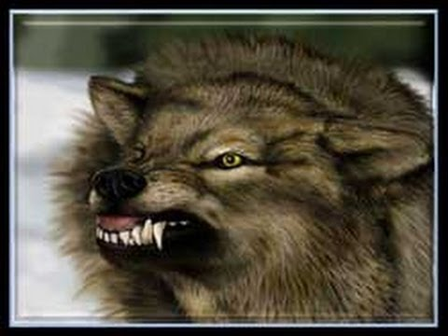
“Not only would outsiders ingratiate themselves with the saints for purposes of selfish gain—wolves entering in, and not sparing the flock,—but schisms and divisions were imminent;…
…and these dissensions were to come through some then present—men who would aspire to leadership, and who would set up their own doctrines, thus drawing disciples away from the Church and unto themselves.”
Acts 20:28-31
(4)

Slide 9
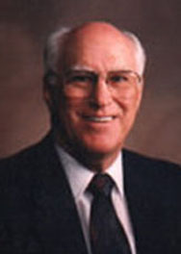
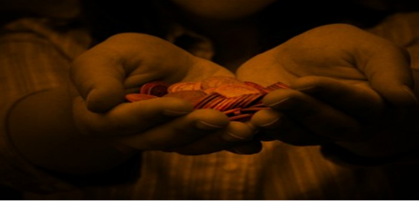
Silver or Gold or Apparel
Yea, ye yourselves know, that these hands have ministered unto my necessities, and to them that were with me.'
"One of the plainest examples of Paul's integrity was his insistence on working with his own hands for his financial support.
He explained that as an 'apostle' he could have required support from the Saints, but that he preferred not to be burdensome (1 Thes. 2:5-9).
To the Corinthians he wrote: 'What is my reward then? Verily that, when I preach the gospel, I may make the gospel of Christ without charge, that I abuse not my power in the gospel.' (1 Cor. 9:18.)
And again: 'Even unto this present hour we both hunger, and thirst, and are naked, and are buffeted, and have no certain dwelling place; and labour, working with our own hands' (1 Cor. 4:11-12)."
One of Paul’s prime concerns on the third journey was to collect funds for the poor in Jerusalem.
Acts 20:33-34
(5)

Slide 10
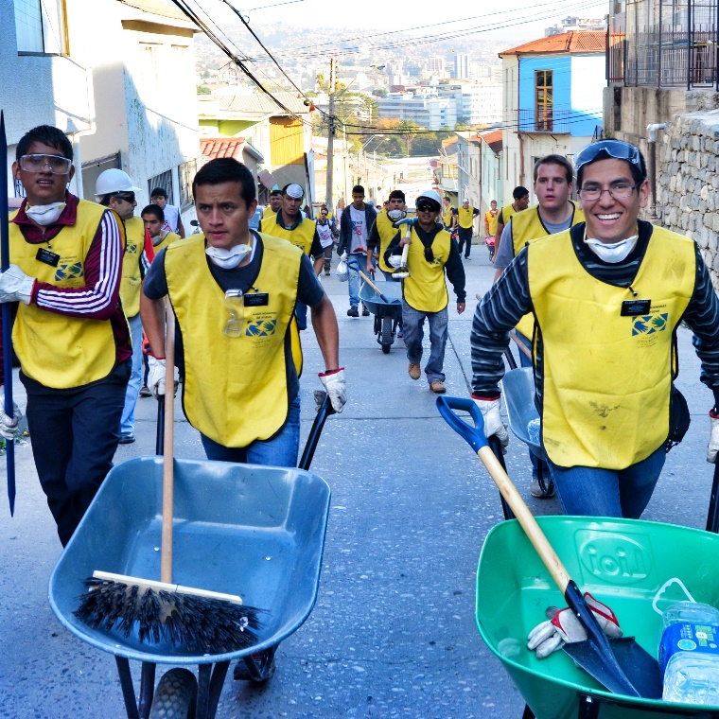
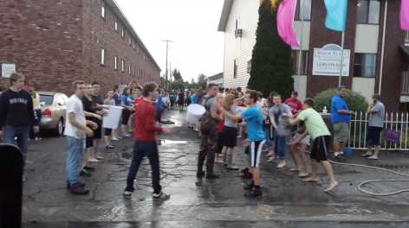
More Blessed To Give Than Receive
Saints throughout the world provide service to others, they follow the Savior’s admonition.
Saints in Russia
Fire in Chile
Teton Dam Flood
Acts 20:35
(1)

Slide 11
Tyre and Caesarea
Paul was determined to go in person to deliver the donations he had gathered for the poor Jerusalem Saints.
Sidon
When Paul stopped in a city called Tyre, some disciples—evidently concerned for Paul’s safety—advised Paul not to go to Jerusalem
Tyre
In Caesarea, a prophet named Agabus prophesied concerning what would happen to Paul in Jerusalem.
Region of Decapolis
Caesarea
…So shall the Jews at Jerusalem bind the man that owneth this girdle, and shall deliver him into the hands of the Gentiles.
Jerusalem
Girdle and Binding = symbolic act
Acts 21:1-11
(1)

Slide 12
Phillip and 4 Women
And now, he imparteth his word by angels unto men, yea, not only men but women also.
Alma 32:23
“Though men are appointed to hold rule in the home and in the Church, women are not one whit behind them in spiritual endowments. They prophesy, receive visions, entertain angels, enjoy the gifts of the Spirit, and qualify with their husbands for full exaltation in the highest heaven.” (7)
Acts 21:9
(1)

Slide 13
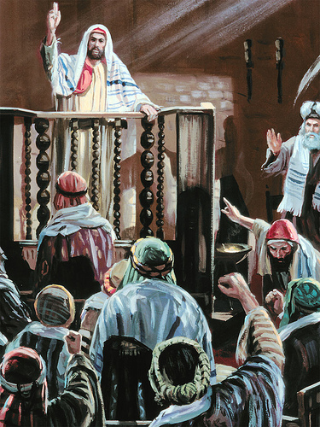
Misunderstood Paul’s Teachings
Paul arrived in Jerusalem and gave a report of his missionary labors to local Church leaders. Paul went to the temple, and when a group of Jews who knew Paul from his missionary journeys saw him, they proclaimed that Paul was a false teacher who taught against the law of Moses and unlawfully brought Gentiles into the temple.
Because of this accusation, a mob removed Paul from the temple and began beating him. Roman soldiers intervened and carried him away to be tried. While on the stairs of the Antonia Fortress
Acts 21:17-21

Slide 14
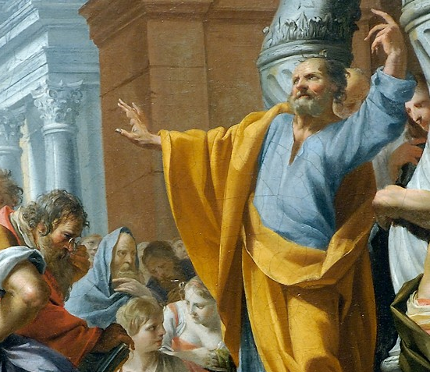
Purifications Rights
To help dispel ill feelings toward Paul, Church leaders encouraged Paul to participate in the weeklong temple purification rites that observant Jews customarily underwent after traveling in Gentile lands.
Paul’s public observance of these temple rites would demonstrate that he did not teach against the law of Moses or the temple, as was rumored. (1)
The Temple rituals would occupy seven days of purification and sacrifice. Paul would pay for the four lambs and eight pigeons used for sacrifice and would attend the four men in their Temple appearances and rituals. … In so doing the Apostle would be obliged to cross the Court of the Gentiles and the Court of the Women, enter the Court of Israel, and finally approach the altar on which burnt offerings were made. He was bound to be in full view of either friend or foe in these Temple areas.” (6)
Acts 21:17-21

Slide 15
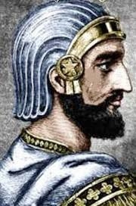
The Roman Captain
Claudius Lysias, and several soldiers broke up the mob that was assaulting Paul and took Paul into custody
Realizing that Paul was not a rebel, the Roman captain allowed Paul to address the crowd who had assailed him. The crowd at the temple listened to Paul tell his conversion story until he mentioned being sent to the Gentiles.
At that point, they reacted with animosity, casting off their outer cloaks and throwing dust into the air—acts by which Jews commonly expressed abhorrence and indignation.
Acts 21:26, 39-22:23
(1)

Slide 16
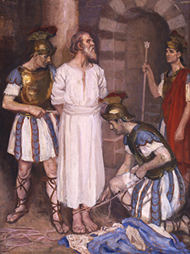
Paul--A Roman Citizen
The Roman chief captain could not understand Paul’s speech, which was delivered in Aramaic, nor could he discover why the crowd was angry at Paul.
Therefore the captain ordered that Paul be scourged, or whipped, and questioned. A scourge, which was a whip or lash made of long strips of leather that were studded with bits of metal or bone and fastened in a wooden handle, was a weapon of torture that could maim and even kill.
Simon H. Vedder
In response to the order, Paul protested that he was a Roman citizen and was therefore protected from examination by torture. Roman citizenship carried with it important privileges and was not easily obtained, as made clear by the conversation recorded in Acts 22:24–30.
Acts 21:24-26
(1)

Slide 17
Conversion Story of Paul
How does Paul describe his initial vision? | Acts 22:6-9
What was Paul instructed to do? | Acts 22:10-11
Whom did Paul meet in Damascus, and what did Paul regain? | Acts 22:12-13
What did Ananias prophesy about Paul? | Acts 22:14-15
How did Paul show his faith in Jesus Christ? | Acts 9:18; Acts 22:16
Acts 22:1-30

Slide 18
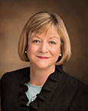
“True conversion is more than merely having a knowledge of gospel principles and implies even more than just having a testimony of those principles. It is possible to have a testimony of the gospel without living it. Being truly converted means we are acting upon what we believe. …
“… Conversion comes as we act upon the righteous principles we learn in our homes and in the classroom. Conversion comes as we live pure and virtuous lives and enjoy the companionship of the Holy Ghost.”
(8)

Slide 19
Sources:
Suggested Hymn: #263 Go Forth With Faith
Videos:
Lift (9:30)
To Be Converted (0:43)
New Testament Institute Student Manual Chapter 33, 34
Gospeldoctrine.com
Elder Jeffrey R. Holland (“A Teacher Come from God,” Ensign, May 1998, 26; see also commentary for John 21:15–17).
James E. Talmage (The Great Apostasy [1968], 28).
Robert J. Matthews, Behold the Messiah, 335
Sidney B. Sperry(Paul’s Life and Letters [1955], 208–9).
McConkie, DNTC,2:181.
Bonnie L. Oscarson (“Be Ye Converted,” Ensign or Liahona,Nov. 2013, 76, 78).
Presentation by ©http://fashionsbylynda.com/blog/

Slide 20
PAUL’S Third MISSIONARY JOURNEY
Troas Paul Raises Eutychus from Death | 20:1–12
Miletus Farewell, Testimony, Counsel | 20:13–38
Toward Jerusalem Agabus’ Prophetic Warnings | 21:1–17
Jerusalem The Gradual Process of Conversion | 21:18–26
Paul Persecuted, Arrested, Bound | 21:27–39
The Story of Paul’s Conversion | 21:40; 22:1–16
Jerusalem The Gradual Process of Conversion | 21:18–26
Paul Persecuted, Arrested, Bound | 21:27–39
Life and Teachings of Jesus and His Apostles Chapter 34, 42

Slide 21
Sacrament Acts 20:7:
Paul participated in the ordinance of the sacrament with other Christians. In celebration of the Resurrection of Jesus Christ, Christians partook of the sacrament on the first day of the week (see verse 7; see also John 20:1). This same pattern is followed in the Church today
Teton Dam Flood:
Utilizing the campus as a base, President Mark Ricks of the Rexburg Regional Welfare Services and other LDS leaders met to assess the situation and to organize the Saints to deal with the aftermath. The waters soon receded, but there was no power in most of Rexburg or in surrounding communities. There was no outside telephone service, no drinking water outside the campus area, and no sewage services. All had been damaged or destroyed in the flood.
Ward bishops organized their leaders and sent them into the homes to assess damages there. A list of missing homes and missing persons was made even as Church headquarters in Salt Lake City dispatched relief supplies. The Idaho National Guard, largely staffed by LDS individuals, moved into the area to help rebuild the damaged roads and to bury the thousands of cattle and other livestock killed in the disaster.
Teams went to the various homes in an effort to render aid and locate missing persons. Daily ward meetings were held to help coordinate relief efforts. Crews of young volunteers helped to staff the Manwaring Center cafeteria, which fed 4,000 persons each meal during the first days of the flood. Others worked in the nursery tending children for Saints who were feverishly working to clear their homes of debris and silt in an attempt to minimize damage.
One of the first wards to organize their cleanup efforts was at Hibbard, about six miles northwest of Rexburg. Aaronic Priesthood-age youths, including Robert Willmore, were organized into teams and were sent into the homes of the elderly to help them with the tedious task of cleaning the homes and repairing the damage caused by the water.
Brent Bell, first counselor in the Hibbard Ward Bishopric, reported that 12 homes were missing, 30 were relatively undamaged, but about 118 homes in the community “are full of mud, the furniture ruined, and the basements full of water. The roads were damaged, and people can’t even get equipment in to work on their homes. So the youth in our ward are providing the muscle power for the elderly. Eventually, though, we’ll get into every home.”
Sept 1976 New Era
Breaking Point: Teton Dam Disaster in Idaho
by Lynn Tilton
Elders Acts 20:17:
"The term 'elders' is used in many other passages of Scripture. In some instances the apostle is called an elder, as Paul and John allude to themselves personally as elders. In some places the term is used in reference to the aged, as in I Timothy 5:1, 2: 'Rebuke not an elder, but entreat him as a father, and the younger men as brethren, the elder women as mothers, the younger as sisters, with all purity.' Yet the quotations made will be ample to prove that the office of Elder was an order anciently in the organization of the Church of Christ." (Cowley's Talks on Doctrine [Chattanooga: Ben. E. Rich, 1902], 65.)
Results of Evil Men—Apostasy Acts 20:28-31:
“In time all ordinances of the gospel were changed, commandments were broken, and the simple principles of the gospel were mixed with pagan philosophy by the ‘grievous wolves’ and apostate disciples who displaced the prophets and apostles who had divine communion with the heavens. Spiritual darkness set in, and unrighteous men took command and closed the heavens against themselves. Visions and contact with the heavens ceased, and the gifts of the spirit came to an end. The blessings and presence of the Twelve Apostles ceased, and the cry went forth that they were no longer needed” President Joseph Fielding Smith (Answers to Gospel Questions, 5 vols. [1957–66], 5:177).
Fire in Chile:
An April fire in the city of Valparaiso, Chile, devastated homes and left many homeless. Not long after the fire thousands of Church members and missionaries cleaned the charred remains of homes and gathered clothes for the victims. The Newsroom Blog
Saints in Russia:
Mormons in Saint Petersburg, Russia, participate in a day of service in a public park earlier this month. Similar service was also provided recently by Latter-day Saints in Moscow, Podolsk, Yaroslavl, Tomsk and other Russian cities. Mormon Newsroom

Slide 22
Misunderstood Acts 21:17-25:
“the Church under direction of Peter and the Twelve, and acting under the guidance of the Spirit, declared that circumcision was not obligatory for gentile converts. However, it apparently did not settle the matter of whether or not Jewish members of the Church should have their children circumcised. As one reads the scriptures on the matter, it becomes evident that the real issue was not circumcision only but also the larger question as to continued observance of the law of Moses by members of the Church. …
“The Jewish part of the church membership, especially in Jerusalem, appears to have been very reluctant to cease from the rituals and ceremony of the law of Moses (Acts 21:17–25). This is a marked contrast to the Church among the Nephites, in which there seems to have been a cessation of the law immediately upon their awareness of the death and resurrection of Jesus Christ. (3 Ne. 15:1–4; Moro. 8:8)” (Bible Dictionary, “Circumcision”).
It is evident from Acts 21:21 that Jewish Christians in Jerusalem had misunderstood Paul’s teachings about the law of Moses. Even though Paul and the other Apostles had taught that circumcision was not a requirement for Gentile coverts, they had not discouraged Jewish converts from following the practice or from observing other aspects of the law of Moses. Jewish Christians continued to worship in the temple (see Acts 2:46; 3:1; 5:19–25, 42), and Paul still considered himself an observant Jew. (1)
Egyptian? Acts 21:38:
A Roman captain, later identified as Claudius Lysias (see Acts 23:26), and several soldiers broke up the mob that was assaulting Paul and took him into custody. The chief captain questioned Paul, mistakenly believing that Paul was an Egyptian rebel. About three years prior to that time, an Egyptian Jew had raised a large following in the wilderness and brought them to the Mount of Olives. He promised his followers that the walls of Jerusalem would crumble when they approached and that they would be able to drive out the Romans with ease. Felix, the Roman governor, met them with his army and defeated them, but he was unable to capture their leader, who still remained a fugitive.

Slide 23
Questions | Scriptures | Answers
How does Paul describe his initial vision? | Acts 22:6-9
What was Paul instructed to do? | Acts 22:10-11
Whom did Paul meet in Damascus, and what did Paul regain? | Acts 22:12-13
What did Ananias prophesy about Paul? | Acts 22:14-15
How did Paul show his faith in Jesus Christ? | Acts 9:18; Acts 22:16
Questions | Scriptures | Answers
How does Paul describe his initial vision? | Acts 22:6-9
What was Paul instructed to do? | Acts 22:10-11
Whom did Paul meet in Damascus, and what did Paul regain? | Acts 22:12-13
What did Ananias prophesy about Paul? | Acts 22:14-15
How did Paul show his faith in Jesus Christ? | Acts 9:18; Acts 22:16
Handout:
Question and answer about Paul’s conversion
Set of 2

