Slide 1
Lesson 97
Trial and Imprisonment of Paul
Acts 23-26

Slide 2
What are some influences of the world that might entice someone to turn away from and stop living according to the commandments and teachings of God?
As we come to closer to God we can receive blessings

Slide 3
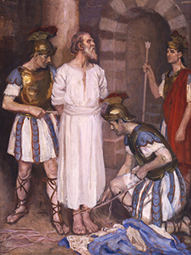
Previously…
Paul was arrested outside the temple in Jerusalem and brought before Jewish leaders
A Roman captain ordered that Paul be scourged, or whipped, and questioned. A scourge, which was a whip or lash made of long strips of leather that were studded with bits of metal or bone and fastened in a wooden handle, was a weapon of torture that could maim and even kill.
Simon H. Vedder
Paul protested that he was a Roman citizen and was therefore protected from examination by torture.
Acts 21-22
(1)

Slide 4
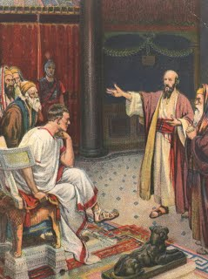
Brought Before Council
Paul’s angry response was not purposefully disrespectful to the high priest; he simply failed to recognize the high priest, perhaps because he had been away from Jerusalem for so long.
When he realized that he had reviled the high priest, Paul immediately expressed deference to the office, if not the man.
When Paul was brought before the Jewish council, the high priest ordered that Paul be struck in the face.
This violated Jewish law, which protected accused persons from being punished until found guilty.
Realizing that the council was composed of two factions—the Pharisees and the Sadducees—Paul cleverly turned the members of the council against one another by declaring that he was a Pharisee and believed in the Resurrection. The Pharisees on the council then defended Paul against the Sadducees, who did not believe in the Resurrection.
Acts 22:30-23:10
(1)

Slide 5
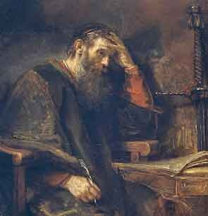
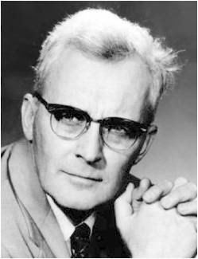
A Visit From the Lord
Be of good cheer, Paul: for as thou hast testified of me in Jerusalem, so must thou bear witness also at Rome.
Why send him to the people and the gentiles if he has to be delivered from them?
'To open their eyes, and to turn them from darkness to light, and from the power of Satan unto God'
"That was his mission: He had to go down into the gutter if he was to get anybody out of it! And you can be sure that Satan is not going to relinquish his power over anybody without a fight!"
Acts 23:11; 18
(2)

Slide 6
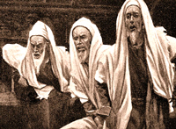
Conspiracy to Kill
A group of Jews “bound themselves under a curse, saying that they would neither eat nor drink till they had killed Paul.”
Secret combinations work under a cloak of secrecy and are characterized by formal oath making, threats of violence (including murder) and plunder, and the seeking of gain and power
…yea, their secret abominations have been brought out of darkness and made known unto us.
And now, my son, I command you that ye retain all their oaths, and their covenants, and their agreements in their secret abominations; yea, and all their signs and their wonders ye shall keep from this people, that they know them not, lest peradventure they should fall into darkness also and be destroyed. Alma 37:26-27
See Also: Helaman 6:16-31
And Ether 8:13-26
Acts 23:12
(1)

Slide 7
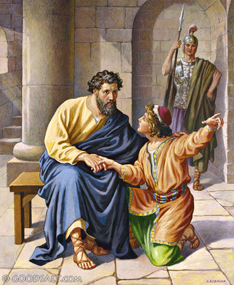
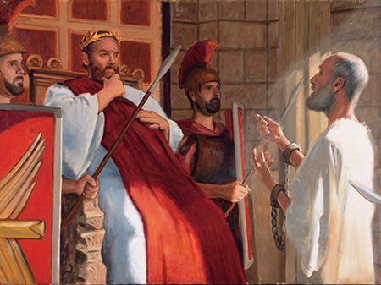
Paul Before Felix
Paul’s nephew heard of the secret plot to kill Paul and quickly told Paul, who sent him to inform the Roman officers. The chief captain, knowing that Paul was a Roman citizen, made arrangements to have Paul escorted by a contingent of soldiers to Caesarea to appear at a trial before the Roman governor Felix.
Paul declared his innocence before the Roman governor Felix. Although convinced of Paul’s innocence, Felix continued to keep Paul under house arrest for two years. Festus replaced Felix as the Roman governor of Judea.
Acts 23:12-25:7
(2)

Slide 8
Tertullus—The Lawyer
Several Jewish priests from Jerusalem attended Paul’s trial in Caesarea, and they hired Tertullus, a Roman lawyer and orator, to convince Felix of Paul’s alleged wrongdoings.
The Charges against Paul:
Creating disturbances among the Romans throughout the empire, an offence against the Roman government.
Paul was a ringleader of the sect of the Nazarenes; disturbed the Jews in the exercise of their religion, guaranteed by the state; introduced new gods, a thing prohibited by the Romans.
Paul attempted to profane the temple, a crime which the Jews were permitted to punish.
It is generally assumed that Tertullus was himself a Hellenistic Jew, though he could have been a Gentile. (3)
Acts 24:1-12
(1)

Slide 9
No Credible Witnesses
Even though 12 days had passed since he was accused, no credible witnesses had been found to testify against him.
He also affirmed his loyalty to God and mentioned that he had come to Jerusalem to deliver alms, showing that his purpose was to relieve suffering and not to incite rebellion.
Acts 24:13
(1)

Slide 10
Appealing to Caesar
"Under Roman law, each citizen accused of crime had the right and privilege of being heard before the imperial seat. Authorities on Roman law assert that local magistrates had discretionary power where appeal was concerned.
They could decide if the case warranted such a privilege where guilt was obvious and the crime of such enormity that a delay would thwart true justice."
Acts 25
(4)

Slide 11
King Agrippa II
King Herod Agrippa, who ruled an area located northeast of the Sea of Galilee, visited Festus and desired to hear Paul’s case.
Son of Herod Agrippa I
Bernice--sister
Drusilla--sister
Wife of Felix
Acts 25:12
(1)

Slide 12
Felix--Procurator (governor) of Judaea at the time of Paul’s arrest by Roman military authorities. He investigated the case and heard Paul speak in his own defense but put off giving any decision. He hoped Paul would have offered him a bribe, but when there was no bribe offered he left Paul still in prison.
Festus--Took Felix’s place as governor of Judaea. Finding Paul in prison at Caesarea, he proposed to try him in Jerusalem. To avoid such a trial, Paul appealed to Caesar. While waiting for an opportunity to send Paul to Rome, Festus was visited by Herod Agrippa. Paul was brought before them and made a speech in his own defense. Festus died 2 years after his appointment to Judaea.

Slide 13
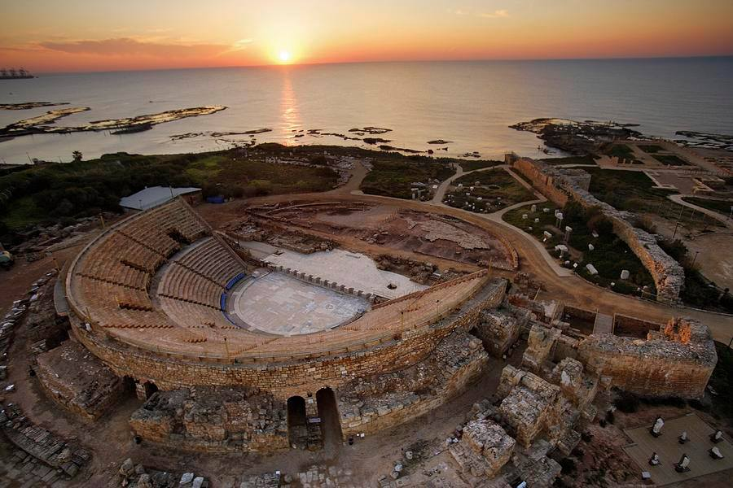
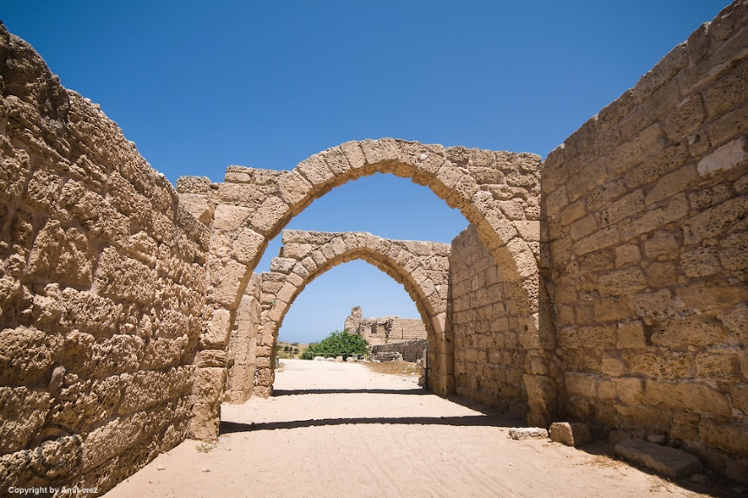
Caesarea An important seaport town of Palestine, on the main road from Tyre to Egypt, 33 miles north of Joppa, and about 60 miles from Jerusalem.
It It was the official residence of Festus, Felix, and other Roman procurators of Judaea.
Typical Roman Amphitheater
Ruins

Slide 14
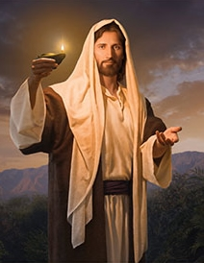
“The Way”
Jesus saith unto him, I am the way, the truth, and the life: no man cometh unto the Father, but by me.
John 14:6
Often used to refer to Christianity; it denotes the path or course of Christians.
Central to Christian belief is the doctrine that Jesus Christ is “the way” of salvation and that through Him all will be resurrected.
Paul declared that the real reason the Jews opposed him was his belief in the Resurrection.
However, he asserted that his message of the Resurrection was not heresy but was identical to the long-held hope of the Jewish nation.
Simon Dewey
Acts 24:14-15; 22; Acts 26:6-8; 28:20
(1)

Slide 15
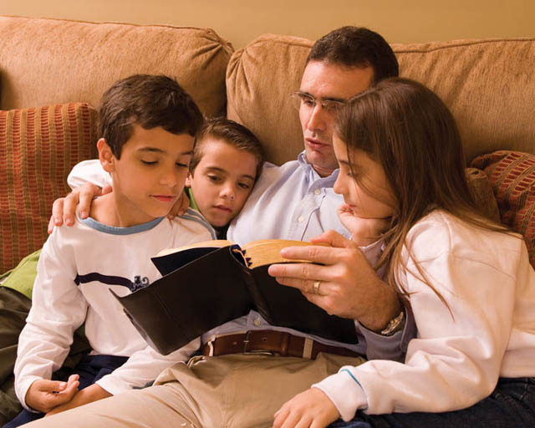
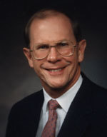
Testimony to King Agrippa
"There are things we can do that will help us to consistently have the Spirit of the Lord in our homes, especially during scripture reading time.
And if we have that Spirit, both the parents and children can be touched, blessed, and changed-and each family member can be strengthened every day we read the words of the Lord together...
If you use spiritual examples from your own life, you will invite the Spirit into your home and will help bring about the conversion of all present.
"We see a classic example of this principle-and its power-in Paul's testimony to King Agrippa."
Acts 26:4-14
(5)

Slide 16
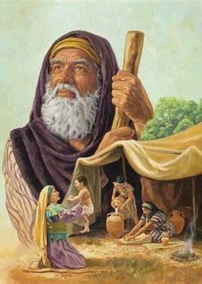
Inheritance
An entrance into the celestial kingdom of God
"An eternal inheritance in an eternal promised land was the hope of Israel.
Abraham, Israel's father, was promised the land of Canaan for himself and his posterity forever, but during his lifetime Abraham never actually received his inheritance.
The hope of Israel was that Abraham and his posterity would yet enter into their promised inheritance.”
Acts 26:6-8
(6)

Slide 17
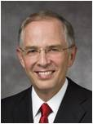
Overcoming Satan’s Power
Live righteously in order to demonstrate you have truly repented.
If we repent and turn to God, we can overcome Satan’s power in our lives, receive forgiveness for our sins, and qualify for the celestial kingdom.
“When we sin, we turn away from God. When we repent, we turn back toward God.
“The invitation to repent is rarely a voice of chastisement but rather a loving appeal to turn around and to ‘re-turn’ toward God.
It is the beckoning of a loving Father and His Only Begotten Son to be more than we are, to reach up to a higher way of life, to change, and to feel the happiness of keeping the commandments.”
Acts 26:19-23
(7)

Slide 18
Believest Thou the Prophets?
To become converted to Jesus Christ, we must choose to believe in and be fully committed to living the gospel
Acts 26:27
(8)

Slide 19
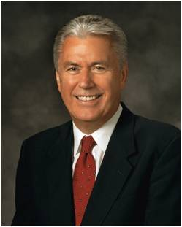
“Two young brothers stood atop a small cliff that overlooked the pristine waters of a blue lake. This was a popular diving spot, and the brothers had often talked about making the jump—something they had seen others do.
“Although they both wanted to make the jump, neither one wanted to be first. The height of the cliff wasn’t that great, but to the two young boys, it seemed the distance increased whenever they started to lean forward—and their courage was fading fast.
(8)

Slide 20
“Finally, one brother put one foot at the edge of the cliff and moved decisively forward. At that moment his brother whispered,
Maybe we should wait until next summer
Brother, I’m committed!
The first brother’s momentum, however, was already pulling him forward.
Ha, Ha, Ha!
Ha, Ha, Ha!
“He splashed into the water and surfaced quickly with a victorious shout.
The second brother followed instantly. Afterward, they both laughed about the first boy’s final words before plunging into the water: ‘Brother, I’m committed.’
(8)

Slide 21
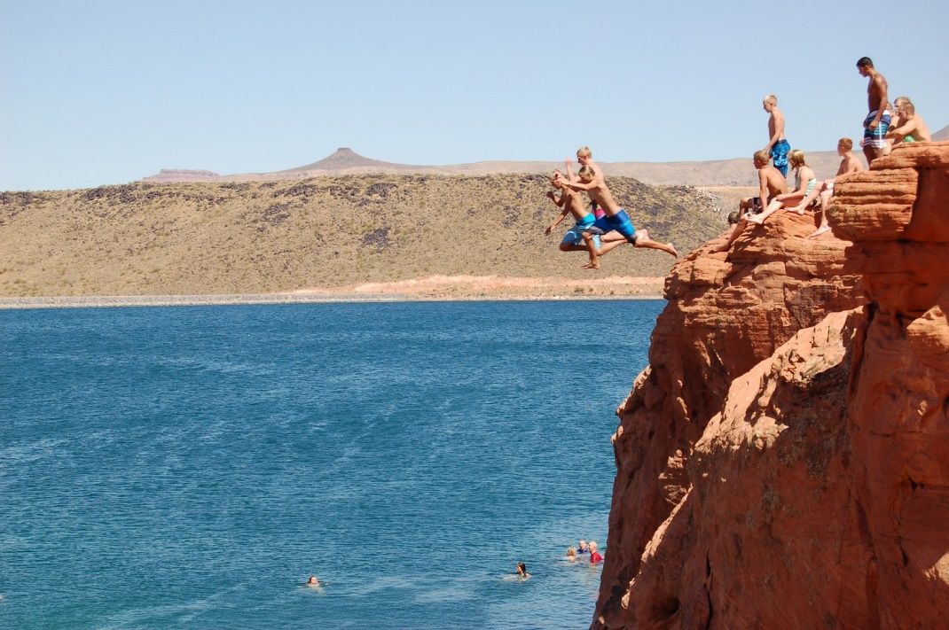
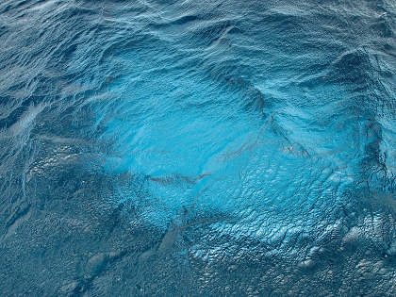
“Commitment is a little like diving into the water. Either you are committed or you are not. Either you are moving forward or you are standing still. There’s no halfway. …
“Those who are only sort of committed may expect to only sort of receive the blessings of testimony, joy, and peace. The windows of heaven might only be sort of open to them. …
“In some way, each of us stands at a decision point overlooking the water. It is my prayer that we will have faith, move forward, face our fears and doubts with courage, and say to ourselves, ‘I’m committed!’”
(8)

Slide 22
Innocent
King Agrippa found Paul innocent and would have freed him.
Because Paul had appealed his case to Caesar they were required to send him to Rome.
Macedonia
Black Sea
Rome
Italy
Adriatic Sea
Mysia
Ephesus
Cilicia
Sicily
Antioch
Syria
Crete
Cyprus
Mediterranean Sea
Caesarea
Jerusalem
Acts 26:30-32

Slide 23
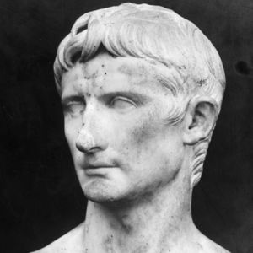
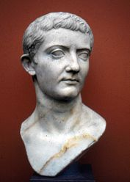
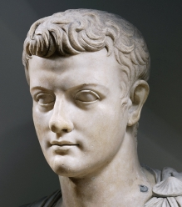
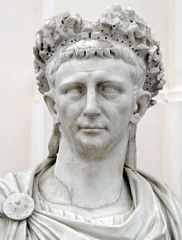
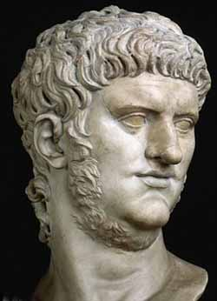
Caesar Roman Emperor (A title by which a Roman emperor was known). Emperors during the New Testament times were:
Augustus 31 B.C.
Tiberius A.D. 14
Caligula A.D. 37
Claudius A.D. 41
Nero A.D. 54

Slide 24
Sources:
Suggested Hymn: #240 Know This, That Every Soul Is Free
Video:
Waiting on Our Road to Damascus (3:45)
“Paul: A Chosen Vessel”
New Testament Institute Student Manual Chapter 34
Hugh Nibley, Brother Brigham Challenges the Saints, edited by Don E. Norton and Shirley S. Ricks, 110 – 111
Wikipedia
Institute Manual, The Life and Teachings of Jesus & his Apostles, 2nd ed., p. 341-2
Gene R. Cook (Searching the Scriptures: Bringing Power to Your Personal and Family Study, 204-9, emphasis added)
Elder Bruce R. McConkie Mormon Doctrine, 2d ed., 367.
Elder Neil L. Andersen (“Repent … That I May Heal You,” Ensign or Liahona, Nov. 2009, 40).
President Dieter F. Uchtdorf(“Brother, I’m Committed,” Ensign, July 2011, 4, 5).
Presentation by ©http://fashionsbylynda.com/blog/

Slide 25
PAUL’S ARREST A.D. 58–60
The Lord Again Appears to Paul | 23:11
The Jewish Conspiracy Against Paul | 23:12–22
Caesarea Paul Transferred to Caesarea | 23:23–35
The Case Before Felix | 24:1–27
Paul Appeals to Caesar | 25:1–22
Paul Testifies Before King Agrippa | 25:23–27; 26:1–32
Jesus Appears to Paul Acts 23:11:
“In his persecuted and straitened state, Paul needed comfort and assurance from on high. How shall such be given him? The Lord could have sent an angel; he could have spoken by the power of the Holy Spirit to the spirit within Paul; or he could have opened the heavens and let him see again the wonders of eternity. But this time—thanks to his valiant service, his unwearying devotion, his willingness to suffer even unto death in the Cause of Christ—this time Paul was blessed with the personal ministrations of the Lord of heaven himself. Jesus stood at his side. Without question much was said and much transpired, of which there has been preserved to us only the promise that the Lord’s special apostle would yet bear witness of the Master in Rome” elder Bruce R. McConkie (Doctrinal New Testament Commentary, 3 vols. [1965–1973], 2:191).
Should have been killed Acts 23:27:
"Prior to Augustus the power of the governor in his province was virtually absolute, and in New Testament times he remained the chief military, executive, and judicial officer, with protection of citizens his special concern. Roman society was based on status, and civil rights followed this system. Slaves had the least protection, and citizens had the most. The latter were mainly either Italians or provincial families that were rewarded for usefulness to Rome. Since they generally served by political or economic influence, Roman citizens in any city were probably at least middle class, the implication of Paul telling the examining tribune that he was born a citizen. (See Acts 22:28.) On that occasion the mere claim of citizenship immediately stopped an intended interrogation under the whip. In the letter of Pliny to Trajan discussed earlier, that governor simply executed provincial Christians who did not forsake their religion, but others 'possessed of the same folly' received better treatment: 'Because they were Roman citizens, I signed an order for them to be transferred to Rome.' Paul could demand the same, which he did after facing either the danger of being murdered in another Jerusalem trial or further imprisonment after already being in custody for two years. He received fair treatment on several other occasions because of his Roman rights. Obviously the Lord called an apostle to the gentiles especially suited to survive the dangers of hot controversy." (Richard Lloyd Anderson, "The Church and the Roman Empire," Ensign, Sept. 1975, 12)
Life and Teachings of Jesus and His Apostles Chapter 42
Bound to Kill Acts 23:12-24:
In this evil covenant, forty men overestimated their own power. The Savior said, 'Swear not at all; neither by heaven; for it is God's throne: Nor by the earth; for it is his footstool...Neither shalt thou swear by thy head, because thou canst not make one hair white or black' (Matt 5:34-36). These forty men had not the power to make one hair white or black, nor did they have power to add one cubit to their stature. Therefore, they were not able to make good on their oath to kill Paul. The Lord, with the help of Paul's young nephew, was able to defy this determined mob. 'And thus we see that by small means the Lord can bring about great things' (1 Ne 16:29).
Unfortunately, we don't know what became of the pitiful hunger strikers. How many days did they last before they broke their oath of abstinence? What were the expressions on their wicked faces when they heard that Paul was being protected by 470 soldiers (v. 23)? What did their family members think of their murderous plot? Although we never hear the end of their pathetic story, we imagine it as a story full of weakness, pride, futility, anger, and resentment-the common lot of Satan's servants.
The Lord designed covenant-making for certain solemn occasions in which the powers of heaven would be used to help the individual fulfill their obligation. The Lord despises covenant-making for evil purposes and the powers of heaven are used in opposition to such evil oaths. Accordingly, the Lord specifically warns us about making oaths we are not able to keep (Matt 5:33-36), underscoring the importance of covenant-keeping in the mind of the Lord. Gospeldoctine.com
What is a Nazarenes? Acts 24:5 "Early Christians were apparently called Nazarenes, since Paul was accused of being a leader of this sect. (See Acts 24:5.) Early historians refer to a Christian group as Nazarenes, Christian Jews who neither would nor could give up their Jewish mode of life. Paul taught that the Mosaic Law was not binding upon gentiles or Jews, having been fulfilled by Christ. Later Nazarenes rejected Paul because of this, even though he had been known as a Nazarene during his lifetime. Later Nazarenes were absorbed within Judaism and Christianity by the end of the fifth century. However, the term Nozri (Nazarene) remains as the Hebrew word for Christian." (Victor L. Ludlow, "Major Jewish Groups in the New Testament," Ensign, Jan. 1975, 26)

Slide 26
Straitest Sect of Our Religion Acts 26:5:
" [Paul] defended himself as 'a Pharisee, the son of a Pharisee' (Acts 23:6) and called the Pharisees the 'strictest' party in Judaism (Acts 26:5, NKJB). Recent committee translations agree on that term, which means 'most exact' or 'most careful' in this context. The Mishnah, the Jewish law written down about A.D. 200, preserves the thinking of the Pharisees, whose fundamental tradition was, 'Be deliberate in judgment, raise up many disciples, and make a fence around the Law.'
Thus, Paul walked in the path of his father and of the fathers of his people, who sought to protect the Mosaic code, which was the central 'Law.' Josephus, a young Pharisee who lived at the time of Paul, explains, 'The Pharisees had passed on to the people certain regulations handed down by former generations and not recorded in the Laws of Moses.'
The Mishnah summarizes these rules about rules, condensing and compacting them into some eight hundred pages in the standard English translation...For Jesus Christ, the process had gone too far, as he accused the Pharisees of cluttering the meaning of God's greatest commandments: 'Ye hold the tradition of men, as the washing of pots and cups, and many other such like things ye do. . . . Ye reject the commandment of God, that ye may keep your own tradition' (Mark 7:8-9)." (Richard Lloyd Anderson, Understanding Paul, 22 - 23.)
To be set at liberty Acts 26:32:
By this saying, one might think that Paul made a mistake when he appealed to Caesar. After two years of imprisonment, Agrippa seems willing to let him go. Did Paul make a mistake in appealing to Caesar?
It is doubtful that Agrippa really would have let him go. Besides, the Lord's plan was to have his most vocal apostle testify before the greatest political authority on the earth. Paul had been told, 'Be of good cheer, Paul: for as thou hast testified of me in Jerusalem, so must thou bear witness also at Rome' (Acts 23:11).
The Lord's plan for Paul was to testify in Rome. Paul knew it, and this is why he appealed to Caesar-not because he was trying to free himself. Paul was comfortable to suffer for Christ's name as 'the prisoner of Jesus Christ' (Eph 3:1).

Slide 27
Paul’s Accounts of His Vision
On the Road to Damascus Acts 9:3-20 | In Jerusalem on the stairs of the Temple Acts 22:4-21 | To King Agrippa Acts 26:9-19
Light from heaven | A great light around Paul | The way a light from heaven, above the brightness of the sun, shining round about me and them which journeyed with me
Fell to the earth | Fell to the ground | All of them fell to the earth
“I am Jesus whom thou persecutest” | “I am Jesus of Nazareth, whom thou persecutest.” | “I am Jesus whom thou persecutest.” In Hebrew tongue
Men with Paul did heard but did not see | The men with Paul heard but did not see and were afraid
Saul is blind for 3 days | Paul could not see for that glory of light
Lead to Ananias and blessed | Lead by the hand to Damascus
 |  | His mission was to “To open their eyes, and to turn them from darkness to light, and from the power of Satan unto God, that they may receive forgiveness of sins, and inheritance among them which are sanctified by faith that is in me.”
These variations are likely due to the different audiences and purposes of each account.
Some critics have found fault with the Prophet Joseph Smith because there are variations in the several recorded accounts of his First Vision. However, as with Paul, these variations do not discredit the essential truth that the Prophet saw a vision of Heavenly Father and the Savior.
(1)

