Slide 2
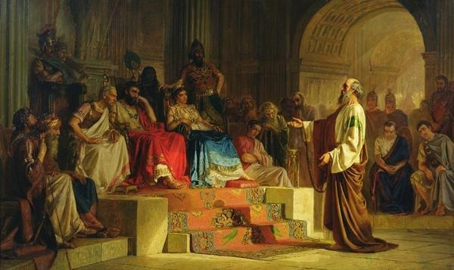
Previously…
58-61 AD
Paul had been falsely charged with treason and imprisoned. Paul appealed his case to Caesar in Rome, which was his right as a Roman citizen.

Slide 3
Boat To Rome
Paul traveled with other prisoners by boat toward Rome, under the custody of a Roman centurion (a Roman military officer who commanded 50 to 100 men).
Macedonia
Black Sea
Rome
Italy
Adriatic Sea
Mysia
Cilicia
Sicily
Antioch
Syria
Crete
Cyprus
Phenice
Mediterranean Sea
Jerusalem
Acts 27:1-8

Slide 4
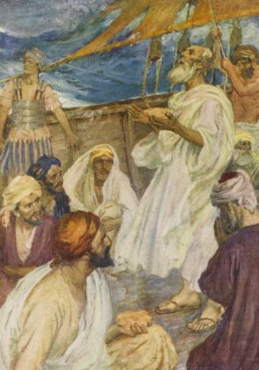
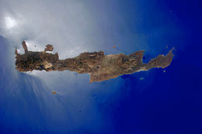
The Warning
After sailing for many days, they stopped at a harbor on the island of Crete.
As they were leaving the harbor, Paul warned those on the ship that they should not continue their journey.
Sirs, I perceive that this voyage will be with hurt and much damage, not only of the lading and ship, but also of our lives.
Acts 27:9-10

Slide 5
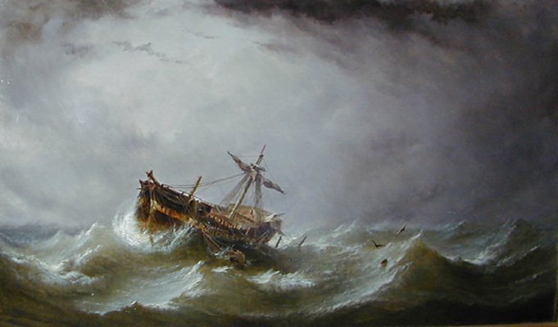
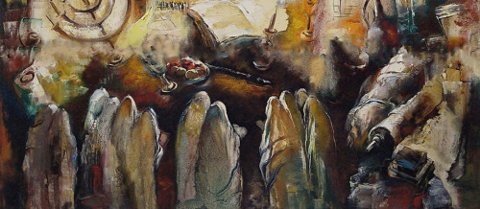
Unsafe Time To Travel
The word fast in this context means voluntarily abstaining from eating.
In this case “the fast” probably referred to the Jewish holy day called the day of Atonement, which marked the beginning of the season during which it was generally regarded as unsafe to travel on the Mediterranean Sea because of violent storms.
Euroclydon = A violent cyclonic Mediterranean storm that threatened the lives of everyone aboard the ship
Acts 27:9, 14

Slide 6
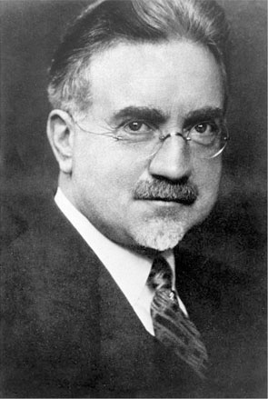
Paul Acting As A Seer
“A seer is one who sees with spiritual eyes.
He perceives the meaning of that which seems obscure to others; therefore he is an interpreter and clarifier of eternal truth. He foresees the future from the past and present.
This he does by the power of the Lord. …
In short, he is one who sees, who walks in the Lord’s light with open eyes.”
Acts 27:10
(2)

Slide 7
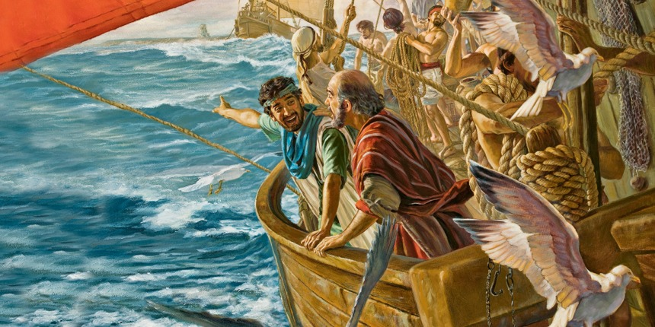
Rejecting Counsel
Rather than heeding Paul’s warning, whom did the centurion trust instead?
Why do you think it may have been easier for the centurion to believe the owner of the ship rather than Paul?
If we ignore the warnings and counsel of the Lord’s servants, then we put ourselves in danger
Why did most people on the ship ignore Paul’s warning?
Acts 27:11-12

Slide 8
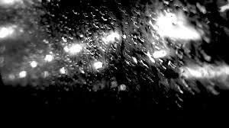
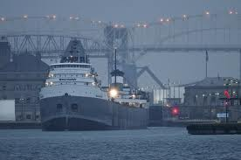
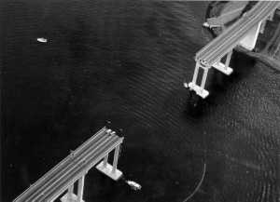
Over the Edge—The Warning
On a dark rainy night, a 7,300-ton barge smashed into two piers of the Tasman Bridge
Three spans of bridge collapsed
Tasman Bridge

Slide 9
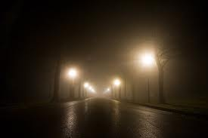
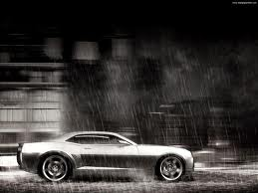
A family was driving across the bridge when the lights went out.
A speeding car passed them and disappeared

Slide 10
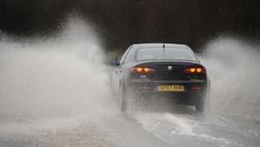
Murray Ling, the father, slammed on his brakes and skidded to a stop, one yard from the edge of a black void.

Slide 11
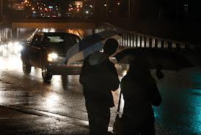
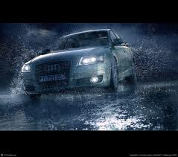
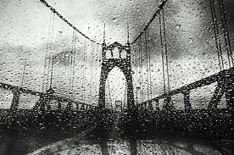
Murray got his family out of the car and began warning oncoming traffic of the disaster ahead.

Slide 12
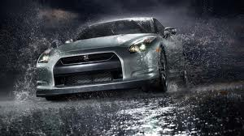
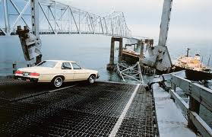
As he waved his arms, to his horror, a car swerved around him and plummeted into the abyss.
A second car stopped in time, but a third car crashed into the Ling’s car at the edge of the bridge.

Slide 13
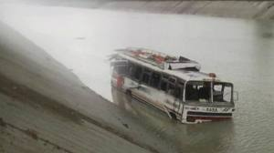
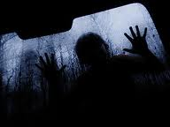
A loaded bus headed toward Murray, ignoring his waving arms.
Murray ran along side the bus drivers window yelling,
“There’s a span missing”

Slide 14
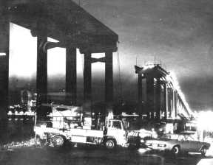
The bus swerved just in time and came to a halt against the railing.
Dozens of lives had been saved.

Slide 15
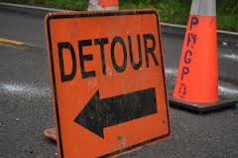
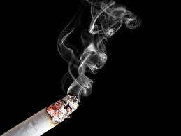
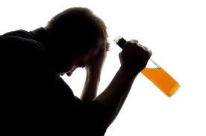
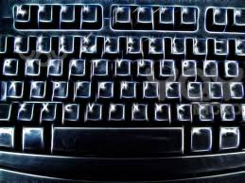
What are some of the warning signs we need to pay attention to?

Slide 16
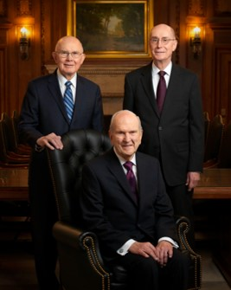
Who has the Lord given us to warn about the dangers ahead?

Slide 17
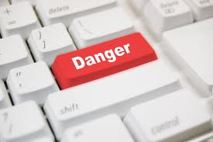
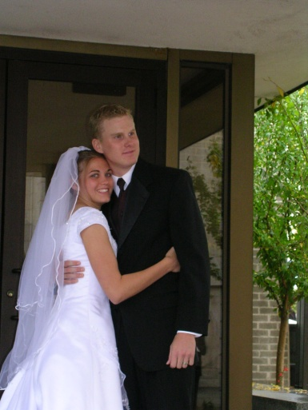
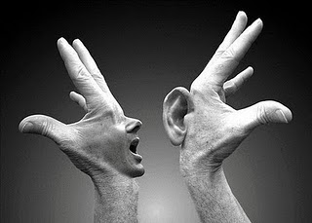
What have the prophets warned us about recently?
Controlling anger and being forgiving
Marriage between a man and a woman
Charity and service
Inappropriate use of the internet

Slide 18
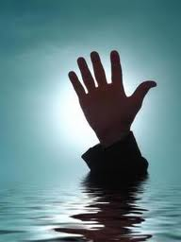
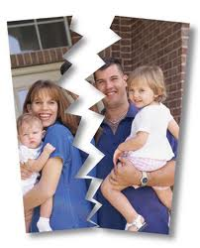
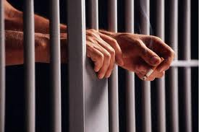
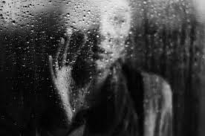
What could happen if we choose not to listen to the prophets?

Slide 19
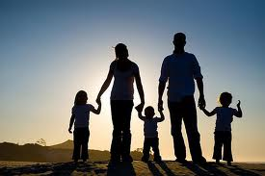
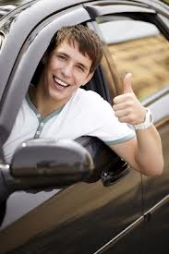
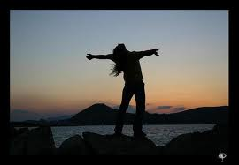
What happens when we do listen and heed?

Slide 20
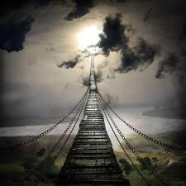
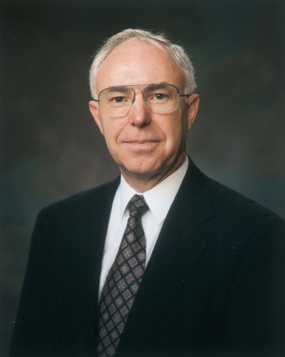
“I am grateful for these Brethren whom we sustain as prophets, seers, and revelators who forewarn us of bridges not to be crossed”
(3)

Slide 21
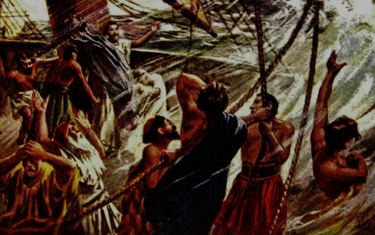
14th Night of the Storm
The crew cast four anchors into the sea to prevent the ship from crashing into rocks.
The crew then went to the front of the ship and acted as though they were about to cast more anchors.
However, they were actually planning to abandon the ship and flee in a small boat because they feared the ship would sink.
If we ignore the warnings and counsel of the Lord’s servants, then we put ourselves in danger
Acts 27:27-30

Slide 22
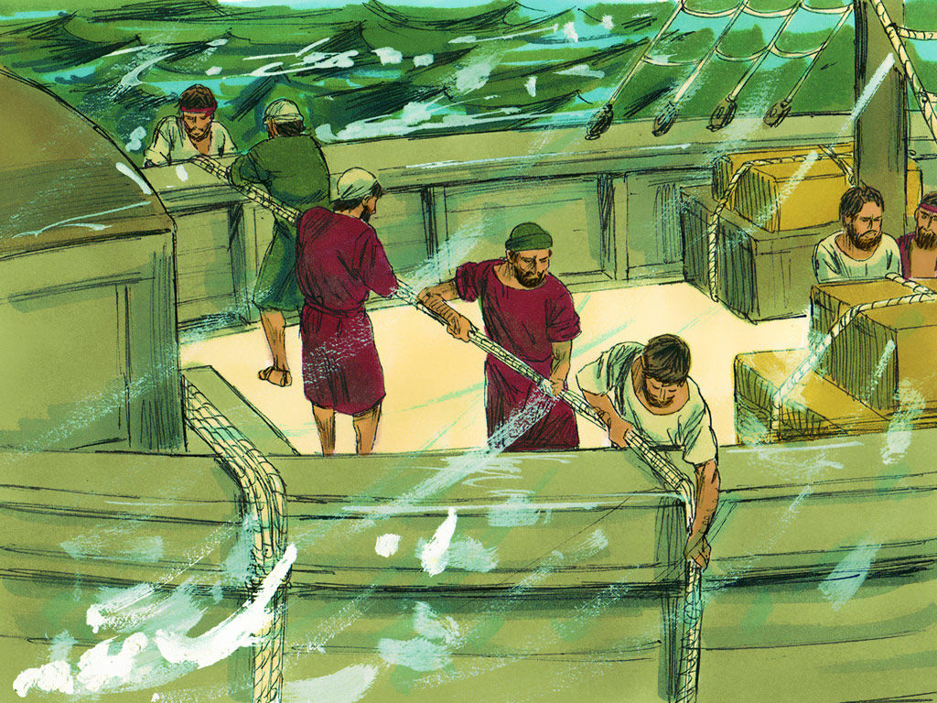
Heeded the Warning
Paul gave the centurion and soldiers a warning to those who were trying to flee the ship.
They heeded his warning and prevented the crew from escaping by cutting the small boat’s ropes and letting it drift away empty.
Acts 27:31-32

Slide 23
You Will Be Safe
The ship crashed as it sailed toward the island of Malta.
Macedonia
Black Sea
Rome
Italy
Adriatic Sea
Mysia
Ephesus
Cilicia
If we heed the counsel and warnings of the Lord’s servants, then the Lord will fulfill His promises to us.
Sicily
Antioch
Syria
Crete
Cyprus
Malta
Mediterranean Sea
Jerusalem
Acts 27:33-41

Slide 24
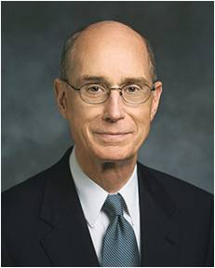
If we heed the counsel and warnings of the Lord’s servants, then we can withstand the dangers that threaten us
“Every time in my life when I have chosen to delay following inspired counsel or decided that I was an exception, I came to know that I had put myself in harm’s way.
Every time that I have listened to the counsel of prophets, felt it confirmed in prayer, and then followed it, I have found that I moved toward safety.”
(4)

Slide 25
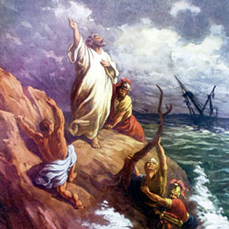
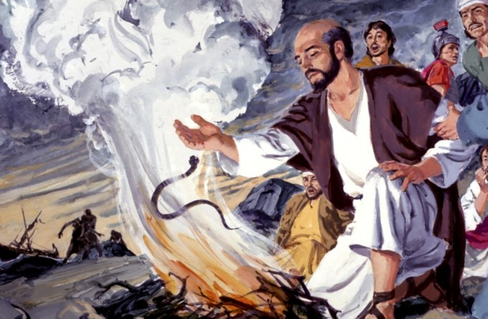
The Viper
Those on board the ship found safety on the island called Melita, also known as Malta.
“barbarous people” = speakers of a strange language, not brutal ruffians.
While Paul was building a fire on the shore, he was bitten by a poisonous snake. However, he was unaffected by the venom.
A Promise Fulfilled
They shall take up serpents; and if they drink any deadly thing, it shall not hurt them; they shall lay hands on the sick, and they shall recover. Mark 16:18
Acts 28:1-5
(1)

Slide 26
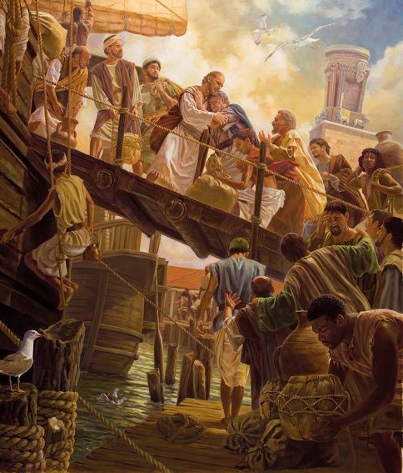
Paul is then taken to Rome
“Paul was suffered to dwell by himself with a soldier that kept him”
Acts 28:16

Slide 27
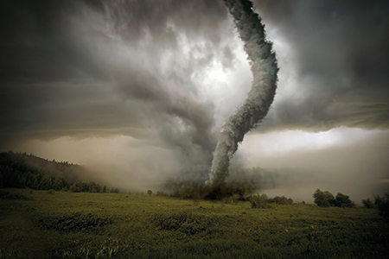
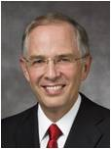
Spiritual Whirlwinds
A whirlwind is a weather phenomenon in which a vortex of wind (a vertically oriented rotating column of air) forms due to instabilities and turbulence created by heating and flow (current) gradients. (5)
Some trials and difficulties that can be likened to whirlwinds
“The worst whirlwinds are the temptations of the adversary. Sin has always been part of the world, but it has never been so accessible, insatiable, and acceptable. There is, of course, a powerful force that will subdue the whirlwinds of sin. It is called repentance.” (6)
“…whirlwinds for what they are—tests, temptations, distractions, or challenges to help you grow.”
Acts 28:1-5

Slide 28
“As far as we know, Paul was the first missionary to preach the gospel in Rome. As he had done in other cities, Paul preached first to the Jews, some of whom believed him, and then turned his attention to ‘all that came in unto him’, many of whom were likely Gentiles.
While under house arrest, Paul wrote what some term his ‘prison epistles’—Colossians, Ephesians, Philemon, and Philippians.
After he spent two years under house arrest in Rome, it is believed that Paul was tried and released and that he thereafter ministered in Asia, Greece, and perhaps Spain before being imprisoned again in Rome. ‘
According to tradition, he was killed during the persecutions under Nero, sometime between A.D. 64 and 68. Paul alluded to his future death in 2 Timothy 4:6–8.”
Acts 28:17-31
(8)

Slide 29
Sources:
Suggested Hymn: #105 Master, the Tempest Is Raging or #97 Lead, Kindly Light
Videos:
Prophets' Warning (1:25)
Spiritual Whirlwinds (2:12)
After the Storm (5:25)
New Testament Institute Student Manual Chapter 33
Elder John A. Widtsoe (Evidences and Reconciliations, arr. G. Homer Durham [1987], 258).
Elder Spencer J. Condie A Mighty Change of Heart Oct.1993 Gen. Conf.
President Henry B. Eyring (“Finding Safety in Counsel,” Ensign, May 1997, 25).
Wikipedia
Elder Neil L. Anderson “Spiritual Whirlwinds,” Ensign or Liahona, May 2014, 18–21)
Life and Teachings of Jesus and His Apostles chapter 42
New Testament Student Manual [Church Educational System manual, 2014], 330.
Presentation by ©http://fashionsbylynda.com/blog/

Slide 30
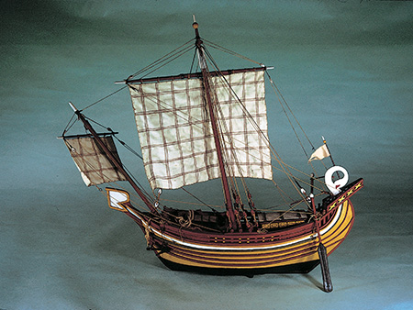
PAUL’S IMPRISONMENT, CA. A.D. 58–60
Departure for Rome | 27:1–8
Crete Shipwreck at Fair Havens | 27:9–44
Melita (Malta) Paul Heals the Sick | 28:1–10
From Malta to Rome | 28:11–15
Rome Paul Preaches in Rome | 28:16–31
Following counsel Acts 27:14-31:
“Every time in my life when I have chosen to delay following inspired counsel or decided that I was an exception, I came to know that I had put myself in harm’s way. Every time that I have listened to the counsel of prophets, felt it confirmed in prayer, and then followed it, I have found that I moved toward safety. Along the path, I have found that the way had been prepared for me and the rough places made smooth. God led me to safety along a path which was prepared with loving care, sometimes prepared long before” (“Finding Safety in Counsel,” Ensign, May 1997, 25).
Reasons why individuals sometimes choose to reject the counsel of Apostles or other Church leaders:
(1) Worldly experience and training. Just as “the centurion believed the master and the owner of the ship” (Acts 27:11) rather than the counsel of Paul, a tentmaker, people today sometimes reject the words of seers or other Church leaders because their counsel does not coincide with the opinions of “experts” in the world.
(2) Convenience. The ship’s crew contended that they should continue their journey because “the haven was not commodious to winter in” (Acts 27:12), meaning it was not a convenient location to spend the winter months. Likewise, adhering to the counsel of Church leaders is not always convenient.
(3) Majority mentality. “The more part” of the passengers advised the centurion “to depart” (Acts 27:12). For many individuals, it makes more sense to agree with the majority than to agree with a servant of God, whose words are not meant to be popular. (1)
Life and Teachings of Jesus and His Apostles Chapter 42
Prophetic Teachings:
“The prophet is not required to have any particular earthly training or credentials to speak on any subject or act on any matter at any time.
“Sometimes there are those who feel their earthly knowledge on a certain subject is superior to the heavenly knowledge which God gives to His prophet on the same subject. They feel the prophet must have the same earthly credentials or training which they have had before they will accept anything the prophet has to say that might contradict their earthly schooling. …
“… The prophet tells us what we need to know, not always what we want to know. …
“How we respond to the words of a living prophet when he tells us what we need to know, but would rather not hear, is a test of our faithfulness. …
“… The prophet can receive revelation on any matter—temporal or spiritual” President Ezra Taft Benson (“Fourteen Fundamentals in Following the Prophet,” in Brigham Young University 1980 Speeches [1981], 3–4; speeches.byu.edu).
This model of a Sidonian merchant ship may be similar to the vessel that carried Paul as a prisoner to Rome.
Photograph by Richard L. W. Cleave

