Slide 1
Lesson 99
Salvation For Everyone
Romans 1-3
Look unto me in every thought; doubt not, fear not.
D&C 6:36

Slide 2
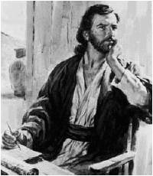
Pauline Epistles
His writings are properly called “Letters”
Under the inspiration of the Holy Spirit, Paul was able to address specific problems and issues of his time.
“The Epistles have an abundance of doctrine, but it is designed for practical application, not theoretical speculation.” (2)
Some letters are lost:
1 Corinthians 5:9
2 Corinthians 10:9-10
Colossians 4:16
2 Thessalonians 3:17
The New Testament contains 9 Pauline letters to the churches and 4 letters to individuals.

Slide 3
Main Form of “Letters”
During Paul’s time:
Form | Scripture Example | Scripture
The sender’s name and office | Paul, a servant of Jesus Christ, called to be an apostle, separated unto the gospel of God | Romans 1:1
The name of the recipient | To all that be in Rome, beloved of God, called to be saints: | Romans 1:7
A greeting or wish for prosperity | Grace to you and peace from God our Father, and the Lord Jesus Christ…For I long to see you that I may impart unto you some spiritual gift… | Romans 1:7, 11
The main body of the letter | The wrath of God rets on those guilty of sin; The deeds of men; the judgements, both Jew and Gentiles; justification; faith, works and grace; being saved through atonement; baptism a similitude; Christ brings eternal life; law of Moses fulfilled in Christ; the inward man; the law of Christ; adopted children of God; the elect; foreordination; salvation; How to live as a saint; How to treat others; fellowshipping and preaching gospel | Romans 1-16
A farewell with closing greetings and good wishes | The grace of our Lord Jesus Christ be with you all. Amen To God only wise, be glory through Jesus Christ for ever. Amen | Romans 16:24,27
The signature of the writer | “I Tertius [the scribe] who wrote this epistle, salute you in the Lord | Romans 16:22
Paul’s testimony is given throughout the letters:
Example: “For I am not ashamed of the gospel of Christ: for it is the power of God unto salvation to every one that believeth…(Romans 1:16)

Slide 4
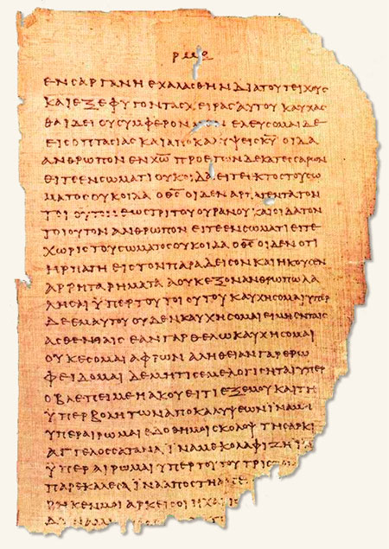
Paul’s Scribe
“Paul followed the usual procedure of using a scribe or amanuensis for the final form of his letters, but he wrote the concluding lines and signature with his own hand to guarantee authenticity.
Paul’s signature found in:
Romans 16:25-27
1 Corinthians 16:21
Galatians 6:11
Colossian 4:8
2 Thessalonians 3:17
Philemon 19
Tertuis wrote his own greeting to the Roman Saints near the conclusion of the epistle
A partially deteriorated page of Papyrus 46, one of the oldest surviving Greek manuscripts of the New Testament. Dating to about A.D. 200, the papyrus contains copies of most of the epistles of Paul, first among them the Epistle to the Romans.

Slide 5
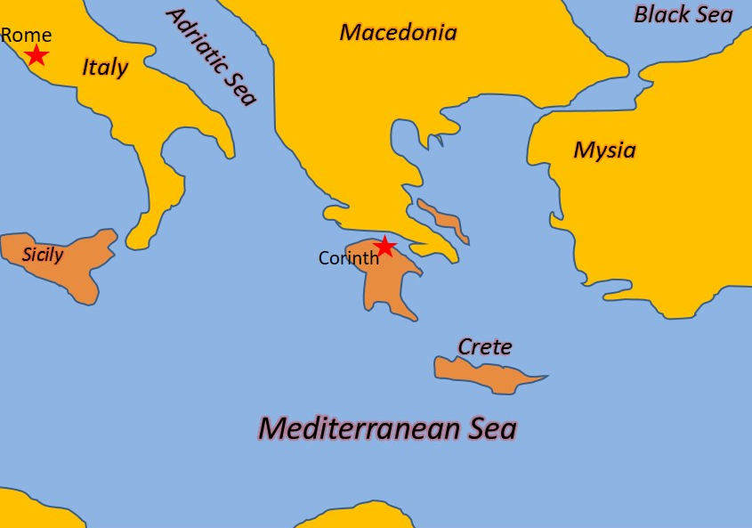
Written to the Romans
Paul writes to the Romans from Corinth around 55-56 AD
3 Reasons why Paul wrote to the Romans:
1. To prepare for his future arrival in Rome
2. To clarify and defend his teachings
3. To promote unity between Jewish and Gentile members of the Church
Phebe (Phoebe) = A notable woman in the church of Cenchreae, was trusted by Paul to deliver his letter to the Romans.
“Paul wrote it to the saints, to members of the Church, to those who already had the gift of the Holy Ghost, to those who had been born again, to those who held the priesthood and enjoyed the gifts of the Spirit.” (3)

Slide 6
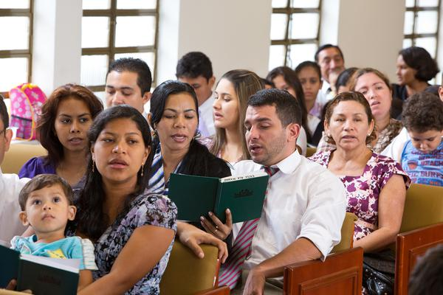
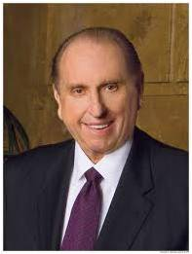
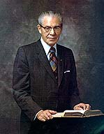
Be Not Ashamed
“If we are not ashamed of the gospel of Christ, then we should not be ashamed to live it. And if we are not ashamed to live it, then we should not be ashamed to share it." (4)
“People expect a great deal from the members of this Church because we profess much.
"Let each of us every day live an exemplary life, that our influence may be felt for good and that others, seeing our good works, may be led to glorify God.
"We are members of the church of Jesus
Christ. May we always live worthy of this." (5)
Romans 1:16

Slide 7
The Power of Salvation
…the righteousness of God revealed from faith to faith
The gospel of Jesus Christ is the power of God unto salvation to all who exercise faith in Jesus Christ
Power = to produce movement which causes effects
'Power', as related to the gospel is that which produces whatever is the objective of the gospel.
In this case the objective is 'the power...unto salvation'; or that which produces salvation." (6)
Romans 1:15-17

Slide 8
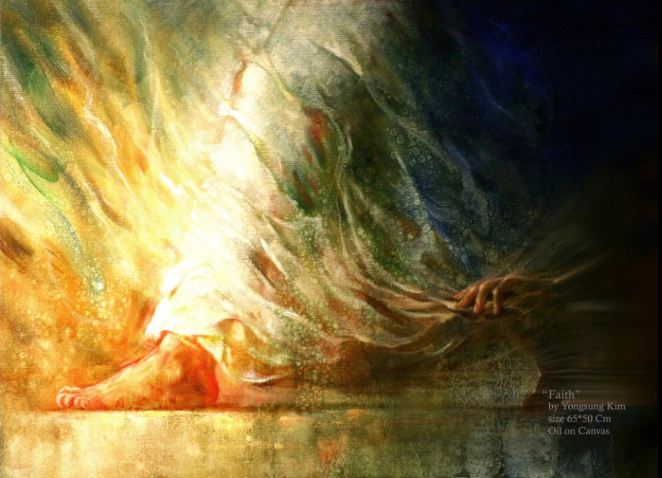
Belief and Faith
“Faith in Jesus Christ … is manifested in a life of obedience to the laws and ordinances of the gospel and service to Christ”
Wholehearted acceptance of and trust in Him as the One who offered Himself in Atonement for our sins.
This deep trust leads to a life of faithfulness, manifested by repenting of sins, being baptized, and trying to live as Jesus Christ taught.
Yongsung Kim
Romans 1:17; Acts 16:30-33; Romans 6:1-11; 1 Corinthians 6:9-11

Slide 9
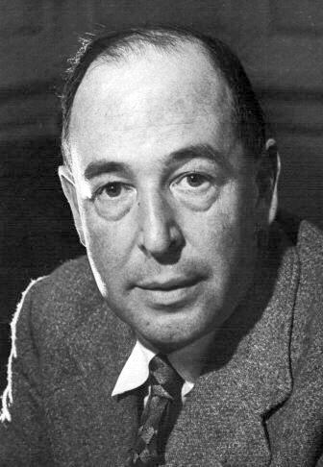
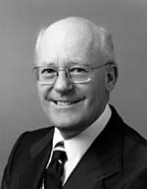
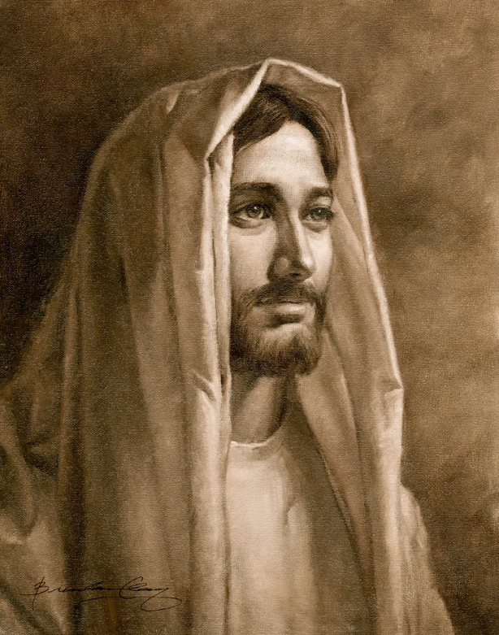
“What Christ desires from each of us is surrender, complete and total—a voluntary gift of trust, faith, and love.”
“Christ says, ‘Give me All. I don’t want so much of your time and so much of your money and so much of your work: I want You.
“…No half-measures are any good. I don’t want to cut off a branch here and a branch there, I want to have the whole tree down. … Hand over the whole natural self, all the desires which you think innocent as well as the ones you think wicked—the whole outfit. I will give you a new self instead. In fact, I will give you Myself: my own will shall become yours.’” (7)
A little girl, misquoting the twenty-third Psalm, put everything in perspective. She said, “The Lord is my shepherd. That’s all I want!”
What more could anyone want? What could be more desirable than to “look unto [Jesus] in every thought”?
(6)

Slide 10
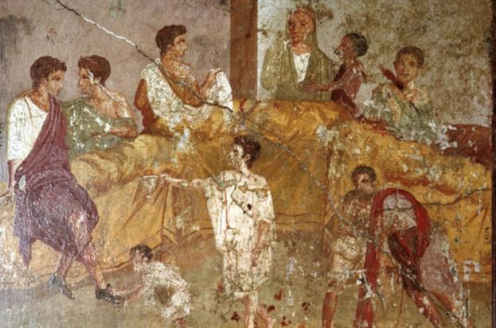
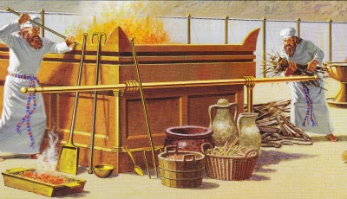
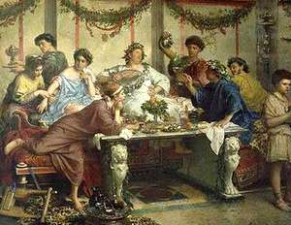
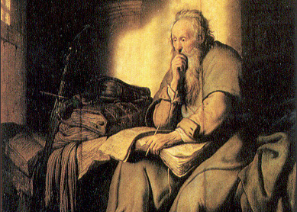
Facing Immoral Behavior
In Paul’s day, some Gentile Christians sought to excuse immoral or sinful behavior by emphasizing God’s mercy and ignoring His perfect justice.
Also, some Jewish Christians believed that observance of the law of Moses was necessary for their salvation.
Paul sought to correct both of these misconceptions.
Romans 1:18

Slide 11
Offensive to God
For I the Lord cannot look upon sin with the least degree of allowance;
D&C 1;31
The “wrath” of God is not hostility toward mankind; rather, it is rejection of sin.
Immorality
It is impossible to sin without the law.
Sin is defined as violation of God's law.
Idolatry
Romans 1:18-32

Slide 12
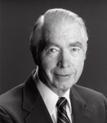
Judgments of God
Those in the Law and Those out of the Law
Paul taught that all people will be judged according to their works, and he showed that the Jews’ unrighteousness came from their living the law of Moses outwardly but not inwardly.
“Paul is explaining that the Jews who violate the law will be worse off than the Gentiles who were never given the law. Again we turn to the teachings of Jacob, 'but wo unto him that has the law given, yea, that has all the commandments of God, like unto us, and that transgresseth them...for awful is his state!'
"Paul argues that the Jew who
violated this moral law was inferior
to the Gentile who kept his
covenant of conscience by his
righteous actions." (9)
All accountable people sin and are in need of God’s forgiveness
Romans 2:5-13

Slide 13
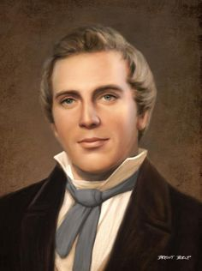
The Prophet Joseph Smith taught:
“God judges men according to the use they make of the light which He gives them.”
Romans 2:12
(10)

Slide 14
"Does salvation come, then, by works?
No, not by the works of the law of Moses, and for that matter, not even by the more perfect works of the gospel itself.
Salvation comes through Christ's atonement, through the ransom he paid, the propitiation he made; without this no good works on the part of men could redeem them from temporal death, which redemption is resurrection, or redeem them from spiritual death, which redemption is eternal life."
Romans 2:20
(10)

Slide 15
Through faithful acceptance of the Atonement of Jesus Christ, all mankind may be justified and receive salvation
Romans 3:26

Slide 16
What actions or thoughts cause a person to draw away from the Lord?
What happens spiritually when we draw away?
What effect does sin have in our lives?
How does it feel to lose the Lord’s spirit?
Why is darkness a good representation for being void of the spirit?
Why do you think some People seem to prefer the darkness to Light?
Righteousness
Sin

Slide 17
What actions or thoughts cause a person to draw toward the Lord?
What happens spiritually when we draw closer to the Lord?
What effect does righteousness have in our lives?
How does it feel when we feel the Lord’s spirit?
Why is light a good representation of the spirit?
Why do you think people prefer the Light of Christ?
Sin
Righteousness

Slide 18
Justification
For All Has Sinned = God cannot accept sin and that every accountable person commits sin.
Being “pardoned from punishment for sin and declared guiltless”
Help or strength, given through the bounteous mercy and love of Jesus Christ”
Justification
Grace
propitiation
Atoning sacrifice and source of mercy
Romans 3:24-31

Slide 19
Sources:
Suggested Hymn: #254 True to the Faith verse 3
Videos:
“Come unto Me, O Ye House of Israel”
Because I Have Been Given Much (4:26)
The Lord’s Law of Chastity Is Clear (1:37)
Natural Affection (2:03)
New Testament Institute Student Manual Chapter
Talk thru the Bible by Bruce Wilkinson and Kenneth Boa pp.367
Elder Bruce R. McConkie (DNTC, 2:216.)
Thomas S. Monson, "That All May Hear," Ensign, May 1995, 49.
N. Eldon Tanner ("Never Be Ashamed of the Gospel of Christ," Ensign, Feb. 1980, 5)
B.H. Roberts (The Falling Away, [Salt Lake City: Deseret Book Co., 1931], 204)
Elder Robert L. Backman Jesus is the Christ Oct. 1991 Gen. Conf.
C. S. Lewis (Mere Christianity, New York: Collier Books, 1960, p. 167.)
Richard Lloyd Anderson, Understanding Paul [Salt Lake City: Deseret Book Co., 1983], 175.)
(Teachings of Presidents of the Church: Joseph Smith [2007], 405).
Elder Bruce R. McConkie (Doctrinal New Testament Commentary, 3 vols. [Salt Lake City: Bookcraft, 1965-1973], 2: 231.)
Presentation by ©http://fashionsbylynda.com/blog/

Slide 20
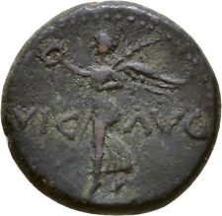
PAUL’S Letter to the Romans (55-56 AD)
The Power of God unto Salvation | 1:1–17
God’s Anger Against the Unrepentant Depraved | 1:18–32
All Men Are Judged by Gospel Standards | 2:1–11
Man Is Not Justified by the Law of Moses | 2:12–29; 3:1–20
Man Is Justified by Faith | 3:21–31
Romans:
“Romans defines the gospel and summarizes the laws by obedience to which full salvation comes. It speaks plainly of Adam’s fall, which brought death, and Christ’s atoning sacrifice, which brought life. It tells how the law of justification works, how men are justified by faith and works, through the blood of Christ. In it are some of the most explicit Biblical teachings on the election of grace, the status of the chosen race, on why salvation cannot come by the law of Moses alone, on why circumcision was done away in Christ, and on how and why salvation was taken to the Gentiles. And it is a chief source of the glorious doctrine of joint-heirship with Christ, that marvelous principle under which men, through celestial marriage and the continuation of the family unit in eternity, can gain exaltation in the highest celestial heaven. …
“In its very nature Romans is an epistle capable of differing interpretations. Those without prior and full knowledge of the doctrines involved find it exceedingly difficult to place Paul’s comments about these doctrines into their true perspective.
For instance, it is on a misunderstanding of the Apostle’s statement about justification by faith alone that the whole sectarian world is led to believe that men are not required to work out their own salvation; and it was this very passage that enabled Martin Luther to justify in his own mind his break with Catholicism, an eventuality of vital importance to the furtherance of the Lord’s work on earth.” Elder Bruce R. McConkie (McConkie, DNTC, 2:212–13.)
Life and Teachings of Jesus and His Apostles Chapter 39
When did Paul Write the Letters to Rome? Acts 20:2-3:
Luke tells us that during Paul’s third missionary journey the apostle spent three months in Corinth. He was probably waiting for good sailing conditions before departing for Jerusalem. From these clues it can be said with some certainty that the letter to Rome was written from Corinth near the end of the third journey, most likely during the winter months of A.D. 57–58.
Life and Teachings of Jesus and His Apostles Chapter 39
"Background: The City
"Perhaps a million people were interlocked in Rome, city of the emperor, the aristocracy, and the masses. Augustus could claim that he found a city of brick and changed it to marble. This boast had merit, for he left behind an astounding list of temples and public buildings that he built and repaired. Political and geographical center of the empire, Rome had long attracted Paul as a culminating missionary opportunity. He wrote to the Saints that he had desired 'these many years to come unto you' (Rom. 15:23)...Rome is wicked but on the move with projects and ideas-an international city and a melting pot...And the Jews? They are also unwelcome realities in Roman satire." (Richard Lloyd Anderson, Understanding Paul [Salt Lake City: Deseret Book Co., 1983], 169.)
"The church at Rome was composed of a mixture of Jewish and gentile converts. The Apostle Paul is aware that the different backgrounds of these two groups, prior to church membership, brought about conflicting views among them. His chief concern is with the claimed necessity and benefits of the law of Moses. Preoccupation with the centuries-old, legalistically annotated law had left a deep imprint in the lives of the Jewish converts to the church. The gentile converts were influenced by the Hellenistic philosophical system and concepts of learning. Their accompanying paganistic worship of idols was an additional deterrent to the proper understanding of gospel truths about which they were cautioned. (Rom. 1:20-25.)" (Edward J. Brandt, "New Testament Backgrounds: Romans," Ensign, Jan. 1976, 82)
Nero Ancient Coins
Rome 41-68 AD

Slide 21
Jew and Greek (Gentile).
The Jews were the surviving members of God’s covenant people, Israel, to whom He had revealed the law of Moses over one thousand years before Christ. Paul used both the terms Greek and Gentile to refer to people who were not born into the house of Israel. (1)
Inward and Outward Acts 2:15-30:
Paul reminded the Roman Saints that circumcision, which had been required by the law of Moses, was no longer required of God’s people, for the Savior’s earthly mission and atoning sacrifice had fulfilled the law of Moses. Any outward ordinance—whether circumcision in the Abrahamic covenant or baptism and the sacrament in the gospel covenant—has meaning only if it is done with sincerity and real intent
Idolatry Romans 1:21-23:
Paul wrote that when people refused to worship the Creator, they often turned to the worship of images of men and beasts. In the Greco-Roman world in which Paul ministered, idol worship and its accompanying mythologies formed an integral part of ancient religion and culture. (1)
Atoning Sacrifice Acts 3:
"So Paul taught these people-who thought that they could be saved by some power that was within them, or by observing the law of Moses-he pointed out to them the fact that if it were not for the mission of Jesus Christ, if it were not for this great atoning sacrifice, they could not be redeemed. And therefore it was by the grace of God that they are saved, not by any work on their part, for they were absolutely helpless. Paul was absolutely right." President Joseph Fielding Smith (Doctrines of Salvation, 3 vols., edited by Bruce R. McConkie [Salt Lake City: Bookcraft, 1954-1956], 2: 310.)
“In the second chapter of Romans, the Apostle Paul teaches that God will ‘judge the secrets of men’ (Romans 2:16). His judgment will be ‘according to truth’ (Romans 2:2). In describing that judgment, Paul contrasted the position of those Jews who preached the law and then did not practice it with Gentiles who did not have the law but whose actions ‘shew the work of the law written in their hearts’ (Romans 2:15). He concluded his example with this teaching:
“‘For he is not a Jew, which is one outwardly; neither is that circumcision, which is outward in the flesh:
“‘But he is a Jew, which is one inwardly; and circumcision is that of the heart, in the spirit, and not in the letter; whose praise is not of men, but of God.’ (Romans 2:28–29.)
“To paraphrase, a person is a true Latter-day Saint if he (or she) is so inwardly, if his conversion is that of the heart, in the spirit, whose praise is not from men for outward acts but from God for the inward desires of his heart.
“… The issue is not what we have done but what we have become. And what we have become is the result of more than our actions. It is also the result of our attitudes, our motives, and our desires” Elder Dallin H. Oaks (Pure in Heart[1988], 138–39).
Immorality Romans 1:24-28:
Paul identified various sexual sins that were common among Gentiles in the ancient Greco-Roman world—sins Paul termed “not convenient,” meaning not fitting or correct. Paul taught that because of people’s immorality, “God gave them up [abandoned or delivered them] unto vile affections” and “to a reprobate mind [depraved thinking]”. They then “[received] in themselves that recompence of their error which was meet”. When people commit sexual sins, they separate themselves from God, and God allows them to experience the consequences of their sins. This does not show a lack of love on God’s part; rather, He is allowing the natural consequences of sinful behavior to occur (see John 15:10; D&C 95:12). (1)
Rome may have been the cultural and political capital at the time, but it was also the capital of sexual sin and homosexuality. Paul could not afford to avoid this subject as it was so prevalent among the Romans of the day. So prevalent in fact that it contributed to the very fall of Rome. "The grandeur of ancient Greece, the majesty of Rome, once the proud rulers of the world, have disappeared; and the verdict of history specifies the prevalence of sexual immorality as among the chief of the destructive agencies by which the fall of those mighty peoples was effected." (Editors' Table, Improvement Era, 1917, Vol. Xx. June, 1917. No. 8)
First Presidency Statement on Same-Gender Marriage:
“Homosexual and lesbian behavior is a serious sin. If you find yourself struggling with same-gender attraction or you are being persuaded to participate in inappropriate behavior, seek counsel from your parents and bishop. They will help you” (For the Strength of Youth [booklet, 2011], 36).
“The Church’s doctrinal position is clear: Sexual activity should only occur between a man and a woman who are married. However, that should never be used as justification for unkindness. Jesus Christ, whom we follow, was clear in His condemnation of sexual immorality, but never cruel. His interest was always to lift the individual, never to tear down. …
“The Church distinguishes between same-sex attraction and behavior. While maintaining that feelings and inclinations toward the same sex are not inherently sinful, engaging in homosexual behavior is in conflict with the ‘doctrinal principle, based on sacred scripture … that marriage between a man and a woman is essential to the Creator’s plan for the eternal destiny of His children’ [“First Presidency Statement on Same-Gender Marriage,” mormonnewsroom.org]” (“Same-Sex Attraction,” Gospel Topics, lds.org/topics).

Slide 22
Structure of Letters During Paul’s Time--Example
Form | Scripture Example | Scripture
The sender’s name and office | Paul, a servant of Jesus Christ, called to be an apostle, separated unto the gospel of God | Romans 1:1
The name of the recipient | To all that be in Rome, beloved of God, called to be saints: | Romans 1:7
A greeting or wish for prosperity | Grace to you and peace from God our Father, and the Lord Jesus Christ…For I long to see you that I may impart unto you some spiritual gift… | Romans 1:7, 11
The main body of the letter | The wrath of God rets on those guilty of sin; The deeds of men; the judgements, both Jew and Gentiles; justification; faith, works and grace; being saved through atonement; baptism a similitude; Christ brings eternal life; law of Moses fulfilled in Christ; the inward man; the law of Christ; adopted children of God; the elect; foreordination; salvation; How to live as a saint; How to treat others; fellowshipping and preaching gospel | Romans 1-16
A farewell with closing greetings and good wishes | The grace of our Lord Jesus Christ be with you all. Amen To God only wise, be glory through Jesus Christ for ever. Amen | Romans 16:24,27
The signature of the writer | “I Tertius [the scribe] who wrote this epistle, salute you in the Lord | Romans 16:22

