Slide 1
Who was John the Baptist?

Slide 2
John’s forthcoming birth and ministry were announced to John’s father by the angel Gabriel
(Luke 1:5-25)

Slide 3
John was the son of Zacharias and Elisabeth being a priestly descent through both parents.

Slide 4
John was a child of promise, with prophecies of his mission having been given by Isaiah (40:3) and Malachi (3:1) and Nephi (1 Nephi 10:7-10)

Slide 5
John was baptized at a
very early age
John was ordained to the priesthood at the time he was eight days old
( D&C 84:27-28)

Slide 6
John was a cousin of Jesus and born 6 months before Jesus

Slide 7
John grew up in the desert until the time arrived for his ministry to prepare the way for the Savior

Slide 8
John had preached and baptized for several months before he baptized the Savior, and continued to do so afterwards for several months.
(John 3:23-24)

Slide 9
John, the beloved, and Andrew, later members of the Twelve were baptized and disciples of John the Baptist. Others were probably tutored by John
(Acts 1:21-22)

Slide 10
At the time of Jesus’ baptism, John saw the sign and heard the voice of the Father bearing record that Jesus was the Beloved Son, in whom the Father was well pleased
(Matthew 3:13-17)

Slide 11
The sign of the dove, as an emblem for the Holy Ghost, was a pre-appointed signal by which John knew he was to recognize that he had baptized the Son of God.
(John 1:29-34)

Slide 12
John was shut up in prison by order of Herod, for criticizing Herod’s unlawful marriage of Herodias
(Mark 6:16-29)

Slide 13
While in prison, John sent two of his disciples to inquire of Jesus to reassure their faith. Jesus took the occasion to bear testimony of the great work John had done, emphasizing that he was unwavering and true.
(Luke 7:24-28)

Slide 14
After nearly a year in prison, John was beheaded at the instigation of Herodias
(Matthew 14:3
Mark 6:17)
John
the Baptist

Slide 15
On May 15, 1829 John came to Joseph Smith and Oliver Cowdery on the banks of the Susquehanna River near Harmony, Pennsylvania, and ordained them to the Priesthood of Aaron
(D&C 13, 27: 7-8)
(JS-H 1:68-72)

Slide 16
John’s ministry has operated in three dispensations; He was the last of the prophets under the law of Moses, he was the first of the New Testament prophets, and he brought the Aaronic Priesthood to the dispensation of the fulness of times.

Slide 17
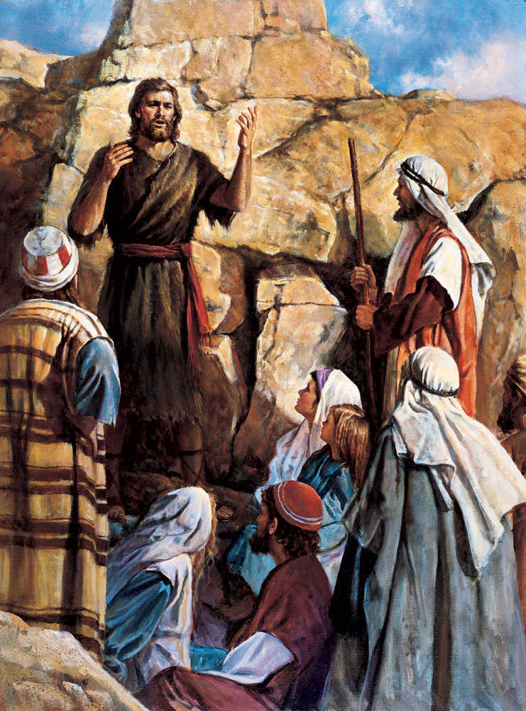

Slide 18
Sources: Bible Dictionary

