Slide 1
Luke’s Historical Account of Paul’s Mission
Acts 8-21

Slide 2
Historical Summary of Saul/Paul
Paul persecutes Church | Acts 8
Jesus appears to Saul—a chosen vessel | Acts 9
Paul is baptized and starts ministry | Acts 9
Paul Goes to Arabia (about 3 years) | Galatians 1:16-17
Paul receives direct revelation from Jesus | Galatians 1:11-12
Paul returns to Damascus ready to preach | Acts 9
Paul is persecuted, disciples help him flee out of a window in a basket | Acts 9

Slide 3
Paul goes to Jerusalem | Acts 9
Barnabas befriends Saul/takes to Peter and James | Acts 9
Paul has vision in Temple—depart to Gentiles | Acts 22
Paul leaves from Caesarea to Tarsus | Acts 9
Paul preaches in Syria and Celicia for 4 years | Galatians 2:24
Barnabas seeks Saul to go to Antioch | Acts 11
Disciples called Christians first in Antioch | Acts 11
Famine in the area | Acts 11

Slide 4
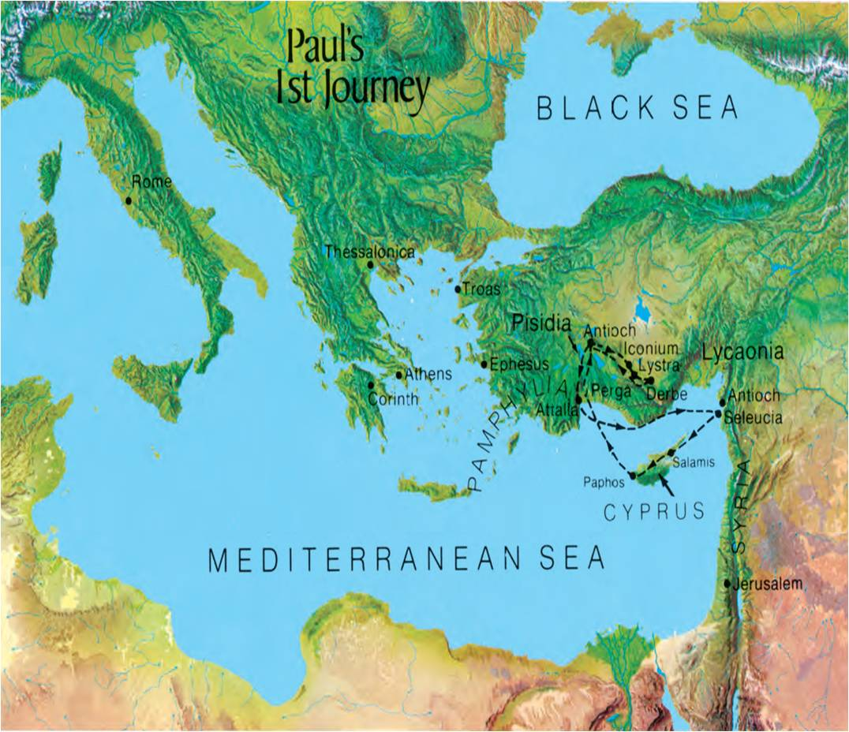

Slide 5
1st Mission—Barnabas companion
Paul and Barnabas are set apart to preach to Gentiles | Acts 13:2-3
They take John Mark as companion, helper | Colossians 4:10
They sail to Cyprus and go to southern Galatia | Acts 13
Luke now refers to Saul as Paul his Roman name | Acts 13:9
They preach in Antioch | Acts 13:4
John Mark leaves Paul and Barnabas | Acts 13:13
Paul’s Sermon | Acts 13:16-41

Slide 6
1st Mission—Barnabas companion
They are Rejected by Jews and expelled | Acts 13:46-50
They go to Iconium, capital of Lycaonian District | Acts 13:51
They are persecuted and flee to Lystra and Derbe | Acts 14:6
Paul is stoned but survives | Acts 14:19
They go to Derbe and revisit converts | Acts 14:20
They return to Lystra, Iconium, Attalia sailing to Antioch to give report of mission /abides 3 years in Antioch | Acts 14:28

Slide 8
2nd Mission—Silas companion
Paul wants to return to previous places—contention over John Mark | Acts 15:36-37
Paul’s new companion—Silas | Acts 15:40
Syria, Cilicia—confirming churches | Acts 15:41
They go to Lystra and Derbe, Timothy joins them | Acts 16:1
They are forbidden to preach in Asia through the Holy Ghost | Acts 16:6
Vision in Trous to go to Macedonia--Philippi | Acts 16:9-12

Slide 9
2nd Mission—Silas companion
Paul and Silas scourged and put in prison | Acts 16:23
Earthquake to release prisoners | Acts 16:26
They go to Thessalonica | Acts 17:1
Preaching causes a Riot at Jason’s house | Acts 17:5-9
Missionaries are asked to leave | Acts 17:10
They go to Berea with success | Acts 17:10
Brethren send Paul away but Silas and Timothy stay in Berea | Acts 17:3
Paul Goes to Athens | Acts 17:15

Slide 10
2nd Mission—Silas companion
Paul’s sermon at Mars Hill | Acts 17:22-31
Paul goes to Corinth | Acts 18:5
Silas and Timothy join him/report on Thessalonica Acts 18:5 | Acts 18:5
Paul’s first Epistle to the Thessalonians
Paul receives vision to stay in Corinth and stays 1 ½ years and writes: Second Epistle to the Thessalonians | Acts 18:9
Paul sails to Syria to Ephesus to Antioch and rests from mission---goes to Feast of Tabernacle | Acts 18:19

Slide 12
3RD Mission—NO KNOWN COMPANION
Paul promises to revisit Corinth | Acts 18:19-21
Paul goes to Galatia—Phrygia—Ephesus (Asia) | Acts 18:23
Quick visit to Corinth | Acts 20:2-3
Paul passes through Macedonia and Achaia then onto Jerusalem “must see Rome” | Acts 19:21
Paul’s plan is abandoned to visit Corinth and writes: 1st Epistle to Corinthians
Paul sends Timothy and Erastus to Macedonia and Paul remains in Roman Asia | Acts 19:22

Slide 13
3RD Mission—NO KNOWN COMPANION
Timothy returns and reports on Corinth and Paul writes: 2nd Epistle to Corinthians sends with Titus
Paul and the silversmith demonstration | Acts 19:24-41
Paul departs from Ephesus to Macedonia | Acts 20:1
Paul sails with others making many stops to Miletus and has Elders from Ephesus present and predicts Apostasy | Acts 20:18-35
Paul sails to Tyre and stays with Philip whose 4 daughters had the gift of prophecy | Acts 21:8-9
Paul is warned by Tyrians not to go to Jerusalem, but returns and reports mission of 4 years | Acts 21:7

Slide 14
