Slide 1
The Bridegroom Cometh
Parable of the 10 Virgins
Part 2
vb

Slide 2
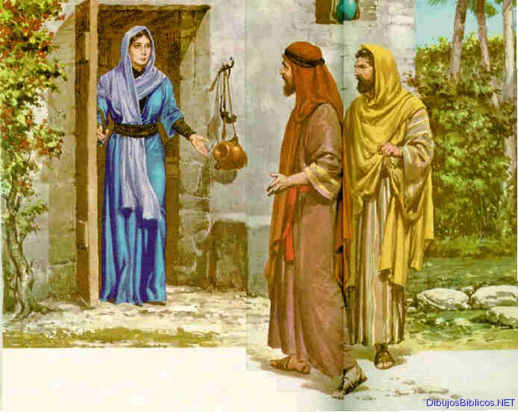
Anxiously Waiting---to hear the shouts of the wedding procession.
Father of bridegroom gives permission and the
“friend of the bridegroom” keeps her informed of progress.

Slide 3
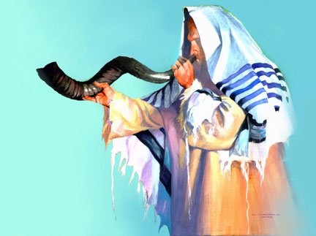
2 Invitations
The First Invitation or calling of the wedding was sent out at the time of the betrothal

Slide 4
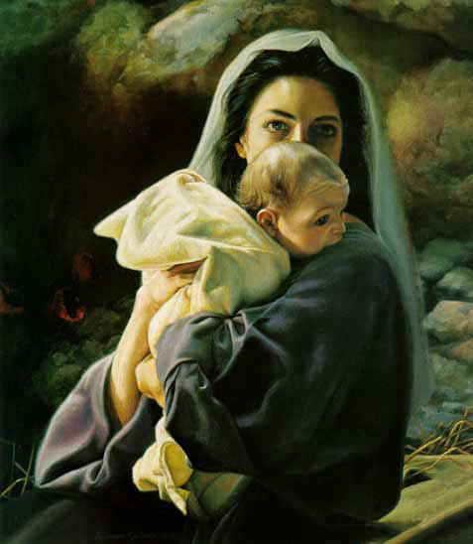
Establishing the “Call” to God’s Children
Jesus comes to earth to set up his kingdom.

Slide 5
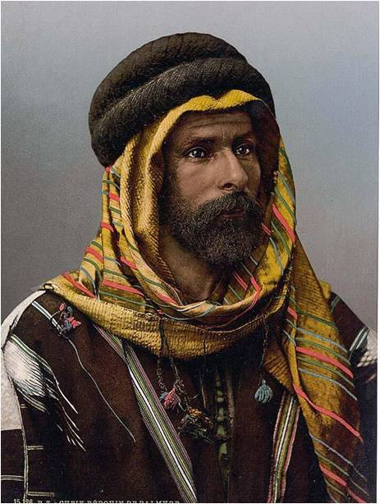
The Second announcement comes when the Bridegroom comes.

Slide 6
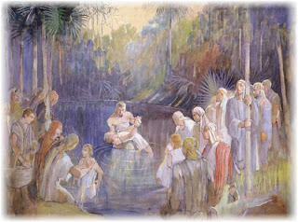
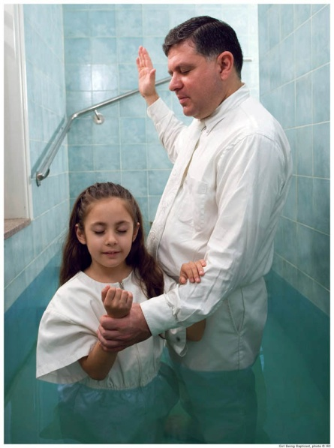
Hearing the “Call”
Showing that he had been invited

Slide 7
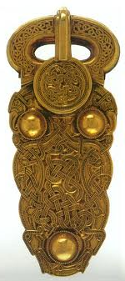
Moving the Buckle
“No citizen of Jerusalem would attend a
banquet without changing his buckle from
(one shoulder to the other shoulder.)
For what reason?
So that another person
should not extend to him an invitation
that would be wasted.”
Beloved Bridegroom Nielson P. 40

Slide 8
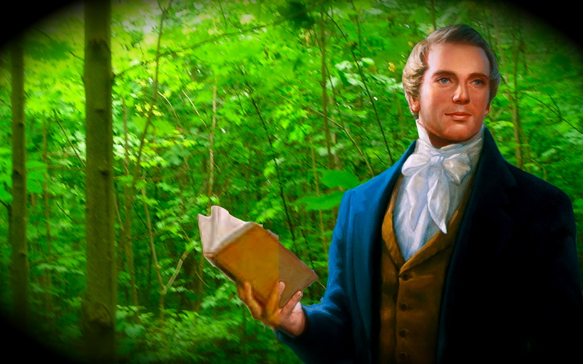
The Second Announcement came with the Restoration which is in effect today.

Slide 9
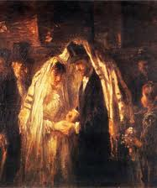
Bridegroom Dress
Richest garments.
Sometimes wearing a crown.
Even though the Bride
would be beautifully
adorned, the groom would
be the center of
attention.

Slide 10
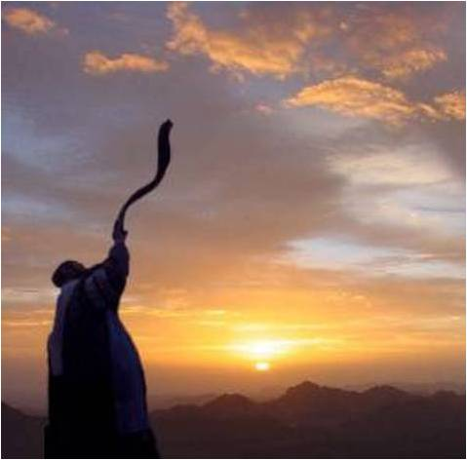
Noisy Procession
Gathering people as they go
Blowing trumpets (shofars)
Most always in the middle of
the night waking everyone on
their way carrying torches to
light their way

Slide 11
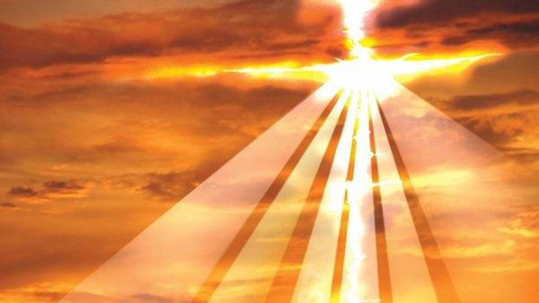
Companions of the Savior are those with
light who can see their way and are calling
out to gather others to Come unto Christ.

Slide 12
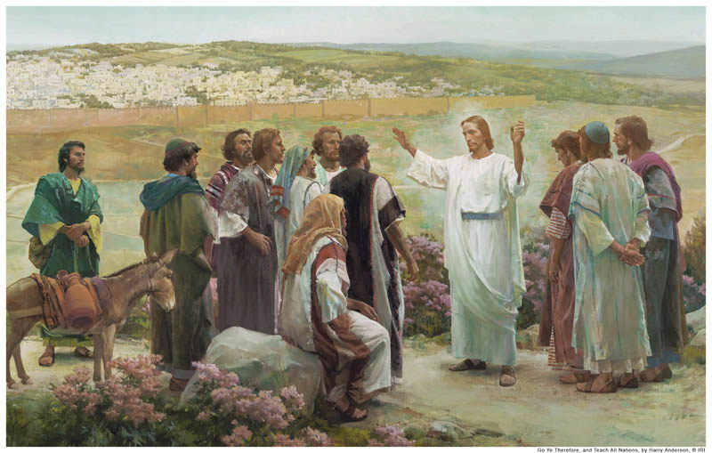
Messenger
“The Bridegroom Cometh”
30 minutes final preparations for the Bride.

Slide 13
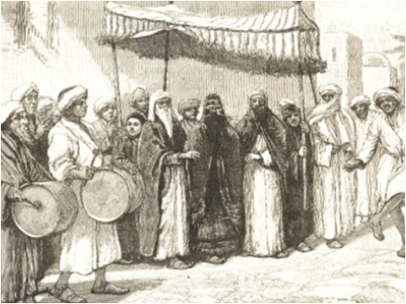
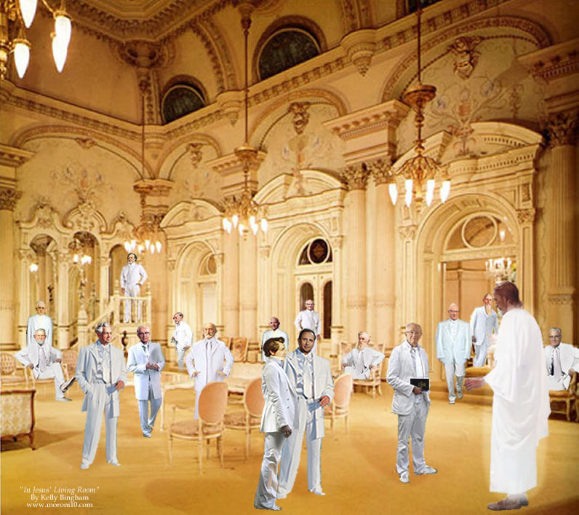
Then they would call out again:
“The Bridegroom cometh!”

Slide 14
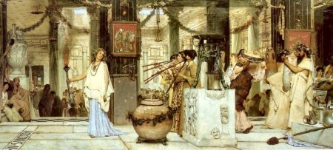
Going to the Bride’s home
Others shout followed by the groom

Slide 15
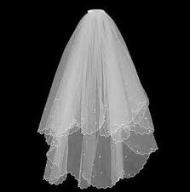
The Right Bride
The bride’s father would check to make sure this was the right young man and would let him take the bride.
The groom was able to check under the veil to make sure it was the right bride.
(mix up Jacob and Rachel)

Slide 16
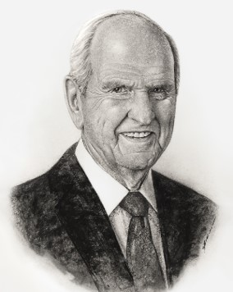
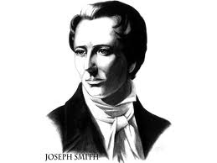
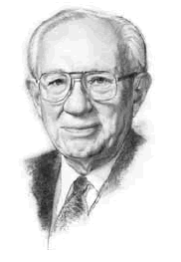
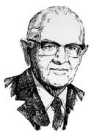
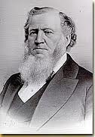
A Prophet is the one who makes the announcements for final preparations.
Read Family Proclamation for our final preparations.

Slide 17
One half hour of silence in the heavens before the Savior comes. (Revelation 8:1)
The Lord will come again in a dark “midnight” hour… (Matthew 24:22)

Slide 18
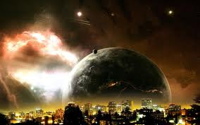
When the world is ripe in iniquity…
“And except those days should be shortened, there should no flesh be saved; but for the elect’s sake those days shall be shortened.”
Matthew 24:22

Slide 19
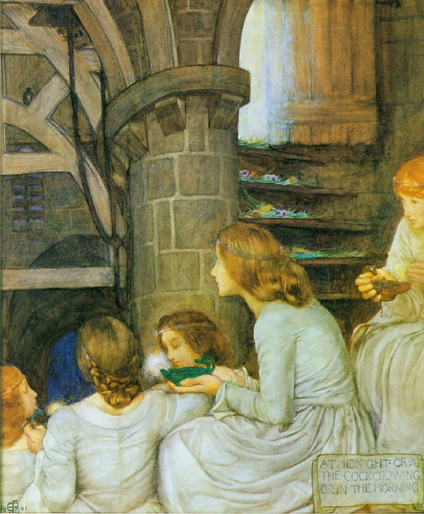
Is the Bride Ready?
“Not good and bad, not righteous and wicked, but wise and foolish. That is, all of them have accepted the invitation to meet the Bridegroom, all are members of the Church…but only five are valiant therein.”
Bruce R. McConkie Doctrinal New Testament 1:685

Slide 20
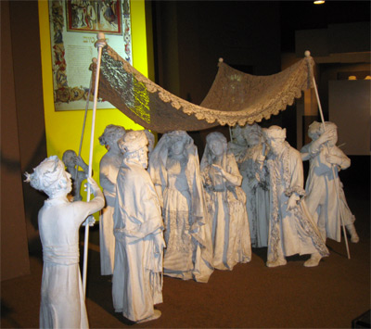
Are We Ready?
They all thought they were ready.
Outwardly , they all appeared prepared.
Lynn G. Robbins Oil in Our Lamps

Slide 21
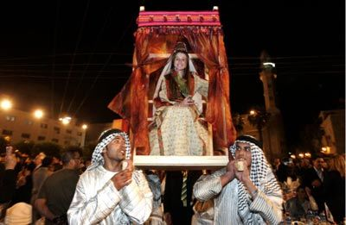
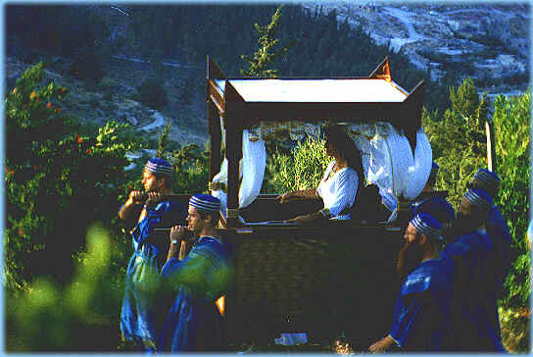
“Lifting up” the bride
“aperion”
Carried to her new house
4 strong honorary men “heroes of Israel” carry chair

Slide 22
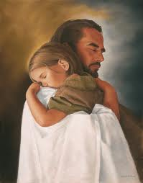
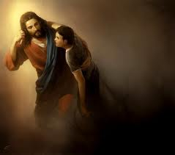
Christ was lifted up on the cross so that he could lift us through the ordinances of the Gospel as administered by the Priesthood.
We are carried in comfort because we bear the name of our Lord.

