Slide 1
The Law of Moses Prepares
Galatians 3-6
Presentation by ©http://fashionsbylynda.com/blog/

Slide 2
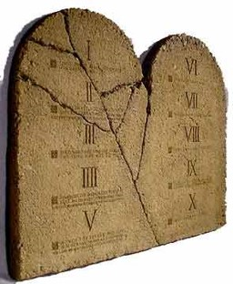
Paul explains the Purpose of the
Law of Moses to the Galatians
“Wherefore then serveth the law?”
What is the purpose of the Law of Moses?
Galatians 3:19

Slide 3
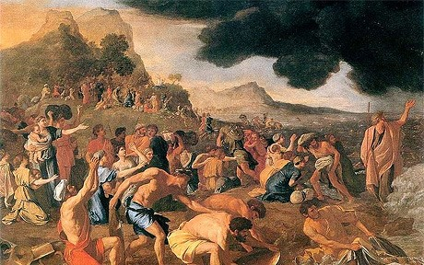
Adding to the Commandments
“It was added because of transgressions,
Because the people were not keeping the commandments
Galatians 3:19

Slide 4
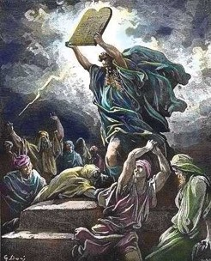
Not Understanding the Law
And now, did they understand the Law? I say unto you, Nay, they did not all understand the law…
…and this because of the hardness of their hearts; for they understood not that there could not any man be saved except it were through the redemption of God.”
Mosiah 13:32

Slide 5
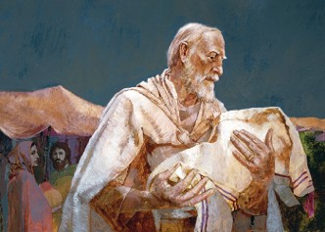
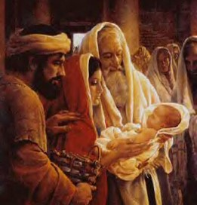
How long shall they be under the Law of Moses?
“till the seed should come to whom the promise was made;”
Till Christ comes and brings in the full gospel
Galatians 3:19

Slide 6
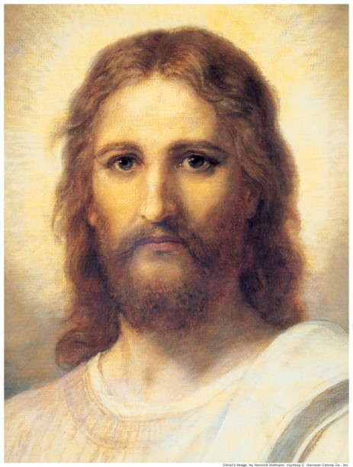
Who is the mediator?
“Now a mediator is not a mediator of one, but God is one.”
Jesus Christ is the mediator
Galatians 3:20

Slide 7
Promises of God
“Is the law then against the promises of God?”
The Law of Moses was a divine institution and was not opposed to God’s promises.
However…
Galatians 3:21

Slide 8
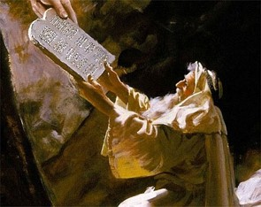
A Guidance—A Beginning
“The Law was given as a protection to the Jews as a moral guide to make them sin-and-guilt-conscious.”
Each one of us has started out with guidance since we were born.
Dr. Sidney B. Sperry

Slide 9
Temporary Wheels
A bike with training wheels
“Yet the Lord God saw that his people were a stiffnecked people, and he appointed unto them a law, even the law of Moses.”
Mosiah 3:14

Slide 10
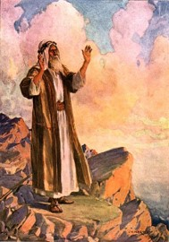
The Law of Training
Lower Law= The Law of Moses
Moses testified of Christ and other prophets, yet the people did not believe Moses therefore they were not prepared to receive Christ.”
Higher Law=Yet to come in the event of Jesus Christ
Mark E. Peterson

Slide 11
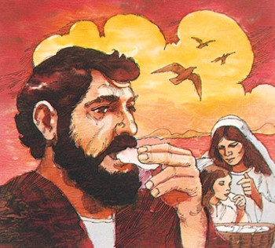
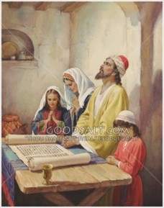
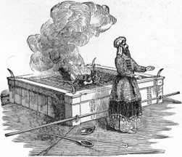
Types of Laws
How to eat
How to celebrate an occasion
Rituals such as sacrifices
How to Pray
“Behold, I am he that gave the law, and I am he who covenanted with my people Israel…

Slide 12
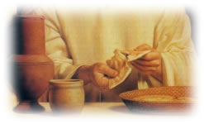
Law Fulfilled
“Behold, I am he that gave the law, and I am he who covenanted with my people Israel…
…therefore, the law in me is fulfilled, for I have come to fulfil the law; therefore it hath an end.”
3 Nephi 15:5

Slide 13
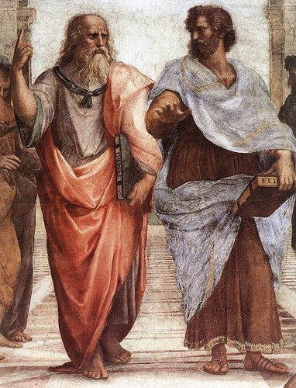
Schoolmaster
“When Christ came there was no need for a tutor (law) for it had filled its purpose”
“Wherefore the law was our schoolmaster to bring us unto Christ, that we might be justified by faith.”
Galatians 3:24

Slide 14
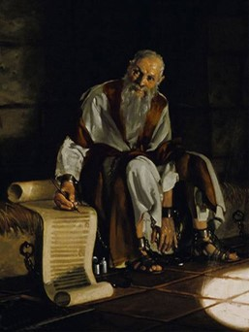
Superior Law
Paul wanted the Galatian Saints to understand that the blessings of the gospel are superior to what the law Moses offered.

Slide 15
Higher Gospel Law
The Bike
“But after that faith is come, we are no longer under a schoolmaster.
Galatians 3:25

Slide 16
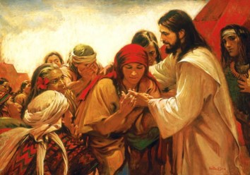
Nephites look for the law to be fulfilled
“And, notwithstanding we believe in Christ, we keep the law of Moses, and look forward with steadfastness unto Christ, until the law shall be fulfilled.”
“For, for this end was the law given; wherefore the law hath become dead unto us, and we are made alive in Christ because of our faith; yet we keep the law because of the commandments.”
2 Nephi 25:24-25

Slide 17
The Law of Moses was given to a righteous people (Galatians 3:19)
The law of Moses was intended to last forever (Galatians 3:19)
Abraham knew that Jesus Christ would come. (JST Galatians 3:20)
The law of Moses removed the need for the promised Savior. (Galatians 3:21)
Everyone sins; everyone needs Jesus Christ and His Atonement.
The law of Moses, by itself, limited spiritual growth (Galatians 3:23)
Yes No
Yes No
Yes No
Yes No
Yes No
Yes No

Slide 18
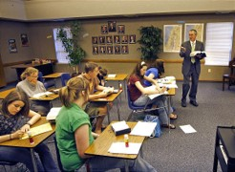
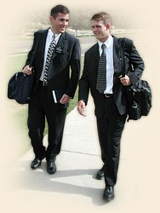
Spiritual Training Wheels of Today
Parents
Primary
Institute
Mission
Seminary

Slide 19
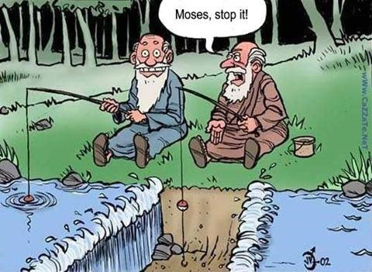
Sources:
Dr. Sidney B. Sperry “Paul’s Life and Letters” page 163, 169
Mark E. Peterson “The Way of the Master” Page 75
Presentation by ©http://fashionsbylynda.com/blog/

