Slide 1
The Marriage Supper
Parable of the 10 Virgins
Part 3

Slide 2
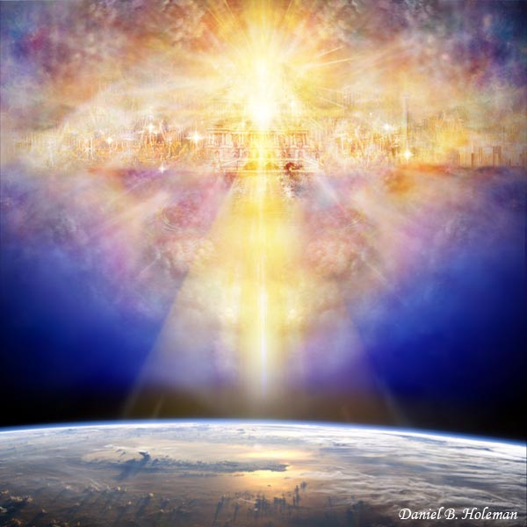
The marriage feast---The Second Coming of the Savior to receive his Church unto Himself.

Slide 3
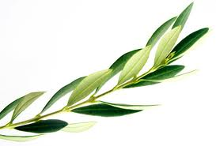
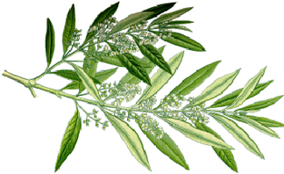
At the newly prepared home the bride and groom are crowned with garlands of olive leaves---symbol of great joy.

Slide 4
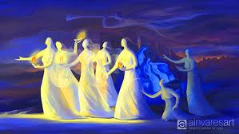
10 Virgins
The Number 10 symbolizes:
Long standing tradition---testing and trials.
Meaning:
Worthiness, consecration, and holiness

Slide 5
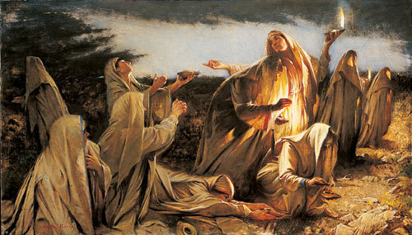
The 10 Virgins represent the Church, they are symbolic of the actual brides…not bridesmaids or guests

Slide 6
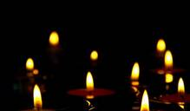
10 was the minimum number of lamps that were required at a wedding while the traditional blessings were recited.

Slide 7
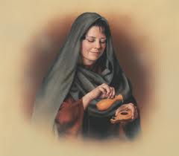
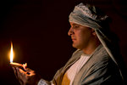
It was a religious duty to bring a light when attending a wedding.

Slide 8
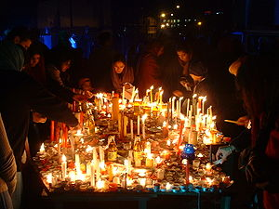
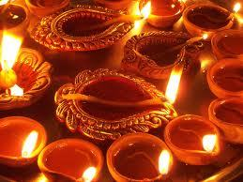
During the weeklong celebration the father’s
house was continually lit.

Slide 9
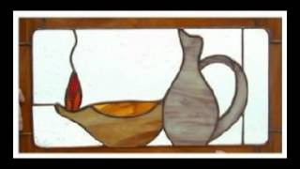
Visitors usually bought oil in the town
where the wedding was to take place. Some
people brought their own with them.
Since the wedding was a surprise and at
night everyone knew they had to have
stores of oil on hand.

Slide 10
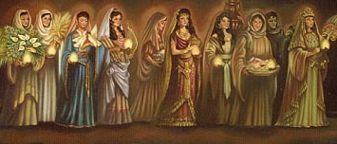
Level of obedience with all ten:
All 10 had lamps with oil in them.
All 10 took lamps with them.
All 10 were invited to the wedding.
(they were all His brides)
All 10 slept, or slumbered, woke up, and went to the wedding.

Slide 11
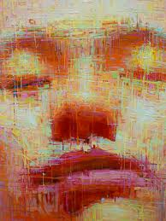
Greek---not all the brides slept
Slumbered---means to nod in signaling or beckoning for what one desires to be done.
Matthew 25:5

Slide 12
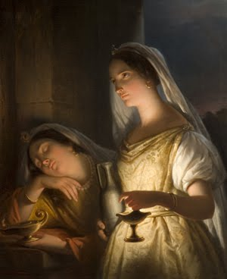
Slumbering--- 5 wise virgins are beckoning for Jesus to return
5 foolish virgins have fallen asleep.

Slide 13
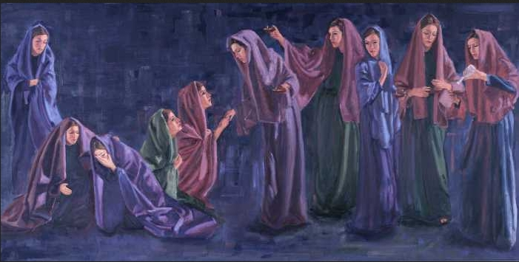
5 foolish virgins knocked, expecting to enter the marriage supper:
They thought they could prepare themselves after the Bridegroom came
Or knowing that they at first had not been prepared to enter, they were hoping for mercy.

Slide 14
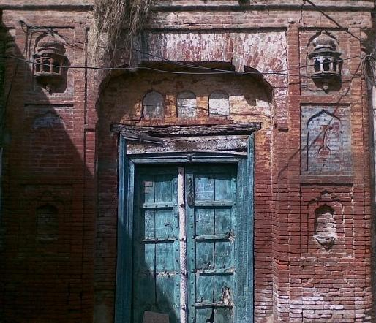
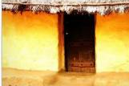
Either way the door was shut

Slide 15
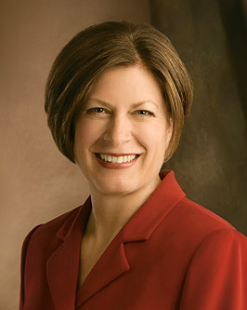
“Learning to recognize and follow the promptings of the Holy Ghost is the most important work we can do personally.”
Julie B. Beck

Slide 16
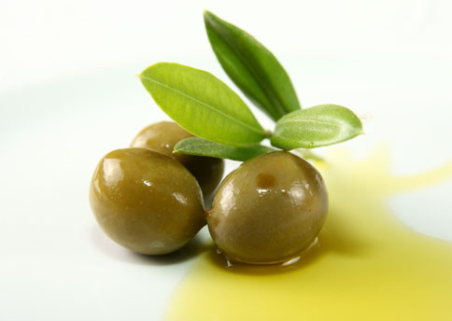
Oil
Olive oil is a symbol of purity and the presence and influence of the Holy Ghost.

Slide 17
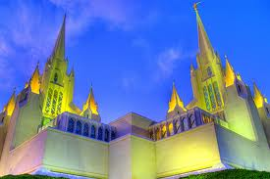
In biblical times
Adequate amount of oil was maintained in lamps
Today—we must exert constant effort to remain temple worthy.

Slide 18
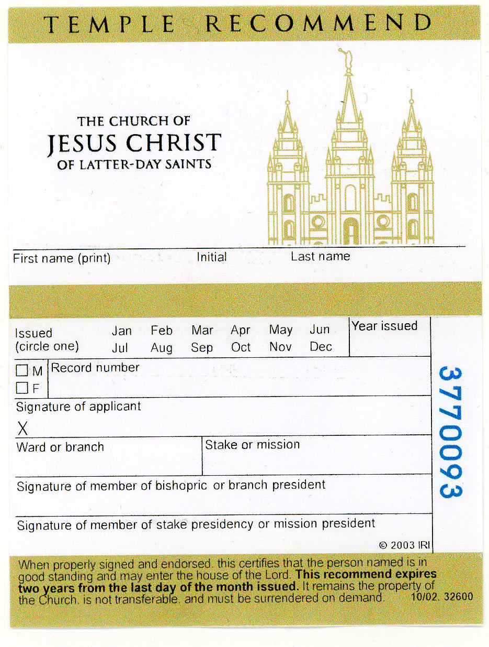
They were not able to enter the door without oil
Neither can we enter the door of the temple without a recommend.

Slide 19
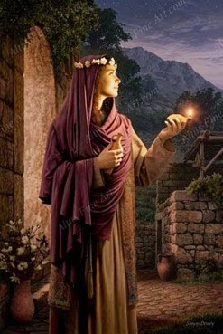
Extra oil is exceedingly important. This extra resource was quite separate from the oil that was in their lamps. The oil the wise carried in their lamps was no greater in supply than the oil in the lamps of the foolish.
All 10 of them saw their lamps began to burn out as the midnight hour approached. The wise virgins certainly had extra oil with them.

Slide 20
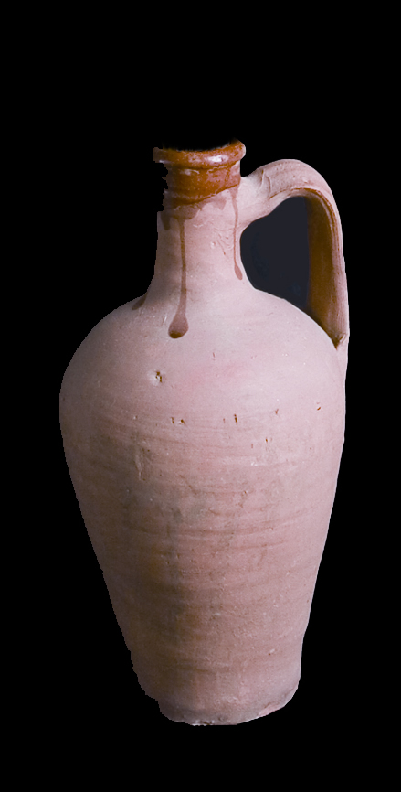
Extra Oil
Their glory and their esteem was not in themselves. The extra oil came from an external source.
Can we save ourselves?
Drop by drop—a process of change that only comes through our submission to Christ.

Slide 21
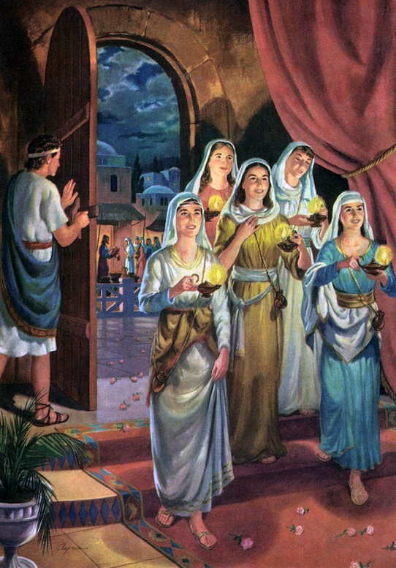
The Door
5 Foolish try to find oil while…
… the 5 Wise are invited in.
A servant is left to guard the door.

Slide 22
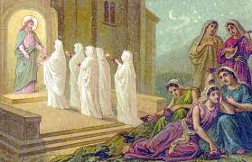
The Guard---The Bridegroom
“for He employeth no servant there.”

Slide 23
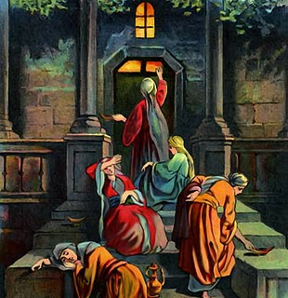
Knock on the Door
“Lord, Lord, open to us.”
“I know you not.” JST “You knew me not”
Matthew 25:11-12

Slide 24
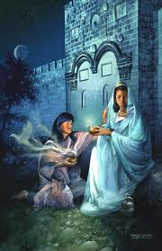
Could the 5 wise virgins share their oil?

Slide 25
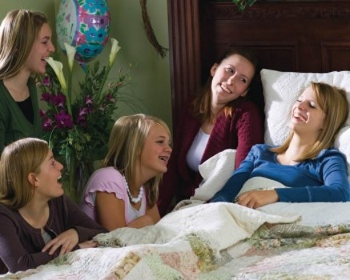
“Not so; lest there be not enough for us and you”
Saints are taught to be compassionate with one another
The wise virgins were not being rude or self-righteous disposition.
Matthew 25:9

Slide 26
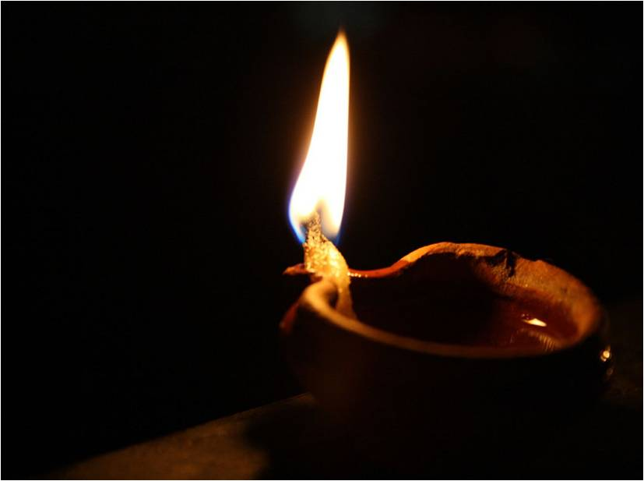
2 thoughts:
Giving their oil would have reduced the evidence of their love and respect for their bridegroom by putting another bride first before Him.
You can not give your testimony to another they must receive their own.

Slide 27
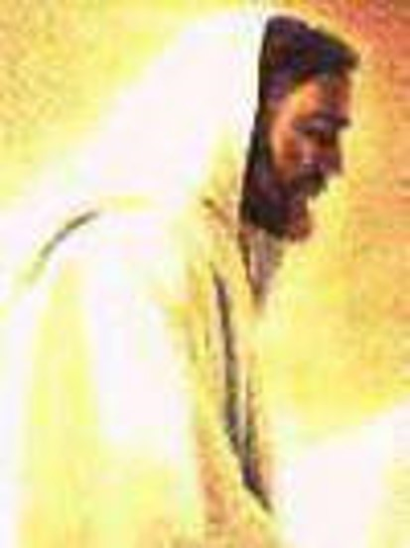
“Go to them that sell and buy for yourselves.”
Buying and “selling” are simply symbolic of getting the oil or character in the only legitimate way---through God and Jesus Christ.
Matthew 25:9

Slide 28
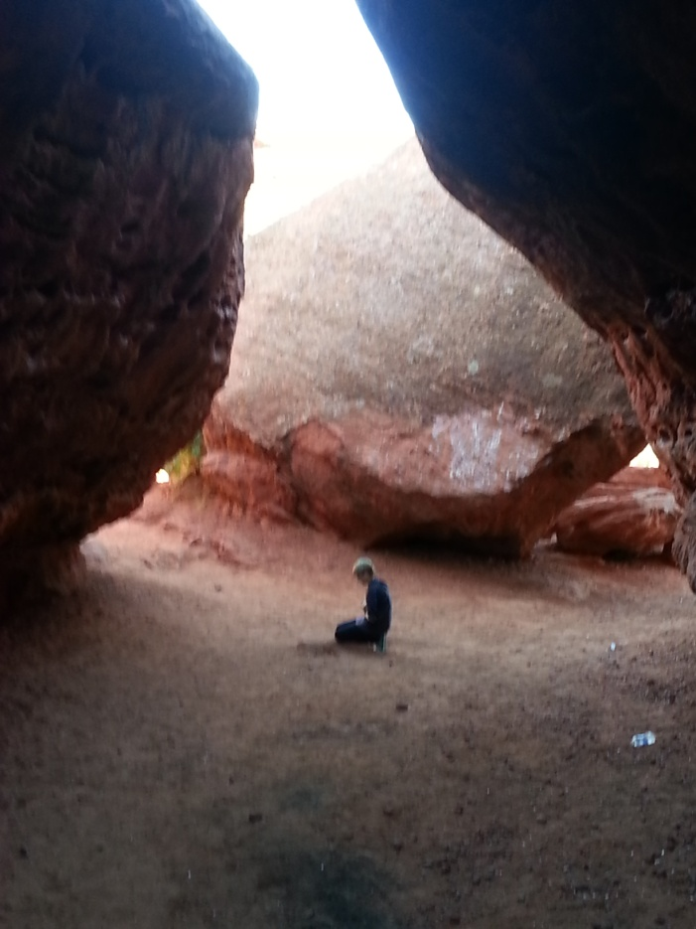
Who “Sells” the oil?
Only Heavenly Father can distribute the oil that brings light. He does it through his Son as we approach the Father in prayer.

Slide 29
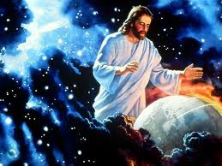
What price do we pay to become like Christ? We give up all - all the world has to offer and all our sins.
The foolish brides also have to give up all - which they had not done or they would have had oil.

Slide 30
It is too late for the foolish virgins.
Do we get all the time we need?
We don't know when our 2nd Coming will be - it will be either at our death, whenever that occurs or at the 2nd Coming.

Slide 31
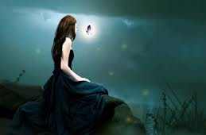
The message of the parable does not teach that they can just go get some oil - or Godlike excellent character - when it is too late.
It is merely the Savior's friendly way of reminding those whom He was teaching to use their agency to pay the price to be ready.

Slide 32
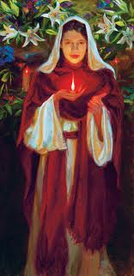
The extra measure of oil requires work.
It requires studying the Scriptures, following the promptings of the Holy Ghost and submitting ourselves to the transforming power of the Savior.

Slide 33
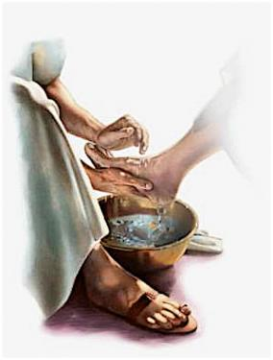
Entrance to the Feast
Washing of hands and feet and anointing, followed by embraced and kissed.
Each guest was individually greeted by the Bridegroom.
All ordinances are done individually.

Slide 34
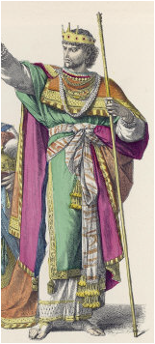
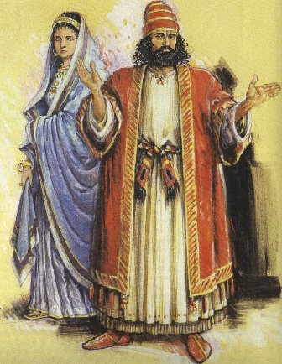
The Wedding
Everyone comes dressed in most beautiful wedding garments.
For Jews white was not a symbol of virginity, but purity and victory over sin.

Slide 35
Garment represents:
The marriage of the Lamb is come, and his wife hath made herself ready…arrayed in fine linen, clean and white for the fine linen is the righteousness of saints.”
(Revelation 19:7-8)

Slide 36
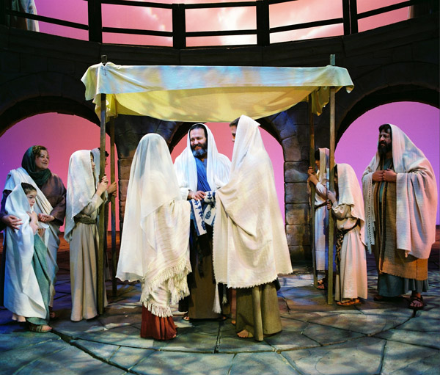
Wedding Canopy
As the bridegroom approaches the canopy (Temple) the guests chant, “Blessed is He who comes.”
“For I say unto you, Ye shall not see me henceforth, till ye shall say, Blessed is he that cometh in the name of the Lord.”
(Matthew 23:39)

Slide 37
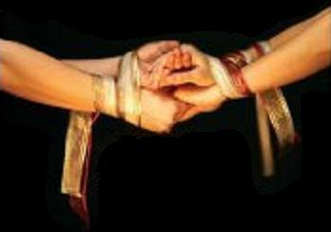
Covenant hands and swaddling bands
“Tying the Knot”
A covenant together that they will live the same high character on the inside and out, especially in their relationship with one another.

Slide 38
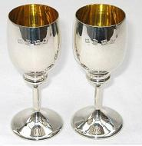
Two cups of wine---
Cup of Joy and Cup of Salvation
Christ drank the bitter cup, we are saved.

Slide 39
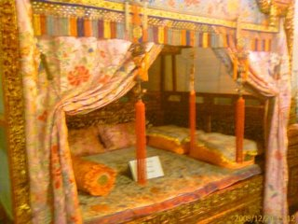
Bridal Chamber
Know one another--Hebrew “Yada” meaning to have intimate experience with.
Bride removes her veil and is seen as she really is.

Slide 40
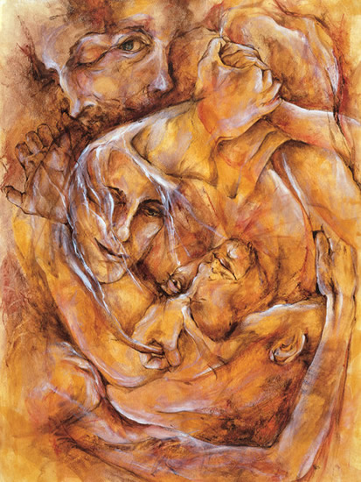
Our Relationship with the Savior
Hebrew word for “one” is “echad” meaning not one single unit but the coming together of more than one into a unity.
The purpose in Biblical understanding was to ”become one” so that together they could “bring forth.”

Slide 41
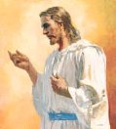
To “Know” Christ is to have intimate spiritual experiences with him.
As we are willing to keep his commandments He will reveal himself to us---removing the veil.

Slide 42
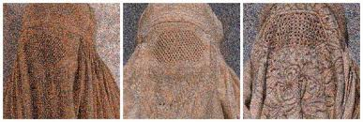
The removal of veil gives one more intimate access.
The bride in ancient days wore a veil over her hair…
…but today we sometimes have other veils that keep us from knowing Christ.

Slide 43
“Behold, when ye shall rend the veil of unbelief which doth cause you to remain in your awful state of wickedness and hardness of heart, and blindness of mind, then shall the great and marvelous things…you shall know…” (Ether 4:15)

Slide 44
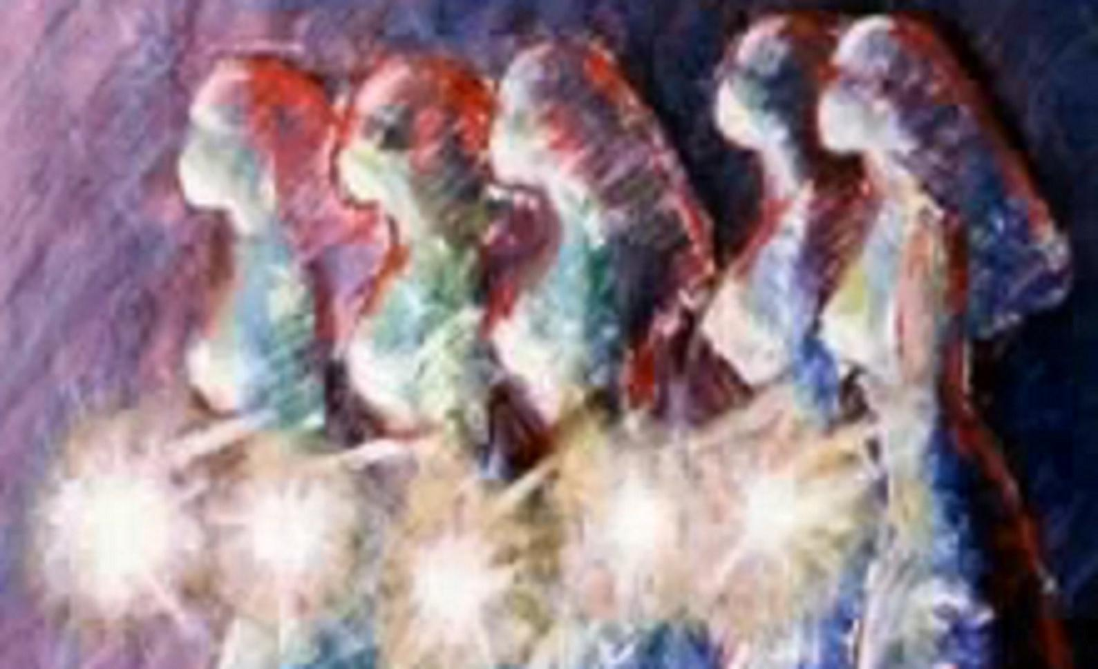
What would happen when we unveil ourselves to Him and we have not been completely faithful to Him while we waited?

Slide 45
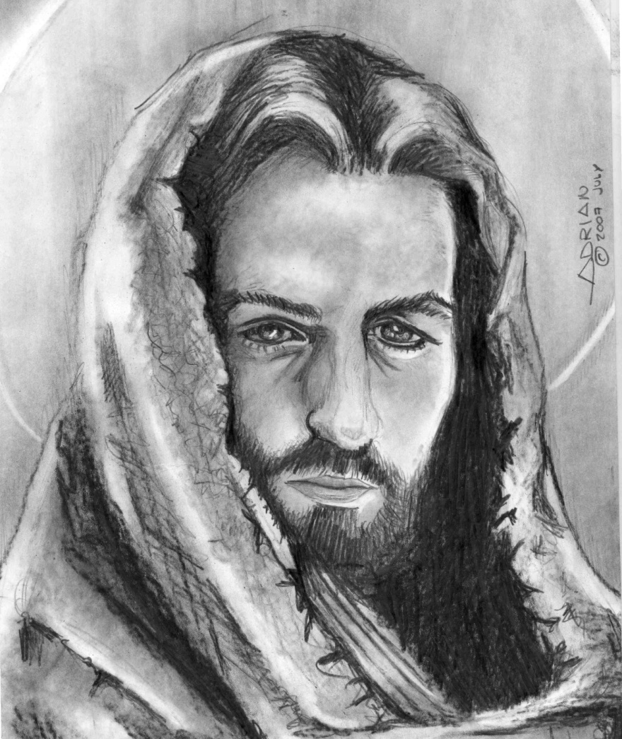
“…and he gave himself up for her, that he might sanctify and cleanse her…that it should be holy and without blemish.”
Ephesians 5:25-27

Slide 46
Sources:
Poway Institute by Becky Davies and Lesley Meacham
Beloved Bridegroom by Donna B. Neilson
Sketches of Jewish Social Life in the days of Christ by Alfred Edersheim
Jesus the Christ by James E. Talmage

