Slide 1
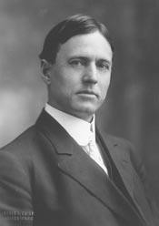
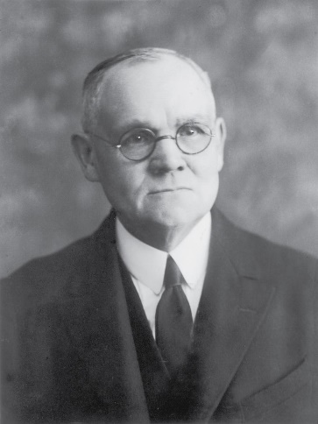
The Trial of Jesus from a lawyer’s Standpoint
Walter M. Chandler’s
Found in James E. Talmage’s
Jesus the Christ pp. 645-648
Online Reading Chapter 34

Slide 2
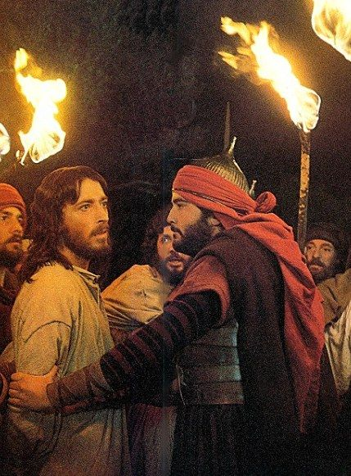
Point 1
The arrest of Jesus was illegal,” since it was effected by night, and through the treachery of Judas, an accomplice, both of which features were expressly forbidden in the Jewish law of that day.

Slide 3
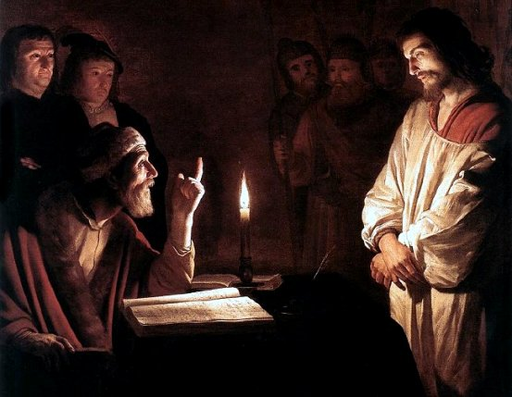
Point 2
The private examination of Jesus before Annas or Caiaphas was illegal”;—for (1) it was made by night;
(2) the hearing of any cause by a ‘sole judge’ was expressly forbidden;
(3) as quoted from Salvador, ‘A principle perpetually reproduced in the Hebrew scriptures relates to the two conditions of publicity and liberty.’

Slide 4
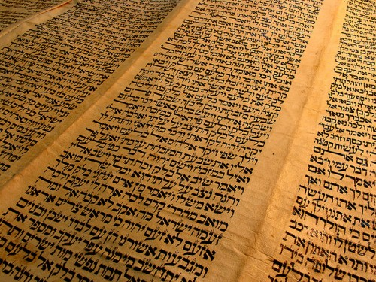
Point 3
The indictment against Jesus was, in form, illegal. ‘The entire criminal procedure of the Mosaic code rests upon four rules: certainty in the indictment; publicity in the discussion; full freedom granted to the accused; and assurance against all dangers or errors of testimony’—Salvador, p. 365.
‘The Sanhedrin did not and could not originate charges; it only investigated those brought before it.’—Edersheim, vol. 1, p. 309.
‘The only prosecutors known to Talmudic criminal jurisprudence are the witnesses to the crime. Their duty is to bring the matter to the cognizance of the court, and to bear witness against the criminal. In capital cases they are the legal executioners also. Of an official accuser or prosecutor there is nowhere any trace in the laws of the ancient Hebrews.’—Mendelsohn, p. 110.
‘The evidence of the leading witnesses constituted the charge. There was no other charge; no more formal indictment. Until they spoke and spoke in the public assembly, the prisoner was scarcely an accused man.’—Innes, p. 41.

Slide 5
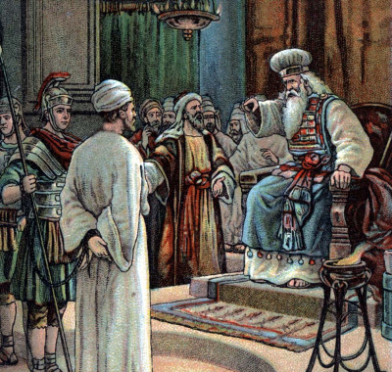
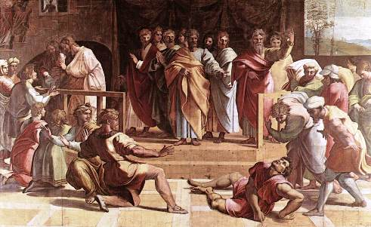
Point 4
The proceedings of the Sanhedrin against Jesus were illegal because they were conducted at night. ‘Let a capital offense be tried during the day, but suspend it at night.’—Mishna, Sanhedrin 4:1.
‘Criminal cases can be acted upon by the various courts during daytime only, by the Lesser Sanhedrions from the close of the morning service till noon, and by the Great Sanhedrion till evening.’—Mendelsohn, p. 112.

Slide 6
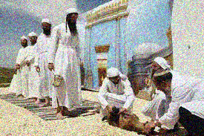
Point 5
‘No session of the court could take place before the offering of the morning sacrifice.’—MM. Lemann, p. 109.
The proceedings of the Sanhedrin against Jesus were illegal because the court convened before the offering of the morning sacrifice. ‘The Sanhedrin sat from the close of the morning sacrifice to the time of the evening sacrifice.’—Talmud, Jeremiah San. 1:19.
‘Since the morning sacrifice was offered at the dawn of day, it was hardly possible for the Sanhedrin to assemble until the hour after that time.’—Mishna, Tamid, ch. 3.

Slide 7
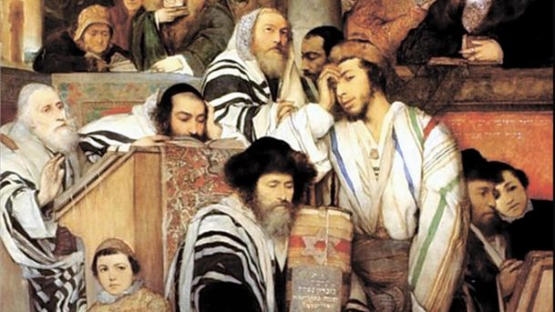
Point 6
The proceedings against Jesus were illegal because they were conducted on the day preceding a Jewish Sabbath; also on the first day of unleavened bread and the eve of the Passover.—‘They shall not judge on the eve of the Sabbath nor on that of any festival.’—Mishna, San. 4:1.
‘No court of justice in Israel was permitted to hold sessions on the Sabbath or any of the seven Biblical holidays. In cases of capital crime, no trial could be commenced on Friday or the day previous to any holiday, because it was not lawful either to adjourn such cases longer than over night, or to continue them on the Sabbath or holiday.’—Rabbi Wise, ‘Martyrdom of Jesus,’ p. 67.

Slide 8
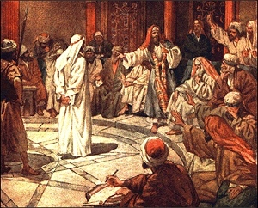
Point 7
The trial of Jesus was illegal because it was concluded within one day. ‘A criminal case resulting in the acquittal of the accused may terminate the same day on which the trial began.
But if a sentence of death is to be pronounced, it cannot be concluded before the following day.’—Mishna, San. 4:1.

Slide 9
Point 8
The sentence of condemnation pronounced against Jesus by the Sanhedrin was illegal because it was founded upon His uncorroborated confession. ‘We have it as a fundamental principle of our jurisprudence that no one can bring an accusation against himself. Should a man make confession of guilt before a legally constituted tribunal, such confession is not to be used against him unless properly attested by two other witnesses.’—Maimonides, 4:2.
‘Not only is self-condemnation never extorted from the defendant by means of torture, but no attempt is ever made to lead him on to self-incrimination. Moreover, a voluntary confession on his part is not admitted in evidence, and therefore not competent to convict him, unless a legal number of witnesses minutely corroborate his self-accusation.’—Mendelsohn, p. 133.

Slide 10
Point 9
The condemnation of Jesus was illegal because the verdict of the Sanhedrin was unanimous. ‘A simultaneous and unanimous verdict of guilt rendered on the day of the trial has the effect of an acquittal.’—Mendelsohn, p. 141.
‘If none of the judges defend the culprit, i.e., all pronounce him guilty, having no defender in the court, the verdict of guilty was invalid and the sentence of death could not be executed.’—Rabbi Wise, ‘Martyrdom of Jesus,’ p. 74.

Slide 11
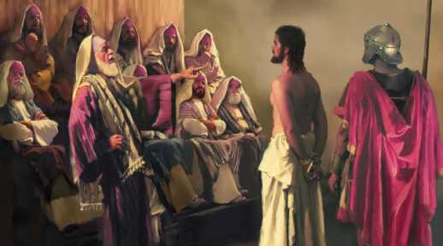
Point 10
The proceedings against Jesus were illegal in that:
(1) The sentence of condemnation was pronounced in a place forbidden by law;
(2) The high priest rent his clothes; (3) The balloting was irregular.
‘After leaving the hall Gazith no sentence of death can be passed upon any one so ever.’—Talmud, Bab. ‘Of Idolatry’ 1:8.
‘A sentence of death can be pronounced only so long as the Sanhedrin holds its sessions in the appointed place.’—Maimonides, 14. See further Levit. 21:10; compare 10:6. ‘Let the judges each in his turn absolve or condemn.’—Mishna, San. 15:5.
‘The members of the Sanhedrin were seated in the form of a semi-circle, at the extremity of which a secretary was placed, whose business it was to record the votes. One of these secretaries recorded the votes in favor of the accused, the other those against him.’—Mishna, San. 4:3. ‘In ordinary cases the judges voted according to seniority, the oldest commencing; in a capital case the reverse order was followed.’—Benny, p. 73.

Slide 12
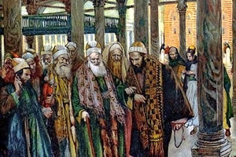
Point 11
The members of the Great Sanhedrin were legally disqualified to try Jesus. ‘Nor must there be on the judicial bench either a relation or a particular friend, or an enemy of either the accused or of the accuser.’—Mendelsohn, p. 108.
Tissot
‘Nor under any circumstances was a man known to be at enmity with the accused person permitted to occupy a position among the judges.’—Benny, p. 37.

Slide 13
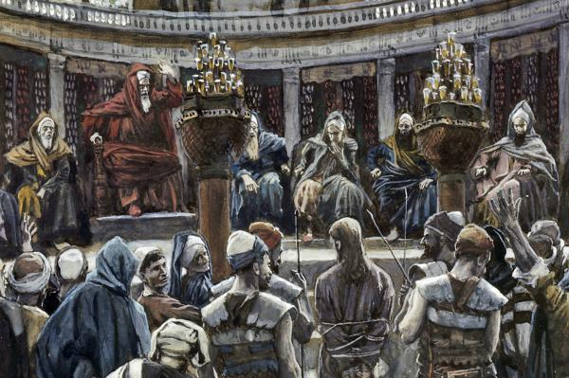
Point 12
The condemnation of Jesus was illegal because the merits of the defense were not considered. ‘Then shalt thou enquire, and make search, and ask diligently.’—Deut. 13:14.
‘The judges shall weigh the matter in the sincerity of their conscience.’—Mishna, San. 4:5.
‘The primary object of the Hebrew judicial system was to render the conviction of an innocent person impossible. All the ingenuity of the Jewish legists was directed to the attainment of this end.’—Benny, p. 56.”

Slide 14
The Author
Born on December 8, 1867 near Yazoo City, Mississippi, Chandler attended public schools, the University of Virginia at Charlottesville, and the University of Mississippi at Oxford. He taught school for a time and then graduated from the University of Michigan at Ann Arbor in 1897. He studied history and jurisprudence at the University of Berlin and the University of Heidelberg in Germany.
He established his law practice in Dallas, Texas, and three years later moved to New York City, where he continued the practice of law and engaged in writing and lecturing.
In 1912, Chandler was elected to Congress to the first of two terms as a Progressive. In 1916, he was elected to a third term to Congress as a Republican. He was an unsuccessful candidate for reelection in the heavily Republican year of 1918.
In 1920, Chandler was elected to a fourth nonconsecutive term as a Republican to the Sixty-seventh Congress (March 4, 1921 – March 3, 1923). He was an unsuccessful candidate for reelection in 1922 and thereafter unsuccessfully contested the election of Sol Bloom to fill a congressional vacancy. He was again an unsuccessful candidate in 1924, even as U.S. President Calvin Coolidge won the electors of New York State.
He served as member of the faculty and lecturer at the American Expeditionary Force University at Beaune, France, during World War I.
After he left Congress early in 1923, he resumed the practice of law in New York City, where he died twelve years later.
He died on March 16, 1935. Chandler was interred in the West Evergreen Cemetery in Jacksonville, Florida.
Walter M. Chandler, of the New York Bar, The Trial of Jesus from a Lawyer’s Standpoint

Slide 15
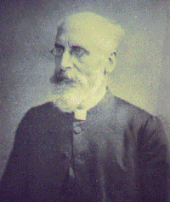
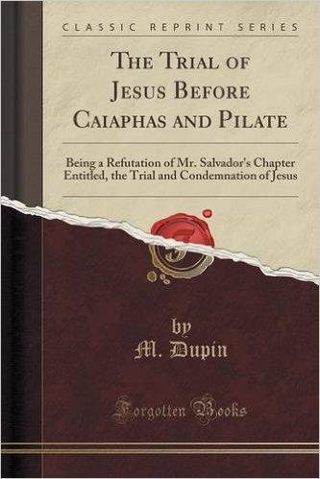
The Authors
Samuel James Andrews, Life of Our Lord
Samuel James Andrews (July 31, 1817 in Danbury, Connecticut– October 11, 1906 in Hartford, Connecticut) was an Irvingite divine. He graduated from Williams College in 1839 and practiced law for some years, but turned his attention to theology, and was a Congregational clergyman from 1848 to 1855. In 1856 he became pastor of the Catholic and Apostolic Church (Irvingite) at Hartford, Connecticut.
Alfred Edersheim,
;
(7 March 1825 – 16 March 1889) was a Jewish convert to Christianity and a Biblical scholar known especially for his book The Life and Times of Jesus the Messiah (1883).
Edersheim was born in Vienna of Jewish parents of culture and wealth. English was spoken in their home, and he became fluent at an early age. He was educated at a local gymnasium and also in the Talmud and Torah at a Hebrew school, and in 1841 he entered the University of Vienna. His father suffered illness and financial reversals before Alfred could complete his university education, and he had to support himself.
M. Dupin The Trial of Jesus Before Caiaphas and Pilate
Online Reading
https://archive.org/details/trialofjesusbefo00dupi

Slide 16
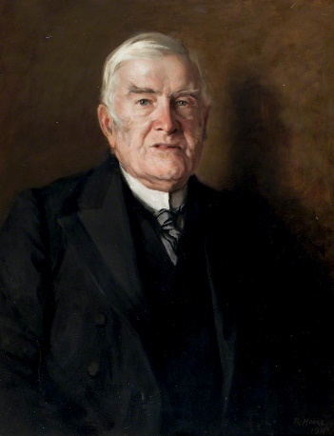
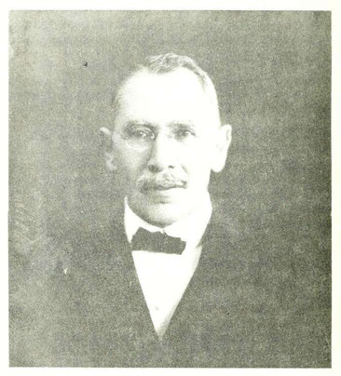
The Authors
Alexander Taylor Innes (1833–1912)
The Trial of Jesus Christ
He was a lawyer, writer, biographer and church historian
Online Reading
https://archive.org/details/trialjesuschris00innegoog
Joseph Salvador (1779–1873) was a scholar from a Sephardi Jewish family in the south of France. Salvador was born in Montpellier. His family had fled to Southern France from Spain in the 15th century in the wake of the Spanish Inquistion where they acculturated to life in France. Salvador's mother was a Roman Catholic. At his personal request, he was buried in the Protestant cemetery of Le Vigan, near Montpellier. Wrote Institutions of Moses
Benny, Philip Berger. The Criminal Code of the Jews, According to the Talmud. Originally published: London: Smith, Elder, & Co. 1880. 133 pp. Reprinted 2006 by The Lawbook Exchange
This study goes beyond the statutes of the Mosaic Pentateuch to the jurisprudence of the Talmud to create a nuanced description of Jewish criminal law. Beginning with a history of the Mosaic code and an overview of the prescriptions of the Talmud, this study goes on to examine the constitution of the courts, procedure, rules of evidence, perjury, methods of punishment and execution, the treatment of murder, adultery and idolatry and cities of refuge.
Samuel Mendelsohn, Criminal Jurisprudence of the Ancient Hebrews
(1850-1922)
Online reading
https://archive.org/details/criminaljurispru00mend

Slide 17
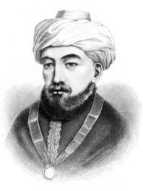
The Author
Moshe ben Maimon (Hebrew: משה בן מימון‎‎ Moshe ben Maymon), or Mūsā bin Maymūn ("Rabbeinu Moshe Ben Maimon", "Our Rabbi/Teacher Moses Son of Maimon"), and Graecized (and subsequently Latinized) Moses Maimonides), a preeminent medieval Sephardic Jewish philosopher and astronomer,]became one of the most prolific and influential Torah scholars and physicians of the Middle Ages. Born in Cordova, Almoravid Empire (present-day Spain) on Passover Eve, 1135 or 1138, he died in Egypt on December 12, 1204, whence his body was taken to the lower Galilee and buried in Tiberias, He worked as a rabbi, physician, and philosopher in Morocco and Egypt.
During his lifetime, most Jews greeted Maimonides' writings on Jewish law and ethics with acclaim and gratitude, even as far away as Iraq and Yemen, and although Maimonides rose to become the revered head of the Jewish community in Egypt, there were also vociferous critics of some of his writings, particularly in Spain. Nonetheless, he was posthumously acknowledged as among the foremost rabbinical arbiters and philosophers in Jewish history, and his copious work comprises a cornerstone of Jewish scholarship. His fourteen-volume Mishneh Torah still carries significant canonical authority as a codification of Talmudic law. He is sometimes known as "ha Nesher ha Gadol" (the great eagle) in recognition of his outstanding status as a bona fide exponent of the Oral Torah.
Aside from being revered by Jewish historians, Maimonides also figures very prominently in the history of Islamic and Arab sciences and is mentioned extensively in studies. Influenced by Al-Farabi (ca. 872–950/951), Avicenna (c. 980 – 1037), and his contemporary Averroes (1126–1198), he in his turn influenced other prominent Arab and Muslim philosophers and scientists. He became a prominent philosopher and polymath in both the Jewish and Islamic worlds.
Moshe ben Maimon ("Maimonides")
Sanhedrin; MM. Lemann, Jesus before the Sanhedrin
1135

