Slide 1
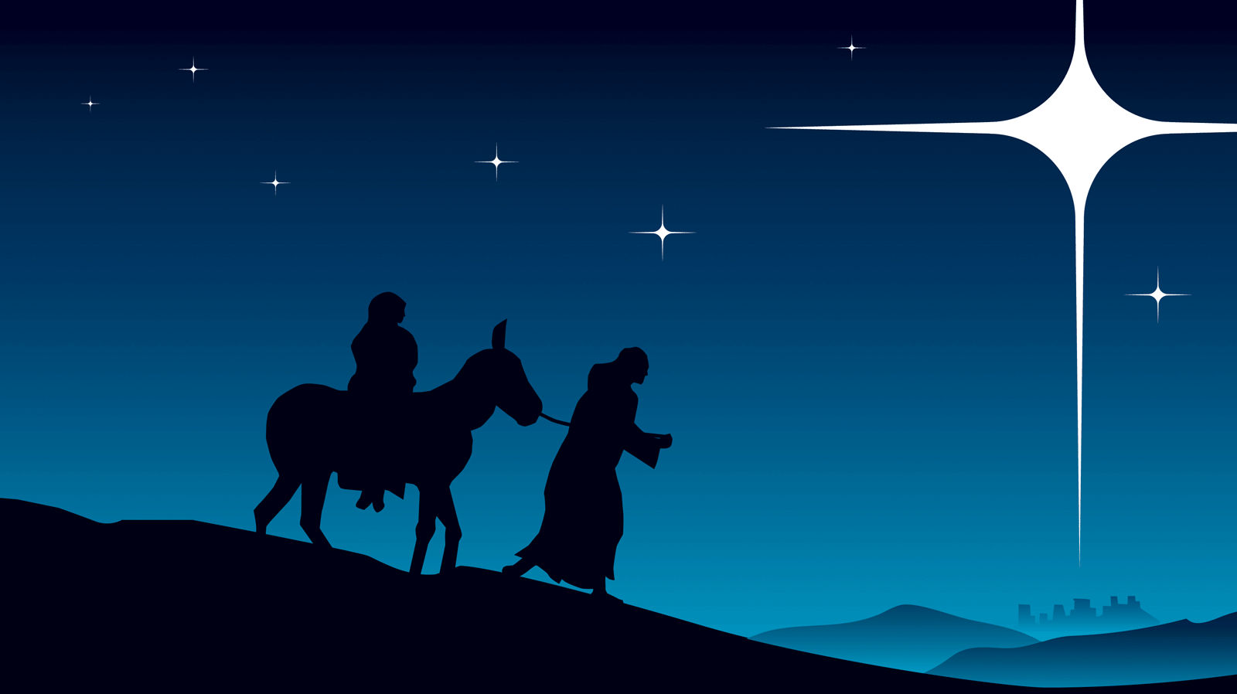
The Birth of
Jesus Christ

Slide 2
Nativity Quiz
1. How many wise men were there?
A. 3
B. 7-8
C. The Bible doesn’t say
2. Did Joseph meet the wise men?
A. Yes, in the stable
B. Yes in their home
C. The Bible doesn’t say.
3. What animal did Mary ride to Bethlehem?
A. A donkey
B. A horse
C. A camel
D. The Bible doesn’t say
4. The Parents named the child Jesus because
A. An angel told Mary
B. An angel told Joseph
C. All of the above
6. What animals were present at the Nativity?
A. Goats, Sheep, and Cattle
B. Chicken and pigeons
C. Pigs
D. Oxen
E. The Bible doesn’t say
7. Who besides the wise men saw the star?
A. Shepherds
B. Herod
C. The Bible does not say
8. How did the star compare in brightness with the
other stars?
A. Far brighter than the other stars.
B. Lots brighter than the other stars.
C. The Bible does not say
9. How soon after Joseph and Mary reached Bethlehem
was Jesus born?
A. Immediately, the same day.
B. The same week.
C. The Bible does not say.
5. What kind of a building was Jesus born in?
A. A stable
B. A cave
C. A hospital
D. The Bible doesn’t say

Slide 3
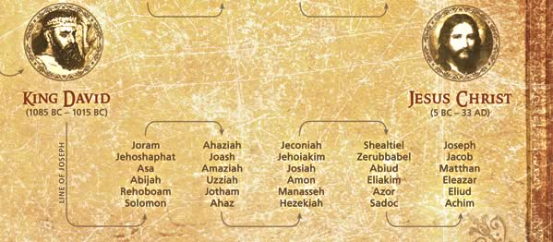
The Lineage of Jesus Christ

Slide 4
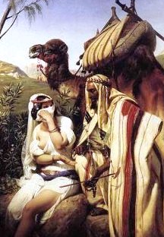
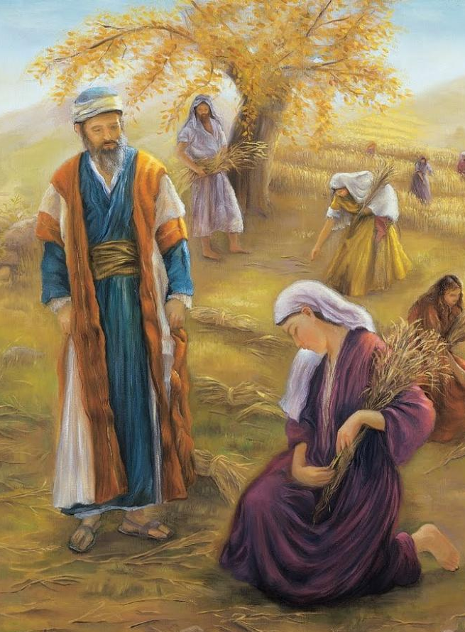
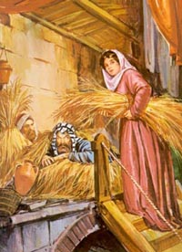
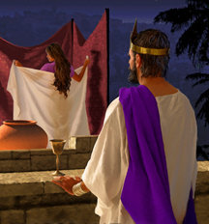
Genealogy of Jesus Christ
Tamar
Ruth
Rahab
Bathsheba

Slide 5
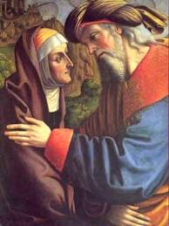
Mary’s Parents - Joachim and Anna
Childless Couple
Joachim tried to offer
a sacrifice
"You are not worthy
to offer sacrifice
with those childless hands."
An Angel appeared:
“A daughter most blessed, by whom
all the nations of the earth
will be blessed, and
through whom will come
the salvation of the world."

Slide 6
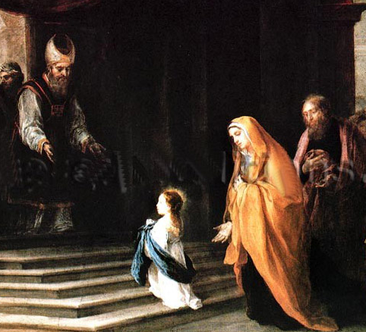
Mary is Presented at the Temple
Miriam or Mary
“Excellence”
or “Bitterness”
Mary was dedicated to temple service
as a small child

Slide 7
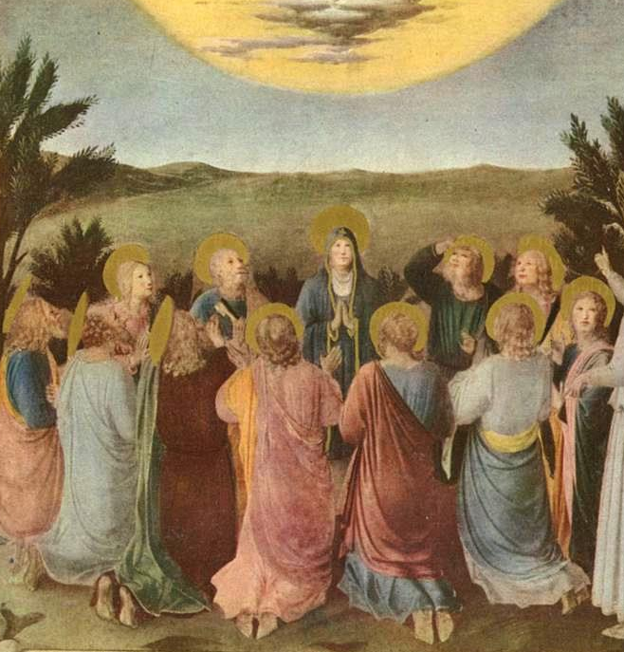
Ancient Prayer Circle

Slide 8
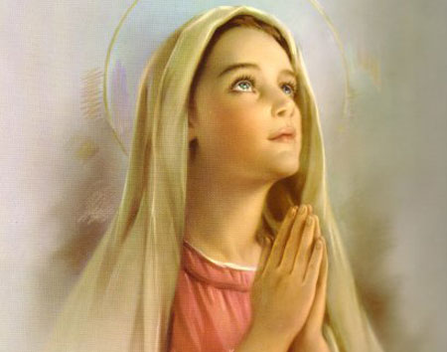
Mary’s Vision in the Temple

Slide 9
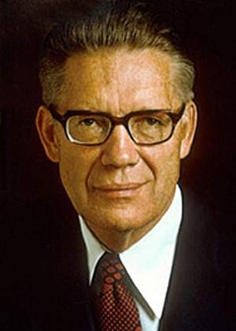
Mary – the Greatest Female Spirit
"Can we speak too highly of her whom the Lord has blessed above all women? There was only on Christ, and there is only one Mary. Each was noble and great in the pre-mortal existence and each was foreordained to the ministry he or she performed. We cannot but think that the Father would choose the greatest female spirit to be the mother of His Son, even as He chose the male spirit like unto Him to be the Savior."
The Mortal Messiah Bruce R McConkie

Slide 10
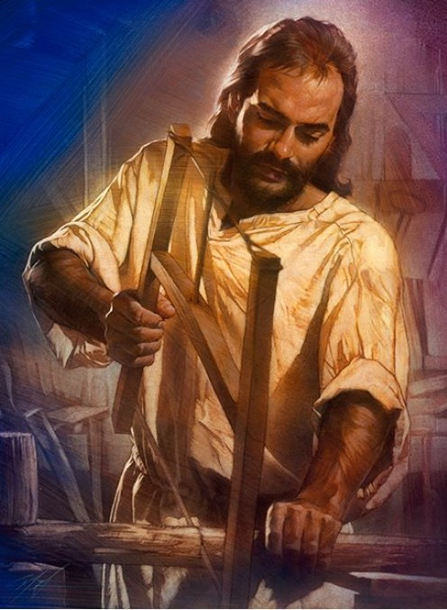
Joseph the Carpenter
He was a just man
Tzaddik
A Master builder
Learned
In tune with the Spirit
Beyond Reproach
Nathan Greene

Slide 11
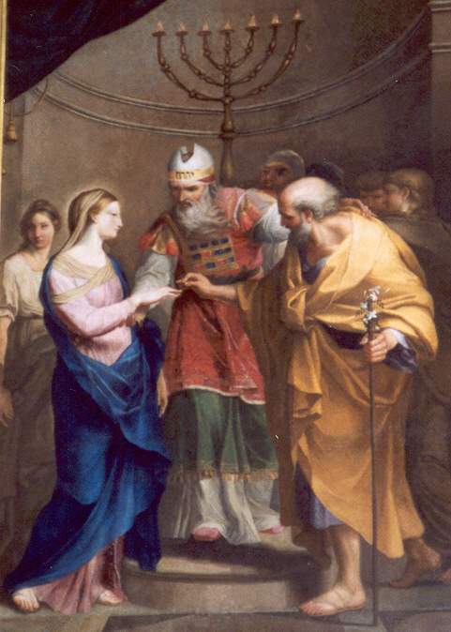
Betrothal of Joseph and Mary
Probably arranged
while children
Bride price is paid and a contract is given by the young man to the young woman
Average Betrothal age:
Females: 12-13
Males: 18-20

Slide 12
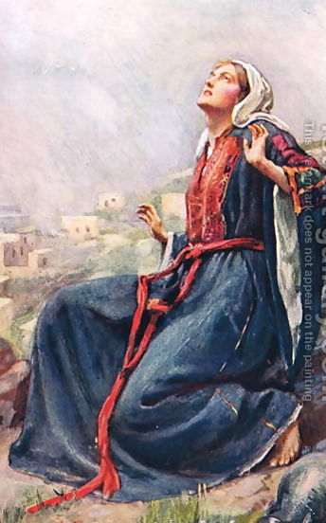
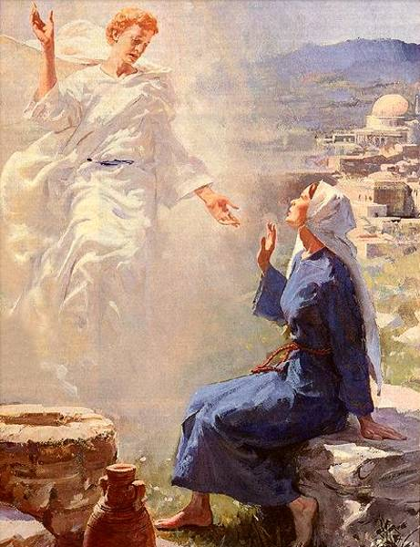
The Annunciation

Slide 13
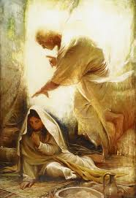
“How Shall this be,
seeing I know not
a Man”

Slide 14
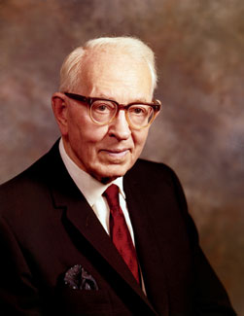
How are we begotten? I answer: just as Jesus Christ was begotten by his Father. The Christian denominations believe that Christ was begotten, not of God but of the Spirit that overshadowed his mother.
This is nonsense.
Why will not the World receive the truth?
Why will they not believe the Father when he says that Jesus Christ is His Only Begotten Son?
Why will they try to explain this truth away and make a mystery of it?
Pres. Joseph Fielding Smith

Slide 15
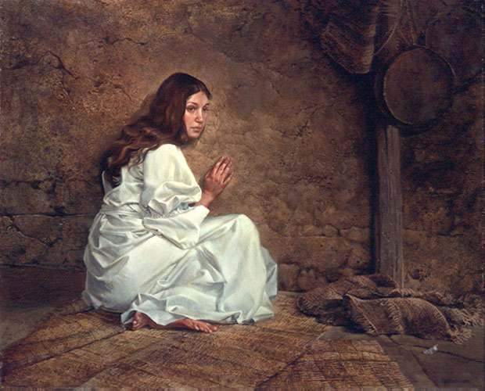
Mary’s Call to be the Mother
of the Savior of the World

Slide 16
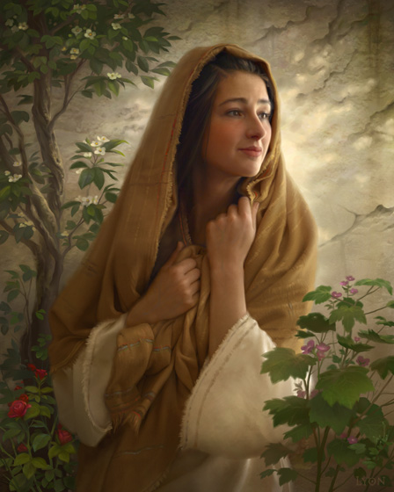
“Mary, Thou Hast Found Favor”
“Behold
The handmaid
of the Lord….
…..Be it unto me according
to thy word.”

Slide 17
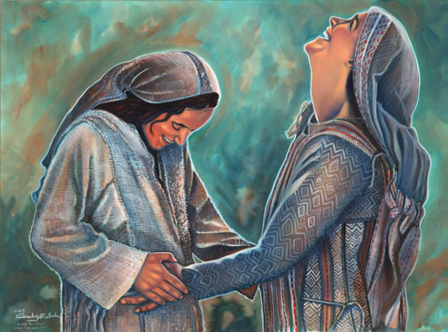
Blessed Art Thou Among Women”

Slide 18
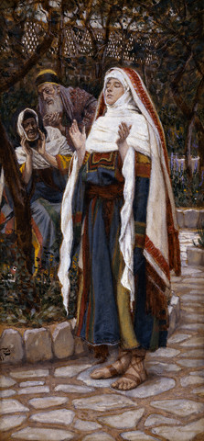
The Magnificat
My soul doth magnify the Lord,
And my spirit hath rejoiced
in God my Saviour.
For he hath regarded the low estate of his handmaiden:
for, behold, from henceforth
all generations
shall call me blessed.
For he that is mighty
hath done to me great things;
and holy is his name.

Slide 19
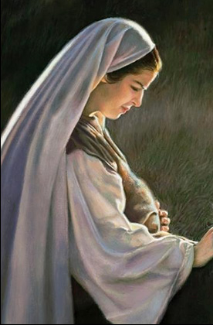
“Mary was Found to Be with Child”
James, the brother of Jesus said,
“And Mary was in her sixth month and behold Joseph came….and entering into her house, he discovered she was big with child. And he…..wept bitterly."

Slide 20
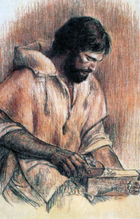
“Joseph was Minded to Put Her Away Privily”

Slide 21
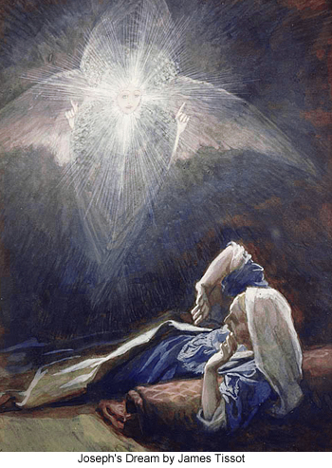
Joseph’s Vision
That which is
conceived in her
is of the Holy Ghost
Joseph had been chosen to be the earthly father of the Savior of the World!

Slide 22
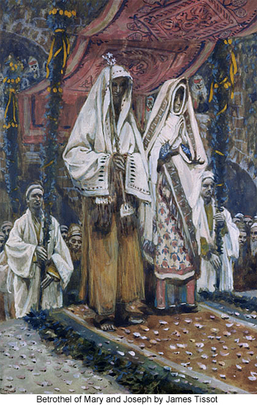
The Marriage of Joseph & Mary
Scholars are divided
Either Joseph and Mary were married immediately
Or Joseph and Mary traveled to Bethlehem and were formally married after Christ’s birth
He “knew her not”

Slide 23
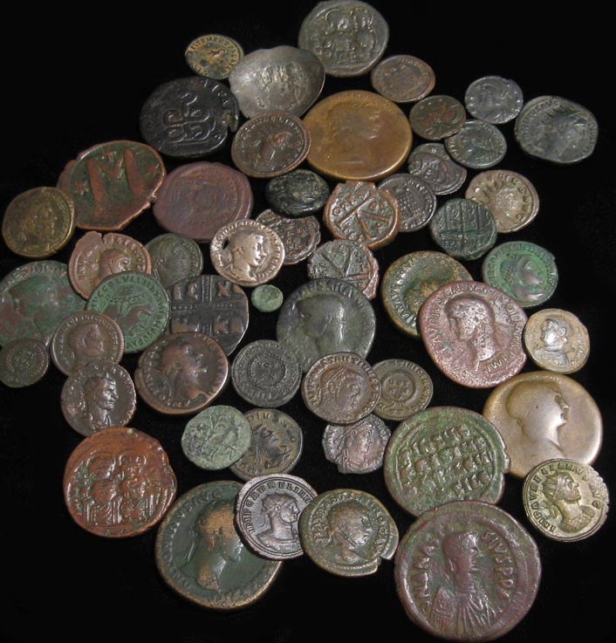
“All the World should be Taxed”
Rome required a Census
and a Tax
The law required that both
Joseph and Mary were to be taxed

Slide 24
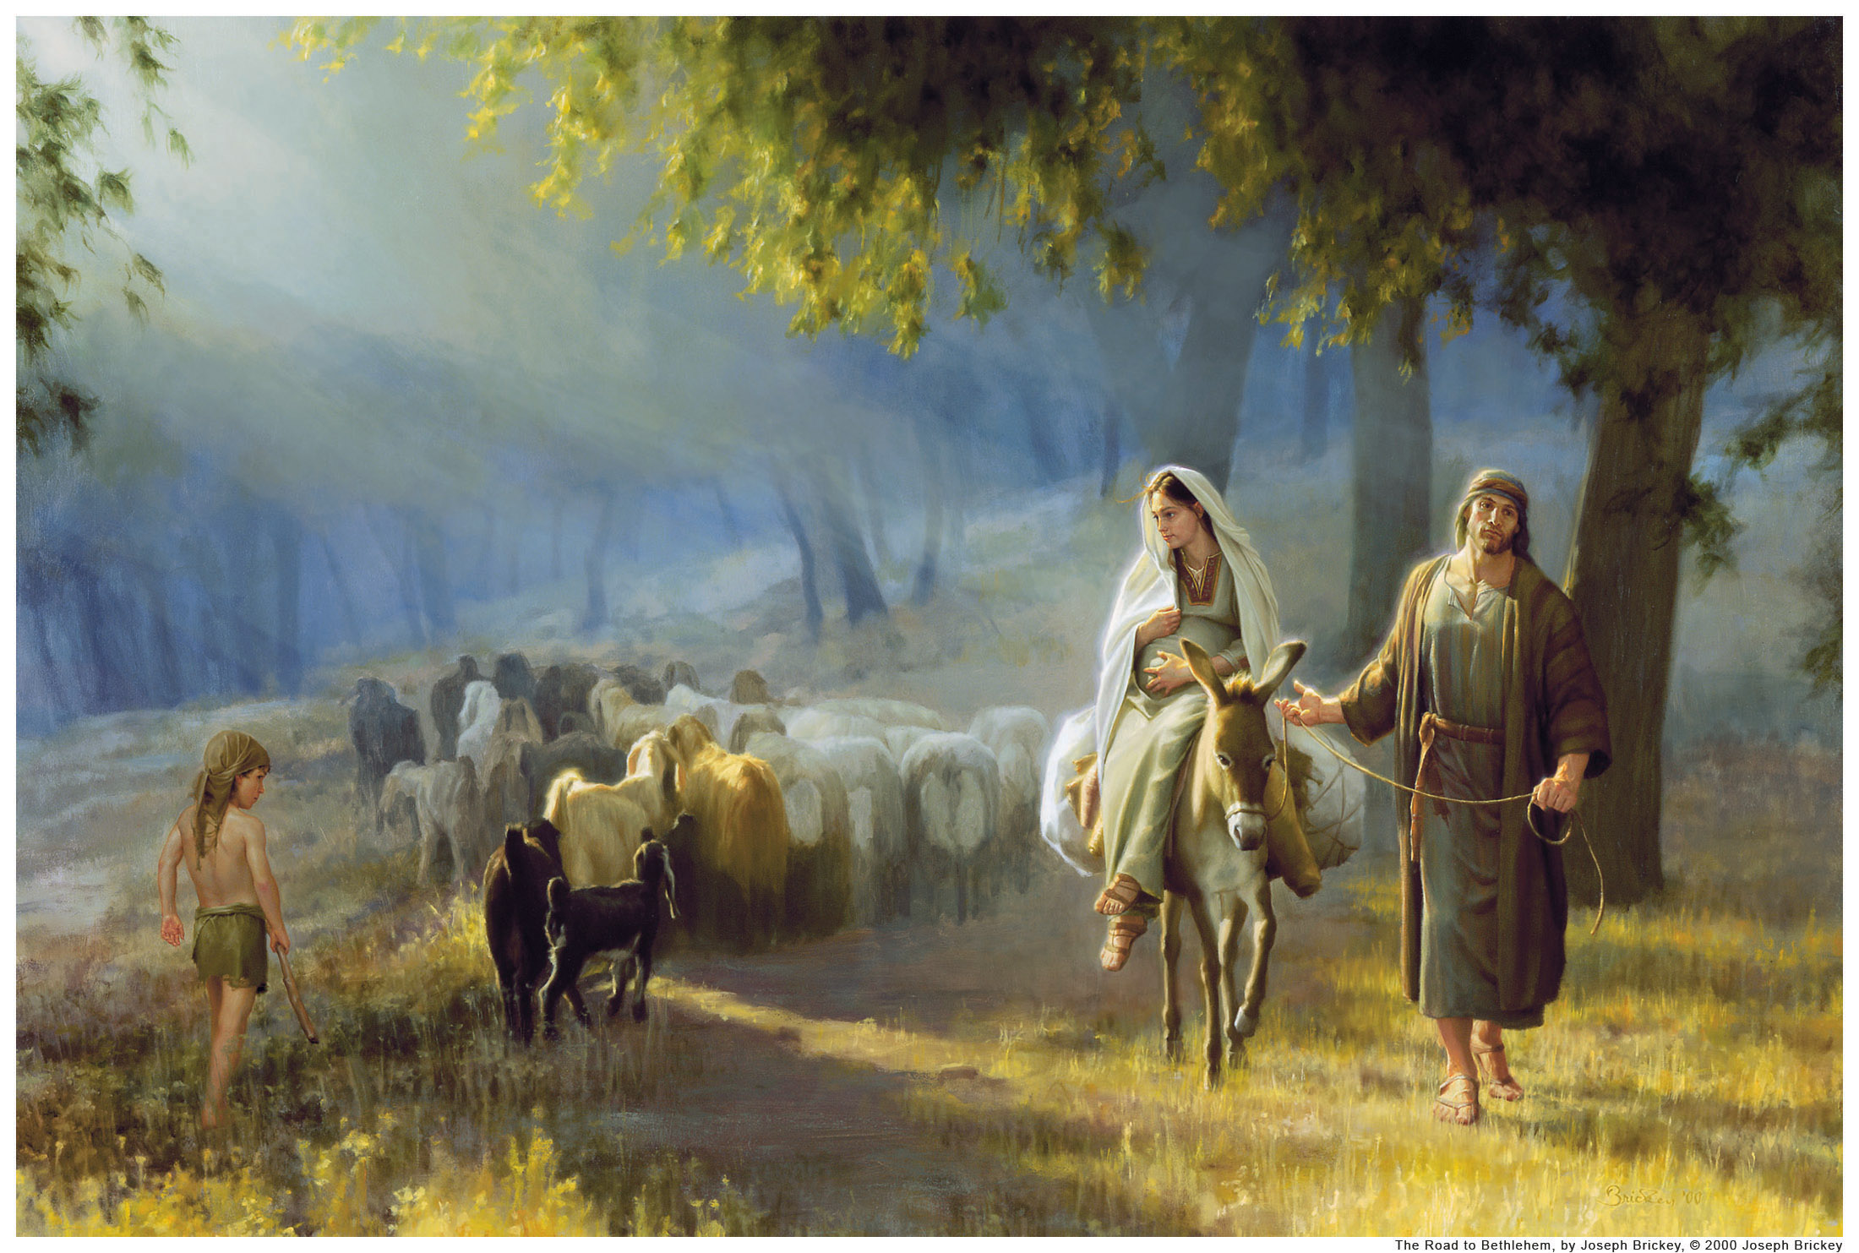
Mary and Joseph went “Up” to Bethlehem

Slide 25
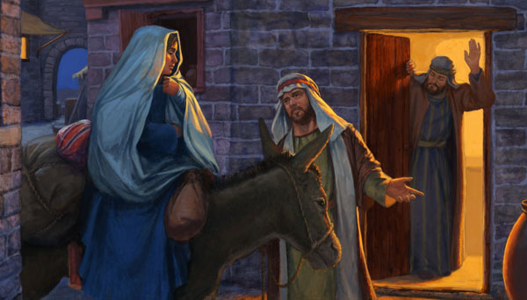
“No Room in the Inn”

Slide 26
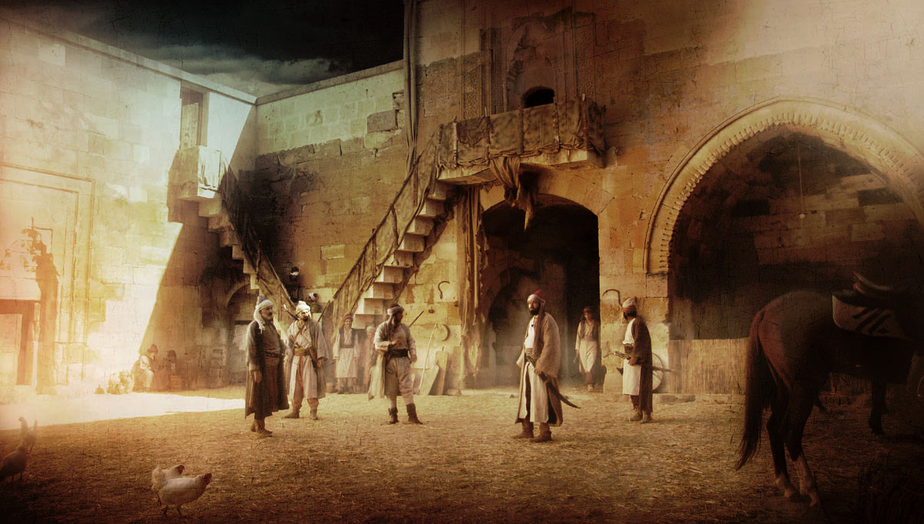
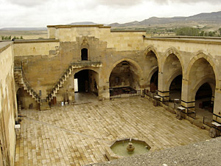
Caravanserai

Slide 27
“No Room in the “Kataluma.”
Manger
Family Area
Guest Room
kataluma
“Stable”
Steps
There was no “room” available in the “kataluma”
or guest room so Joseph and Mary
shared the Family Room attached to the “stable.”

Slide 28
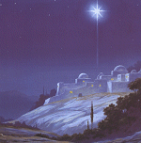
The Star
Matthew emphasizes the Star – reminding the Jews that a star announced the birth of Abraham and Moses
Only the Wise Men saw the Star. The Star may have been literal or a symbol for frequent visitations from an angel who guided the Wise Men.

Slide 29
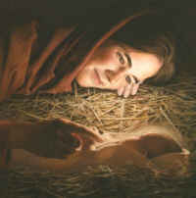
The Birth of Jesus

Slide 30
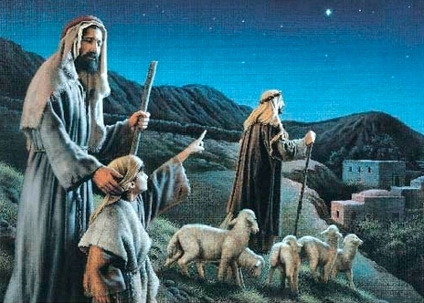
The Shepherds = Outcasts

Slide 31
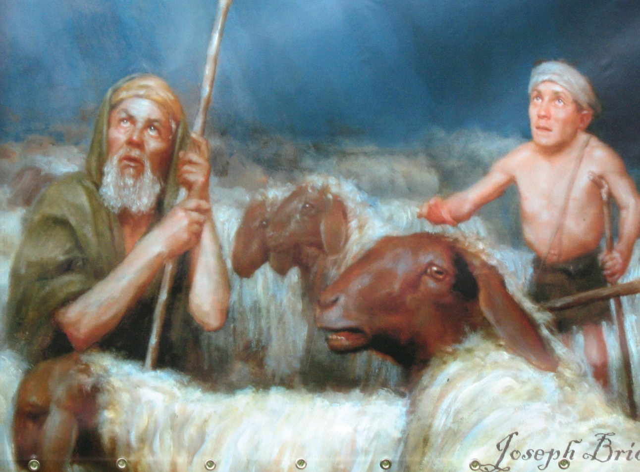
The First Witnesses
Shepherd Priests
Sacred duty: First born male lambs without blemish
for the Passover sacrifices

Slide 32
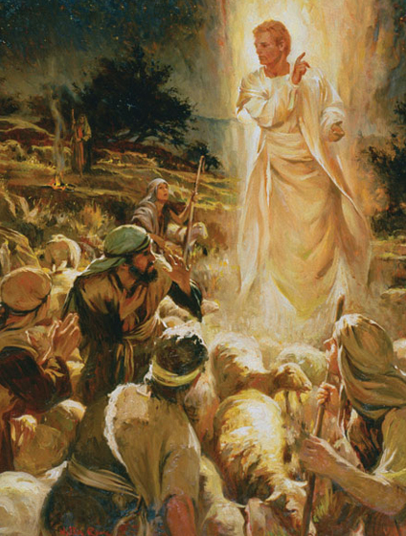
Fear Not
I bring you
good tidings of
great joy!
For unto you is born….a Saviour,
which is Christ the Lord!

Slide 33
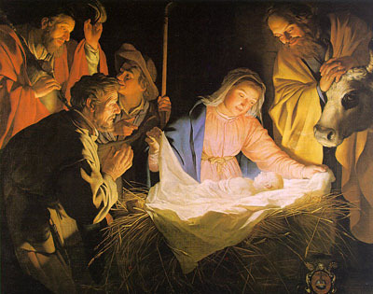
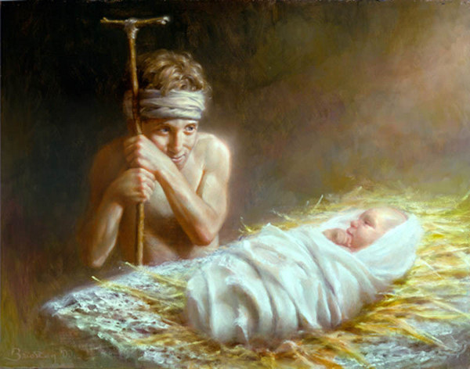
Ye shall find the babe….
……Wrapped in swaddling bands

Slide 34
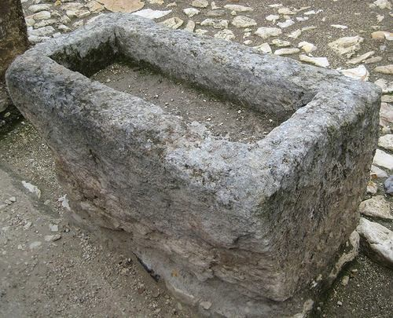
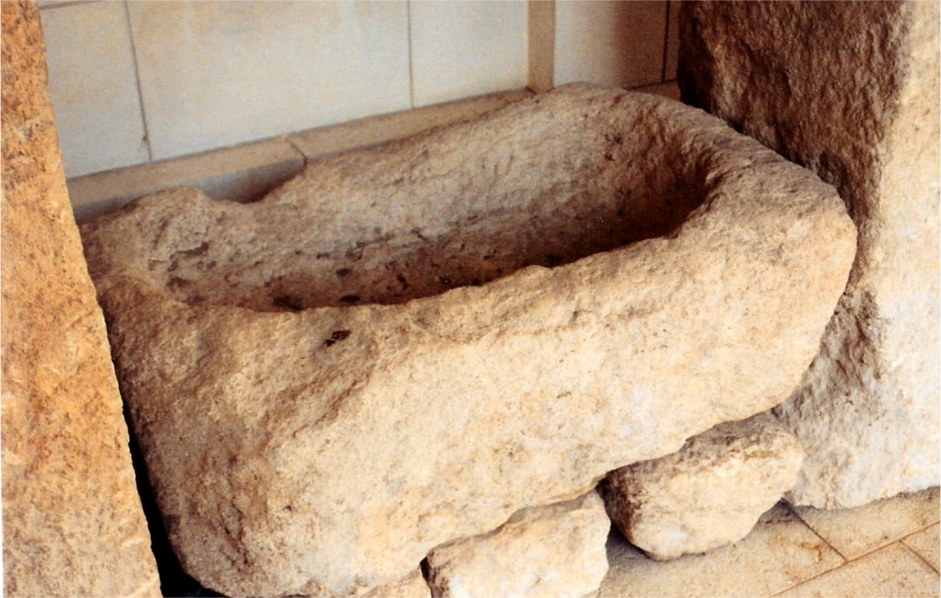
….Lying in
a manger.

Slide 35
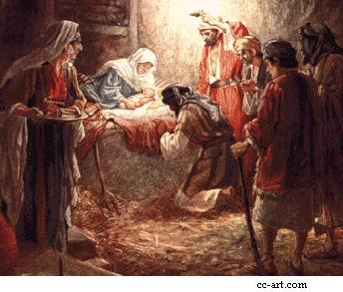
A Name and a Blessing
Circumcision

Slide 36
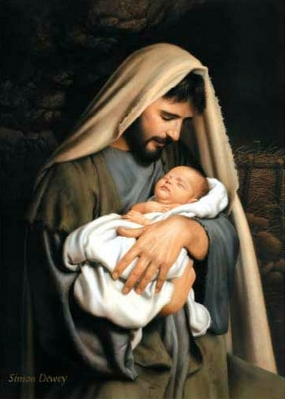
Joseph
named him
“Yeshua”
“Jehovah is Salvation”

Slide 37
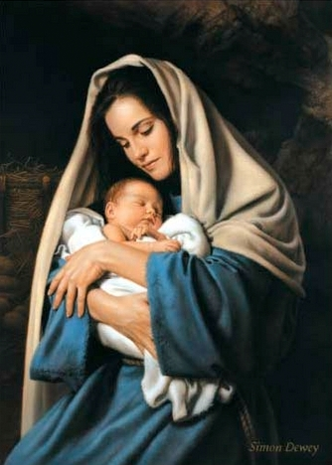
“Immanuel”
“He is God!”
“God is
with us!”

Slide 38
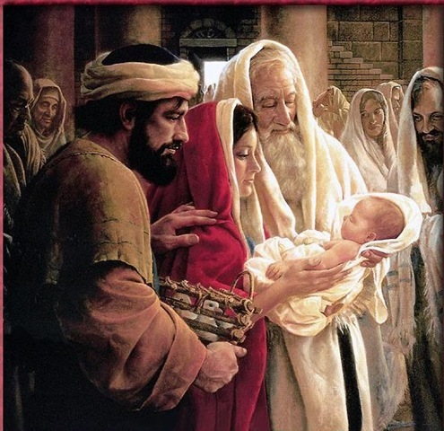
The Dedication of Jesus at the Temple
40 days after birth
A lamb is to be sacrificed to redeem the child.
Two doves were brought for Mary’s purification and atonement.

Slide 39
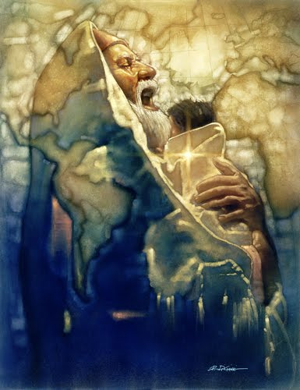
Simeon
Revealed to him that he would not die until he had seen the Messiah.
He came by the Spirit into the Temple
“A sword shall pierce thy breast.”

Slide 40
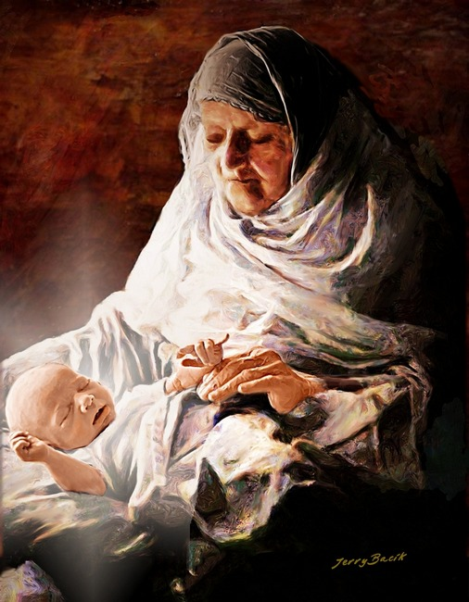
Anna
Married at 12-14
Widowed at 19-21
Unmarried for 84 years
At least 101 years old when she saw the Savior
Anna = Grace
Phanuel = Face of God
Asher = Happy and blessed
“Happy am I” for I have seen “the face of God”
through His “Grace.”

Slide 41
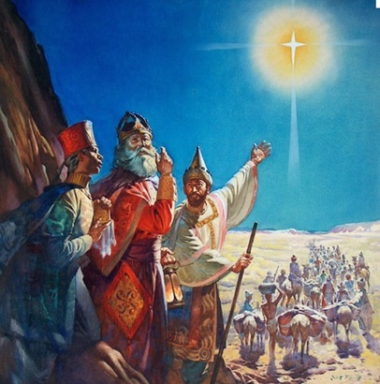
The Magi = the Wise Men
Religious men from the Diaspora
According to the scriptures:
The only people who saw the star.

Slide 42
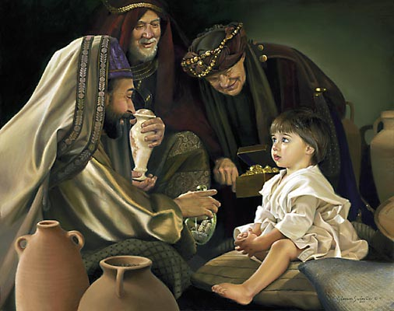
How Many Wise Men Were There?

Slide 43
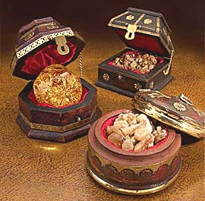
Gold = King
Incorruptible, pure, valuable, eternal
Frankincense = Priest
Temple incense, sacrifice, prayer, resurrection
Myrrh = Healer
Balm, healing, death, atonement

Slide 44
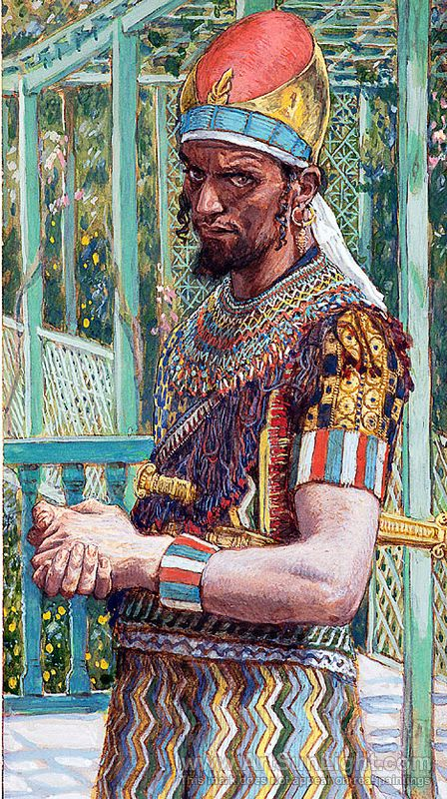
Herod the Great
Arabian ancestry
Brilliant genius
Richest man in the Roman Empire
Baby Killer

Slide 45
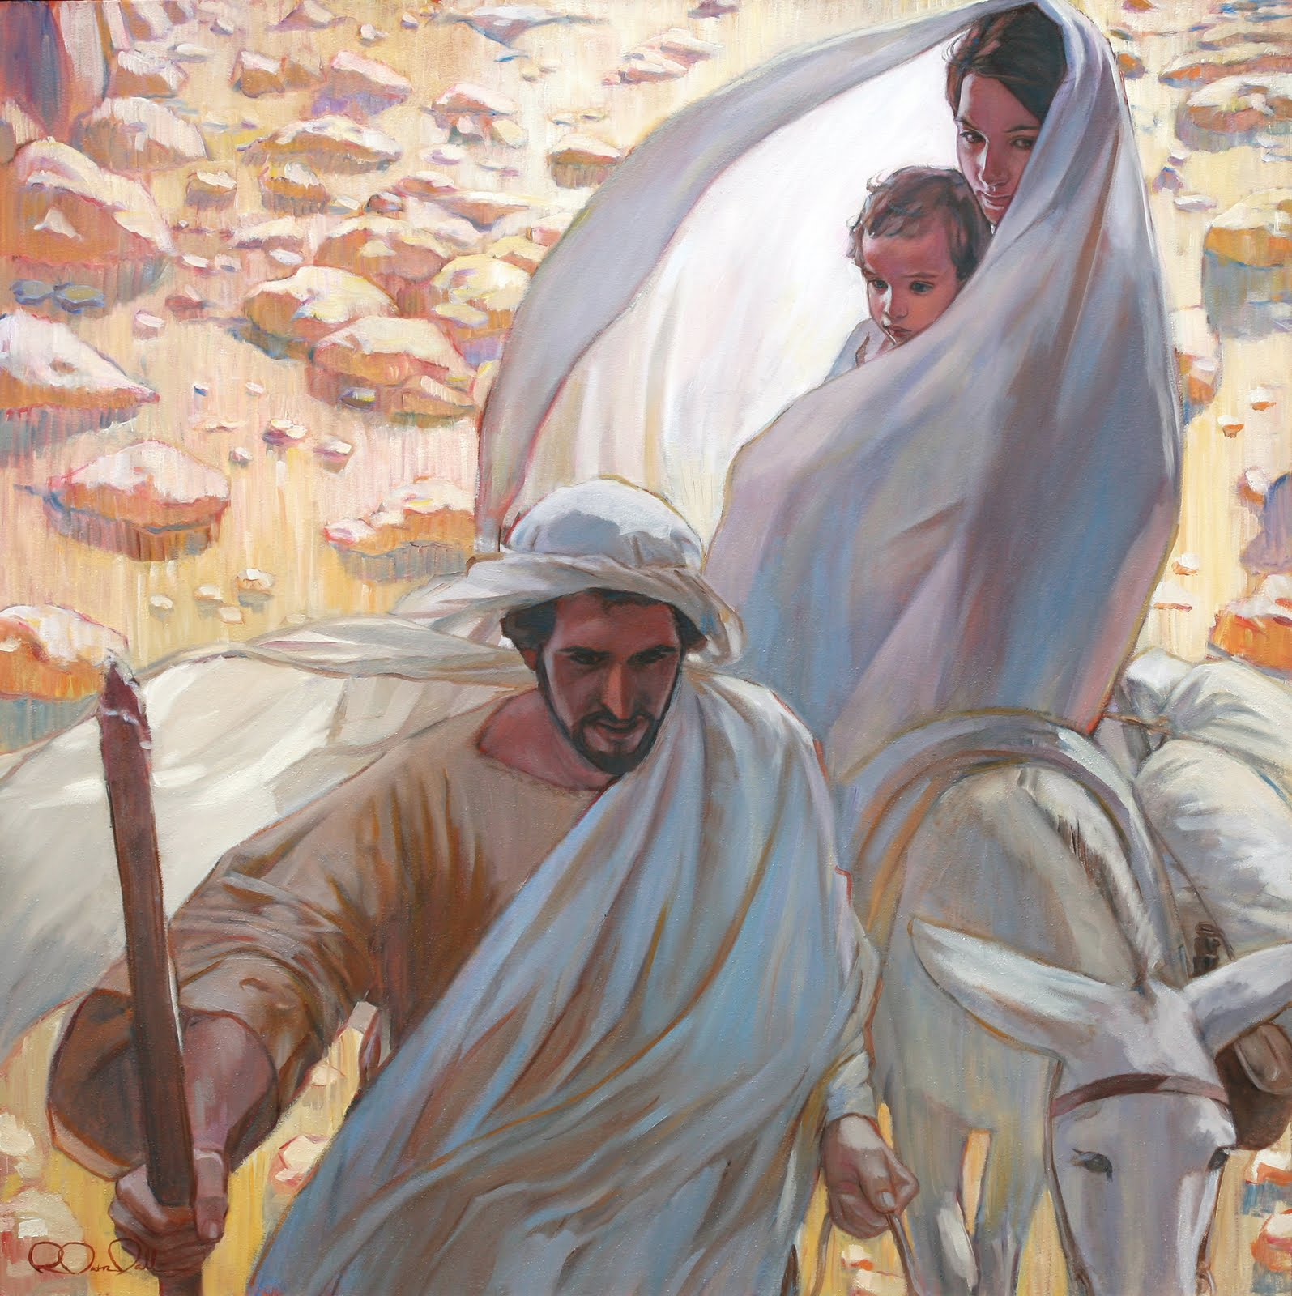
Flight into Egypt
Joseph was warned in another vision to go
to Egypt

Slide 46
Heliopolis =
Zi - On
The same area of Goshen where the Israelite slaves lived

Slide 47
Herod has Zacharias Killed
Herod orders the death of males 2 years and younger.
Zacharias sends Elizabeth and John to the desert
Herod’s soldiers come
Zacharias is killed between the altar and the porch of the Temple

Slide 48
The
Glorious Advent of our Savior

Slide 49
Sources:
Becky Davies and Lesley Meachum Poway Institute
See Script for presentation

