Slide 1
Lesson 83
The Work Continues Through The Holy Spirit
Acts 2
And it came to pass when they were all baptized and had come up out of the water, the Holy Ghost did fall upon them, and they were filled with the Holy Ghost and with fire.
3 Nephi 19:13
Day of Pentecost

Slide 2
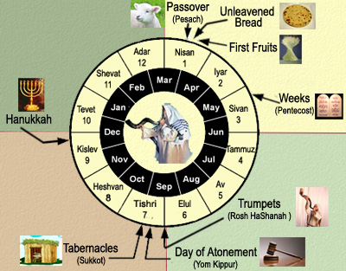
Pentecost--A Pilgrimage Festival
“And when the day of Pentecost was fully come, they were all with one accord in one place.”
7 weeks after the death and resurrection of Jesus, and about 1 week after the Savior ascended into heaven.
50 days after the Feast of the Passover.
A new meat offering (Leviticus 23:16)
Acts 2:1
(1)

Slide 3
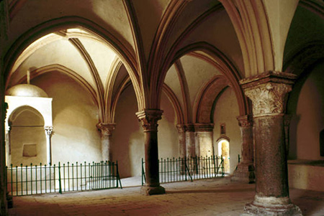
Pentecost Upper Room In Jerusalem
The interior of the traditional site of the “upper room” in Jerusalem where the Apostles and early members of the Church met to pray after the Savior’s Ascension and where the Spirit was poured out on the day of Pentecost.
Though this room was built in A.D.1335, it is located on the site of earlier structures that date to Roman times.
D. Kelly Ogden
Acts 2
(2)

Slide 4
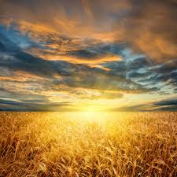
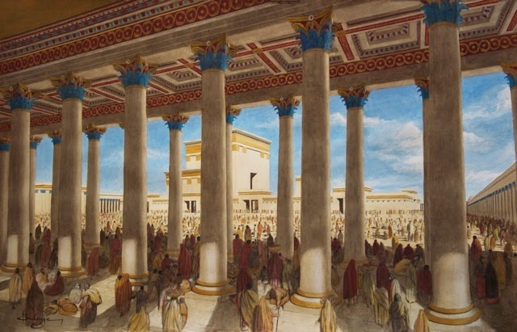
During which those 50 days the harvest of corn was being gathered in called the “Feast of the harvest, the firstfruits of thy Labours”
(Exodus 23:16)
“Three times in a year all thy males shall appear before the Lord God.”
(Exodus 23:17)

Slide 5
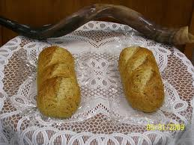
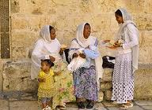
Just before the Day of Pentecost
“The feast of weeks” lasting a single day of holy convocation. The seven sabbaths shall be complete.”
(Deut. 16:10) and (Leviticus 23:21)
The new meal offering:
2 loaves of leavened bread made of fine flour of new wheat.

Slide 6
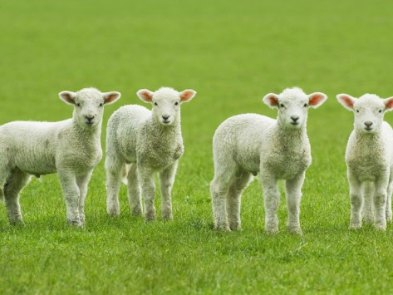
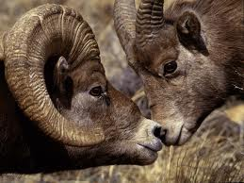
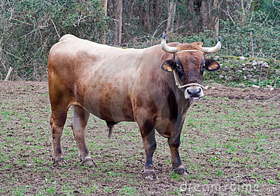
Special animal sacrifices were made.
(Leviticus 23:18)
For a meat and drink offering:
7 lambs without blemish of the first year, one young bullock, and two rams.

Slide 7
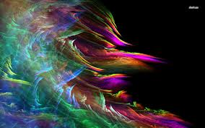
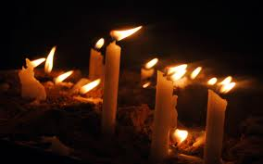
“And suddenly there came a sound from heaven as of a rushing mighty wind…
…and it filled all the house where they were sitting.”
Acts 2:2

Slide 8
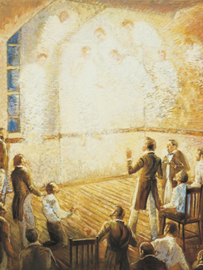
Revelation From Heaven
“The very name Pentecost comes into the Christian vocabulary as synonymous with breathtaking spiritual manifestations and a divine outpouring of the Holy Ghost upon all the people. Revelation came from heaven with the sound ‘as of a rushing mighty wind, and it filled all the house’ and it filled the brethren.” (8)
Prophet Joseph Smith prayed for a special outpouring the Spirit from on high:
This plea was fulfilled, not just once, but several times during the days following the initial dedicatory services. Joseph Smith recorded that on one occasion, “a noise was heard like the sound of a rushing mighty wind, which filled the [Kirtland] Temple, and all the congregation simultaneously arose, being moved upon by an invisible power; many began to speak in tongues and prophesy; others saw glorious visions; and I beheld the Temple was filled with angels, which fact I declared to the congregation.” (9)
Acts 2:2; D&C 109:36-37

Slide 9
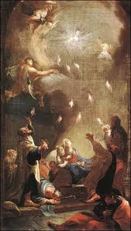
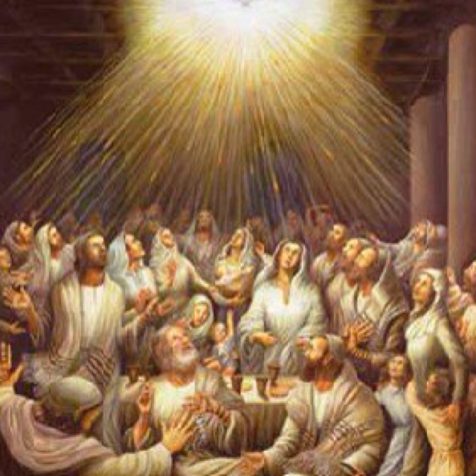
Cloven tongues—The gift of tongues
Anciently, fire often symbolized the divine presence or influence.
This was a sign that the disciples had received the gift of the Holy Ghost, promised by the Savior.
“And there appeared unto them cloven tongues like as of fire…
Tongues that are cloven or forked, or that have the appearance of the flame of a fire
…and it sat upon each of them.”
Acts 2:3

Slide 10
Fire—Environment of Heaven Brought to Earth
And the angel of the Lord appeared unto him in a flame of fire out of the midst of a bush;
Exodus 3:2
And it came to pass that Nephi and Lehi were encircled about as if by fire…
And when they saw that they were encircled about with a pillar of fire, and that it burned them not…
Helaman 5:23-24
And the Lord went before them by day in a pillar of a cloud, to lead them the way; and by night in a pillar of fire, to give them light; to go by day and night:
Exodus 13:21
…they saw that they were encircled about, yea every soul, by a pillar of fire.
And behold, the Holy Spirit of God did come down from heaven, and did enter into their hearts, and they were filled as if with fire,…
Helaman 5:43, 45
And the sight of the glory of the Lord was like devouring fire on the top of the mount in the eyes of the children of Israel.
Exodus 24:17
The divine fire can be described as the “everlasting burnings of God; for God dwells in everlasting burnings.” (9)
Acts 2:3

Slide 11
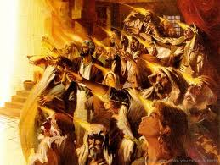
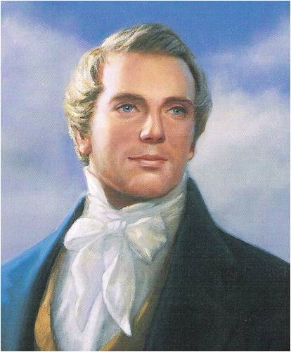
“And they were all filled with the Holy Ghost, and began to speak…
'The gift of tongues by the power of the Holy Ghost in the Church, is for the benefit of the servants of God to preach to unbelievers, as on the day of Pentecost.' (9)
“Be not so curious about tongues, do not speak in tongues except there be an interpreter present; the ultimate design of tongues is to speak to foreigners, and if persons are very anxious to display their intelligence, let them speak to such in their own tongues [that is in the tongues of the foreigners].' (10)
…with other tongues, as the Spirit gave them utterance.
Acts 2:4

Slide 12
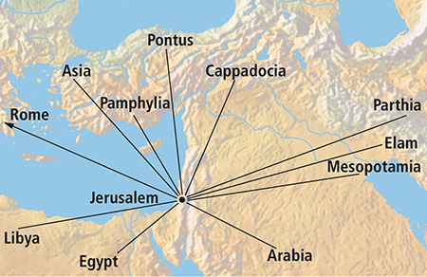
Speaking to them in their own language
Parthians
Medes
Elamites
Mesopotamia
Judaea
Cappadocia
Pontus
Asia
Cretes
Arabians
The gift of tongues was given to the early Apostles on the day of Pentecost so they could preach the gospel in multiple languages. (2)
All those dwelling at Jerusalem, Jews, devout men, out of every nation could hear and understand the words of the Apostle Peter.
Acts 2:5-11

Slide 13
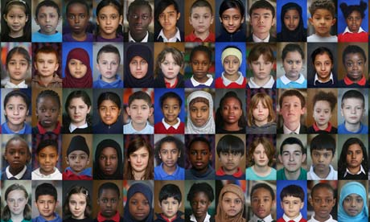
Peter Declares
As we are filled with the Holy Ghost, He will help us teach and testify to others
“…I will pour out of my Spirit upon all flesh…
…and your sons and your daughters shall prophesy…
Acts 2:17; Joel 2:28

Slide 14
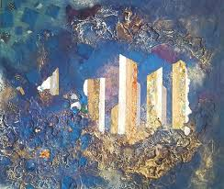
Peter Continues
…and your young men shall see visions…
…and your old men shall dream dreams.”
Acts 2:17; Joel 2:28

Slide 15
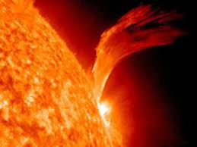
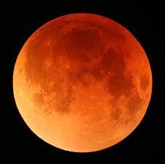
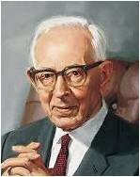
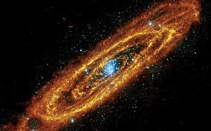
The Coming of the Lord
Wonders in heaven
Signs beneath the earth
Blood, fire and vapour of smoke
The sun turned to darkness
The moon into blood
The sun has not yet been darkened. We are informed that this will be one of the last acts just preceding the coming of the Lord.“ (11)
“…whosoever shall call on the name of the Lord shall be saved.”
Acts 2:19-20; Joel 2:30-31

Slide 16
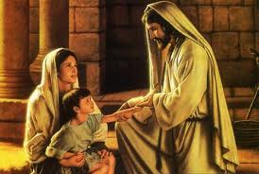
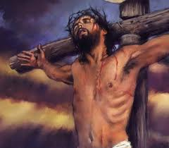
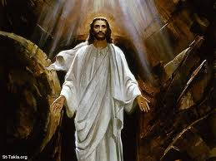
Peter Testifies of Christ
Jesus’ miracles and wonders and signs.
Him who was crucified and slain
Him who was raised up after His pains and death
Acts 2:22-24

Slide 17
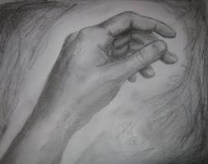
The Promise of the Holy Ghost
“Therefore being by the right hand of God exalted, and having received the Father the promise of the Holy Ghost…
…he hath shed forth this, which ye now see and hear.”
Acts 2:33

Slide 18
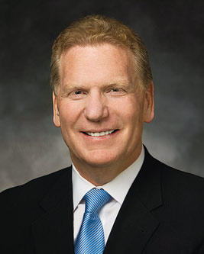
Receiving the Gift the Holy Ghost
“Before baptism, all honest and sincere seekers of truth can feel the influence of the Holy Ghost from time to time. However, the opportunity to receive the constant companionship of the
Holy Ghost…is available only to
worthy, baptized members who
receive the gift of the Holy Ghost
by the laying on of hands through
those holding the priesthood
authority of God.”
(3)

Slide 19
Who is the Holy Ghost?
“The Holy Ghost is the third member of the Godhead, and, as such, like God the Father and Jesus Christ.”
(3)

Slide 20
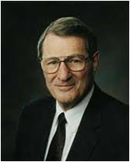
What Does the Holy Ghost Do?
A director: a spiritual Liahona
“Life is no labyrinth; mortality is no maze if a man possesses the gift of the Holy Ghost to guide him.”
(6)

Slide 21
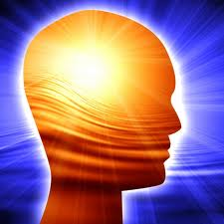
What Does the Holy Ghost Know?
He knows our thoughts and the intents of our hearts
“Yea, I tell thee, that thou mayest know that there is none else save God that knowest thy thoughts and the intents of thy heart.”
D&C 6:16
(3)

Slide 22
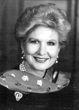
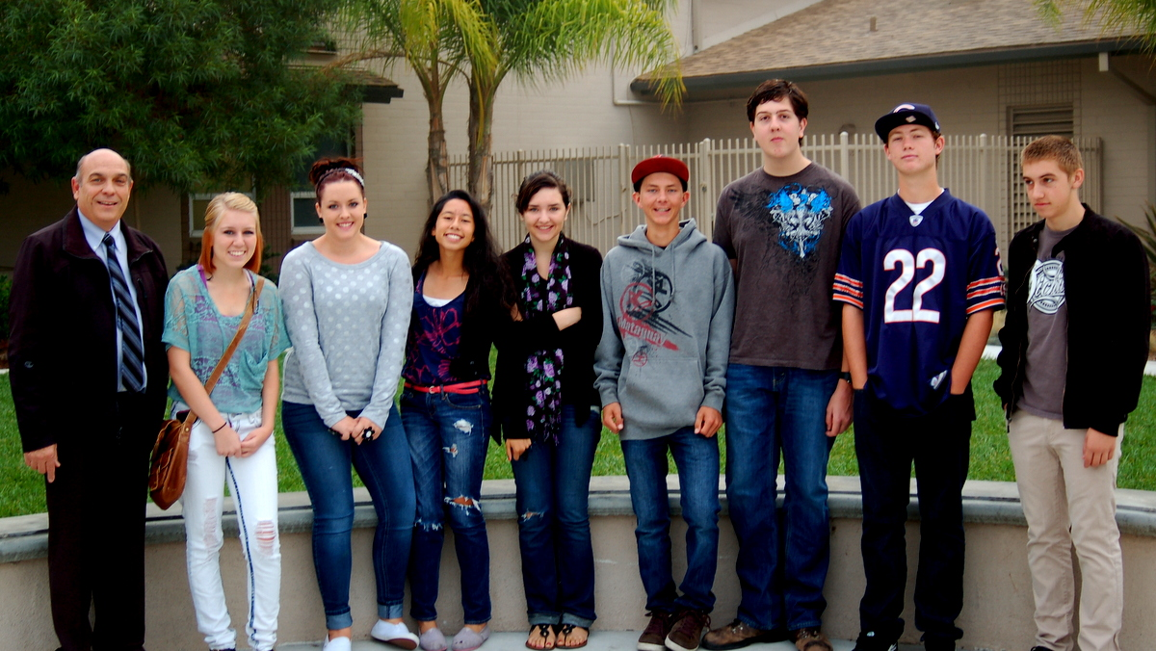
What does the Holy Ghost Know?
“Next to God Himself, the Holy Ghost knows more about your gifts, your strengths, and your weakness…”
Ramona Seminary 2012-13
(5)

Slide 23
What does the Holy Ghost want for us?
He loves us just like Heavenly Father and Jesus and wants us to be happy.
“He knows the challenges we will face, He can guide us and teach us all things we must do to return and live with our Heavenly Father once again.”
(3)

Slide 24
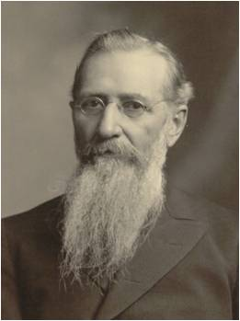
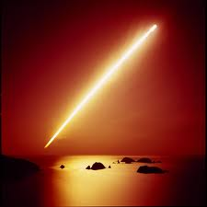
How do I know I have the Gift of the Holy Ghost?
“…thus when it becomes necessary to speak to us, he is able to do so by acting through the other Spirit, that is, through the Light of Christ.”
(7)

Slide 25
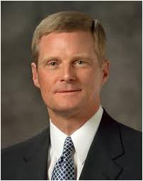
“The Holy Ghost does not become operative in our lives merely because hands are placed upon our heads. …
As we receive this ordinance [confirmation], each of us accepts a sacred and ongoing responsibility to desire, to seek, to work, and to so live that we indeed ‘receive the Holy Ghost’ and its attendant spiritual gifts.”
(13)

Slide 26
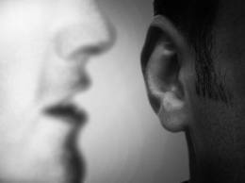
How Does the Holy Ghost Communicates
“The Holy Spirit communicates through feelings and impressions.”
“Silent Promptings---to act upon without delay.”
(3)

Slide 27
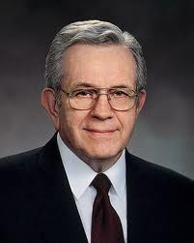
How Do You Recognize the Holy Ghost?
“The Holy Ghost speaks with a voice that you feel more than you hear...While we speak of ‘listening’ to the whisperings of the Spirit, most often one describes a spiritual prompting by saying, ‘I had a feeling..’”
(4)

Slide 28
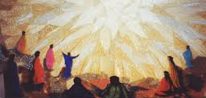
What is the purpose of the Holy Ghost?
“…bear witness of God the Father and of His Son, Jesus Christ, and to teach us the truth of all things.”
“And by the power of the Holy Ghost ye may know the truth of all things.”
(Moroni 10:5)
(3)

Slide 29
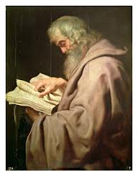
What can I do?
“For behold, again I say unto you that if ye will enter in by the way, and receive the Holy Ghost, it will show unto you all things what ye should do.”
A daily prayer and scripture reading to invite the Holy Ghost for direction.
2 Nephi 32:5

Slide 30
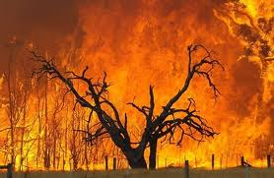
Other Names for the Holy Ghost:
The Comforter---gives hope, and peace.
The Spirit of Fire---burning feeling
The teacher and revelator---enlightens our minds and quickens our understanding, causing truth to be written in our souls and a change in our hearts.
“For the Holy Ghost shall teach you in the same hour what ye ought to say.”
(Luke 12:12) (D&C 11:13)
(3)

Slide 31
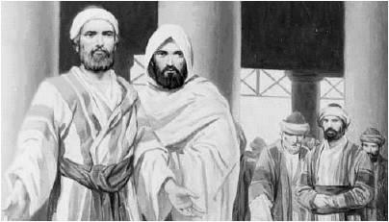
What shall we do?
“Now when they heard this, they were pricked in their heart…
Peter’s words had “pierced” them, bringing grief and remorse. As the people came to the terrible realization that they had crucified their Messiah, they may have feared that they had lost hope of salvation. (2)
As we receive the word of God by the power of the Holy Ghost, our hearts will change and we will be converted to Jesus Christ
…Men and brethren, what shall we do?”
Acts 2:37

Slide 32
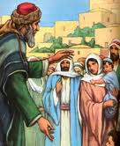
“…Repent, and be baptized…in the name of Jesus Christ for the remission of sins…
…and ye shall receive the gift of the Holy Ghost.”
Acts 2:38

Slide 33
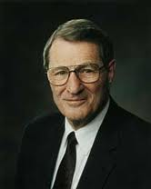
“Repentance takes care of the past, faith in the future, and the Holy Ghost helps us with today.”
(4)

Slide 34
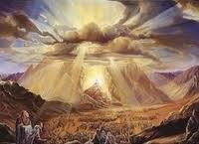
The Promise to the Children
"I call attention to the universality of this promise. It was made to those who were listening to the apostles, but not to them alone, it extended to their children, to them also that were afar off-to those who were a hundred years off, or five hundred, or five to ten thousand years off; the promise was to them; and as if this was not sufficiently universal, the apostle adds, 'even as many as the Lord our God shall call'-call to what? to as many of course, as are called to yield obedience to the Gospel-to all such the promise extends." (12)
Acts 2:39

Slide 35
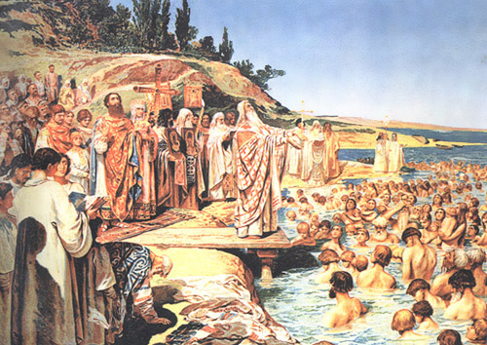
3,000 Souls Saved
When we have faith in Jesus Christ, repent, and are baptized, we are prepared to receive the gift of the Holy Ghost
“Then they that gladly received his word were baptized…
How about that for missionary work?
Acts 2:41

Slide 36
Sources:
Suggested Hymn: #238 Behold Thy Sons and Daughters, Lord
Video:
A Mighty Change: Conversion(2:48)
Bible Dictionary King James Version
New Testament Institute Manual Chapter 29
“An Unspeakable Gift from God” by Elder Craig C. Christensen Oct. 2012 General Conference
With quotes from Boyd K. Packer
Eve and the Mortal Journey by Beverly Campbell
The Neal A. Maxwell Quote Book
Doctrines of Salvation—Joseph Fielding Smith with quotes from President Joseph F. Smith
Elder Jeffrey R. Holland (“Therefore, What?” 6; si.lds.org).
Prophet Joseph Smith (History of the Church,2:428; 6:317);(Teachings, p. 195.)
Elder Bruce R. McConkie (Teachings, pp. 247-248.) (Doctrinal New Testament Commentary, 3 vols. [Salt Lake City: Bookcraft, 1965-1973], 2: 33.)
(The Way to Perfection [Salt Lake City: Genealogical Society of Utah, 1949], 280.)
B.H. Roberts (The Gospel and Man's Relationship to Deity [Salt Lake City: Deseret News, 1901], 178.)
Elder David A. Bednar (“Receive the Holy Ghost,” Ensign or Liahona, Nov. 2010, 95).
Presentation by ©http://fashionsbylynda.com/blog/

Slide 37
The Gift of the Holy Ghost Acts 2:3:
"You may have the administration of angels, you may see many miracles; you may see many wonders in the earth; but I claim that the gift of the Holy Ghost is the greatest gift that can be bestowed upon man.
"You may surround any man or woman with all the wealth and glory that the imagination of man can grasp, and are they satisfied? No. There is still an aching void. On the other hand, show me a beggar upon the streets, who has the Holy Ghost, whose mind is filled with that spirit and power, and I will show you a person who has peace of mind, who possesses true riches, and those enjoyments that no man can obtain from any other source." (The Discourses of Wilford Woodruff, edited by G. Homer Durham [Salt Lake City: Bookcraft, 1969], 5.)
Gift of Tongues Acts 2:5-11:
“The true gift of tongues is made manifest in the Church more abundantly, perhaps, than any other spiritual gift. Every missionary who goes forth to teach the gospel in a foreign language, if he [or she] is prayerful and faithful, receives this gift” President Joseph Fielding Smith (Answers to Gospel Questions, 5 vols. [1957–66], 2:29).
Prophecy of Joel Acts 2:16-17
This Spirit which you now see resting upon these Apostles of Jesus of Nazareth, is that same Spirit which your Prophet Joel says will, in the last days, be poured out upon all flesh. Obviously he did not mean that this occasion of the Apostles receiving the Holy Ghost was a complete fulfilment of Joel's prediction…
Joel's prophecy for its complete fulfilment requires that the Spirit of the Lord, the Holy Ghost, shall be poured out upon all flesh; and undoubtedly refers to that time which shall come in the blessed millennium when the enmity shall not only cease between man and man, but even between the beasts of the forests and of the fields; and between man and beast, as described by Isaiah in the following language:
'The wolf also shall dwell with the Lamb, and the leopard shall lie down with the kid; and the calf and the young lion and the fatling together; and a little child shall lead them. And the cow and the bear shall feed; their young ones shall lie down together: and the lion shall eat straw like the ox. And the suckling child shall play on the hole of the asp, and the weaned child shall put his hand on the cockatrice' den. They shall not hurt nor destroy in all my holy mountain; for the earth shall be full of the knowledge of the Lord, as the waters cover the sea.' (Isa. 11:6-9)
…Joel was speaking of the last days indeed, and not of a circumstance that occurred in connection with a period more properly designated as the Dispensation of the Meridian of Time...therefore at some time future from the days of the Apostles, we may look forward to a universal outpouring of God's Holy Spirit upon all flesh, resulting in a universal peace and widespread knowledge of God.“ Joseph Smith (History of The Church, 1: xxxiii.)
The Effect of the Holy Ghost On the Apostles Acts 2:4:
"The early chapters of Acts record the activities of the coming of the Holy Ghost at the feast of Pentecost. It was the gift of the Holy Ghost that they received on that occasion, for the Twelve and the other members of the Church had already enjoyed the power of the Holy Ghost, else they would not have had testimonies of the Savior and of the gospel. They would not have responded to the gospel in the first place had not the Spirit borne witness to their souls. But now they had the full power and gift of the Holy Ghost." (Robert J. Matthews, Selected Writings of Robert J. Matthews: Gospel Scholars Series [Salt Lake City: Deseret Book Co., 1999], 282.)
Latter-day Pentecost:
"(Sunday, March 27, 1836) I met the quorums in the evening and instructed them respecting the ordinance of washing of feet, which they were to attend to on Wednesday following; and gave them instructions in relation to the spirit of prophecy, and called upon the congregation to speak, and not to fear to prophesy good concerning the Saints...Do not quench the Spirit, for the first one that opens his mouth shall receive the spirit of prophecy.
"Brother George A. Smith arose and began to prophesy, when a noise was heard like the sound of a rushing mighty wind, which filled the temple, and all the congregation simultaneously arose, being moved upon by an invisible power; many began to speak in tongues and prophesy; others saw glorious visions; and I beheld the temple was filled with angels, which fact I declared to the congregation. The people of the neighborhood came running together (hearing an unusual sound within, and seeing a bright light like a pillar of fire resting upon the temple), and were astonished at what was taking place. This continued until the meeting closed at eleven p.m.
"The number of official members present on this occasion was four hundred and sixteen, being a greater number than ever assembled on any former occasion." Joseph Smith (History of the Church 2:428.)

Slide 38
Signs of the Times Acts 2:19:
Following the destruction of the Twin Towers in New York City, President Gordon B. Hinckley also quoted Joel 2:28-32 (See Conference Report, Nov. 2001, 4). Certainly, an event so apocalyptic and dramatic would seem to warrant mention in the scriptures. But just as Peter's reference to Joel's prophecy does not mean that the entire passage has been fulfilled (see commentary for Acts 2:16-17), President Hinckley's use of the same passage does not mean that all of Joel's prophecy has been fulfilled. His reference certainly means that the destruction of the twin towers in New York City was one of the signs of the times. That 'blood, and fire, and pillars of smoke' (Joel 2:30) is an excellent description of that fateful and tragic event. But just as Joel's prophecy about the Lord pouring out his spirit has multiple fulfillments, we can expect more 'blood, and fire, and pillars of smoke' before the sun darkens, the moon is turned to blood, and the stars fall from the heavens.
Prior to Sep. 11, 2001, Elder Neal A. Maxwell prophetically commented:
"Has any generation seen such ominous 'vapours of smoke' as ours, with its atomic mushroom clouds over the pathetic pyres of Hiroshima and Nagasaki? (See D&C 45:41; Joel 2:30-31; Matthew 24:24; Acts 2:19.) But, alas, even these may fall short of later fulfillments." (If Thou Endure It Well [Salt Lake City: Bookcraft, 1996], 12.)
Pricked in Their Hearts Acts 2:37:
“True conversion comes through the power of the Spirit. When the Spirit touches the heart, hearts are changed. When individuals … feel the Spirit working with them, or when they see the evidence of the Lord’s love and mercy in their lives, they are edified and strengthened spiritually and their faith in Him increases. These experiences with the Spirit follow naturally when a person is willing to experiment upon the word. This is how we come to feel the gospel is true.” Elder Russell M. Nelson (“Now Is the Time,” Ensign, Nov. 2000, 75).
All Things in Common Acts 2:44:
"We hear of this unique arrangement first in the days of Enoch, one of the greatest prophets who ever lived on this earth...He gathered his people together in the city of Enoch, about which the scripture says: 'And the Lord called his people Zion, because they were of one heart and one mind, and dwelt in righteousness; and there was no poor among them.' (Moses 7:18.)
"We might try to imagine a society in which there were no poor, no slums, no idlers, and no sinners. Apparently this idea worked pretty well in the entire city of Enoch, for all its people were eventually translated and taken up into heaven.
"This economic order was also practiced for a time in the days of Jesus. In Acts 2:44 we find this reference: 'And all that believed were together, and had all things common.' The scripture also says: 'And the multitude of them that believed were of one heart and of one soul: neither said any of them that ought of the things which he possessed was his own, but they had all things common.' (Acts 4:32.)
"There was also a period of great righteousness among the Nephites. Of them the record says: 'And they had all things common among them; therefore there were not rich and poor, bond and free, but they were all made free, and partakers of the heavenly gift.' (4 Ne. 1:3)
"This program would mean a utopia among us if we had the righteousness and self-control to make it work...But because of human weaknesses, this system has never seemed to work very well for very long. We have too much selfishness and too many idlers to make any common program work very well. There are too many people who want to take more out of life than they put in.
"To make this higher law really work, everyone would need to be ambitious, virtuous, and love his neighbor as himself. It would be necessary for each one to live as near to the top of his condition as possible. Because we haven't been able to qualify for the United Order, the Lord has instituted some lesser laws, including tithing, fast offerings, and other welfare programs. However, because of our personal weaknesses and lack of faith, even these lesser laws are not obeyed very well." Sterling W. Sill (The Wealth of Wisdom[Salt Lake City: Deseret Book Co., 1977], 208 - 210.)
King David Acts 2:29-31
"Peter had the keys of eternal judgment. And he saw David in Hell and knew for what reason, and that David would have to remain there until the resurrection at the coming of Christ.
"Even David must wait for those times of refreshing [Acts 3:19-20] before he can come forth and his sins be blotted out. For Peter speaking of him says, 'David hath not yet ascended into heaven, for his sepulchre is with us to this day.' His remains were then in the tomb. Now we read that many bodies of the Saints arose at Christ's resurrection, probably all the Saints. But it seems that David did not. Why? Because he had been a murderer." (Kent P. Jackson, comp. and ed., Joseph Smith's Commentary on the Bible [Salt Lake City: Deseret Book Co., 1994], 144.)
Concerning King David’s eternal inheritance, Elder Bruce R. McConkie of the Quorum of the Twelve Apostles taught that David “received the promise that his soul would not be left in hell, that is, he would not be a son of perdition, he would not be cast out eternally with the devil and his angels.
Rather, when death and hell deliver up the dead which are in them, he shall come forth from the grave and receive that inheritance which he merits. See Rev. 20:11–15” Elder Bruce R. McConkie (Doctrinal New Testament Commentary,3 vols. [1965–73], 2:39).

Slide 39
Event | Acts
Kingdom to Be Restored to Israel | 1:1–8
Mount of Olives: Christ Ascends to Heaven | 1:9–14
Jerusalem: Apostles Choose Successor to Judas | 1:15–26
The Holy Ghost and the Day of Pentecost | 2:1–21
Peter Testifies of Jesus’ Resurrection | 2:22–36
How to Gain Salvation | 2:37–40
All Things in Common | 2:41–47
Peter Heals Man Lame from Birth | 3:1–16
Age of Restoration Is Prior to Christ’s Second Coming | 3:17–24
The Children of the Covenant | 3:25, 26
Salvation Comes Only Through Christ | 4:1–12
Sadducees Seek to Silence Apostles | 4:13–22
Saints Glory in Testimony of Jesus | 4:23–31
Saints Practice United Order | 4:32–37
Fate of Deceivers | 5:1–11
Event | Acts
Apostles Continue Miracles of Jesus | 5:12–16
Angels Deliver Apostles from Prison | 5:17–26
Apostles Testify of Christ | 5:27–32
Persecution Is Not of God | 5:33–42
Seven Chosen to Assist Apostles | 6:1–6
Stephen Transfigured Before the Sanhedrin | 6:7–15
Stephen Preaches about Israel | 7:1–36
Moses—A Prototype of Christ | 7:37–40
Stephen Testifies of Apostasy in Israel | 7:41–53
Stephen Sees the Father and the Son | 7:54–60; 8:1
Saul Persecutes the Church | 8:1–4
Samaria: Philip Works Miracles, Converts Simon | 8:5–13
Apostles Confer Gift of the Holy Ghost | 8:14–17
Simon Seeks to Buy Gift of the Holy Ghost | 8:18–25
Toward Gaza: Philip Preaches Christ, Baptizes Eunuch | 8:26–40
The Acts of The Apostles, Written by Luke to Theophilus, 61-63 AD
The Events That Occurred 33-36 AD (1-8)
Life and Times of Jesus Christ Section 7 Chapter 29

Slide 40
