Slide 1
Lesson 84
“Silver and Gold have I none…”
Peter and John heal a lame man at the Gate Beautiful
Acts 3:1-11

Slide 2
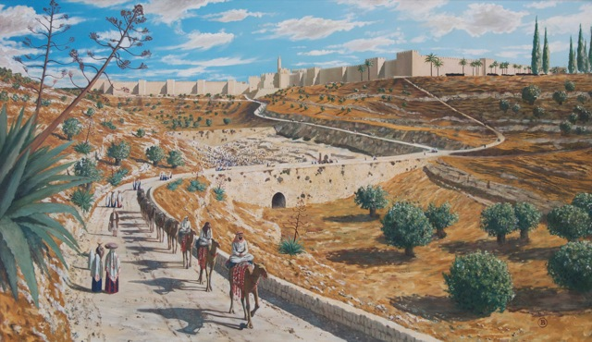
“Now Peter and John went up together into the temple…
…at the hour of prayer, being the ninth hour.”
Acts 3:1

Slide 3
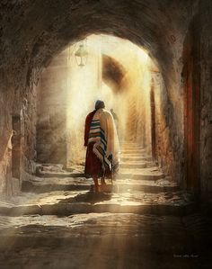
Prayers 3 times a day
3rd hour---9:00 AM
6th hour---12:00 noon
9th hour---3:00 PM

Slide 4
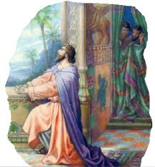
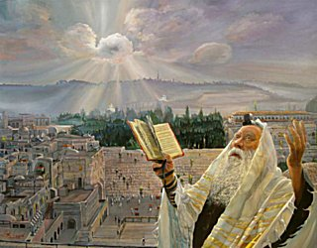
Prayers 3 times a day
“Cry unto him in your houses, yea, over all your household, both morning, mid-day, and evening.” (Alma 34:21)
Daniel prayed 3 times a day
Now when Daniel knew that the writing was signed, he went into his house; and his windows being open in his chamber toward Jerusalem, he kneeled upon his knees three times a day, and prayed, and gave thanks before his God, as he did aforetime.
Daniel 6:10
Their prayers were to be toward the temple. (Psalms 5:7)

Slide 5
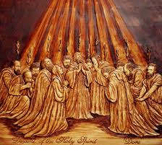
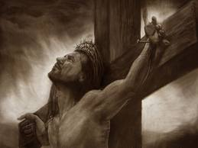
3rd hour:
Jesus is crucified--- (Mark 15:25)
Pentecost where all were filled with the Holy Ghost, (cloven tongues) (Acts 2:3-4)

Slide 6
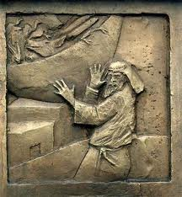
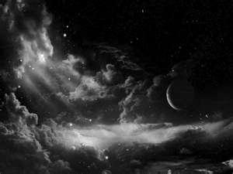
6th hour:
“Darkness over all the land” (Mark 15:33-34) and (Matthew 27:45)
Peter prays on the housetop and has a vision (Acts 10:9)

Slide 7
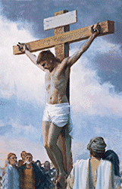
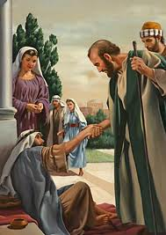
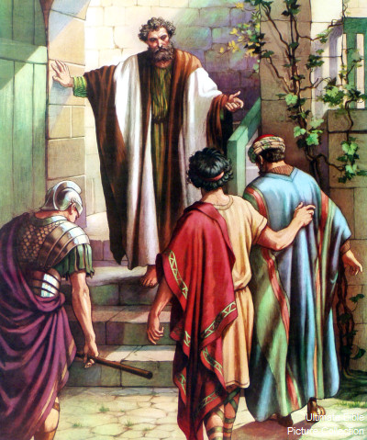
9th hour:
Jesus dies on the cross
(Luke 23:44-46)
Peter and John go to temple and heal a lame man.
(Acts 3:1-11)
Cornelius fasts and prays and sees a man in bright clothing.
(Acts 10:30)

Slide 8
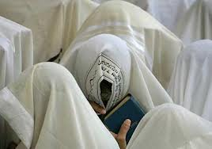
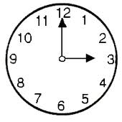
Ninth Hour: A fixed time of prayer is a fixed time of prayer of the Divine Office of almost all the traditional Christian liturgies. It consists mainly of psalms and is said around 3 p.m. Its name comes from Latin and refers to the ninth hour of the day after dawn.
This hour is now described more generally as the "midafternoon prayer" and may be said whenever convenient during the day, or omitted entirely. However, bishops and priests are still expected to recite the full sequence of hours, as closely as possible to the traditional time of day.

Slide 9
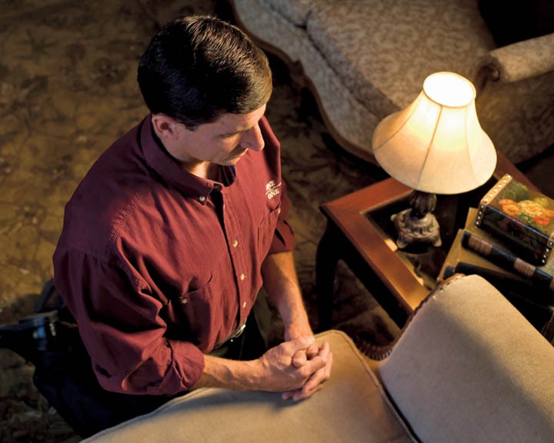
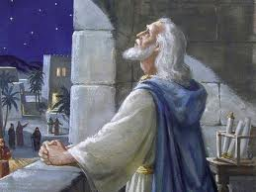
Hours of Prayer
These Prayers were a vital part of one’s spiritual value system.
They would have had the same “order of service” for their prayers.
One such prayer is found in Psalm 5 and 117:
Hear the right, O Lord, attend unto my cry, give ear unto my prayer, that goeth not out of feigned lips…
Give ear to my words, O Lord, consider my meditation…

Slide 10
Question?
If the custom was to pray three times a day, were they at the synagogues praying during Jesus’ crucifixion…
If the custom was to pray three times a day, were they at the synagogues praying during the darkness…
If the custom was to pray three times a day, were they at the synagogues praying during Jesus’ death…

Slide 11
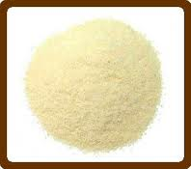
Peter Probably Brought a “Gift Offering”
One did not come to the House of the Lord without an offering, especially at the hours of prayer.
“And when any will offer a meat offering unto the Lord, his offering shall be of fine flour; and he shall pour oil upon it, and put frankincense thereon;”
(Lev. 2:1)

Slide 12
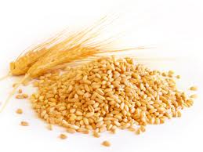
Quintessential Gift Offering
Grain, Frankincense, and Oil
Grain: raw and mixed with oil
OR
mixed with oil and cooked into unleavened bread
OR
cooked into wafers and spread with oil.

Slide 13
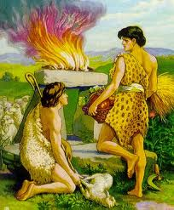
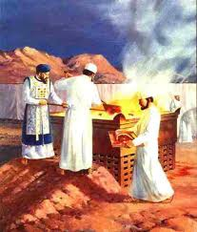
‘Mincha’ or ‘Minha’ for the Afternoon
Prayer service in Judaism
“Therefore If thou bring thy gift to the altar…Leave there thy gift before the altar…”
(Matthew 5:23-24)
Offering by Cain and Able
(Genesis 4:3-4)

Slide 14
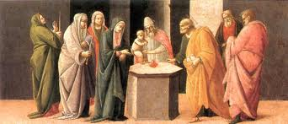
Traditional
Ten such cakes of bread had to be made for each offering. A portion of this was then burnt on the altar, along with the frankincense, while the remainder was allocated to the priests, who were to eat it within the sanctuary.

Slide 15
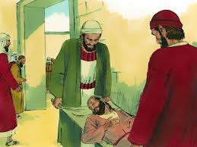
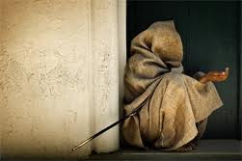
“And a certain man lame from his mother’s womb was carried…
…whom they laid daily at the gate of the temple…
Acts 3:2

Slide 16
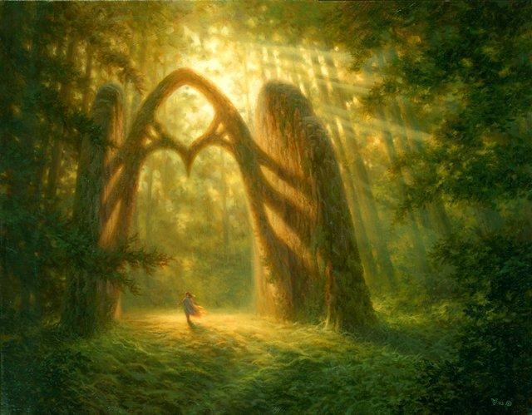
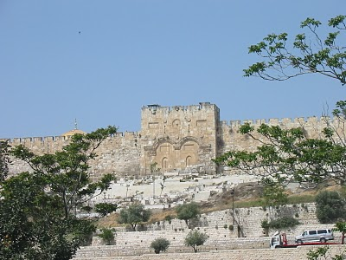
…which is called Beautiful…
This is the only time this gate is mentioned as Gate Beautiful in the Bible.
Acts 3:2

Slide 17
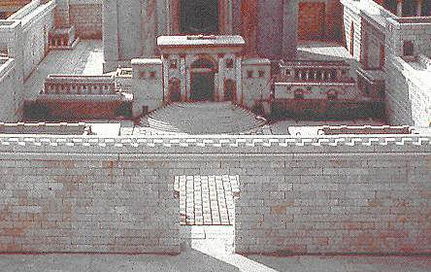
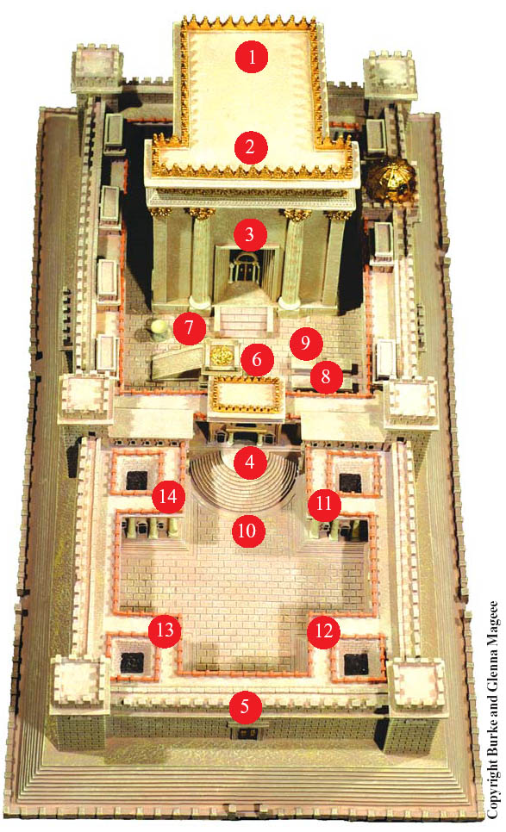
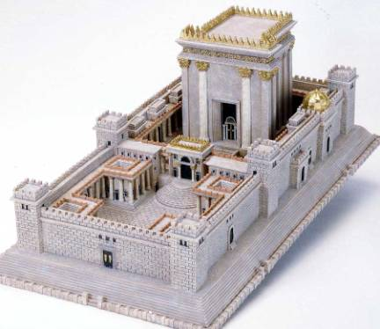
Gate Beautiful
Holy of Holies
Veil
Holy Place:
Altar of Incense
Table of Shewbread
Menorah
Porch
Priest’s storage
4. Nicanor Gate
5. Gate Beautiful
6. Upper Court
7. Laver
8. Alter of Sacrifice
Priests Courtyard
Women’s Court
Leper’s Chamber Court
Chamber of Wood
Chamber of Nazarites
Chamber of Oils
Traditions says it is the gate leading into the women’s court.
Another name: Double Gate, at the southern end of the temple wall

Slide 18
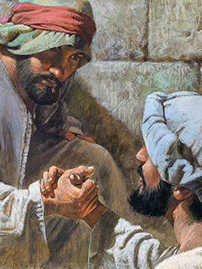
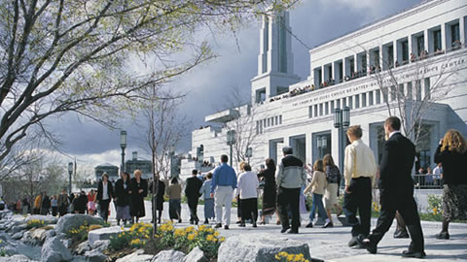
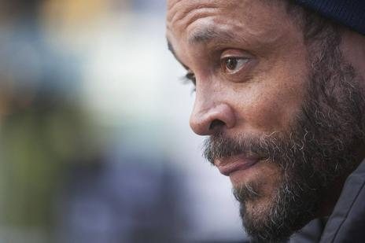
“Who seeing Peter and John about to go into the temple…
Robert T. Barrett
This may have been a good time for a person to receive alms from the people…food for the day.
…asked an alms.”
Acts 3:3

Slide 19
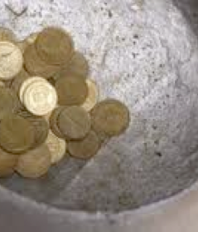
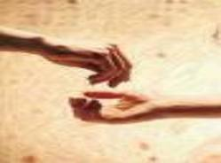
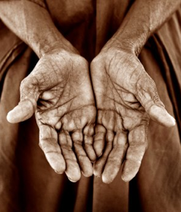
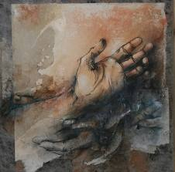
…to ask alms of them that entered into the temple;”
Alms:
money, food, or other donations given to the poor or needy; anything given as charity:
The hands of the beggars were outstretched for alms.
Acts 3:2

Slide 20
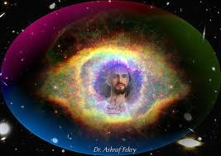
Look on us, Recognize me
“And Peter, fastening his eyes upon him with John, said…
Peter and John wanted this man to look at him, see him, see who he was, who they represented.
When we look toward our Savior and understand who He is, and what He can do for us, then can we be healed.
Acts 3:4

Slide 21
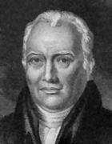
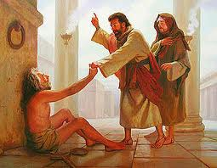
“And he gave heed unto them, expecting to receive something of them.”
Because it was a constant custom for all who entered the temple to carry money with them to give to the treasury, or to the poor, or to both. It was on this ground that the friends of the lame man laid him at the gate of the temple, as this was the most likely place to receive alms. (7)
Acts 3:5

Slide 22
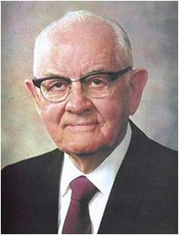
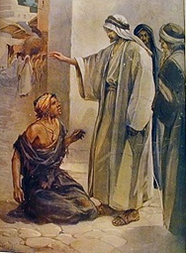
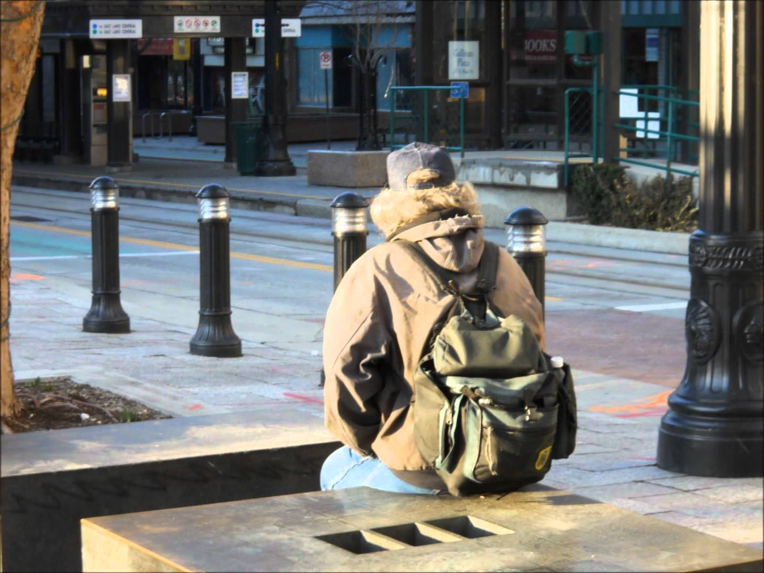
“The Peter said, Silver and gold have I none; but such as I have give I thee:…
So poor were the apostles that their had nothing to give, either to the sacred treasury, or to the distressed. (7)
All of us need to ponder those words. Do we, too, have something we need to share?
Yes! We have the gospel of Jesus Christ, the gospel of peace, the gospel of joy. We have truths that can make any person better and more fulfilled, any marriage happier and sweeter, any home more heavenly. We have the priesthood power of God to bless our homes and lives and the lives of others. Yes, it is to ourselves, our homes, our quorums, our classes, our Church assignments that we must carry more energetically those things that we have received. And it is to our nonmember neighbors and associates that we are now asked to also "give such as we have." The Lord has commanded us to do so. We must lengthen our stride and must do it now." (8)
Acts 3:6

Slide 23
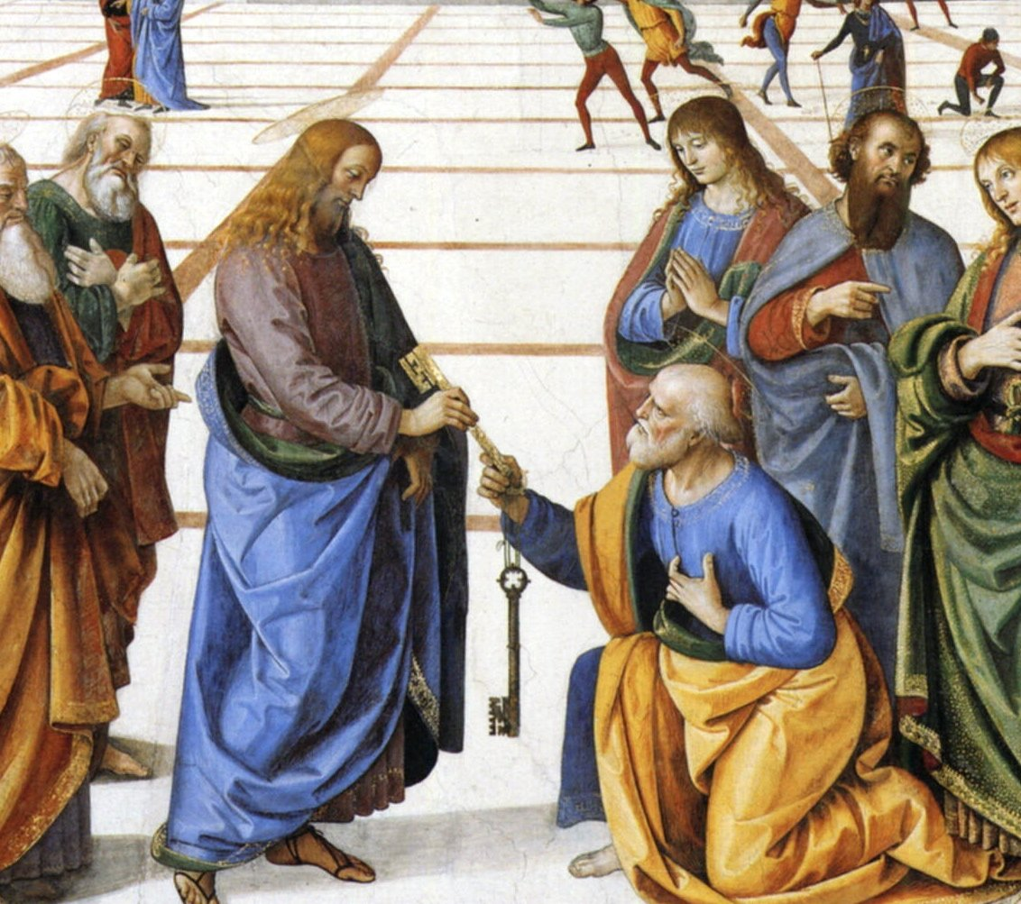
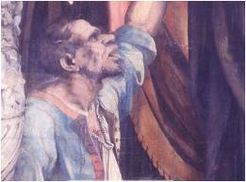
“Peter had no money but he had riches: ‘such as he had’ included every key to the kingdom of God on earth, priesthood power to raise the dead, faith to strengthen bones and sinews, a strong right hand of Christian fellowship.
He could not give silver or gold but he could give that which is always purchased ‘without money and without price’ —and he gave it”
Ho, every one that thirsteth, come ye to the waters, and he that hath no money; come ye, buy, and eat; yea, come, buy wine and milk without money and without price.
Isaiah 55:1
(6)

Slide 24
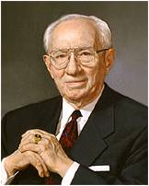
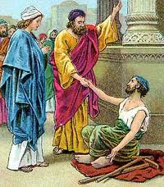
Rise Up and Walk
“And he took him by the right hand, and lifted him up…
“Now note that Peter took him by the right hand and lifted him up. Peter had to reach down to lift the lame man. We must also reach down.”
Acts 3:6-7
(3)

Slide 25
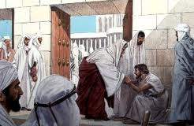
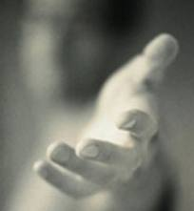
Lifted Him Up
An act of Healing… “But Jesus took him by the hand, and lifted him up; and he arose.”
“Let us open our hearts, let us reach down and lift up, let us open our purses, let us show a greater love for our fellowmen.” (3)
“Inasmuch as ye have done it unto one of the least of these my brethren, ye have done it unto me.”
Acts 3:7; Mark 9:27; Matthew 25:40

Slide 26
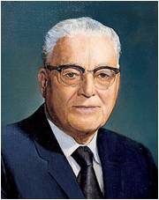
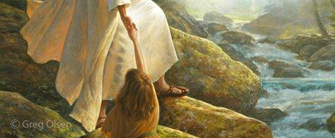
Can You Rescue A Soul?
“You cannot lift another soul until you are standing on higher ground than he is.
You must be sure, if you would rescue the man, that you yourself are setting the example of what you would have him be. You cannot light a fire in another soul unless it is burning in your own soul.”
(9)

Slide 27
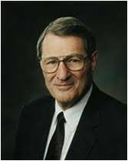
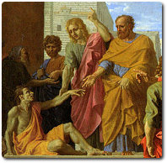
“One cannot have adequate faith in a Christ whom he does not adequately know.”
The lame man must have known who these apostles were and who they represented
(2)

Slide 28
In what ways was the blessing this man received greater than the alms he had originally asked for?
…and immediately his feet and ankle bones received strength.”
Heavenly Father might not answer our prayers in the ways we want or expect Him to, but His answers are always for our greater good
Acts 3:7

Slide 29
“And he leaping up stood, and walked, and entered with them into the temple…
…walking, and leaping, and praising God.”
Then shall the lame man leap as an hart, and the tongue of the dumb sing: for in the wilderness shall waters break out, and streams in the desert.
Isaiah 36:5
Acts 3:8

Slide 30
“…the scriptures remind us that we don’t have to walk through life alone. Christ came that we might have life and have it more abundantly.”
(4)

Slide 31
Wonderment and Amazement
People gathered together on the porch of Solomon’s Temple
Without hesitation Peter testified to the Jewish leaders that it was not any mortal power that had healed the lame man—Jesus, whom they had delivered up and killed, had healed the man. (1)
Acts 3:9-11

Slide 32
Wonderment and Amazement
Porch
20 cubits--length
X 10 cubits (breadth)
1 Kings 6:3

Slide 33
Peter Testifies of Christ
Peter was speaking to the people who had called for or consented to the Crucifixion of Jesus Christ.
“[Peter] did not say to them, ‘Repent and be baptized, for the remission of your sins;’ but he said, ‘Repent ye therefore, and be converted, that your sins may be blotted out, when the times of refreshing shall come from the presence of the Lord.’
“… They could not be baptized for the remission of sins for they had shed innocent blood.”
Acts 3:19
(10)

Slide 34
Doctrinal Mastery
Repent ye therefore, and be converted, that your sins may be blotted out, when the times of refreshing shall come from the presence of the Lord;
And he shall send Jesus Christ, which before was preached unto you:
Whom the heaven must receive until the times of restitution of all things, which God hath spoken by the mouth of all his holy prophets since the world began.
Acts 3:19-21

Slide 35
Refreshing--Regeneration
And Jesus said unto them, Verily I say unto you, That ye which have followed me, in the regeneration when the Son of man shall sit in the throne of his glory, ye also shall sit upon twelve thrones, judging the twelve tribes of Israel.
Matthew 19:28
It is the day ‘when the earth shall be transfigured, even according to the pattern which was shown unto mine apostles upon the mount. …’ the Lord says.
It is the day when ‘the earth will be renewed and receive its paradisiacal glory.’
It is the day of the ‘new earth’ that Isaiah saw, the earth which will prevail when wickedness ceases, when the millennial era is ushered in. …
It is the day when men ‘shall beat their swords into plowshares, and hooks’, a day of
universal peace and justice, a
millennial era when Christ shall reign
personally upon the earth.” (11)
Prophets in all ages have foretold the latter-day Restoration of the gospel
Acts 3:19; Isaiah 65:17; Isaiah 2:4; D&C 63:21; Tenth Article of Faith

Slide 36
Restitution--Restoration
When Jesus Christ would visit the earth before His Second Coming
“An age in which God has promised to restore all things that he spoke by the mouth of all his holy prophets since the world began.
“Thus, Christ came once and ministered among men, climaxing his ministry with his atoning sacrifice and ascension to his Father. He is to come again, a second time, in a day of refreshing and renewal, to reign personally upon the earth.
But he cannot come this second time until an age in the earth’s history commences which has the name the times of restitution,
or in other words he cannot come until the age or period of restoration; and in that age or period all essential things that God ever gave in any age of the earth for salvation, betterment, blessing, and edification of his children will be restored again.” (11)
Peter also taught that Jesus Christ would remain in heaven until the “times of restitution of all things”
(1)
Acts 3:21

Slide 37
Sources:
Suggested Hymn #98 I Need Thee Every Hour
Video:
“Peter and John Heal a Man Crippled Since Birth” (3:21)
Wrong Roads (3:58)
New Testament Institute Manual Chapter 30
Neal A. Maxwell May Ensign 1986 p. 35
Gordon B. Hinckley “Reaching Down to Lift Another.” Oct. General Conf. 2011
Marvin J. Ashton…April 1991 General Conf. “A Voice of Gladness”
Robert Somerville “The Hours of Prayer” Biblical Times of Memorial
Elder Jeffrey R. Holland (“The Lengthening Shadow of Peter,” Ensign, Sept. 1975, 30).
Adam Clarke Commentary
President Spencer W. Kimball ("Always a Convert Church: Some Lessons to Learn and Apply This Year," Ensign, Sept. 1975, 2)
President Harold B. Lee (“Stand Ye in Holy Places,” Ensign, July 1973, 123).
Prophet Joseph Smith (in History of the Church, 6:253).
Elder Bruce R. McConkie in CR, Oct. 1967, p. 43. also in Life and Teachings of Jesus and His Apostles Section 7 Chapter 29
Presentation by ©http://fashionsbylynda.com/blog/

Slide 38
The Miracle of Healing: Acts 3:6-7:
"The greatest miracles I see today are not necessarily the healing of sick bodies, but the greatest miracles I see are the healing of sick souls, those who are sick in soul and spirit and are downhearted and distraught, on the verge of nervous breakdowns. We are reaching out to all such, because they are precious in the sight of the Lord, and we want no one to feel that he is forgotten.
"I read again and again the experience of Peter and John, as they went through the gate beautiful on the way to the temple. Here was one who had never walked, impotent from his birth, begging alms of all who approached the gate. And as Peter and John approached, he held out his hand expectantly, asking for alms. Peter, speaking for this pair of missionaries-church authorities-said, 'Look on us.' And, of course, that heightened his expectation. Then Peter said, 'Silver and gold have I none; but such as I have give I thee: In the name of Jesus Christ of Nazareth rise up and walk.' (Acts 3:4, Acts 3:66.)
"Now in my mind's eye I can picture this man and what was in his mind. 'Doesn't this man know that I have never walked? He commands me to walk.' But the biblical record doesn't end there. Peter just didn't content himself by commanding the man to walk, but he 'took him by the right hand, and lifted him up. . . .' (Acts 3:7.)
"Will you see that picture now of that noble soul, that chiefest of the apostles, perhaps with his arms around the shoulders of this man, and saying, 'Now, my good man, have courage. I will take a few steps with you. Let's walk together, and I assure you that you can walk, because you have received a blessing by the power and authority that God has given us as men, his servants.' Then the man leaped with joy.
"You cannot lift another soul until you are standing on higher ground than he is. You must be sure, if you would rescue the man, that you yourself are setting the example of what you would have him be. You cannot light a fire in another soul unless it is burning in your own soul. You teachers, the testimony that you bear, the spirit with which you teach and with which you lead, is one of the most important assets that you can have, as you help to strengthen those who need so much, wherein you have so much to give. Who of us, in whatever station we may have been in, have not needed strengthening?" President Harold B. Lee (Stand Ye in Holy Places [Salt Lake City: Deseret Book Co., 1974], 186-187.)
The Miracle of Grace:
“Peter did not ask the Lord to heal the cripple; he did not pray to God to pour out his grace and healing virtue upon the lame man. Instead—acting in the Lord’s name and by virtue of a delegation of priestly authority already received—he himself commanded the miracle to occur. Peter was the Lord’s servant, his representative and agent; he stood in the place and stead of Christ, doing what the Master would have done if personally present” (Doctrinal New Testament Commentary, 3 vols. [1965–73], 2:46).
The word "restitution" has more meanings than just a "restoration." Restitution means to make payment for something or to restore something to its original condition. Certainly, the Restoration encompasses all the keys, priesthood, covenants, gospel principles, doctrines, and ordinances necessary for us. But the Lord has much more than this in mind. His plan of restitution includes gathering 'together in one all things in Christ, both which are in heaven, and which are on earth; even in him' (Eph. 1:10). Think of all the things for which restitution has not yet come. All these must occur when the Lord comes again. They include:
1) Restitution made to the righteous saints for their righteousness (Isa. 59:18)-this includes all the blessings of the Christ's Millenial reign
2) Restitution made to the wicked for their wickedness (Isa 40:31; 54:17, DC 45:58)-'for this was the day of vengeance which was in my heart' (DC 133:51).
3) A geographical restitution-meaning a) that the city of Enoch will return to the earth and be joined to Zion (Moses 7:62-64), b) that the continents will return to their original position (DC 133:23), c) mountains shall be broken down and deserts will become pools of living water (DC 133:22, 29).
4) The earth will be renewed and receive its paradisiacal glory as in the days of the Garden of Eden (Isa 51:3). This will include the lamb lying down with the lion (Isa 11:6-9), a return to the pure Adamic language (Zeph. 3:9), and a return to peace and harmony among men and all creatures.
5) Many doctrinal practices will be restored again, including the law of consecration, the law of plural marriage (Isa 4:1), and even some animal sacrifice (DC 13).
6) The promises made to the house of Israel will all be fulfilled. Abraham's descendants will inherit the land promised them (Gen 15:15), Israel will be gathered to Jerusalem and Zion (Isa 51:1), and will finally live in peace as prophesied.
"Although we now live in the 'last days' and much restoration has taken place, in truth, the Restoration has barely begun. Perhaps we have identified the Restoration primarily in terms of priesthood, Church organization, and gospel ordinances as given through the Prophet Joseph Smith. While these were the beginning, and without priesthood none of the other things could occur, the Restoration events yet to take place are more in number and of greater earth-shaking consequence than those that have so far taken place. The Restoration will continue throughout and beyond the Millennium until every soul is resurrected and judged and until all mankind and the earth itself have reached their final status." (Selected Writings of Robert J. Matthews: Gospel Scholars Series [Salt Lake City: Deseret Book Co., 1999], 394.)

Slide 39
Events That Happened During the Hour of Prayer
3rd hour 9:00 AM | 6th Hour 12:00 PM | 9th Hour 6:00 PM
Jesus is Crucified (Mark 15:25) | Darkness in the land (Mark 15:33-34; Matthew 27:45; Luke 23:44) | Jesus dies on the cross (Luke 23:44-46)
Parable of the Vineyard (Matthew 20:3-4) | Parable of the Vineyard (Matthew 20:5) | Parable of the Vineyard (Matthew 20:5)
Peter Preaches at the Pentecost (Acts 2:15) | Preparation for the Passover (John 19:14 | Peter and John heal lame man at temple (Acts 3:1)
 | Jesus at Jacob’s well (John 4:9) | Jesus Cries, “Why Hast Thou Forsaken Me” (Matthew 27:43; Mark 15:34)
 | Peter Prays on the housetop (Acts 10:9) | Cornelius fasts and prays and sees a man in bright clothing. (Acts 10:30)

Slide 40
Acts 3:22-23
Peter Talks About Moses
Did not Moses save Israel from the most powerful military force on the earth? Will not Christ save Israel from an army assembled from all nations? Was not Moses the lawgiver for Israel? Will not Christ dispense the word of the Lord from Jerusalem and the law of the Lord from Zion? Did not Moses offer the children of Israel a land of promise, flowing with milk and honey? Will not Christ establish Israel in their land of promise and supply pools of living water and the bread of life? Did not Moses live with his people, judge them, and lead them in person? Will not Christ become the Great Judge and dwell with his people?
While we don't think about Moses delivery of the children of Israel in apocalyptic terms, we should. Moses' delivery of the children of Israel is a type of Christ's delivery of Israel from a besieging army. Even the destructions which were brought upon Egypt are but a foreshadowing of the way in which his enemies will be destroyed. Indeed, the destruction of Egypt at the hand of Moses shows us how the Lord will destroy Babylon in the last days. Fortunately, he will not need his saints to fight, for he has promised 'I will fight your battles' (DC 105:14) just as he fought their battles in Moses' day (Ex. 14:14).
After the plagues of Egypt are repeated upon the wicked of the last days, the saints will clearly see the connection. Then it will seem most natural to 'sing the song of Moses, the servant of God' in conjunction with 'the song of the Lamb, saying, Great and marvelous are thy works, Lord God Almighty; just and true are thy ways, thou King of saints.' (Rev. 15:3) Then will the saints understand in fullness that the prophet whom the Lord should raise up like unto Moses would be like him in so many ways. For 'it shall come to pass, that every soul, which will not hear that prophet, shall be destroyed from among the people.' (Acts 3:23, see also JS-Hist. 1:40)

Slide 41
Event | Acts
Kingdom to Be Restored to Israel | 1:1–8
Mount of Olives: Christ Ascends to Heaven | 1:9–14
Jerusalem: Apostles Choose Successor to Judas | 1:15–26
The Holy Ghost and the Day of Pentecost | 2:1–21
Peter Testifies of Jesus’ Resurrection | 2:22–36
How to Gain Salvation | 2:37–40
All Things in Common | 2:41–47
Peter Heals Man Lame from Birth | 3:1–16
Age of Restoration Is Prior to Christ’s Second Coming | 3:17–24
The Children of the Covenant | 3:25, 26
Salvation Comes Only Through Christ | 4:1–12
Sadducees Seek to Silence Apostles | 4:13–22
Saints Glory in Testimony of Jesus | 4:23–31
Saints Practice United Order | 4:32–37
Fate of Deceivers | 5:1–11
Event | Acts
Apostles Continue Miracles of Jesus | 5:12–16
Angels Deliver Apostles from Prison | 5:17–26
Apostles Testify of Christ | 5:27–32
Persecution Is Not of God | 5:33–42
Seven Chosen to Assist Apostles | 6:1–6
Stephen Transfigured Before the Sanhedrin | 6:7–15
Stephen Preaches about Israel | 7:1–36
Moses—A Prototype of Christ | 7:37–40
Stephen Testifies of Apostasy in Israel | 7:41–53
Stephen Sees the Father and the Son | 7:54–60; 8:1
Saul Persecutes the Church | 8:1–4
Samaria: Philip Works Miracles, Converts Simon | 8:5–13
Apostles Confer Gift of the Holy Ghost | 8:14–17
Simon Seeks to Buy Gift of the Holy Ghost | 8:18–25
Toward Gaza: Philip Preaches Christ, Baptizes Eunuch | 8:26–40
The Acts of The Apostles, Written by Luke to Theophilus, 61-63 AD
The Events That Occurred 33-36 AD (1-8)
Life and Times of Jesus Christ Section 7 Chapter 29

