Slide 1
Lesson 141
Commandments
Part 3
Presentation by ©http://fashionsbylynda.com/blog/

Slide 2
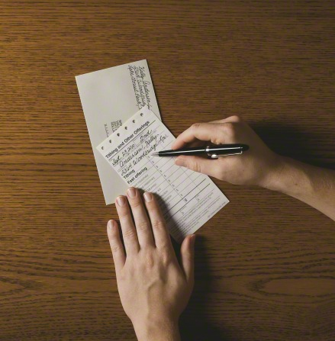
God’s Commandments include:
Praying daily
Studying the word of God
Repenting
Obeying the law of chastity
Paying a full tithe
Fasting
Forgiving others
Observing the Word of Wisdom
Teaching the gospel to others
Bring ye all the tithes into the storehouse, that there may be meat in mine house, and prove me now herewith, saith the Lord of hosts, if I will not open you the windows of heaven, and pour you out a blessing, that there shall not be room enough to receive it.
Malachi 3:10

Slide 3
Open the Windows of Heaven
The prophet Malachi, speaking for the Lord, corrected the Jews, who had strayed from the Lord, and commanded them to return to Him by following His commandments, including the commandment to pay tithes and offerings.
If we do not pay our tithing, we are robbing God; paying tithing supplies the Lord’s kingdom with necessary material resources;
God invites us to prove, or test, His promises by obeying the commandment to pay tithing; and God promises to open the windows of heaven if we pay our tithing.

Slide 4
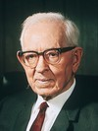
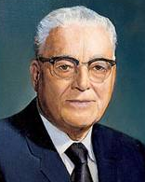
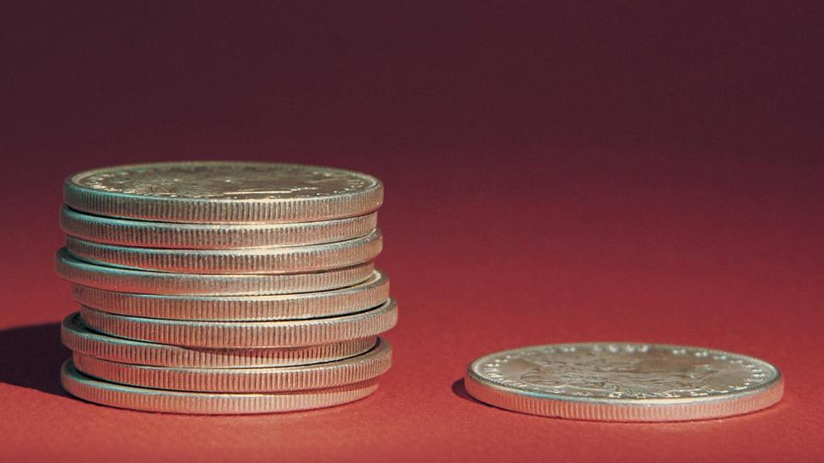
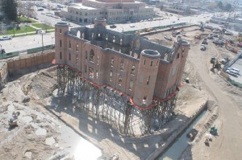
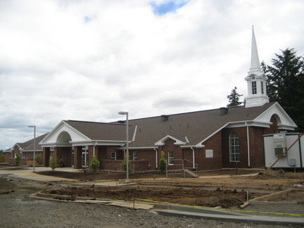
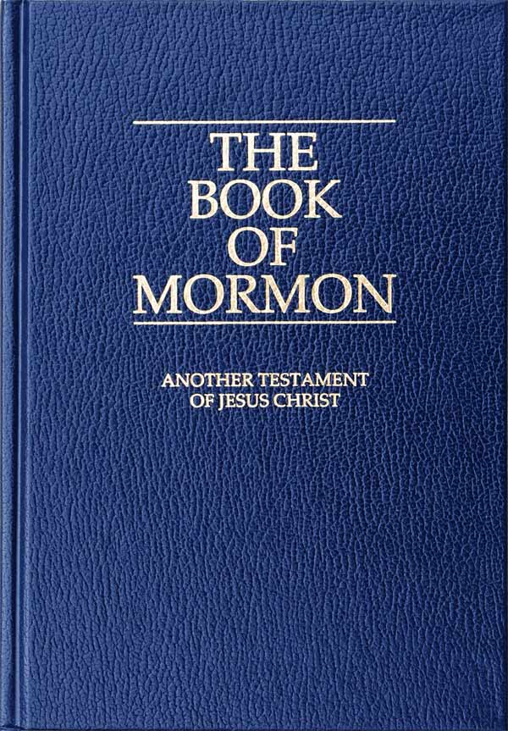
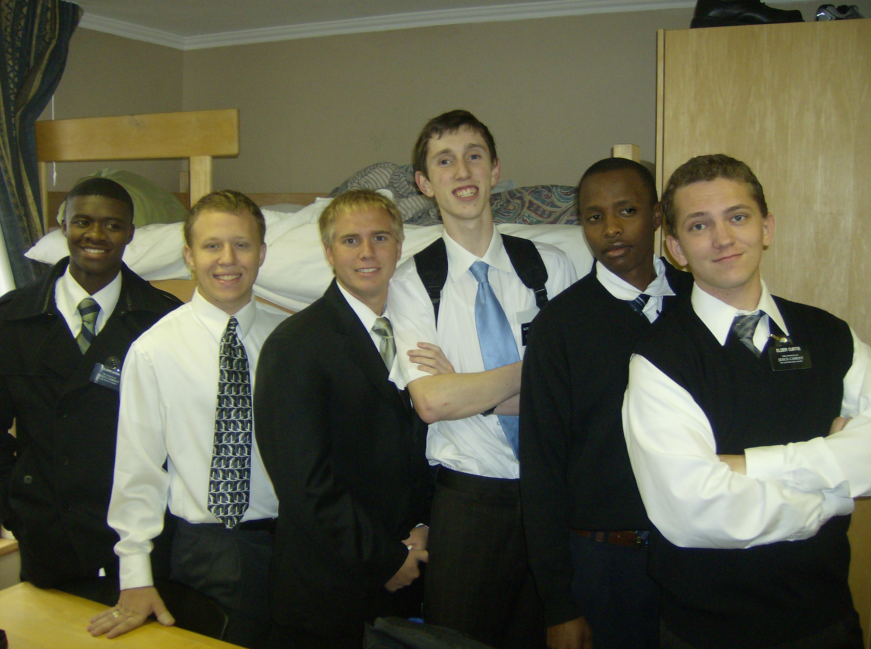
“The simplest statement we know of is the statement of the Lord himself, namely, that the members of the Church should pay ‘one-tenth of all their interest annually’ [D&C 119:4], which is understood to mean income. No one is justified in making any other statement than this” (1)
“A tithe is one-tenth of your income. …
“… Tithing is used to build temples and meetinghouses, translate and publish the scriptures, do missionary and family history work, and in other ways build God’s kingdom on earth” (2)
Provo City Center Temple

Slide 5
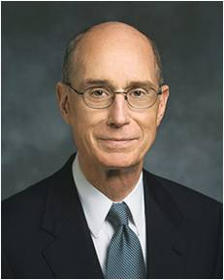
Preparing to Receive
The gift of eternal life
“…when we pay our tithes to the Church, our Heavenly Father pours out blessings upon us. Anyone who has consistently paid a full tithe knows that is true.
The blessings are sometimes spiritual and sometimes temporal.
They are given in the Lord’s time and according to what He knows is best for us. …
“… all of us who have paid a consistent full tithe feel greater confidence in asking God for what we and our families need.
He has promised blessings even greater than we can receive when we have been faithful to our covenant to pay our tithes…
“Third, those who pay tithing feel an increase in their love of God and of all God’s children.
That increase of love comes from understanding how the Father uses the tithes we offer to bless people in this world and for eternity.”
(3)

Slide 6
What do you think President Eyring means when he says paying tithing prepares us to feel what we need to feel to receive the gift of eternal life?
How do you think paying a full tithe can help us prepare for eternal life?
How have you or someone you know experienced one of the blessings President Eyring mentioned or other blessings we can receive as we obey the law of tithing?

Slide 7
Including Fasting
Is not this the fast that I have chosen? to loose the bands of wickedness, to undo the heavy burdens, and to let the oppressed go free, and that ye break every yoke?
Is it not to deal thy bread to the hungry, and that thou bring the poor that are cast out to thy house? when thou seest the naked, that thou cover him; and that thou hide not thyself from thine own flesh?
Isaiah 58:6-7
(3)

Slide 8
Fasting
Fasting is intended to help us overcome wickedness, relieve our own and others’ burdens, and care for the poor and needy.
“A proper fast day observance typically includes abstaining from food and drink for two consecutive meals in a 24-hour period, attending fast and testimony meeting, and giving a generous fast offering to help care for those in need.” (4)
“Fast with a purpose. Begin and end your fast with prayer, expressing gratitude and asking for help with special needs you or others may have.” (5)
(3)

Slide 9
What “bands of wickedness” (Isaiah 58:6) do you want to have loosed?
What “heavy burdens” (Isaiah 58:6) would you like the Lord’s help in undoing for yourself or someone else?
What needs (physical, emotional, mental, or spiritual) of another person could you help meet by fasting or by paying a generous fast offering?
(3)

Slide 10
Sources:
Suggested Hymn: #124 How Gentle God’s Commands
Video: The Fast Offering (8:07)
(First Presidency letter, Mar. 19, 1970).
For the Strength of Youth [booklet, 2011], 38
Henry B. Eyring, “The Blessings of Tithing,” Ensign, June 2011, 5
Handbook 2: Administering the Church [2010], 21.1.17
For the Strength of Youth [booklet, 2011], 39).
Old Testament Seminary Teacher Manual
Presentation by ©http://fashionsbylynda.com/blog/

