Slide 1
Lesson 103
Ordinances and Covenants
Part 1

Slide 2
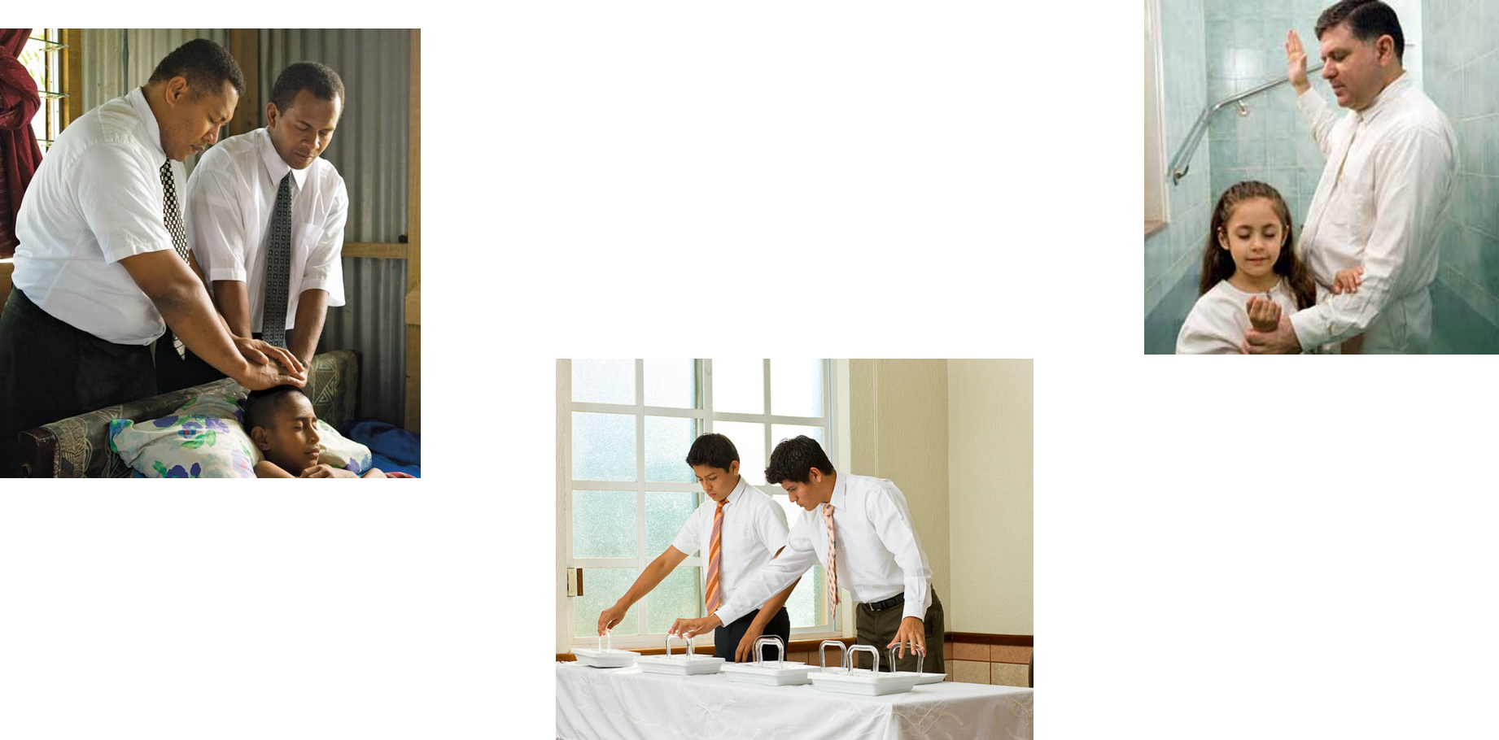
Definition of Ordinance
An ordinance is a sacred act that is performed by the authority of the priesthood. Each ordinance was designed by God to teach spiritual truths, often through symbolism.

Slide 3
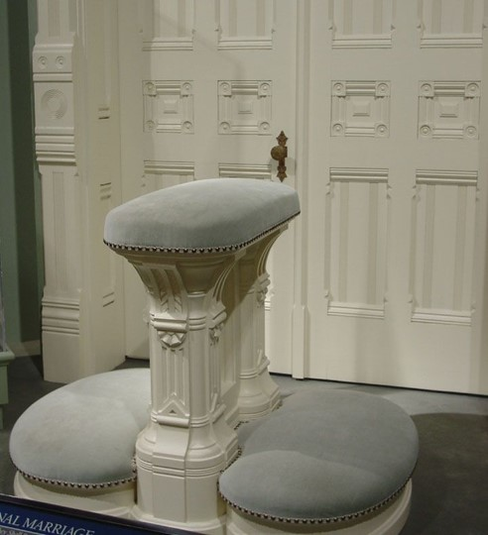
Exaltation
Without these saving ordinances we cannot become like our Heavenly Father or return to live in His presence eternally.
The saving ordinances are performed under the direction of those who hold priesthood keys.
Some ordinances are essential to exaltation and are called saving ordinances.
Only by receiving the saving ordinances and keeping the associated covenants can we obtain all of the blessings made available through the Atonement of Jesus Christ.
Therefore, in the ordinances thereof, the power of godliness is manifest.
And without the ordinances thereof, and the authority of the priesthood, the power of godliness is not manifest unto men in the flesh;
For without this no man can see the face of God, even the Father, and live.
D&C 84:20-22

Slide 4
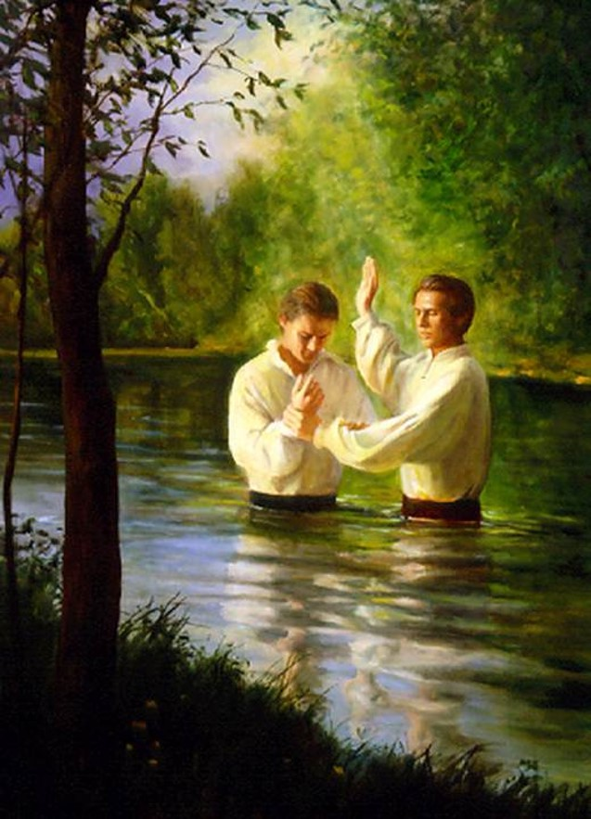
Saving Ordinances
The first saving ordinance of the gospel is baptism by immersion in water by one having authority.
Baptism is necessary for an individual to become a member of the Church of Jesus Christ and to enter the celestial kingdom.
After a person is baptized, one or more Melchizedek Priesthood holders confirm him or her a member of the Church and bestow upon him or her the gift of the Holy Ghost.
Now this is the commandment: Repent, all ye ends of the earth, and come unto me and be baptized in my name, that ye may be sanctified by the reception of the Holy Ghost, that ye may stand spotless before me at the last day.
3 Nephi 27:20

Slide 5
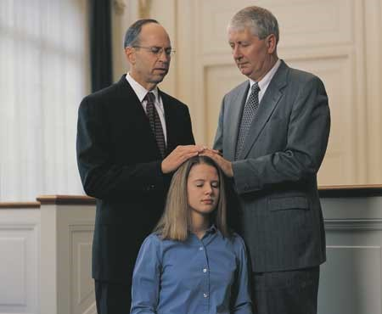
Gift of the Holy Ghost
The gift of the Holy Ghost is different from the influence of the Holy Ghost.
Before baptism, a person can feel the influence of the Holy Ghost and receive a testimony of the truth.
After receiving the gift of the Holy Ghost, a person who keeps his or her covenants has the right to the constant companionship of the Holy Ghost.

Slide 6
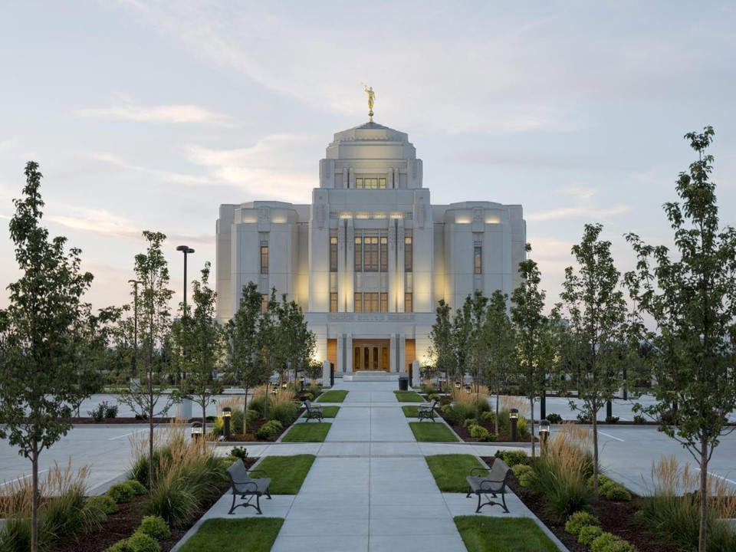
Other Saving Ordinances
Other saving ordinances include ordination to the Melchizedek Priesthood (for men), the temple endowment, and the marriage sealing.
In the temple, these saving ordinances can also be performed vicariously for the dead.
Meridian Idaho Temple
Vicarious ordinances become effective only when the deceased persons accept them in the spirit world and honor the related covenants.
Kansas City Temple Baptismal Font

Slide 7
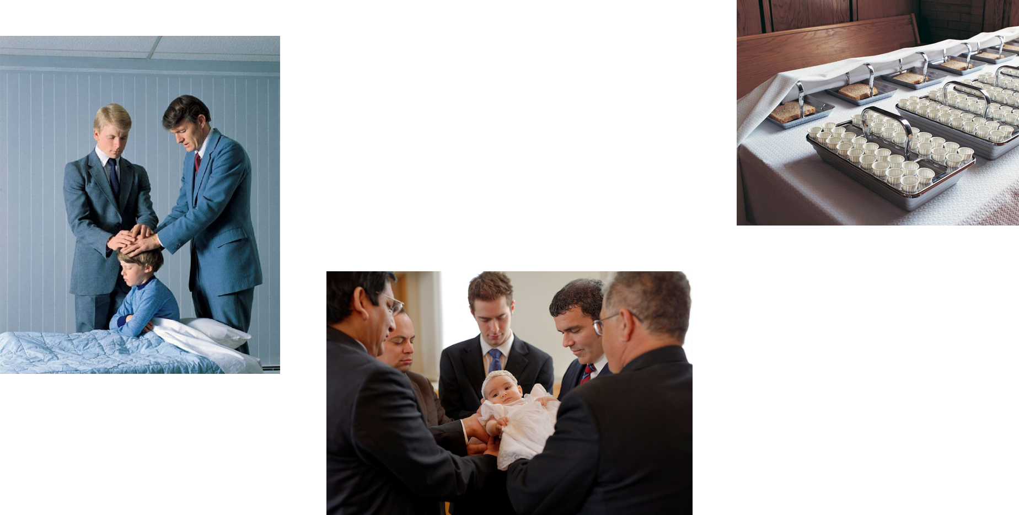
Other Ordinances
Other ordinances, such as partaking of the sacrament to renew our baptismal covenants, administering to the sick, and the naming and blessing of children, are also important to our spiritual development.

Slide 8
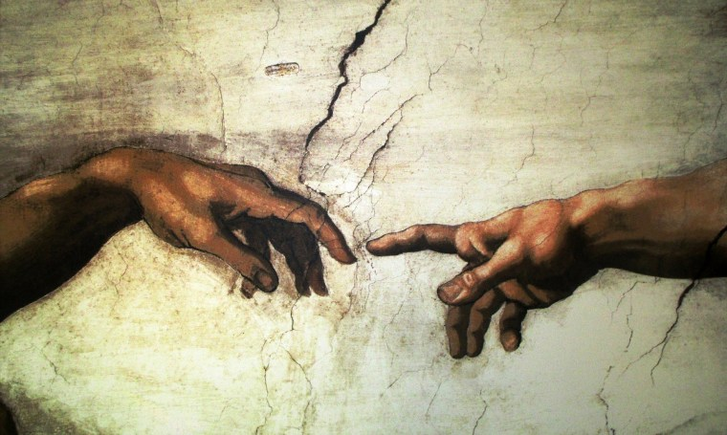
Covenant
A covenant is a sacred agreement between God and man. God gives the conditions for the covenant, and we agree to do what He asks us to do; God then promises us certain blessings for our obedience.
Now therefore, if ye will obey my voice indeed, and keep my covenant, then ye shall be a peculiar treasure unto me above all people: for all the earth is mine:
And ye shall be unto me a kingdom of priests, and an holy nation. These are the words which thou shalt speak unto the children of Israel.
Exodus 19:5-6
I, the Lord, am bound when ye do what I say; but when ye do not what I say, ye have no promise.
D&C 82:10
If we do not abide by our covenants, then we will not receive the promised blessings.

Slide 9
Covenant Through Ordinances
All of the saving ordinances of the priesthood are accompanied by covenants. For example, we covenant with the Lord through baptism.
Men who receive the Melchizedek Priesthood enter into the oath and covenant of the priesthood.
We renew covenants we have made by partaking of the sacrament.

Slide 10
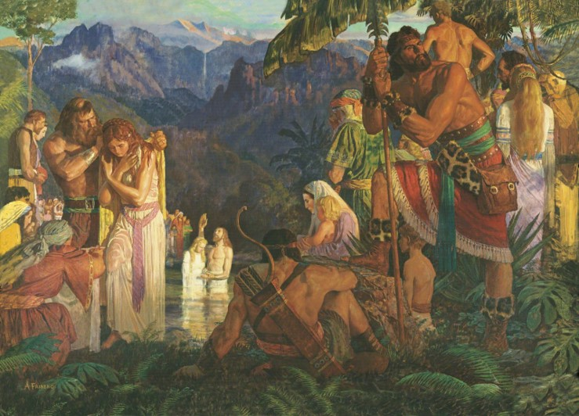
And it came to pass that he said unto them: Behold, here are the waters of Mormon (for thus were they called) and now, as ye are desirous to come into the fold of God, and to be called his people, and are willing to bear one another’s burdens, that they may be light;
Yea, and are willing to mourn with those that mourn; yea, and comfort those that stand in need of comfort, and to stand as witnesses of God at all times and in all things, and in all places that ye may be in, even until death, that ye may be redeemed of God, and be numbered with those of the first resurrection, that ye may have eternal life—
Now I say unto you, if this be the desire of your hearts, what have you against being baptized in the name of the Lord, as a witness before him that ye have entered into a covenant with him, that ye will serve him and keep his commandments, that he may pour out his Spirit more abundantly upon you? Mosiah 18:8-10

Slide 11
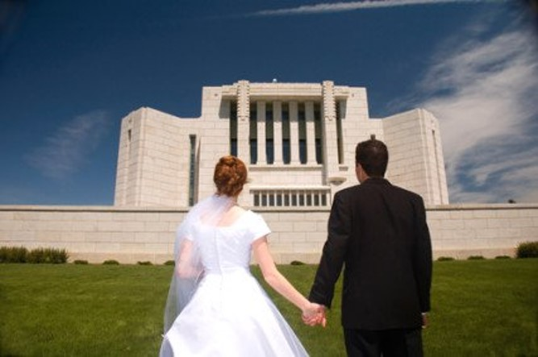
Further Covenants
We make further covenants as we receive the saving ordinances of the endowment and the marriage sealing in the temple.
We prepare to participate in ordinances and make covenants in the temple by living the standards of worthiness the Lord has set

Slide 12
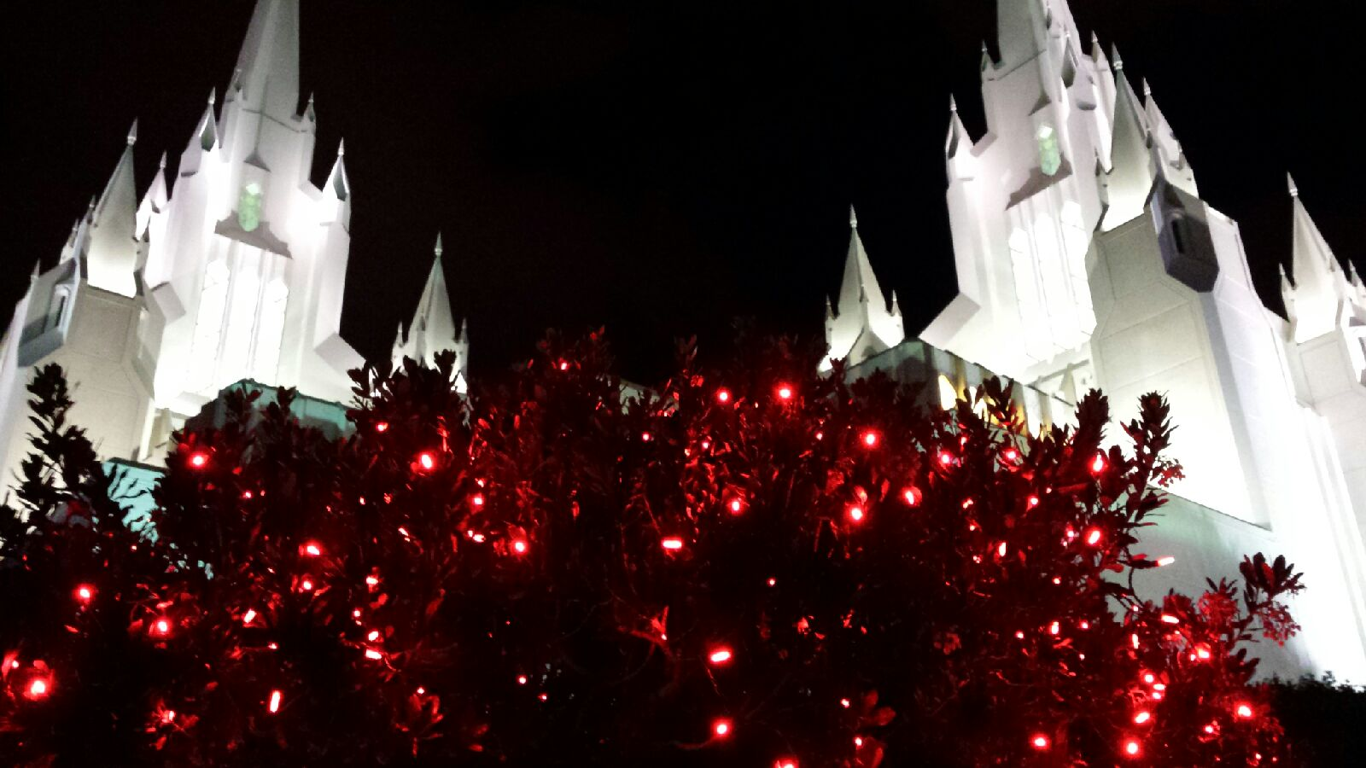
Worthy
It is vital that we are worthy to enter the temple because the temple is literally the house of the Lord.
It is the most holy of any place of worship on earth.
“When we talk about covenant keeping, we are talking about the heart and soul of our purpose in mortality” (1).

Slide 13
God gives the conditions for the covenant, and we agree to do what He asks us to do; God then promises us certain blessings for our obedience.

Slide 14
What do we covenant to do when we are baptized?
We “are willing to take upon [ourselves] the name of [Jesus Christ]” and promise to “always remember him and keep his commandments” [D&C 20:77; see also Moroni 4:3].
We also covenant to “bear one another’s burdens, … to mourn with those that mourn[,] … [to] comfort those that stand in need of comfort, and to stand as witnesses of God at all times and in all things, and in all places” [Mosiah 18:8–10].)

Slide 15
Sources:
Suggested Hymn: #180 Father in Heaven, We Do Believe
1. Jeffrey R. Holland, “Keeping Covenants: A Message for Those Who Will Serve a Mission,” New Era, Jan. 2012, 2
Presentation by ©http://fashionsbylynda.com/blog/

Slide 16
What is the definition of an ordinance?
What makes saving ordinances different from other ordinances?
What are some examples of saving ordinances?
What are some examples of ordinances that are not saving ordinances?
What is the definition of a covenant?
What is the relationship between a saving ordinance and a covenant?
What is the definition of an ordinance?
What makes saving ordinances different from other ordinances?
What are some examples of saving ordinances?
What are some examples of ordinances that are not saving ordinances?
What is the definition of a covenant?
What is the relationship between a saving ordinance and a covenant?
What is the definition of an ordinance?
What makes saving ordinances different from other ordinances?
What are some examples of saving ordinances?
What are some examples of ordinances that are not saving ordinances?
What is the definition of a covenant?
What is the relationship between a saving ordinance and a covenant?
What is the definition of an ordinance?
What makes saving ordinances different from other ordinances?
What are some examples of saving ordinances?
What are some examples of ordinances that are not saving ordinances?
What is the definition of a covenant?
What is the relationship between a saving ordinance and a covenant?

