Slide 1

Lesson 106
1 and 2 Chronicles
And these plates of brass, which contain these engravings, which have the records of the holy scriptures upon them, which have the genealogy of our forefathers, even from the beginning—
Alma 37:3

Slide 2
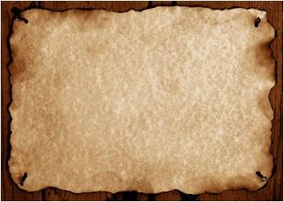
2 Chronicles
Judges
1 Chronicles
Joshua
Ruth
1 Kings
2 Kings
2 Samuel
1 Samuel
Nehemiah
Ezra
Esther
The books of 1 and 2 Chronicles contain a brief history of the Lord’s people from the time of Adam to the time of King Cyrus of Persia.
1 Chronicles provides a genealogy of the Lord’s people from the time of Adam to the time of the Babylonian captivity as well as a brief account of the reign of King David.

Slide 3
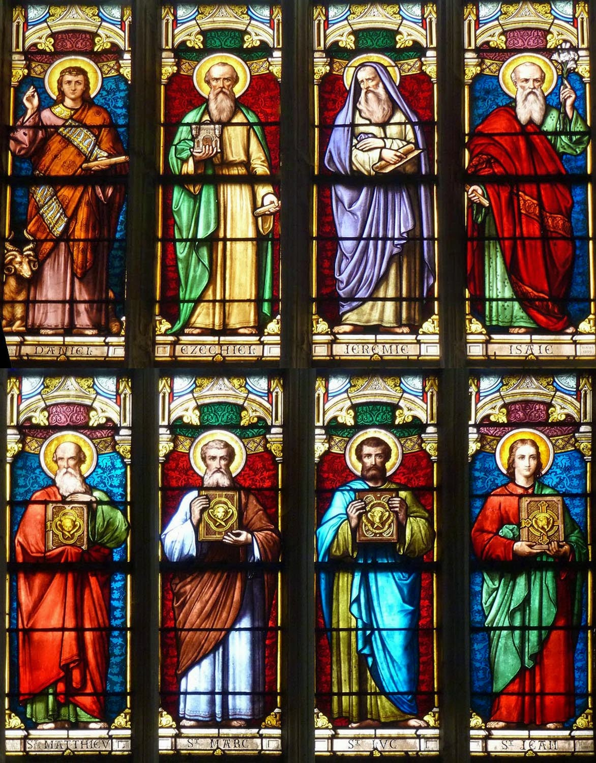
Prophets During the Reign of the Kings
NORTH
Ahijah
Jehu
Elijah
Michaiah
Jonah
Amos
Hosea
Micha
SOUTH
Iddo
Azariah
Obediah
Joel
Isaiah
Micah
Nahum
Zephaniah
Habakkuk
Jeremiah
Ezekiel
Daniel
Hanani
Jehaziel

Slide 4
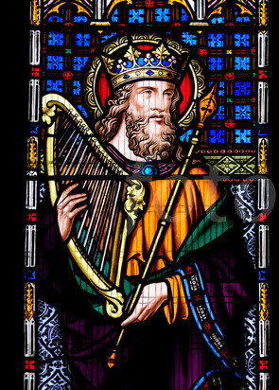
Psalm
A poem of praise, worship, or lamentation, often set to music.
David wrote some of the psalms contained in the book of Psalms
Give thanks unto the Lord, call upon his name, make known his deeds among the people.
Sing unto him, sing psalms unto him, talk ye of all his wondrous works.
Glory ye in his holy name: let the heart of them rejoice that seek the Lord.
Seek the Lord and his strength, seek his face continually.
Remember his marvellous works that he hath done, his wonders, and the judgments of his mouth;
1 Chronicles 16:8-12

Slide 5
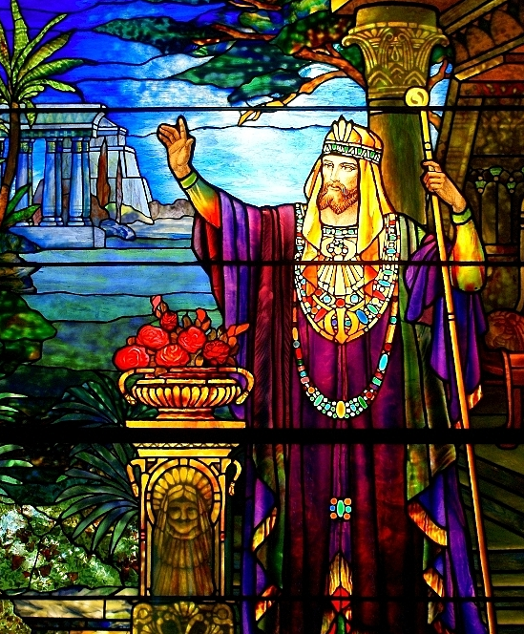
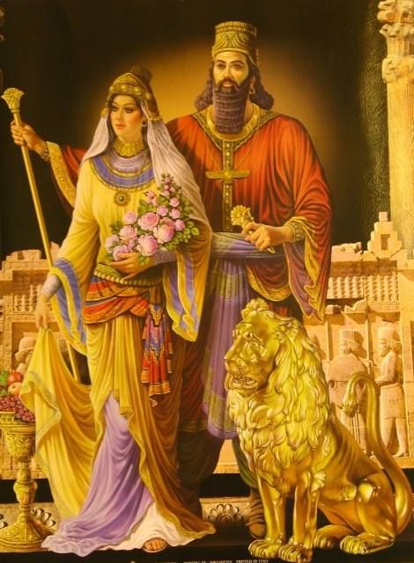
2 Chronicles
This book provides a history of events from the time of King Solomon until the time when King Cyrus of Persia allowed the Jews to return to Jerusalem

Slide 6
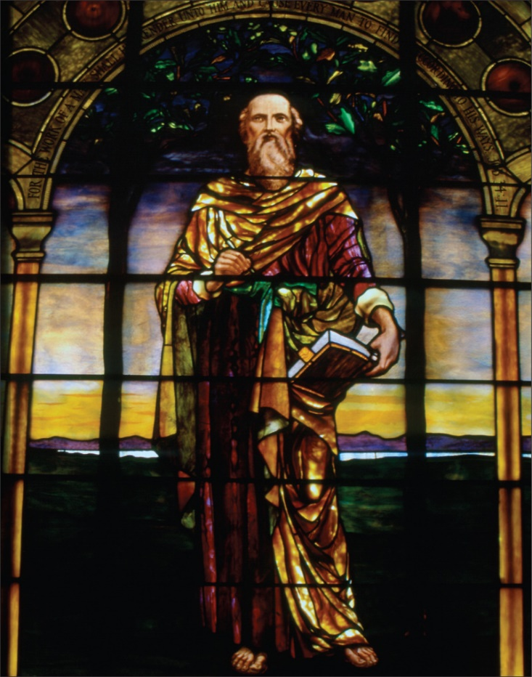
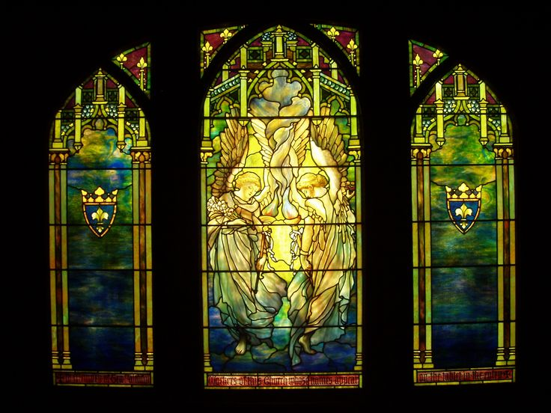
Wisdom Literature
Psalms and Proverbs, along with Job, Ecclesiastes, and the Song of Solomon, are collectively known as the wisdom literature or the poetry books.
"Job" (detail) Tiffany Glass and Decorating Company, 1897, Restored by Bovard Studio, 2000
Ecclesiastes Angels, Stained Glasses. Louis Comfort Tiffany Glass

Slide 7
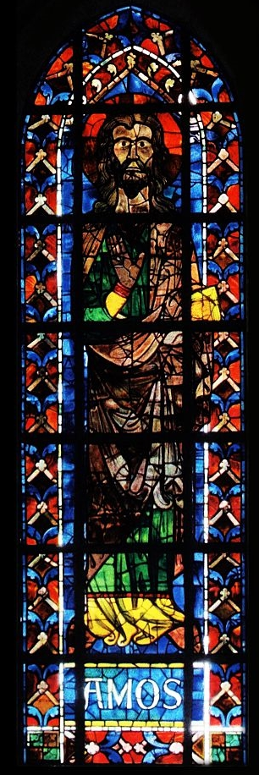
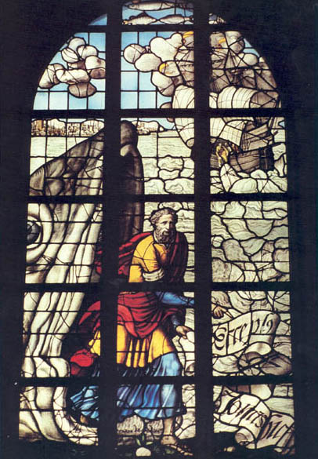
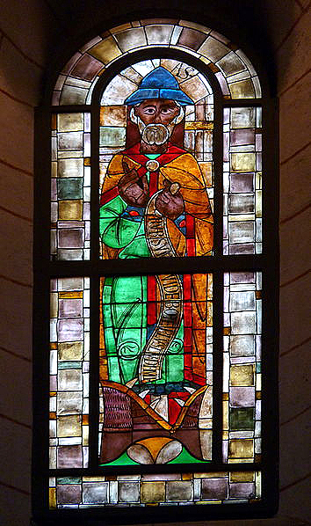
Amos, Jonah, and Hosea
The Lord called prophets to minister to the people in the Northern Kingdom

Slide 8
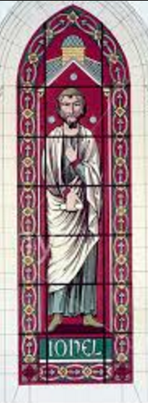
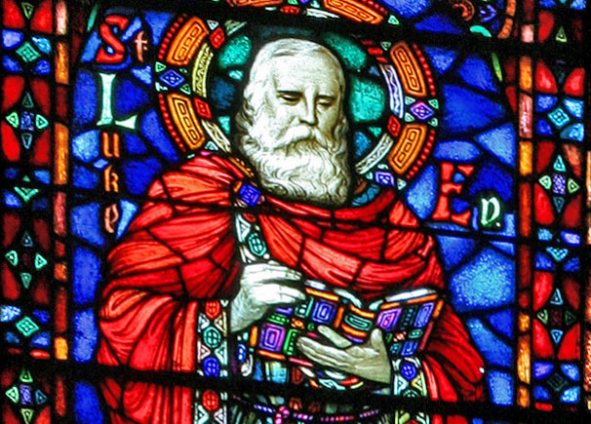
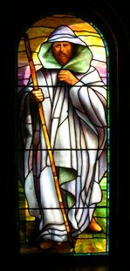
Joel, Isaiah, and Micah
The Lord called prophets to minister to the people in the Southern Kingdom

Slide 9
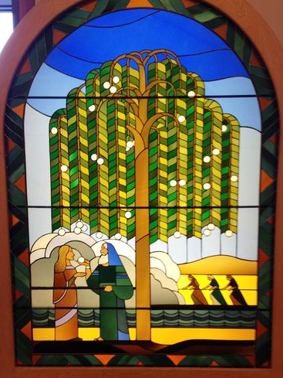
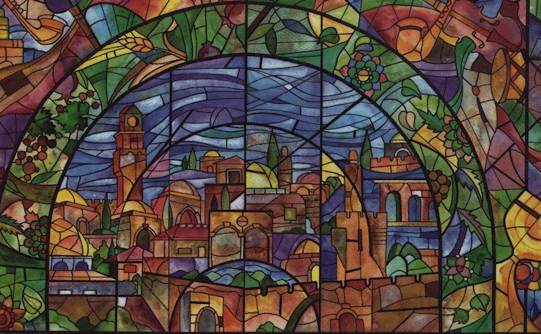
Lehi
The Lord called Lehi to leave Jerusalem before the captivity of Judah
Lehi and his family left Jerusalem shortly before the Babylonians destroyed Jerusalem in 586 B.C.

Slide 10
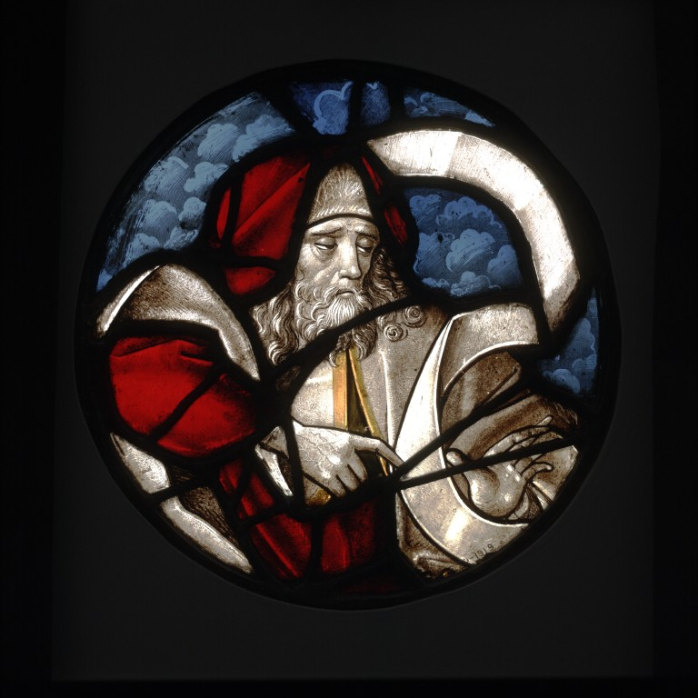
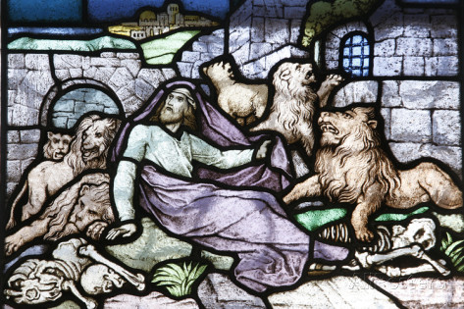
Daniel and Ezekiel
While the Jews were in captivity in Babylon the Lord continued to call Prophets

Slide 11
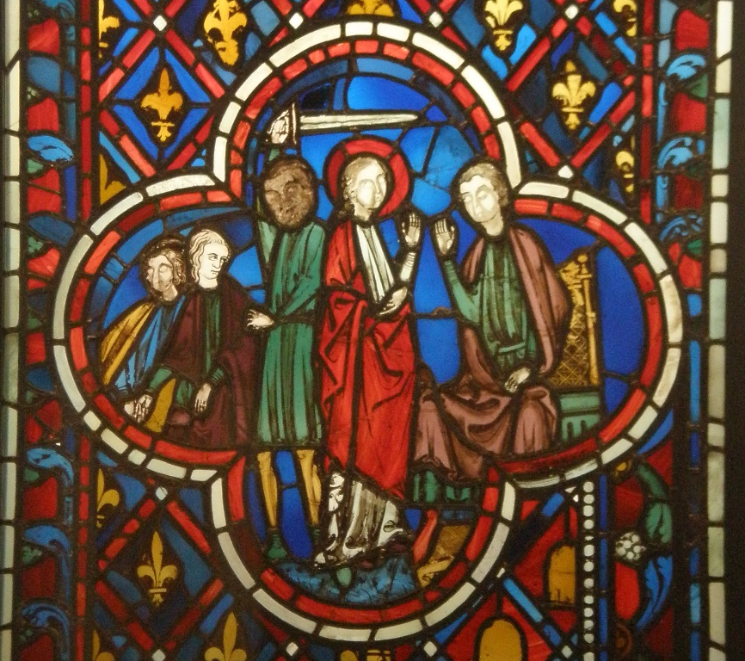
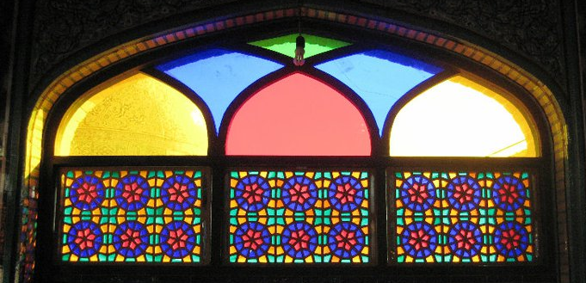
The Persians
The Persians conquered the Babylonian Empire and allowed the Jews from the former Kingdom of Judah to return to Jerusalem to rebuild the temple

Slide 12
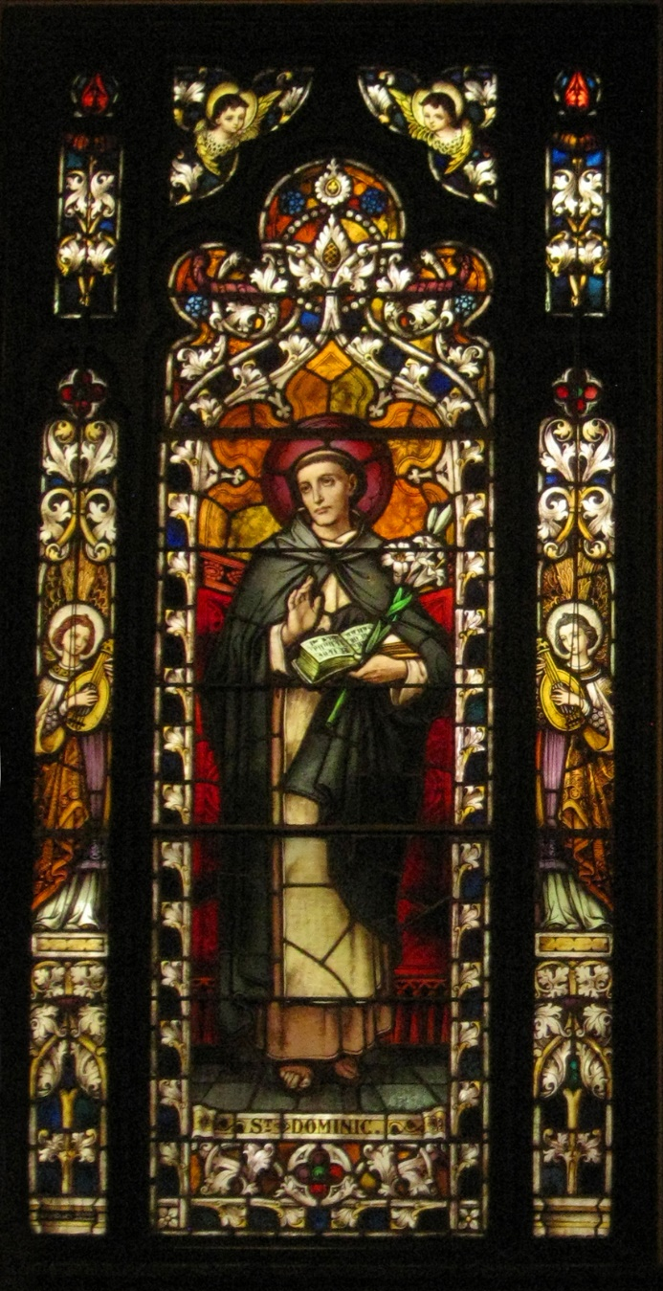
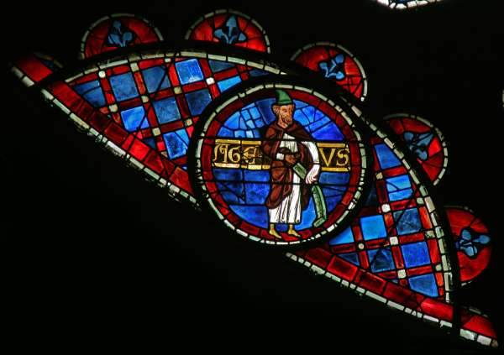
Haggai and Zechariah
They administer to the Jews who returned to Jerusalem

Slide 13
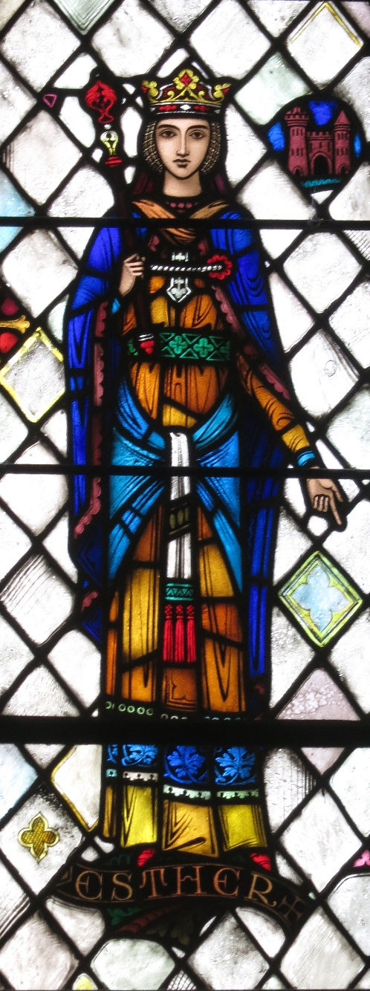
Esther--Queen of Persia
Some years later, a Jew named Esther became the queen of Persia.

Slide 14
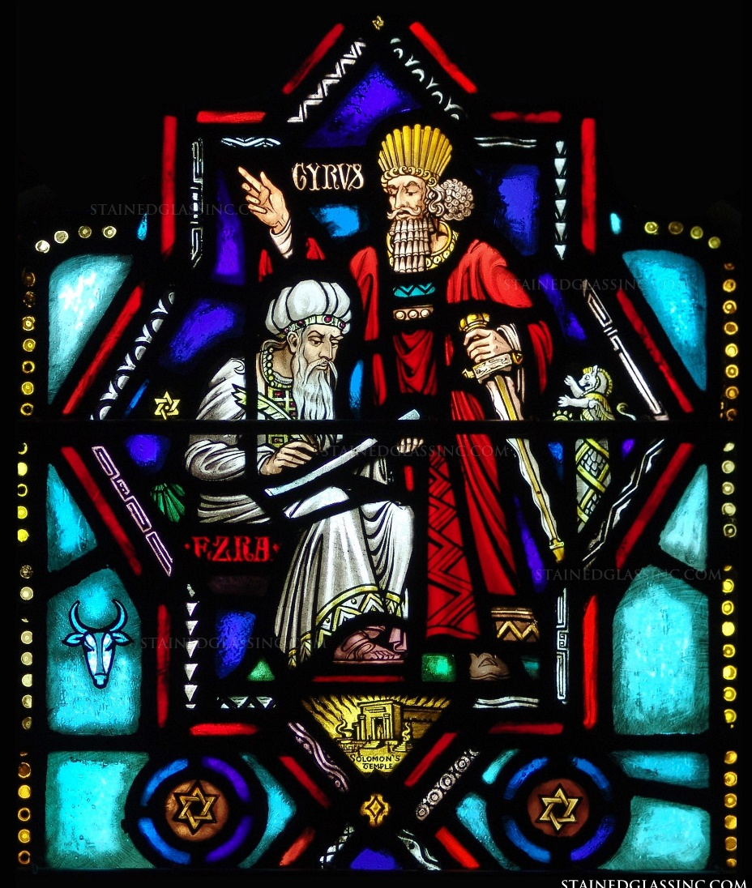
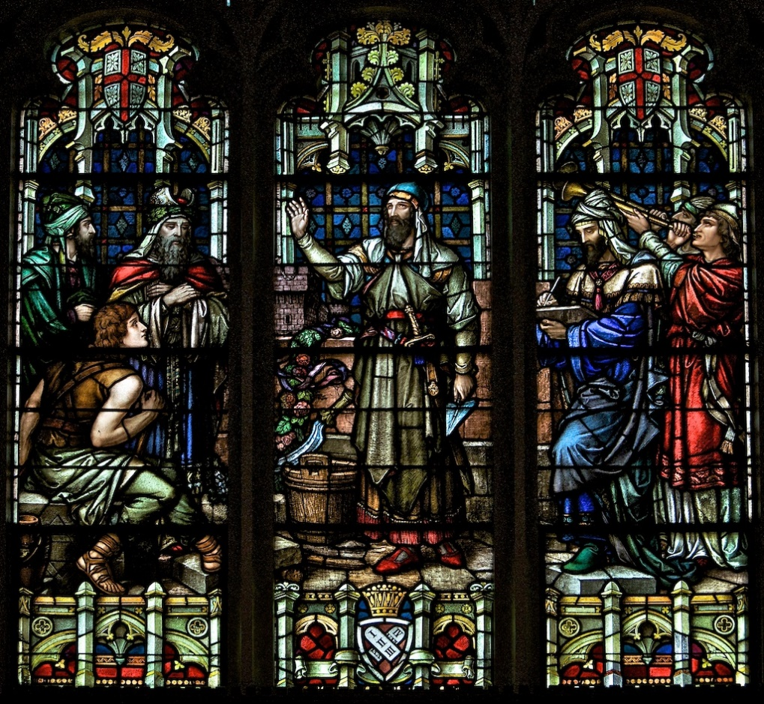
Ezra and Nehemiah
Ezra led most of the Jews back to Jerusalem and sought to reestablish the law of Moses among the people.
Nehemiah also came to Jerusalem and led the Jews in rebuilding the walls of the city
St. Vincent de Paul Chapel, St. Louis, MO

Slide 15
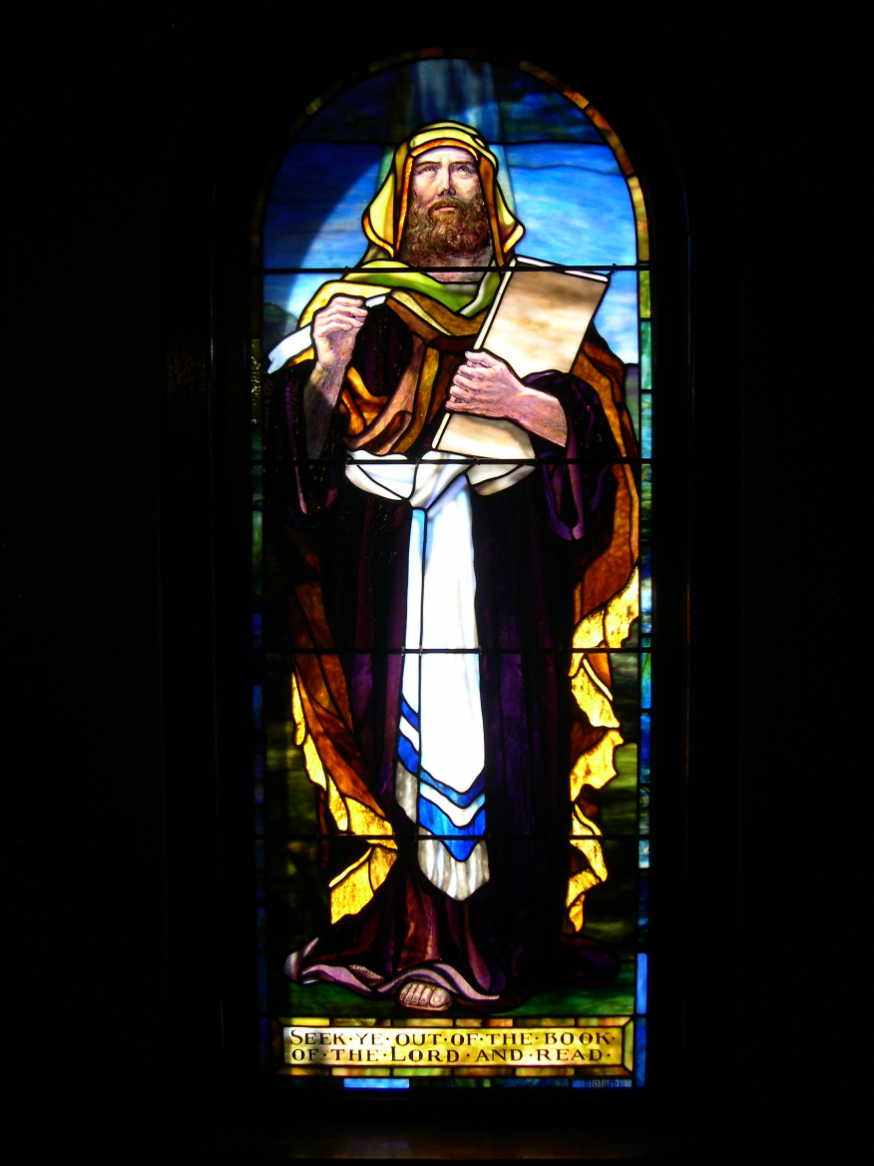
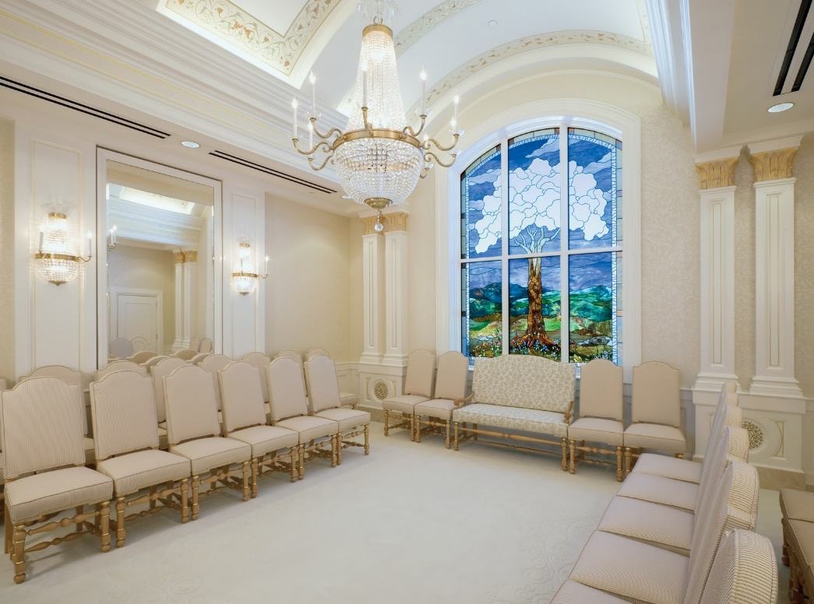
Malachi
The Last Prophet in the Old Testament
The prophecy of Malachi was spoken about 430 BC
The Old Testament prophet Malachi foresaw Elijah’s role in latter-day temple and family history work.
(Malachi 4:5-6)
(1)

Slide 16
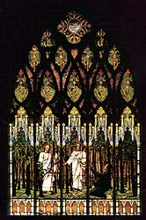
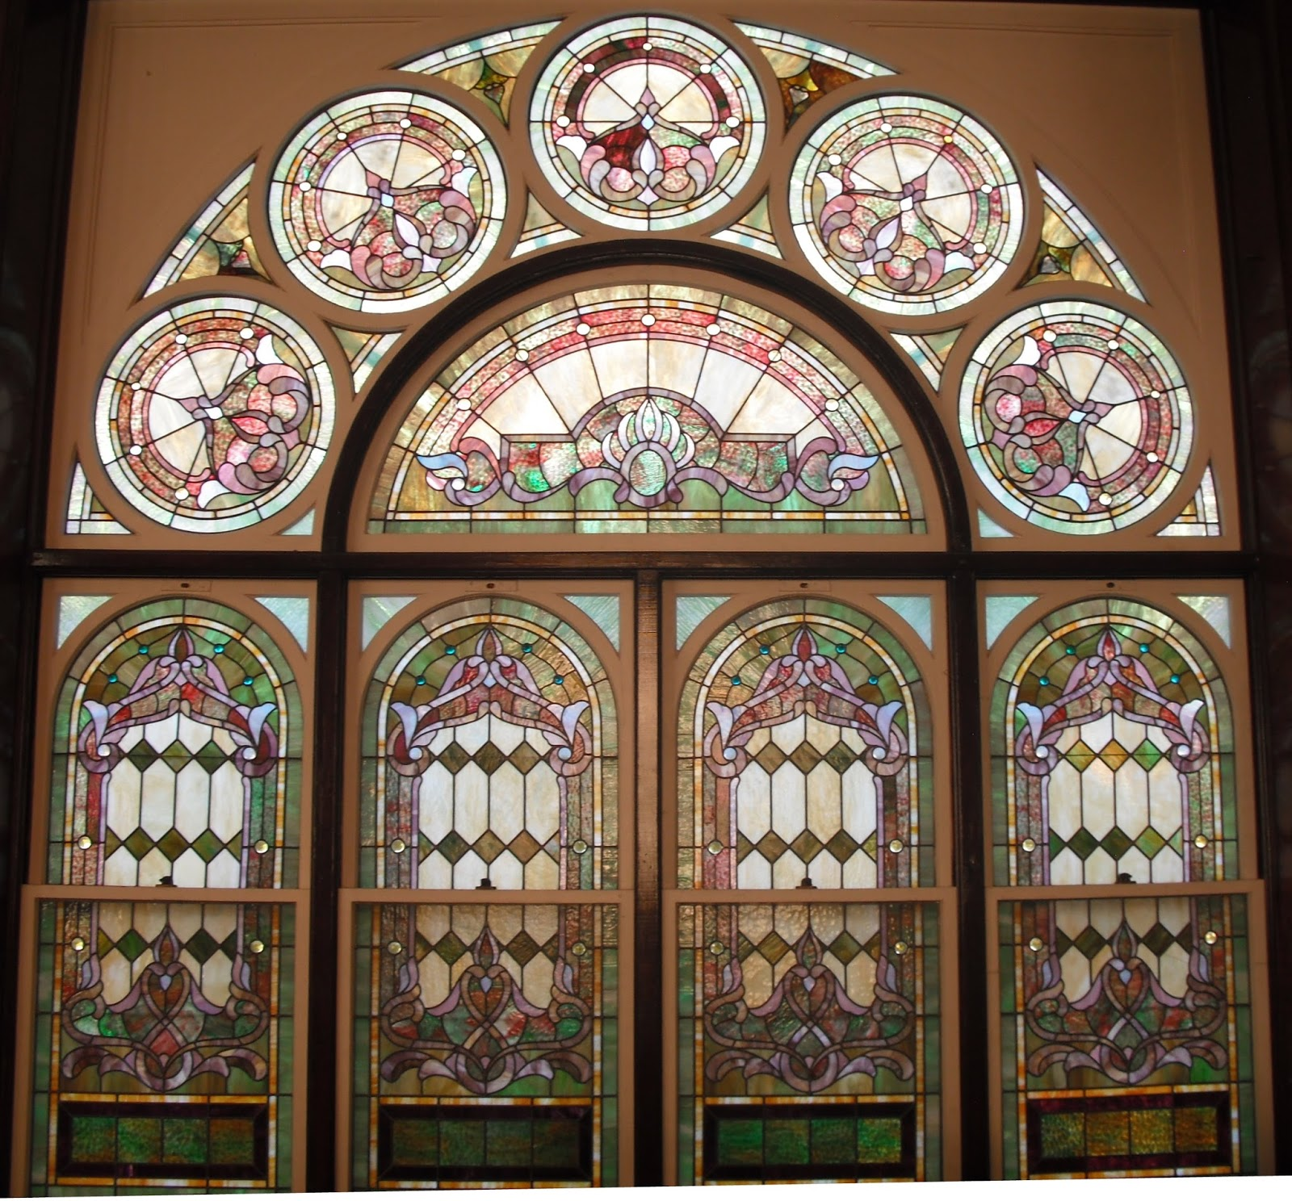
Sources:
Videos: The Lord Communicates Through Prophets (1:52)
God’s Laws Bless His Children (2:08)
Bible Dictionary
Suggested Hymn:
Go, Ye Messengers of
Glory #262 Verse 2
Liberty Park Ward, Utah
Kaysville Utah Tabernacle
Presentation by ©http://fashionsbylynda.com/blog/

Slide 17
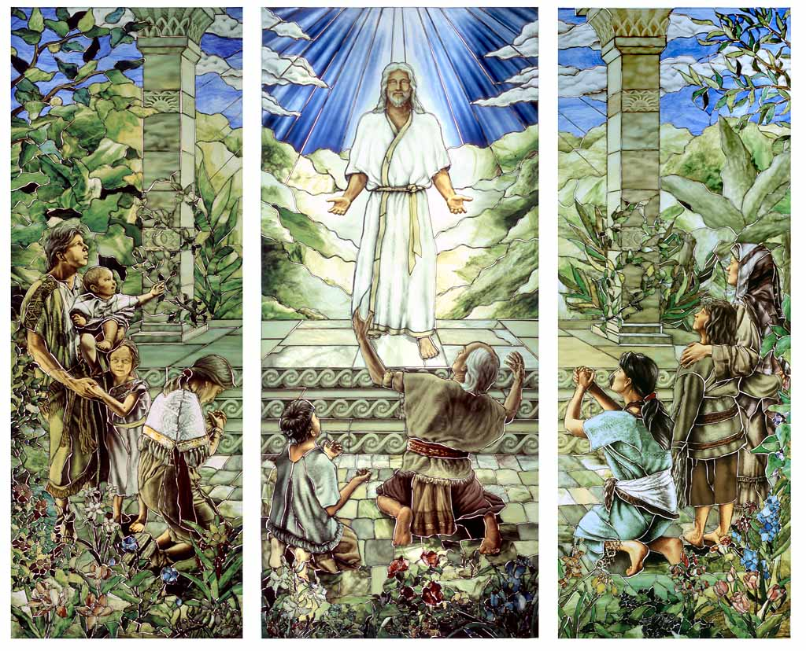
Sao Paulo Brazil—LDS Temple

Slide 18
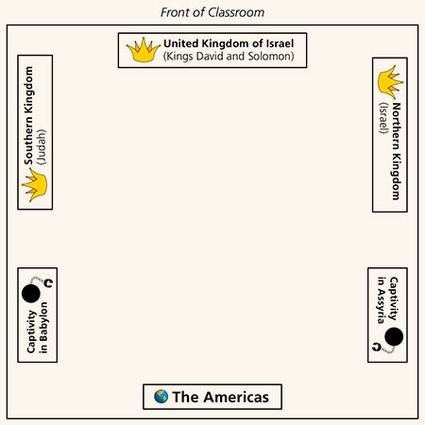

Slide 20
Elhanan—also son of Dodo of Bethleham and apparently a brother of Eleazar
Shammoth—the Harorite, sometimes spelled Shmmah, the Harodite
Helez—the Pelonite
Ira—the son of Ikkesh the Tekoite
Abiezer—the Antothite
Sibbecai—the Hushathite, identified as Mebunnai in 2 Samuel 23:27
Ilai—the Ahohite identified as Zalmon in 2 Samuel 23:28
Maharai—the Netphathite
Heled—son of Baanah the Netophathite identified as Heleb in 2 Sam. 23:29
Ithai—son of Ribai of Gibeah in Benjamin
Benaiah—the Pirathonite
Hurai—of the brooks of Gaash, identified as Hiddai in 2 Samuel 23:30
Abiel—the Arbathite, identified as Abialbon in 2 Sam. 23:31
Azmaveth—the Baharumite
Eliahba—the Shaalbonite
Jonathan—the son of Shage the Hararite
Ahiam—son of Sacar the Hararite
Eliphal—son of Ur, identified as Elephelet in 2 Sam. 23:34
Hepher—the Mecherathite
Ahijah—the Pelonite
Hezro—the Carmelite, identified as Hezrai in 2 Sam. 23:35
Naarai—son of Ezbai
Joel—the brother of Nathan
Mibhar—the son of Haggeri
Zelek—the Ammonite
Naharai—the Berothite, who served as the armor-bearer for Joab, the chief commander.
Ira—the Ithrite
Gareb—the Ithrite
Uriah—the Hittite, husband of Bath-sheba and a loyal soldier to David
Joab—Commander-in-chief under David. He was King David’s nephew who murdered Abner but was rehabilitated in the minds of the people after going up the water way and capturing Jerusalem (Jebus) from the inside
Abishai—elder brother of Joab and therefore another nephew of David. He accompanied David on the dangerous night mission into the camp of Saul. He saved David’s life when he was about to be killed by Goliath’s son. In one battle he slew 300 Philistines. He was loyal to David during Absalom’s rebellion.
Jashobeam—a Hachmonite who was chief of David’s captains and famed for having taken on a large body of Philistines single-handedly
Eleazar—son of Dodo, the Ahohite, who was with David at Pasdammin, and when the other soldiers had fled he was one of the few that stood his ground and drove the Philistines away.
Benaiah—son of Jehoiada. He slew two lion-like men of Moab; also he went down and slew a lion in a pit in a snowy day. And he slew an Egyptian, man of great stature.
Asahel—youngest brother of Joab and Abishai, a nephew of David. He was extremely fleet-footed and was overtaking Abner, commander of the northern Kingdom when Abner thrust his spear into Asahel so that the butt-end pierced him through and killed him.
David’s Mighty Ones
David moved his 600 band and their families from place to place
He called them his “mighty ones”
Found in 1 Chronicles 11
W. Cleon Skousen
The Fourth Thousand Years pp. 98-100

Slide 21
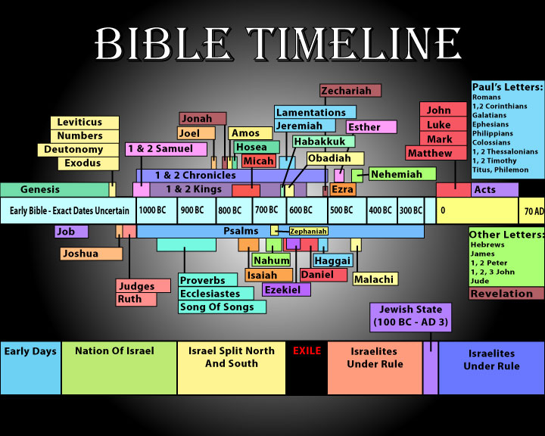

Slide 22
Judah—931 BC to 586 BC
Israel—931 BC to 722 BC
Approximate dates
Kings | Year | Years Reigned | Prophets | Kings | Year | Years Reigned | Prophets
Jeroboam | 930-909 BC | 22 | Ahijah, man of God Iddo | Rehoboam | 930-913 BC | 17 | Shemaiah, Iddo
Nadab | 909-908 BC | 2 |  | Abijam/Abijah | 913-910 BC | 3 | Iddo
Baasha | 908-886 BC | 24 | Jehu | Asa | 910-869 BC | 41 | Azariah, Hanani
Elah | 886-895 BC | 2 |  | Jehoshaphat | 872-848 BC | 25 | Jehaziel
Zimri, Tibni, Omri | 885 BC | 7 days, 12 |  | Jehoran | 848-841 BC | 8 | Obadiah ?
Ahab | 874-853 BC | 22 | Elijah, Michaiah | Ahazaih | 841 BC | 1
Ahaziah | 853-852 | 2 | Elijah | Athaliah | 841-835 BC | 6
Jehoram/Joram | 852-841 BC | 12 | Elisha | Jehoash/Joash | 835-796 BC | 40 | Joel
Jehu | 841-814 BC | 28 | Elisha | Amaziah | 796-767 BC | 29 | Joel
Jehoahaz | 814-798 BC | 17 | Elisha | Azariah/Uzziah | 792-740 BC | 52 | Joel, Isaiah
Jehoash/Joash | 798-782 BC | 16 | Elisha Jonah | Jotham | 750-735 BC | 16 | Isaiah, Micah
Jeroboam II | 793-753 BC | 41 | Jonah, Amos, Hosea | Ahaz | 735-715 BC | 16 | Isaiah, Micah
Zechariah | 753 BC | 6 mon | Hosea | Hezekiah | 715-686 BC | 29 | Isaiah, Micah
Shallum | 752 BC | 1 mon | Hosea | Manasseh | 697-642 BC | 55 | Nahum
Menahem | 752-742 BC | 10 | Hosea | Amon | 642-640 BC | 2 | Nahum
Pekahiah | 742-740 BC | 2 | Hosea | Josiah | 640-609 BC | 31 | Naham, Zephaniah, Habakkuk, Jeremiah, Huldah
Pekah | 752-732 BC | 20 | Hosea, Micha | Jehoahaz | 609 BC | 3 mon | Habakkuk, Jeremiah
Hoshea | 732-722 BC | 9 | Hosea, Micha | Jehoiakim | 609-598 BC | 11 | Habakkuk, Jeremiah, Daniel
 |  |  |  | Jehoiachin | 598 BC | 3 mon | Jeremiah, Daniel
 |  |  |  | Zedekiah | 597-586 BC | 11 | Jeremiah, Ezekiel, Daniel
http://gen2revarg.com/gentorevkingsandprophets.html
Red indicates Righteous Kings
Mark Barry—the kings of Judah and Israel

