Slide 1
Lesson 108
Building Spiritual Walls
Nehemiah
The Lord loveth the gates of Zion more than all the dwellings of Jacob.
Psalms 87:2
A Psalm or Song for the sons of Korah.

Slide 2
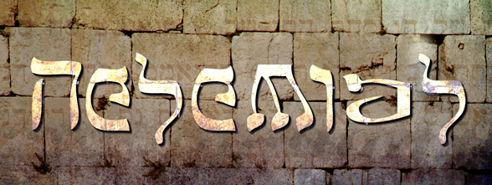
1 Chronicles
Judges
2 Kings
2 Chronicles
Joshua
Ruth
1 Kings
2 Samuel
1 Samuel
Nehemiah
Ezra
Esther
The book of Nehemiah provides an account of Nehemiah, a leader of the Jews who had returned to Jerusalem.
Under his direction, the walls of Jerusalem were rebuilt.
The author of the book of Nehemiah is unknown. However, the book has an autobiographical style.
The record was started at Shushan, in Persia, in “the twentieth year,” which refers to the reign of King Artaxerxes of Persia, who ruled from 465 B.C. to 424 B.C.

Slide 3
Nehemiah
He was the son of Hachaliah and from the tribe of Judah
He was an officer in the court of Artaxerxes of Persia as his ‘cupbearer’ approximately 445 BC
He obtained from the king of Persia to rebuild the walls and structures of Jerusalem 14 years after Ezra had led the first group of Jews back to Jerusalem
He was the governor of Judah
The book of Nehemiah is a sequel to the book of Ezra historically and regarded as one in the Jewish canon
Two other ‘Nehemiah’s are mentioned in connection with this time period:
an individual listed among those who accompanied Zerubbabel with the first group of people returning from the Babylonian captivity
Nehemiah, son of Azbuk who worked repairing the walls of Jerusalem under the leadership of the governor…Nehemiah (Nehemiah 3:16)
Nehemiah’s description of the building has been extremely valuable to archaeologists in locating the foundations of these original walls and gates of the old city

Slide 4
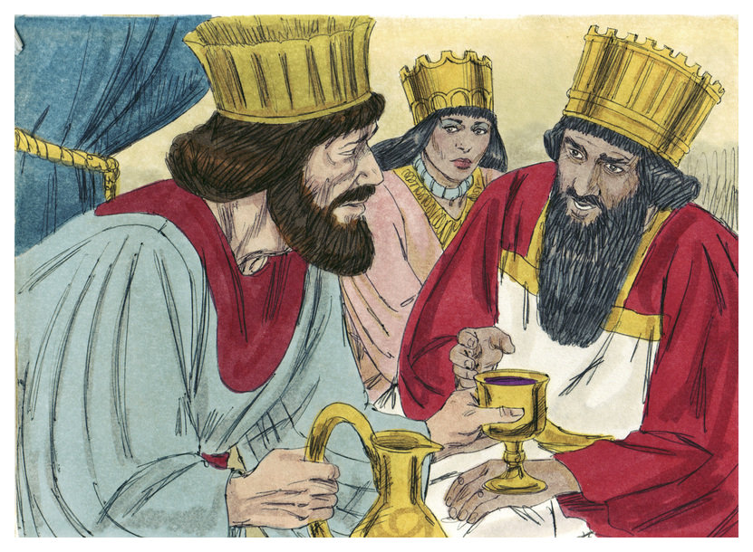
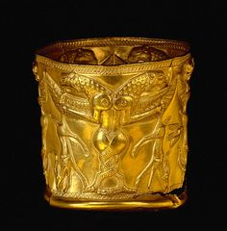
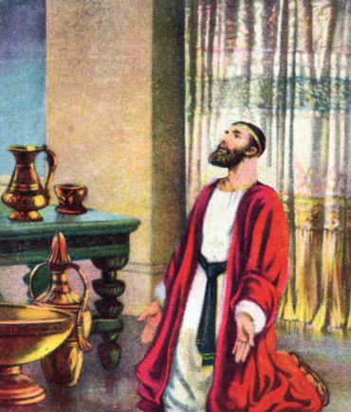
The Cupbearer
Assassination was a constant threat to a king, and poisoned food or drink was one of the most effective ways to accomplish it.
The cupbearer, the one who ensured that the king’s food and drink were safe, was in a position of great trust and responsibility.
Even though he was in Persia enjoying power and importance, Nehemiah had not forgotten his people and homeland. When he heard of their sad condition, he fasted and prayed for his people.
Nehemiah morns and fasts for the people in Jerusalem
Nehemiah 1
(2)

Slide 5
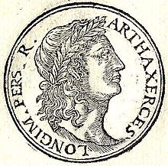
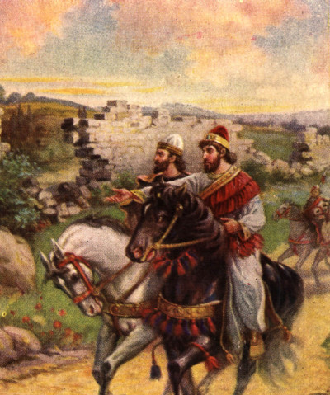
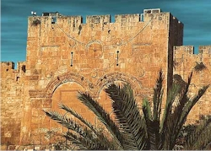
King Artaxerxes
The favor in which Nehemiah was held by King Artaxerxes is evident not only in that he granted him permission to return but also in that he gave him guards, an escort, and a safe conduct through the lands on his return to Judah “beyond the river,” or west of the Euphrates.
The king also granted him permission to use timber from the royal forests to rebuild the walls of Jerusalem as well as the gates and his own house.
Nehemiah 2:7-16
(2)

Slide 6
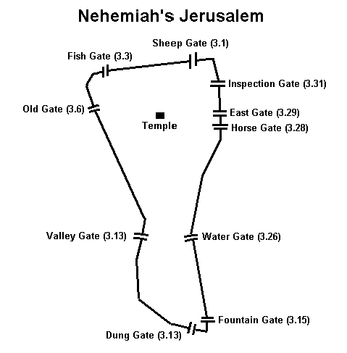
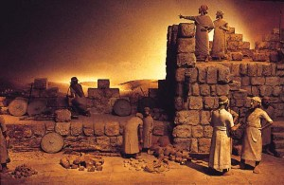
Nehemiah’s Return
Then answered I (Nehemiahh) them, and said unto them, The God of heaven, he will prosper us; therefore we his servants will arise and build: but ye have no portion, nor right, nor memorial, in Jerusalem.
Nehemiah lists those who worked on the gates surrounding Jerusalem
Nehemiah 2:20; 3

Slide 7
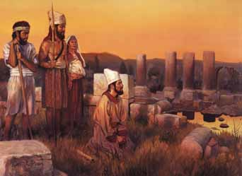
Opposition
Tobiah was an Ammonite official (possibly a governor of Ammon, possibly also of Jewish descent) who incited the Ammonites to hinder Nehemiah's efforts to rebuild Jerusalem. He, along with Sanballat the Horonite and Geshem the Arabian, resorted to a stratagem and, pretending to wish a conference with Nehemiah, invited him to meet them at Ono, Benjamin. Four times they made the request, and every time Nehemiah refused to come. Their object was to frighten him from completing the restoration of Jerusalem's walls and to do him some kind of harm. (4)
Sanballat, the governor of Samaria, and the governors of other nearby areas opposed the plans of the Jews for Jerusalem and resented the protection given them by the Persian king.
A deep bitterness had developed between the Samaritans and the Jews who had returned with Zerubbabel. (2)
Geshem was an ally of Sanballat and Tobiah and adversary of Nehemiah and from an Arab tribe named Gushamau. When Nehemiah proceeded to rebuild the wall of Jerusalem, the Samaritan and the Arabs made efforts to hinder him Geshem, probably a chief of the Arabs, joined the Samaritans and accused Nehemiah of conspiracy against the Persian king. (3)
Nehemiah 2:19; 4

Slide 8
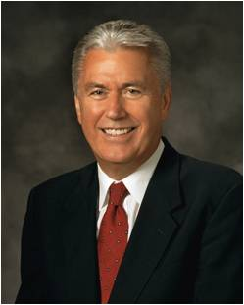
We will accomplish the work of the Lord despite opposition if we each do our part
“Think of the power we would have as individuals … if, in response to every temptation to lose focus or lower our standards—the standards of God, we responded, ‘I am doing a great work and cannot come down.’” (5)
Nehemiah 2:19; 4

Slide 9
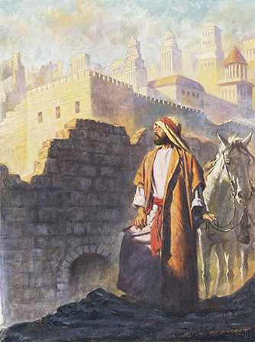
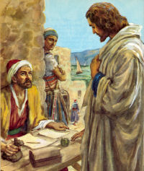
Taxes
One of the reasons the Jews were still in great poverty was the unrighteous oppression of the people by their previous rulers.
Nehemiah could have glutted himself in the same manner, but instead he became angry about the over taxation (the king’s tribute), usury (interest), slavery, and the confiscation of private property.
Although his predecessors “were chargeable unto the people” or, in other words, laid a heavy burden upon the people, Nehemiah showed his greatness as the governor by not accepting a salary from the taxes of the people.
He was wealthy and chose to serve without remuneration.
Nehemiah 5
(2)

Slide 10
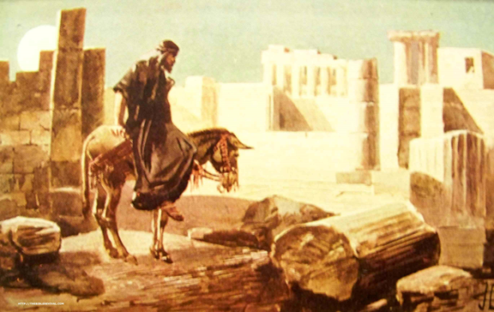
Guarding the Wall
Sanballat, the governor of Samaria, was angry they were building the wall.
But the plan they laid to attack and prevent the repair of the walls, now about halfway up was frustrated by Nehemiah, who had those who guarded and those who labored arm themselves by day and by night.
Nehemiah’s encouragement to the Jews to defend their families and homes is similar to the charge Moroni gave in the Book of Mormon.
Nehemiah 4; 6
(2)

Slide 11
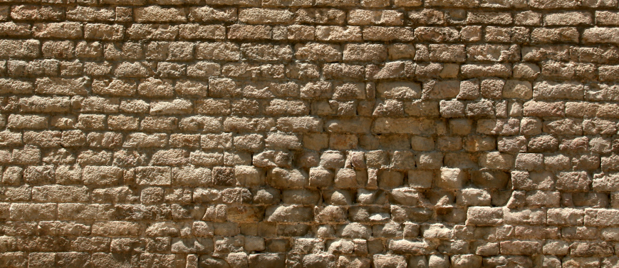
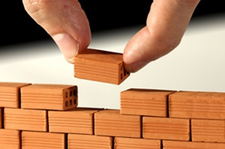
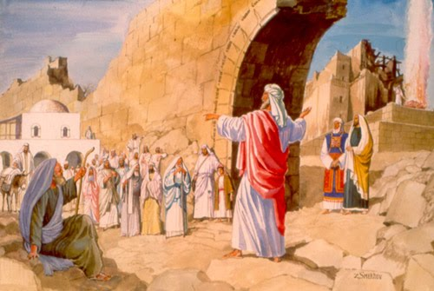
The Wall—Physical and Spiritual Protection
The wall was finished in fifty-two days and watches were set to protect those who lived in the city.
The holy city became a unifying force as families were chosen by lot to come live in it Sanballat and the other enemies of Judah fully understood the significance of the walls and of Nehemiah’s unifying leadership. That is why their opposition was so persistent.
The walls were a protection, but they were also an important physical symbol of the establishment of the Jews as a people.
Nehemiah 6; 11:1-2
(3)

Slide 12
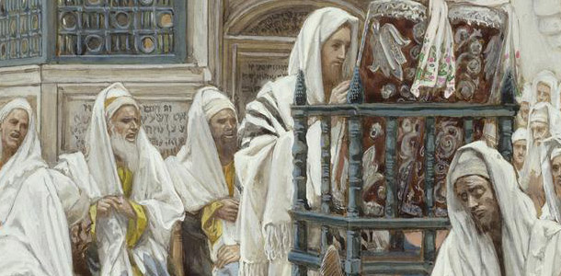
“Put From the Priesthood”
Men who claimed to be of the tribe of Levi but did not have genealogical records to prove their ancestry were denied the priesthood.
The Lord inspired Nehemiah to trace the genealogy of the Israelites who had returned to Jerusalem.
.
Nehemiah 7

Slide 13
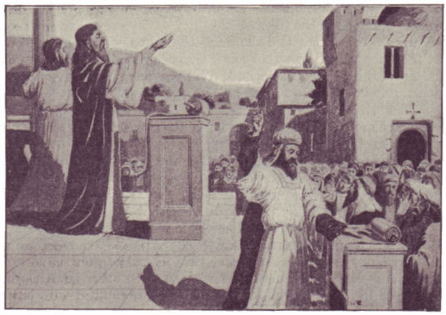
Ezra Reads From the Scriptures
Tirshatha—title for the governor (Nehemiah)
The Jews who were living in Jerusalem during Nehemiah’s time had been lost spiritually for several years without the nourishment of scriptures or sacred ordinances..
When Ezra took out the copy of the Law which he had brought from Babylon, the people who had been sitting cross-legged on the ground immediately stood up out of respect for these sacred writings. (6)
Allowing all to hear the law Ezra set up a broadcasting system…
He erected a high platform on which he stood.
He read a few passages of scripture and then 13 Priests and a number of Levites who were scattered throughout the audience provided a brief commentary on each of the verses.
This lasted 6 hours. (6)
Nehemiah 8:1-17

Slide 14
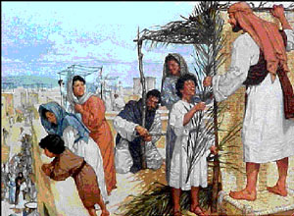
Feast of the Tabernacle
Once again, Nehemiah’s great goodness was demonstrated. He did not call for religious observance alone. He called on the people not only to join in a religious feast but to remember the poor, to share their joy in God’s goodness by charitable service.
So the people went forth, and brought them, and made themselves booths, every one upon the roof of his house, and in their courts, and in the courts of the house of God, and in the street of the water gate, and in the street of the gate of Ephraim.
And they kept the feast seven days; and on the eighth day was a solemn assembly, according unto the manner.
Nehemiah 8:16-18
(2)

Slide 15
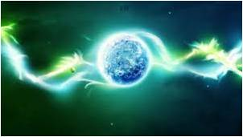
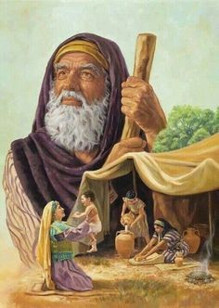
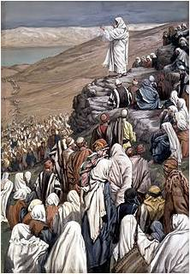
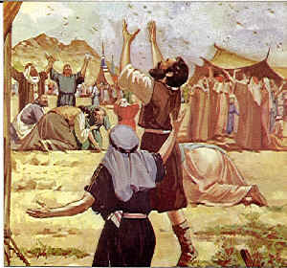
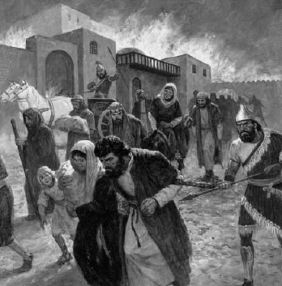
Ezra Reads From the Scriptures
Nehemiah 9:6 | The Creation | Genesis 1
Nehemiah 9:7 | The Abrahamic Covenant | Genesis 11-17
Nehemiah 9:9-11 | The Exodus From Egypt | Exodus 1-14
Nehemiah 9:12 | The pillar of fire and smoke | Exodus 13:21-22
Nehemiah 9:13-14 | Giving of the Law | Exodus 20
Nehemiah 9:15 | The manna, and water from the rock | Exodus 16-17
Nehemiah 9:17 | The rebelliousness of the Israelites | Exodus and Numbers
Nehemiah 9:18 | The golden calf incident | Exodus 32
Nehemiah 9:19 | The pillar of Cloud | Deuteronomy 31:12
Nehemiah 9:20-25 | Taking possession of inherited land | Joshua
Nehemiah 9:26-29 | Wickedness and disobedience | Kings
Nehemiah 9:30 | Rejection of the Prophets words | Kings
Nehemiah 9:32 | Assyrians take Israel captive | Deuteronomy 28:25, 64
Nehemiah 9:34 | Judah also is taken into captivity by Babylon | 2 Kings: 24-25
Nehemiah’s and Ezra’s sought to bring the people back into the covenant by using the scriptures.
(2)

Slide 16
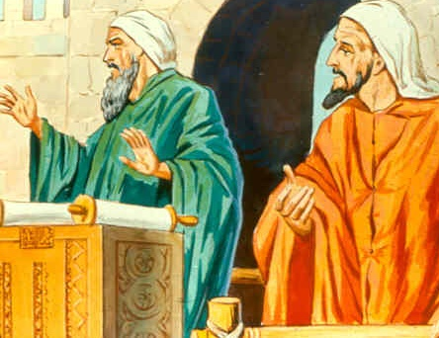
“Entered into a Curse?”
The phrase “and entered into a curse, and into an oath, to walk in God’s law” (v. 29) was clarified by Joseph Smith to read: “And entered into an oath, that a curse should come upon them if they did not walk in God’s law.”
JSTNehemiah 10:29
(2)

Slide 17
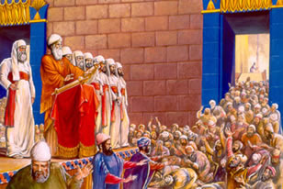
A New Covenant
After the Israelites understood the scriptures, they covenanted not to marry outside of Israel and to keep the Sabbath day holy.
As we learn from the scriptures about God and His goodness, we have a greater desire to enter into and keep His covenants
The Covenants Made—Reestablishing obedience to the law of Moses:
To marry within Israel
To keep the Sabbath
To pay a temple tax instituted by Moses
To make offerings—a dedication of the firstborn to the Lord
To support the Levites and priests with their tithes
Do all things necessary to sustain the temple
Nehemiah 10:30-39
(2)

Slide 18
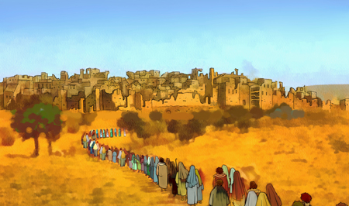
After the Walls Are Dedicated
Most people lived in the country where they could farm.
“Practically all of the rulers of Judah lived inside Jerusalem but the people remained aloof.” (6)
In order to make the city sufficiently strong to resist an attack the people drew lots…every tenth family was asked to move into Jerusalem.
This is the last recorded event before Nehemiah returned to the capital of Persia.
He had been in Jerusalem 12 years.
Nehemiah 11

Slide 19
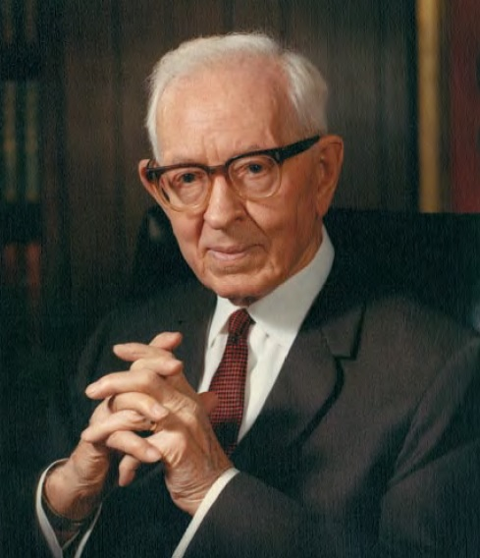
“Every covenant, contract, bond, obligation, and commandment we have received by revelation and coming from the Almighty has the one purpose in view, the exaltation and perfection of the individual who will in full faith and obedience accept it. He that ‘receiveth a commandment with doubtful heart, and keepeth it with slothfulness, the same is damned,’ [D&C 58:29] the Lord has said. Unfortunately there are a great many who receive covenants in that way.” (8)

Slide 20
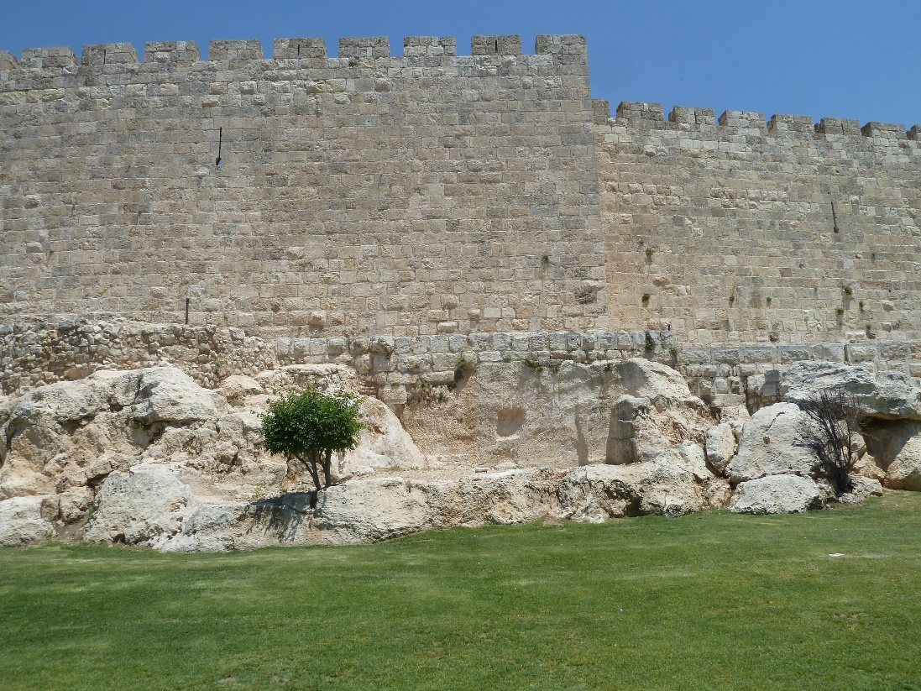
Nehemiah Returns to Jerusalem
He is a man who left a position of great wealth and influence and out of love for God and his people dedicated his life to righteous purposes
Many of the Jews struggled to live according to their covenants.
Nehemiah returned to Jerusalem and helped them keep their covenants by removing evil influences and reinstituting Sabbath observance.
Nehemiah cleared the synagogues of foreigners and then cleansed the temple of a resident apostate.
He enforced controls on buying and selling on the Sabbath and further advised all Israel to marry wives from among their own people.
He also kicked Tobiah out, whom the High Priests had furnished him an apartment.
Nehemiah 13
(2)

Slide 21
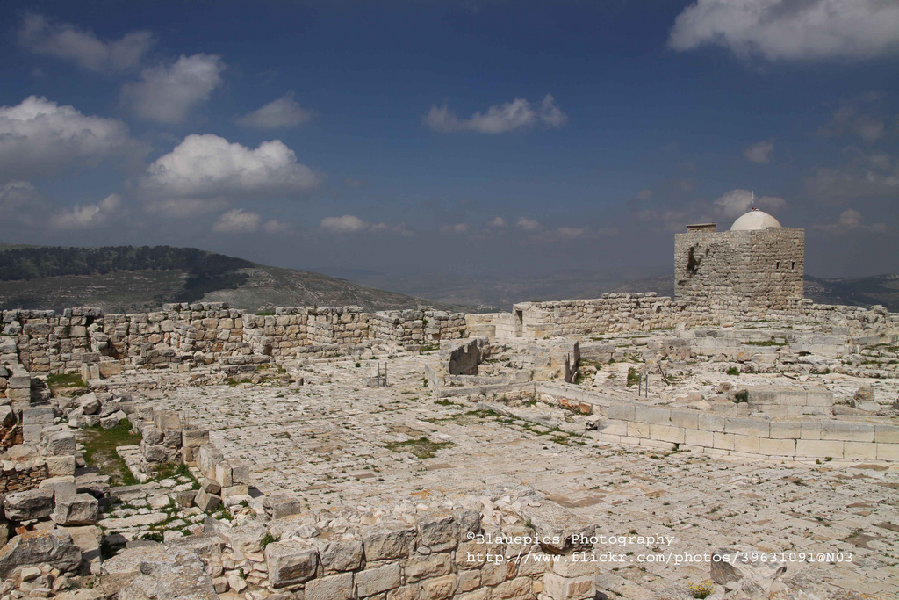
A Rival Temple
In later times the Samaritans viewed Mount Gerizim as the holy mountain in opposition to the Jews who saw Jerusalem as the sacred place (see John 4:19–22).
Although it is not specifically stated, the conflict mentioned here in Nehemiah was what led to the establishment of Mount Gerizim as the holy place of the Samaritans.
“After the return from the Babylonian captivity Gerizim again became a place of importance, as the center of the Samaritan worship.
A certain Manasseh, son or grandson of Joiada, a priest in Jerusalem (Neh. 13:28), had married the daughter of Sanballat the Horonite. Refusing to put her away, he was expelled from the priesthood, and took refuge with the Samaritans, among whom, as a member of the high priestly family, he set up upon Mount Gerizim a rival temple and priesthood (John 4:20).” (2,7)

Slide 22
Sources:
Suggested Hymn: #7 Israel, Israel God is Calling (verse 4)
Video: We Are Doing a Great Work and Cannot Come Down (3:00)
Elder Jeffrey R. Holland “Remember How You Felt,” New Era, Aug. 2004, 6
Old Testament Institute Manual (Builder of Walls and Wills)
Jewish Encyclopedia
Wikipedia
President Dieter F. Uchtdorf (“We Are Doing a Great Work and Cannot Come Down,” Ensign or Liahona, May 2009, 62).
W. Cleon Skousen The Fourth Thousand Years pp. 794-795
(Bible Dictionary, s.v. “Gerizim.”)
Joseph Fielding Smith (Doctrines of Salvation,1:155–56.)
Presentation by ©http://fashionsbylynda.com/blog/

Slide 23
Sanballat:
One of the chief opponents of Nehemiah when he was building the walls of Jerusalem and carrying out his reforms among the Jews. "Sanballat," according to Sayce (in Hastings, "Dict. Bible," s.v.), is connected with the Assyrian "Sinballidh," and means "Sin has vivified." He was called also "the Horonite," and was associated with Tobiah the Ammonite and Geshem the Arabian (Neh. ii. 19, iv. 7). But his home was evidently at Samaria, from whatever "Horon" he may have come.
The first arrival at Jerusalem of Nehemiah and his escort aroused the sleeping enmity of these opponents of the Jews. They were grieved (ib. ii. 10) that the welfare of the Jews should be fostered. When Nehemiah actually disclosed his intention of building the walls of Jerusalem they laughed him to scorn (ib. ii. 19), and said, "Will ye rebel against the king?" Nehemiah resented their insinuation, and gave them to understand that they had no right in Jerusalem, nor any interest in its affairs. As soon as Sanballat and his associates heard that Nehemiah and the Jews were actually building the walls, they were angry (ib. iv. 1-3); and Sanballat addressed the army of Samaria with a contemptuous reference to "these feeble Jews." Tobiah appeased him by saying that a jackal climbing on the wall they were building would break it down. Nehemiah and his builders, the Jews, vigorously hurried the work, while Sanballat and his associates organized their forces to fight against Jerusalem (ib. iv. 8). Nehemiah prepared to meet the opposition and continued the work on the walls. Five different times Sanballat and his confederates challenged Nehemiah and the Jews to meet them in battle in the plain of Ono (ib. vi. 1-7). Nehemiah was equal to the emergency and attended strictly to his work. Then Sanballat, with Jews in Jerusalem who were his confederates, attempted to entrap Nehemiah in the Temple (ib. vi. 10-13); but the scheme failed. These treacherous Jews, however, kept Sanballat and Tobiah informed as to the progress of the work in Jerusalem. Nehemiah's far-sighted policy and his shrewdness kept him out of the hands of these neighbor-foes. In his reforms, so effectively carried out, he discovered that one of the grandsons of the high priest Eliashib had married a daughter of this Sanballat, and was thus son-in-law of the chief enemy of the Jews (ib. xiii. 28). The high priest was driven out of Jerusalem on the ground that he had defiled the priesthood.
Josephus ("Ant." xi. 7, § 2) gives a different story, placing Sanballat later on in Persian history, during the reign of Darius Codomannus. His story is probably a traditional account of the origin of the Temple on Mt. Gerizim. Jewish Encyclopedia
Opposition:
Members of the Church earlier in this dispensation experienced similar opposition. Consider what President George Q. Cannon, who was a member of the First Presidency, said of the persecution in Utah around 1884: “It is very encouraging to think that, in the midst of the assaults which are being made upon the Church of Jesus Christ of Latter-day Saints, and the threats that are in circulation concerning us and our future fate, there is faith enough found in the midst of the people to pursue, without discouragement and without cessation, the great work which we feel that our Father has laid upon us. We have not been situated as we were in Nauvoo, when we finished our temple there, for then the workmen who labored upon it, were like the Jews in the days of Nehemiah, when they undertook to rebuild the walls of Jerusalem, and had to labor a portion of the time at least, and a great portion of it too, with their instruments of labor in one hand, and weapons to defend themselves in the other. We were surrounded by mobs, and living in a constant state, it may be said of fear, because of the threats which were made and the combinations which were formed, and the attacks upon our outlying settlements in the burning of houses, in the destruction of grain, in the shooting down of cattle, and in the driving out of the people from their homes.” (In Journal of Discourses, 25:167.)
Nehemiah 8:8—forgotten law and rites:
One Bible scholar commented on verse 8 as follows: “The Israelites, having been lately brought out of the Babylonish captivity, in which they had continued seventy years, according to the prediction of Jeremiah, [25:11], were not only extremely corrupt, but it appears that they had in general lost the knowledge of the ancient Hebrew to such a degree, that when the book of the law was read, they did not understand it: but certain Levites stood by, and gave the sense, i. e., translated into the Chaldee dialect. … It appears that the people were not only ignorant of their ancient language, but also of the rites and ceremonies of their religion, having been so long in Babylon, where they were not permitted to observe them. This being the case, not only the language must be interpreted, but the meaning of the rites and ceremonies must also be explained; for we find from ver. 13, &c., of this chapter, that they had even forgotten the feast of tabernacles, and every thing relative to that ceremony.” (Adam Clarke, The Holy Bible … with a Commentary and Critical Notes, 2:781–82; see

Slide 24
The Feast:
Bruce R. McConkie explained its peculiar significance:
“One of the three great feasts at which the attendance of all male Israelites was compulsory, the Feast of Tabernacles, was by all odds Israel’s greatest feast. Coming five days after the Day of Atonement, it was thus celebrated when the sins of the chosen people had been removed and when their special covenant relation to Jehovah had been renewed and restored. Above all other occasions it was one for rejoicing, bearing testimony, and praising the Lord. In the full sense, it is the Feast of Jehovah, the one Mosaic celebration which, as part of the restitution of all things, shall be restored when Jehovah comes to reign personally upon the earth for a thousand years. Even now we perform one of its chief rituals in our solemn assemblies, the giving of the Hosanna Shout, and the worshipers of Jehovah shall yet be privileged to exult in other of its sacred rituals.
“Also known as the Feast of Booths, because Israel dwelt in booths while in the wilderness, and as the Feast of Ingathering, because it came after the completion of the full harvest, it was a time of gladsome rejoicing and the extensive offering of sacrifices. More sacrifices were offered during the Feast of the Passover than at any other time because a lamb was slain for and eaten by each family or group, but at the Feast of Tabernacles more sacrifices of bullocks, rams, lambs, and goats were offered by the priests for the nation as a whole than at all the other Israelite feasts combined. The fact that it celebrated the completion of the full harvest symbolizes the gospel reality that it is the mission of the house of Israel to gather all nations to Jehovah, a process that is now going forward, but will not be completed until that millennial day when ‘the Lord shall be king over all the earth,’ and shall reign personally thereon. Then shall be fulfilled that which is written: [Zechariah 14:9–21]. That will be the day when the law shall go forth from Zion and the word of the Lord from Jerusalem. Manifestly when the Feast of Tabernacles is kept in that day, its ritualistic performances will conform to the new gospel order and not include the Mosaic order of the past.” (The Promised Messiah, pp. 432–33.)
Importance of Reading the Scriptures to the People: Nehemiah 8:1-12
“The reading of the law to the people by Ezra the scribe is of particular importance because it appears to have been the first time a synagogue, or a place to read and expound the scriptures, was established in Jerusalem after the return from Babylon. One Bible scholar commented on verse 8 as follows: ‘The Israelites, having been lately brought out of the Babylonish captivity, in which they had continued seventy years, according to the prediction of Jeremiah, [25:11], were not only extremely corrupt, but it appears that they had in general lost the knowledge of the ancient Hebrew to such a degree, that when the book of the law was read, they did not understand it: but certain Levites stood by, and gave the sense, i.e., translated into the Chaldee dialect. … It appears that the people were not only ignorant of their ancient language, but also of the rites and ceremonies of their religion, having been so long in Babylon, where they were not permitted to observe them. This being the case, not only the language must be interpreted, but the meaning of the rites and ceremonies must also be explained; for we find from ver. 13, &c., of this chapter, that they had even forgotten the feast of tabernacles, and every thing relative to that ceremony’ [Adam Clarke, The Holy Bible … with a Commentary and Critical Notes, 2:781–82]” (Old Testament Student Manual: 1 Kings–Malachi, 3rd ed. [Church Educational System manual, 2003],336–37).
What Became of the Samaritans: (A Rival Temple)
In later times the Samaritans viewed Mount Gerizim as the holy mountain in opposition to the Jews who saw Jerusalem as the sacred place (see John 4:19–22). Although it is not specifically stated, the conflict mentioned here in Nehemiah was what led to the establishment of Mount Gerizim as the holy place of the Samaritans.
“After the return from the Babylonian captivity Gerizim again became a place of importance, as the center of the Samaritan worship. A certain Manasseh, son or grandson of Joiada, a priest in Jerusalem (Neh. 13:28), had married the daughter of Sanballat the Horonite. Refusing to put her away, he was expelled from the priesthood, and took refuge with the Samaritans, among whom, as a member of the high priestly family, he set up upon Mount Gerizim a rival temple and priesthood (John 4:20).” (Bible Dictionary, s.v. “Gerizim.”) (3)
“the tithes of the tithes.” Nehemiah 10:38:
The Levites were to tithe their own support money for the priests. Originally the temple tax was half a shekel for everyone over twenty years of age (see Exodus 30:13). This amount was reduced to a “third part,” or one third of a shekel. Such offerings were still a practice in the days of Jesus (see Luke 21:1–4).
Something of interest about the Gates: next pages

Slide 25
The Gates At Jerusalem | Personal Significance | Prophetic/Historical Significance
Sheep Gate (Neh 3:1,32) The very first gate mentioned is the sheep gate. It was called the sheep gate because this was the gate which the sheep and lambs used in the sacrifice were bought through. | Personal aspect: No prizes for knowing that this speaks of the very first experience we come into in our Christian life – that is, a realisation that Jesus was the Lamb of God that takes away the sins of the world. The sheep gate then speaks to us of the cross and the sacrifice that was made for our sins. It is the starting point of everything but you will also notice if you read the entire chapter that the sheep gate is also mentioned at the very end once we have come full circle. That is because everything starts and ends with Jesus’ death on the cross. | Prophetic aspect: This gate points to the first coming of Jesus Christ 2000 years ago to be the Lamb of God who takes away the sins of the world (John 1:29). He is the sacrifice foretold in this sheep gate. He is the door by which everyone must enter to be saved (John 10:7-9).
Fish Gate (Neh 3:3) The Fish gate was mentioned next. It was called the fish gate because the fisherman of Galilee would bring their catch in through this gate to be sold. | Personal aspect: For us, it speaks of evangelism as we have been called to be ‘fishers of men’ (Matt 4:19). It is a natural progression in our Christian life that after seeing that Jesus died for our sins, we would then want to tell others about it. Surveys have shown that believers who have been saved less than two years win the most people to the Lord. Their simple testimony of what Jesus has done in their lives qualifies them to be great ‘fishers of men.’ So this is the next step in the Christian life. | Prophetic aspect: This gate speaks of the church in the first century (the apostolic era) where believers on fire for God sacrificed all and went out to turn the world upside down with the message of Jesus Christ! And that is what happened. Starting with the Jews and then travelling out to the Gentiles in the then known world, the Apostles and disciples of the Lord truly were ‘fishers of men’ and the growth of Christianity spread rapidly during the first century.
Old Gate (Neh 3:6) Following from the Fish gate was the Old gate. Nehemiah is the only book in the Bible where it is called the Old gate and it may have been one of the original gates made. | Personal aspect: This speaks to us of the old ways of truth. A young Christian having experienced the sheep gate, then the fish gate, soon sees the need for experiencing the old gate. This means learning the old ways of truth that never change. Jeremiah 6:16 states ‘Thus says the Lord, Stand by the ways and see and ask for the ancient paths, where the good way is and walk in it; And you will find rest for your souls.’ Too many Christian’s today want something new. The latest teaching, the latest experience... Or they try to change truth to make it acceptable with what the world thinks is right ‘today’ (which may not be the same as what it thinks ‘tomorrow’.) But the Ancient of Days calls us back to His long established ways that do not change and remain the same yesterday, today and forever. | Prophetic aspect: Prophetically this speaks of the period of the Church Fathers around 100-325 AD (sometimes known as the Ante-Nicene era). This was a period where a defence of the faith and the truth of God were further established to counter attacks and persecution from unbelievers.

Slide 26
Valley Gate (Neh 3:13) Several valleys surround Jerusalem and this gate apparently opened out to the valley of Hinnom. | Personal aspect: Examining the picture above you notice that there is a long distance before you come to the next gate, which is the valley gate. For a new Christian the Lord allows a ‘honeymoon’ type period where He teaches you and His presence is strong in your life. This can go on for some time as indicated by the positioning of the old and valley gates. But sooner or later the valley gate must come. The valley gate speaks to us of humbling and trials – valley type experiences used by the Lord for our personal growth. Never easy but the Christian needs to remember that in the natural nothing really grows on the mountain tops, but it certainly does down in the valleys. So it is in the spiritual. Never a nice experience but it always produces fruit. | Prophetic aspect: In the history of the church the valley gate would speak of the humbling and suppression of the true church following on from when ‘Christianity’ was made a state religion under Constantine (~390AD). Pagan rituals were adapted and brought into the ‘church’ and spiritual regression ensued. This long period continued with the ‘dark ages’ and the further establishment of Roman Catholicism as the face of ‘Christianity’ to the world.
Dung (Refuse) Gate (Neh 3:14) All of Jerusalem’s refuse and rubbish was taken out through the dung gate, down to the valley of Hinnom, where it would be burned. | Personal aspect: Again there is quite a distance to the next gate indicating that, unfortunately, the valley experience can carry on for some time. But the result of that experience is clearly seen in this next gate – the dung gate. This is where the rubbish is removed and this is what happens in our own life. Valley experiences are used by the Lord to clear away the rubbish so that true faith, refined by the fire, can come forth and produce fruit. Clearing away the rubbish in our lives is never easy but the benefits of this experience can be seen in the next gate. You will notice also that at this point of your Christian life there is a dramatic ‘turning of the corner’ that takes place. From the diagram above, up until this point we have been moving downward and the experiences have been hard, but having come to this point there is a sharp turn in the road and we begin to move upward again. | Prophetic aspect: The dung gate speaks of the rubbish that became established within the ‘church’ during the dark and medieval ages leading up to the reformation. Some of doctrinal ‘rubbish’ that needed removing included the teachings of indulgences, purgatory, salvation by various sacraments and works, exaltation of Mary as the ‘Mother of God’ and the man-made church hierarchy and papal authority. There was a lot to be removed!
Fountain Gate (Neh 3:15) The fountain gate is located near the pool of Siloah and was often used by the people for cleaning before proceeding on to the temple. | Personal aspect: You will notice from the picture that the fountain gate is located extremely close to the dung gate. In other words, after a valley type experience where rubbish in our lives is cleared out through the dung gate, true faith comes forth and the fountains begin to flow quite quickly! This speaks to us of the living waters of the Holy Spirit that cleanse our lives and empower us for our Christian life. Jesus said: ‘Whoever believes in me, as the Scripture has said, streams of living water will flow from within him." (John 7:38) | Prophetic aspect: In church history, this speaks of the period beginning with the reformation (1517-1600). It was a time when the truth of God’s word was established again as Bibles were printed for the common man to read and the key truth of salvation by grace through faith opened the fountains of salvation to flow again.

Slide 27
Water Gate (Neh 3:26) The Water Gate led down to the Gihon Spring which was located adjacent to the Kidron Valley | Personal aspect: The next gate we arrive at is the water gate. The water gate is a picture of the word of God and its effect in our life. Eph 5:26 states ‘… having washed her by the water of the word.’ Psalm 119:9 states that it is only through God’s word that we can be clean. It is no coincidence that this gate was located next to the fountain gate as the two often go together. The Holy Spirit is the one who makes the word of God alive to us personally, allowing cleansing, encouragement and direction to take place in our life. | Prophetic aspect: From 1600-1900 the word of God made a dramatic impact in the lives of many around the world. Some of the great men of God preached the word including John Bunyan in the time of the Puritans, John Wesley, George Whitefield, Charles Spurgeon, D.L Moody among others. The preaching and cleansing of the word went forth into countries and continents previously starved of the word through men such as Hudson Taylor, Adoraim Judson and William Carey.
Horse Gate (Neh 3:28) The horse gate was close to the King’s stables and the men of Jerusalem would ride their horses out of this gate to war. | Personal aspect: The horse gate speaks to us of warfare as horses were used in battle and became a symbol of war. Revelation 19:11 ‘I saw Heaven opened, and behold a white horse; and he that sat upon him was called Faithful and True, and in righteousness does He judge and make war.’ Spiritual warfare, as we will see in this entire study on Nehemiah, is a requirement of every Christian because we are all in a battle whether we know it or not. It is also interesting that the horse gate follows the water (word) gate for as the word goes forth the spiritual warfare is sure to increase! | Prophetic aspect: Horses speak of speed and war. From the 1900’s onwards both of these certainly apply! The speed of medical, technological, industrial and scientific advancements was beyond comparison. And yet with it came two world wars, countless wars between nations and constant ethnic unrest. For the church it has been one battle after another with the rise of the cults, Biblical criticism. Modernism and liberalism leading to an increasing apostasy within the church. The ultimate fulfilment prophetically of the horse gate will be in the Tribulation – the Day of the Lord as described in Revelation 6-19.
East Gate (Neh 3:29) The East gate is located on the opposite side of the Mount of Olives. | Personal aspect: Ezekiel 44:1-3 ‘… the gate that looked toward the east, and it was shut. The Lord said to me, ‘This gate shall be shut; it shall not be opened, and no one shall enter by it, for the Lord God of Israel has entered by it.’ The east gate opens and looks toward the Mount of Olives and we know that when Jesus returns He will return to this mount. (Zech 14:4). He will then enter Jerusalem by the east gate. The east gate then speaks of the return of Jesus Christ. For our Christian life it shows us of our need to live with this hope and to long for His return. A specific crown is even given to those who do this (2 Tim 4:8). | Prophetic aspect: Please take note how the last three gates (Horse, East and Inspection gate) in the picture are very close together because so are the events which they symbolize. Prophetically the east gate is very close to the horse gate because the day of God’s wrath ends with the coming of the Lord Jesus to Jerusalem on earth. (See Zech chapter 14).
Inspection Gate (Neh 3:31) Also known as the Miphkad gate. The word in Hebrew has a military connection and according to tradition it was at this gate that David would meet his troops to inspect them. | Personal aspect: The final gate is the inspection gate. This gate speaks to us of the examination of our lives by the Lord. This occurs in this life as indicated by Paul in 1 Cor 4:4: ‘For I am conscious of nothing against myself, yet I am not by this acquitted; but the one who examines me is the Lord.’ The ultimate fulfilment is at the Bema seat of Christ (as spoken of in 1 Cor 3:10-15, 2 Cor 5:10) where our lives are inspected and rewarded appropriately. In our Christian experience we should be living with this in mind. We are called to live our lives with eternity in view, caring more for the things of eternity than the temporal that we see around us. | Prophetic aspect: Following the return of the Lord there is a judgement of the nations that will occur as well. This is recorded in the sheep and the goats judgement in Mathew 25:31-46. From here he will separate all the people who survived the tribulation into those that can enter into His kingdom on earth (sheep) and those that are to go into everlasting destruction (the goats). And then the Lion of Judah shall reign in His Messianic Kingdom!
Chart found at: http://www.jesusplusnothing.com/studies/online/nehem3.htm

