Slide 1

Lesson 111
The Trials of Job
Job 1-16
Behold, we count them happy which endure. Ye have heard of the patience of Job, and have seen the end of the Lord; that the Lord is very pitiful, and of tender mercy.
James 5:11

Slide 2

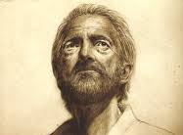
Introducing the Book of Job
We do not know who wrote the book of Job.
We do not know when or where the book of Job was written.
The book of Job is written almost entirely in poetic language, with a prologue and an epilogue in prose, and is often classified as wisdom literature.
TRADITION:
Several theories have been advanced for the date of writing:
It was written shortly after the events occurred, perhaps by Job or Elihu
It was written by Moses in Midian (1485-1445 BC)
It was written in the time of Solomon (c 950 BC)
It was written during or after the Babylonian captivity (2)

Slide 3
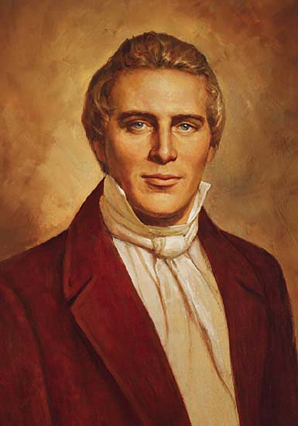
Fiction or Real?
Some have wondered if Job was a fictional character, but both ancient scripture and modern revelation clarify that Job was a real person who went through very real suffering.
Though these three men, Noah, Daniel, and Job, were in it, they should deliver but their own souls by their righteousness, saith the Lord God.
Ezekiel 14:14
Modern revelation confirms the existence of the man Job. As recorded in the Doctrine and Covenants, Jesus Christ comforted the Prophet Joseph Smith by comparing his afflictions to those of Job:
“Thou art not yet as Job; thy friends do not contend against thee, neither charge thee with transgression, as they did Job” (D&C 121:10). (1)

Slide 4
The Character of Job
He was a good man who feared God and shunned evil (Job 1:1)
He was wealthy but not caught up in wealth (Job 1:3, 21)
He had integrity (Job 2:3)
He strengthened the weak (Job 4:3-4)
He walked in the Lord’s paths and esteemed the Lord’s words (Job 23:10-12)
He was compassionate to the widow, the poor, the lame, and the blind (Job 29:12-16)
He was concerned for his enemies and forgave them (Job 31:29-30)

Slide 5


The Questions
Why do righteous people suffer?
Why do righteous people choose righteousness?

Slide 6
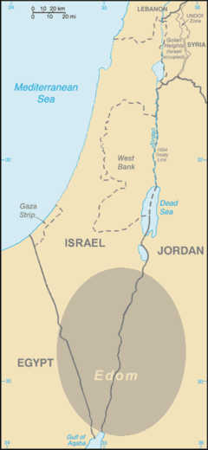
The Land of Uz
The Land of Uz (Hebrew: ארץ עוץ‎) is a location mentioned in the Old Testament, most prominently in the Book of Job, which begins, "There was a man in the land of Uz, whose name was Job".
Scholars have not identified any actual country which corresponds to Uz. (4)
However: The location of this land of Uz is unknown, and even the time in which Job lived is questioned. (5)
Job 1:1

Slide 7
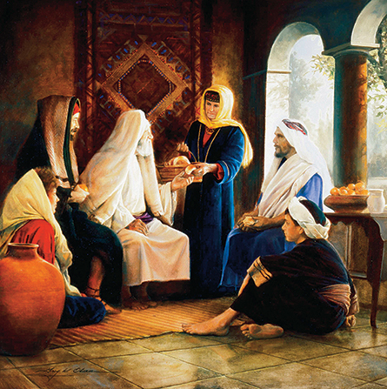
Was Job Perfect?
Perfect does not mean Job was without sin.
Rather it implies that Job faithfully kept the commandments of God.
Those who keep the commandments and endure to the end will eventually be made perfect through the Atonement of Jesus Christ.
Therefore I would that ye should be perfect even as I, or your Father who is in heaven is perfect.
3 Nephi 12:48
Job had children and wealth
Job 1:1-6

Slide 8
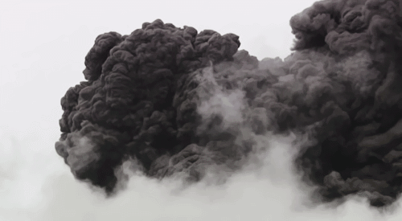
The Lord and Satan’s Conversation
During the Council in Heaven
The first two chapters were an intriguing mixture of apparent folklore and knowledge of the premortal existence.
While the unknowing Job went about an earth day’s labor, Satan challenged the Lord in heaven contending that goodness was another form of selfishness and Job would forsake it when the rewards were gone.
Satan is a Hebrew word used in the form of Hassatan= “the adversary,” which describes the devil’s role here
Job 1:6-12
(1)

Slide 9
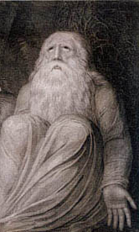
Satan’s Claim
Satan is a Hebrew word used in the form of Hassatan= “the adversary,” which describes the devil’s role here
Satan claimed that Job feared or worshipped the Lord only because the Lord had protected and blessed Job.
If the Lord removed His protection from Job, Satan claimed that Job would curse God.
The Lord does not really make agreements with Satan. The conversations between the Lord and Satan in the book of Job are presented in a poetic narrative that emphasizes Satan’s role as our adversary.
In reality, the Lord has power over Satan and has no need to bargain with him.
Job 1:9-11; Job 2:1-6

Slide 10
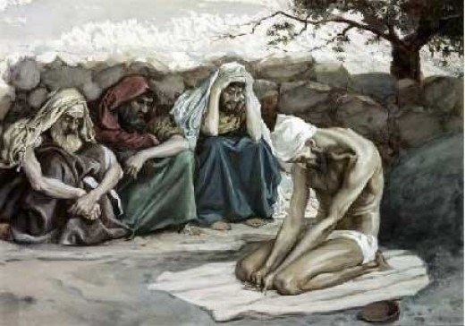
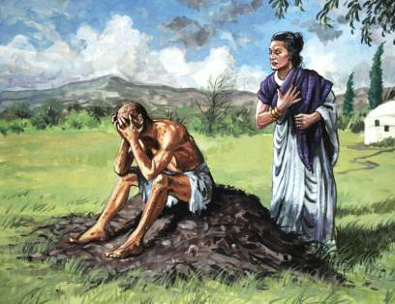
Satan: Permitted to Destroy
The Lord withdrew some of His protective care but Satan could not have Job’s life taken (Job 1:12)
Satan was permitted to destroy Job’s herds and flocks, to slay his servants and all his children, and to curse Job with boils, all as a test of Job’s faith.
…Job was not deserted—three old friends came to grieve with him, sitting in sackcloth and ashes and silence.
To his wife’s pitiful jeering suggestion that he “curse God,” Job answered triumphantly:
“… What? shall we receive good at the hand of God, and shall we not receive evil?” (Job 2:10.)
(1)
Job 1:10-12

Slide 11
The Trials of Job
Loss of servants, property, and income (Job 1)
Loss of children (Job 1:16-19)
Physical illness and pain (Job 2:7; 7:5; 16:16)
Restless sleep filled with nightmares (Job 7:4, 14)
Cruel accusations and loss of support from friends and family (Job 2:9; 4:1,7-8; 11:1-6; 19: 13-22)
Confusion about why he was asked to go through these trials (Job 10:15)
Mockery by those who delighted in his downfall (Job 16:10-11; 30:1, 8-10)
The feeling that God had forgotten him or was not listening (Job 19:6-8; 23:3-4)

Slide 12
Sabeans and Chaldeans
The Sabeans mentioned here are supposed to have been the same with those who were the descendants of Abraham by Keturah, whose son Jokshan begat Sheba. The sons of Keturah were sent by Abraham into the east, Genesis 25:6, and inhabited Arabia Deserta, on the east of the land of Uz.
Hordes of predatory banditti were frequent in those countries and continue so to the present day. They made sudden incursions, and carried off men, women, children, cattle, and goods of every description; and immediately retired to the desert, whither it was in vain to pursue them.
The Chaldeans inhabited each side of the Euphrates near to Babylon, which was their capital. They were also mixed with the wandering Arabs, and lived like them on rapine.
They were the descendants of Chesed, son of Nahor and brother of Huz, from whom they had their name Casdim, which we translate Chaldeans.
They divided themselves into three bands, in order the more speedily and effectually to encompass, collect, and drive off the three thousand camels: probably they mounted the camels and rode off.
Job 1:15-17
(6)

Slide 13
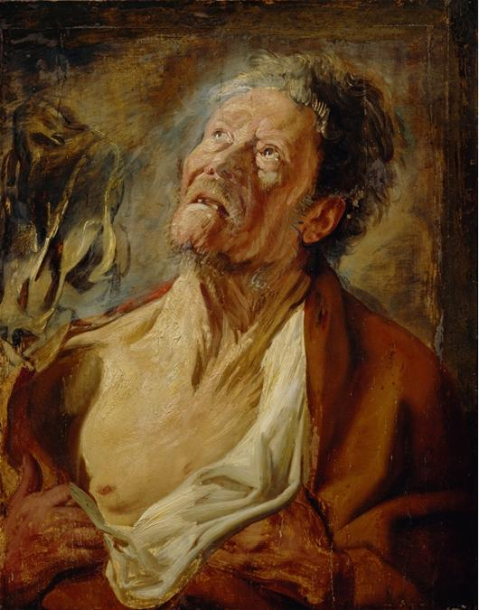
Job’s Response to Trials
Then Job arose, and rent his mantle, and shaved his head, and fell down upon the ground, and worshipped,
We can choose to have faith in God even in the midst of our trials
Satan is real. He is here on earth and he is allowed to tempt us. If we resist his influence and follow the Savior, he cannot have power over us. (1)
Job 1:20-22

Slide 14
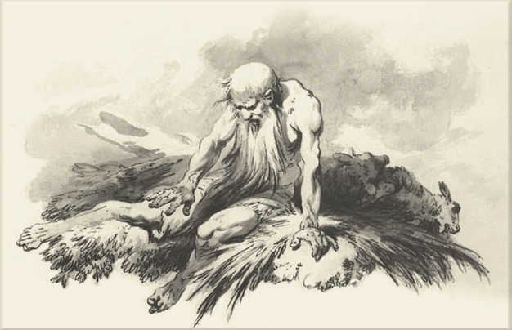
Sores and Boils
His scraping himself with a potsherd (potsherd is a piece of broken pottery) indicates a disease accompanied with intolerable itching, one of the characteristics of the smallpox…(6)
Job 2:7-8

Slide 15
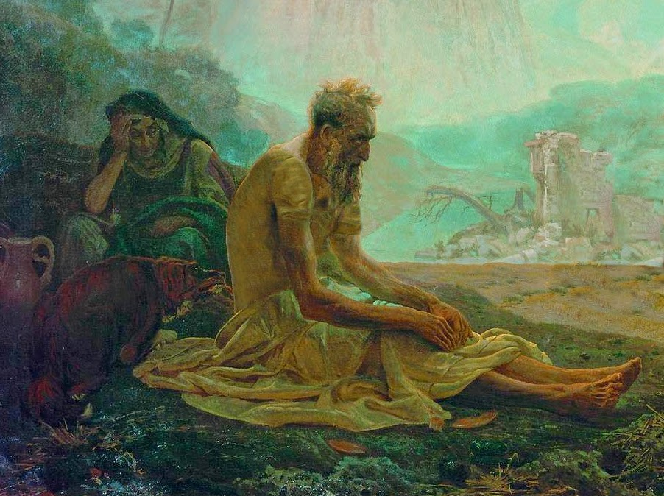
Job’s Wife
Dost thou still retain thine integrity? curse God, and die.
Thou speakest as one of the foolish women speaketh.
What? shall we receive good at the hand of God, and shall we not receive evil? In all this did not Job sin with his lips.
Job 2:9-10

Slide 16
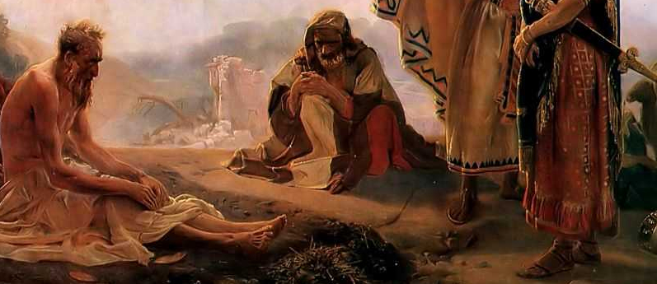
Eliphaz, Bildad, and Zophar
His friends came to Job to comfort him in his afflictions. Job expressed some of his thoughts and feelings to his friends
Eliphaz: Job 4:7–9; 15:4–6
Bildad: Job 8:1–6, 20
Zophar: Job 11:1–6
Rent Their Mantle--the actions that were used in order to express profound grief; such as wrapping themselves in sackcloth, covering the face, strewing dust or ashes upon the head, sitting upon the bare ground, etc., etc.; significant actions which were in use among all nations.
Job 2:11-16

Slide 17
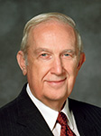

“When you face adversity, you can be led to ask many questions. Some serve a useful purpose; others do not. To ask, Why does this have to happen to me? Why do I have to suffer this, now? What have I done to cause this? will lead you into blind alleys. It really does no good to ask questions that reflect opposition to the will of God. Rather ask, What am I to do? What am I to learn from this experience? What am I to change? Whom am I to help? How can I remember my many blessings in times of trial? …
“This life is an experience in profound trust—trust in Jesus Christ, trust in His teachings, trust in our capacity as led by the Holy Spirit to obey those teachings. … To trust means to obey willingly without knowing the end from the beginning. To produce fruit, your trust in the Lord must be more powerful and enduring than your confidence in your own personal feelings and experience.”
(7)

Slide 18
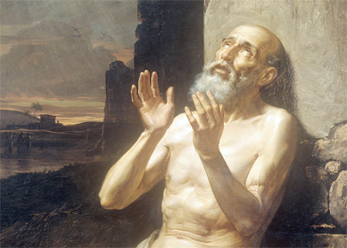
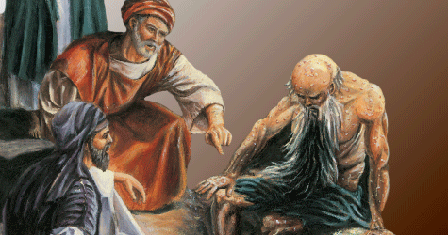
Summary of Job 4-16
Job 3:1–11 | Job 4:7–9; 15:1–6 | Job 8:6, 20; 18:1–5
Job laments his afflictions and wonders if it would have been better to never have been born. | Eliphaz states that the righteous are not punished by God; Job should confess his sins. | Bildad claims that God, who is just, does not punish the innocent; Job should admit he sinned.

Slide 19
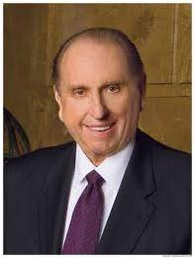
“Weeping may endure for a night, but joy cometh in the morning.”
Whenever we are inclined to feel burdened down with the blows of life, let us remember that others have passed the same way, have endured, and then have overcome.
There seems to be an unending supply of trouble for one and all. Our problem is that we often expect instantaneous solutions, forgetting that frequently the heavenly virtue of patience is required. (“Look to God and Live.”
(10)

Slide 20
Sources:
Suggested Hymn: #129 Where Can I Turn For Peace?
Videos: My New Life (5:13)
Mountains to Climb (5:05)
Learning Through Trials (2:29)
Your Trust in the Lord (1:22)
My New Life (8:20)
1. Gospel Doctrine Manual Lesson 132
Tradition—what the world is speculating. Talk thru the Bible by Bruce Wilkinson and Kenneth Boa p. 145
Rebecca L. Cornwall The “Old Dead Book” of Job July 1974 Ensign
Wikipedia
See article from Church News
Adam Clarke Bible Commentary
Elder Richard G. Scott (“Trust in the Lord,” Ensign, Nov. 1995, 17).
8. President Thomas S. Monson Ensign, May 1998, 52)
Presentation by ©http://fashionsbylynda.com/blog/

Slide 21
Neal A. Maxwell made a profound statement when he said, “None of us can tell Christ anything about depression!” (Ensign, Apr. 1997, 10) Indeed, none of us can tell Christ anything about pain. None of us can tell Christ anything about injustice. None of us can tell Christ anything about being misunderstood or misrepresented. He suffered more than any that he might “know how to succor his people according to their infirmities.” (Alma 7:12) Why is this so important? Is it just so that Christ can empathize? Is there more to the story?
Now we finally get to the point. Christ suffered all things so that no one could say to him at the judgment bar, “you don’t know what it was like for me.” He knows what it was like. He went through it. The wisdom and justice of Elohim will not allow any soul to preach to Him at the judgment bar. Instead, all will acknowledge that he has been just; all “people shall see eye to eye and shall confess before God that his judgments are just” (Mosiah 16:1). What does this have to do with Job? Well, just imagine the self-justifiers at the last day. Can you hear them saying to God, “sure Christ suffered more than any mortal, but he was the Son of God with divine characteristics. Of course he could suffer in righteousness, he was perfect. Where is the mortal that had to suffer such unfair treatment?”
Enter Job stage right. It is no coincidence that Job’s story was preserved. He said, “O that my words were now written! Oh that they were printed in a book! That they were graven with an iron pen and lead in the rock for ever!” (Job 19:23-24) It is crucial to the Lord’s plan of justice that Job’s story is told. His words were “printed in a book.” His story has been engraven in the rock forever. The Lord saw to it. He called Job from before the foundation of the world to suffer more than any other mortal would suffer save Christ. His mission was to be treated completely unfairly and not blame God. He performed his mission perfectly. Now, none of us, no matter what we have suffered, can justifiably blame God. None of us can say God has treated us unfairly. None of us can say that God is unjust. None of us have had it as bad as Job. Even Joseph Smith, with all that he suffered was “not yet as Job.” None of us, with all that we suffer, have suffered “as Job.” None of us, with all the injustices of mortality, can complain to the Lord that He has treated us unfairly. None of us.
This is why the story of Job was scripted.
The Power to Resist:
Do you think a just God would permit Satan to try us beyond our power to resist? Then the Lord will always give us power to resist if we will remain true and faithful to the end and seek the Lord and his guidance in all the trials and difficulties, even though we may think they are unjust. Nearly all of us go through some experience in this life of sickness, disease, trouble, financial difficulties, many even born with difficulties and handicaps—not because of any cause on their part as we see it, but because that is the part that the Lord wants us to go through as a trial and temptation to see if we will prove faithful to the end, in spite of these conditions, which are as far as we are concerned without cause.
Why, then, did the Lord first say to Satan "only upon himself put not forth thine hand." The Lord knew the strength of Job, so step by step Job was strengthened and given more power. Had the Lord said in the beginning, "All right, Lucifer, you may have full power over Job, you may do anything you wish with him, except you cannot take his life." I doubt if Job would have had the strength to resist all he went through and still remain faithful. But in the wisdom of the Lord he was just given part of it at a time. By so doing he was strengthened, in the first step sufficiently to take the next step. And then having proved faithful to the end the Lord restored to him his blessings many-fold, thus having become in that degree perfect. Eldred G. Smith(Conference Report, October 1962, Afternoon Meeting 62)
Integrity:
“always doing what is right and good, regardless of the immediate consequences. It means being righteous from the very depth of our soul, not only in our actions but, more important, in our thoughts and in our hearts. Personal integrity implies such trustworthiness and incorruptibility that we are incapable of being false to a trust or covenant.” Elder Joseph B. Wirthlin (in Conference Report, Apr. 1990, 38; or Ensign, May 1990, 30).
Struggles and Staying Power:
“Spiritual staying power requires strength—strength to be achieved by feasting upon the gospel of Jesus Christ regularly, deeply, and perceptively. If you and I go unnourished by the gospel feast which God has generously spread before us, we will be vulnerable instead of durable” Elder Neal A. Maxwell (“If Thou Endure Well” [fireside address at Brigham Young University, 2 Dec. 1984], 5).

Slide 22
Land of Uz:
According to the Dead Sea document, The War Scroll, the land of Uz is mentioned as existing somewhere beyond the Euphrates possibly in relation to Aram. In Column 2 verse 11, it is noted, "they shall fight against the rest of the sons of Aramea: Uz, Hul, Togar, and Mesha, who are beyond the Euphrates."
Uz is sometimes identified with the kingdom of Edom, roughly in the area of modern-day southwestern Jordan and southern Israel. Lamentations 4:21 reads: "Rejoice and be glad, O daughter of Edom, that dwellest in the land of Uz" Other locations proposed for Uz include more southern Arabia, especially Dhofar, said to be the home of the original Arabs; Bashan in modern-day southern Syria/western Jordan; Arabia east of Petra, Jordan; and even modern-day Uzbekistan.
The name Uz is mentioned several times in the Bible. In Genesis, Uz is the son of Aram, a direct descendant of Shem. In Genesis 36:28 and 1 Chronicles 1:42, Uz is a son of Dishan, and in 1 Chronicles 1:17, Uz is a son of Shem. Wikipedia
The land in which Job dwelt, Job 1:1 Jeremiah 25:20 La 4:21. The Seventy call it Ausitis. It appears to have been a region in Arabia Deserta, between Palestine, Idumaea, and the Euphrates, and most probably not far from the borders of Idumaea. It is uncertain whether its inhabitants were descendants of Uz the son of Aram, Huz the son of Nahor, or Uz the Horite, Genesis 10:23 22:21 36:28. They appear to have had much knowledge of the true God and the principles of virtue and religion. Bible Hub
Job: Church News Archives
The scriptures do not state that Job was a prophet, or that he had any priestly calling. However, there is no doubt that he was a righteous man. In Job 1:1, he is described as a man who was "perfect and upright, and one that feared God, and eschewed evil." (Job 1:1.)
Much mystery surrounds Job. According to the book that bears his name, Job lived in the land of Uz. The location of this land of Uz is unknown, and even the time in which Job lived is questioned. Some scholars say he lived during the time of the patriarchs - Abraham, Isaac and Jacob. Others think he might have lived as late as the time of Malachi. Besides not having any information about the time or place in which Job lived, scholars know practically nothing of the man himself. Some boldly contend Job is a fictitious character who had a leading role in a purely literary story in the Bible.
In A Companion to Your Study of the Old Testament, Daniel H. Ludlow wrote: "Interpretations to the book of Job have been so varied and extreme that it has been claimed that Job has suffered more from the hands of the critics than he ever did from the hands of Satan.
"Many critics of the Bible have suggested that Job is a mythological character. In modern times, however, the Lord has verified that Job existed as a real person. To an inquiring Joseph Smith, the Lord replied: `Thou art not yet as Job; thy friends do not contend against thee, neither charge thee with transgression, as they did Job.' (D&C 121:10.)"
Giving further evidence that Job was indeed a real person are two other scriptures that mention him by name, Ezekiel 14:14 and James 5:11.
Sources: A Companion to Your Study of the Old Testament, by Daniel H. Ludlow; and April 1969 and October 1987 general conference reports
Church News: http://www.ldschurchnewsarchive.com/articles/20381/Scholars-know-little-of-Job-time-or-place-in-which-he-lived.html

Slide 23
Another Perspective on Job:
The book of Job is one of the oldest books in the Bible, although we don’t know exactly how old the book is, there is no doubt that it is ancient. Some scholars believe that Job, is mentioned early on in the Bible in the book of Genesis as “Jobab” (Genesis 10:29), one of the sons of Joktan, which would put Job in the ear between Noah and Abraham. In the opening chapter of the Book of Job, we learn that he is from the land of Uz, well there was a man named Huz (Uz?), who was Abraham’s nephew (see Genesis 22:21), perhaps the land of Uz was named after him?
Eliphaz (Job 2:11) was the son of Esau (Genesis 34:10-11); this son of Esau had another son named Teman (Genesis 36:10-11), and the descendants of Teman were known for their wisdom (Jeremiah 49:7). Bildad is called a Shuhite (Job 2:11), and Shuah was a son of Abraham through Keturah (Genesis 35:2).
http://zachsscripturestudy.blogspot.com/2013/02/job-1-2.html
Resisting Satan:
“The power to resist Satan may be stronger than we realize. The Prophet Joseph Smith taught: ‘All beings who have bodies have power over those who have not. The devil has no power over us only as we permit him. The moment we revolt at anything which comes from God, the devil takes power’ [The Words of Joseph Smith, ed. Andrew F. Ehat and Lyndon W. Cook (1980), 60].
“He also stated, ‘Wicked spirits have their bounds, limits, and laws by which they are governed’ [History of the Church, 4:576]. So Satan and his angels are not all-powerful” (“The Forces That Will Save Us,” President James E. Faust Ensign, Jan. 2007, 8).
The Three Friends:
Eliphaz the king on the Thaimanites. Eliphaz was one of the sons of Esau; and Teman, of Eliphaz, Teman was a city of Edom.
Bildad the Shuhite - Or, as the Septuagint, Baldad, tyrant of the Suchites. Shuah was the son of Abraham by Keturah: and his posterity is reckoned among the Easterns. It is supposed he should be placed with his brother Midian, and his brother's sons Sheba and Dedan. See Genesis 25:2, Genesis 25:3. Dedan was a city of Edom, see Jeremiah 49:8, and seems to have been situated in its southern boundary, as Teman was in its western. Ezekiel 25:13.
Zophar the Naamathite - Or, according to the Septuagint, Σωφαρ Μιναιων Βασιλευς, Sophar king of the Minaites. He most probably came from that Naamah, which was bordering upon the Edomites to the south and fell by lot to the tribe of Judah, Joshua 15:21-41. These circumstances, which have already been mentioned in the introduction, prove that Job must have dwelt in the land of Edom, and that all his friends dwelt in Arabia Petraea, or in the countries immediately adjacent. That some of those Eastern people were highly cultivated, we have at least indirect proof in the case of the Temanites, Jeremiah 49:7; : Concerning Edom thus saith the Lord of hosts, Is wisdom no more in Teman? Is counsel perished from the prudent? Is their wisdom vanished? They are celebrated also in Baruch 3:22, 23. Speaking of wisdom he says: It hath not been heard of in Chanaan; neither hath it been seen in Theman. The Agarenes that seek wisdom upon earth, the merchants of Meran and of Theman, the expounders of fables, and searchers out of understanding, none of these have known the way of wisdom. It is evident enough from these quotations that the inhabitants of those districts were celebrated for their knowledge; and the sayings of Job's three friends are proofs that their reputation for wisdom stood on a very solid foundation.
While Job’s friends intended to comfort him, their hasty judgments regarding the reasons for his suffering actually added to his misery. President Dieter F. Uchtdorf of the First Presidency taught:
“It is unworthy of us as Christians to think that those who suffer deserve their suffering. … Our Savior willingly took upon Himself the pain and sickness and suffering of us all—even those of us who appear to deserve our suffering.
“In the book of Proverbs we read that ‘a friend loveth at all times, and a brother is born for adversity.’ Let us love at all times. And let us especially be there for our brothers and sisters during times of adversity” (“You Are My Hands,” Ensign or Liahona, May 2010, 69–70).

Slide 24
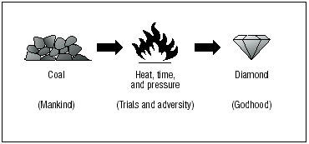
Job 1-2 | Job, a just and faithful man, experiences sever trials. He remains faithful to the Lord despite losing his possessions, children, and health
Job 13:13-16 Job 19:23-27 | Job finds strength in trusting the Lord and in his testimony of the Savior
Job 27:2-6 | Job finds strength in his personal righteousness and integrity
Job 42:10-17 | After Job has faithfully endured his trials, the Lord blesses him
The Prophet Joseph Smith said: “I am like a huge, rough stone rolling down from a high mountain; and the only polishing I get is when some corner gets rubbed off by coming in contact with something else, … knocking off a corner here and a corner there. Thus I will become a smooth and polished shaft in the quiver of the Almighty” (Teachings of the Prophet Joseph Smith, sel. Joseph Fielding Smith [1976], 304).

