Slide 1
Lesson 112 Part 2
A Vision of Heavenly Father’s Plan
Job 38-42
“Never, never, never give up.”
--Winston Churchill

Slide 2
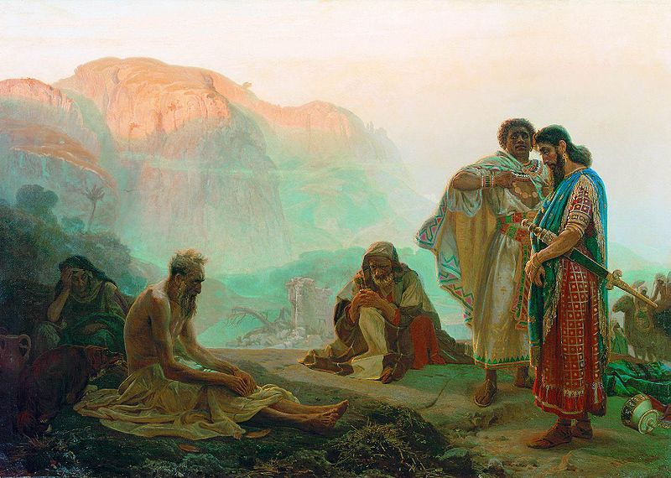
Previously…
Job’s friends accuse him of sin because of all his afflictions, and that God is punishing him.
“As you know, it (Job) narrates the afflictions that befell a righteous man and considers reasons for those afflictions.
It does not entirely answer the question of why Job, or anyone, might suffer pain and sorrow, but does state clearly that affliction is not necessarily a sign of God’s anger and a punishment for sin, as Job’s friends told him.
The book suggests that affliction, if not for punishment, may be for experience, discipline, and instruction.” (1)

Slide 3
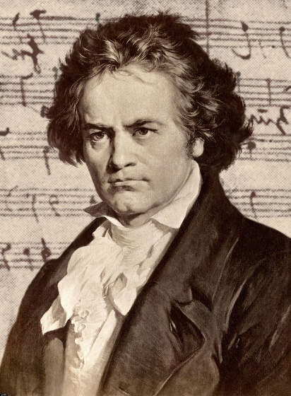
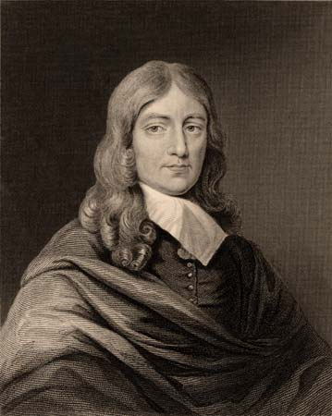
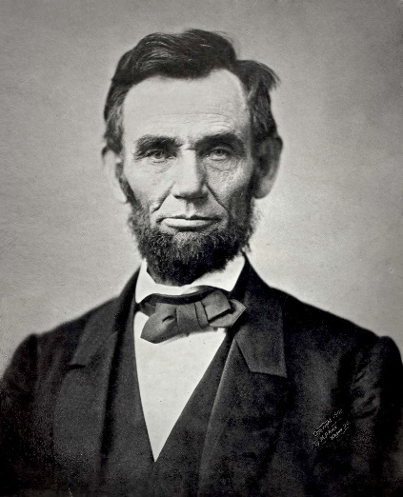
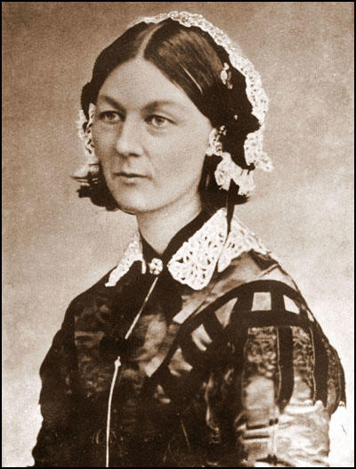
Leaving a Permanent Mark on the World
John Milton was blind when he wrote Paradise Lost.
Abraham Lincoln was laughed at as a gangling, awkward country boy who had many failures; but he became one of the greatest and most eloquent presidents of the United States.
Ludwig von Beethoven was deaf when he finished some of his greatest musical compositions..
Florence Nightingale devoted her life to save the lives of countless wounded soldiers.
Their example should give hope to all of us. They succeeded not only because the Lord had endowed them with gifts, as he has each of us in varying degrees, but because they applied themselves steadfastly. (1)

Slide 4
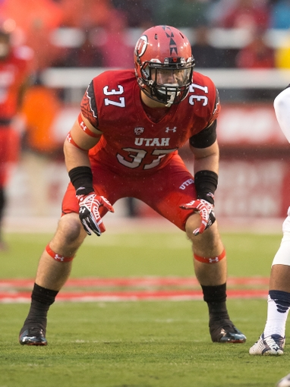
Genius is only the power of making continuous efforts
“Perseverance is a positive, active characteristic. It is not idly, passively waiting and hoping for some good thing to happen. It gives us hope by helping us realize that the righteous suffer no failure except in giving up and no longer trying.” (1)
Christian Drews—University of Utah

Slide 5
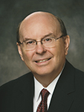
Limited Perspective
What can cause us to have a limited perspective?
Viewing earth life and its challenges without knowledge or understanding of Heavenly Father’s plan of happiness or faith in that plan.
“From the limited perspective of those who do not have knowledge, understanding, or faith in the Father’s plan—who look at the world only through the lens of mortality with its wars, violence, disease, and evil—this life can seem depressing, chaotic, unfair, and meaningless.” (2)

Slide 6
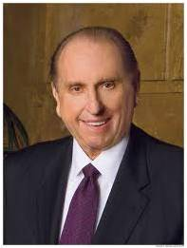
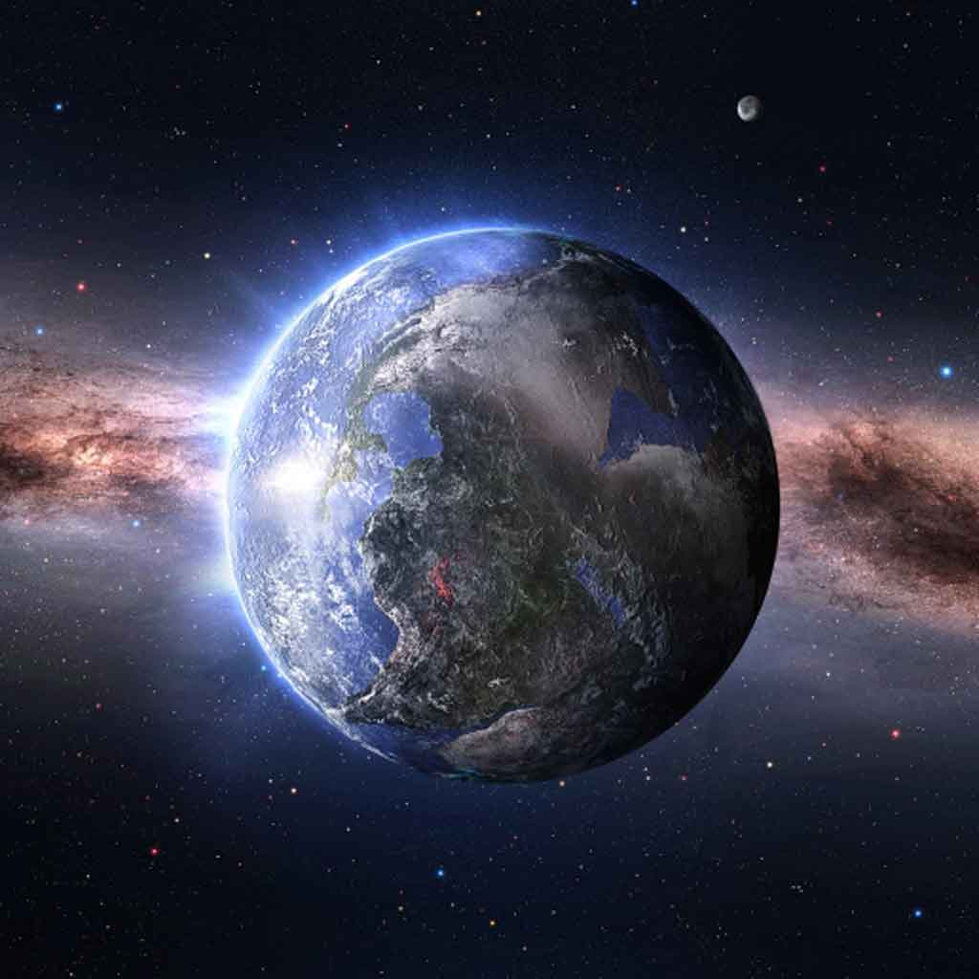
The Lord Speaks to Job
What did the Lord say He wanted Job to do?
To answer His Questions
Where were you during the creation of the earth?
Who created the earth?
Who are the sons of God?
“We lived before our birth into mortality. In our premortal state, we were doubtless among the sons and daughters of God who shouted for joy because of the opportunity to come to this challenging yet necessary mortal existence.
We knew that our purpose was to gain a physical body, to overcome trials, and to prove that we would keep the commandments of God.” (4)
Job 38:1-7

Slide 7
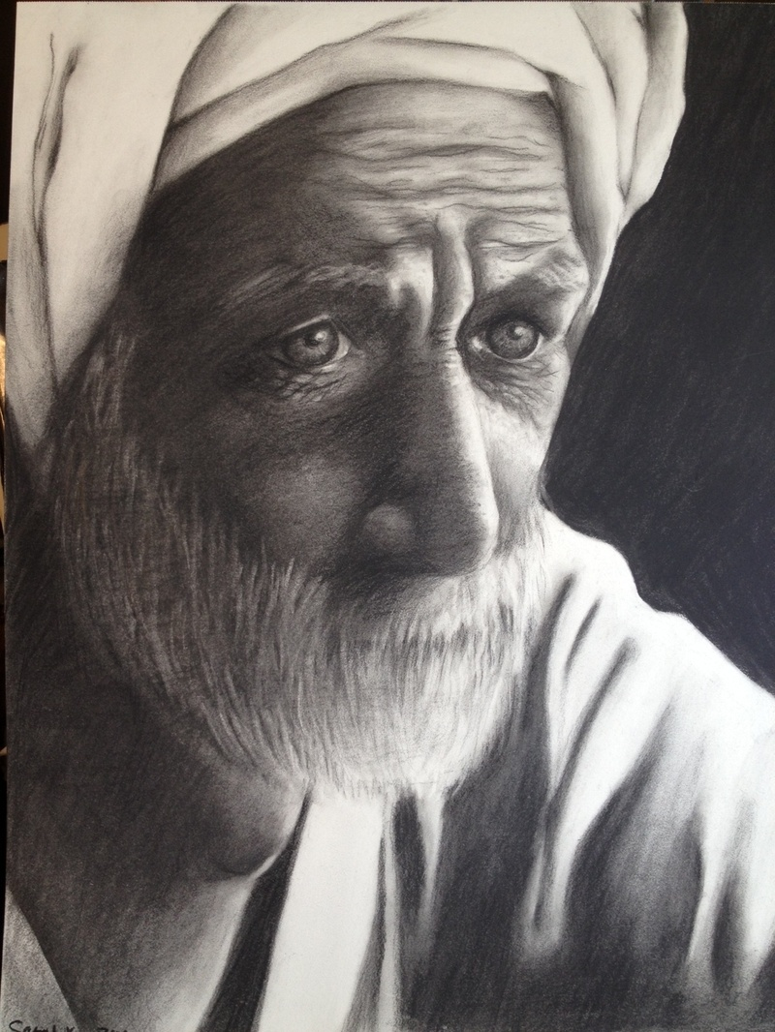
The Power of the Lord
The Lord illustrated His knowledge and power by asking Job many questions about how He created and still directs the earth, emphasizing the limited knowledge and power of humans.
Job 39-41

Slide 8
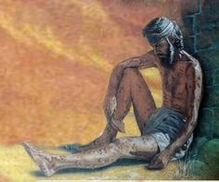
Job Knows…
The Lord has all power and knows all things.
Why do you think it would be important to have a testimony of this truth—particularly during times when we face challenges?
Job 42:1-2

Slide 9
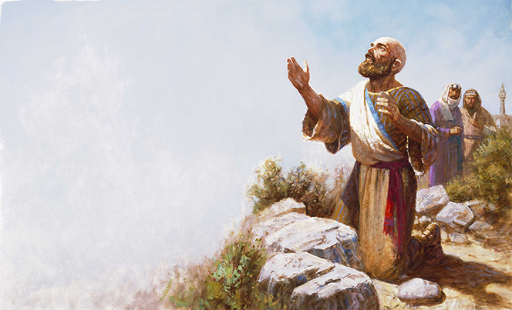
Job Acknowledged His Weaknesses
I have heard of thee by the hearing of the ear: but now mine eye seeth thee.
Wherefore I abhor myself, and repent in dust and ashes.
Gary L. Kapp
Job did not hate himself. Rather, he humbly acknowledged his weaknesses, sins, and limitations before the Lord
Job 42:5-6

Slide 10
To The Friends
The Lord spoke to Job’s friends who had misjudged Job and tried to convince him that he did not deserve the Lord’s mercy.
Gary L. Kapp
The friends repented and made sacrifices unto the Lord for their mistreatment of Job
The Lord wants us to pray for those who misjudge us
Job 42:7

Slide 11
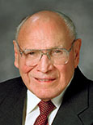
Twice As Much as Before
If we remain faithful to the Lord in our trials, then He will bless us abundantly according to His will
“The Lord compensates the faithful for every loss. That which is taken away from those who love the Lord will be added unto them in His own way.
While it may not come at the time we desire, the faithful will know that every tear today will eventually be returned a hundredfold with tears of rejoicing and gratitude.
“One of the blessings of the gospel is the knowledge that when the curtain of death signals the end of our mortal lives, life will continue on the other side of the veil. There we will be given new opportunities. Not even death can take from us the eternal blessings promised by a loving Heavenly Father.” (5)
Job 42:10-17

Slide 12
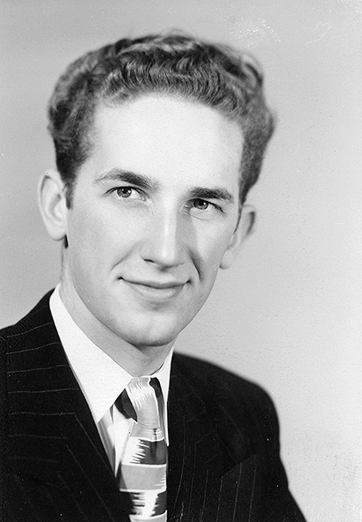
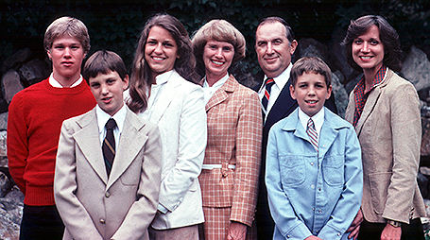
Richard G. Scott found various jobs to earn money for college. One summer he worked on an oyster boat off the coast of Long Island, New York. Another summer he traveled to Utah to work for the forest service cutting down trees; he also repaired railroad cars.
Another summer he asked for a job with the Utah Parks Company, even though they had told him they had no openings. He offered to wash dishes for two weeks for no pay. He told the hiring manager, “If you don’t like my work, you don’t have to pay me.” He figured he would at least have a place to stay and food to eat. He was hired after showing initiative to help with cooking as well as washing dishes.
About five years after they [Richard and Jeanene Watkins] were married, Elder and Sister Scott underwent what he described as “a growing experience”—a difficult trial that ended up being a blessing in his family’s life. They had a daughter and a son at this time, ages three and two. Sister Scott was pregnant with a baby girl. Sadly, the baby passed away at birth. Then just six weeks later, their two-year-old son Richard died following surgery to correct a congenital heart defect.
Elder and Sister Scott later adopted four more children.
Devoting His Best to the Lord’s Work
Excerpts From: Elder Richard G. Scott
(1928–2015)
(6)

Slide 13
Sources:
Suggested Hymn: #101 Guide Me To Thee
Videos: Mountains to Climb (5:05)
Come What May, And Love It (3:31)
He Will Give You Help (4:43))
1. Elder Joseph B. Wirthlin Never Give Up Oct. 1978 Gen. Conf. and Bible Dictionary, LDS edition of the King James Version, s.v. “Job”).
2. Elder Quentin L. Cook (“The Songs They Could Not Sing,” Ensign or Liahona, Nov. 2011, 104).
Winston Churchill “These Are Great Days,” in War Speeches, ed. Charles Eada, Boston: Little, Brown and Co., 1942, pp. 286–88)
President Thomas S. Monson (“He Is Risen!” Ensign or Liahona, May 2010, 88).
Elder Joseph B. Wirthlin (“Come What May, and Love It,” Ensign or Liahona, Nov. 2008, 28).
.
https://www.lds.org/prophets-and-apostles/biographies/elder-richard-g-scott?lang=eng
Presentation by ©http://fashionsbylynda.com/blog/

Slide 14
“Genius is only the power of making continuous efforts. The line between failure and success is so fine that we scarcely know when we pass it; so fine that we are often on the line and do not know it. How many a man has thrown up his hands at a time when a little more effort, a little more patience would have achieved success? A little more persistence, a little more effort, and what seemed a hopeless failure may turn into a glorious success. … There is no defeat except within, no really insurmountable barrier save one’s own inherent weakness of purpose” (author unknown, Second Encyclopedia, ed. Jacob M. Brand, Englewood Cliffs, N.J.: Prentice Hall, 1957, p. 152). From Joseph B. Wirthlin’s Never Give Up Oct. 1987 Gen. Conf.
Answering Job’s Prayers:
The Lord finally answered Job’s prayers. He did not seem, however, to answer the questions Job and his friends raised about why Job was suffering. Instead, the Lord gave answers in the form of more questions. The Lord’s questions give us perspectives about His greatness and about life that are very important to people facing trials in their lives. Job 38–39 explains how Job could have more confidence in the Lord so that he could more fully trust that his trials would be for his benefit.
Remaining Faithful During Times of Trials:
“A pattern in the scriptures and in life shows that many times the darkest, most dangerous tests immediately precede remarkable events and tremendous growth. ‘After much tribulation come the blessings’ [D&C 58:4]. The children of Israel were trapped against the Red Sea before it was parted [see Exodus 14:5–30]. Nephi faced danger, anger from his brothers, and multiple failures before he was able to procure the brass plates [see 1 Nephi 3–4]. Joseph Smith was overcome by an evil power so strong that it seemed he was doomed to utter destruction. When he was almost ready to sink into despair, he exerted himself to call upon God, and at that very moment he was visited by the Father and the Son [see Joseph Smith—History 1:15–17].
Often investigators face opposition and tribulation as they near baptism. Mothers know that the challenges of labor precede the miracle of birth. Time after time we see marvelous blessings on the heels of great trials” Elder Paul V. Johnson (“More Than Conquerors through Him That Loved Us,” Ensign or Liahona, May 2011, 78–79).
Trials a Source of Experience:
“Is there not wisdom in [God’s] giving us trials that we might rise above them, responsibilities that we might achieve, work to harden our muscles, sorrows to try our souls? Are we not exposed to temptations to test our strength, sickness that we might learn patience, death that we might be immortalized and glorified?
“If all the sick for whom we pray were healed, if all the righteous were protected and the wicked destroyed, the whole program of the Father would be annulled and the basic principle of the gospel, free agency, would be ended. No man would have to live by faith.
“If joy and peace and rewards were instantaneously given the doer of good, there could be no evil—all would do good but not because of the rightness of doing good. There would be no test of strength, no development of character, no growth of powers, no free agency, only satanic controls” President Spencer W. Kimball (Faith Precedes the Miracle[1972], 97).

