Slide 2
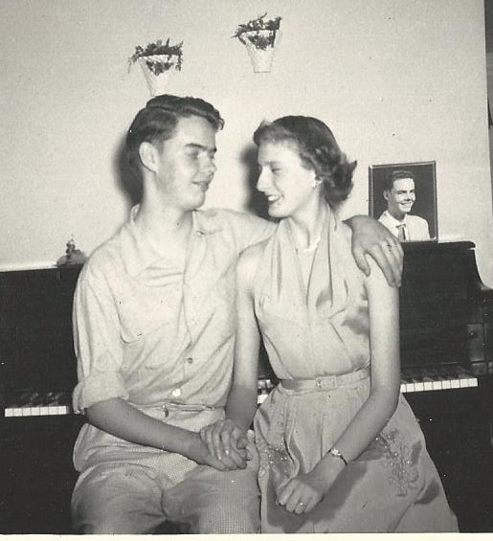
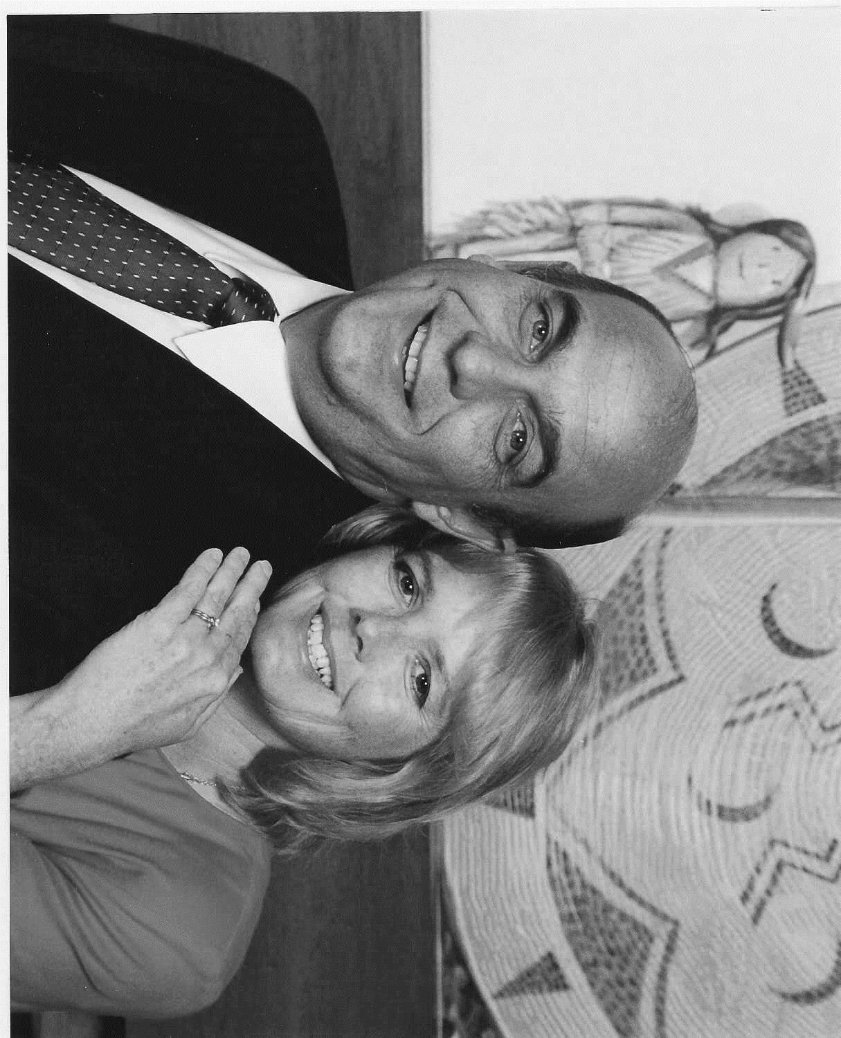
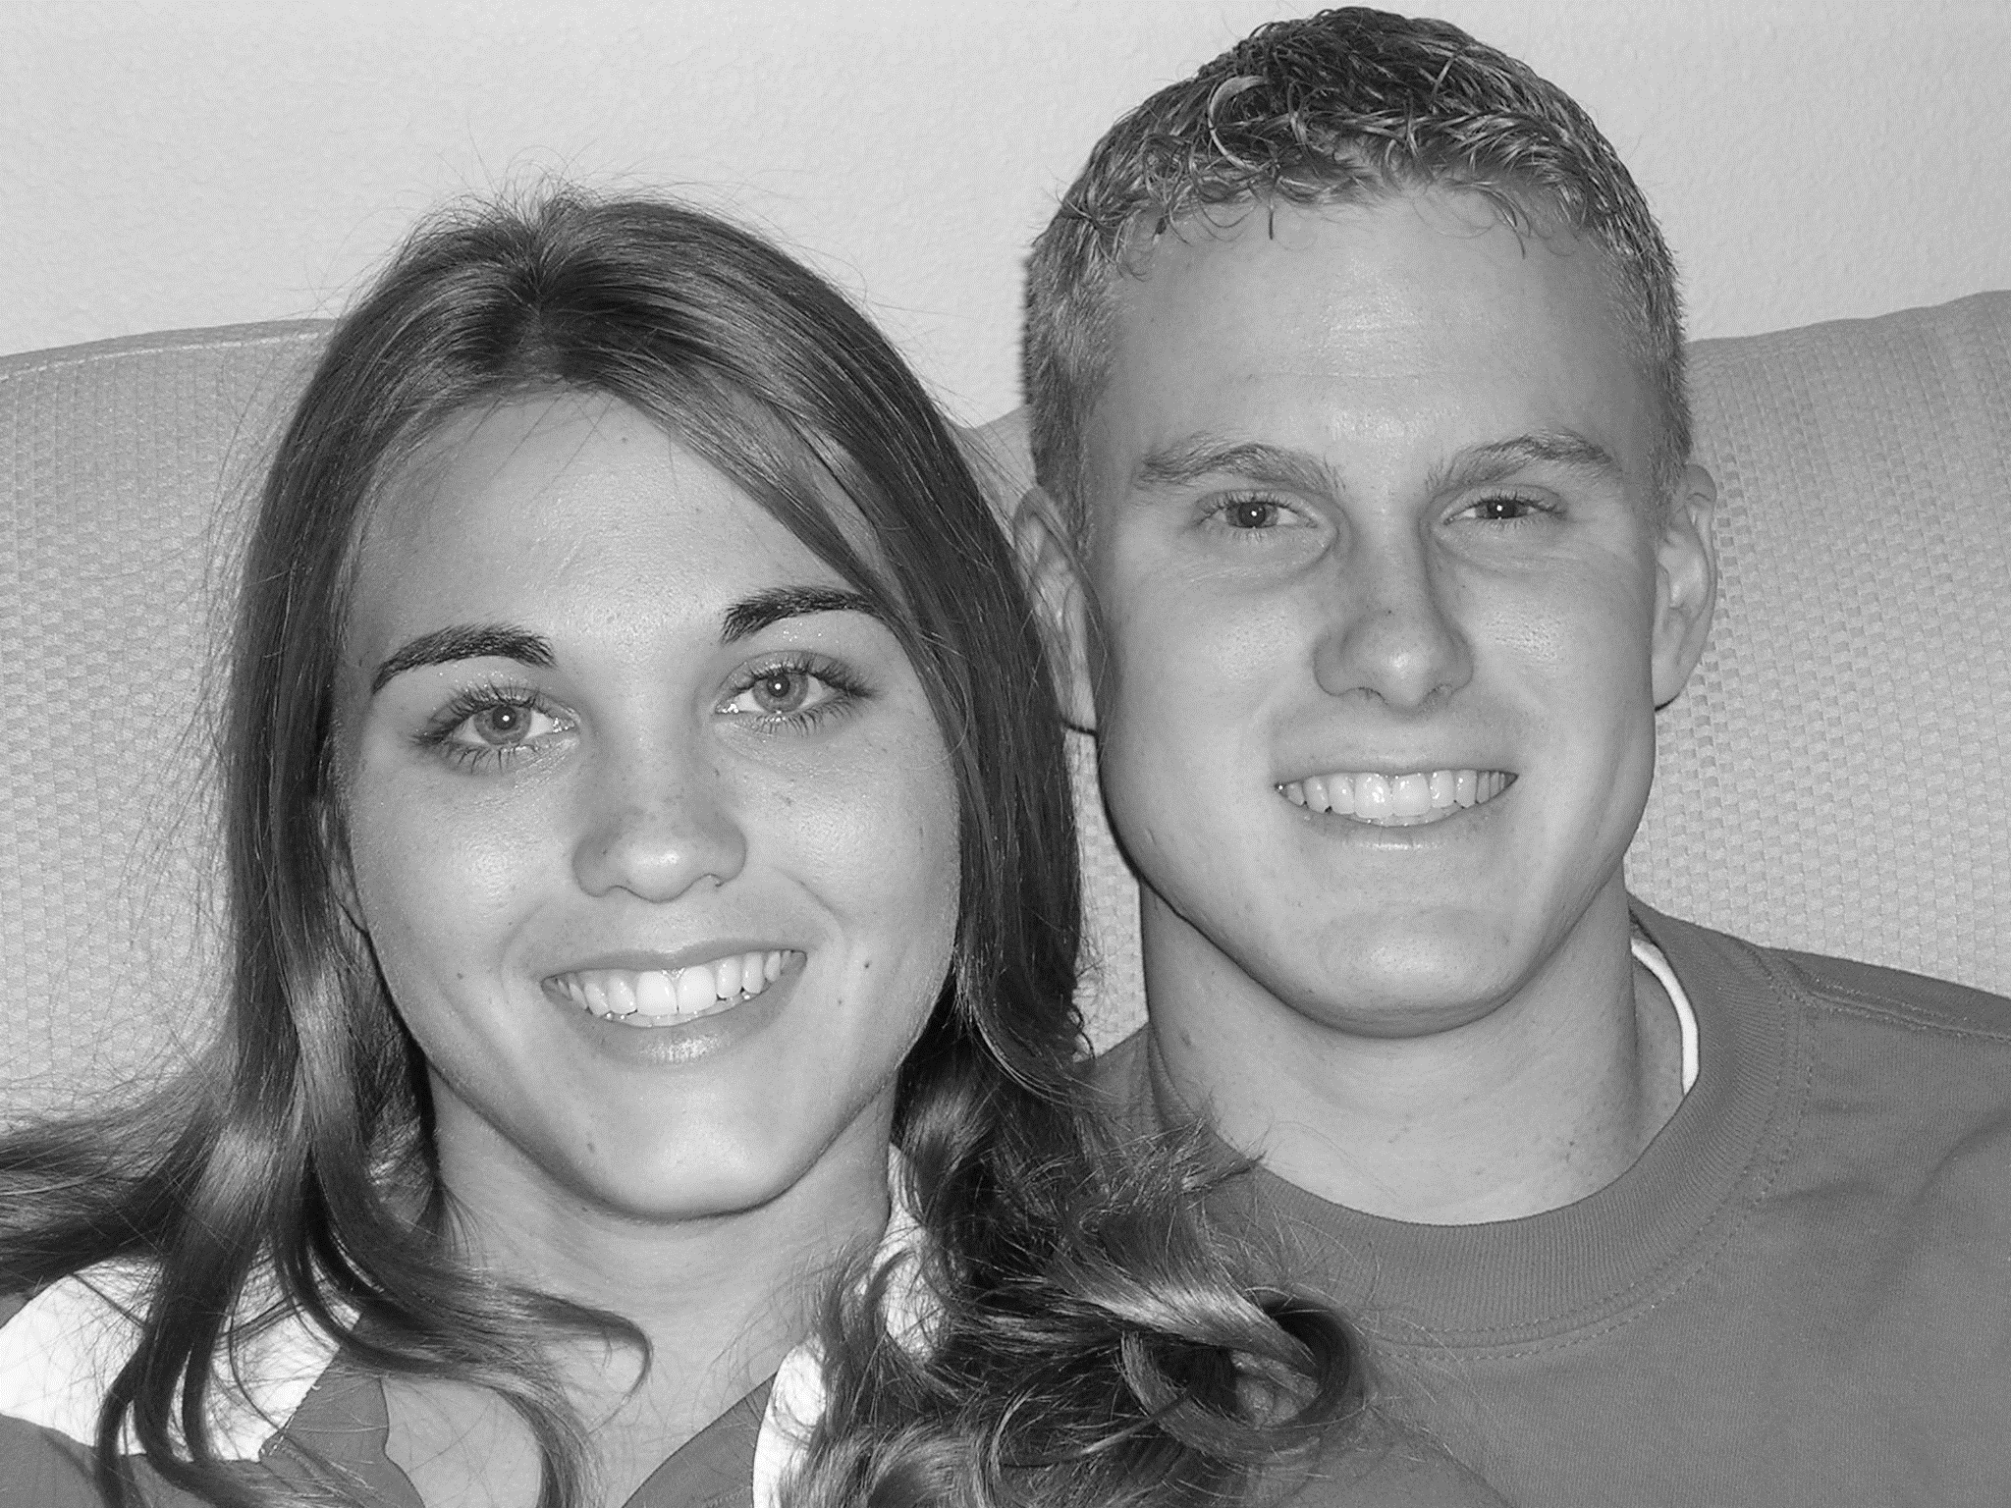
Therefore shall a man leave his father and his mother, and shall cleave unto his wife: and they shall be one flesh.
Genesis 2:24

Slide 3
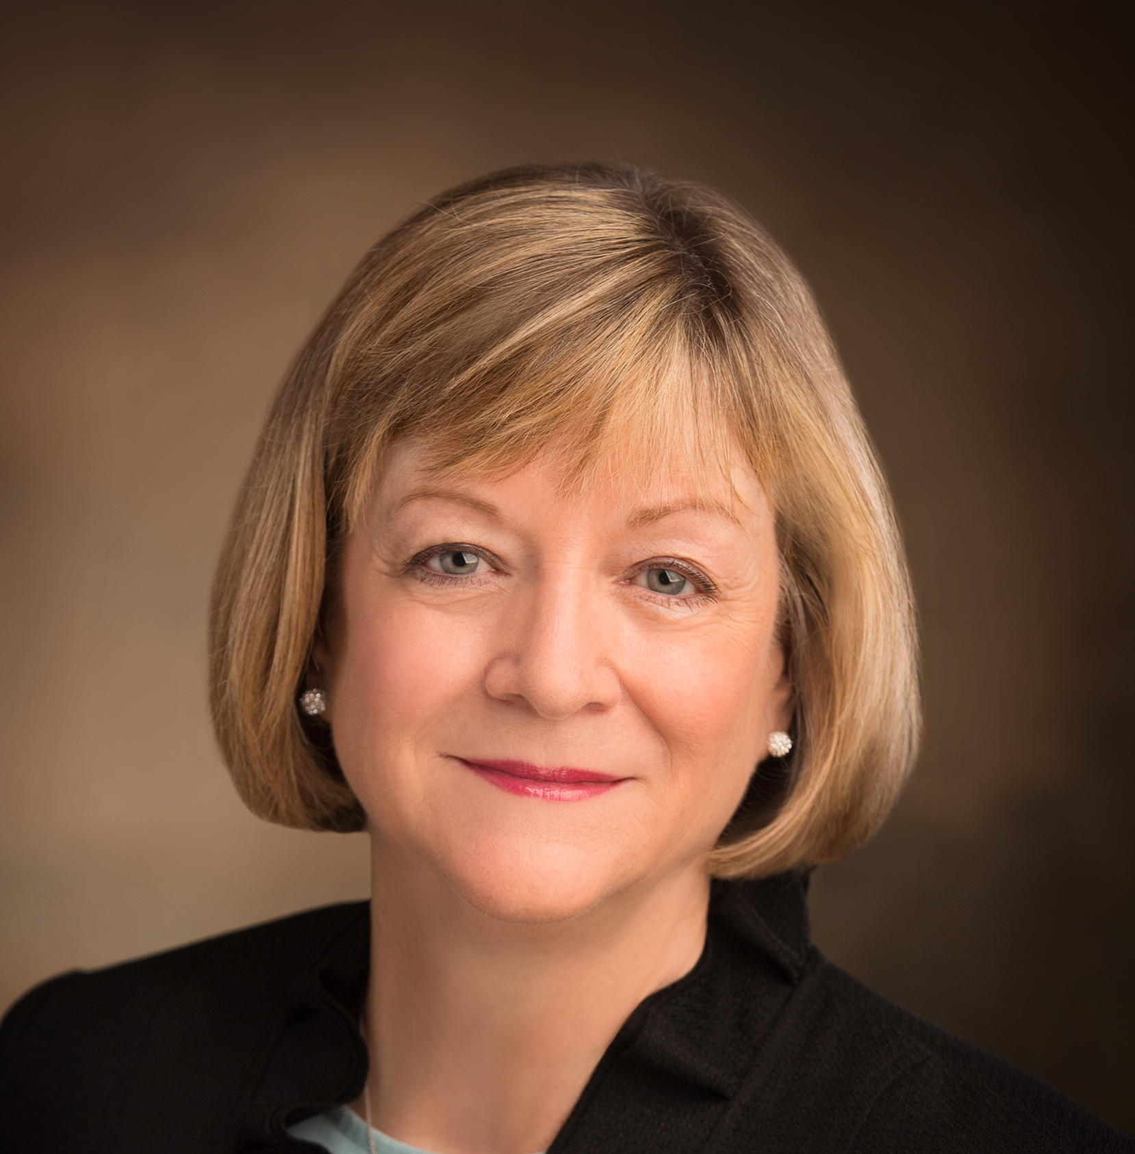
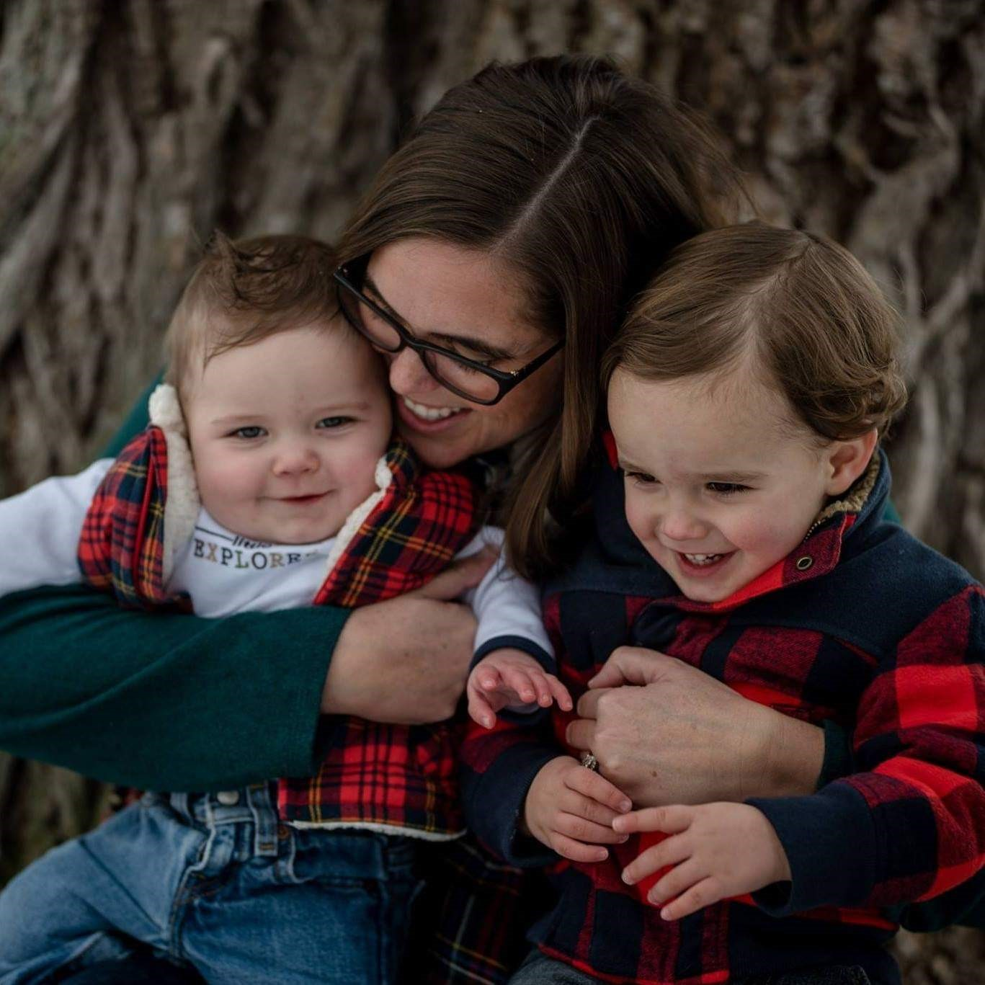
How can belonging to a family contribute to a person’s happiness?
“May I point out something obvious?
Life rarely goes exactly according to plan for anyone, and we are very aware that not all [individuals] are experiencing what the proclamation [on the family] describes.
It is still important to understand and teach the Lord’s pattern and strive for the realization of that pattern the best we can.
“We should remember that a loving Heavenly Father is aware of our righteous desires and will honor His promises … [to] those who faithfully keep their covenants” (1).

Slide 4
Marriage between a man and a woman is ordained of God, and the family is central to His plan of salvation and to our happiness.
And again, verily I say unto you, that whoso forbiddeth to marry is not ordained of God, for marriage is ordained of God unto man.
Wherefore, it is lawful that he should have one wife, and they twain shall be one flesh, and all this that the earth might answer the end of its creation;
D&C 49:15-16
Only by entering into and faithfully keeping the covenant of celestial marriage can a man and a woman fulfill their divine, eternal potential.
1 Corinthians 11:11; D&C 131:1–4

Slide 5
God has commanded His children to multiply and replenish the earth.
And God blessed them, and God said unto them, Be fruitful, and multiply, and replenish the earth, and subdue it: and have dominion over the fish of the sea, and over the fowl of the air, and over every living thing that moveth upon the earth.
Genesis 1:28
The sacred powers of procreation are to be employed only between a man and a woman who have been lawfully wedded as husband and wife.
Genesis 39:9; Alma 39:9

Slide 6
Happiness in family life is most likely to be achieved when founded upon the teachings of the Lord Jesus Christ.
Husband and wife have a solemn responsibility to love and care for each other and for their children. Parents are to rear their children in love and righteousness and provide for their physical and spiritual needs..

Slide 7
By divine design, fathers are to preside over their families in love and righteousness and provide the necessities of life.
Mothers are primarily responsible for the nurture of their children. In these sacred responsibilities, fathers and mothers are obligated to help one another as equal partners.

Slide 8
The divine plan of happiness enables family relationships to continue beyond the grave.
Through family history and temple service, we can make the ordinances and covenants of the gospel available to our ancestors.
The earth was created and the gospel was revealed so that families could be formed, sealed, and exalted eternally.
Malachi 4:5–6

Slide 9
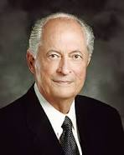
Marriage between a man and a woman is ordained of God, and the family is central to His plan of salvation and to our happiness.
“While our individual salvation is based on our individual obedience, it is equally important that we understand that we are each an important and integral part of a family and the highest blessings can be received only within an eternal family.
When families are functioning as designed by God, the relationships found therein are the most valued of mortality.
The plan of the Father is that family love and companionship will continue into the eternities.
Being one in a family carries a great responsibility of caring, loving, lifting, and strengthening each member of the family so that all can righteously endure to the end in mortality and dwell together throughout eternity. It is not enough just to save ourselves.
It is equally important that parents, brothers, and sisters are saved in our families.”(2)

Slide 10
Cleave = to cling to or be strongly joined together.
Therefore shall a man leave his father and his mother, and shall cleave unto his wife: and they shall be one flesh.
Genesis 2:24
Since the beginning of time marriage between a man and a woman has been ordained by God
Ordained = to order, decree, or appoint by virtue of superior authority.

Slide 11
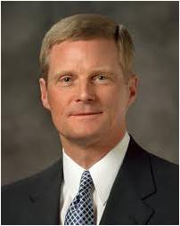
“After the earth was created, Adam was placed in the Garden of Eden. Importantly, however, God said ‘it was not good that the man should be alone’, and Eve became Adam’s wife and helpmeet.
The unique combination of spiritual, physical, mental, and emotional capacities of both males and females was needed to enact the plan of happiness. ‘Neither is the man without the woman, neither the woman without the man, in the Lord’.
The man and the woman are intended to learn from, strengthen, bless, and complete each other.
“… Marriage between a man and a woman is the authorized channel through which premortal spirits enter mortality” (3).
Moses 3:18; Genesis 2:18; 1 Corinthians 11:11

Slide 12
Kayla is a member of your seminary class. As class begins, Kayla explains to the class that she has a friend on social media named Eric who is not a member of the Church.
Eric has asked questions about what Kayla believes, and Kayla and Eric have had positive conversations as Kayla has shared the gospel with him.
Kayla says, “Last night Eric asked a question that I wasn’t sure how to respond to, and I’d like to talk about it as a class before I answer him.
He wants to know why the Church opposes gay marriage, because he believes that any two people who love each other should be able to marry. What could I say to help Eric understand what we believe and why we believe it?”

Slide 13
Why does the Church oppose gay marriage?
Should any two people who love each other be able to marry?
Eric’s Assumptions
God’s purposes for marriage
We look on marriage and the bearing and nurturing of children as part of God’s plan and a sacred duty of those given the opportunity to do so. (5)
Opposing same-sex marriage is not fair to everyone or that love should be the only requirement for two people to get married.

Slide 14
Where Can I Go To Find Answers?
Pray about the sources you look up on the internet
Asking Parents Bishop, Seminary Teacher, Seminary Classmates
Mormon
Newsroom [mormonnewsroom.org]
The Family:
A Proclamation to the World
General Conference Addresses
Ensign Articles

Slide 15
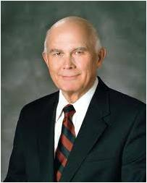
“Knowledge of God’s plan for His children gives Latter-day Saints a unique perspective on marriage and family.
We are correctly known as a family-centered church. Our theology begins with heavenly parents, and our highest aspiration is to attain the fulness of eternal exaltation.
We know this is possible only in a family relationship. We know that the marriage of a man and a woman is necessary for the accomplishment of God’s plan.(5)
(see more of article on slide 18)

Slide 16
Sources:
Suggested Hymn: # 300 Families Can Be Together Forever
Video: What is the Purpose of a Family? (1:17)
Bonnie L. Oscarson, “Defenders of the Family Proclamation,” Ensign or Liahona, May 2015, 15).
Robert D. Hales, “The Eternal Family,” Ensign, Nov. 1996, 65
David A. Bednar, “We Believe in Being Chaste,” Ensign or Liahona, May 2013, 41–42
Dallin H. Oaks, “No Other Gods,” Ensign or Liahona, Nov. 2013, 73, 74–75
Old Testament Seminary Teacher’s Manual Lesson 114
Presentation by ©http://fashionsbylynda.com/blog/

Slide 17
“Motherhood consists of three principal attributes or qualities: namely, (1) the power to bear, (2) the ability to rear, (3) the gift to love. …
“This ability and willingness properly to rear children, the gift to love, and eagerness, yes, longing to express it in soul development, make motherhood the noblest office or calling in the world” President David O. McKay (Gospel Ideals, 453).
“It is divinely ordained what a woman should do. … The divine work of women involves companionship, homemaking, and motherhood” (“In His Steps,” 64).
“Brethren of the priesthood, I continue to emphasize the importance of mothers staying home to nurture, care for, and train their children in the principles of righteousness” (in Conference Report, Oct. 1987, 60; or Ensign, Nov. 1987, 49; see also To the Fathers in Israel, 3–4).
See To the Mothers in Zion, on pages 352–57.
“A mother’s role is also God-ordained. Mothers are to conceive, bear, nourish, love, and train. They are to be helpmates, and are to counsel with their husbands” (in Conference Report, Apr. 1984, 6; or Ensign, May 1984, 6).
“It is divinely ordained what a woman should do, but a man must seek out his work. The divine work of women involves companionship, homemaking, and motherhood. It is well if skills in these three areas can first be learned in the parents’ home and then be supplemented at school if the need or desire presents itself” (“In His Steps,” 64).
“There are voices in our midst which would attempt to convince you that these home-centered truths are not applicable to our present-day conditions. If you listen and heed, you will be lured away from your principal obligations.
“Beguiling voices in the world cry out for ‘alternative life-styles’ for women. They maintain that some women are better suited for careers than for marriage and motherhood.
“These individuals spread their discontent by the propaganda that there are more exciting and self-fulfilling roles for women than homemaking. Some even have been bold to suggest that the Church move away from the ‘Mormon woman stereotype’ of homemaking and rearing children. They also say it is wise to limit your family so you can have more time for personal goals and self-fulfillment” President Ezra Taft Benson (“The Honored Place of Woman,” Ensign, Nov. 1981, 105).
“Marriage is a partnership. Each is given a part of the work of life to do. The fact that some women and men disregard their work and their opportunities does not change the program.
“When we speak of marriage as a partnership, let us speak of marriage as a full partnership. We do not want our LDS women to be silent partners or limited partners in that eternal assignment! Please be a contributing and full partner” (“Privileges and Responsibilities of Sisters,” Ensign, Nov. 1978, 106).
“The Lord organized the whole program in the beginning with a father who procreates, provides, and loves and directs, and a mother who conceives and bears and nurtures and feeds and trains. The Lord could have organized it otherwise but chose to have a unit with responsibility and purposeful associations where children train and discipline each other and come to love, honor, and appreciate each other. The family is the great plan of life as conceived and organized by our Father in heaven” President Spencer W. Kimball (in Conference Report, Apr. 1973, 151; or Ensign, July 1973, 15).
“Mothers are given a sacred privilege to ‘bear the souls of men; for herein is the work of [the] Father continued, that he may be glorified’ (D&C 132:63).
“The First Presidency has said: ‘Motherhood is near to divinity. It is the highest, holiest service to be assumed by mankind’ (in James R. Clark, comp., Messages of the First Presidency of The Church of Jesus Christ of Latter-day Saints,6 vols. [Salt Lake City: Bookcraft, 1965–75], 6:178). The priesthood cannot work out its destiny, nor can God’s purposes be fulfilled, without our helpmates. Mothers perform a labor the priesthood cannot do. For this gift of life, the priesthood should have love unbounded for the mothers of their children. …
“… The Lord has commanded that women and children have claim on their husbands and fathers for their maintenance (see D&C 83; 1 Timothy 5:8). President Ezra Taft Benson has stated that when a husband encourages or insists that his wife work out of the home for their convenience, ‘not only will the family suffer in such instances, … but [his] own spiritual growth and progression will be hampered’ President Howard W. Hunter (in Conference Report, Oct. 1987, pp. 60–61; or Ensign, Nov. 1987, p. 49)” (in Conference Report, Oct. 1994, 67, 69; or Ensign, Nov. 1994, 50–51).
Women’s Divine Roles and Responsibilities

Slide 18
“Knowledge of God’s plan for His children gives Latter-day Saints a unique perspective on marriage and family. We are correctly known as a family-centered church. Our theology begins with heavenly parents, and our highest aspiration is to attain the fulness of eternal exaltation. We know this is possible only in a family relationship. We know that the marriage of a man and a woman is necessary for the accomplishment of God’s plan. Only this marriage will provide the approved setting for mortal birth and to prepare family members for eternal life. We look on marriage and the bearing and nurturing of children as part of God’s plan and a sacred duty of those given the opportunity to do so. We believe that the ultimate treasures on earth and in heaven are our children and our posterity. …
“There are many political and social pressures for legal and policy changes to establish behaviors contrary to God’s decrees about sexual morality and contrary to the eternal nature and purposes of marriage and child-bearing. These pressures have already authorized same-gender marriages in various states and nations. Other pressures would confuse gender or homogenize those differences between men and women that are essential to accomplish God’s great plan of happiness.
“Our understanding of God’s plan and His doctrine gives us an eternal perspective that does not allow us to condone such behaviors or to find justification in the laws that permit them. And, unlike other organizations that can change their policies and even their doctrines, our policies are determined by the truths God has identified as unchangeable.
“Our twelfth article of faith states our belief in being subject to civil authority and ‘in obeying, honoring, and sustaining the law.’ But man’s laws cannot make moral what God has declared immoral. Commitment to our highest priority﻿—to love and serve God﻿—requires that we look to His law for our standard of behavior. For example, we remain under divine command not to commit adultery or fornication even when those acts are no longer crimes under the laws of the states or countries where we reside. Similarly, laws legalizing so-called ‘same-sex marriage’ do not change God’s law of marriage or His commandments and our standards concerning it. We remain under covenant to love God and keep His commandments and to refrain from serving other gods and priorities﻿—even those becoming popular in our particular time and place.
“In this determination we may be misunderstood, and we may incur accusations of bigotry [treating others with hatred and intolerance], suffer discrimination, or have to withstand invasions of our free exercise of religion. If so, I think we should remember our first priority﻿—to serve God﻿—and, like our pioneer predecessors, push our personal handcarts forward with the same fortitude they exhibited” (Dallin H. Oaks, “No Other Gods,” Ensign or Liahona, Nov. 2013, 73, 74–75).
“[Heavenly Father] wants His children to come to earth, following the eternal pattern of families that exists in heaven. Families are the basic organizational unit of the eternal realms, and so He intends for them also to be the basic unit on earth. Though earthly families are far from perfect, they give God’s children the best chance to be welcomed to the world with the only love on earth that comes close to what we felt in heaven﻿—parental love. Families are also the best way to preserve and pass on moral virtues and true principles that are most likely to lead us back to God’s presence” (Henry B. Eyring, “Gathering the Family of God,” Ensign or Liahona, May 2017, 20).
“For His work to succeed … God ordained that men and women should marry and give birth to children, thereby creating, in partnership with God, the physical bodies that are key to the test of mortality and essential to eternal glory with Him. He also ordained that parents should establish families and rear their children in light and truth [see D&C 93:36–40], leading them to a hope in Christ. …
“The social science case for marriage and for families headed by a married man and woman is compelling. … But our claims for the role of marriage and family rest not on social science but on the truth that they are God’s creation. It is He who in the beginning created Adam and Eve in His image, male and female, and joined them as husband and wife to become ‘one flesh’ and to multiply and replenish the earth [see Genesis 1:26–28; 2:7, 18, 21–24]. … It is in the matrimonial union of male and female as one that we attain perhaps the most complete meaning of our having been made in the image of God﻿—male and female. Neither we nor any other mortal can alter this divine order of matrimony. It is not a human invention. Such marriage is indeed ‘from above, from God’ and is as much a part of the plan of happiness as the Fall and the Atonement” (D. Todd Christofferson, “Why Marriage, Why Family,” Ensign or Liahona, May 2015, 51, 52).
The following resources provide additional prophetic counsel and information about the doctrine of marriage and family:
“The Divine Institution of Marriage,” mormonnewsroom.org.
Dallin H. Oaks, “The Plan and the Proclamation,” Ensign or Liahona, Nov. 2017, 28–31.
Bonnie L. Oscarson, “Defenders of the Family Proclamation,” Ensign or Liahona, May 2015, 14–17.
L. Tom Perry, “Why Marriage and Family Matter—Everywhere in the World,” Ensign or Liahona, May 2015, 39–42.
David A. Bednar, “Marriage Is Essential to His Eternal Plan,” Ensign, June 2006, 82–87.
Dallin H. Oaks, “Same-Gender Attraction,” Ensign, Oct. 1995, 6–14.
mormonandgay.lds.org.
“Same-Sex Attraction” and “Same-Sex Marriage,” Gospel Topics, topics.lds.org.

