Slide 1
Lesson 115
Sacred Songs, Poems, and Prayers
Psalms Part 2
HYMNS
Psalms 51-150

Slide 2
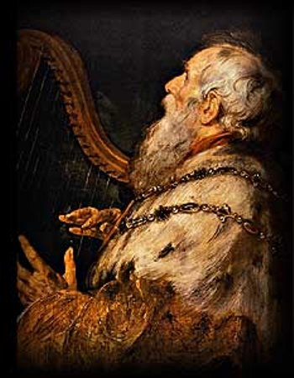
Plea For Forgiveness
Although David “hath fallen from his exaltation” because he had planned the death of Uriah, he received a promise that his soul would not be left in hell. (3)
see also: Psalm 16:8–10
David’s humility and heartfelt desire to be restored to God’s grace and acceptance are examples of true principles of repentance (4)
If we acknowledge our sins and offer the Savior a broken heart and contrite spirit, then He can make us clean.
As we understand the merciful character of God, we will have confidence to turn to Him to seek forgiveness of our sins and help with our troubles.
Psalm 51

Slide 3
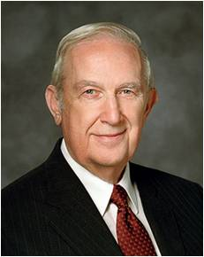
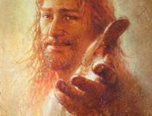
If you are suffering the disheartening effects of transgression, please recognize that the only path to permanent relief from sadness is sincere repentance with a broken heart and a contrite spirit.
Realize your full dependence upon the Lord and your need to align your life with His teachings.
There is really no other way to get lasting healing and peace. Postponing humble repentance will delay or prevent your receiving relief.
Admit to yourself your mistakes and seek help now. Your bishop is a friend with keys of authority to help you find peace of mind and contentment. The way will be opened for you to have strength to repent and be forgiven.
(5)

Slide 4
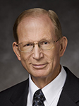
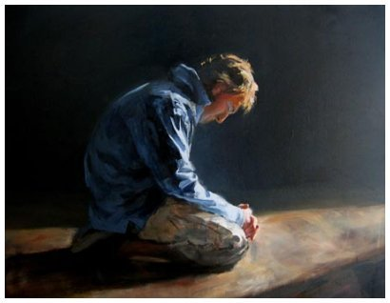
“Those who have a broken heart and a contrite spirit are willing to do anything and everything that God asks of them, without resistance or resentment.
We cease doing things our way and learn to do them God’s way instead.
In such a condition of submissiveness, the Atonement can take effect and true repentance can occur.”
(6)

Slide 5
What Do These Objects Have In Common?
N

Slide 6
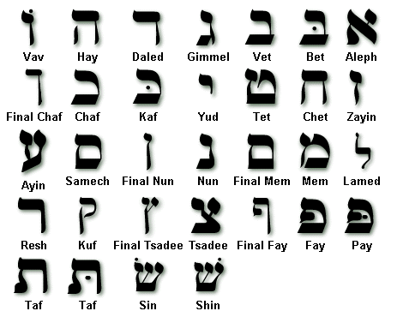
Psalm 119
Psalm 119 is a poem containing eight verses of scripture for each of the 22 letters of the Hebrew alphabet
Remember you are reading right to left

Slide 7
Psalm 119
ה He
O Lord, teach us Thy statutes, Thy law, and Thy commandments.
ד Daleth
O Lord, grant us Thy law, and make us to understand Thy precepts.
ג Gimel
O Lord, open our eyes, that we may behold wondrous things out of Thy law
ב Beth
Ponder the precepts and ways of the Lord.
א Aleph
Blessed are they who keep the commandments.
י Jod
O Lord, let Thy tender mercies come upon us.
ט Teth
O Lord, teach us Thy statutes.
ח Cheth
Make faithful people our companions.
ז Zain
The Lord’s statutes and judgments comfort us during our pilgrimage.
ו Vau
O Lord, give us mercy, truth, and salvation.
ס Samech
Depart from evildoers and keep the commandments of God.
נ Nun
The Lord’s word is a lamp unto our feet.
מ Mem
The Lord’s law and His testimonies should be our meditation all the day.
ל Lamed
O Lord, save us, for we have sought Thy precepts.
כ Caph
All the Lord’s commandments are faithful.
ק Koph
O Lord, hear the voice of Thy servants according to Thy loving kindness.
צ Tzaddi
The Lord’s law is the truth.
פ Pe
The Lord’s testimonies are wonderful.
ע Ain
O Lord, we are Thy servants; give us understanding.
ר Resh
Great are Thy tender mercies, O Lord.
ת Tau
All the Lord’s commandments are righteousness.
ש Schin
Those who love the Lord’s law have peace.

Slide 8
Symbols of Psalm 119
Psalm: 119: 14,72,127
Psalm 119:54
HYMNS
Psalm 119:35
Psalm 119:103
Psalm 119:24
The Lord used symbols to describe his love for the word of God and the blessings that can come through diligently studying and obeying His words.

Slide 9
Lamp
Thy word is a lamp unto my feet, and a light unto my path.
Psalms 119:105
As we study the word of God, we can receive guidance for our lives

Slide 10
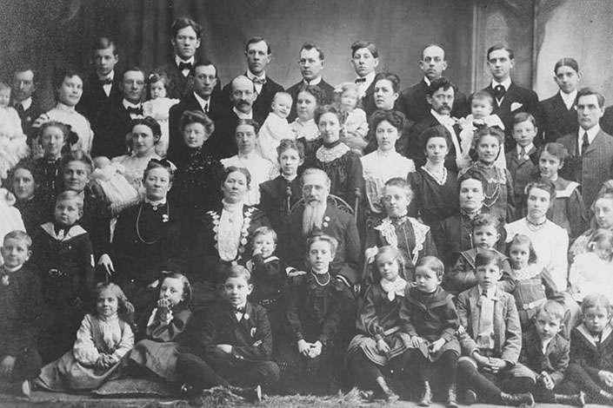
Children are a cherished gift from the Lord
Heritage--an inheritance, possession, or gift from the Lord.
Quiver—a case for holding arrows
Children are gifts from the Lord and can bring parents great happiness
Psalm:127
Joseph F. Smith Family

Slide 11
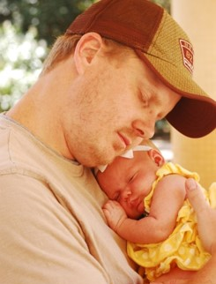
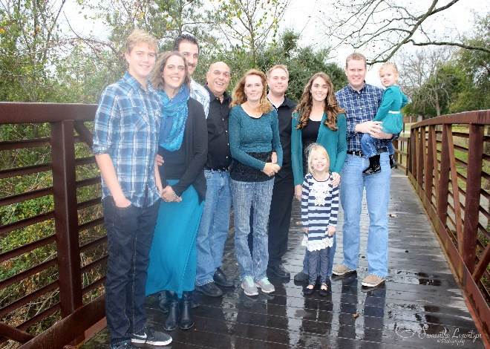
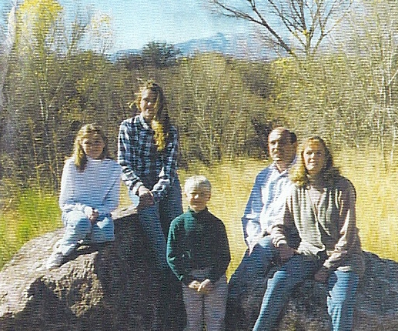
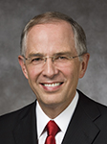
“It is a crowning privilege of a husband and wife who are able to bear children to provide mortal bodies for [the] spirit children of God. We believe in families, and we believe in children.
“When a child is born to a husband and wife, they are fulfilling part of our Heavenly Father’s plan to bring children to earth. …
“Families are central to God’s eternal plan. I testify of the great blessing of children and of the happiness they will bring us in this life and in the eternities.”
(7)

Slide 12
David’s Prayers
Psalms 140:1,4
Psalms 141:4
Psalms 142:5-6
Deliver me, O Lord, from the evil man: preserve me from the violent man;
I cried unto thee, O Lord: I said, Thou art my refuge and my portion in the land of the living.
Incline not my heart to any evil thing, to practise wicked works with men that work iniquity: and let me not eat of their dainties.
Keep me, O Lord, from the hands of the wicked; preserve me from the violent man; who have purposed to overthrow my goings.
Attend unto my cry; for I am brought very low: deliver me from my persecutors; for they are stronger than I.

Slide 13
David’s Prayers
Psalm 143:8-10
Psalm 144:11
Cause me to hear thy lovingkindness in the morning; for in thee do I trust: cause me to know the way wherein I should walk; for I lift up my soul unto thee.
Rid me, and deliver me from the hand of strange children, whose mouth speaketh vanity, and their right hand is a right hand of falsehood:
Deliver me, O Lord, from mine enemies: I flee unto thee to hide me.
As we pray to God in sincerity and truth, He will be near us and if we love God, He will spiritually preserve us
Teach me to do thy will; for thou art my God: thy spirit is good; lead me into the land of uprightness.

Slide 14
Sources:
Suggested Hymn: #72 Praise to the Lord, the Almighty
Videos: Our Spiritual Purpose (3:00)
Laie Hawaii Temple Cultural Celebration (3:13)
A Broken Heart and a Contrite Spirit (0:34)
Origin (4:57)
Having Children in Faith (2:25)
Elder David A. Bednar (“Clean Hands and a Pure Heart,” Ensign or Liahona, Nov. 2007, 82)..
Question’s and Answers…June 1975 Ensign
History of the Church, 6:253 and D&C 132:9.
Bible Dictionary “David”
Richard G. Scott ("Trust in the Lord," Ensign, Nov. 1995, 16)
Elder Bruce D. Porter(“A Broken Heart and a Contrite Spirit,” Ensign or Liahona, Nov. 2007, 32).
7. Elder Neil L. Andersen(“Children,” Ensign or Liahona, Nov. 2011, 28, 31).

Slide 15
A Family Proclamation To The World
We, the First Presidency and the Council of the Twelve Apostles of The Church of Jesus Christ of Latter-day Saints, solemnly proclaim that marriage between a man and a woman is ordained of God and that the family is central to the Creator’s plan for the eternal destiny of His children.
All human beings—male and female—are created in the image of God. Each is a beloved spirit son or daughter of heavenly parents, and, as such, each has a divine nature and destiny. Gender is an essential characteristic of individual premortal, mortal, and eternal identity and purpose.
In the premortal realm, spirit sons and daughters knew and worshipped God as their Eternal Father and accepted His plan by which His children could obtain a physical body and gain earthly experience to progress toward perfection and ultimately realize their divine destiny as heirs of eternal life. The divine plan of happiness enables family relationships to be perpetuated beyond the grave. Sacred ordinances and covenants available in holy temples make it possible for individuals to return to the presence of God and for families to be united eternally.
The first commandment that God gave to Adam and Eve pertained to their potential for parenthood as husband and wife. We declare that God’s commandment for His children to multiply and replenish the earth remains in force. We further declare that God has commanded that the sacred powers of procreation are to be employed only between man and woman, lawfully wedded as husband and wife.
We declare the means by which mortal life is created to be divinely appointed. We affirm the sanctity of life and of its importance in God’s eternal plan.
Husband and wife have a solemn responsibility to love and care for each other and for their children. “Children are an heritage of the Lord” (Psalm 127:3).
Parents have a sacred duty to rear their children in love and righteousness, to provide for their physical and spiritual needs, and to teach them to love and serve one another, observe the commandments of God, and be law-abiding citizens wherever they live. Husbands and wives—mothers and fathers—will be held accountable before God for the discharge of these obligations.
The family is ordained of God. Marriage between man and woman is essential to His eternal plan. Children are entitled to birth within the bonds of matrimony, and to be reared by a father and a mother who honor marital vows with complete fidelity. Happiness in family life is most likely to be achieved when founded upon the teachings of the Lord Jesus Christ. Successful marriages and families are established and maintained on principles of faith, prayer, repentance, forgiveness, respect, love, compassion, work, and wholesome recreational activities. By divine design, fathers are to preside over their families in love and righteousness and are responsible to provide the necessities of life and protection for their families. Mothers are primarily responsible for the nurture of their children. In these sacred responsibilities, fathers and mothers are obligated to help one another as equal partners. Disability, death, or other circumstances may necessitate individual adaptation. Extended families should lend support when needed.
We warn that individuals who violate covenants of chastity, who abuse spouse or offspring, or who fail to fulfill family responsibilities will one day stand accountable before God. Further, we warn that the disintegration of the family will bring upon individuals, communities, and nations the calamities foretold by ancient and modern prophets.
We call upon responsible citizens and officers of government everywhere to promote those measures designed to maintain and strengthen the family as the fundamental unit of society.
This proclamation was read by President Gordon B. Hinckley as part of his message at the General Relief Society Meeting held September 23, 1995, in Salt Lake City, Utah.

Slide 16
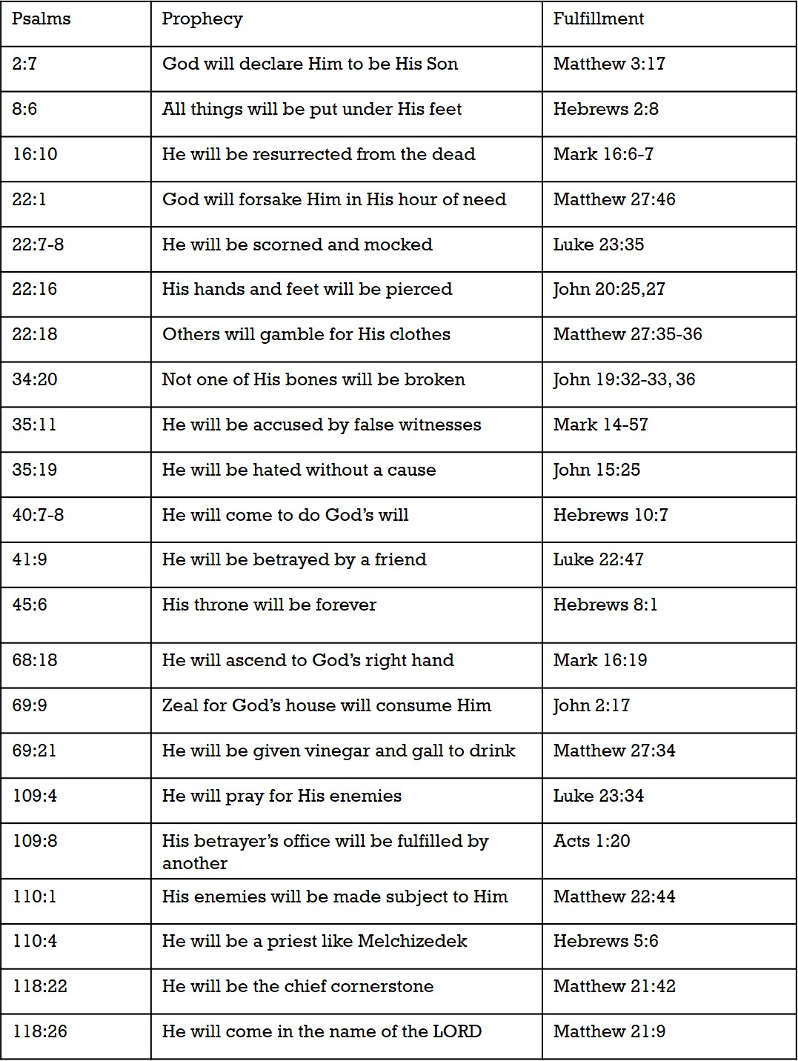
Color Chart
Jesus Christ, The King (portrayed in Matthew)
Jesus Christ, The Servant (portrayed in Mark)
Jesus Christ, the Son of God (portrayed by Luke)
Jesus Christ, the Son of God (portrayed by John)
Jesus Prophesied in Psalms
Chart from: Talk thru the Bible by Bruce Wilkinson and Kenneth Boa

Slide 17
Psalms 1-41
1. Two ways of Life | 2. Coronation of the Lord’s Anointed | 3. Victory in the Face of Defeat | 4. Evening Prayer for Deliverance | 5. Morning Prayer for Guidance | 6.Prayer for God’s Mercy
7. Wickedness Justly Rewarded | 8. God’s Glory and Man’s Dominion | 9. Praise for Victory over Enemies | 10. Petition for God’s Judgment | 11. God Tests the Sons of Men | 12. The Pure Words of the LORD
13. The Prayer for God’s Answer—Now | 14. The Characteristics of the Godless | 15. The Characteristics of the Godly | 16. Eternal Life for One Who Trusts | 17. “Hide Me Under the Shadow of Your Wings” | 18. Thanksgiving for Deliverance by God
19. The Works and Word of God | 20. Trust Not in Chariots and Horses but in God | 21. Triumph of the King | 22. Psalm of the Cross, “The LORD is my Shepherd” | 23. Psalm of the Divine Shepherd | 24. Psalm of the King of Glory
25. Prayer for Instruction | 26. “Examine Me, O Lord, and Prove Me? | 27. Trust in the Lord and Be Not Afraid | 28. Rejoice Because of Answered Prayer | 29. The Powerful Voice of God | 30. Praise for Dramatic Deliverance
31. “Be of Good Courage” | 32. The Blessedness of Forgiveness | 33. God Considers All Man’s Works | 34. Seek the Lord | 35. Petition for God’s Intervention | 36. The Loving Kindness of God
37. “Rest in the Lord” | 38. The Heavy Burden of Sin | 39. Know the Measure of Man’s Day | 40. Delight to Do God’s Will | 41. The Blessedness of Helping the Poor
The book of Psalms begins with a contrast between the godly and the ungodly.
Some of these psalms put great emphasis on trusting God rather than earthly objects or people and remind us that we need not fear because God is with us.
Another psalm reminds us that God will judge our hearts and that we should seek after God’s mercy.

Slide 18
Psalms 42-72
42. Seek After the Lord | 43. “Hope in God” | 44. Prayer for Deliverance by God | 45. The Psalm o the Great King | 46. “God is Our Refuge and Strength” | 47. The LORD Shall Subdue All Nations
48. Praise of Mount Zion | 49. Riches Cannot Redeem | 50. The Lord Shall Judge All people | 51. Confession and Forgiveness of Sin | 52. The LORD Shall Judge the Deceitful | 53. A Portrait of the Godless
54. The LORD Is Our Helper | 55. “Cast Your Burden Upon the LORD | 56. Fears in the Midst of Trials | 57. Prayers in the Midst of Perils | 58. Wicked Judges Will Be Judged | 59. Petition for Deliverance from Violent Men
60. Prayer for Deliverance of the Nation | 61. Prayer When Overwhelmed | 62. Wait for God | 63. Thirst for God | 64. Prayer for God’s Protection | 65. God’s Provision through Nature
66. Remember What God Has Done | 67. God Shall Govern the Earth | 68. God is the Father of the Fatherless | 69. Petition for God to Draw Near | 70. Prayer for the Poor and Needy | 71. Prayer for the Aged
72. The Reign of the Messiah | Psalms 42-72
These psalms could be summarized with the phrase “God is our refuge and strength” (Psalm 46:1).
One psalm reminds us to cast our burdens upon the Lord in every challenge or trial.
Another encourages us to wait patiently upon God in all things.

Slide 19
Psalms 73-89
73. Perspective of Eternity | 74. Request for God to Remember His Covenant | 75. “God Is the Judge” | 76. The Glorious Might of God | 77. When Overwhelmed, Remember God’s Greatness | 78. God’s Continued Guidance in Spite of Unbelief
79. Avenge the Defilement of Jerusalem | 80. Israel’s Plea for God’s Mercy | 81. God’s Plea for Israel’s Obedience | 82. Rebuke of Israel’s Urgent Judges | 83. Plea for God to Destroy Israel’s Enemies | 84. The Joy of Dwelling with God
85. Prayer for Revival | 86. “Teach Me Your Way, O LORD” | 87. Glorious Zion, City of God | 88. Crying from Deepest Affliction | 89. Claiming God’s Promises in Affliction
These psalms encompass several themes and frequently describe God as a judge who can rebuke wicked earthly judges and destroy Israel’s enemies.
In Psalm 86, King David records a plea that God teach us His way so we can walk in truth

Slide 20
Psalms 90-106
90. “Teach Us to Number Our Days” | 91. Abiding in “The Shadow of the Almighty” | 92. It is Good to Praise the LORD | 93. The Majesty of God | 94. Vengeance Belongs only to God | 95. Call to Worship the LORD
96. Declare the Glory of God | 97. Rejoice! The LORD Reigns! | 98. Sing a New Song to the LORD | 99. “Exalt the LORD Our God” | 100. “Serve the LORD with Gladness” | 101. Commitment of a Holy Life
102. Prayer of an Overwhelmed Saint | 103. Bless the LORD, All you People! | 104. Psalm Rehearsing Creation | 105. Remember, God Keeps His Promises | 106. “We Have Sinned”
Many of these psalms encourage us to praise the Lord, remember that vengeance belongs to Him, declare His glory, and serve Him with gladness

Slide 21
Psalms 107-150
107. God Satisfies the Longing Soul | 108. Awake Early and Praise the LORD | 109. Song of the Slandered | 110. The Coming of the Priest-King-Judge | 111. Praise for God’s Tender Care | 112. The Blessings of Those Who Fear God
113. The Condescending Grace of God | 114. In Praise for the Exodus | 115. To God Alone Be the Glory | 116. Love the LORD for What He Has Done | 117. Praise of All | 118. Better to Trust God Than Man
119. Praise of the Scriptures | 120. A Cry in Destress | 121. God is Our Keeper | 122. Pray for the Peace of Jerusalem” | 123. Plea for the Mercy of God | 124. God is on Our Side
125. Trust in the LORD and Abide Forever | 126. “Sow in Tears, Reap in Joy” | 127. Children are God’s Heritage | 128. Blessing on the House of the God-fearing | 129. Plea of the Persecuted | 130. “My Soul Waits for the Lord”
131. A Childlike Faith | 132. Trust in the God of David | 133. Beauty of the Unity of the Brethren | 134. Praise the LORD in the Evening | 135. God Has Done Great Things! | 136. God’s Mercy Endure Forever
137. Tears in Exile | 138. God Answered My Prayer | 139. “Search Me, O God” | 140. Preserve Me form Violence | 141. Set a Guard, O LORD, over My Mouth | 142. “No One Cares for My Soul”
143. “Teach Me to Do Your Will” | 144. “What Is Man?” | 145. Testify to God’s Great Acts | 146. “Do Not Put Your Trust in Prince” | 147. God Heals the Brokenhearted | 148. All Creation Praises the LORD
149. “The Lord Take Pleasure in His People” | 150. “Praise the LORD”
These psalms recognize that “children are an heritage of the Lord” (Psalm 127:3) and that they are an eternal blessing for righteous parents. One psalm near the end of the book offers a heartfelt plea that the Lord will deliver us and keep us from the evil and violent practices of wicked men.

Slide 22
Some excerpts from Psalms
Psalm 24 | Read at the dedication of the Kirtland temple by Sidney Rigdon | At nine o'clock a. m. [March 27, 1836] President Sidney Rigdon commenced the services of the day by reading the 96th and 24th Psalms... President Rigdon then read the 18th, 19th and 20th verses of the 18th chapter of Matthew, and preached more particularly from the 20th verse
Psalm 24:3-4 | Who shall ascend into the hill of the Lord?... He that hath clean hands, and a pure heart | In my mind, "clean hands" suggests a cleanliness of body; a "pure heart" suggests a purity of motive; a soul not lifted up unto vanity is one who retains humility; and one who has not sworn deceitfully is one who enters the temple honorably and fully qualified to receive the blessings of the temple. Carlos E. Asay (Family Pecan Trees: Planting a Legacy of Faith at Home [Salt Lake City: Deseret Book Co., 1992], 215)
Psalm 30:5 | weeping may endure for a night, but joy cometh in the morning | It may safely be assumed that no person has ever lived entirely free of suffering and tribulation, nor has there ever been a period in human history that did not have its full share of turmoil, ruin, and misery. To all who so despair, may I offer the assurance found in the psalm "Weeping may endure for a night, but joy cometh in the morning.” Thomas S. Monson "Look to God and Live," Ensign, May 1998, 52
Psalm 35 | Read at the First Continental Congress | Reverend Duché opened the second session on September 7th, 1774 with prayer. It was not a perfunctory prayer, but one that was a time of profound prayer. Opening the session he read the 35th Psalm, and then broke into extemporaneous prayer.
Psalm 40 | I waited patiently for the Lord; and he inclined unto me, and heard my cry. | The Messiah will come and preach righteousness—He will declare salvation—The righteous will say, The Lord be magnified. Heading of Psalm 40
Psalm 51 | thy tender mercies | I have reflected repeatedly upon the phrase "the tender mercies of the Lord." Through personal study, observation, pondering, and prayer, I believe I have come to better understand that the Lord's tender mercies are the very personal and individualized blessings, strength, protection, assurances, guidance, loving-kindnesses, consolation, support, and spiritual gifts which we receive from and because of and through the Lord Jesus Christ. Truly, the Lord suits "his mercies according to the conditions of the children of men“ Elder David A. Bednar "The Tender Mercies of the Lord," Ensign, May 2005, 99

Slide 23
Psalm 51:5 I was shapen in iniquity; and in sin did my mother conceive me
Joseph Fielding Smith
Question: "In a discussion with a gentleman of another faith, he made the statement that a child is born in sin. That the conceiving of a child even in lawful wedlock is a sin. Of course I have been taught differently and voiced our teachings on the original sin of Adam and Eve, and then made the statement, 'To my knowledge, there is not any scripture in the Bible that states that a child which is born in lawful wedlock is born in sin, thus making the child guilty of sin.' This person showed me a statement in Psalm 51:5, which reads: 'Behold, I was shapen in iniquity; and in sin did my mother conceive me.'
"I have studied the scriptures, have read the numerous other literature which strengthened my testimony in relation to original sin, but I cannot explain the statement of David in this passage, when he was the youngest of several children. Several of the non-members are waiting for me to prove I am right. I have satisfied them as to our belief on original sin. They also refer to the fact that it was a Jewish belief that the woman had to go through a purification period and ceremony after childbirth, and if it is not a sin why was it necessary for this purification?"
Answer: No matter what David said, he was not born in sin. The opening verses of this psalm give us the key to the nature of David's remark.
A Broken Heart and A Contrite Spirit:
“In ancient times when people wanted to worship the Lord and seek His blessings, they often brought a gift. For example, when they went to the temple, they brought a sacrifice to place on the altar. After His Atonement and Resurrection, the Savior said He would no longer accept burnt offerings of animals. The gift or sacrifice He will accept now is ‘a broken heart and a contrite spirit’ [3 Nephi 9:20]. As you seek the blessing of conversion, you can offer the Lord the gift of your broken, or repentant, heart and your contrite, or obedient, spirit. In reality, it is the gift of yourself—what you are and what you are becoming” Elder D. Todd Christofferson (“When Thou Art Converted,” Ensign or Liahona, May 2004, 12).
A Broken Heart and A Contrite Spirit:
“Godly sorrow is a gift of the Spirit. It is a deep realization that our actions have offended our Father and our God. It is the sharp and keen awareness that our behavior caused the Savior, He who knew no sin, even the greatest of all, to endure agony and suffering. Our sins caused Him to bleed at every pore. This very real mental and spiritual anguish is what the scriptures refer to as having ‘a broken heart and a contrite spirit.’ Such a spirit is the absolute prerequisite for true repentance” President Ezra Taft Benson (“A Mighty Change of Heart,” Ensign, Oct. 1989, 4).
Psalm 51:11 take not thy holy spirit from me
Rulon G. Wells
It is a terrible thing to get the gift of the Holy Ghost and then lose it. We can only do that through transgression. If we have only kept ourselves clean, we have it still... It is a terrible thing to lose it, and that is what some people have done. I call attention to one historical instance of it. There was David... O how full and overflowing was he with that faith and confidence in God, in whom he believed to the bottom of his soul. But David sinned against God, and in the agony of his soul and in his repentant mood, he cried out to the Lord, "Create in me a clean heart, O God, and renew a right spirit within me. Cast me not away from thy presence; and take not thy holy Spirit from me." O, Latter-day Saints, it is a terrible thing to have it taken away. David obtained a promise before he died that the Lord would not leave his soul in hell, and I like to think that he will yet receive compensation for all that he has done in upbuilding the faith of mankind in those unstinted words of his wherein he expresses his devotion and faith in God. (Conference Report, April 1926, Afternoon Session 78 - 79)

Slide 24
So then we had this slightly unusual piece of music and we said, 'OK, what are we going to do with it?' Bono said, 'Let's do a psalm.' Opened up the bible and found Psalm 40. 'This is it. Let's do it.' And within forty minutes we had worked out the last few elements for the tune, Bono had sung it, and we mixed it. And literally, after finishing the mix, we walked out through the door and the next band walked in." - The Edge, U2 By U2 2006
Something of Interest
U 2 “40”
Psalm 40:1-4
I waited patiently for the Lord He inclined and heard my cry He brought me up out of the pit Out of the miry clay I will sing, sing a new song I will sing, sing a new song How long to sing this song How long to sing this song How long, how long, how long How long to sing this song He set my feet upon a rock And made my footsteps firm Many will see Many will see and hear I will sing, sing a new song I will sing, sing a new song I will sing, sing a new song I will sing, sing a new song How long to sing this song How long to sing this song How long, how long, how long How long to sing this song
The portion of Psalm 40 that inspired Bono's lyrics: I waited patiently for the Lord And He inclined to me and heard my cry He brought me up out of the pit of destruction Out of the miry clay And He set my feet upon a rock, making my footsteps firm He put a new song in my mouth A song of praise to our God Many will see and fear and will trust in the Lord
https://www.youtube.com/watch?v=1XzHlySYR_Y

Slide 25
Psalm 119 is “an acrostic poem with eight verses for each of the twenty-two letters of the Hebrew alphabet. … One Hebrew letter and its name appears above each eight-verse segment” (Ellis T. Rasmussen, A Latter-day Saint Commentary on the Old Testament[1993], 455).
Each eight-verse segment of the psalm begins with its corresponding letter of the Hebrew alphabet.
In “The Family: A Proclamation to the World” we learn:
“The family is central to the Creator’s plan for the eternal destiny of His children. …
“Husband and wife have a solemn responsibility to love and care for each other and for their children. ‘Children are an heritage of the Lord’ (Psalm 127:3). Parents have a sacred duty to rear their children in love and righteousness, to provide for their physical and spiritual needs, and to teach them to love and serve one another, observe the commandments of God, and be law-abiding citizens wherever they live” (“The Family: A Proclamation to the World,” Ensign, Nov. 2010, 129).
“The rising generation need to understand that the command to ‘multiply, and replenish the earth’ [Genesis 1:28; Moses 2:28] remains in force. Bearing children is a faith-based work. … Motherhood and fatherhood are eternal roles. Each carries the responsibility for either the male or the female half of the plan. Youth is the time to prepare for those eternal roles and responsibilities” (“Teaching the Doctrine of the Family,” Ensign, March 2011, 15). Sister Julie S. Beck

Slide 26
Some excerpts from Psalms
Psalm 82:6 | I have said, Ye are gods; and all of you are children of the most High | "THE DOCTRINE OF A PREMORTAL LIFE, once common to the faith of Jews and Christians alike, is now the exclusive province of Latter-day Saints. Joseph Fielding McConkie Answers: Straightforward Answers to Tough Gospel Questions [Salt Lake City: Deseret Book Co., 1998], 80) "The revelations of the Restoration plainly teach that we are God's children and thus were created in his image and likeness. We approach such declarations with a sense of sacred reverence, for they are chief among those plain and precious truths that were taken from the scriptures by evil and designing men. Joseph Fielding McConkie, Joseph Smith: The Choice Seer [Salt Lake City: Bookcraft, 1996], chap. 11)
Psalms 113-118 | Read or Sung at the Passover Meal | Use the special Passover Hallel. All 6 Psalms of the Hallel are recited in their entirety, but in 2 parts. Conduct the Passover Seder. This is a ritual feast conducted on the first night of Passover. The Hallel recited during the Seder is unique in that it is recited during the day on all other occasions. Raise and hold the second cup at Magid, the fifth part of the Seder. The first part of the Hallel is introduced with 10 expressions of praise. These expressions represent the 10 plagues of Egypt. Recite Psalms 113 and 114 just before the drinking of the second cup of wine while sitting down. This is the only time the Hallel is recited in 2 parts. Women are obligated to recite the Hallel at this time unlike other occasions. The leader of the Seder recites the first part of each Psalm and the other attendants recite the last part of each Psalm in response. Recite Psalms 115 through 118 during the 13th part of the Seder, also while sitting down. This part of the Seder is actually called the Hallel and is done just before drinking the fourth cup of wine (http://www.ehow.com/how_2145844_recite-hallel-passover.html(link is external))
Psalm 115-118 | During the Last Supper | Their recitation must have been especially poignant to the Master. He probably was the only one at the table who knew how literally, and how immediately, they would be fulfilled.
Psalm 127:3-5 | Children are an heritage of the Lord | May the Lord bless you, my beloved sisters. You are the guardians of the hearth. You are the bearers of the children. You are they who nurture them and establish within them the habits of their lives. No other work reaches so close to divinity as does the nurturing of the sons and daughters of God. May you be strengthened for the challenges of the day. May you be endowed with wisdom beyond your own in dealing with the problems you constantly face. May your prayers and your pleadings be answered with blessings upon your heads and upon the heads of your loved ones. We leave with you our love and our blessing, that your lives may be filled with peace and gladness. President Gordon B. Hinckley ("Stand Strong against the Wiles of the World," Ensign, Nov. 1995, 101)

Slide 27
Psalm 119
ה He
O Lord, teach us Thy statutes, Thy law, and Thy commandments.
ד Daleth
O Lord, grant us Thy law, and make us to understand Thy precepts.
ג Gimel
O Lord, open our eyes, that we may behold wondrous things out of Thy law
ב Beth
Ponder the precepts and ways of the Lord.
א Aleph
Blessed are they who keep the commandments.
י Jod
O Lord, let Thy tender mercies come upon us.
ט Teth
O Lord, teach us Thy statutes.
ח Cheth
Make faithful people our companions.
ז Zain
The Lord’s statutes and judgments comfort us during our pilgrimage.
ו Vau
O Lord, give us mercy, truth, and salvation.
ס Samech
Depart from evildoers and keep the commandments of God.
נ Nun
The Lord’s word is a lamp unto our feet.
מ Mem
The Lord’s law and His testimonies should be our meditation all the day.
ל Lamed
O Lord, save us, for we have sought Thy precepts.
כ Caph
All the Lord’s commandments are faithful.
ק Koph
O Lord, hear the voice of Thy servants according to Thy loving kindness.
צ Tzaddi
The Lord’s law is the truth.
פ Pe
The Lord’s testimonies are wonderful.
ע Ain
O Lord, we are Thy servants; give us understanding.
ר Resh
Great are Thy tender mercies, O Lord.
ת Tau
All the Lord’s commandments are righteousness.
ש Schin
Those who love the Lord’s law have peace.

Slide 28
Behold, my soul delighteth in the things of the Lord; and my heart pondereth continually upon the things which I have seen and heard.
Nevertheless, notwithstanding the great goodness of the Lord, in showing me his great and marvelous works, my heart exclaimeth: O wretched man that I am! Yea, my heart sorroweth because of my flesh; my soul grieveth because of mine iniquities.
I am encompassed about, because of the temptations and the sins which do so easily beset me.
And when I desire to rejoice, my heart groaneth because of my sins; nevertheless, I know in whom I have trusted.
My God hath been my support; he hath led me through mine afflictions in the wilderness; and he hath preserved me upon the waters of the great deep.
He hath filled me with his love, even unto the consuming of my flesh.
He hath confounded mine enemies, unto the causing of them to quake before me.
Behold, he hath heard my cry by day, and he hath given me knowledge by visions in the night-time.
And by day have I waxed bold in mighty prayer before him; yea, my voice have I sent up on high; and angels came down and ministered unto me.
And upon the wings of his Spirit hath my body been carried away upon exceedingly high mountains. And mine eyes have beheld great things, yea, even too great for man; therefore I was bidden that I should not write them.
O then, if I have seen so great things, if the Lord in his condescension unto the children of men hath visited men in so much mercy, why should my heart weep and my soul linger in the valley of sorrow, and my flesh waste away, and my strength slacken, because of mine afflictions?
And why should I yield to sin, because of my flesh? Yea, why should I give way to temptations, that the evil one have place in my heart to destroy my peace and afflict my soul? Why am I angry because of mine enemy?
Awake, my soul! No longer droop in sin. Rejoice, O my heart, and give place no more for the enemy of my soul.
Do not anger again because of mine enemies. Do not slacken my strength because of mine afflictions.
Rejoice, O my heart, and cry unto the Lord, and say: O Lord, I will praise thee forever; yea, my soul will rejoice in thee, my God, and the rock of my salvation.
O Lord, wilt thou redeem my soul? Wilt thou deliver me out of the hands of mine enemies? Wilt thou make me that I may shake at the appearance of sin?
May the gates of hell be shut continually before me, because that my heart is broken and my spirit is contrite! O Lord, wilt thou not shut the gates of thy righteousness before me, that I may walk in the path of the low valley, that I may be strict in the plain road!
O Lord, wilt thou encircle me around in the robe of thy righteousness! O Lord, wilt thou make a way for mine escape before mine enemies! Wilt thou make my path straight before me! Wilt thou not place a stumbling block in my way—but that thou wouldst clear my way before me, and hedge not up my way, but the ways of mine enemy.
O Lord, I have trusted in thee, and I will trust in thee forever. I will not put my trust in the arm of flesh; for I know that cursed is he that putteth his trust in the arm of flesh. Yea, cursed is he that putteth his trust in man or maketh flesh his arm.
Yea, I know that God will give liberally to him that asketh. Yea, my God will give me, if I ask not amiss; therefore I will lift up my voice unto thee; yea, I will cry unto thee, my God, the rock of my righteousness. Behold, my voice shall forever ascend up unto thee, my rock and mine everlasting God. Amen.
Nephi’s Psalm
2 Nephi 4:16-35
There is no question about the course Nephi charted. He chose, through his faith, to lift himself toward the things of righteousness. “Awake, my soul!” he exclaimed. “No longer droop in sin. Rejoice, O my heart, and give place no more for the enemy of my soul” (2 Nephi 4:28).
“My Soul Delighteth in the Things of the Lord”
Stephen Jones April 29, 2004

