Slide 2
How have children brought happiness and joy to you or someone you know?
God has commanded His children to multiply and replenish the earth.
And God blessed them, and God said unto them, Be fruitful, and multiply, and replenish the earth, and subdue it: and have dominion over the fish of the sea, and over the fowl of the air, and over every living thing that moveth upon the earth.
Genesis 1:28

Slide 3
Multiply and replenish = fill
What can we learn from the fact that this was the first commandment God gave to Adam and Eve?
“The first commandment that God gave to Adam and Eve pertained to their potential for parenthood as husband and wife. We declare that God’s commandment for His children to multiply and replenish the earth remains in force.” (1)

Slide 4
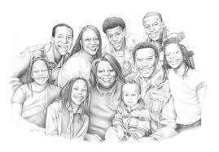
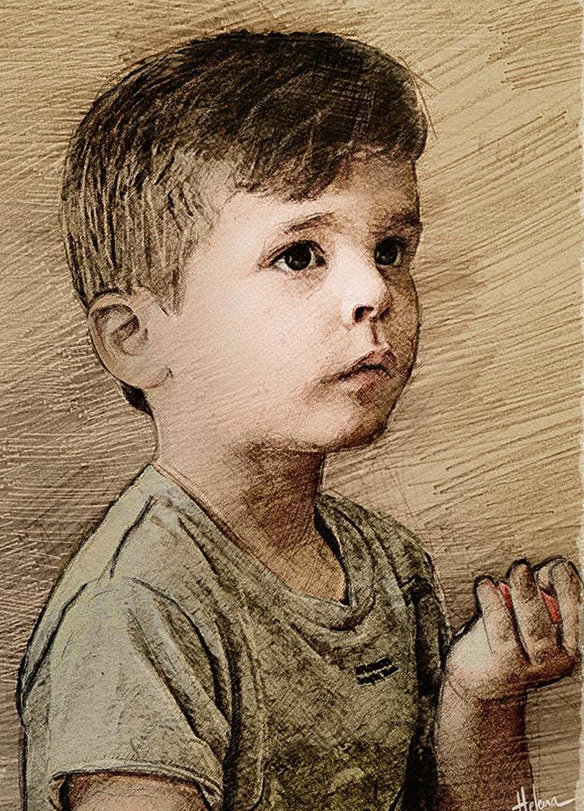
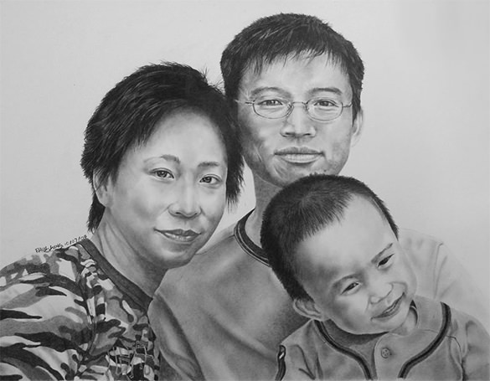
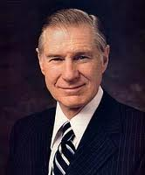
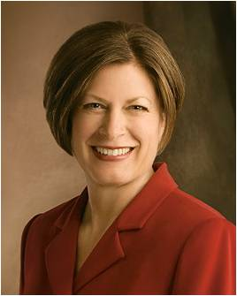
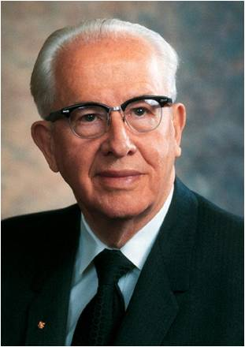
Multiply and replenish = fill
President Ezra Taft Benson taught that young couples should not postpone having children and that ‘in the eternal perspective, children﻿—not possessions, not position, not prestige﻿—are our greatest jewels’ (3)
“Whereas in many cultures in the world children are ‘becoming less valued’ (2), in the culture of the gospel we still believe in having children. …

Slide 5
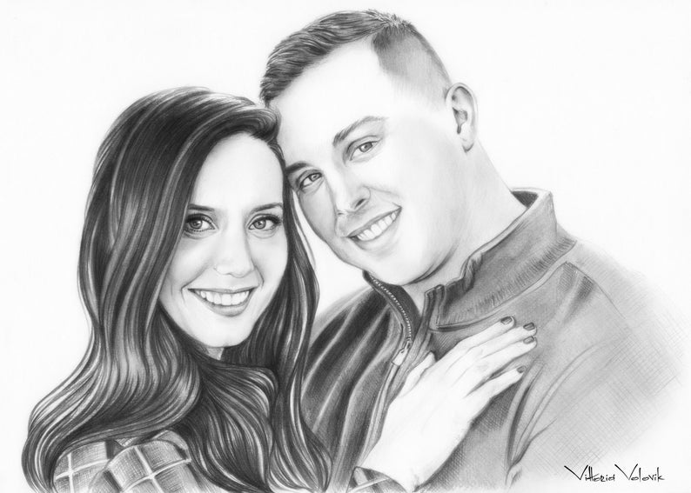
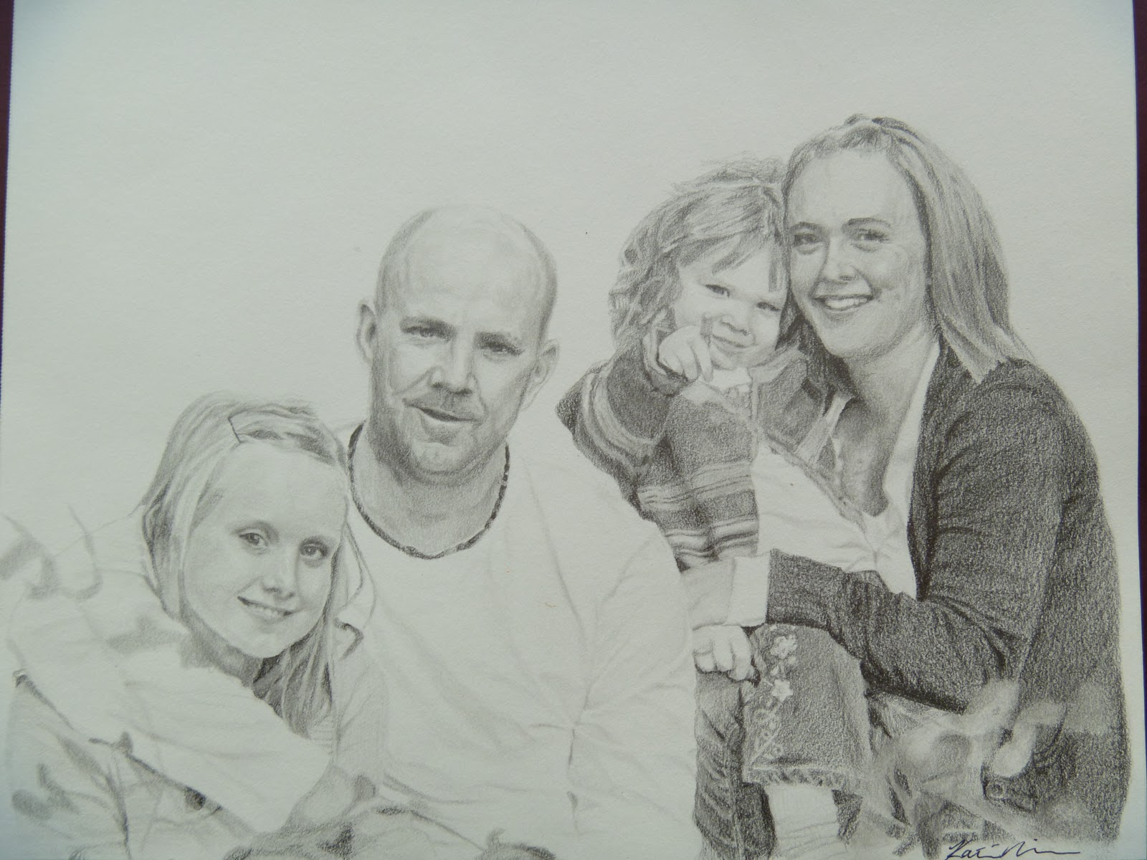
“God ordained that men and women should marry and give birth to children, thereby creating, in partnership with God, the physical bodies that are key to the test of mortality and essential to eternal glory with Him. …
“A family built on the marriage of a man and woman supplies the best setting for God’s plan to thrive﻿—the setting for the birth of children, who come in purity and innocence from God, and the environment for the learning and preparation they will need for a successful mortal life and eternal life in the world to come”. (4)
Katie Neilsen

Slide 6
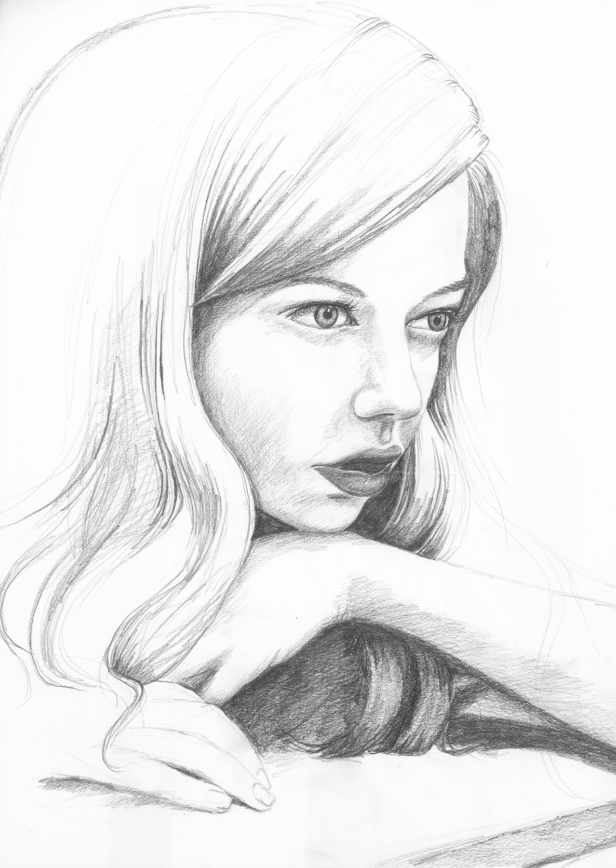
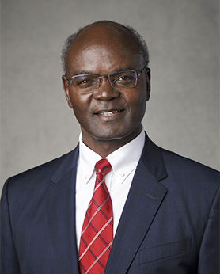
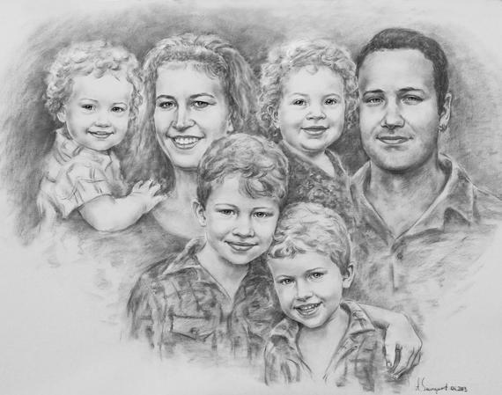
“Our physical bodies are a blessing from God.
We received them for the purposes of fulfilling Heavenly Father’s work ‘to bring to pass the immortality and eternal life of man’.
The body is the means by which we can attain our divine potential.
Melissa Peterson
“Marriage between a man and a woman is the institution that God ordained for the fulfillment of the charge to multiply.” (5)
“The body enables Heavenly Father’s obedient spirit children to experience life on earth.
Bearing children gives other spirit children of God the opportunity to also enjoy life on earth.
All who are born in mortality have the opportunity to progress and to be exalted if they obey God’s commandments.
Moses 1:39;Moses 5:10-11
Alexander Steingart

Slide 7
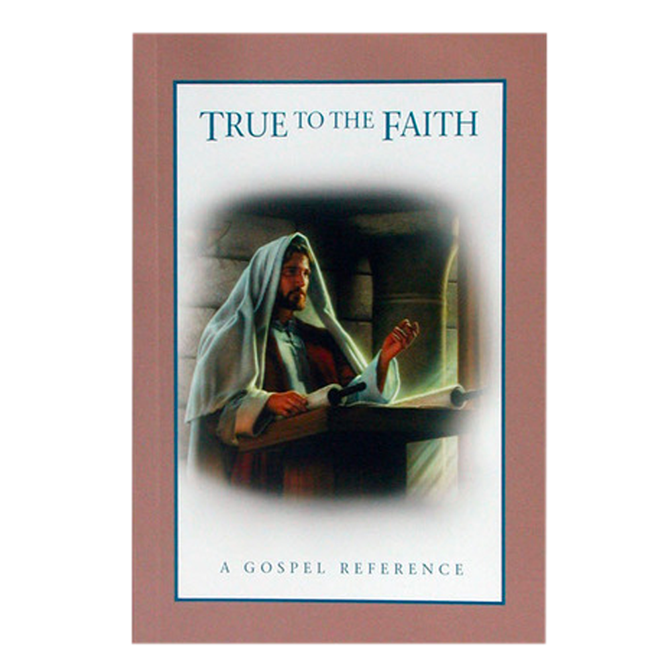
“Latter-day prophets have denounced abortion, referring to the Lord’s declaration, ‘Thou shalt not … kill, nor do anything like unto it’.
Their counsel on the matter is clear: Members of The Church of Jesus Christ of Latter-day Saints must not submit to, perform, encourage, pay for, or arrange for an abortion.
If you encourage an abortion in any way, you may be subject to Church discipline.
“Church leaders have said that some exceptional circumstances may justify an abortion, such as when pregnancy is the result of incest or rape, when the life or health of the mother is judged by competent medical authority to be in serious jeopardy, or when the fetus is known by competent medical authority to have severe defects that will not allow the baby to survive beyond birth. But even these circumstances do not automatically justify an abortion.
Those who face such circumstances should consider abortion only after consulting with their local Church leaders and receiving a confirmation through earnest prayer” (6)
D&C 59:6

Slide 8
Sources:
Suggested Hymn: #294 Love At Home
Video: The Plan of Salvation (9:40)
The Family: A Proclamation to the World,” Ensign or Liahona, May 2017, 145
James E. Faust, “Challenges Facing the Family,” Worldwide Leadership Training Meeting, Jan. 10, 2004, 2
To the Mothers in Zion(pamphlet, 1987), 3, 4]” (Julie B. Beck, “Mothers Who Know,” Ensign or Liahona, Nov. 2007, 76).
D. Todd Christofferson, “Why Marriage, Why Family,” Ensign or Liahona, May 2015, 51, 52)
Joseph W. Sitati, “Be Fruitful, Multiply, and Subdue the Earth,” Ensign or Liahona, May 2015, 127).
True to the Faith: A Gospel Reference [2004], 4).
Articles About Abortion:
Russell M. Nelson, “Reverence for Life,” Ensign, May 1985, 11–14.
Boyd K. Packer, “Covenants,” Ensign, Nov. 1990, 84–86.
“Church Issues Statement on Abortion,” Ensign, Mar. 1991, 78.
Handbook 2: Administering the Church (2010), 21.4.1.
Presentation by ©http://fashionsbylynda.com/blog/

