Slide 2
Isaiah 5:20 Review
Evil
Good
Darkness
Light
Bitter
How can knowing that many will try to get you to believe that evil is good and good is evil help you in your life?
Sweet

Slide 3
Potential Conditions
Why might a person carry a coat even though the weather is not cold or wet?
Carrying a coat is a solution to the potential condition

Slide 4
Preparation
What are some other examples of solutions that can be prepared before a particular condition occurs?

Slide 5
Advance Preparation
The Savior would be required to carry out Heavenly Father’s plan of happiness
Lucifer, one of Heavenly Father’s spirit children, rebelled against Heavenly Father’s plan. He is commonly known as Satan

Slide 6
Satan’s Demand
Redemption for all
Not One Soul Lost
Moses 4:1

Slide 7
One Plan
“Although we sometimes hear it said that there were two plans—Christ’s plan of freedom and agency, and Lucifer's of slavery and compulsion—such teaching does not conform to the revealed word.
Christ did not present a plan of redemption and salvation nor did Lucifer.
There were not two plans up for consideration; there was only one; and that was the plan of the Father: originated, developed, presented, and put in force by him. Christ, however, made the Father’s plan his own by his willing obedience to its terms and provisions.”
Elder Bruce R. McConkie
Plan 1
Heavenly Father’s Plan
Plan 2
Lucifer’s Plan

Slide 8
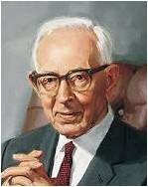
“Just what authority Lucifer held before his rebellion we do not know, but he was an angel of light, his name Lucifer, meaning torchbearer.
Agency was given unto the spirits of men, and they had their talents and individual traits of character there as they do here.
It was due to this fact that Lucifer, who was proud and ambitious, rebelled against the Father when his pan for salvation of fallen man was rejected.”
Joseph Fielding Smith
Moses 4:1

Slide 9
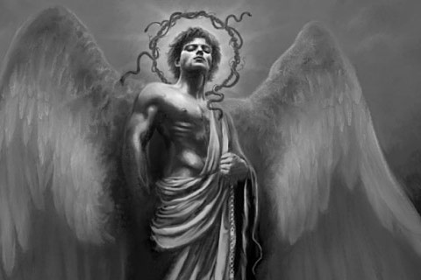
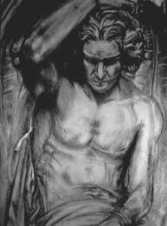
Lucifer’s Name
Appears only once in the Bible
How art thou fallen from heaven, O Lucifer, son of the morning! how art thou cut down to the ground, which didst weaken the nations!
For thou hast said in thine heart, I will ascend into heaven, I will exalt my throne above the stars of God: I will sit also upon the mount of the congregation, in the sides of the north:
I will ascend above the heights of the clouds; I will be like the most High.
Isaiah 14:12-14

Slide 10
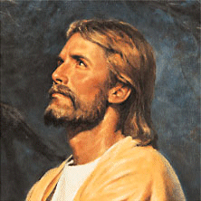
“My Beloved Son”
Who verily was foreordained before the foundation of the world, but was manifest in these last times for you.
1 Peter:1:20
Behold, I am he who was prepared from the foundation of the world to redeem my people. Behold, I am Jesus Christ.
Ether 3:14
And the Lord said: Whom shall I send? And one answered like unto the Son of Man: Here am I, send me. And another answered and said: Here am I, send me. And the Lord said: I will send the first.
Abraham 3:27
Jesus Christ was chosen in the premortal existence to be the Redeemer of mankind
Moses 4:2

Slide 11
Rebellion and a War of Words
“There was war in Heaven. That war was a war of words; it was a conflict of ideologies; it was a rebellion against God and his laws.
Lucifer sought to dethrone God, to sit himself on the divine throne, and to save all men without reference to their works.
He sought to deny men their agency so they could not sin.
He offered a mortal life of…evil…
following which all men would be
saved.”
Elder Bruce R. McConkie
My Way or the Highway
Satan seeks to deceive and blind us so he can lead us captive at his will.
Moses 4:3-4

Slide 12
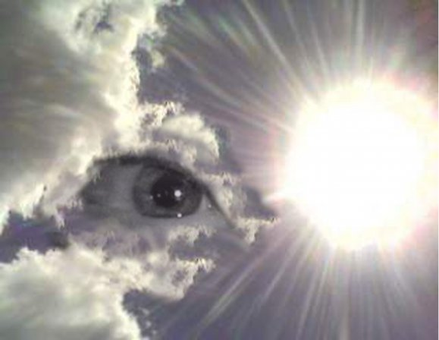
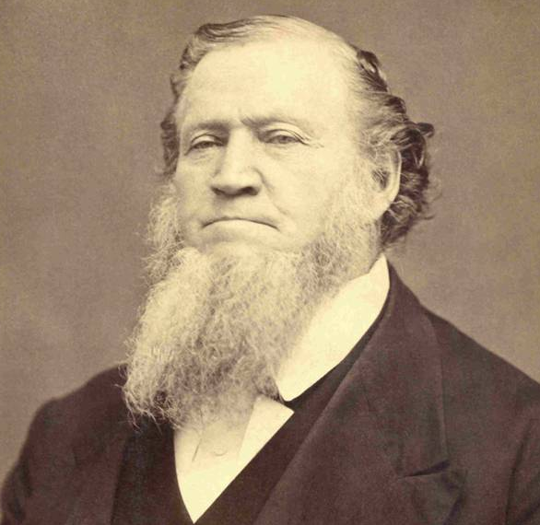
Fallen Spirits
“Every person who desires and strives to be a Saint is closely watched by fallen spirits that came here when Lucifer fell, and by the spirits of wicked persons who have been here in tabernacles and departed from them, but who are still under the control of the prince of the power of the air.
Those spirits are never idle: they are watching every person who wishes to do right and are continually prompting them to do wrong.”
Brigham Young
Those who followed Satan are called “Sons of Perdition”
Moses 4:3-4

Slide 13
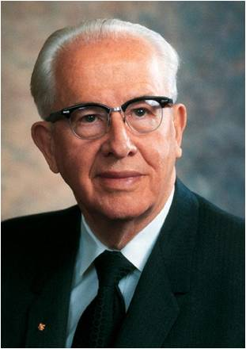
Satan’s Influence
“The war that began in heaven is not yet over. The conflict continues on the battlefield of mortality. And one of Lucifer’s primary strategies has been to restrict our agency through the power of earthly governments. Proof of this is found in the long history of humanity.”
Ezra Taft Benson
Moses 4:3-4

Slide 14
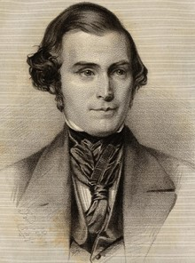
Through The Mouth of The Serpent
Satan is symbolic as a serpent and taught that Satan “sought to destroy the world” by tempting Adam and Eve in the Garden of Eden
Jeremiah Dirt
…even that old serpent that did beguile our first parents, which was the cause of their fall; Mosiah 16:3
“The devil can adapt himself to the belief of any person…If he could get you to swallow down one or two great lies that would effect your destruction, and which you would preach and destroy many others, he would not mind how many truths you might believe…he could only deceive you and lead you astray.” Orson Pratt
Chameleon’s have the ability to change skin color with their environment to deceive their predators—they have the ability to adapt themselves to their situations
Moses 4:5-6

Slide 15
Adam
He helped in creating the earth
He was created in the image of God
His name means “man” or “many” (Moses 1:34)
He experienced ‘The Fall’ enabling his posterity to come to know the gospel of Jesus Christ
He was the first man on earth. The “first father” meaning the head of descending lineage of priesthood authority upon the earth (Abraham 1:3)
He held the keys of salvation under the counsel and direction of the Holy One (D&C 78:16)
He is also called “Michael—the father of all—in his premortal or post-mortal state and has the title of “Archangel” (D&C 107:54)
Michael in Hebrew means “one who is like God”
He will have his final defeat of Satan and his hosts at the end of the millennial period (D&C 88:112-115)
He rendered his final blessing to his posterity three years before his death at Adam-ondi-Ahman
He died at age 930
Who’s Who

Slide 16
Eve
Eve—meaning the mother of all living
She was the completion of the earth
She was the first woman of humankind and the divine “help meet” given to Adam (Genesis 2:18)
She was created in the image of God
She was joined together with Adam in marriage for time and for all eternity by the power of that everlasting priesthood (Genesis 2:24)
She used her God-given agency, in wisdom, in the best interests of her children for generations
She was partnered to Adam and taught their children to follow God
She and her partner worshipped the Lord in prayer
She and Adam heeded divine commandments of obedience and sacrifice
She is honored among the Latter-day Saints
Who’s Who and Elder Russell M. Nelson

Slide 17
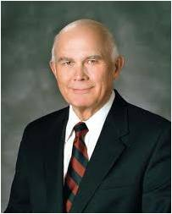
The First Commandment
“To the first man and woman on earth, the Lord said, ‘Be fruitful, and multiply’.
This commandment was first in sequence and first in importance.
It was essential that God’s spirit children have mortal birth and an opportunity to progress toward eternal life.”
Dallin H. Oaks
Moses 2:28; Gen. 1:28; Abr. 4:28

Slide 18
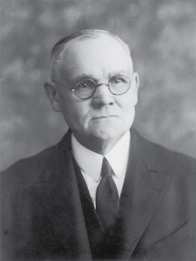
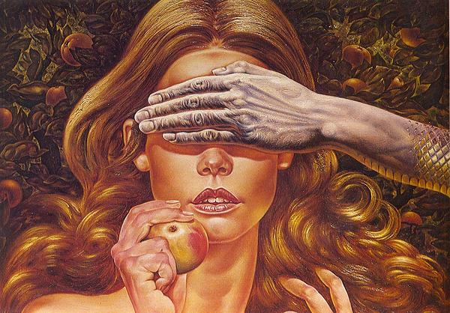
Beguiled
A deceptive way of charming or enchantment, winning over, seducing, spellbinding
“Eve was fulfilling the foreseen purposes of God by the part she took in the great drama of the fall…(Satan) knew not the mind of God…his effort contributed to the plan of man’s eternal progression.”
James E. Talmage
Rebecca Guay
But I fear, lest by any means, as the serpent beguiled Eve through his subtilty, so your minds should be corrupted from the simplicity that is in Christ.
2 Corinthians 11:3
Moses 4:6

Slide 19
The Fruit--Symbolically
The world has depicted the fruit eaten as an apple, however we do not know what kind of fruit it was.
The Lord has not revealed the nature of the fruit of the tree of knowledge of good and evil, nor has He elaborated on the specific processes that caused Adam and Eve to become mortal.
Blessed art thou among women, and blessed is the fruit of thy womb. Luke 1:24
Therefore shall they eat of the fruit of their own way, and be filled with their own devices.
Proverbs 1:31
And he that reapeth receiveth wages, and gathereth fruit unto life eternal: that both he that soweth and he that reapeth may rejoice together.
John 4:36
Moses 4:9; Genesis 3:3

Slide 20
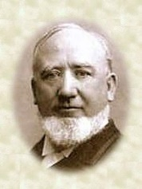
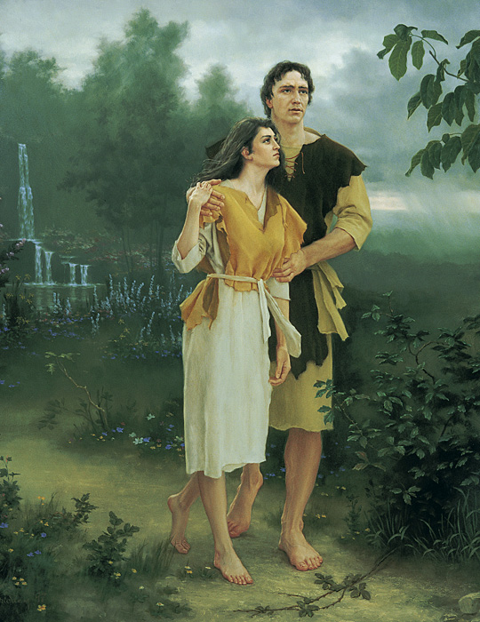
Truth Be Told
“The devil in tempting Eve told a truth when he said…that she should eat of the tree of knowledge of good and evil [that they] would become as Gods…
But it was accompanied with a lie.
He never tells the complete truth. The devil had to lie in order to accomplish his purposes.”
George Q. Cannon
“The Father had said that they should die (if they partook of the fruit.)”
George Q. Cannon
Because Adam and Eve transgressed this command and partook of the fruit of the tree of the knowledge of good and evil, they were cast out from the presence of the Lord.
lds topics—Fall of Adam
Moses 4:10

Slide 21
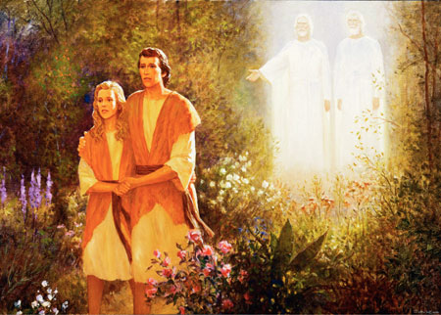
To Die
Spiritual Death—Away from the presence of Heavenly Father
They also became mortal—subject to physical death.
This spiritual and physical death is called the Fall.
The Lord stated, “Thou mayest choose for thyself”, indicating that the Fall had to occur as a result of human choice.
Moses 3:17, 4:12; Genesis 3:6

Slide 22
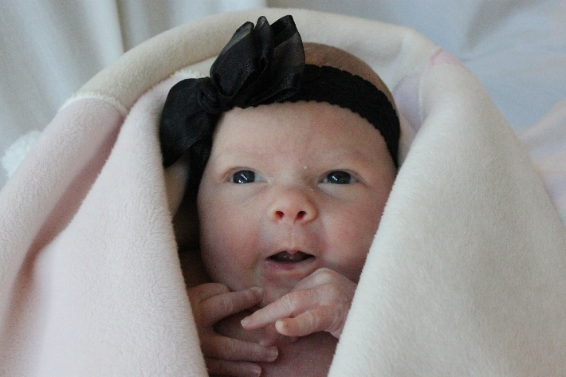
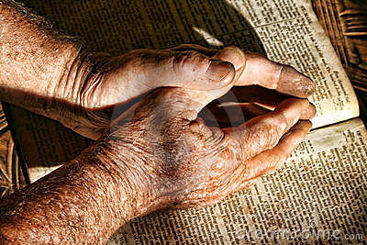
The Fall
“Adam had the privilege of making a choice, with the penalty of death awaiting him if he ate the fruit of the tree. We may assume that Adam would not have eaten if Eve had not partaken. When she did, Adam realized that he had to partake or he and Eve would have been separated forever.”
Joseph Fielding Smith
Because of the Fall, all mankind will experience physical death
If Adam and Eve had not partaken of the fruit, they would not have had the opportunity to have children in mortality. Therefore, we would not have been able to come to earth to receive physical bodies, be tested, and prepare for eternal life—frustrating the plan of salvation.
Adam Spizak
Because our bodies are mortal—or subject to physical death—we experience additional consequences of the Fall before we die, such as physical imperfections and pain.
Moses 4:29

Slide 23
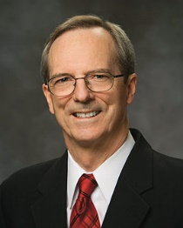
Before And After The Fall
Conditions before the Fall
Conditions after the Fall
Dwelt in the presence of Heavenly Father
Immortal
Not subject to pain, disease, or death
In a state of innocence—meaning they to experience a fullness of joy--children
Cast out and removal from the presence of Heavenly Father, both temporality and spiritually
Mortality
Physical imperfections and pain
Injuries
Heartaches
Illness
Diseases
Able to bear children and take part in the plan of salvation
Moses 4:13-25 excerpts from Tad R. Callister

Slide 24
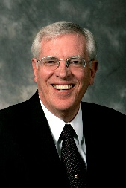
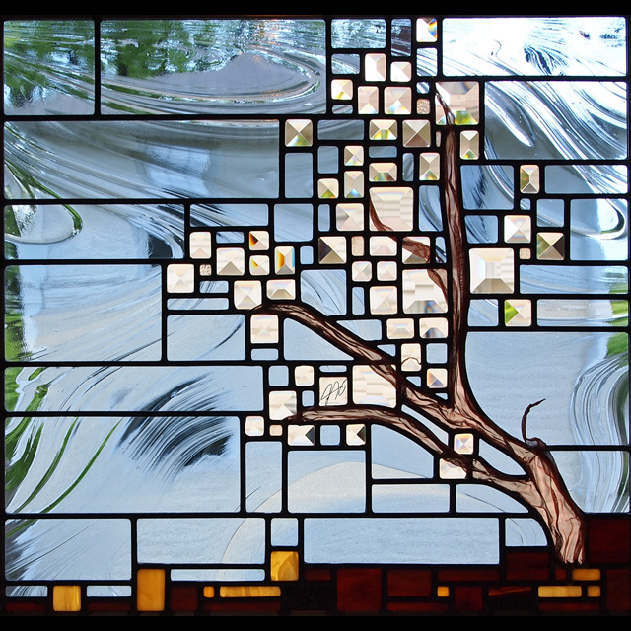
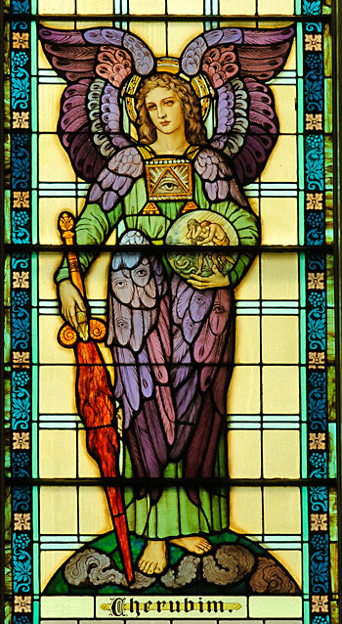
The Tree of Life
For behold, if Adam had put forth his hand immediately, and partaken of the tree of life, he would have lived forever, according to the word of God, having no space for repentance; yea, and also the word of God would have been void, and the great plan of salvation would have been frustrated.
Alma 42:5
if “[Adam and Eve] would have lived forever, … having no space for repentance; … the great plan of salvation would have been frustrated.
Cherubum—creatures of the heavenly world who are not a part of the earthly realm. Their holiness represents them in aspects of the sanctuary (Eden)
Flaming Sword—symbol of God’s justice, power, and punishment
Richard D. Draper
Moses 4:28

Slide 25
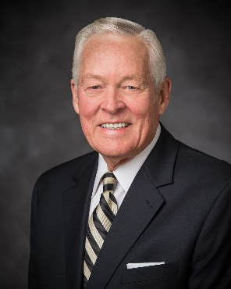
Spiritual Death
“Currently, we are all in the state of spiritual death. We are separated from God. He dwells in heaven; we live on earth. We would like to return to Him.”
Elder Earl C. Tingey
Because of the Fall, all mankind will experience spiritual death
What is the solution Heavenly Father prepared in advance to help us overcome physical and spiritual death?
Moses 4:29-31

Slide 26
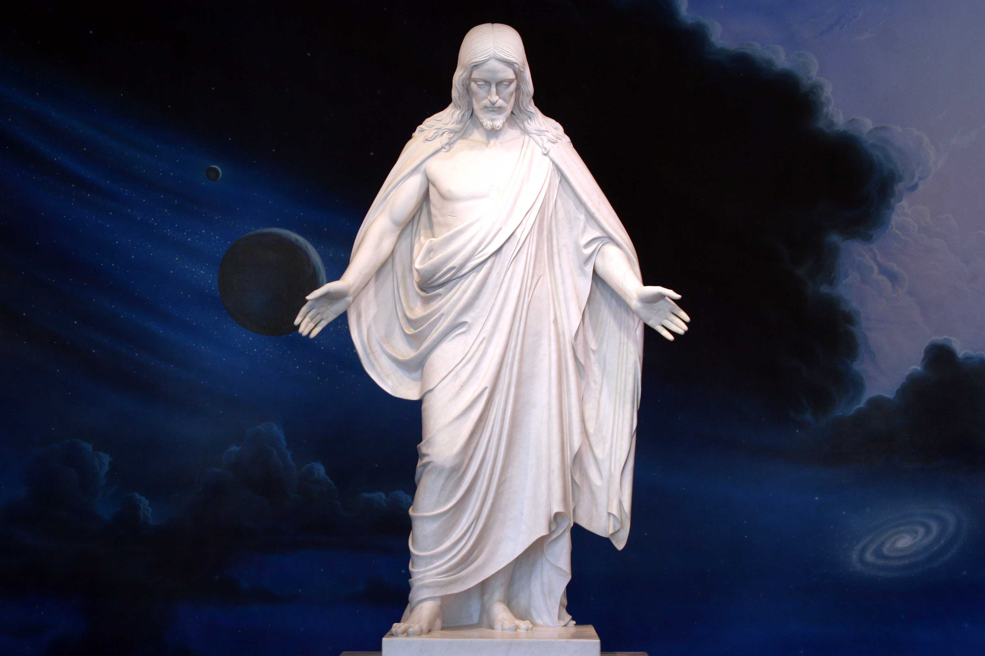
Part of the Plan
Jesus Christ was chosen in the premortal existence to be the Redeemer of mankind
Moses 4:29-31

Slide 27
Presentation by ©http://fashionsbylynda.com/blog/
Sources:
Suggested Song: #110 Follow the Prophet…1st and last verse. Children’s Songbook
Joseph Fielding Smith Church History and Modern Revelation 2:51-52
Improvement Era, April 1962 p. 230 (The Fall of Adam and Eve)
Elder Bruce R. McConkie Improvement Era May 1953 Millennial Messiah p. 666-67
Dallin H. Oaks “The Great Plan of Happiness,” Ensign, Nov. 1993, 72).
Brigham Young Journal of Discourses 7:239
Ezra Taft Benson The Constitution, a Heavenly Banner pp. 2-3
James E. Talmage Articles of Faith pp. 69-70
Orson Pratt Journal of Discourses 13:73
George Q. Cannon Gospel Truth 1:16
Who’s Who in the Old Testament by Ed J. Pinegar and Richard J. Allen pp. 8-10, 55-56
Elder Russel M. Nelson Lessons from Eve October 1987 Gen. Conf.
Tad R. Callister The Infinite Atonement pp. 31-39
Richard D. Draper, S. Kent Brown, Michael D. Rhodes The Pearl of Great Price Verse by Verse Commentary p. 50
Elder Earl C. Tingey (“The Great Plan of Happiness,” Ensign or Liahona, May 2006, 73).

Slide 28
Lucifer:
is the King James Version rendering of the Hebrew word הֵילֵל in Isaiah 14:12. This word, transliterated hêlêl or heylel, occurs only once in the Hebrew Bible and according to the KJV-influenced Strong's Concordance means "shining one, morning star". The word Lucifer is taken from the Latin Vulgate, which translates הֵילֵל as lucifer, meaning "the morning star, the planet Venus", or, as an adjective, "light-bringing". The Septuagint renders הֵילֵל in Greek as ἑωσφόρος (heōsphoros), a name, literally "bringer of dawn", for the morning star.
the Latin word lucifer meant "light-bringing" The Latin word lucifer is also used of Jesus in the Easter Proclamation prayer to God regarding the paschal candle:
("May this flame be found still burning by the Morning Star: the one Morning Star who never sets, Christ your Son, who, coming back from death's domain, has shed his peaceful light on humanity, and lives and reigns for ever and ever")
Wikipedia
Lucifer the name:
Treating "Lucifer" as a name for the devil or Satan, they may use that name when speaking of such accounts of the devil or Satan as the following: - Satan inciting David to number Israel (1 Chronicles 21:1) - Job tested by Satan (Book of Job) - Satan ready to accuse the high priest Joshua (Zechariah 3:1-2) - Sin brought into the world through the devil's envy (Wisdom 2:24) - "The prince of the power of the air, the spirit that is now at work in the sons of disobedience" (Ephesians 2:2) - "The god of this world" (2 Corinthians 4:4). - The devil disputing with Michael about the body of Moses (Jude 1:9) - The dragon of the Book of Revelation "who is called the devil and Satan" (Revelation 12:9;20:2)
In Islam the Devil is known as Iblīs
The name means the Shining One or Light bearer. He is also known as the Son of the Morning. Lucifer was a spirit son of Heavenly Father and led the rebellion in the premortal life. The name Lucifer appears only once in the Bible (Isa. 14:12). Latter-day revelation gives more detail on Lucifer’s fall (D&C 76:25–29). LDS Guide To the Scriptures
War In Heaven:
The Prophet Joseph Smith taught:
“The contention in heaven was—Jesus said there would be certain souls that would not be saved; and the devil said he would save them all, and laid his plans before the grand council, who gave their vote in favor of Jesus Christ. So the devil rose up in rebellion against God, and was cast down, with all who put up their heads for him” (Teachings of Presidents of the Church: Joseph Smith [2007], 209).
What happened to Lucifer?
The proposition of Lucifer was an act of rebellion against God.
God had already decreed that man should have his free agency.
Lucifer coveted and asked for a power which was the prerogative of the Almight and alone belonged to God
For the rebellion Lucifer was cast out and became Satan
The power by which he was cast out, was by a certain power or Priesthood which had been conferred by God on His Only Begotten.
Being cast down and becoming Satan,…the devil,…the father of lies…his office was to deceive and to blind men.
John Taylor Mediation and Atonement p. 98
Two truths concerning Satan: Elder Jeffrey R. Holland:
“Number one, Satan, or Lucifer, or the father of lies—call him what you will—is real, the very personification of evil. His motives are in every case malicious, and he convulses at the appearance of redeeming light, at the very thought of truth. Number two, he is eternally opposed to the love of God, the Atonement of Jesus Christ, and the work of peace and salvation. He will fight against these whenever and wherever he can. He knows he will be defeated and cast out in the end, but he is determined to take down with him as many others as he possibly can” (“We Are All Enlisted,” Ensign or Liahona, Nov. 2011, 44).
Cherubim
Figures representing heavenly creatures, the exact form being unknown. They are found in the Holy of Holies, on the Mercy Seat of the Ark (Ex. 25:18, 22; 1 Kgs. 6:23–28;Heb. 9:5), and in the visions of Ezekiel (Ezek. 10; 11:22). In the account of the Fall, cherubim are represented as keeping “the way of the tree of life” (Gen. 3:24). Bible Dictionary
Fire
Frequently the symbol of God’s presence, revealed either in mercy or in judgment. Bible Dictionary

Slide 29
If I Were The Devil By Paul Harvey
I would gain control of the most powerful nation in the world;
I would delude their minds into thinking that they had come from man's effort, instead of God's blessings;
I would promote an attitude of loving things and using people, instead of the other way around;
I would dupe entire states into relying on gambling for their state revenue;
I would convince people that character is not an issue when it comes to leadership;
I would make it legal to take the life of unborn babies;
I would make it socially acceptable to take one's own life, and invent machines to make it convenient;
I would cheapen human life as much as possible so that life of animals are valued more than human beings;
I would take God out of the schools, where even the mention of His name was grounds for a lawsuit;
I would come up with drugs that sedate the mind and target the young, and I would get sports heroes to advertise them;
I would get control of the media, so that every night I could pollute the minds of every family member for my agenda;
I would attack then family, the backbone of any nation. I would make divorce acceptable and easy, even fashionable. If the family crumbles, so does the nation;
I would compel people to express their most depraved fantasies on canvas and movies screens, and I would call it art;
I would convince the world that people are born homosexuals, and that their lifestyles should be accepted and marveled;
I would convince the people that right and wrong are determined by a few who call themselves authorities and refer to their agendas as politically correct;
I would persuade people that the church is irrelevant and out of date; the Bible is for the naive:
I would dull the minds of Christians, and make them believe that prayer is not important, and that faithfulness and obedience are optional;
I GUESS I WOULD LEAVE THINGS PRETTY MUCH THE WAY THEY ARE!

