Slide 1
Lesson 120
Consequences, Woes, and Judgments
Isaiah 3-5
For the vineyard of the Lord of hosts is the house of Israel, and the men of Judah his pleasant plant: and he looked for judgment, but behold oppression; for righteousness, but behold a cry.
Isaiah 5:7

Slide 2
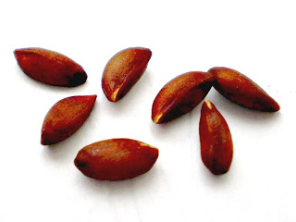
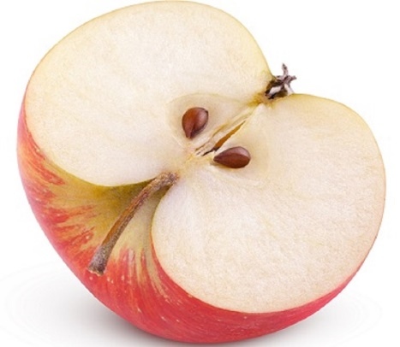
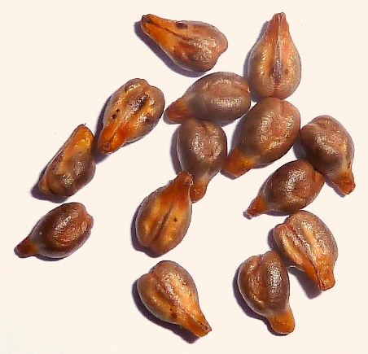
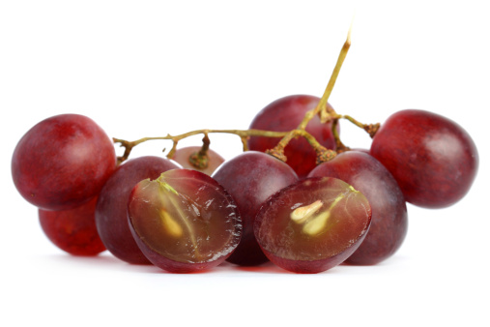
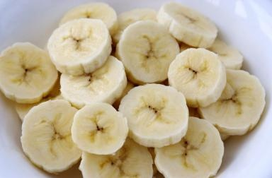
Seeds
If you wanted apples, which seed would you need to plant and nourish?
Why would you not expect a banana seed or grape seed to produce apples?

Slide 3
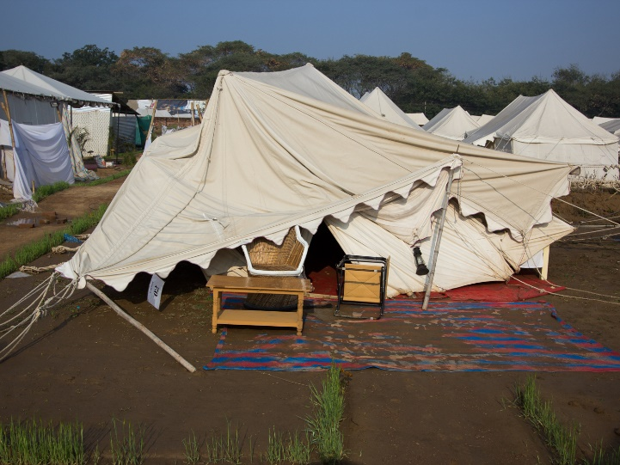
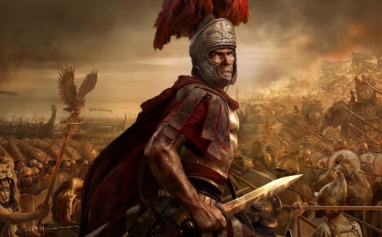
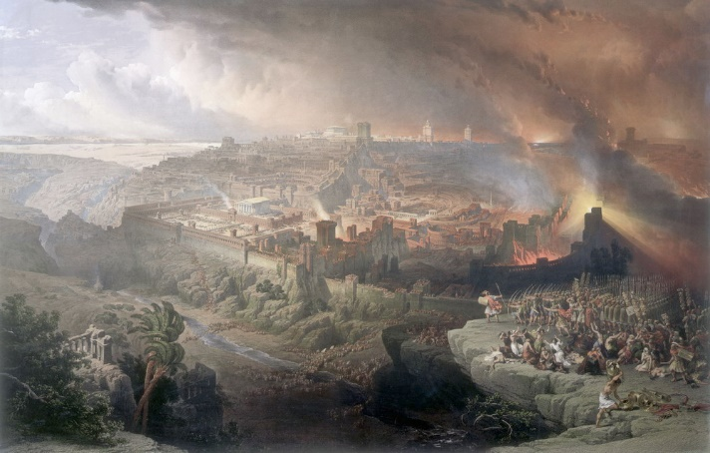
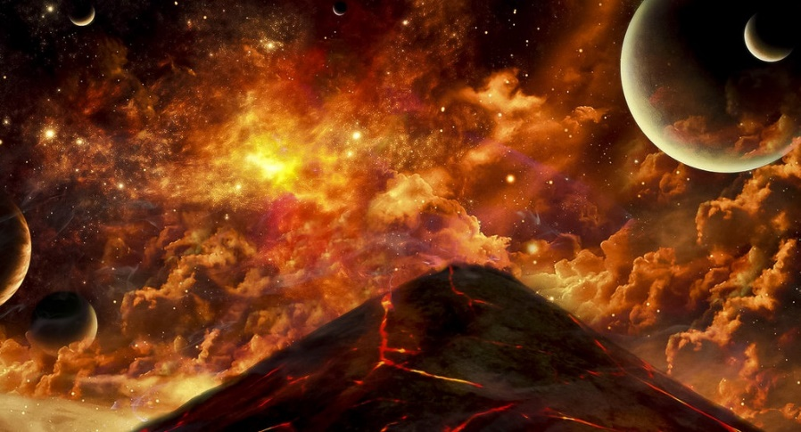
No Leadership
Stay/Staff—Supply/Support
When God removes his supply and support chaos happens.
Three times Jerusalem would be sieged and destroyed:
When a stay, or tent prop or stakes are removed the tent collapses
Rome
Babylon
Armageddon
Isaiah 3:2-5

Slide 4
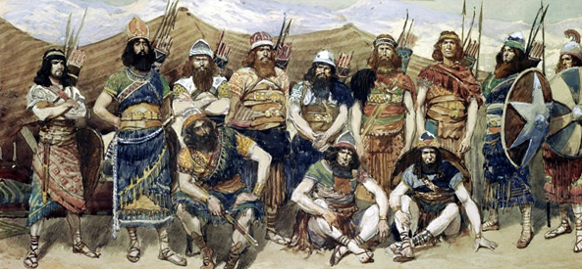
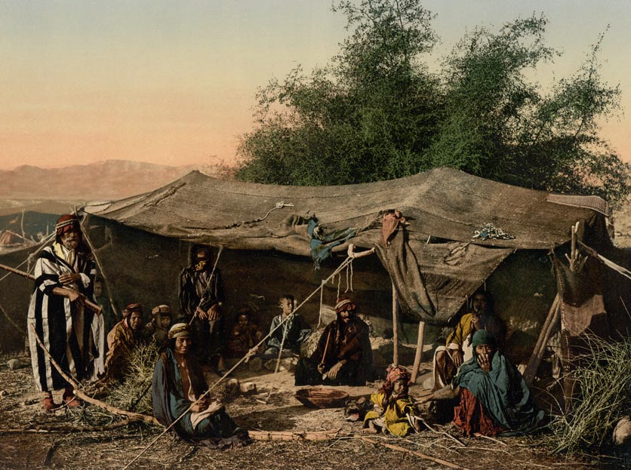
Prophecy of Judah and Jerusalem
Mighty man
Men of war
A judge
A prophet
The prudent
The old (ancient)
Captains
The honourable man
The counsellor
The cunning artificer
The eloquent orator
These will be made puppets of false ideology and take into captivity, leaving the masses who are easy to control.
When there is no prophet, who is there to warn the people and call them to repentance?
Let them alone: they be blind leaders of the blind. And if the blind lead the blind, both shall fall into the ditch.
Matthew 15:14
Isaiah 3:2-3

Slide 5
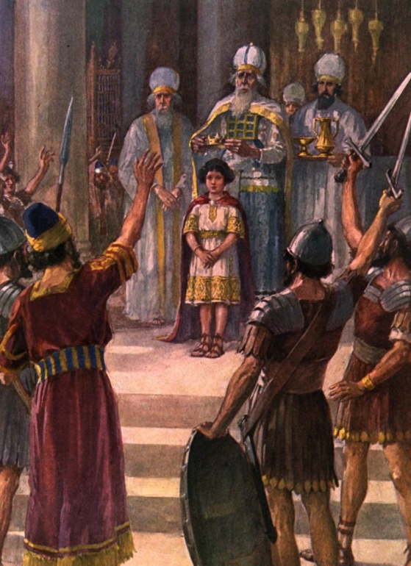
Children of Princes
Gentiles, or those with childish understanding will lead—the inexperienced ruled
Joash was a king of Judah, and the sole surviving son of Ahaziah after the massacre of the royal family ordered by his grandmother, Athaliah.
He was age 7 when he began his reign. However, being his age he had others in control.
2 Chronicles 24:1
From Manasseh to Zedekiah all the kings who ruled were between the ages of 7-25 and all but one fell to evil leadership…incapable of bringing order
When a society breaks down the people are oppressed.
When the youth rule and the elderly are discarded
But he (Rehoboam) forsook the counsel of the old men, which they had given him, and consulted with the young men that were grown up with him, and which stood before him:
1 Kings 12:6-11
Isaiah 3:4-5

Slide 6
Chiasmus—People Oppressed
Jerusalem and Judah are addressed (v.1)
B. Bread and water are taken away (v.1)
C. Society’s leaders are listed (vv. 2-3)
D. Children rule over princes (v.4)
E. People oppress each other (v. 5)
D. Youth rebel against the elders (v. 5)
C. Family leaders are called upon (v. 6)
B. Lack of bread and leadership (v. 7)
A. Jerusalem and Judah are ruined (v. 8)
(3)
Isaiah 3:1-8

Slide 7
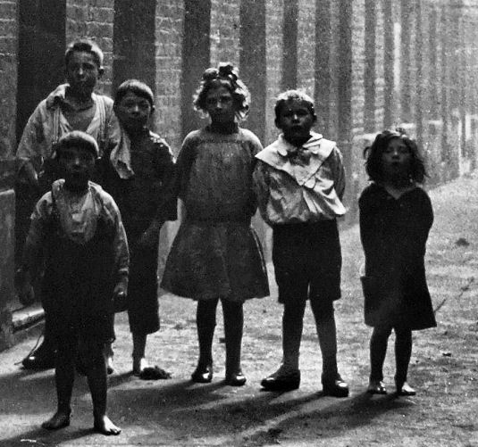
Jerusalem Ruined and Judah Fallen
They have brought evil, trouble, or disaster upon themselves
Children in particular have borne the brunt of these negative social trends. All one need do is look at any American newspaper any day of the week to read yet another story about the devastating effects of current social trends on the young.
Widespread family breakdown generates unparented children who attend schools that increasingly resemble detention centers rather than spaces of enduring training, discipline, and education in a safe environment.
Family breakdown contributes to out-of-wedlock births and juvenile violence at unprecedented levels. The family, of course, cannot deal with all of these things alone. Looking at troubles for families points us to a wider disintegration of the social ecology within which families are nested. (1)
Social Breakdown of the family and extreme physical poverty of the state
Isaiah 3:8-9

Slide 8
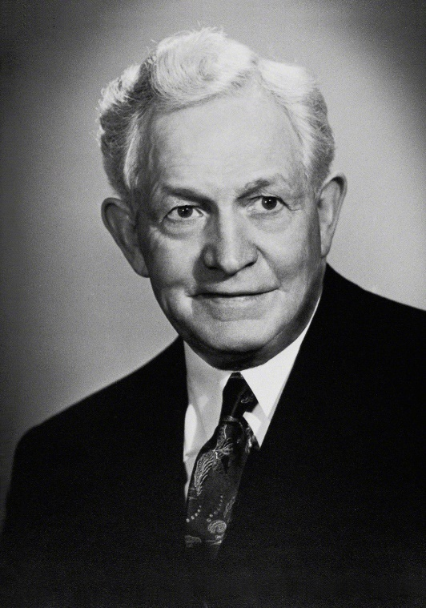
“Every man and every person who lives in this world wields an influence, whether for good or for evil. It is not what he says alone; it is not alone what he does. It is what he is. Every man, every person radiates what he or she really is. … It is what we are and what we radiate that affects the people around us.
“As individuals, we must think nobler thoughts. We must not encourage vile thoughts or low aspirations. We shall radiate them if we do. If we think noble thoughts; if we encourage and cherish noble aspirations, there will be that radiation when we meet people, especially when we associate with them.’ (2)
Isaiah 3:8-9

Slide 9
Blessings Are A Choice
What seed must you plant in order to obtain the fruit you desire?
If we are righteous, we will enjoy the blessings of our choices. If we sin, we will suffer the negative consequences of our choices.
Isaiah 3:10

Slide 10
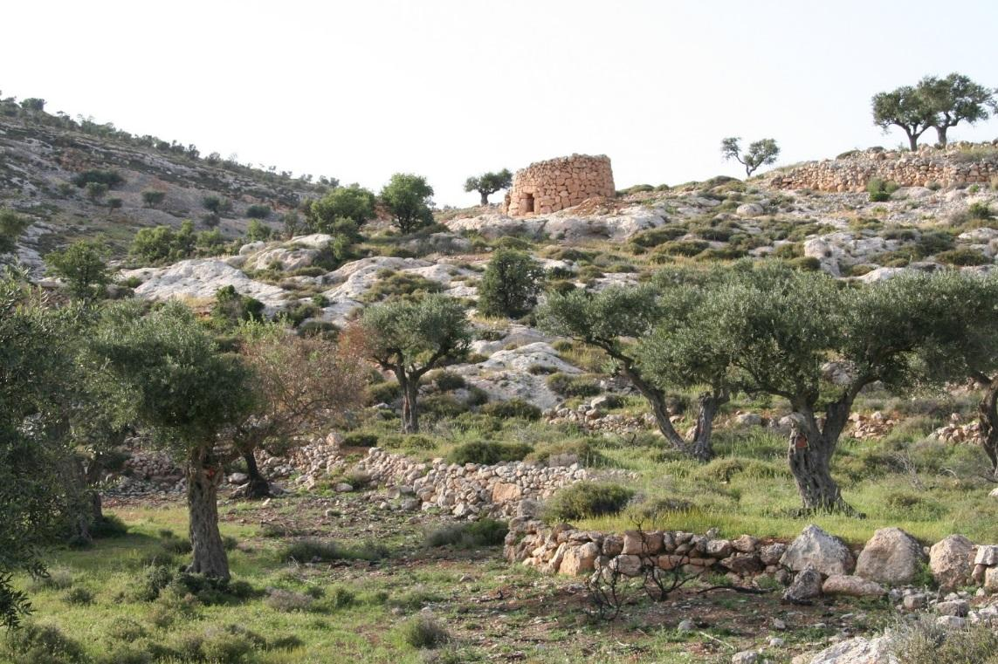
The Lord’s Vineyard is Oppressed
The vineyard is a symbol of the chosen people (see Isaiah 5:7)
The rulers of Israel were called to be watchmen over the vineyard.
Instead of guarding the Lord’s vineyard they had oppressed the people and consumed the vineyard (5)
In spite of all that the Lord had done for the people, they had still rejected Him. They were, therefore, ripe for destruction. The judgment of God must come upon them for they have been so wicked that they had "eaten up the vineyard," stolen from the poor, beaten the people to pieces, and ground the faces of the poor. (4)
Isaiah 3:14-15

Slide 11
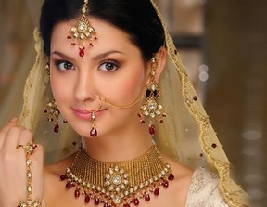
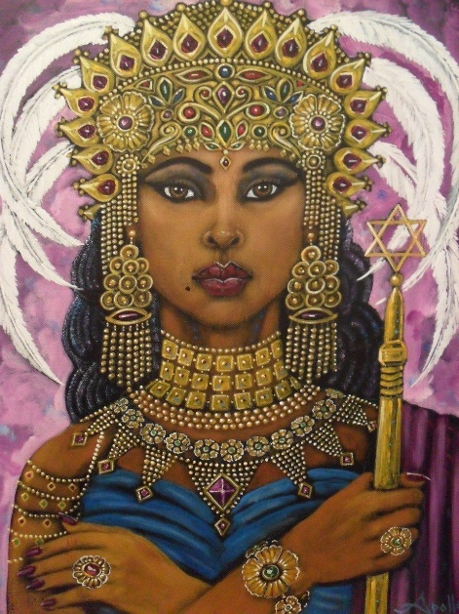
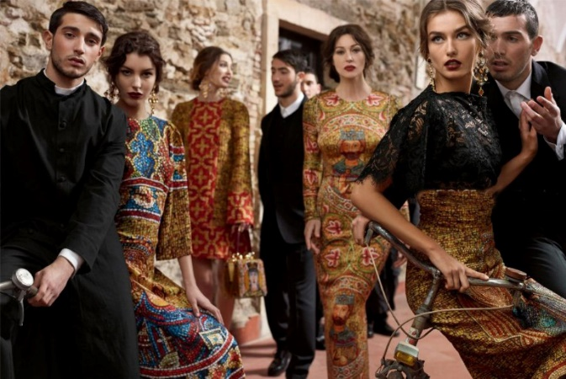
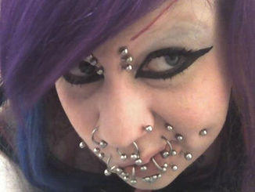
Daughters of Zion—
can also be applied to Men
These unusual verses describe the many beauty accessories of the daughters of Zion.
Their attempts to look beautiful are driven from their superficiality, haughtiness, and wicked practices.
Their beauty is superficial and their reward will be a stink instead of a sweet smell, a rent 'instead of a girdle', baldness 'instead of well set hair', sackcloth 'instead of a stomacher', and 'burning instead of beauty.'
Isaiah shows that the wickedness prevailing in Israel and Judah included the women, who were proud, arrogant, and more concerned with their clothing, jewels, and personal appearance than with righteousness. But these verses can also be applied in the latter days, when women will once more lose sight of proper priorities.
Isaiah 3:16-26

Slide 12
I
Stretched forth necks
Mincing…making a tinkling with their feet
Discover their secret parts
Cauls…round tires like the moon
Muffler
F. Bonnet
G. Tablets
H. Earrings and Nose Jewels
I. Changeable suits of apparel
J. Mantle
K. Wimples
L. Crisping pins
___Clothing for festivals only
___They would be put to shame
___ Veil
___Pride
___Charms or amulets, nose rings
___Ornamental chains connecting rings about ankles with bells
___ Headdress
___ Hair curling implements
___Type of shawl or veil worn over the head
___Ornamental jewelry in shape of suns and moons
___ Overcloak
___ Perfume Boxes
C
E
A
H
B
F
L
K
D
J
G
Isaiah 3:16-22

Slide 13
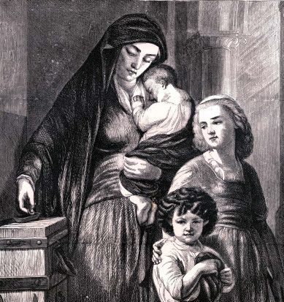
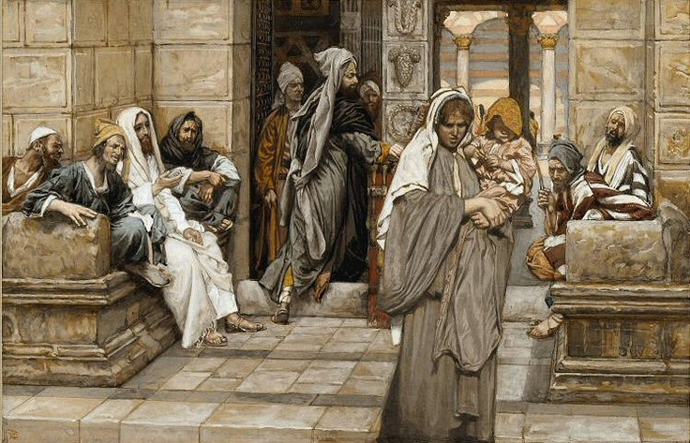
7 Women
This is caused by the scarcity of men, a result of the devastation of war mentioned in Isaiah 3:25–26.
The conditions under which these women would accept this marriage (“eat our own bread, and wear our own apparel”) are contrary to the Lord’s order of marriage
(Exodus 21:10; D&C 132:58–61).
To be unmarried and childless in ancient Israel was a disgrace (see Genesis 30:23; Luke 1:25).
So terrible would conditions in those times be that women would offer to share a husband with others and expect no material support from him, if they could claim they were married to him. (5)
Isaiah 4:1

Slide 14
Branch of the Lord
He refers to Joseph whose patriarchal blessing said he would be like “a fruitful vine by a well who branches would run over the wall.” (Gen. 49:22)
God gave a promise that out of the fruit of his loins the Lord would raise up a righteous branch.” (2 Nephi 3:5)
Jesus is called the branch and an offshoot of the House of Israel—the righteous branch
Fruit—blessings of the restored gospel
This branch will become fruitful and blessed because of temples. The temple was associated with abundance and prosperity of any people.
Isaiah 4:2

Slide 15
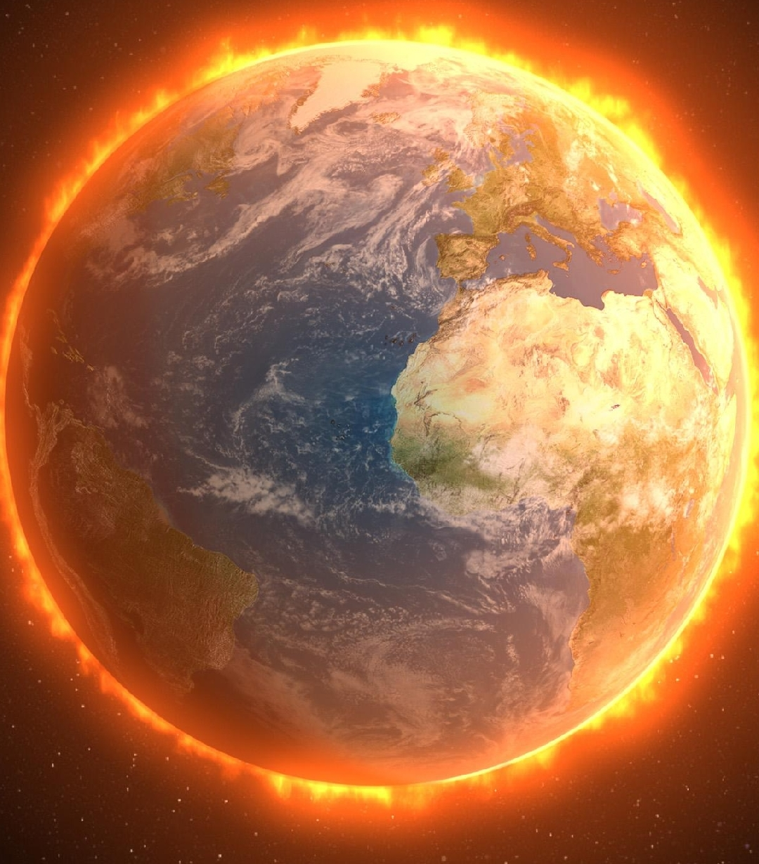
The Cleansing of the Earth
Isaiah foresaw the Lord’s cleansing of the earth of wickedness and the cleansing and redemption of His people in the millennial day. Point out that in the Joseph Smith Translation, Isaiah 4:1 is moved to become the last verse of Isaiah 3.
When Moroni visited Joseph Smith in Sept. 1823 he quoted Isaiah 4:5-6 and said that this prophecy would soon find fulfillment.
Isaiah 4:4

Slide 16
Every Dwelling Place
Zion will be a place of physical and spiritual refuge to the pure in heart.
Our individual homes will become holy places
The sacred place of Zion:
And it shall be called the New Jerusalem, a land of peace, a city of refuge, a place of safety for the saints of the Most High God
D&C 45:66
Isaiah 4:6
The Tijuana Mexico Temple.

Slide 17
Parable of the Vineyard
The loss of protection for the vineyard, the neglect, and the effects of famine would result from Israel’s transgression
The Parable explains why it is that the kingdoms of Israel and Judah were allowed to be destroyed-because of their wickedness, for when the lord came to his vineyard
Sing a Song—same as Allegory of the Olive Tree (Jacob 5)
The servant—Isaiah
The lord of the vineyard “my well-beloved”—the Lord of Hosts
The Vineyard—the House of Israel
The fruit--grapes
Isaiah 5:1-7

Slide 18
Towers—Temples
Watchmen--Prophets
Well Beloved--Savior
The Vineyard—The Covenant People--Israel
Fence and Stones--preparation
Fruitful Hill—The Lord places us where we will have the best harvest
Grapes
wild—sour—worthless.
Symbol of decaying and evil people
Winepress—Christ’s atonement
Isaiah 5:2

Slide 19
What Should the Lord Do?
“What could have been done more to my vineyard, that I have not done in it? wherefore, when I looked that it should bring forth grapes, brought it forth wild grapes?”
Even though they had been raised in sweet conditions, they had become wicked—they unknowingly pronounce judgment on themselves
Isaiah 5:4

Slide 20
God’s Protection is Taken Away
The wall, hedge and tower were Gods Protection
What happens when we reject God?
He simply leaves the sinner alone to face life’s adversities and Satan’s buffeting without the comfort and protection of His Spirit.
Isaiah 5:5

Slide 21
Form of Tough Love
I will lay it waste
The land (and the individual) becomes a wasteland without care and protection
No Rain—No Revelation, no word of God
Briars and thorns--
Consequences that come
Designed to help us turn back to God
Apostasy
Isaiah 5:6

Slide 22
Woe--Condemning the Rich
During Isaiah’s time each family received an inheritance.
They were to maintain it and pass it down to posterity
Greedy men were buying up all the real estate in hopes of enriching themselves
Judah was forfeiting her individual freedoms to a central government which was controlling the property.
Losing Personal Ownership
Isaiah 5:8

Slide 23
Woe—Habitual Evil
Drink early in the morning
Musical instruments
Gone into Captivity
Hell hath enlarged herself
Mean/mighty man
Strangers eat in the waste places
Definition of an alcoholic
The need for constant entertainment. Some music is associated with alcohol and that lifestyle makes them not even aware of God
The popular culture drives away the Spirit and leads the people into captivity and they don’t even know…they are past feeling.
Where does Satan get his power?
From us. Hell’s mouth is a metaphor—using the symbolism of feasting—all those that “swallow” wickedness will get swallowed by hell.
The commoner/masses and the leaders will be humbled. This lifestyle is no respecter of persons and will bring everyone down
Foreigners will take Israel over and move in
Isaiah 5:11-17

Slide 24
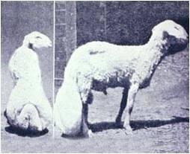
Woe—Vanity
Draw iniquity with cords of vanity
Cart Rope
Honor is given to men in unscrupulous business deals calling it “good business” Money buys the façade of respectability, but it is vanity
These sheep have huge tails and in order for them to move around they need to have their tail put on a cart
The wicked pulls his sins around in a cart. Metaphor for Pride/Vanity
We accommodate our sins and the body suffers as our life’s best goes into the fat in the tail. If we cut it off we could be free—but instead we protect it and carry he burden.
Isaiah 5:18

Slide 25
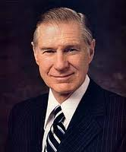
Woe—Evil Good and Good Evil
People who have lost the ability to distinguish right from wrong, as well as people who are knowingly trying to deceive
So called ‘New Morality’
A reversal of values
What used to be a known standard is now its opposite
“Political Correctness”
“Many modern professors of human behavior advocate as a cure to an afflicted conscience that we simply ignore the unwanted messages. They suggest that we change the standard to fit the circumstances so that there is no longer a conflict, thus easing the conscience. The followers of the divine Christ cannot subscribe to this evil and perverse philosophy with impunity. For the troubled conscience in conflict with right and wrong, the only permanent help is to change the behavior and follow a repentant path.” (6)
Isaiah 5:20

Slide 26
Doctrinal Mastery
Woe unto them that call evil good, and good evil; that put darkness for light, and light for darkness; that put bitter for sweet, and sweet for bitter!
Isaiah 5:20

Slide 27
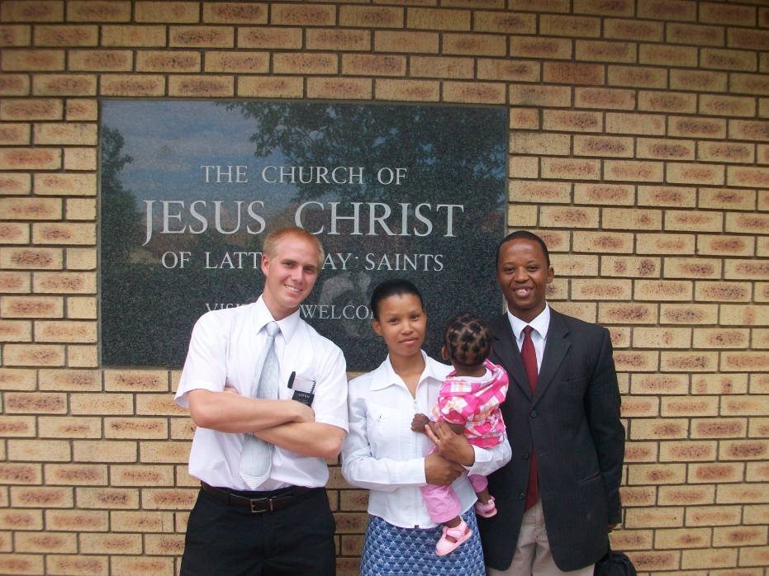
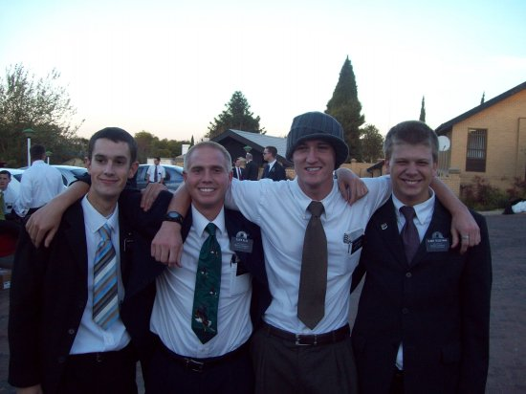
None Shall Be Weary
Those who are immersed in the Atonement and doing God’s work will not be weary
They don’t carry burdens
The Spirit provides the energy
Girdle/latchet
Those who come to Zion will be those in constant state of preparedness
Prey
Lions don’t carry prey off—they eat them
These lions are mighty missionaries and members assisting in the gathering, bringing souls to Christ
Isaiah 5:27-29

Slide 28
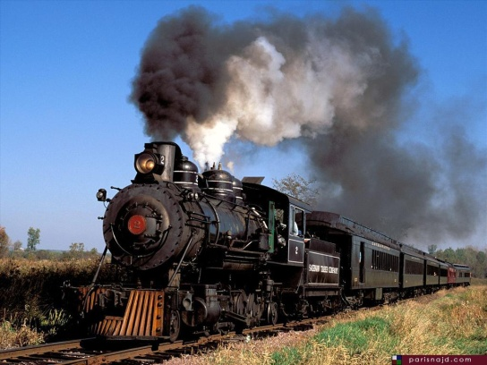
Latter Day Transportation ?
Food for Thought:
“In fixing the time of the great gathering, Isaiah seemed to indicate that it would take place in the day of the railroad train and the airplane : (Isaiah 5:26-29)
Since there were neither trains nor airplanes in that day, Isaiah could hardly have mentioned them by name. However, he seems
to have described them in unmistakable words. How better could ‘their horses’ hoofs be counted like flint, and ‘their wheels like a whirlwind’ than in the modern train? How better could ‘their roaring…be like a lion’ than in the roar of the airplanes?
Trains and airplanes do not stop for night. Therefore, was not Isaiah justified in saying: ‘none shall slumber nor sleep; neither shall the girdle of their loins be loosed, nor the latchet of their shoes be broken’?
With this manner of transportation the Lord can really ‘hiss unto them from the ends of the earth,’ that ‘they shall come with speed swiftly.’ Indicating that Isaiah must have foreseen the airplane, he stated ‘Who are these that fly as a cloud, and as the doves to their windows?” (Isaiah 60:8)
(7)
Isaiah 5:26-29

Slide 29
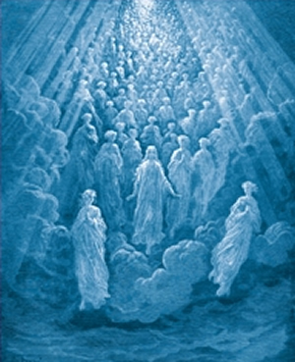
In That Day—The Last Days
Roar against them
The children of Zion, armed with the Spirit and His gifts and the priesthood are mightier than the great roaring of the earth’s oceans.
Darkness and sorrow
Contrast to Zion and God’s protection
The spiritual light will be on Zion and the wicked will be only darkness and sorrow.
Isaiah 5:30

Slide 30
Sources:
Suggested Hymn: #113 Our Savior’s Love
Videos: Why Does God Give Us Commandments? (0:39)
To Young Women (3:41)
Jean Bethke Elshtain was a professor at the University of Chicago Divinity School when this forum address was delivered at Brigham Young University on 29 October 1996.
President David O. McKay (Man May Know for Himself, p. 108.)
Victor L. Ludlow Unlocking Isaiah p. 93
Gospeldoctine.com
Old Testament Institute Manual The Establishment of Zion (Isaiah 1-12)
James E. Faust Unwanted Messages November Ensign 1986
LeGrand Richards Israel! Do You Know? Pg. 182
Presentation by ©http://fashionsbylynda.com/blog/

Slide 31
The eventual Fall of Judah and Jerusalem:
Isaiah described the eventual fall of Judah and Jerusalem in terms of the noted officials and respected persons of his day. These included government, military, educational, and religious leaders. With the loss of such individuals, the nation would fall under despotic reign at the hands of youthful puppets. Finally, it would rush toward anarchy as the last struggles for power were exercised within the ruling family. (See Keil and Delitzsch, Commentary, 7:1:130–35.)
The people would be so desperate for leadership that they would select rulers because they were able to dress decently, but even family leaders would refuse to help.
Answers to Isaiah 3:16-23
I, C, E, A, H, B, F, L, K, D, J, G
Young, Book of Isaiah, 1:162-66: Keil and Delitzsch, Commentary, 7:1:144-47)." (Old Testament Student Manual, 140-141)
7 Women:
So many men will be killed in the destructions and wars will which accompany the Second Coming that there will be an incredible difference in the number of living males and females. The culture of Isaiah, understandably, is reflected in his prophecies-as in the statement, "only let us be called by thy name to take away our reproach." Anciently, a woman who could have no children was described with the unflattering adjective, "barren." This was because great emphasis was placed on marriage and a woman's ability to have children. What else can we conclude from this verse? In the Millennium, the practice of polygamy will be reinstated-at least for some individuals, as part of "the restitution of all things" (Acts 3:21).
"...'seven women' (meaning simply a lot of women) will request a man's hand in marriage. Economic problems will be such that these women will be willing to provide their own food and clothing, contrary to the usual marriage customs. According to the Hebrew scriptures (Exodus 21:10), a man was required to provide a wife with food and clothing; but in this case Isaiah observes that the women are willing to waive that right. Having a good knowledge of the importance of marriage, they request a man to take away their reproach. In Isaiah's day and, indeed, in many parts of the Near East today, it was and is a disgrace to remain unmarried." (Book of Mormon compendium, by Sidney Sperry, chapter 11, 2 Nephi14)
Babes:
“With the leaders of society killed or taken into captivity, only the poor, weak masses remained. Therefore the warning to the “capricious children” or “babes shall rule over Israel most like refers to people with childish understanding who will unsuccessfully face the challenge of bring order to anarchy.”
The warning can also be understood literally, though, since many of the Jewish kings before the Babylonian captivity came to rule at a very early age. Ahaz, Hezekiah, Amon, and Jehoiakim were all in their early 20’s. Manasseh was only 12, Josiah a mere 8 years old and Jehoiachim either 18 or 8, depending upon whether the age recorded in 2 Kings or 2 Chronicles is correct. (2 Kings 24:8; 2 Chr. 36:9) Victor L. Ludlow. Unlocking Isaiah p. 94-95
Children of exploitation—the Oppressed:
“We have recently been reminded that in this land there still persists, notwithstanding the protection of the law, a merciless exploitation of children in certain industries. And there are still those, not a few, show without compassion “grind the faces of the ‘”. If we do not willing give of our substance, and if we cold refuse to assist those in need, we are participating in cruelty again the poor.” President Gordon B. Hinckley Blessed are the Merciful Ensign, May 1990, 69
Haughtiness:
“Isaiah, one of the great prophets of early times, saw our day, and he described the conditions that would prevail among the ‘daughters of Zion’ in these latter days. …
“Now, in this modern day, Isaiah’s prophecy has been and is being fulfilled. …
“The standards expressed by the General Authorities of the Church are that women, as well as men, should dress modestly. They are taught proper deportment and modesty at all times. It is, in my judgment, a sad reflection on the ‘daughters of Zion’ when they dress immodestly. Moreover, this remark pertains to the men as well as to the women. The Lord gave commandments to ancient Israel that both men and women should cover their bodies and observe the law of chastity at all times.” Joseph Fielding Smith (Answers to Gospel Questions,5:172–74.)

Slide 32
Stretched forth necks
Mincing…making a tinkling with their feet
Discover their secret parts
Cauls…round tires like the moon
Muffler
F. Bonnet
G. Tablets
H. Earrings and Nose Jewels
I. Changeable suits of apparel
J. Mantle
K. Wimples
L. Crisping pins
___Clothing for festivals only
___They would be put to shame
___ Veil
___Pride
___charms or amulets, nose rings
___ornamental chains connecting rings about ankles with bells
___ Headdress
___ Hair curling implements
___Type of shawl or veil worn over the head
___Ornamental jewelry in shape of suns and moons
___ Overcloak
___ Perfume Boxes

Slide 33
The Branch of the Lord: Isaiah 11:1
“Since it takes a first and a second coming to fulfill many Messianic prophecies, we of necessity must consider them here, and in the case of the Davidic-Messianic utterances show also how they apply to our Lord’s Second Coming. Christ is the Son of David, the Seed of David, the inheritor, through Mary his mother, of the blood of the great king. He is also called the Stem of Jesse and the Branch, meaning Branch of David. Messianic prophecies under these headings deal with the power and dominion he shall wield as he sits on David’s throne, and have reference almost exclusively to his second sojourn on planet earth.
“Jesse was the father of David. Isaiah speaks of the Stem of Jesse, whom he also designates as a branch growing out of the root of that ancient worthy. He recites how the Spirit of the Lord shall rest upon him; how he shall be mighty in judgment; how he shall smite the earth and slay the wicked; and how the lamb and the lion shall lie down together in that day—all of which has reference to the Second Coming and the millennial era thereby ushered in. (Isa. 11.) As to the identity of the Stem of Jesse, the revealed words says: ‘Verily thus saith the Lord: It is Christ.’ (D&C 113:1–2.) This also means that the Branch is Christ, as we shall now see from other related scriptures.
“By the mouth of Jeremiah, the Lord foretells the ancient scattering and the latter-day gathering of his chosen Israel. After they have been gathered ‘out of all countries whither I have driven them,’ after the kingdom has been restored to Israel as desired by the ancient apostles in Acts 1:6, then this eventuality, yet future and millennial in nature, shall be fulfilled: ‘Behold the days come, saith the Lord, that I will raise unto David a righteous Branch, and a King shall reign and prosper, and shall execute judgment and justice in the earth. In his days Judah shall be saved, and Israel shall dwell safely: and this is his name whereby he shall be called, THE LORD OUR RIGHTEOUSNESS.’ (Jer. 23:3–6.) That is to say, the King who shall reign personally upon the earth during the Millennium shall be the Branch who grew out of the house of David. He shall execute judgment and justice in all the earth because he is the Lord Jehovah, even him whom we call Christ.
“Through Zechariah the Lord spoke similarly: ‘Thus saith the Lord of hosts: … I will bring forth my servant the BRANCH. … I will remove the iniquity of the land in one day [meaning that the wicked shall be destroyed and the millennial era of peace and righteousness commence]. In that day, saith the Lord of hosts, shall ye call every man his neighbour under the vine and under the fig tree.’ (Zech. 3:7–10.) Of that glorious millennial day the Lord says also: ‘Behold the man whose name is The BRANCH; and he shall grow up out of his place, and he shall build the temple of the Lord: Even he shall build the temple of the Lord; and he shall bear the glory, and shall sit and rule upon his throne.’ (Zech. 6:12–13.)
“That the Branch of David is Christ is perfectly clear. We shall now see that he is also called David, that he is a new David, an Eternal David, who shall reign forever on the throne of his ancient ancestor. ‘It shall come to pass in that day, saith the Lord of hosts, ‘that is, in the great millennial day of gathering, that ‘they shall serve the Lord their God, and David their king, whom I will raise up unto them.’ (Jer. 30:8–9.)
“‘In those days, and at that time, will I cause the Branch of righteousness to grow up unto David; and he shall execute judgment and righteousness in the land. In those days shall Judah be saved, and Jerusalem shall dwell safely: and this is the name wherewith she shall be called, The Lord our righteousness,’ which is to say that because the Great King himself reigns in her midst, even the city shall be called after him. ‘For thus saith the Lord; David shall never want a man to sit upon the throne of the house of Israel. …If ye can break my covenant of the day, and my covenant of the night, and that there should not be day and night in their season; Then may also my covenant be broken with David my servant, that he should not have a son to reign upon his throne.’ (Jer. 33:15–21.) David’s temporal throne fell long centuries before our Lord was born, and that portion of Israel which had not been scattered to the ends of the earth was in bondage to the iron yoke of Rome. But the promises remain. The eternal throne shall be restored in due course with a new David sitting thereon, and he shall reign forever and ever. …
“Through Ezekiel, the Lord speaks of this One Shepherd in this way: ‘I will save my flock. … And I will set up one shepherd over them, and he shall feed them, even my servant David; he shall feed them, and he shall be their shepherd. And I the Lord will be their God, and my servant David a prince among them.’ When that day comes, ‘I will make with them a covenant of peace,’ the Lord says, meaning they shall have again the fulness of the everlasting gospel. Then ‘there shall be showers of blessing’; all Israel shall dwell safely and know that the Lord is their God. (Ezek. 34:22–31.)
“Through Ezekiel, the Lord also tells of the coming forth of the Book of Mormon, which becomes the instrument in his hands to bring to pass the gathering of Israel. Of that day of gathering he says, ‘I will make them one nation in the land upon the mountains of Israel; and one king shall be king to them all.’ In that day he promises to ‘cleanse them,’ by baptism, ‘so shall they be my people, and I will be their God. And David my servant shall be king over them; and they all shall have one shepherd: they shall also walk in my judgments, and observe my statutes, and do them. And they shall dwell in the land that I have given unto Jacob my servant, wherein your fathers have dwelt; and they shall dwell therein, even they, and their children, and their children’s children for ever: and my servant David shall be their prince for ever.’
“Then the Lord restates that his gathered people shall have his everlasting gospel with all its blessings; that he will set his sanctuary, meaning his temple, in their midst forevermore (as Zechariah recorded); and all Israel shall know that the Lord is their God. (Ezek. 37:15–28.)
“How glorious shall be the coming day when the second David, who is Christ, reigns on the throne of the first David; when all men shall dwell safely; when the earth shall be dotted with temples; and when the gospel covenant shall have full force and validity in all the earth!” Bruce R. McConkie (The Promised Messiah, pp. 192–95).

Slide 34
A Home on the Mountain: Zion:
“The time is to come when God will meet with all the congregation of his Saints, and to show his approval, and that he does love them, he will work a miracle by covering them in the cloud of his glory. I do not mean something that is invisible, but I mean that same order of things which once existed on the earth so far as the tabernacle of Moses was concerned, which was carried in the midst of the children of Israel as they journeyed in the wilderness. … But in the latter days there will be people so pure in Mount Zion, with a house established upon the tops of the mountains, that God will manifest himself, not only in their Temple and upon all their assemblies, with a visible cloud during the day, but when the night shall come, if they shall be assembled for worship, God will meet with them by his pillar of fire; and when they retire to their habitations, behold each habitation will be lighted up by the glory of God,—a pillar of flaming fire by night.
“Did you ever hear of any city that was thus favored and blessed since the day that Isaiah delivered this prophecy? No, it is a latter-day work, one that God must consummate in the latter times when he begins to reveal himself, and show forth his power among the nations.” Elder Orson Pratt (In Journal of Discourses, 16:82.)

