Slide 1
Lesson 121
Marriage and Family
Part 3

Slide 2
Plan of Salvation
Birth and death are essential parts of the plan of salvation, and they provide significant points of transition in a person’s eternal journey.
Premortal Life
Mortal Life
Postmortal Spirit World
Birth
Death

Slide 3
Choices
God has given us clear commandments governing choices that deal specifically with the powers of life and death.
Example
He has commanded us to “multiply, and replenish the earth” and not to abuse the sacred powers of procreation.
God has commanded us not to murder or “do anything like unto it”
Thou shalt love thy neighbor as thyself. Thou shalt not steal; neither commit adultery, nor kill, nor do anything like unto it. D&C 59:6
And God blessed them, and God said unto them, Be fruitful, and multiply, and replenish the earth, and subdue it: and have dominion over the fish of the sea, and over the fowl of the air, and over every living thing that moveth upon the earth. Genesis 1:28

Slide 4
Law of Chastity
The sacred powers of procreation are to be employed only between a man and a woman who have been lawfully wedded as husband and wife
The sacred powers of procreation are to be employed only between a man and a woman who have been lawfully wedded as husband and wife.
There is none greater in this house than I; neither hath he kept back any thing from me but thee, because thou art his wife: how then can I do this great wickedness, and sin against God? Genesis 39:9

Slide 5
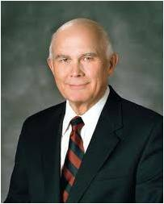
“Our theology begins with heavenly parents, and our highest aspiration is to attain the fullness of eternal exaltation. …
We know that the marriage of a man and a woman is necessary for the accomplishment of God’s plan. …
We look on marriage and the bearing and nurturing of children as part of God’s plan and a sacred duty of those given the opportunity to do so. …
“The power to create mortal life is the most exalted power God has given to His children. Its use was mandated by God’s first commandment to Adam and Eve, but other important commandments were given to forbid its misuse.
The emphasis we place on the law of chastity is explained by our understanding of the purpose of our procreative powers in the accomplishment of God’s plan.
Outside the bonds of marriage between a man and a woman, all uses of our procreative powers are to one degree or another sinful and contrary to God’s plan for the exaltation of His children.” (1)
Exodus 20:14; 1 Thessalonians 4:3

Slide 6
Sexual Purity
Physical intimacy between husband and wife is beautiful and sacred. It is ordained of God for the creation of children and for the expression of love between husband and wife. God has commanded that sexual intimacy be reserved for marriage.
When you are sexually pure, you prepare yourself to make and keep sacred covenants in the temple. You prepare yourself to build a strong marriage and to bring children into the world as part of an eternal and loving family.
You protect yourself from the spiritual and emotional damage that come from sharing sexual intimacy outside of marriage.
You also protect yourself from harmful diseases.
Remaining sexually pure helps you to be confident and truly happy and improves your ability to make good decisions now and in the future. (2)

Slide 7
The Lord’s Standard
The Lord’s standard regarding sexual purity is clear and unchanging. Do not have any sexual relations before marriage, and be completely faithful to your spouse after marriage.
Do not allow the media, your peers, or others to persuade you that sexual intimacy before marriage is acceptable. It is not. In God’s sight, sexual sins are extremely serious. They defile the sacred power God has given us to create life.
The prophet Alma taught that sexual sins are more serious than any other sins except murder or denying the Holy Ghost.
Know ye not, my son, that these things are an abomination in the sight of the Lord; yea, most abominable above all sins save it be the shedding of innocent blood or denying the Holy Ghost? Alma 39:5
(2) For further reading see handout

Slide 8
It’s Possible
Through His Atonement, Jesus Christ has made it possible for anyone who has violated the law of chastity to repent and be forgiven.
Talk to a bishops or branch presidents if you have committed sexual sin so you can enjoy the peace and confidence that come from being sexually pure.
Yongsung Kim
“victims of sexual abuse are not guilty of sin and do not need to repent” (2)

Slide 9
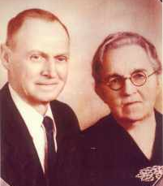
Families Can Be Together Forever
A friend who has recently decided to become a member of the Church.
This friend is concerned because his grandparents died without having learned about the restored Church of Jesus Christ.
He worries that because they were never baptized, they will not be able to live with God eternally.

Slide 10
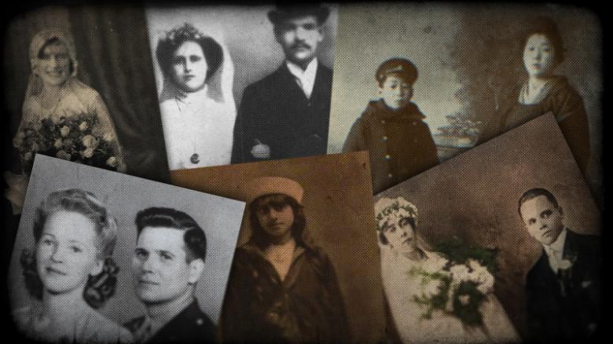
Blessings After Life
Ancestors can receive the blessings of salvation through our participation in family history and temple service.
The divine plan of happiness enables family relationships to continue beyond the grave.
The earth was created and the gospel was revealed so that families could be formed, sealed, and exalted eternally.
Through family history and temple service, we can make the ordinances and covenants of the gospel available to our ancestors.
Malachi 4:5–6

Slide 11
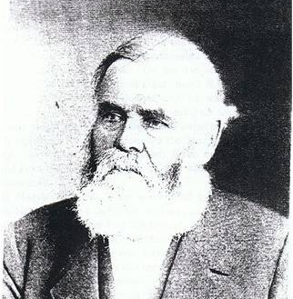
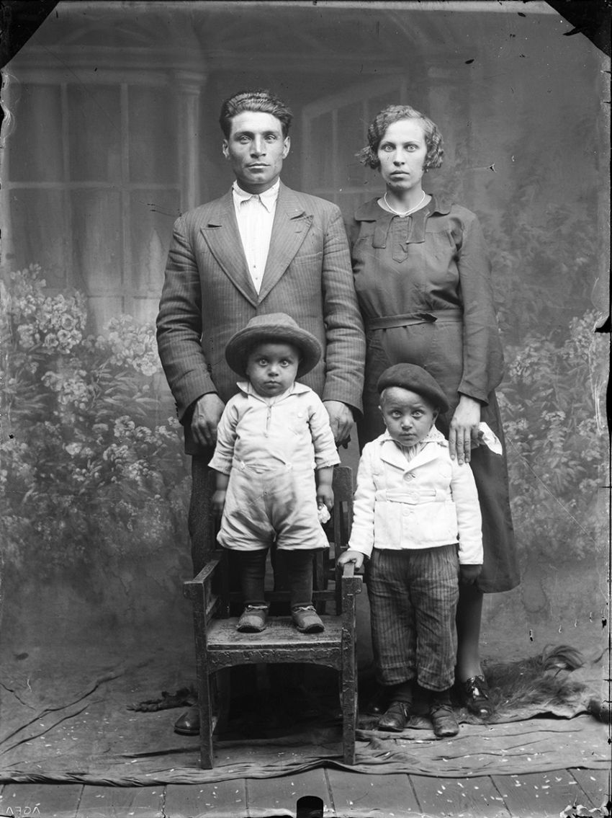
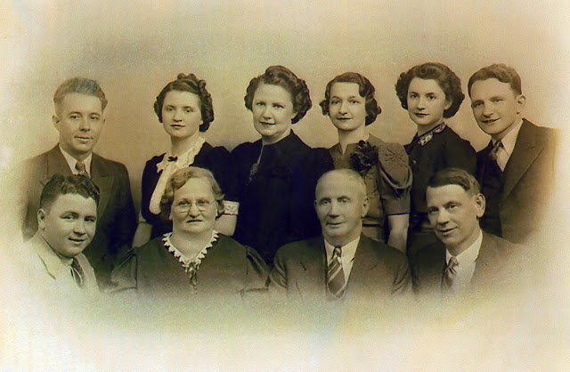
Through family history and temple service, we can make the ordinances and covenants of the gospel available to our ancestors.
Why do our ancestors need the ordinances and covenants of the gospel?
Some ordinances are essential to exaltation and are called saving ordinances. Only by receiving the saving ordinances and keeping the associated covenants can we obtain all of the blessings made available through the Atonement of Jesus Christ. Without these saving ordinances we cannot become like our Heavenly Father or return to live in His presence eternally.

Slide 12
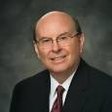
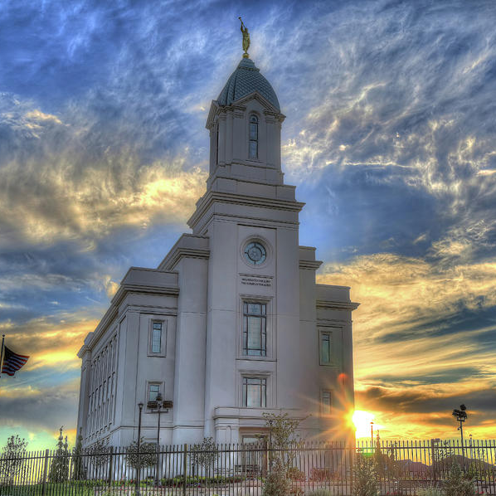
“If the youth in each ward will not only go to the temple and do baptisms for their dead but also work with their families and other ward members to provide the family names for the ordinance work they perform, both they and the Church will be greatly blessed.
Don’t underestimate the influence of the deceased in assisting your efforts and the joy of ultimately meeting those you serve.
The eternally significant blessing of uniting our own families is almost beyond comprehension. (3)
Cedar City Utah Temple

Slide 13
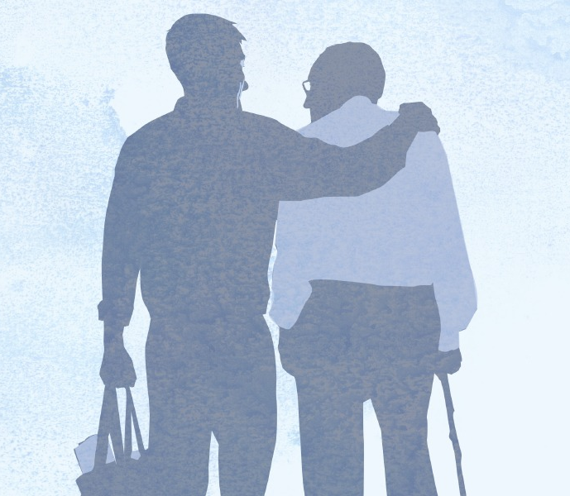
Behold, I will send you Elijah the prophet before the coming of the great and dreadful day of the Lord:
And he shall turn the heart of the fathers to the children, and the heart of the children to their fathers, lest I come and smite the earth with a curse. Malachi 4:5-6
And he shall plant in the hearts of the children the promises made to the fathers, and the hearts of the children shall turn to their fathers. If it were not so, the whole earth would be utterly wasted at his coming. JSH 1:39

Slide 14
Malachi
Malachi was the last known prophet of the Old Testament. He ended his book by prophesying that the prophet Elijah would one day return to the earth.
The prophecy is Malachi 4:5-6 began to be fulfilled when Elijah appeared to the Prophet Joseph Smith and Oliver Cowdery in the Kirtland Temple on April 3, 1836, and conferred upon them the sealing keys of the priesthood, which are necessary for temple work.

Slide 15
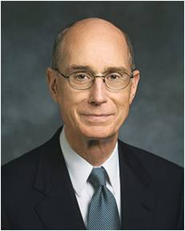
“From that day [April 3, 1836] to this, interest in exploring one’s family history has grown exponentially. At ever-increasing rates, people seem drawn to their ancestry with more than just casual curiosity. Genealogical libraries, associations, and technologies have emerged around the world to support this interest. The internet’s power to enhance communications has enabled families to work together to do family history research with a speed and thoroughness never before possible.
“Why is all of this happening? For lack of a better term, we call it the ‘spirit of Elijah.’ We could also equally call it ‘fulfillment of prophecy.’ I bear testimony that Elijah did come. The hearts of the children﻿—of you and me﻿—have turned to our fathers, our ancestors. The affection you feel for your ancestors is part of the fulfillment of that prophecy. It is deeply seated in your sense of who you are. …
“Many of your ancestors did not receive [priesthood] ordinances. But in the providence of God, you did. And God knew that you would feel drawn to your ancestors in love and that you would have the technology necessary to identify them. He also knew that you would live in a time when access to holy temples, where the ordinances can be performed, would be greater than ever in history. And He knew that He could trust you to accomplish this work in behalf of your ancestors.” (4)

Slide 16
How has the fulfillment of Malachi’s prophecy influenced us today?
What has God provided in our day that enables us to find our ancestors and perform saving ordinances in their behalf?
How does it make you feel to know that God trusts you to find your ancestors and then participate in temple ordinances in their behalf?
When have you felt blessed by your participation in family history and temple service?

Slide 17
Sources:
Suggested Hymn: #291 Turn Your Hearts
Videos:
I Choose to Be Pure (4:19)
Spiritual Dynamite (2:40)
Dallin H. Oaks, “No Other Gods,” Ensign or Liahona, Nov. 2013, 73, 74
“Sexual Purity” in For the Strength of Youth ([booklet, 2011], 35–37).
Quentin L. Cook see Howard W. Hunter, “A Temple-Motivated People,” Ensign, Feb. 1995, 2–5; Liahona, May 1995, 2–7]” (Quentin L. Cook, “Roots and Branches,” Ensign or Liahona, May 2014, 46–47).
Henry B. Eyring, “Gathering the Family of God,” Ensign or Liahona, May 2017, 21
Presentation by ©http://fashionsbylynda.com/blog/

Slide 18
Never do anything that could lead to sexual transgression. Treat others with respect, not as objects used to satisfy lustful and selfish desires.
Before marriage, do not participate in passionate kissing, lie on top of another person, or touch the private, sacred parts of another person’s body, with or without clothing.
Do not do anything else that arouses sexual feelings.
Do not arouse those emotions in your own body.
Pay attention to the promptings of the Spirit so that you can be clean and virtuous.
The Spirit of the Lord will withdraw from one who is in sexual transgression.
Avoid situations that invite increased temptation, such as late-night or overnight activities away from home or activities where there is a lack of adult supervision.
Do not participate in discussions or any media that arouse sexual feelings.
Do not participate in any type of pornography.
The Spirit can help you know when you are at risk and give you the strength to remove yourself from the situation. Have faith in and be obedient to the righteous counsel of your parents and leaders.
Homosexual and lesbian behavior is a serious sin.
If you find yourself struggling with same-gender attraction or you are being persuaded to participate in inappropriate behavior, seek counsel from your parents and bishop. They will help you.
Victims of sexual abuse are not guilty of sin and do not need to repent. If you have been a victim of abuse, know that you are innocent and that God loves you. Talk to your parents or another trusted adult, and seek your bishop’s counsel immediately. They can support you spiritually and assist you in getting the protection and help you need. The process of healing may take time.
Trust in the Savior. He will heal you and give you peace.
If you are tempted to commit any form of sexual transgression, seek help from your parents and bishop. Pray to your Father in Heaven, who will help you resist temptation and overcome inappropriate thoughts and feelings. If you have committed sexual transgression, talk to your bishop now and begin the process of repentance so that you can find peace and have the full companionship of the Spirit.
Make a personal commitment to be sexually pure. By your words and actions, encourage others to do the same.
section “Sexual Purity” in For the Strength of Youth ([booklet, 2011], 35–37).

