Slide 1
Lesson 124 Part 1
Scattering and Gathering of Israel
Isaiah 17-23
Yea, the word of the Lord concerning his church, established in the last days for the restoration of his people, as he has spoken by the mouth of his prophets, and for the gathering of his saints to stand upon Mount Zion, which shall be the city of New Jerusalem.
Doctrine and Covenants 84:2

Slide 2
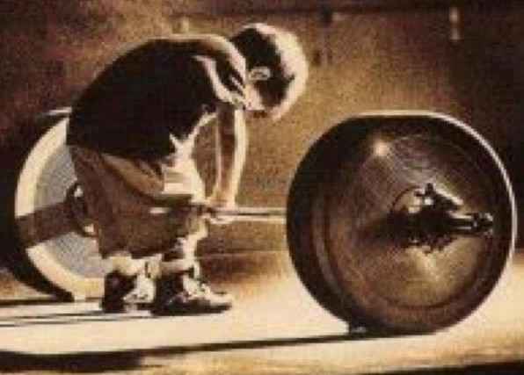
I Can Do It Myself
Those who trust themselves and refuse the Lord’s help
Why do some people trust in their own strength and wisdom rather than trusting God’s way?
What are the consequences of not trusting in God?

Slide 3
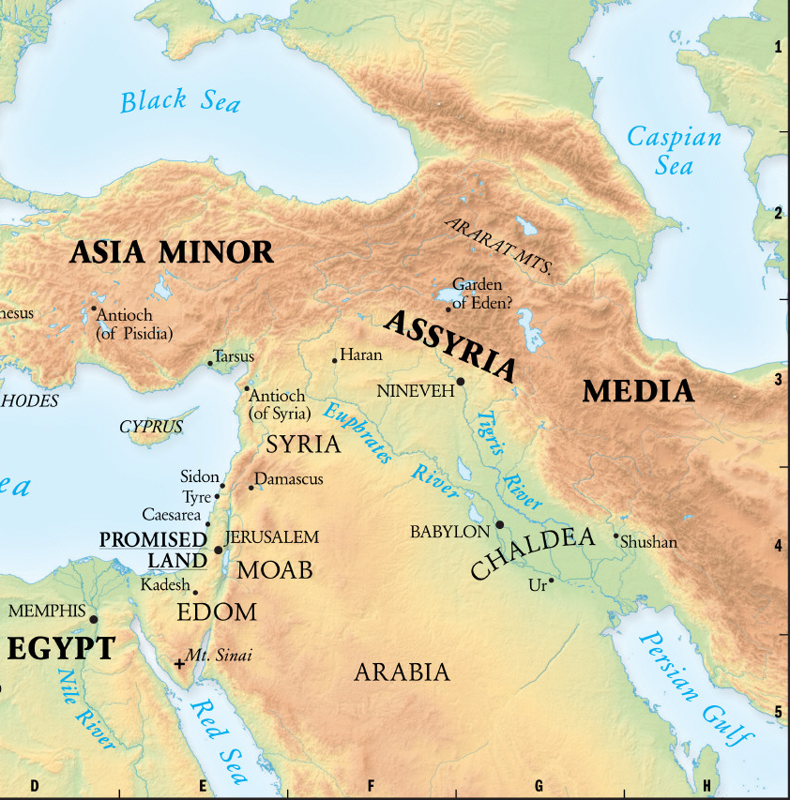
Nations Would Be Conquered
Damascus is the capital and the second-largest city of Syria after Aleppo. It is commonly known in Syria. Today it is the seat of the central government and all of the government ministries.
Ephraim = also known as Ephron
thought by many to be identical with Ophrah. Located on the border of Judah within the town of et- Taiyibeh.
Valley of Rephaim = descending southwest from Jerusalem to the Valley of Elah below. -It is an ancient route from the coastal plain to the Judean Hills. Probably named after the legendary race of giants.
Aroera = a Biblical town on the north bank of the River Arnon to the east of the Dead Sea in present-day Jordan. The town was an ancient Moabite settlement, and built by the Tribe of Gad.
Isaiah prophesied that these two nations would be conquered and scattered by the Assyrian army.
Isaiah also prophesied that the Lord would rebuke and destroy the Assyrians and the other nations who oppressed Israel.
Isaiah 17:1-4 Isaiah 10:5-6
(1)

Slide 4
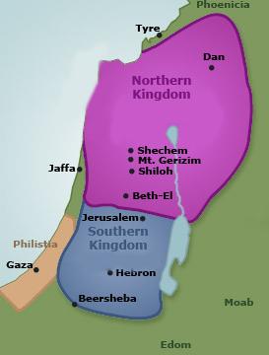
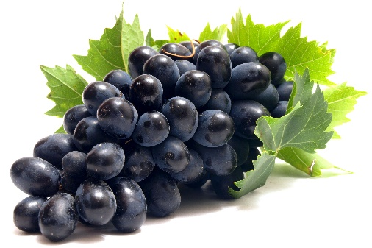
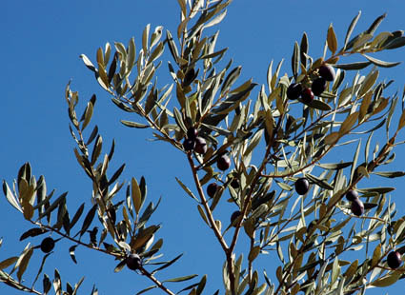
Damascus—Syria—To Be Humbled
All the powers of the world, including the neighbors of Judah as well as the nations of the world that despoiled the Lord’s people, will themselves be destroyed by the mighty judgments of God
Northern Kingdom = by the mountain defense of Ephraim
Yet the Lord promises, that a remnant of these nations, like the Israelites, will also be preserved.
Gleaning grapes = Those few missed by the harvester
Olives = harvesting by shaking the branches which always left a few scattered fruits in the topmost branches
Also like Israel, this remnant of the Gentiles will turn to God and forsake their false religions
Isaiah 17:6-8

Slide 5
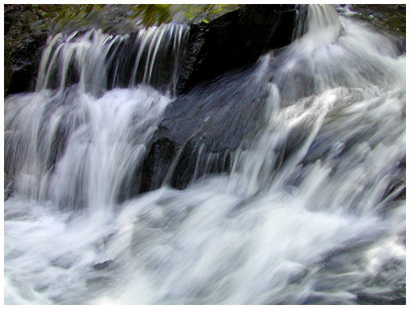
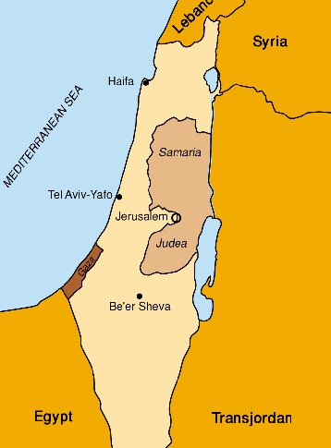
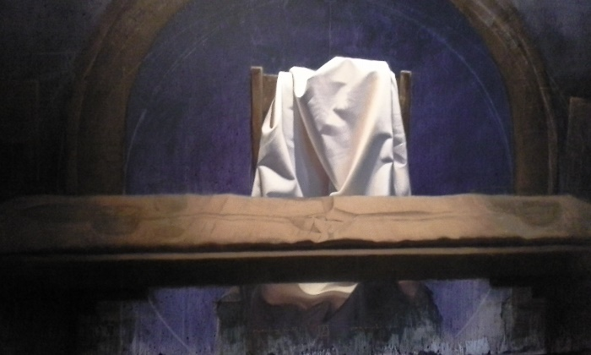
Woe—A Warning
Strange slips "Shoots from a foreign soil“ = strange and idolatrous worship, a reliance from neighboring cities especially Egypt.
Like the rushing of mighty waters = the sound of people suffering
He is not = "He is no more“
They will have forgotten to rely on the Lord
That spoil us = Though God may permit the wicked to prevail for a time against his people… yet in the end those shall be overthrown, and the glory of the Lord shall shine brightly on them that fear him; for the earth shall be subdued, and the universe filled with his glory (3)
Isaiah 17:9-14

Slide 6
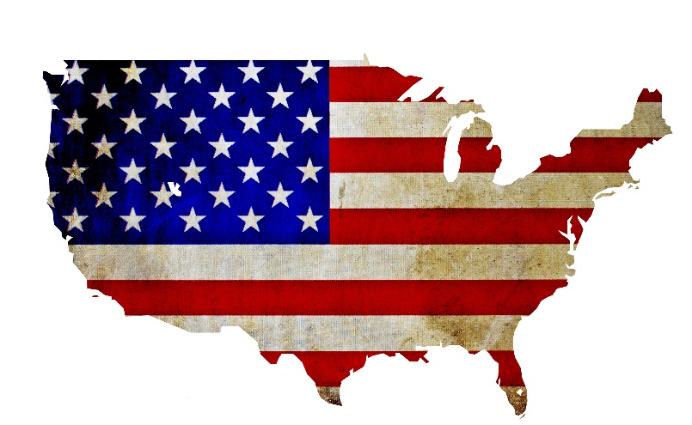
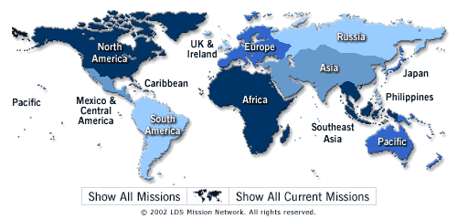
Woe—A Greeting
Land
Ambassadors
And
Messengers
“the land shadowing with wings”
Can refer to the Americas, where the Restoration of the Church began
Can refer to Apostles and missionaries, who travel all over the world to spread the gospel.
Isaiah 18:1-4

Slide 7
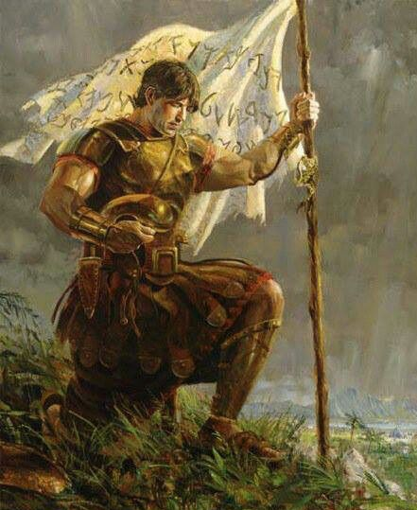
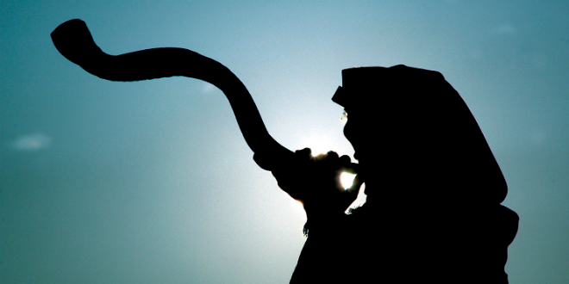
Woe—A Gathering
Ensign
Trumpet
both an ensign and a trumpet can symbolize the latter-day call to gather to the restored Church of Jesus Christ.
A flag or banner around which armies gather for battle,
Can be used to call people together
Isaiah 18:1-4

Slide 8
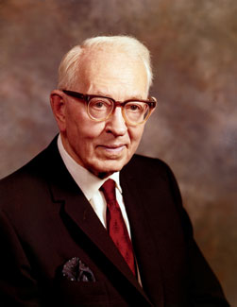
Vessels of Bulrushes
“…the vessels are vessels of speed; that the nation scattered and peeled refers to the land of Israel, which was denuded of its forests;
that the ensign refers to the restoration of the gospel that is published as a standard before the nations;
that the missionaries are going to gather Israel who were scattered; and that only the Latter-day Saints can fully understand this chapter because it deals with the great work of gathering, in which they are engaged.”
Isaiah 18:2
(3)

Slide 9
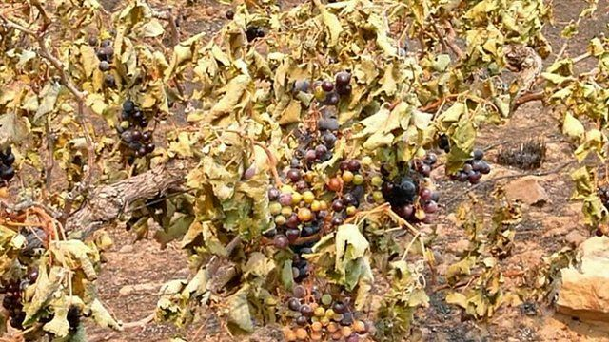
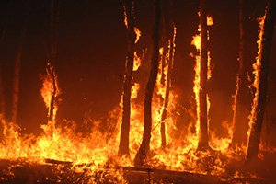
The Vineyard of Destruction
The destruction of the wicked and the gathering of the righteous in the latter days.
Isaiah 18:4-6

Slide 10
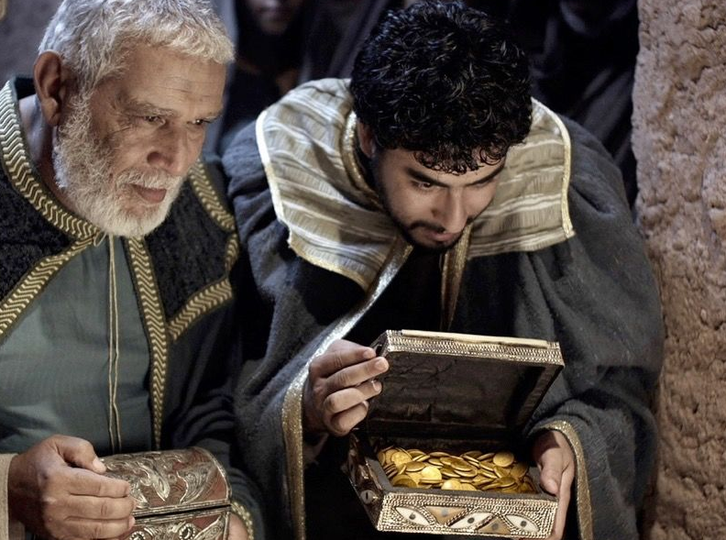
A Present
In that time shall the present be brought unto the Lord of hosts of a people scattered and peeled, and from a people terrible from their beginning hitherto; a nation meted out and trodden under foot, whose land the rivers have spoiled, to the place of the name of the Lord of hosts, the mount Zion.
The Egyptians were in alliance with the kingdom of Judah, and were fellow-sufferers with the Jews under the invasion of their common enemy Sennacherib; and so were very nearly interested in the great and miraculous deliverance of that kingdom, by the destruction of the Assyrian army.
Upon which wonderful event it is said, 2 Chronicles 32:23, that "many brought gifts unto Jehovah to Jerusalem, and presents to Hezekiah king of Judah; so that he was magnified of all nations from henceforth." It is not to be doubted, that among these the Egyptians distinguished themselves in their acknowledgments on this occasion. (2)
Isaiah 18:7

Slide 11
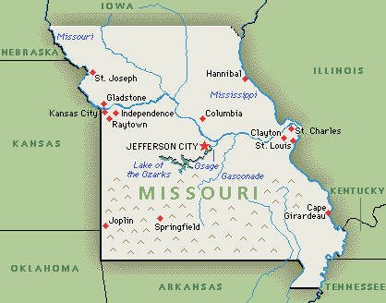
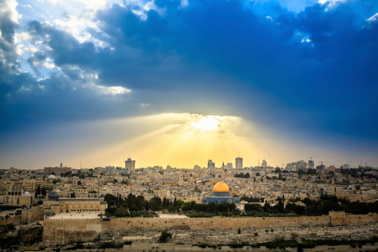
The Gift of the Saints
The Saints are so determined to offer to the Lord a worthy gift of gathered Israel that, as the Prophet Joseph Smith said, they “have labored without pay, to instruct the United States [and now the world] that the gathering had commenced in the western boundaries of Missouri, to build a holy city, where, as may be seen in the eighteenth chapter of Isaiah, the present should ‘be brought unto the Lord of Hosts.’”
Mount Zion is identified in modern revelation as the New Jerusalem. Thus, once the Church is restored and Ephraim begins the work of gathering Israel from their scattered and peeled condition, they can present a restored house of Jacob to the Lord as a gift that will delight Him.
Isaiah 18:7; Isaiah 11:13-14 D&C 84:2
(4)

Slide 12
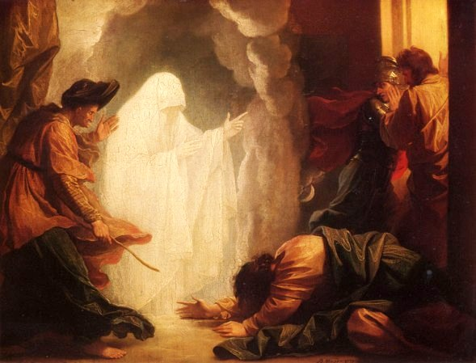
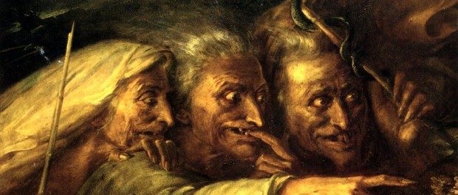
The Wizard
“One of the most evil and wicked sects supported by Satan is that which practices witchcraft, such craft involving as it does actual intercourse with evil spirits.
A witch is one who engages in this craft, who practices the black art of magic, who has entered into a compact with Satan, who is a sorcerer or sorceress. Modernly the term witch has been limited in application to women.
“There are no witches, of course, in the sense of old hags flying on broomsticks through October skies; such mythology is a modernistic spoofing of a little understood practice that prevailed in all the apostate kingdoms of the past and which even now is found among many peoples.”
Isaiah 19:3
(5)

Slide 13
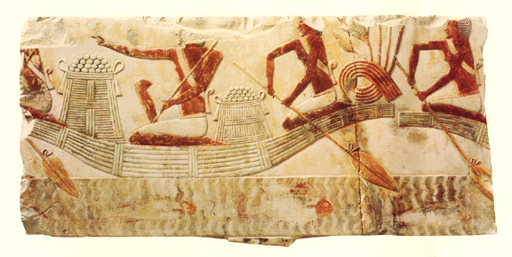
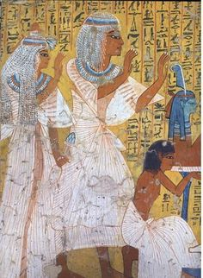
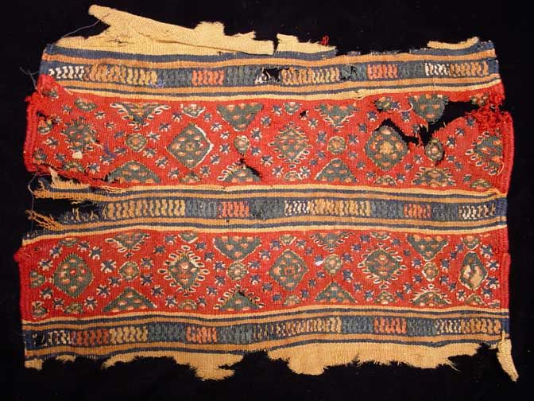
Evil Practice Prophecy
Isaiah prophesied that because of Egypt’s idol worship and evil practices the Lord would smite Egypt. However, Isaiah also prophesied that the Egyptians would eventually recognize their need for the Lord and turn to Him.
Three things represent the major industries of Egypt for which she had gained a fine reputation.
Fishing was universally important in this river-nation.
The fine flax represents the fine-twined linen that was world renowned. It was the white material used in the sacred coverings of the tabernacle of Moses.
The “network” weaving is the process of making the cotton garment common in Egypt. To have all three fail would be a national calamity.
Isaiah 19:8-9 Exodus 25:4
(6)

Slide 14
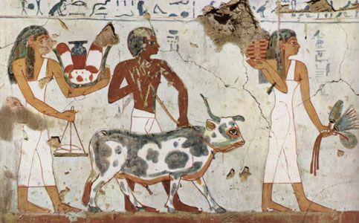
Egypt and Other Nations Destroyed
Prophetic dualism.
His “burden” on Egypt has (1) a physical fulfillment experienced by the nation and her people both in Isaiah’s time and in future times,
(2) a spiritual fulfillment that pertains to the world of the latter days.
Why does Isaiah use Egypt, Moab, and Babylon to describe the wicked of latter days?
“‘Babylon marks its idolatry, Egypt its tyranny, Sodom its desperate corruption, Jerusalem its pretensions to sanctity on the ground of spiritual privileges, whilst all the while it is the murderer of Christ in the person of his members.’
Isaiah 19:11-25; 20-21
New York, Albany, and Boston see D&C 84:114
(5)

Slide 15
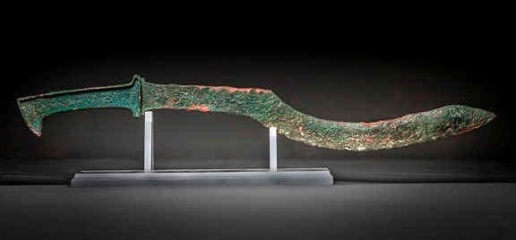
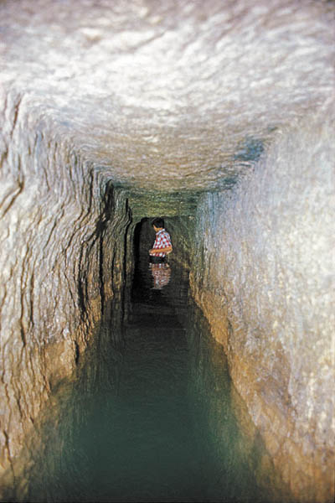
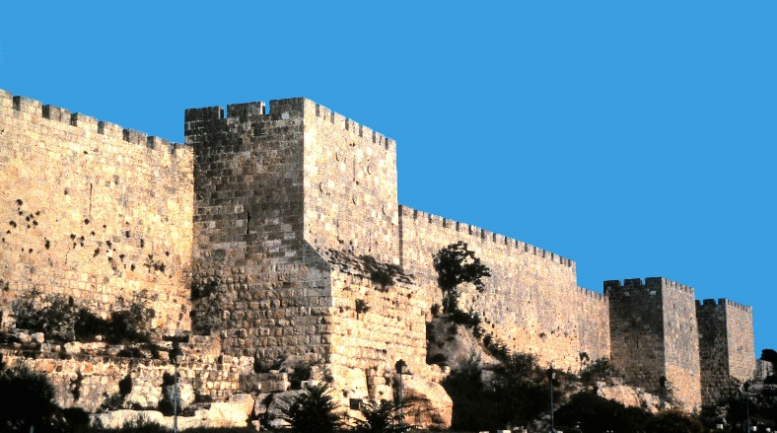
Babylon Attacked
Isaiah prophesied that Jerusalem would be spared from the Assyrian army
However, Isaiah prophesied that Jerusalem would not be spared when the Babylonian army attacked more than a century later.
What would protect the Israelites from Babylon?
Their supply of weapons
The fortifications that strengthened the city wall
Hezekiah’s tunnel, which diverted water into the city from a spring outside the city wall.
Isaiah 22-23
(5)

Slide 16
Can we trust in our own fortifications and our own strength?
Trusting in our own strength instead of trusting in God can lead us into sin and ultimately to destruction
(5)

Slide 17
Shebna and Eliakim
Shebna was the keeper of the treasury of Jerusalem
He was prideful about Jerusalem’s wealth
Isaiah prophesied that Assyria would take Shebna and many of Jerusalem’s treasure into captivity.
Eliakim was a person who loved and obeyed the Lord.
What do you think Isaiah was trying to teach with this story?
Isaiah 22:15-22

Slide 18
Love of Treasures VS Love of God
Only by replacing the love of treasures with the love of God could Jerusalem and its people be redeemed.
Likewise, we can be saved only if we abandon the things of the world and follow the Savior.
Eliakim points us to Jesus Christ and the Atonement.
Jesus Christ holds the key of the house of David and the keys of salvation for all mankind
Key to the House of David = the right to rule, which can be obtained only through the holy priesthood of God.
Jesus Christ holds all the keys of the priesthood and has power to “shut” and to “open”, that is, to bind or loose, and no one can override that power.
Isaiah 22:15-22
(6)

Slide 19
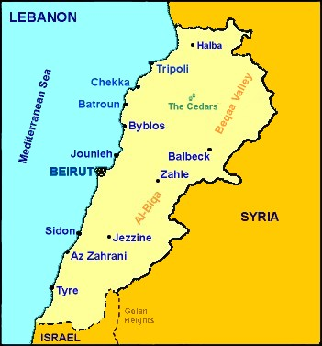
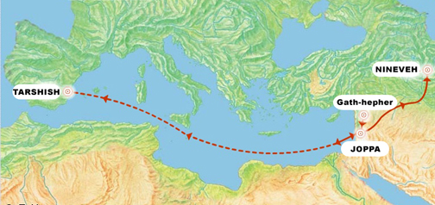
More Places Destroyed
Isaiah prophesied that the coastal city of Tyre, located in modern-day Lebanon, would also be destroyed.
Ships of Tarshish = Tarshish was said to have supplied vast quantities of important metals to Israel and Phoenicia. Its importance stems in part from the fact that biblical passages tend to understand Tarshish as a source of King Solomon's great wealth in metals - especially silver, but also gold, tin and iron (Ezekiel 27)
Jonah mentions Tarshish as a distant place and tried to hide from the Lord. (But that’s another story)
Zidon = Sidon the oldest city of Canaan; situated twenty miles south of Beirut. Its territory extended from the slopes of the Lebanon to the coast, and was bounded on the south by Asher and Zebulun
Land of Chittim (Kittim) = found in the book of Jasher also. The children of Chittim are the Romans that lived in the Valley of Canopia which is by the Tiber River.
"isles of Kittim“ are also found in the Book of Jeremiah 2:10 (West Coast of Cyprus)
Isaiah 23
(1)

Slide 20
Sources:
Suggested Hymn: #6 Redeemer of Israel
Wikipedia
Adam Clarke Bible Commentary
President Joseph Fielding Smith (see Signs of the Times, pp. 51–55).
History of the Church, 2:132. also found in Old Testament Institute Manual
Bruce R. McConkie, Mormon Doctrine, p. 840.
([Robert Jamieson and others, Commentary on the Whole Bible, ] p. 577.)” (Doctrinal New Testament Commentary,3:510.)
6. Old Testament Institute Manual (A Voice of Warning)
Presentation by ©http://fashionsbylynda.com/blog/

Slide 21
Ephriam:
The Ephron of 2 Chronicles 13:19 is often identified with Ephraim and the Ophrah of Joshua 18:23. Ophrah was in the tribal territory of Benjamin and near Bethel. Ophrah, which we are equating with Taybeh (tie-BAY), is only 4 miles north-east of Bethel and about 15 miles from Jerusalem.
What is the name of Ephraim today? Ephraim is often identified with a Christian Arab town in the West Bank Palestinian territory known as At-Taybe. On Highway 60 a sign points to Taybeh, the spelling I am using. Carta’s Israel Touring Atlas spells it Et-Tayibeh.
Ruins of a Byzantine church remain at Taybeh. There are also Crusader ruins. The Madaba Map from Jordan reflects the traditions of the 6th century A.D. Add this to the biblical evidence we mentioned equating Ephron, Ophrah, and Ephraim, and we have strong evidence that Taybeh marks the site of Ephraim.
Ferrell’s Travel Blog
https://ferrelljenkins.wordpress.com/2013/06/02/more-about-ephraim/
Wings:
“Isaiah 18:1“ is a mistranslation. In the Catholic Bible it reads: ‘Ah, land of the whirring of wings, beyond the rivers of Cush,’ and in Smith and Goodspeed’s translation it reads: ‘Ah! Land of the buzzing of wings, which lies beyond the rivers of Ethiopia.’ The chapter shows clearly that no woe was intended, but rather a greeting, as indicated in these other translations. A correct translation would be, ‘Hail to the land in the shape of wings.’ Now, do you know of any land in the shape of wings? Think of your map. About twenty-five years ago one of the current magazines printed on the cover the American continents in the shape of wings, with the body of the bird between. I have always regretted that I did not preserve this magazine. Does not this hemisphere take the shape of wings; the spread out wings of a bird?”
…the vessels are vessels of speed; that the nation scattered and peeled refers to the land of Israel, which was denuded of its forests; that the ensign refers to the restoration of the gospel that is published as a standard before the nations; that the missionaries are going to gather Israel who were scattered; and that only the Latter-day Saints can fully understand this chapter because it deals with the great work of gathering, in which they are engaged (see Signs of the Times, pp. 51–55).President Joseph Fielding Smith (Signs of the Times, p. 51; see also History of the Church, 6:322; Orson Pratt, in Journal of Discourses, 16:84–85; Spencer W. Kimball, “Why Call Me Lord, Lord and Do Not the Things Which I Say?” Ensign, May 1975, p. 4.)
The Olive and it’s uses are precious:
Oil for anointing the body – Deuteronomy 28:40.
Oil for anointing sheep – Psalm 23:5.
Medication – Isaiah 1:6; Mark 6:13.
Anointing priests, et al. – Exodus 29:7; Psalm 133.
Oiling the shields of war – Isaiah 21:5.
Something of Interest
D&C 84:114 These cities were the subject of another prophet’s testimony. Elder Wilford Woodruff addressed a conference in Logan, Utah, on 22 August 1863. Speaking directly to the youth in attendance, he declared: “‘Now, my young friends, I wish you to remember these scenes you are witnessing during the visit of President Young and his brethren. Yea, my young friends, treasure up the teachings and sayings of these prophets and apostles as precious treasure while they are living men, and do not wait until they are dead. A few days and President Young and his brethren, the prophets and apostles and Brothers Benson and Maughan, will be in the spirit world. You should never forget this visitation. You are to become men and women, fathers and mothers; yea, the day will come, after your fathers, and these prophets and apostles are dead, you will have the privilege of going into the towers of a glorious Temple built unto the name of the Most High (pointing in the direction of the bench), east of us upon the Logan bench; and while you stand in the towers of the Temple and your eyes survey this glorious valley filled with cities and villages, occupied by tens of thousands of Latter-day Saints, you will then call to mind this visitation of President Young and his company. You will say:
That was in the days when Presidents Benson and Maughan presided over us; that was before New York was destroyed by an earthquake; it was before Boston was swept into the sea, by the sea heaving itself beyond its bounds; it was before Albany was destroyed by fire; yea, at that time you will remember the scenes of this day. Treasure them up and forget them not.’ President Young followed and said: ‘What Brother Woodruff has said is revelation and will be fulfilled.’” (In Lundwall, Temples of the Most High, pp. 97–98.) Old Testament Institute Manual (A Voice of Warning)

Slide 22
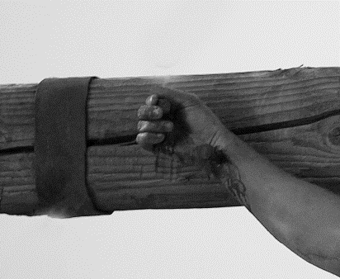
The Houses have ye broken down to fortify the wall:
The phrase “the houses have ye broken down to fortify the wall” (Isaiah 22:10) refers to the houses that were destroyed to fortify the walls of the city during Hezekiah’s time.
The phrase “a ditch between the two walls” in verse 11 refers to Hezekiah’s tunnel (see 2 Kings 20:20; 2 Chronicles 32:3–4). The people were proud of themselves for the engineering feat of diverting water into the city, but they did not even think about the Lord, who had created the spring from which the water came. One interpretation of verse 1 is that some of the people mistakenly assumed that the tunnel and other earlier physical preparations, not the Lord’s power, had saved Judah from the invading Assyrians. Thus, when the Babylonians attacked, they trusted that these preparations would save them once again. Isaiah taught the people that unless they trusted in the Lord these preparations would not save them.
“Isaiah made a symbol of Shebna’s replacement, Eliakim. His name means ‘God shall cause to arise,’ anticipating the Savior, who holds the ‘key of the house of David’ but was fastened ‘as a nail in a sure place’ until the burden of the Atonement was complete. Upon Him rests ‘all the glory of his father’s house.’ Isaiah recommended depending on Him for everlasting security (Isa. 22:20–25 and fn.)” (Ellis T. Rasmussen, A Latter-day Saint Commentary on the Old Testament [1993], 517–18).
“The ‘nail in a sure place’ (Isaiah 22:23) is messianic and symbolizes the terrible reality of the cross, though only a part of the total suffering of the Lord that caused Him to ‘tremble because of pain, and to bleed at every pore, and to suffer both body and spirit’ (D&C 19:18). Just as the nail of the cross that was driven in the sure place secured the body of the one being crucified, so the Savior Himself is, to all who will, a nail in a sure place, for He has given them power so that none need be lost (see John 17:12). As Christ brings the redeemed to the Father, the glory becomes His own, and the redeemed and their offspring will become part of the family of heaven under the throne of Christ (see D&C 19:2; Matthew 28:18; 1 Corinthians 15:27–28; Philippians 2:5–11; 3:21)” (Old Testament Student Manual: 1 Kings–Malachi, 3rd ed. [Church Educational System manual, 2003], 159).

Slide 23
The Burden Prophecies Isaiah 20-23
Tartan | Cup bearer of Sargon, probably chief captain of Sennacheribe at the siege of Jerusalem | Isaiah 20:1 | 2 Kings 18:17
Isaiah Walking “Naked and Barefoot”? | “With the great importance attached to the clothing in the East, where the feelings upon this point are peculiarly sensitive and modest, a person was looked upon as stripped and naked if he had only taken off his upper garment. What Isaiah was directed to do, therefore, was simply opposed to common custom, and not to moral decency. He was to lay aside the dress of a mourner and preacher of repentance, and to have nothing on but his tunic (cetoneth); and in this, as well as barefooted, he was to show himself in public.” | Isaiah 20:2
Desert of the Sea | symbolic name, and they believe it alluded to Babylon. That city sat on a hot and dusty plain in the Euphrates valley, but anciently, before flood control dams were built, the whole plain was flooded each spring during the high water runoff of the Euphrates. Thus, Babylon sat both in a desert and on a sea. | Isaiah 21:1-2 | Jeremiah 51:13 Revelation 17:1, 51
Sorrowful in his visions The destruction of Babylon, the destruction of the Babylon of the world before the advent of the Lord Jesus Christ in the last days | The pain caused by the vision given to Isaiah was so intense that its descriptive words in Hebrew portray his condition to be more than mere sorrow: “ Chalchalah is the contortion produced by cramp, tzirim is the word properly applied to the pains of childbirth; na avah means to bend, or bow one’s self, and is also used to denote a convulsive utterance of pain; ta ah, which is used in a different sense from Ps. xcv. 10, denotes a feverish and irregular beating of the pulse. The darkness of evening and night, which the prophet loved so much (cheshek, a desire arising from inclination, and always longed for, either that he might give himself up to contemplation, or that he might rest from outward and inward labour, had been changed into quaking by the horrible vision.” | Isaiah 21:3-10 | Psalm 38:11 1 Kings 9:1,19 Nahum 2:11
Asses and Camels and horsemen | Physical trappings of the Persian Army. The animals provided useful carriage for food and implements of war but were also effectively used by the Persians “to throw the enemy into confusion” | Isaiah 21:7
Keil and Delitzsch,Commentary, 7:1:370, 372, 377, 379, 381).

Slide 24
The Burden Prophecies Isaiah 20-23
Threshing | Israel was threshed: mowed off its own field, beaten, and carried captive into Babylon. This verse seems to be a foreshadowing of the event that is portrayed in some detail in | Isaiah 21:10 | Isaiah 22:3-4
Arabians and Edomites | As Isaiah used the destruction of every major sister nation to Israel as a type of the judgment that is to be administered to the wicked and their organizations in the last day, so he here, almost parenthetically, prophesied the destruction of even the minor nations of the east. Dumah is located in the northern heart of the Arabian Desert; Dedanim identifies the residents of Dedan, which is southeast of the gulf of Aqaba along the coast of the Red Sea; and Kedar is the region eastward from Mount Hermon that includes the area called Bashan. | Isaiah 21:11-17
Valley of Vision” | Jerusalem was Isaiah’s home, and therefore the place where he received his visions and revelations, it is not surprising that he would call it the place of vision. After making it clear that the enemies of Israel would not go unpunished by revealing the various “burdens” upon them, the Lord had Isaiah return to the theme he was developing before—that Israel and Judah faced the judgments of God. Thus, following the pronouncements on the world, a pronouncement was added for Jerusalem, who had become part of the world. | Isaiah 22:1-7 | Isaiah 22:9 Isaiah 13-21
House of the forest | “The forest-house [was] built by Solomon upon Zion for the storing and display of valuable arms and utensils … and so called because it rested upon four rows of cedar columns that ran all round (it was in the centre of the fore-court of the royal palace …)” | Isaiah 22:8
Call to Sorrow and Mourning | Signs of great sorrow and grief. Baldness (not natural baldness, but the shaving of the hair) was a great shame and signified great calamity. The Lord suggests that when Judah saw their impending doom they should have seen it as a call to deep repentance and clothed themselves with sackcloth and baldness. Instead, they acted as though they had been called to a joyous feast, and they were singing the refrain of the world: “let us eat and drink; for to morrow we shall die.” As is typical of the wicked in a time of crisis, they would prefer to indulge their passions than to repent. | Isaiah 22:12-13 | Isaiah 3:24 Isaiah 22:17-19
Keil and Delitzsch,Commentary, 7:1:394 Old Testament Institute Manual (A Voice of Warning)

Slide 25
The Burden Prophecies Isaiah 20-23
Tyre | Even though Babylon would have possession of the world’s imperial power in the near future, Tyre had control of, and was the commercial center of, that contemporary world. Therefore, holding a grasp upon the traffic in the world’s wealth, it was fitting that the Lord address them with a separate warning. | Isaiah 23 | Ezekiel 26-28
Tarshish and the Land of Chittim | Tarshish may have been Tartessus in Spain, a sister merchant to Tyre in shipping and trade. Chittim was an early name for present-day Cyprus. Phoenicia should properly be seen as the center of world trade during this period. | Isaiah 23:1
Zidon | Sidon (Zidon) was the older city of the Phoenicians, whereas Tyre was the newer site that had gained supremacy during the Assyrian era. Sidon received her revenue from the grain (seed) of Sihor (the Nile waters of Egypt). So renowned had the merchants become that they were honored by their national associates as great ones. | Isaiah 23:2-3 | Revelation 18:23 Isaiah 23:8
Trye a harlot | Like Babylon, Tyre represented the world and so eventually would come under the judgments of God. Like Babylon, she was seen as a harlot committing fornication (joining in wickedness) with the kingdoms of the world. The seventy years may refer to her coming judgments. Isaiah shows that eventually the merchandise of Tyre (the world) will be put to proper use in building the kingdom of Jehovah. | Isaiah 23:14-18 | Revelation 17:1-2
Old Testament Institute Manual (A Voice of Warning)

