Slide 1
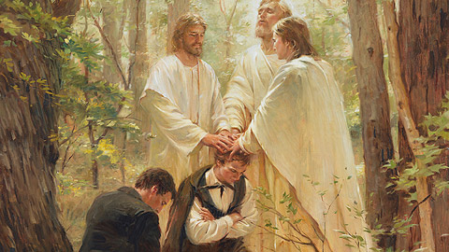
Lesson 125
The Great Apostasy and Restoration
Prophecy
Isaiah 29
And it shall come to pass that the Lord God shall bring forth unto you the words of a book, and they shall be the words of them which have slumbered.
And behold the book shall be sealed; and in the book shall be a revelation from God, from the beginning of the world to the ending thereof.
2 Nephi 27:6-7

Slide 2
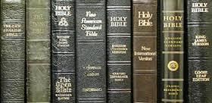
Why Are There So Many Churches If They Believe in the Bible?
Christian denominations interpret the Bible and Christ’s doctrine differently
In the standard Protestant Bible there are 66 books, in the Roman Catholic Bible 73 books, and in the Eastern Orthodox Bible 78. Almost all Christian churches agree on the same 27 books of the New Testament. The major difference is in whether to include the books of the Apocrypha or Deuterocanonical books. Those books are: 1 Esdras, 2 Esdras, Tobit, Judith, Wisdom of Solomon, Ecclesiasticus, Baruch, the Letter of Jeremiah, Prayer of Manasseh, 1 Maccabees, 2 Maccabees. Protestants don't include the Apocrypha because it was never part of the Old Testament Hebrew canon.

Slide 3
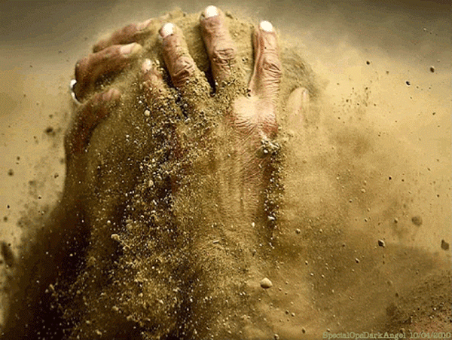
Whisper Out of the Dust
Ariel = Another name for Jerusalem
Ariel is not mentioned in Book of Mormon but Nephi describes events happening to his descendants as they are smitten by the Gentiles in the “last days”
Isaiah describes the terrible destruction that will fall upon Judah
587-586 B.C. by Babylonians
70 A.D. by Romans
Isaiah 29:3-5

Slide 4
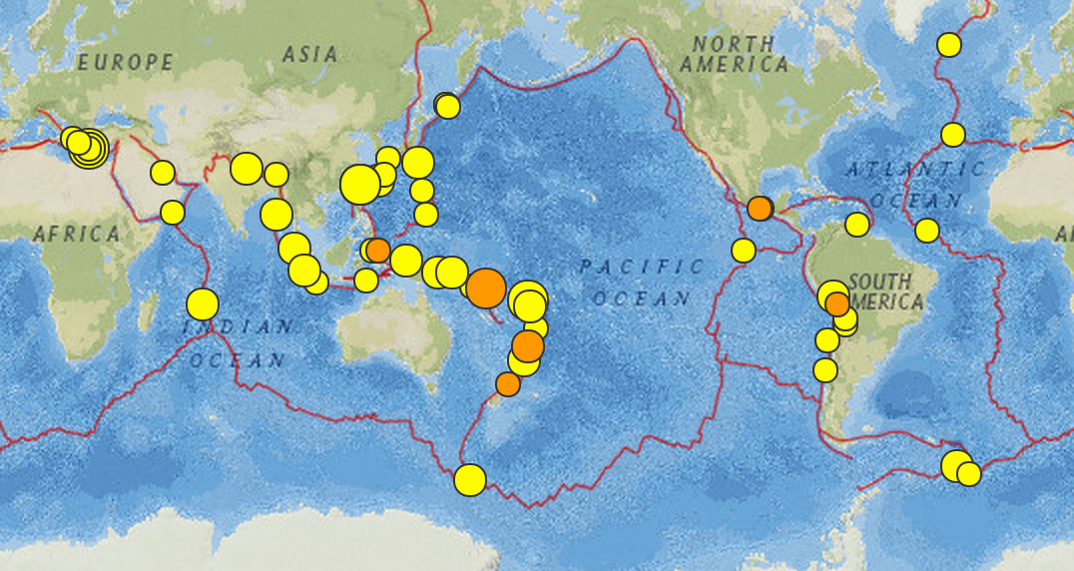
Thunder and Earthquakes
During the past decade there have been many examples of large-scale adversities affecting tens or hundreds of thousands or millions. Only a few can be mentioned. In addition to wars in many nations, we have had earthquakes in Japan, California, China, Armenia, and Mexico; hurricanes or tornadoes in Florida and the central United States; volcanic eruptions in the Philippines; flooding in India and North America; and famine and pestilence in Africa and elsewhere. (1)
This image depicts the earthquakes that took place in the week 17-23 April 2015. Image by USGS.
After your testimony cometh the testimony of earthquakes, ...
And also cometh the testimony of the voice of thunderings, and the voice of lightnings, and the voice of tempests, and the voice of the waves of the sea heaving themselves beyond their bounds.
And all things shall be in commotion; and surely, men's hearts shall fail them; for fear shall come upon all people (D&C 88:89-91).
Isaiah 29:6

Slide 5
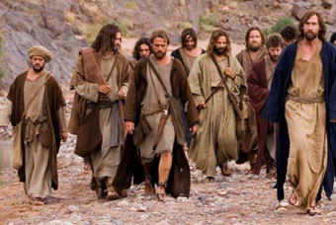
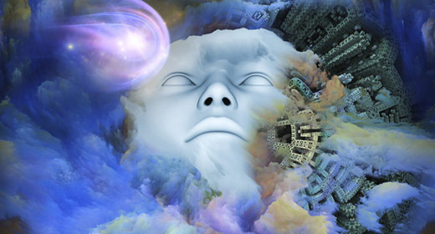
A Deep Sleep—An Apostasy
People would experience “the spirit of deep sleep,” and the prophets and seers would be covered, or removed from the people.
With the loss of the prophets and the straying of the Lord’s people from the truth, the world would fall into a state of spiritual darkness. This falling away from truth is called apostasy.
Isaiah 29:10

Slide 6
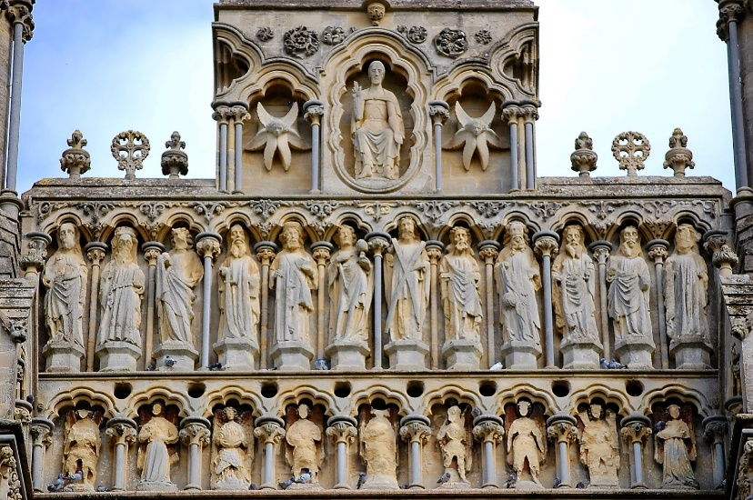
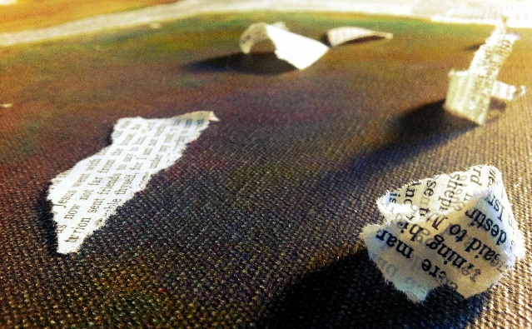
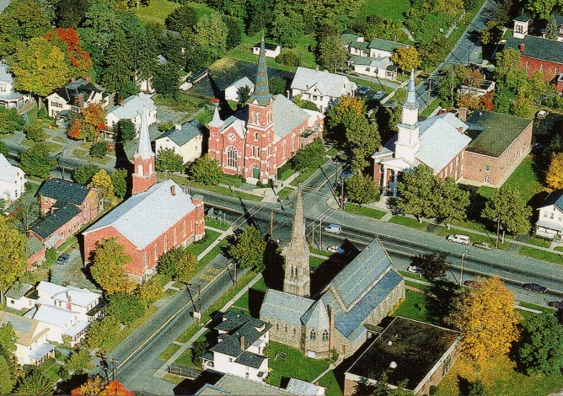
The Great Apostasy
This would occur after the death of the Savior and His Apostles.
Over time, people changed many gospel principles and ordinances and altered the organization of the Savior’s Church.
Consequently, the Lord withdrew the authority and keys of His priesthood from the earth. Many of the “plain and precious” parts of the Bible were also corrupted or lost, and the people no longer had an accurate understanding of God.
Eventually many churches were established, but they did not have the authority to perform priesthood ordinances or to properly interpret the Bible.
Isaiah 29:9-10 1 Nephi 13:26-29

Slide 7
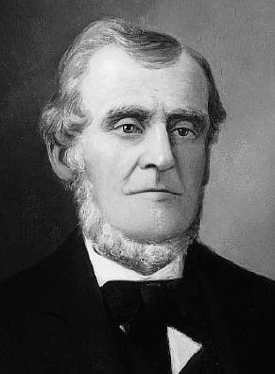
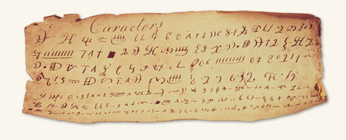
One Is Learned
In 1828, Joseph Smith copied some of the characters onto a piece of paper. Martin Harris asked if he could present a copy of some of the characters from the plates to scholars in New York who had knowledge of ancient languages and civilizations.
Several copies of the characters were made. It is unknown whether this was the actual copy that Martin Harris presented to the scholars. He took them to Professor Charles Anthon
Martin Harris
Isaiah 29:11

Slide 8
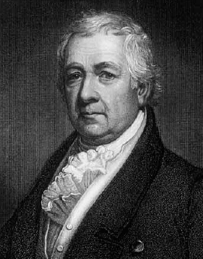
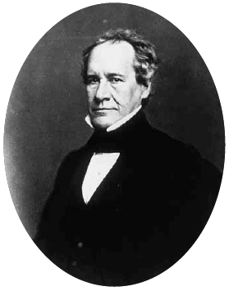
Those Who Do Not Believe
Professor Anthon stated that the translation was correct, more so than any he had before seen translated from the Egyptian.
He gave Martin a certificate, certifying to the people of Palmyra that they were true characters, and that the translation of such of them as had been translated was also correct.
Dr. Samuel Latham Mitchell—1764-1831
The Professor asked Martin how he obtained them and Martin answered that an angel had revealed them to Joseph Smith.
He then took the certificate and tore it up.
Martin then took it to Dr. Samuel Latham Mitchell and he also did the same thing
Professor Charles Anthon
Isaiah 29:11

Slide 9
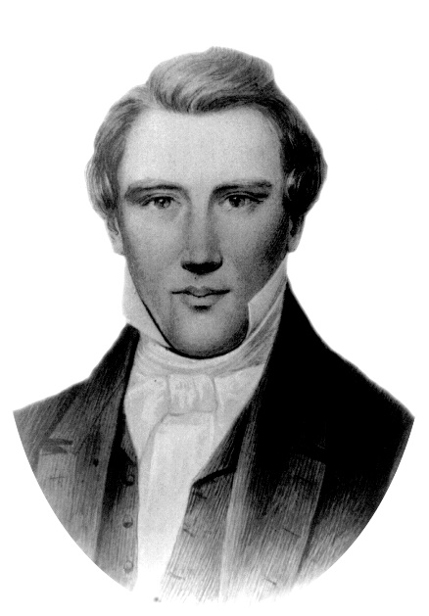
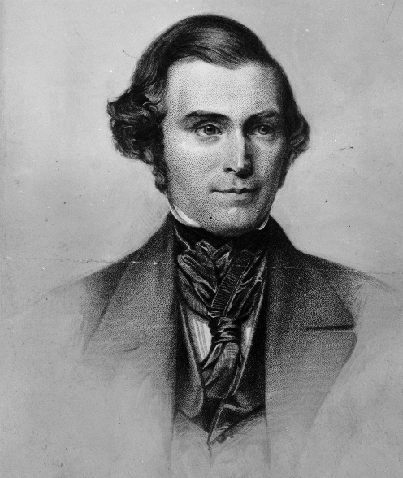
The Unlearned Man
The unlearned man to whom the book was delivered was, of course, Joseph Smith.
“Now in regard to Joseph Smith’s qualifications or attainments in learning, they were very ordinary. He had received a little education in the common country schools in the vicinity in which he had lived. He could read a little, and could write, but it was in such an ordinary hand that he did not venture to act as his own scribe, but had to employ sometimes one and sometimes another to write as he translated.
This unlearned man did not make the same reply that the learned man did. For when the book was delivered to this unlearned youth and he was requested to read it, he replied, ‘I am not learned.’ I suppose he felt his weakness when the Lord told him to read this book; for he thought it was a great work.” (2)
Isaiah 29:12

Slide 10
Doctrinal Mastery
Wherefore the Lord said, Forasmuch as this people draw near me with their mouth, and with their lips do honour me, but have removed their heart far from me, and their fear toward me is taught by the precept of men:
Therefore, behold, I will proceed to do a marvelous work among this people, even a marvellous work and a wonder: for the wisdom of their wise men shall perish, and the understanding of their prudent men shall be hid.
Isaiah 29:13-14

Slide 11
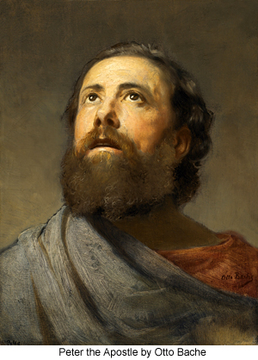
A Marvelous Work
“What would really constitute a marvelous work and a wonder? Why should not honest lovers of truth welcome the pronouncement of such a work?
Should any generation reject revealed truth when sent from heaven, even as they rejected the Christ when he came among men?
Why does it seem so much easier to accept and believe in the dead prophets than in living prophets?
Otto Bache
“In the accomplishment of this promised marvelous work and a wonder, the Lord had in mind a ‘restitution of all things’ and moved upon Peter to so prophesy to those who had crucified his Lord: [Acts 3:19–21].”
Isaiah 29:12
(3)

Slide 12
Restitution of All Things
The entire restoration of the priesthood—the Church, the ordinances, the gospel truths—constitute the marvelous work and a wonder that Isaiah foretold.
Isaiah 29:13-14
(4)

Slide 13
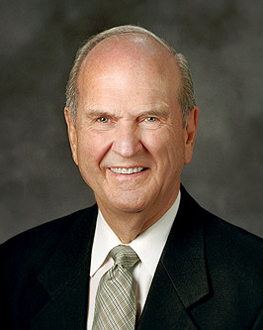
“Isaiah foresaw that God would do ‘a marvellous work and a wonder’ in the latter days. …
That marvelous work would include the coming forth of the Book of Mormon and the Restoration of the gospel.”
(5)

Slide 14
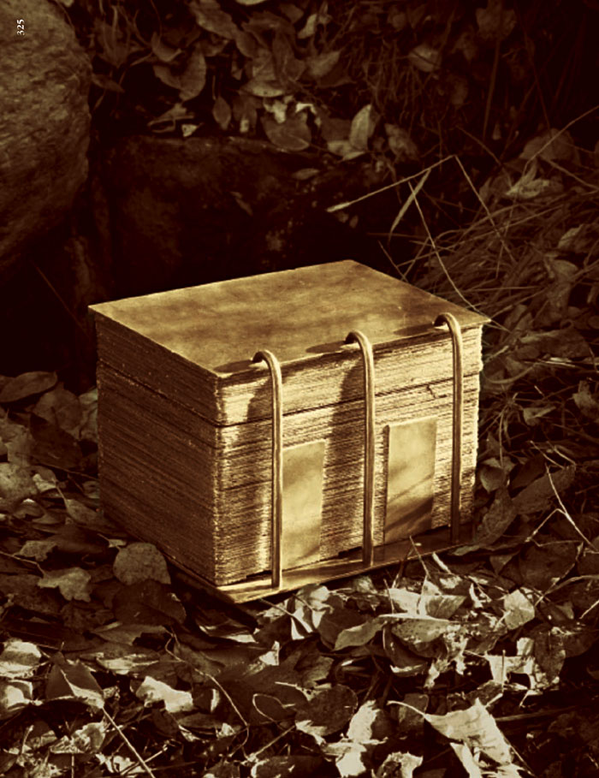
Hidden
Seek deep to hide their counsel from the Lord, and their works are in the dark
“A sacred book was to come forth before that time—one which was new to the world, one that told of a fallen nation which was destroyed suddenly—a book to be offered in the latter days to a learned man who would reject it, but to be given by divine means to an unlettered man through whom it was to be given to the world. …
Isaiah 29:15
(6)

Slide 15
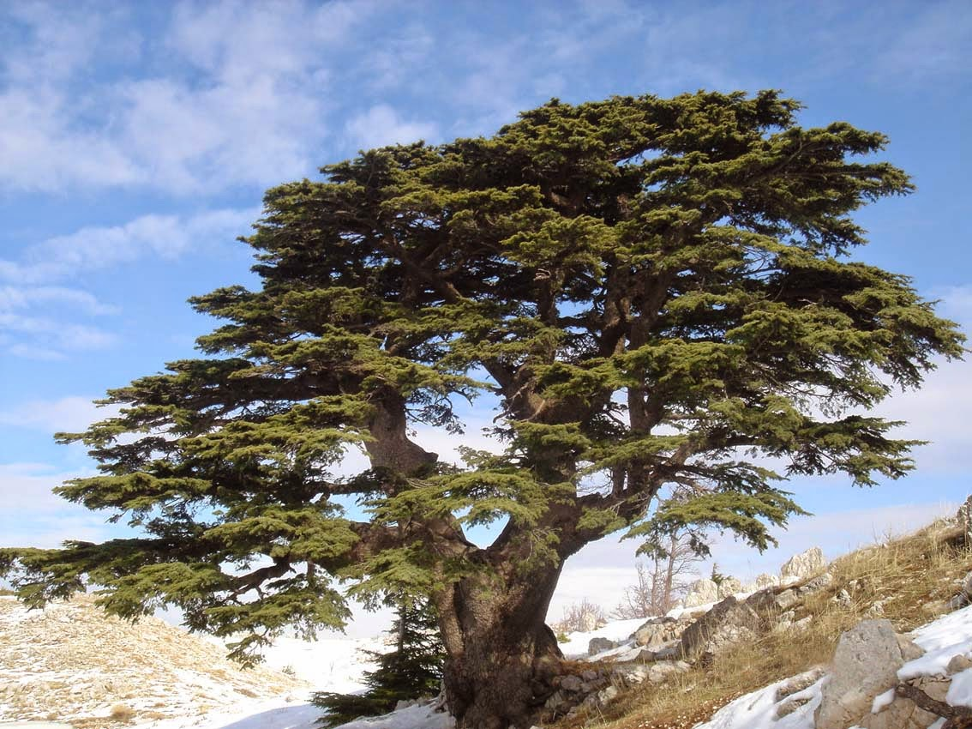
Gathering of the Jews
‘… I will cause them to return to the land that I gave to their fathers, and they shall possess it.’ (Jer. 30:3.)
Isaiah indicated that Palestine, long languishing in the grip of the desert, was destined to be turned into a fruitful field in connection with the gathering of the Jews to their homeland. …
“Not only did the prophets predict its appearance, but Isaiah set a limit on the time of its publication. That time limit was related to the period when fertility would return to Palestine. Isaiah said that the book would come forth first, and then added that in ‘a very little while … Lebanon shall be turned into a fruitful field, and the fruitful field shall be esteemed as a forest.’
Isaiah 29:15-17
(6)

Slide 16
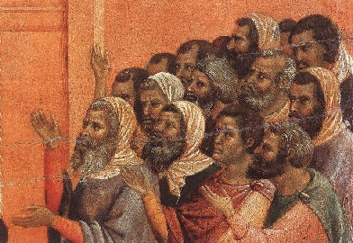
Deaf or Blind
But if he repent not of his sins, which are unbelief and blindness of heart, let him take heed lest he fall. D&C 58:15
Spiritual deafness as “the state of those who are lacking in spirituality, whose spirit ears are not attuned to the whisperings of the still small voice of the Spirit.
Similarly, spiritual blindness is the identifying mark which singles out those who are unable to see the hand of God manifest in the affairs of men.
Such have ‘unbelief and blindness of heart’ they are ‘hard in their hearts, and blind in their minds.’
…they began to be hard in their hearts, and blind in their minds, and began to disbelieve all which they had heard and seen 3 Nephi 2:1
Isaiah 29:18-19
(7)

Slide 17
FALSE DOCTRINE | BOOK OF MORMON REFERENCE THAT COUNTERS THE FALSE DOCTRINE | CORRECT DOCTRINE CLARIFIED IN THE BOOK OF MORMON
Babies who die without having been baptized are lost. | Moroni 8:8–12
Since we are saved by grace, we only need to acknowledge our belief in Jesus Christ to be saved. | 2 Nephi 25:23–26
Only the righteous will be resurrected. | Alma 11:42–45
After the death and Resurrection of Jesus Christ, He became a spirit essence without a physical body. | 3 Nephi 11:9–15
Baptism is not essential for salvation. | 2 Nephi 31:4–11
“…little children are whole, for they are not capable of committing sin; wherefore the curse of Adam is taken from them in me, that it hath no power over them; and the law of circumcision is done away in me.”
“…for we know that it is by grace that we are saved, after all we can do.”
“…notwithstanding we believe in Christ, we keep the law of Moses.”
“Now, this restoration shall come to all, both old and young, both bond and free, both male and female, both the wicked and the righteous…”
“And it came to pass that the multitude went forth, and thrust their hands into his side, and did feel the prints of the nails in his hands and in his feet…”
“Follow thou me…Repent ye, repent ye, and be baptized in the name of my Beloved Son”
Isaiah 29:18-24

Slide 18
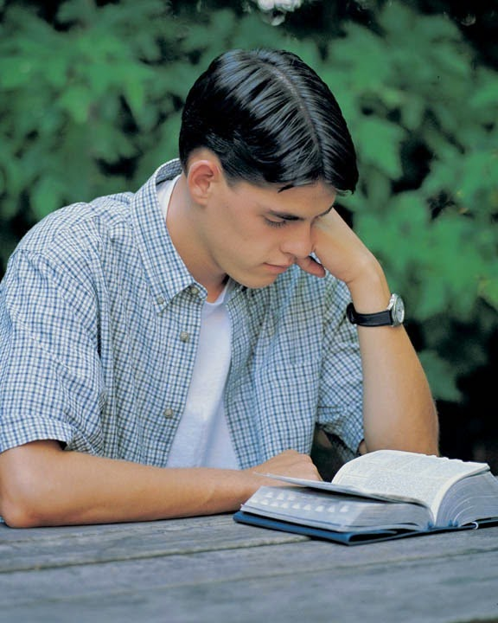
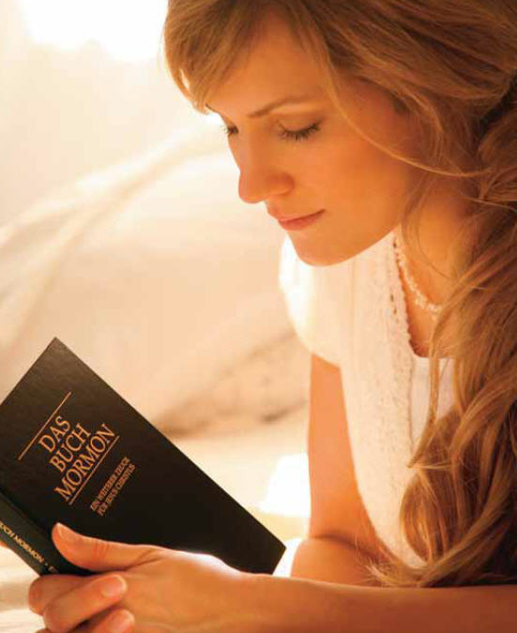
Jacob’s Prosperity
They also that erred in spirit shall come to understanding, and they that murmured shall learn doctrine.
“… those who have read this book will bear me record that their minds have been forever set at rest in regard to doctrine, so far as the ordinances of the kingdom of God are concerned. Those who erred, and did not know whether sprinkling, pouring or immersion was the true method of baptism, now know?
Why?
Because the Book of Mormon reveals the mode as it was given to the ancient Nephites on this continent. So in regard to every other principle of the doctrine of Christ—it is set forth in such great plainness that it is impossible for any two persons to form different ideas in relation to it, after reading the Book of Mormon.”
Isaiah 29:22-24
(2)

Slide 19
Sources:
Suggested Hymn: #264 Hark, All Ye Nations
Videos:
A Marvelous Work and a Wonder (5:46)
The Book of Mormon—a Book from God (1:50)
Dallin H. Oaks "Adversity," Ensign, July 1998, 7-8
Orson Pratt (In Journal of Discourses,15:186.)
Journal of Discourses, 15:188–89.)
Elder LeGrand Richards (A Marvelous Work and a Wonder, pp. 34–35.)
Old Testament Institute Manual (Prophecies of the Dispensation of the fullness of Times) Chapter 15
Elder Russell M. Nelson (“Scriptural Witnesses,” Ensign or Liahona, Nov. 2007, 46, endnote 26).
Elder Mark E. Petersen In Conference Report, Oct. 1965, p. 61.
Elder Bruce R. McConkie Mormon Doctrine, p. 184
Presentation by ©http://fashionsbylynda.com/blog/

Slide 20
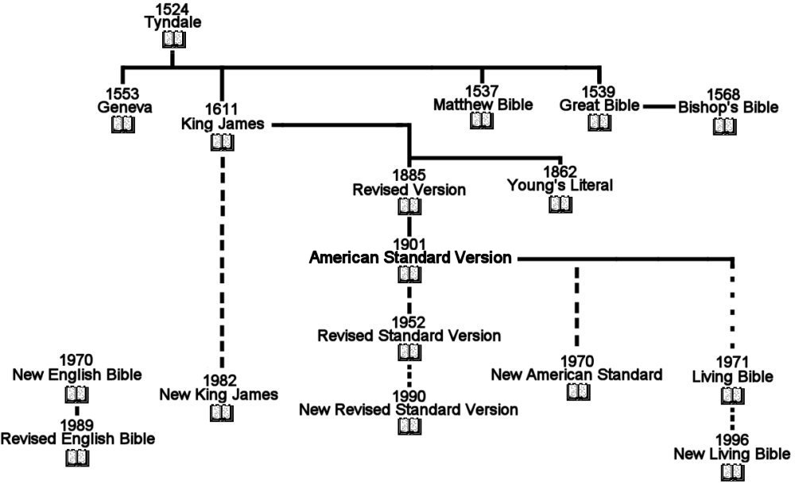
The Bible Over the Years
The books which make up the Christian Old Testament differ between the Catholic (see Catholic Bible), Orthodox, and Protestant (see Protestant Bible) churches, with the Protestant movement accepting only those books contained in the Hebrew Bible, while Catholics and Orthodox have wider canons. A few groups consider particular translations to be divinely inspired, notably the Greek Septuagint and the Aramaic Peshitta.
Bible Translations made since 2014
7,000 Approximate number of languages spoken in the world today
2,195 Number of translations into new languages currently in progress
1,329 Number of languages with a translation of the New Testament
Number of languages with a translation of the Bible (Protestant Canon)
Wikepedia

Slide 21
The First Presidency has released the following letter regarding the King James Version of the Bible. August 1992 Ensign
Many versions of the Bible are available today. Unfortunately, no original manuscripts of any portion of the Bible are available for comparison to determine the most accurate version. However, the Lord has revealed clearly the doctrines of the gospel in these latter-days. The most reliable way to measure the accuracy of any biblical passage is not by comparing different texts, but by comparison with the Book of Mormon and modern-day revelations.
While other Bible versions may be easier to read than the King James Version, in doctrinal matters latter-day revelation supports the King James Version in preference to other English translations. All of the Presidents of the Church, beginning with the Prophet Joseph Smith, have supported the King James Version by encouraging its continued use in the Church. In light of all the above, it is the English language Bible used by The Church of Jesus Christ of Latter-day Saints.
The LDS edition of the Bible (1979) contains the King James Version supplemented and clarified by footnotes, study aids, and cross-references to the Book of Mormon, the Doctrine and Covenants, and the Pearl of Great Price. These four books are the standard works of the Church. We encourage all members to have their own copies of the complete standard works and to use them prayerfully in regular personal and family study, and in Church meetings and assignments.
Sincerely your brethren,
Ezra Taft Benson
Gordon B. Hinckley
Thomas S. Monson
Scholars Examine Bible's Role in the Restoration
5 MARCH 2011
“Concern should not be for the perfection, but for the inspiration of the message.” Robert R. Millet
During Joseph Smith’s lifetime, nine new translations of all or significant parts of the Bible were published in addition to the JST.
Previously, the KJV Bible was simply “the Bible,” ancient scripture professor Kent P. Jackson explained. But a growing understanding of Greek and Hebrew and a concern that translators of the KJV Bible deliberately or innocently selected words that did not render the original authors’ meanings led to many different translations of the Bible.
“Like all other translations, the King James [Version] did not always give us words that expressed perfectly the authors’ intent, but the doctrinal imperfections of the King James translation were never an issue for Latter-day Saints and remain, for the most part, invisible to us,” he said. “That is because . . . modern revelation defines them correctly.” Kent P. Jackson
BYU Religious Study Center
Lebanon is first mentioned in the description of the boundary of Palestine ( Deuteronomy 1:7 ; 11:24 ). It was assigned to Israel, but was never conquered ( Joshua 13:2-6 ; Judges 3:1-3 ). And then later in Isaiah 29:17.
It is called "the white mountain of Syria," and is the loftiest and most celebrated mountain range in Syria. Lebanon is mentioned more than 70 times in the Old Testament.
The cedar of Lebanon (Cedrus libani) was prized throughout the ancient Near East. The Palermo Stone indicates cedar was imported to Egypt. David used it on his palace and Solomon used the wood for the temple in Jerusalem.
But over the centuries, no matter how horrible the conflict, Lebanon's beauty has always grown back. Both in the land and in the people.
The Lebanon range is now inhabited by a population of about 300,000 Christians, Maronites, and Druses, and is ruled by a Christian governor. The Anti-Lebanon is inhabited by Mohammedans, and is under a Turkish ruler.
CBN World News; Bible Study Tools; Bible Places.com
The Unlearned Man:
Emma Smith, who assisted her husband Joseph Smith at times in the translation of the Book of Mormon by acting as a scribe, bore this testimony:
“I am satisfied that no man could have dictated the writing of the manuscripts unless he was inspired; for, when [I acted] as his scribe, [Joseph] would dictate to me hour after hour; and when returning after meals, or after interruptions, he would at once begin where he had left off, without either seeing the manuscript or having any portion of it read to him. … It would have been improbable that a learned man could do this; and, for one so … unlearned as he was, it was simply impossible.
“Joseph … could neither write nor dictate a coherent and well-worded letter; let alone dictating a book like the Book of Mormon. And, though I was an active participant in the scenes that transpired, … it is marvelous to me, ‘a marvel and a wonder,’ as much so as to any one else” (“Last Testimony of Sister Emma, ”The Saints’ Herald, Oct. 1, 1879, 290).

Slide 22
Isaiah 29 and 2 Nephi 26-27 Compared
King James Version | JST: Isaiah | 2 Nephi:26-27 Isaiah 29 | Description or Contents
29:1-2 | 29:1-2 |  | Isaiah’s Introduction
29:3-4 | 29:3-4 | 26: 15-17 | Warfare and “speech out of the dust”
 |  | 26:17 | Sealed records hidden from unbelievers
29:5 | 29:5 | 26:18 | Multitudes disappear as chaff
29:6-10 | 29:6-10 | 27:2-5 | God’s signs; man’s empty dreams, closed eyes
29:11 | 29:11-12 | 27:6-7 | Visions and words of a sealed book
 | 29:12-20 | 27:8-15 | Book delivered to a man; shown to witnesses
29:11 | 29:20 | 27:15 | Words of book shown to a learned man
 | 29:21 | 27:15-17 | Learned man wants to see sealed book
29:11 | 29:21 | 27:18 | Learned man says he cannot read sealed book
29:12 | 29:22-26 | 27:20-23 | God instructs man with the sealed book
 | 29:26-32 | 27:24-35 | God’s marvelous works and wonders
Unlocking Isaiah in the Book of Mormon by Victor L. Ludlow p. 205

