Slide 1
Lesson 126 Part 1
Destruction and the Millennium
Isaiah 30-35
They that remain, and are pure in heart, shall return, and come to their inheritances, they and their children, with songs of everlasting joy, to build up the waste places of Zion—
D&C 101:18

Slide 2
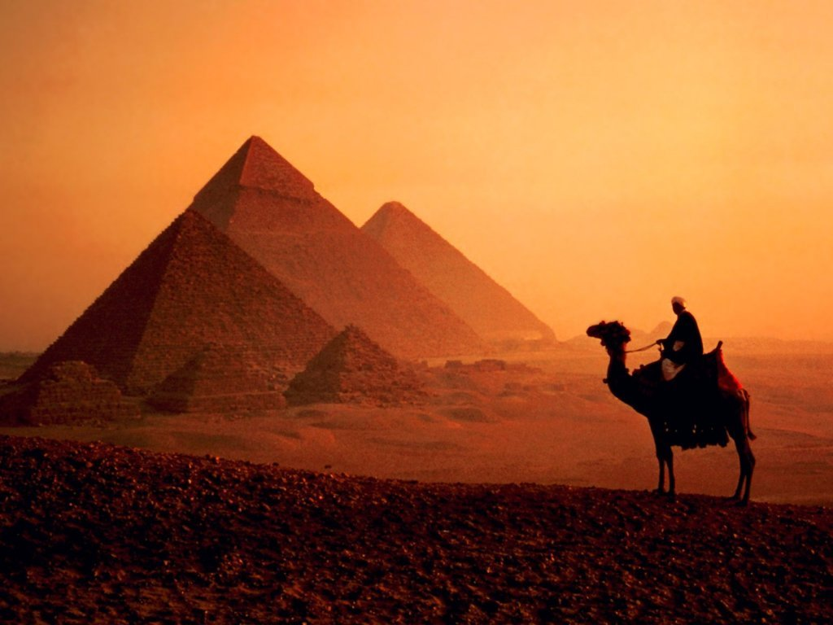
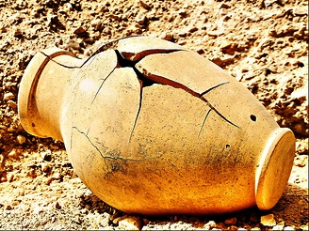
Egypt
Isaiah warns Judah not to trust in Egypt and to trust in the Lord instead
Israel and Judah had been cautioned by the Lord not to put their trust in other nations. But this people refused to hearken, and they turned to Egypt for protection from the Assyrians.
The Lord berated them for seeking to “strengthen themselves in the strength of Pharaoh, and to trust in the shadow of Egypt”.
All of this, Isaiah said, “shall help in vain, and to no purpose”.
As a result, Israel would be broken as easily as a clay pot.
Isaiah 30:2
(1)

Slide 3
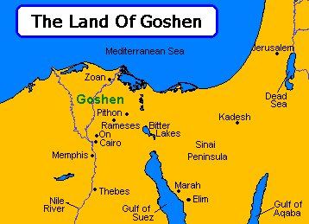
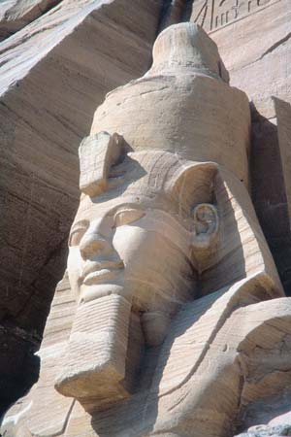
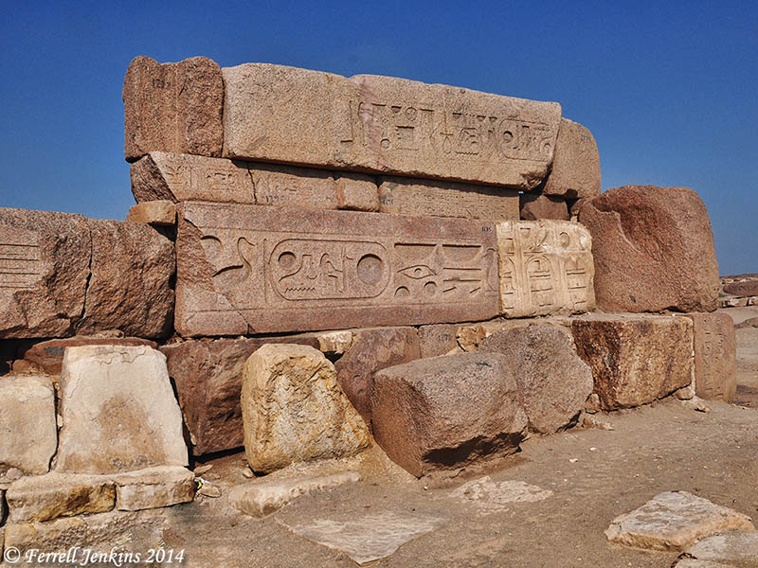
Princes at Zoan
Zoan--An important Egyptian city of great antiquity, almost as old as Hebron. Hebron was built 7 years before Zoan. (2)
The princes of Zoan are become fools, the princes of Noph are deceived; they have also seduced Egypt, even they that are the stay of the tribes thereof. (Isaiah 19:13)
Ferrell Jenkins
Isaiah 30:2 Isaiah 19:11-17

Slide 4
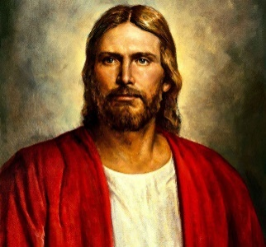
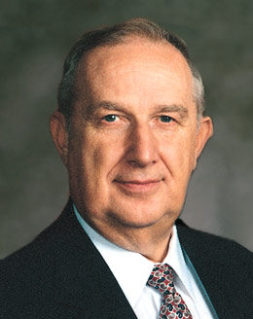
Aligning With The Lord
“This life is an experience in profound trust— trust in Jesus Christ, trust in His teachings, trust in our capacity as led by the Holy Spirit to obey those teachings for happiness now and for a purposeful, supremely happy eternal existence. To trust means to obey willingly without knowing the end from the beginning.”
“Realize your full dependence upon the Lord and your need to align your life with His teachings.”
Isaiah 30:1-7
(4)

Slide 5
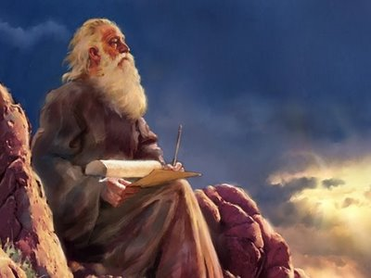
Isaiah’s Record
The Lord’s commanded Isaiah to write in a book the Lord’s words regarding the people’s rebellion.
Isaiah 30:8

Slide 6
“Unfortunately, messengers of divinely mandated commandments are often no more popular today than they were anciently. …
“Sadly enough, … it is a characteristic of our age that if people want any gods at all, they want them to be gods who do not demand much, comfortable gods, smooth gods who not only don’t rock the boat but don’t even row it, gods who pat us on the head, make us giggle, then tell us to run along and pick marigolds.”
Isaiah 30:9-11
(3)

Slide 7
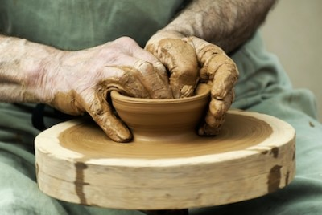
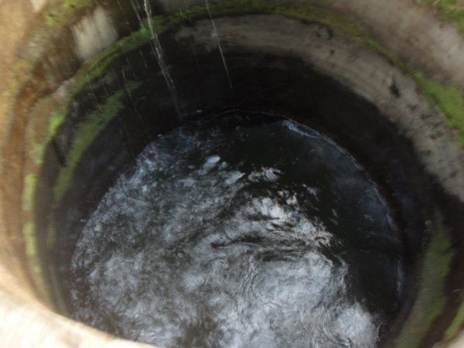
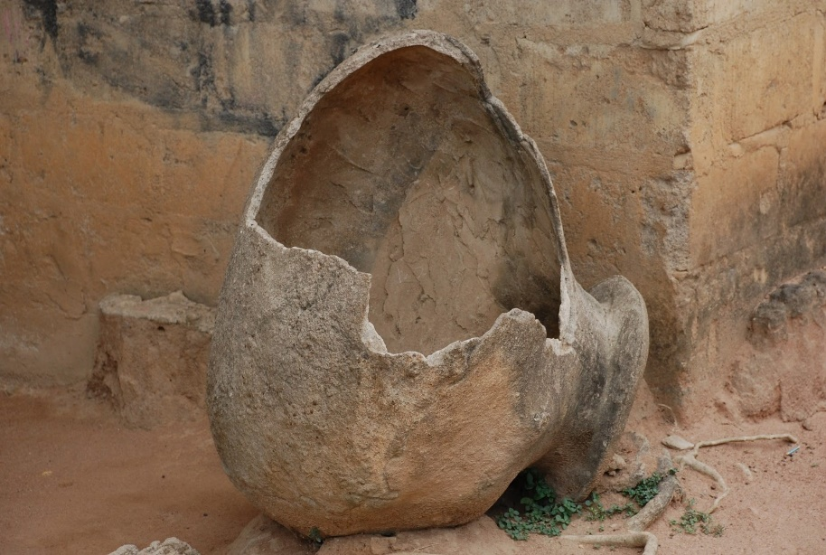
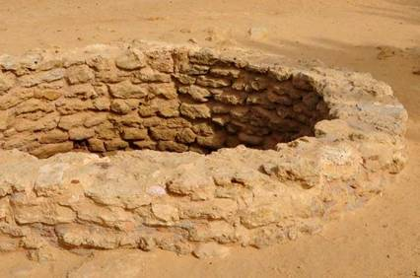
Judah’s Rebellion
If we rebel against God by rejecting the words of the prophets, then we will be weakened
…and if we continue to reject the words of the prophets, we will suffer spiritual destruction
Isaiah 30:12-14

Slide 8
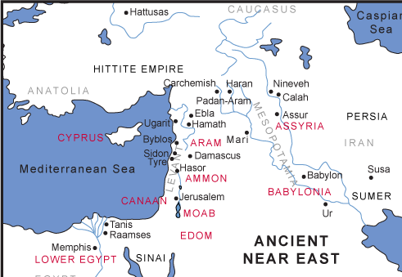
A Comfort in the Last Days
“the first warning speaks against trusting the wisdom of man, and the second against trusting the power of man” (5)
Only the Lord can save Israel. Isaiah said, “Turn ye unto him from whom the children of Israel have deeply revolted,” and “then shall the Assyrian fall with the sword, not of a mighty man,” but of the Lord.
The “Egyptian” and the “Assyrian” of the latter days may be those in whom a modern people trust rather than in the Lord. (1)
In the last days the Lord will defend the righteous inhabitants of Zion.
Isaiah 31

Slide 9
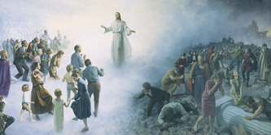
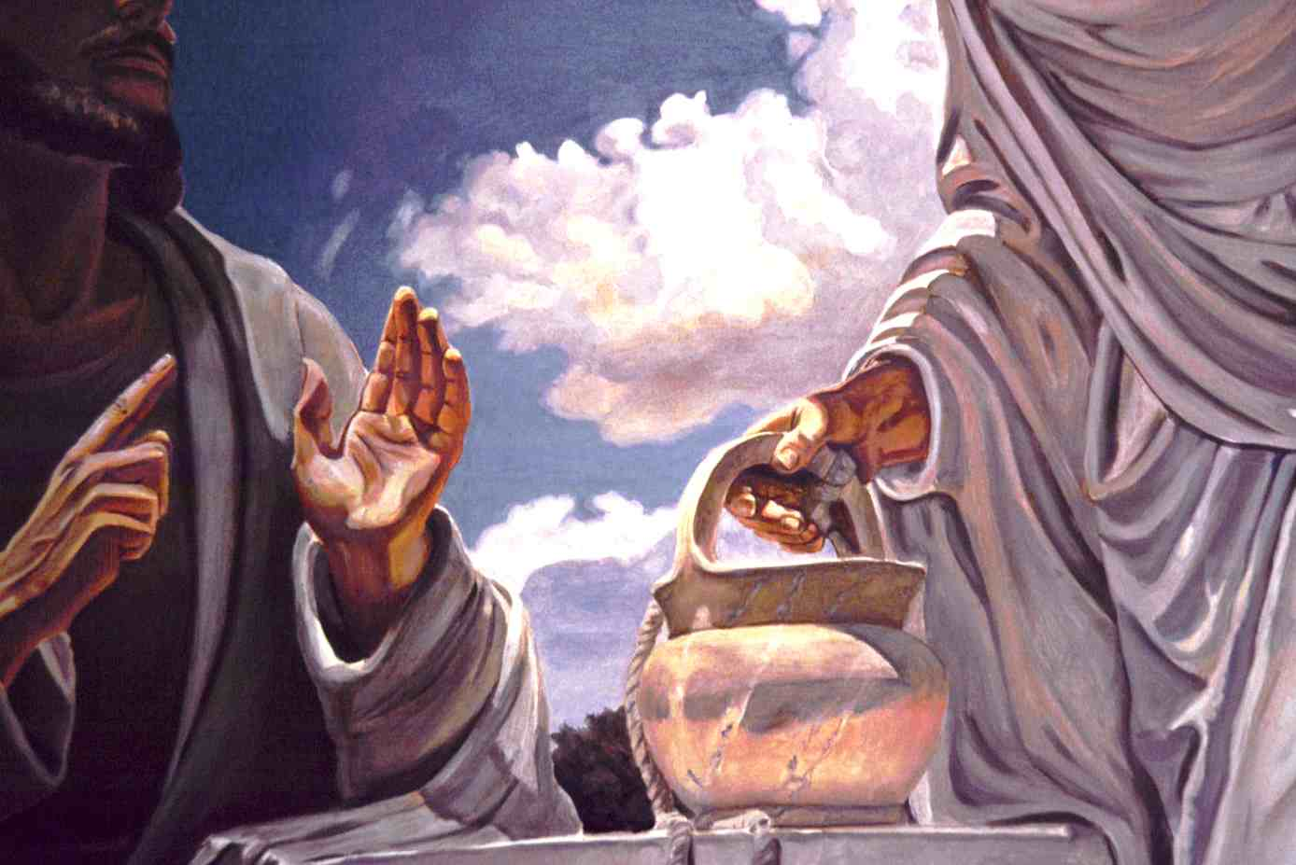
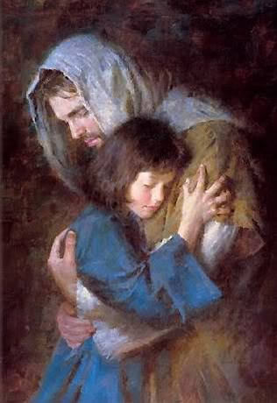
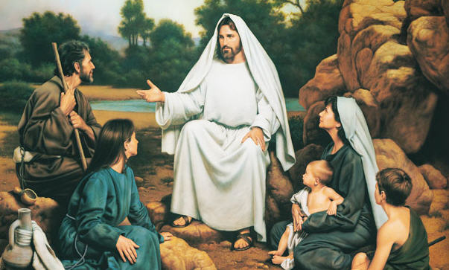
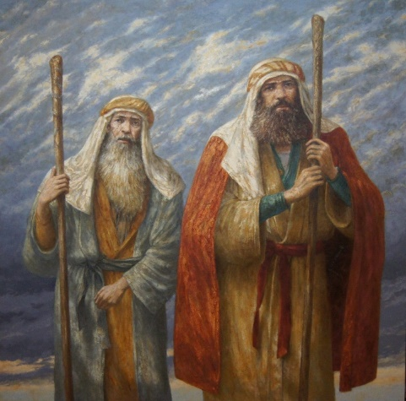
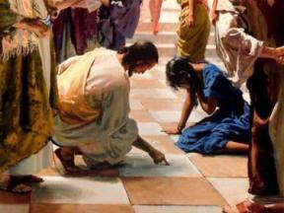
Hiding Place From the Wind =
Protection
Rivers of Water = Christ is the living water
Vile person = Those who call good evil and evil good
Churl = rude, deceiver
Those who are unworthy will not have a place
A King Shall Reign
The Savior in the Second Coming
See and hear = those who listen and understand the true doctrine of the gospel
Stammering = Those who are incapable of expressing themselves, but shall be ready to speak (interpretations of tongues)
Heart of rash = those who take time and not judge in haste
Isaiah 32:1-8

Slide 10
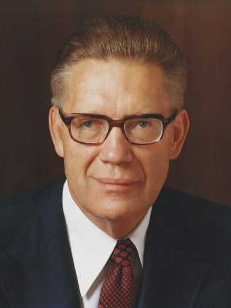
If I were to stand in God’s presence, would I feel worthy to be in His presence?
1. We must keep the commandments. We must speak the truth and work the works of righteousness. We shall be judged by our thoughts, our words and our deeds.
3. We must reject every effort to buy influence, and instead deal fairly and impartially with our fellowmen….
Salvation is free; it cannot be purchased with money; and those only are saved who abide the law upon which its receipt is predicated. Bribery is of the world.
If we walk righteously, speak uprightly, and do not participate in evil, we will be worthy to dwell in the presence of God
2. We must act with equity and justice toward our fellowmen. It is the Lord himself who said that he, at the day of his coming, will be a swift witness against those that oppress the hireling in his wages.
4. We must not center our attention on evil and wickedness. We must cease to find fault and look for good in government and in the world. We must take an affirmative, wholesome approach to all things..
Isaiah 33:15-16
(6)

Slide 11
The Second Coming
Come near
Indignation of the Lord
Slain/stink/blood
God’s warning the last days is not just to the chosen people, but all nations including all things upon the earth
What happens when God’s wrath is ignited? He withdraws His protective spirit
The death toll will be so high that they can’t dispose of the dead
Host of heaven dissolved
Sword bathed in heaven
A great phenomenon in the heavens and the earth—movement toward Kolob
The sword of death will fall upon the depraved as wicked fight against wicked
Isaiah 34:1-4
(7)

Slide 12
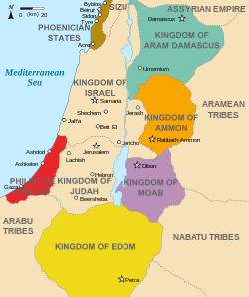
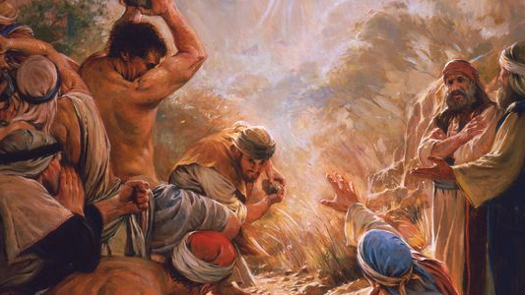
Idumea--used to represent the world
Idumea or Edom in Hebrew was the region south of Judea originally inhabited by the reputed descendants of Jacob's brother Esau.
This is where Esau’s posterity intermarried with Ishamel’s posterity.
Blood is the symbol for wickedness
Sword, blood, and sacrifice
Destruction of wicked is the price required to pay for killing the prophets and innocent people
Isaiah 34:5-6
(7, 8)

Slide 13
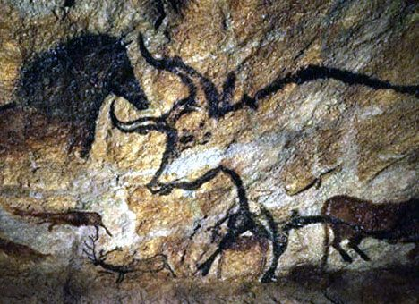
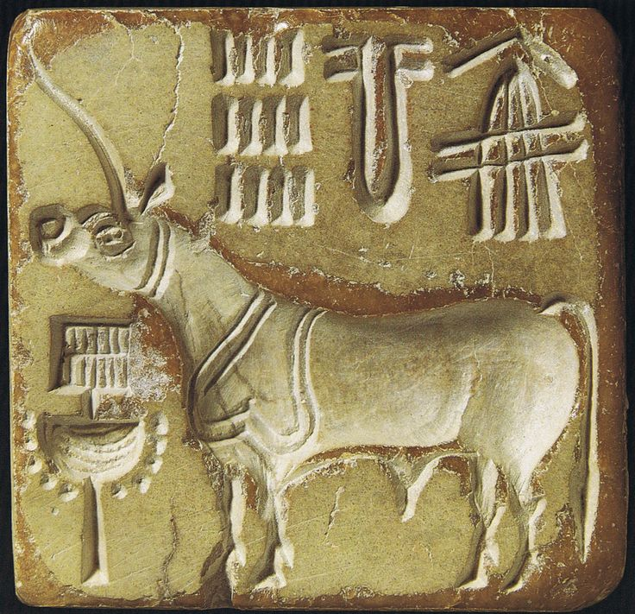
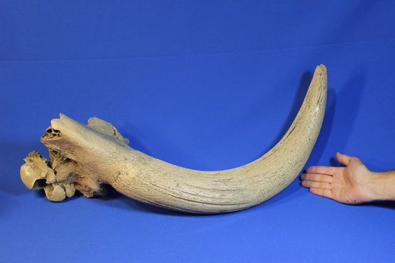
Unicorn
In the Bible it was symbolic of 2 horns and a blessing given to Joseph as being the 2 great tribes—Ephraim and Manasseh
A Unicorn is the ferocious wild ox called “aurochs” now extinct. They are slightly less than elephants in size with great speed
Massive Fossil Auroch Horn - Over 2.5 Feet Long! This amazing, imposing fossil horn comes from an auroch (Bos primigenius). It is an unbelievable, rare discovery from the bed of the North Sea in Holland. The auroch is the ancestor of all modern cattle, but this prehistoric bovine was much larger. It dates back to the Pleistocene Epoch - 40,000 years ago - the era of great Ice Age mammals
Isaiah 34:7-15
(7)

Slide 14
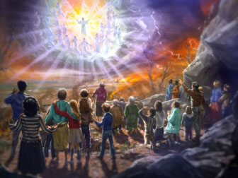
Lamb’s Book of Life--Exaltation
Not all people, of course, are wicked, and those who are not will be saved from the destroying fire—both the spiritual (hell) and the physical.
The names of the children of the Lord who have kept their covenants are enrolled in a special book known as “the book of the Lord”, “the book of the law of God”
Isaiah 34:16-17 1 Nephi 22:15-17 Revelation 20:12 D&C 85:5
(1)

Slide 15
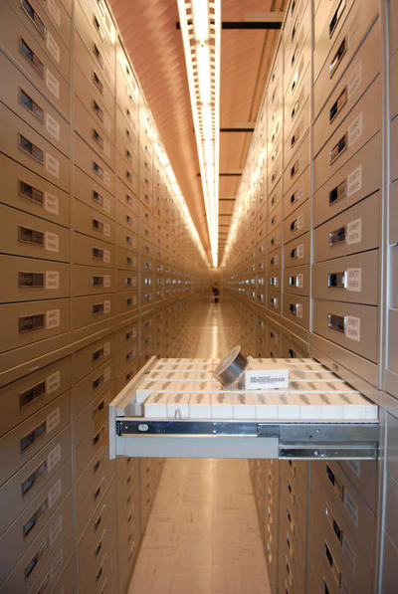
Records of Our Works
Records of our works are kept on earth by the Lord’s clerks, but the book of life is the record kept in heaven. Both records should agree. Of those whose names are recorded in the heavenly book, “no one of these shall fail”.
The promise that “none shall want [lack] their mate” is particularly interesting to Latter-day Saints since we know that only through the ordinance of celestial marriage can we have our mate eternally.
Isaiah 34:16-17 D&C 128:6-9 JST 34:16
(1)

Slide 16
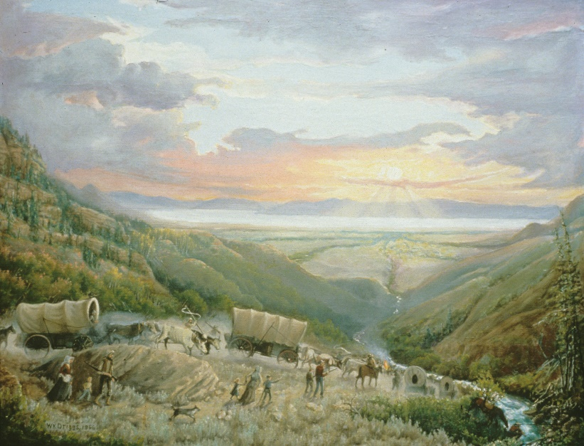
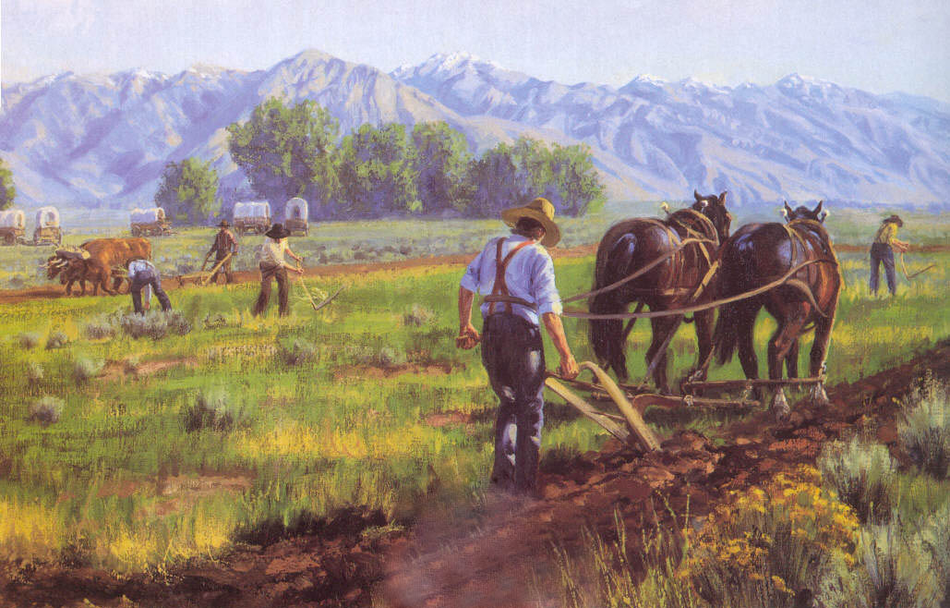
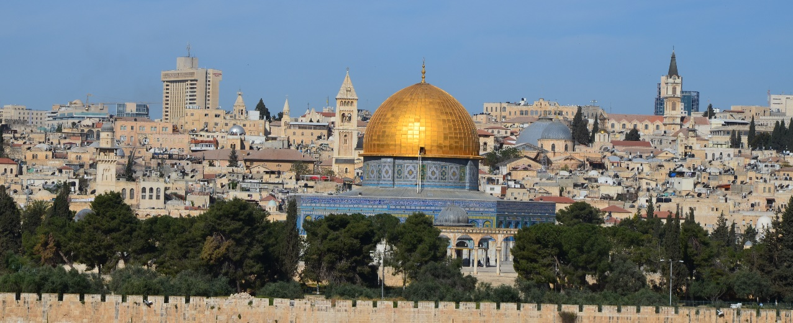
A Wilderness and Solitary Place
When the Saints arrived in the Salt Lake Valley in July 1847, it could be described as a “wilderness” and a “solitary place.”
The Saints went to work immediately, and soon the desert valleys of Utah began to “blossom as the rose.”
But this prophecy may also be fulfilled by the settlement of modern Jews in the Holy Land, where similar things are taking place.
Isaiah 35:1
(1)

Slide 17
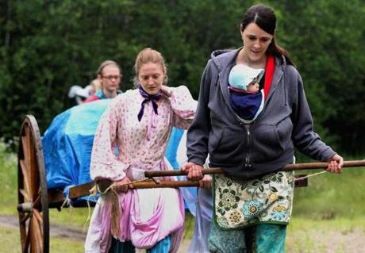
Strengthen And Confirm
What can we do to strengthen the faith of others?
Strengthen the faith of those who are exhausted, discouraged, or fearful
As we testify that the Lord will come to save and heal us, we can strengthen the faith of others
Isaiah 35:3-6

Slide 18
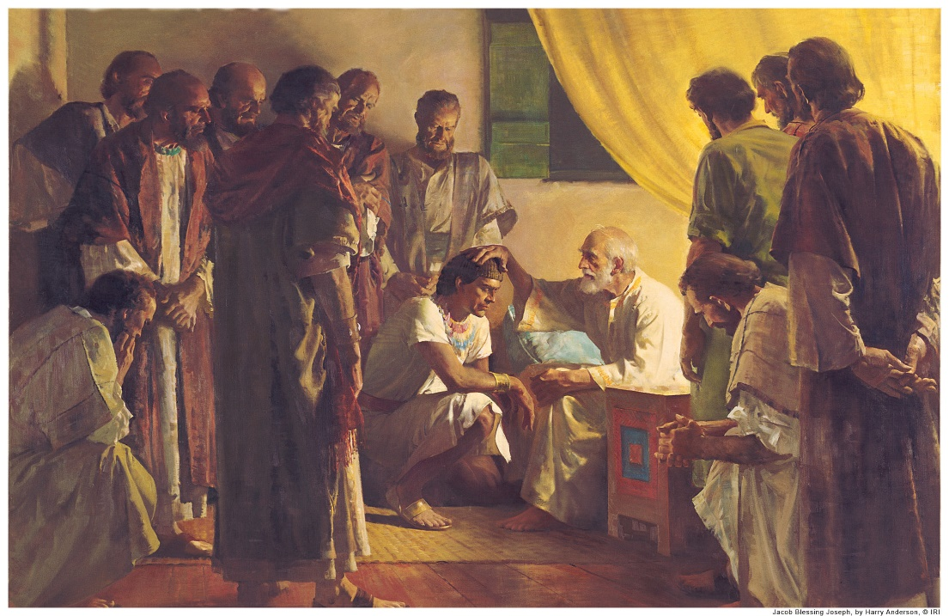
The Ransomed of the Lord
Generally acknowledged to refer to the return of the ten tribes.
But these references may also include all the tribes. Only the “redeemed” of the Lord, that is the righteous, shall tread the “highway” or “way of holiness”—”the unclean shall not pass over it.”
And there shall they fall down and be crowned with glory, even in Zion, by the hands of the servants of the Lord, even the children of Ephraim.
D&C 133:32
Since Ephraim is the source of the ten tribes’ blessings, it stands to reason that Ephraim must be gathered first. The ten tribes may then “come to Zion with songs and everlasting joy upon their heads.”
Judah also shall be gathered as part of this same picture.
Isaiah 35:8-10
(1)

Slide 19
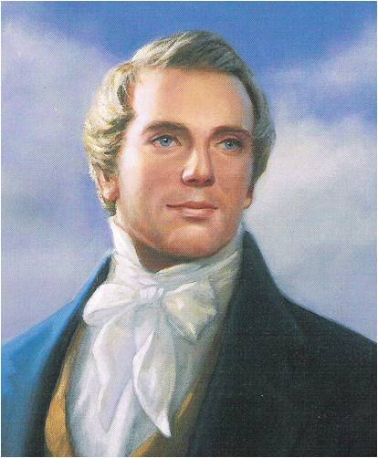
“Our western tribes of Indians are descendants from that Joseph who was sold into Egypt, and … the land of America is a promised land unto them, and unto it all the tribes of Israel will come, with as many of the Gentiles as shall comply with the requisitions of the new covenant. But the tribe of Judah will return to old Jerusalem.
The city of Zion spoken of by David, in the one hundred and second Psalm, will be built upon the land of America, ‘And the ransomed of the Lord shall return, and come to Zion with songs and everlasting joy upon their heads.’; and then they will be delivered from the overflowing scourge that shall pass through the land. But Judah shall obtain deliverance at Jerusalem.
…the Good Shepherd will put forth his own sheep, and lead them out from all nations where they have been scattered in a cloudy and dark day, to Zion, and to Jerusalem; besides many more testimonies which might be brought.”
Isaiah 35:8-10
(9)

Slide 20
Sources:
Suggested Hymn: #128 When Faith Endures
Videos: The Cost—and Blessings—of Discipleship (1:04)
The Lord’s Work Moves Forward with Each of Us (1:16)
Old Testament Institute Manual (Prophecies of the Dispensation of the fullness of Times) Chapter 15
Jewish Encyclopedia
Elder Jeffrey R. Holland (“The Cost—and Blessings—of Discipleship,” Ensign or Liahona, May 2014, 7)
Elder Richard B. Scott Trust in the Lord November 1995 Ensign or Oct. 1995 Gen. Conf.
Nyman, “Great Are the Words of Isaiah,” p. 118
Elder Bruce R. McConkie “Think on These Things” January 1974 Ensign
Poway Institute Handout by Becky Davies and Lesley Meacham
Bible Dictionary
President Joseph Smith Teachings, p. 17
Presentation by ©http://fashionsbylynda.com/blog/

Slide 21
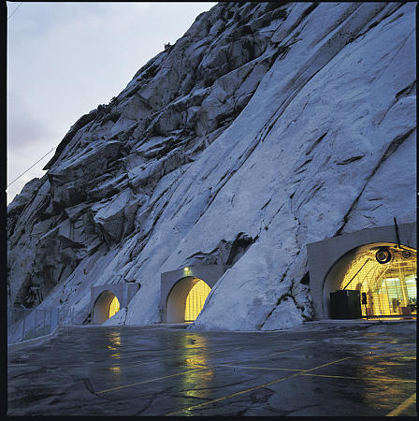
Idumea:
“Now, some Bible commentators, because of the name of Idumea, a little country east of the Jordan, is mentioned, have an idea that this had reference to that little country; but the term Idumea is one that the Lord uses to mean the world. You will find it so recorded in Section 1 of the Doctrine and Covenants. He is speaking of the world.”
“That is to take place in the dispensation of the Fulness of Times, and this prophecy had nothing to do with that little country called Idumea but to the nations of the earth.” President Joseph Fielding Smith (Signs of the Times, p. 151).(The Signs of the Times, p. 150.)
Besides genealogical preservation and storage, Granite Mountain Records Vault serves as the deep archives for a myriad of church materials — including scriptures in every language published, large leather-bound temple ordinance books that were hand-kept through the 1960s, materials and minutes from presiding priesthood quorums, financial records, backup tapes and audio-visual masters from "Legacy" to "Johnny Lingo."
Armageddon::
Isaiah seems to parallel passages in Ezekiel, Joel, and Jeremiah where the great battle of Armageddon is foretold. This parallelism explains the reference to the “armies” (Isaiah 34:2) and the vast slaughter that will take place (see vv. 3, 5–7). The “pitch” and “brimstone” and “smoke” of verses 9 and 10 suggest the results of nuclear warfare, which could logically accompany the last great wars.
According to the prophets, some important events must take place before the battle actually begins:
The house of Israel will be gathered from among the heathen (the Gentiles) and returned to their own land (see Ezekiel 36:24; 37:21).
The land of Israel will be rebuilt and reinhabited by the covenant people (see Ezekiel 36:10–12, 33–36).
The land will become highly productive and fruitful, even like the Garden of Eden (see Ezekiel 36:8, 29–30, 34–35).
There will be one nation in the land of Israel again (see Ezekiel 37:22).
Jerusalem will be reestablished as the capital city of the Israelites (see Zechariah 1:16–17; 2:12; 12:6;3 Nephi 20:46).
Judah will become powerful in politics and warfare (see Isaiah 19:16–17; Zechariah 10:3, 5–6).
A great combination of organizations serving Satan will arise in the last days. This combination has several names: the “beast … out of the sea” (Revelation 13:1), representing the kingdoms of the earth (see JST, Revelation 13:1; 17:8–14; Bruce R. McConkie, Doctrinal New Testament Commentary 3:520); the “great and abominable church,” “the church of the devil,” “the great whore,” and “the mother of … abominations” (Revelation 17:1, 5).

Slide 22
“To all the Kings of the World;
To the President of the United States of America;
To the Governors of the several States;
And to the Rulers and People of all Nations:”
In it they said:
“Know ye:
“That the kingdom of God has come: as has been predicted by ancient prophets, and prayed for in all ages; even that kingdom which shall fill the whole earth, and shall stand for ever.
“The great Eloheem … has been pleased once more to speak from the heavens: and also to commune with man upon the earth, by means of open visions, and by the ministration of Holy Messengers.
“By this means the great and eternal High Priesthood, after the Order of His Son, even the Apostleship, has been restored; or, returned to the earth.
“This High Priesthood, or Apostleship, holds the keys of the kingdom of God, and power to bind on earth that which shall be bound in heaven; and to loose on earth that which shall be loosed in heaven. And, in fine, to do, and to administer in all things pertaining to the ordinances, organization, government and direction of the kingdom of God.
“Being established in these last days for the restoration of all things spoken by the prophets since the world began; and in order to prepare the way for the coming of the Son of Man.
“And we now bear witness that his coming is near at hand; and not many years hence, the nations and their kings shall see him coming in the clouds of heaven with power and great glory.
“In order to meet this great event there must needs be a preparation.
“Therefore we send unto you with authority from on high, and command you all to repent and humble yourselves as little children, before the majesty of the Holy One; and come unto Jesus [Christ] with a broken heart and a contrite spirit; and be baptized in his name, for the remission of sins (that is, be buried in the water in the likeness of his burial and rise again to newness of life, in the likeness of his resurrection), and you shall receive the gift of the Holy Spirit, through the laying on of the hands of the Apostles and elders, of this great and last dispensation of mercy to man.
“This Spirit shall bear witness to you, of the truth of our testimony; and shall enlighten your minds, and be in you as the spirit of prophecy and revelation. It shall bring things past to your understanding and remembrance; and shall show you things to come.
“By the light of this Spirit, received through the ministration of the ordinances—by the power and authority of the Holy Apostleship and Priesthood, you will be enabled to understand, and to be the children of light; and thus be prepared to escape all the things that are coming on the earth, and so stand before the Son of Man.
“We testify that the foregoing doctrine is the doctrine or gospel of Jesus Christ, in its fulness; and that it is the only true, everlasting, and unchangeable gospel; and the only plan revealed on earth whereby man can be saved.” (Messages of the First Presidency, 1:252–54.) Ezra Taft Benson October 1975 Gen. Conf.
Proclamation to the Nations
The kingdom of God has come, with revelation and authority.
The Lord has commanded the rulers and all others to repent and be baptized.
Blessings come from the gift of the Holy Ghost.
The American Indians are a remnant of the House of Israel and will be civilized and receive the gospel.
New Jerusalem will be built on the American continent.
The Jews are together to Jerusalem, rebuild the temple and city and create their own government.
The rulers of the Gentiles are to use their material means to foster these objectives.
A great work is ahead, all are invited to help, and none can remain neutral toward the kings.
The resulting polarization will culminate in Armageddon
First published by Parley P. Pratt in 1845
Restated by President Ezra Taft Benson in October 1975 Gen. Conf.

Slide 23
Testimonies of the Good Shephard
Isaiah 35:10 | And the ransomed of the Lord shall return, and come to Zion with songs and everlasting joy upon their heads: they shall obtain joy and gladness, and sorrow and sighing shall flee away.
Joel 2:32 | And it shall come to pass, that whosoever shall call on the name of the Lord shall be delivered: for in mount Zion and in Jerusalem shall be deliverance, as the Lord hath said, and in the remnant whom the Lord shall call.
Isaiah 26:20-21 | Come, my people, enter thou into thy chambers, and shut thy doors about thee: hide thyself as it were for a little moment, until the indignation be overpast. For, behold, the Lord cometh out of his place to punish the inhabitants of the earth for their iniquity: the earth also shall disclose her blood, and shall no more cover her slain.
Jeremiah 31:12 | Therefore they shall come and sing in the height of Zion, and shall flow together to the goodness of the Lord, for wheat, and for wine, and for oil, and for the young of the flock and of the herd: and their soul shall be as a watered garden; and they shall not sorrow any more at all.
Psalm 1:5 | Therefore the ungodly shall not stand in the judgment, nor sinners in the congregation of the righteous.
Ezekiel 34:11-13 | For thus saith the Lord God; Behold, I, even I, will both search my sheep, and seek them out. 12 As a shepherd seeketh out his flock in the day that he is among his sheep that are scattered; so will I seek out my sheep, and will deliver them out of all places where they have been scattered in the cloudy and dark day. 13 And I will bring them out from the people, and gather them from the countries, and will bring them to their own land, and feed them upon the mountains of Israel by the rivers, and in all the inhabited places of the country.

