Slide 1
Lesson 128
Marriage and Family
Part 4

Slide 2
Maria has become friends with a boy at school she really likes.
One day he asks her to send him an inappropriate picture of herself.
When he sees that she is hesitant to do so, he tells her that it’s not that bad and that a lot of other students are sharing pictures like that.
Maria worries that if she does not send him the picture, he and his friends will make fun of her and she might lose his friendship.

Slide 3
What could Maria do to act in faith in this situation?
What might be some worldly assumptions or ideas that could cause someone to think that asking for or sending these kinds of photos is not immoral or wrong?
What gospel doctrine or principle might help Maria in this situation?

Slide 4
Importance of Chastity and Virtue
The prophets have taught about the importance of chastity and virtue.
“Chastity is sexual purity. … To be chaste, you must be morally clean in your thoughts, words, and actions” (1).
Chastity is a part of virtue, which is “a pattern of thought and behavior based on high moral standards” (2)
What are some of the differences between prophets’ teachings about chastity and virtue and the world’s attitude toward these things?

Slide 5
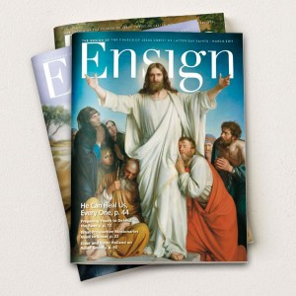
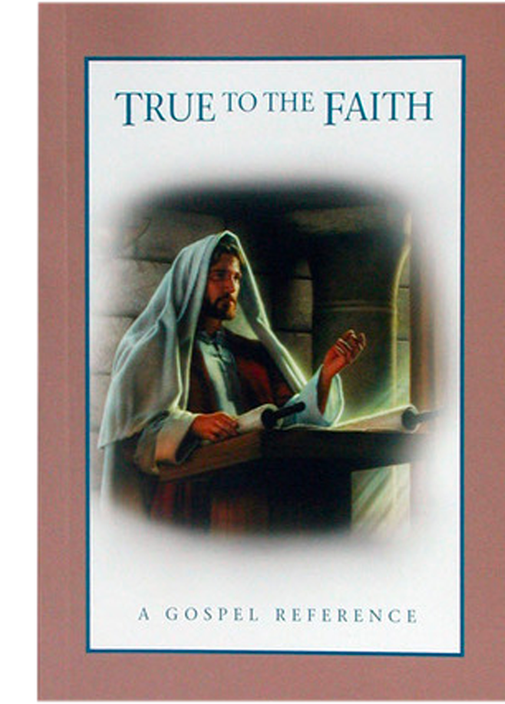
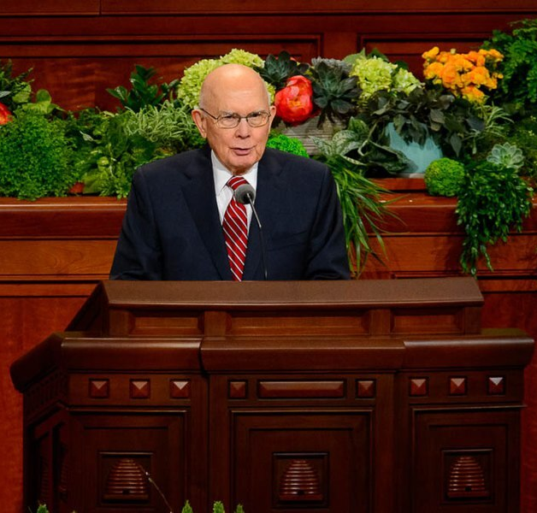
Divinely Appointed Sources:
For the Strength of Youth
General Conference talks
True to the Faith

Slide 6
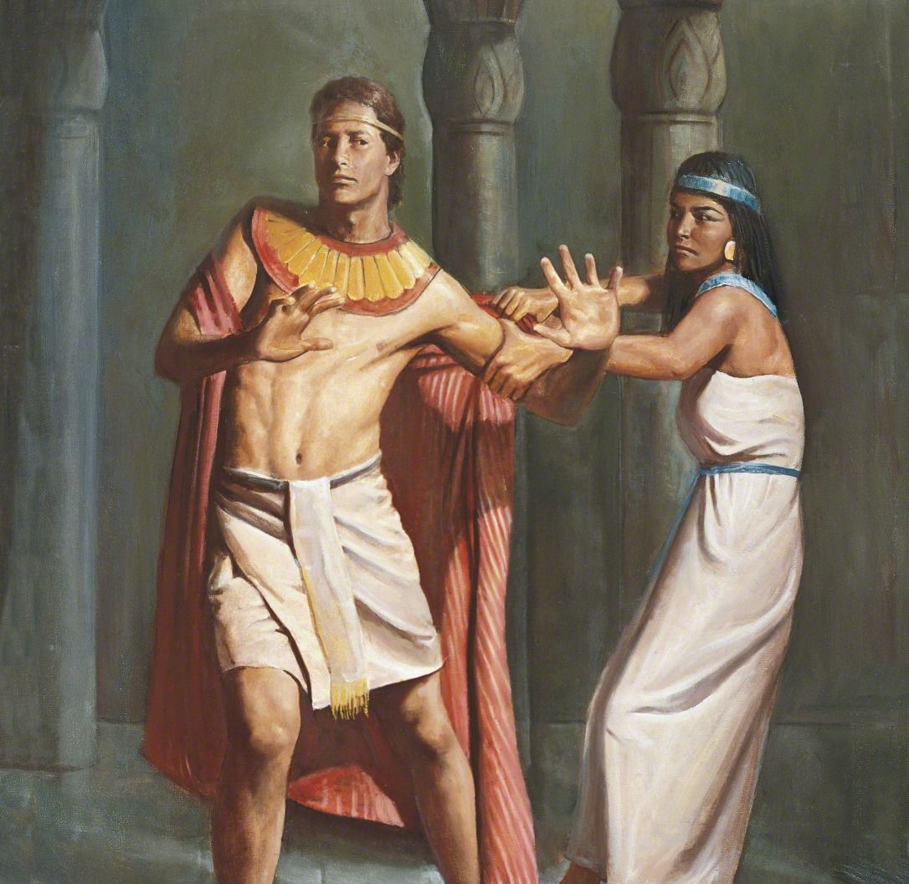
There is none greater in this house than I; neither hath he kept back any thing from me but thee, because thou art his wife: how then can I do this great wickedness, and sin against God? Genesis 39:9
Del Parson

Slide 7
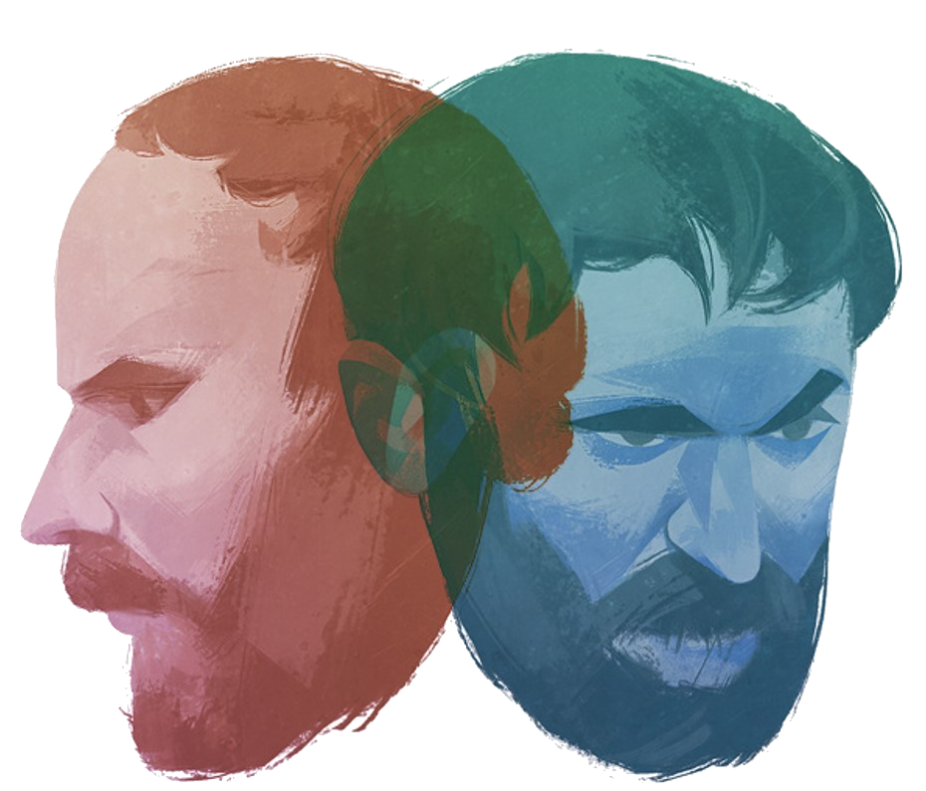
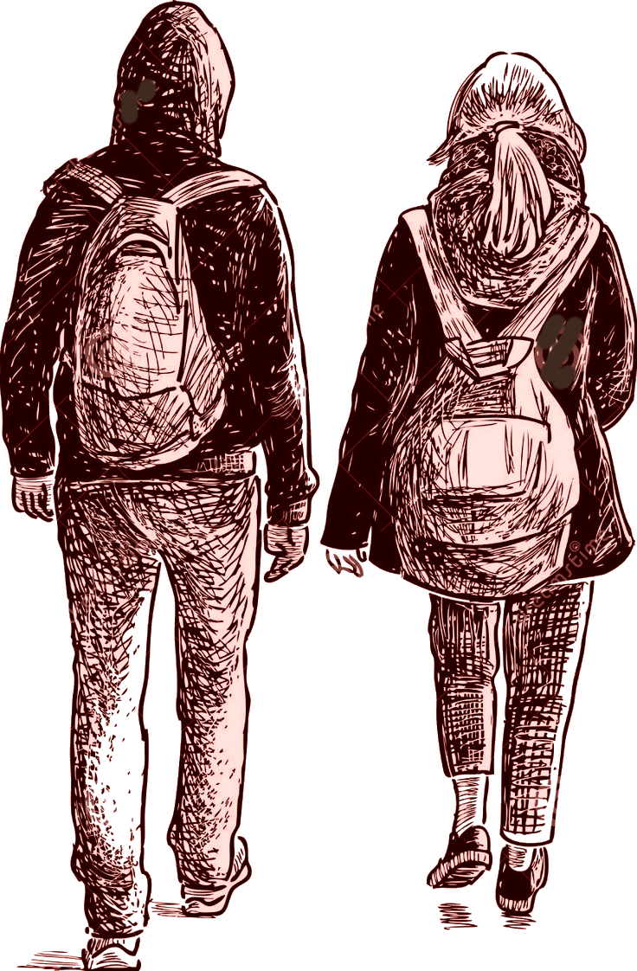
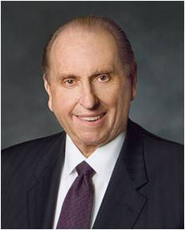
“My young friends, be strong.
The philosophies of men surround us. … Do not be deceived. … You know what is right and what is wrong, and no disguise, however appealing, can change that.
The character of transgression remains the same. If your so-called friends urge you to do anything you know to be wrong, you be the one to make a stand for right, even if you stand alone.
Have the moral courage to be a light for others to follow.
There is no friendship more valuable than your own clear conscience, your own moral cleanliness﻿—and what a glorious feeling it is to know that you stand in your appointed place clean and with the confidence that you are worthy to do so.” (3)
Jelena Vasiljevic

Slide 8
Sources:
Suggested Hymn: #239 Choose the Right
True to the Faith: A Gospel Reference [booklet, 2004], 29
Young Women Personal Progress [booklet, 2009], 70
Thomas S. Monson, “Examples of Righteousness,” Ensign or Liahona, May 2008, 65
Presentation by ©http://fashionsbylynda.com/blog/

