Slide 1
Lesson 129
“Come Ye Near Unto Me”
Isaiah 48-50
I, the Lord, am bound when ye do what I say; but when ye do not what I say, ye have no promise.
D&C 82:10

Slide 2
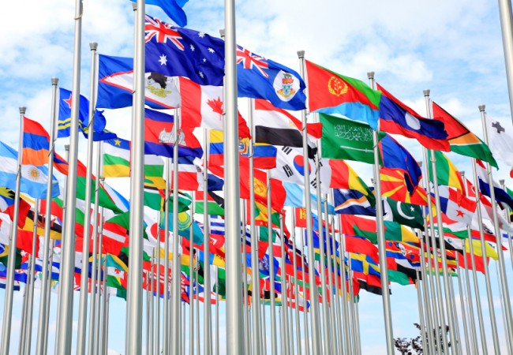
Is It Possible to Have Peace in the World?
OR…
Isaiah 30:2
(1)

Slide 3
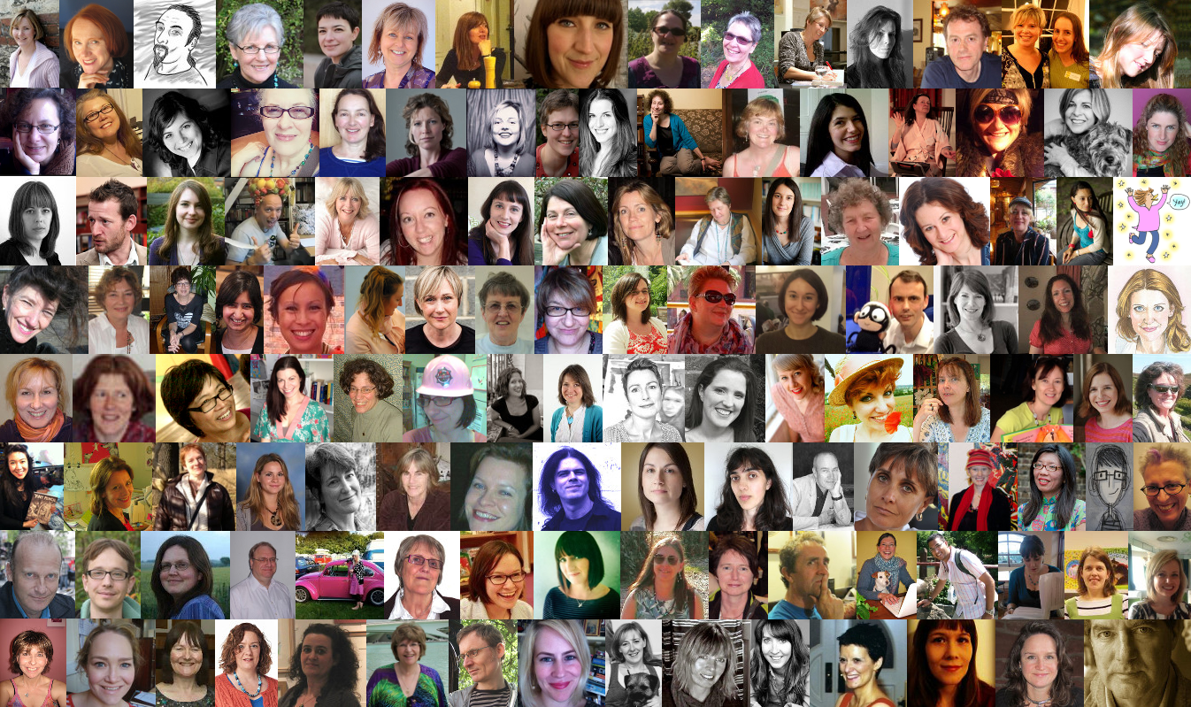
Is it possible to have peace in your lives?

Slide 4
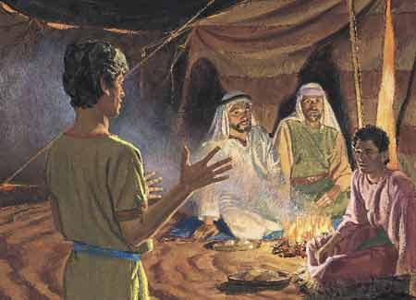
Isaiah 48/1 Nephi 20
Nephi stated that his reason for reading Isaiah to his brethren was so that he “might more fully persuade them to believe in the Lord their Redeemer” 1 Nephi 19:23
(4)

Slide 5
Judah’s Apostasy
“waters of Judah” = Baptism
Even though the Israelites made covenants with the Lord “they do not stay themselves upon the … Lord” = Apostatized
Apostasy State:
1. Individuals or groups of people turn away from the principles of the gospel
2. People were without divine direction from living prophets.
3. Many churches were established, but they did not have priesthood power to lead.
4. Parts of the holy scriptures are corrupted or lost, and no one had the authority to confer the gift of the Holy Ghost or perform other priesthood ordinances. (2)
5. The abandonment or renunciation of a religious or political belief--Wikipedia
Isaiah 48:1-8

Slide 6
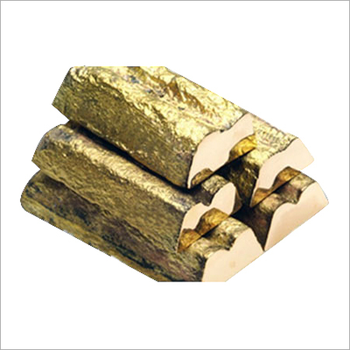
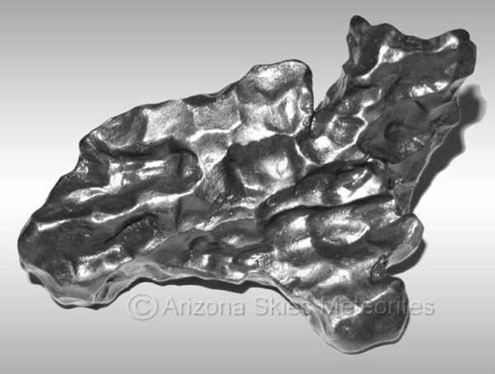
Obstinate
Iron Sinew: stiff necked
A sinew is a tendon. Just as iron does not bend easily, a prideful person will not bow his or her neck in humility.
The phrase “iron sinew” indicates that many people in the house of Israel were filled with pride.
Brow brass: hard headed
Is generally taken to represent judgment, also of evil content.
"I know that thou art obstinate, and thy neck is an iron sinew, and thy brow brass" (Isa. 48:4).
Pride
Isaiah 48:4

Slide 7
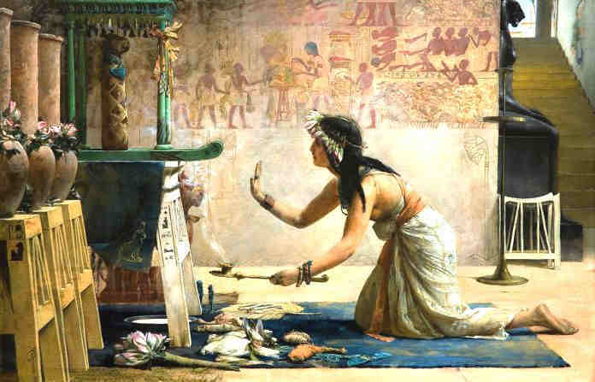
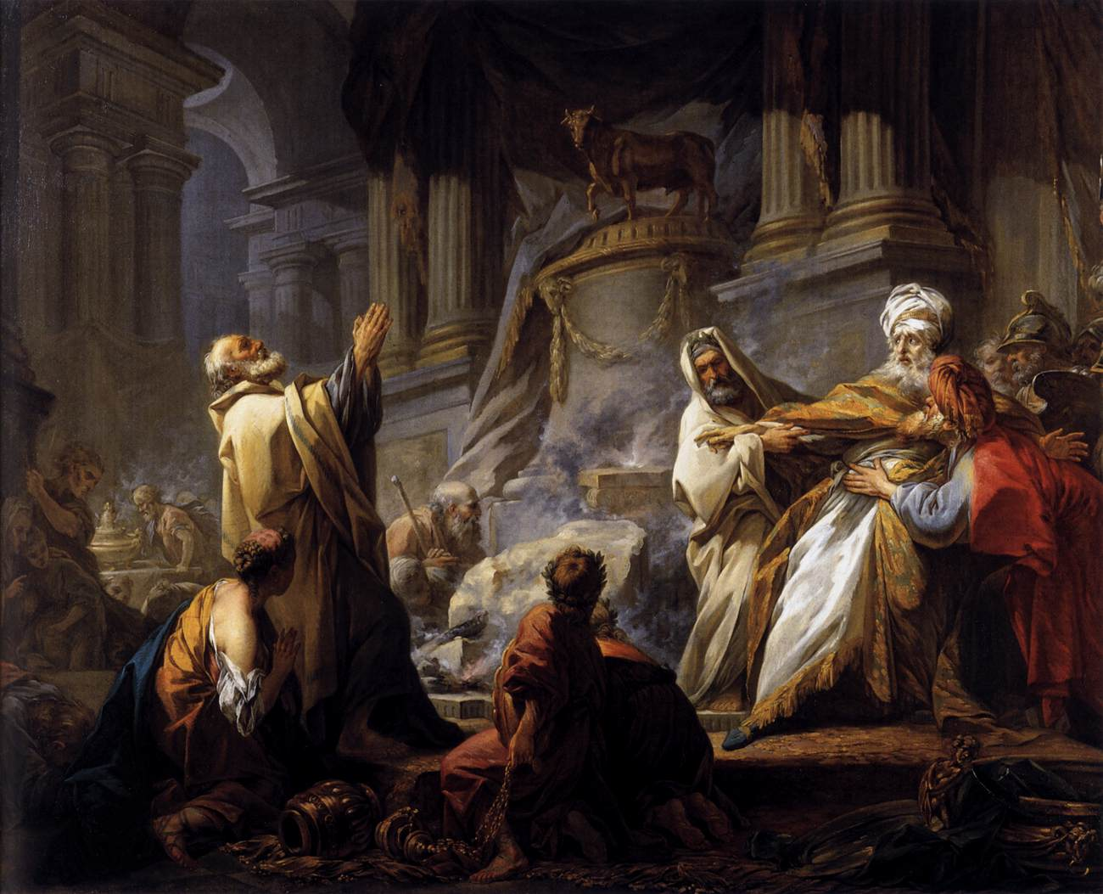
O’ Those Graven Images
Israelites could not attribute the Lord’s acts to their graven images and idols
Isaiah told the people that they would not be able to mistake His work for the work of their idols
The people had become like the graven images they had attached themselves to---stiff, stubborn, and resistant
Isaiah 48:5

Slide 8
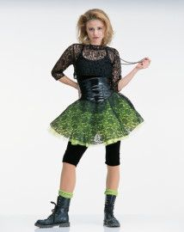
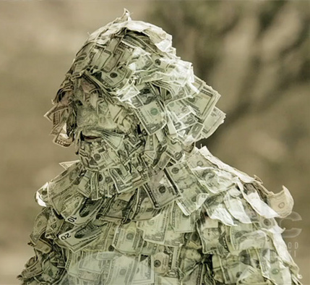
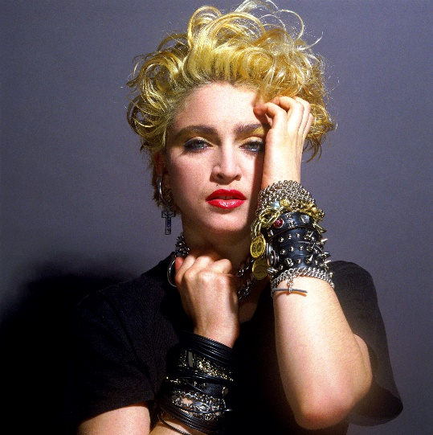
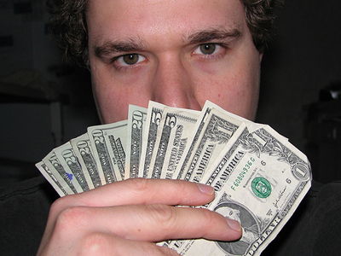
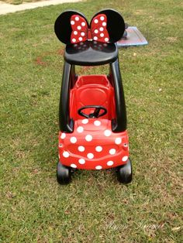
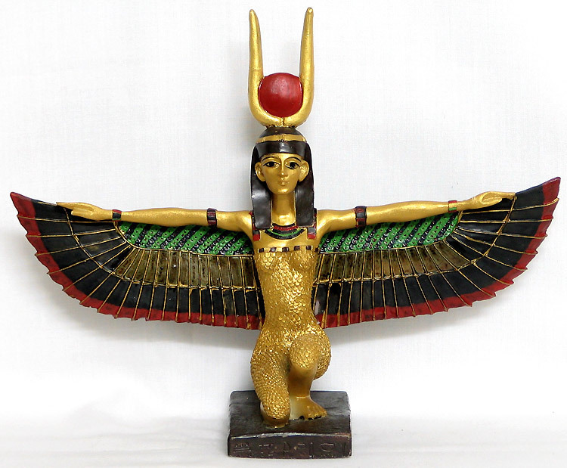
Becoming Like Our Idols
Isaiah 48:1-8

Slide 9
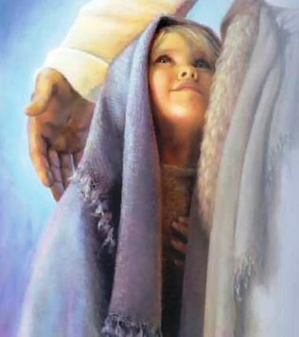
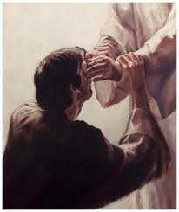
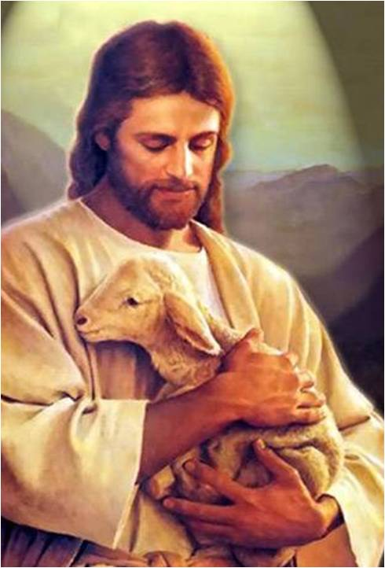
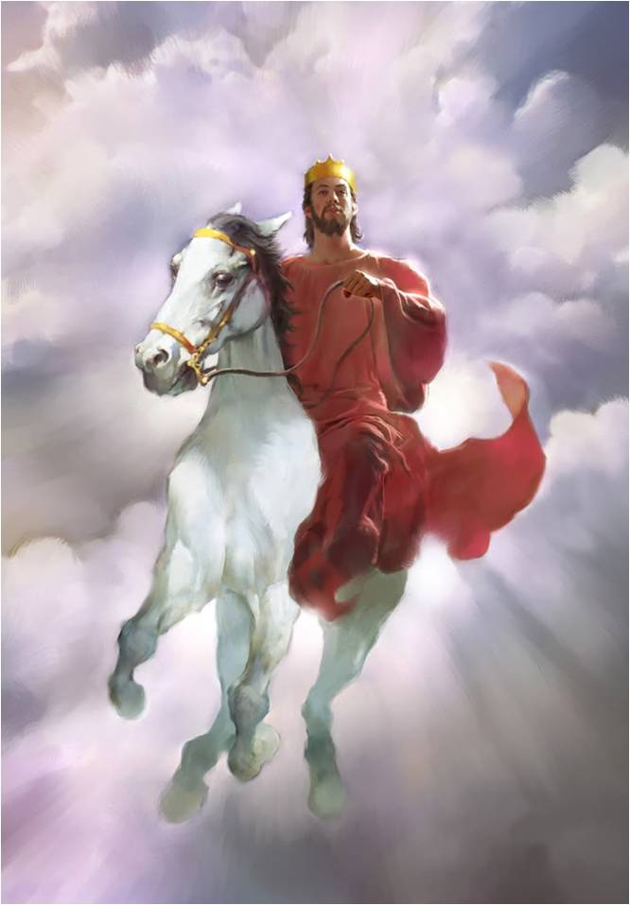
Name’s Sake
Scripture | What is known that belong to Him
Deuteronomy 18:20; Matthew 21:9 | His Authority
Isaiah 48:9 | His dignity and glory
Proverbs 18:10 | His protection and favor
Exodus 34:5 | His character
Matthew 6:9 | His divine attributes in general
Deuteronomy 12:5; 14:24 | His name where the revelation or manifestation of His perfection
Isaiah 48:9
(4)

Slide 10
He Will Forgive
“Although the children of Israel were (and still are) stubborn and unrighteous at times, the Lord explains that He will forgive them and eventually exalt them.” (3)
For my name’s sake will I defer mine anger, and for my praise will I refrain for thee, that I cut thee not off.
Furnace of affliction = the metals in the furnace undergo intense heat and softening during the refining process as they are molded into a new form.
The chosen people must go through difficult trials to become softened, pliable, and purified. (3)
Did you notice the smile?
Christ truly serves as our Refiner
Isaiah 48:9-15

Slide 11
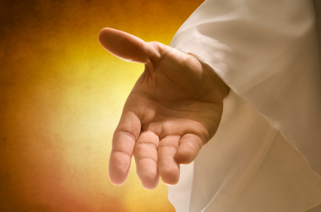
My Right Hand
Mine hand also hath laid the foundation of the earth, and my right hand hath spanned the heavens: when I call unto them, they stand up together.
“It is the right hand of God—the covenant hand
Moses depicts the symbolic power of the Lord’s right hand, declaring to his people that the law came from Sinai—fiery law (Det. 33:2)
Right hand = a place of exaltation (Alma 28:12)
Right Hand extends a promise of strength and support
I, the Lord, am bound when ye do what I say; but when ye do not what I say, ye have no promise. D&C
Isaiah 48:13
(3)

Slide 12
I Am He – The Role of the Eternal God
The Creator God of the Father’s works Verse 13
The Advocate God of the Father’s plan Verse 14
The Administrator God of the Father’s will Verse 15
The Teacher God of the Father’s commandments Verse 17
The Leader God of the Father’s way Verse 17
Isaiah 48:12-17

Slide 13
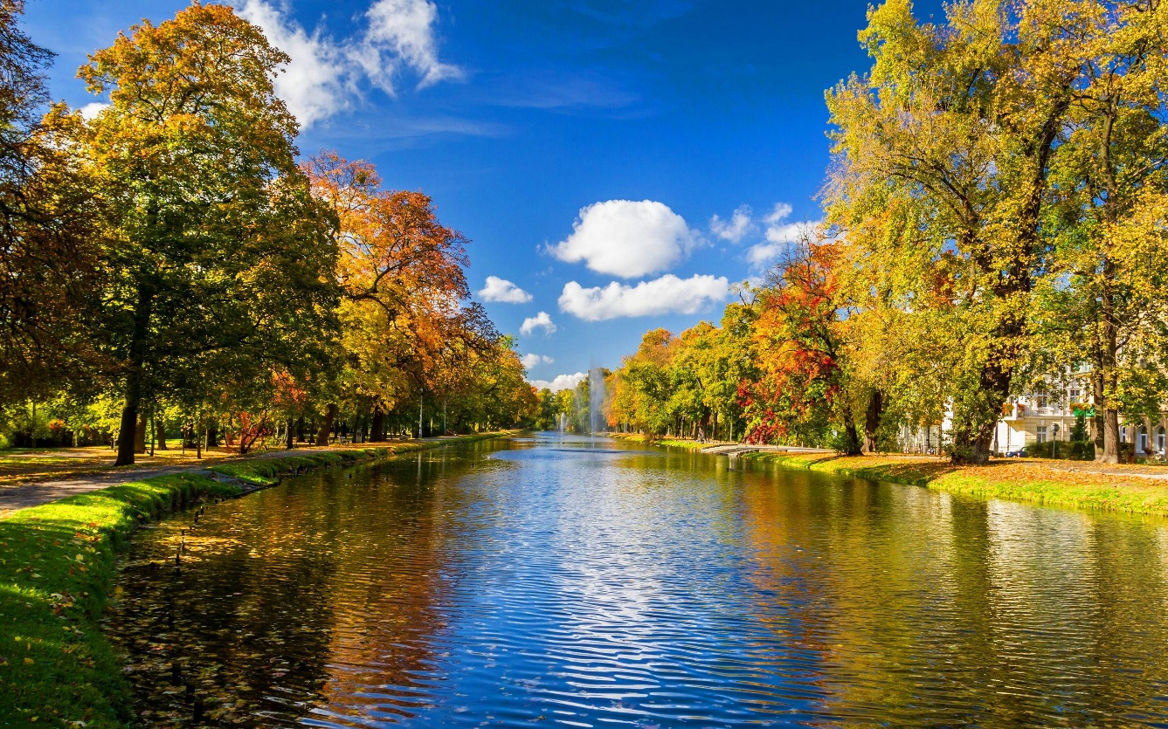
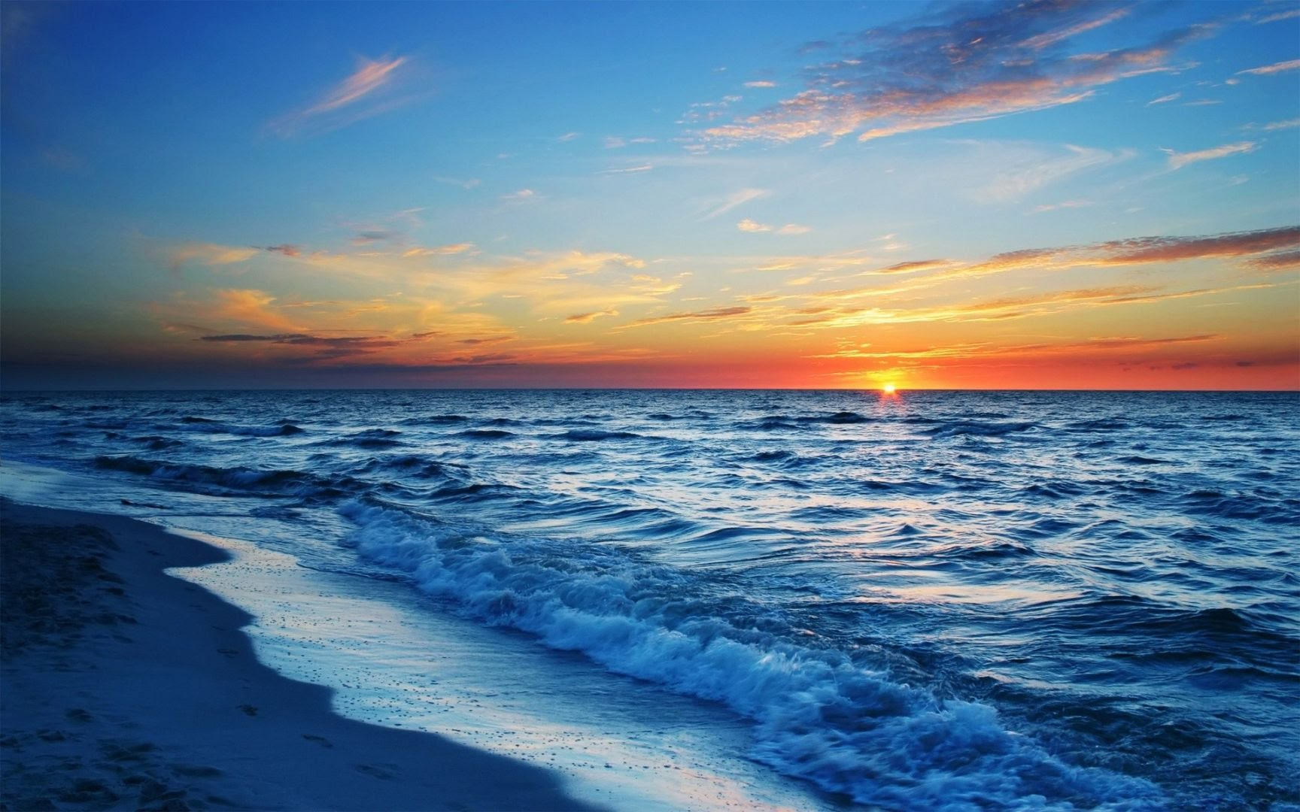
Blessings of Obedience—Peace
Peace of the River
Waves of the Sea
Unyielding dedication to righteous obedience
Isaiah 48:18

Slide 14
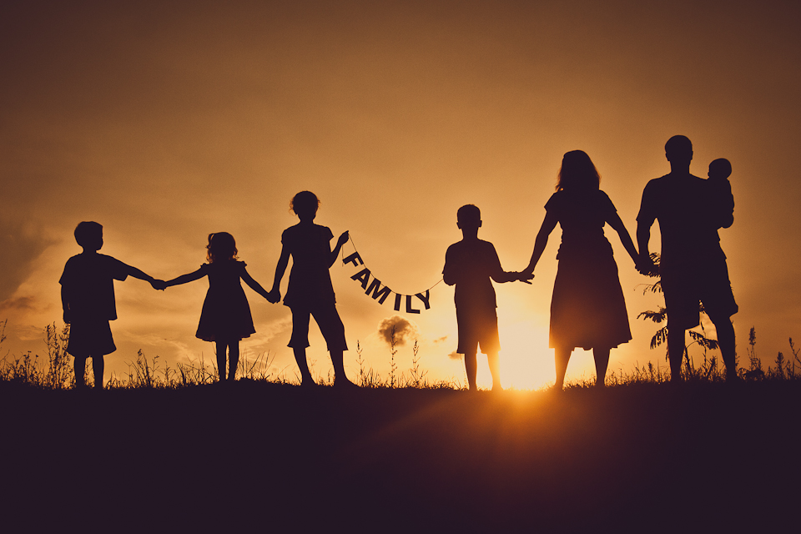
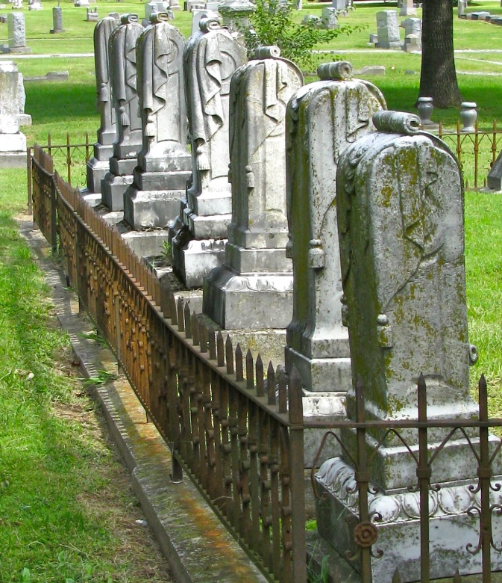
Seed As the Sand
“Posterity is a blessing promised to the righteous, as outlined the Abrahamic Covenant.”
A righteous posterity will enjoy the blessings of the gospel now; while an unrighteous posterity will have to wait to be gathered.”
Isaiah 48:19 Genesis 12:1-3 and Abraham 2:9-10
(5)

Slide 15
Go Ye Out of Babylon
Leaving Babylon
Isaiah is prophesying of the release of Israel as Jewish captive form Babylon (537 B.C.)
However…
He is also telling future generations to leave spiritual Babylon behind.
Leaving Babylon and the Chaldeans is symbolic of leaving worldliness behind and coming unto the Lord
Go ye out from among the nations, even from Babylon, from the midst of wickedness, which is spiritual Babylon.
D&C 133:14
Isaiah 48:20
(5)

Slide 16
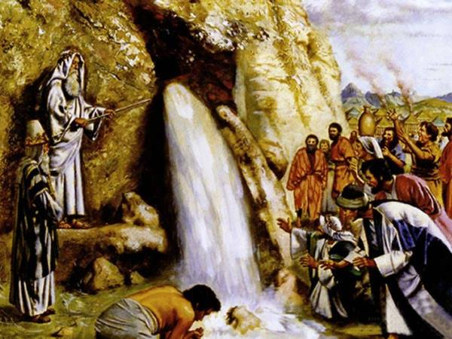
Waters Flow Out of the Rock
The Saviors protective care and redeeming power
The Living Water that comes from Christ
Psalm 95:1
The Rock of our salvation
Isaiah 48:21
(5)

Slide 17
There is No Peace For The Wicked
Do not suppose, because it has been spoken concerning restoration, that ye shall be restored from sin to happiness. Behold, I say unto you, wickedness never was happiness.
Alma 41:10
Can you find peace outside of the plan of happiness?
If we hearken to the Lord’s commandments, then we will have peace
Isaiah 48:22
(5)

Slide 18
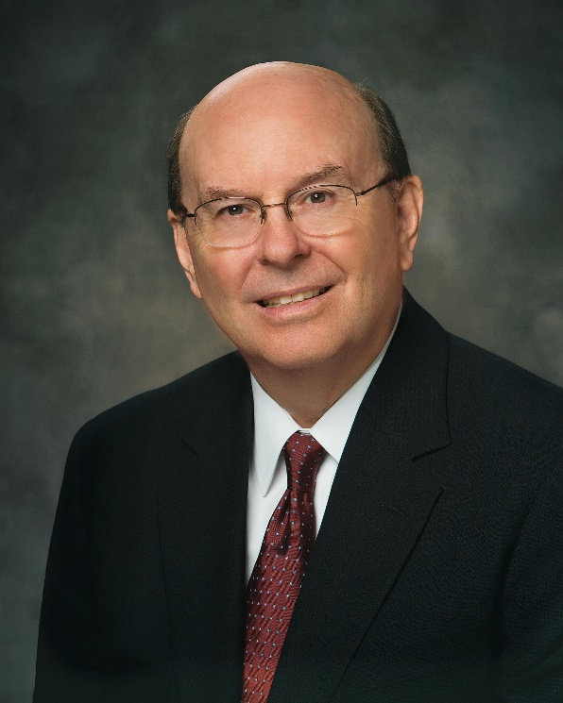
“We all long for peace. Peace is not just safety or lack of war, violence, conflict, and contention. Peace comes from knowing that the Savior knows who we are and knows that we have faith in Him, love Him, and keep His commandments, even and especially amid life’s devastating trials and tragedies. …
“… Even with the trials of life, because of the Savior’s Atonement and His grace, righteous living will be rewarded with personal peace.”
Isaiah 48:18
(8)

Slide 19
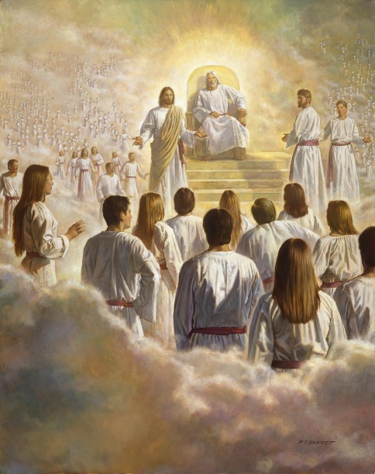
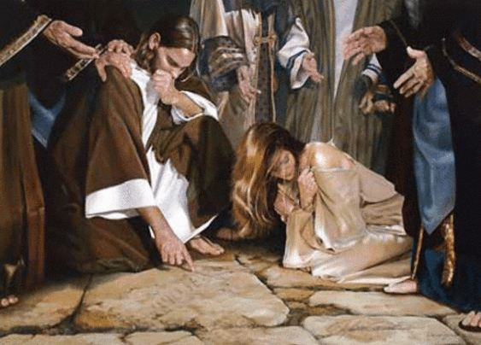
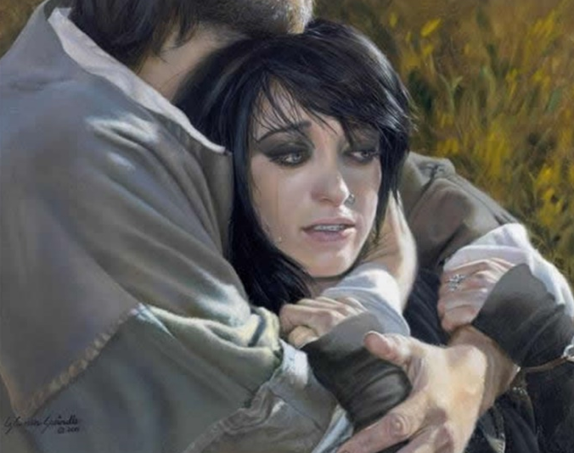
The Call
“Called me from the womb”
“made mention my name”
Jesus was foreordained in the Pre-existence
And she shall bring forth a son, and thou shalt call his name Jesus: for he shall save his people from their sins.
Matthew 1:21
“Mouth is like a sharp sword”
Justice and Mercy—2 edged—cuts to the center
“Shadow of His hand”
A place of ultimate safety—He is always there
Liz Lemon Swindle
Isaiah 49:1-2, 5
(6)

Slide 20
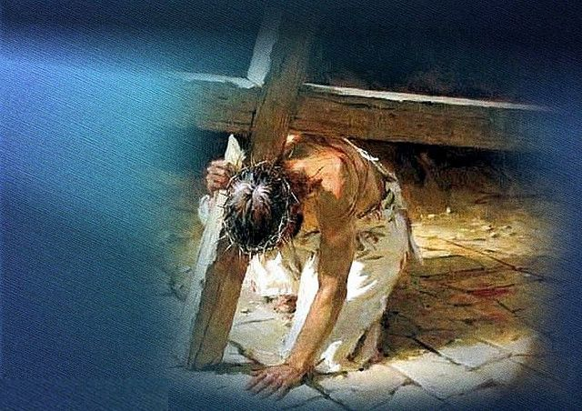
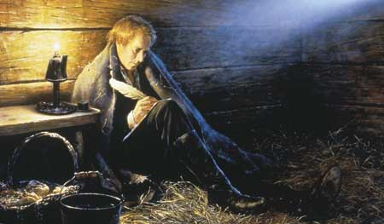
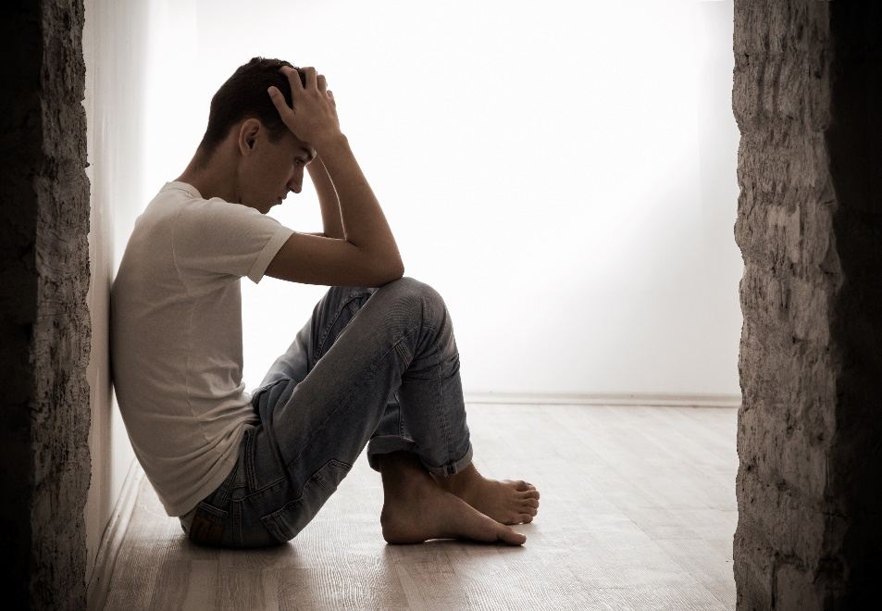
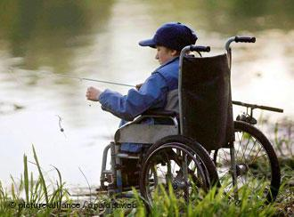
Obedience Through Trials and Suffering
“Polished shaft”
His trials will prepare and perfect him
Isaiah 49
(6)

Slide 21
I am like a huge, rough stone rolling down from a high mountain; and the only polishing I get is when some corner gets rubbed off by coming in contact with something else…Thus I will become a smooth and polished shaft in the quiver of the Almighty.”
Isaiah 49
(7)

Slide 22
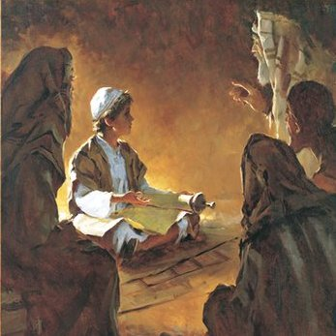
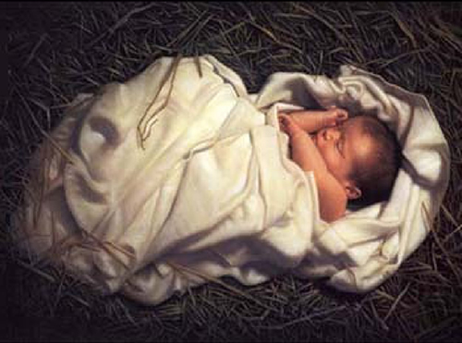
“In his quiver he hath hid me”
Jesus was born of humble circumstance
He had been sheltered from the world until it was time for His mission
Isaiah 49:2
(6)

Slide 23
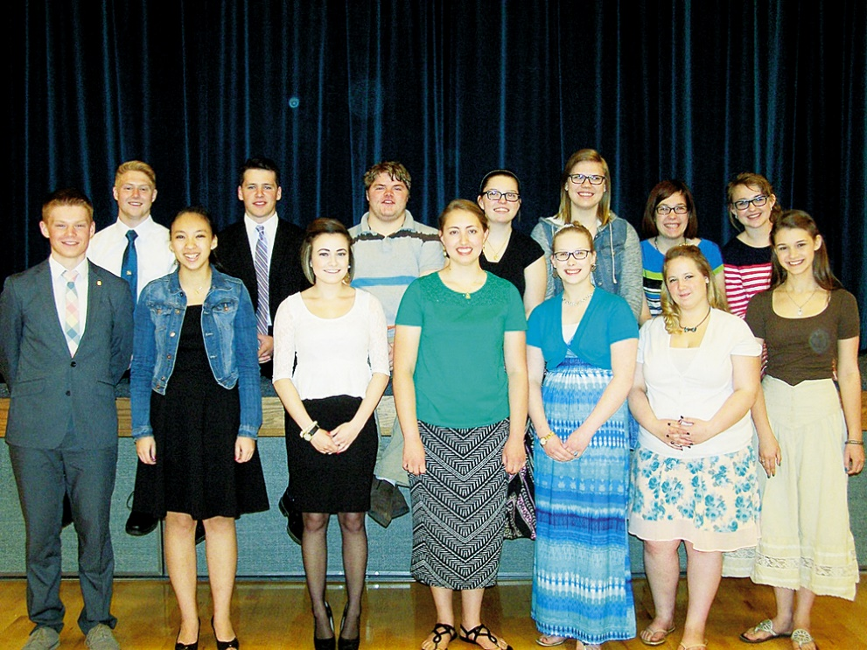
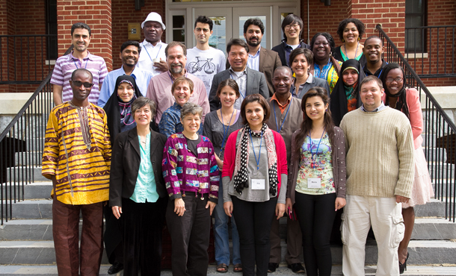
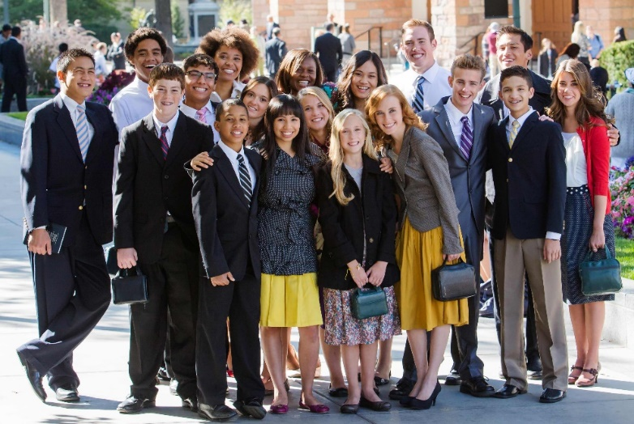
“My Servant—All of Us”
It will be through the work done by Christ and His spiritual children that will glorify the Father who increases through His exalted children
Isaiah 49:3
(6)

Slide 24
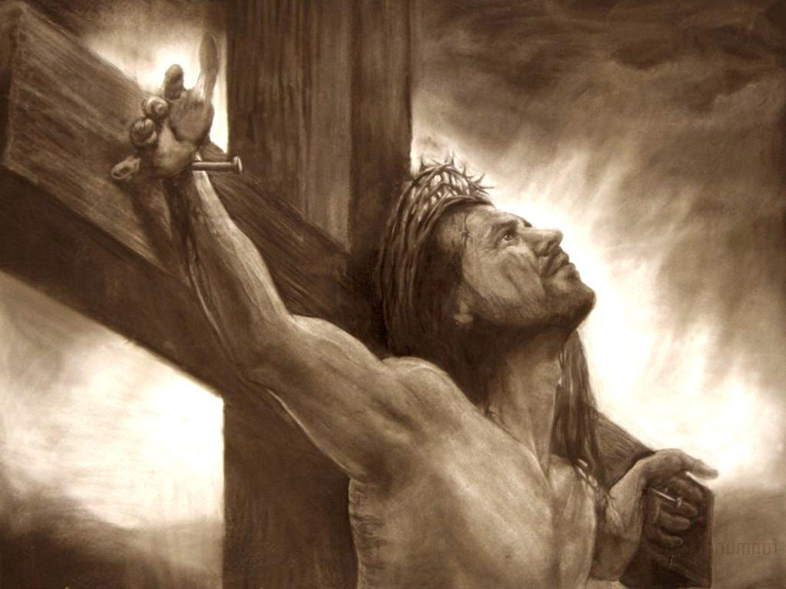
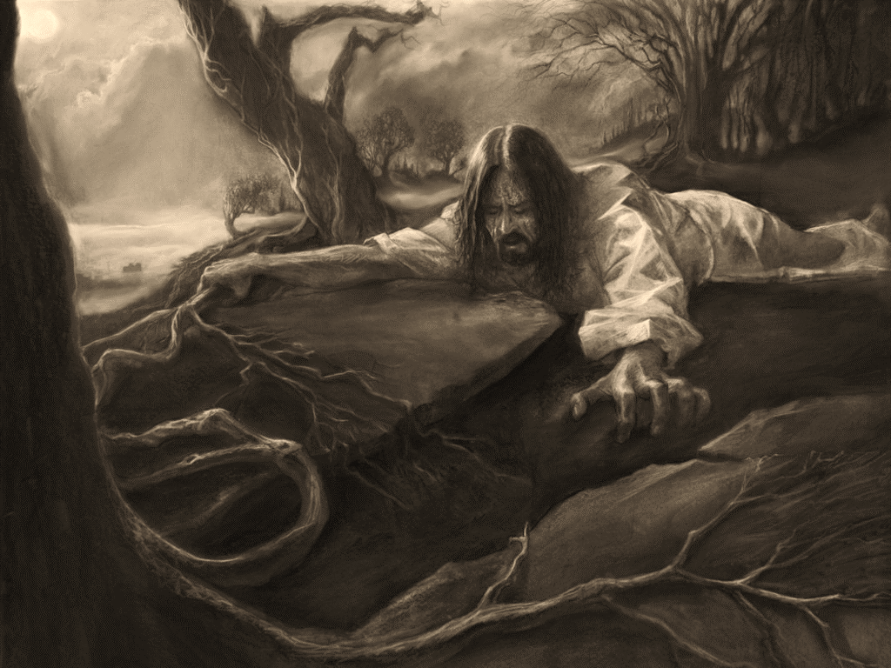
“Labored in Vain”
The Savior has done all that was required of Him and in the end---it will be enough
We are not called to be successful in all things
We are called to be faithful in all things
Isaiah 49:4
(6)

Slide 25
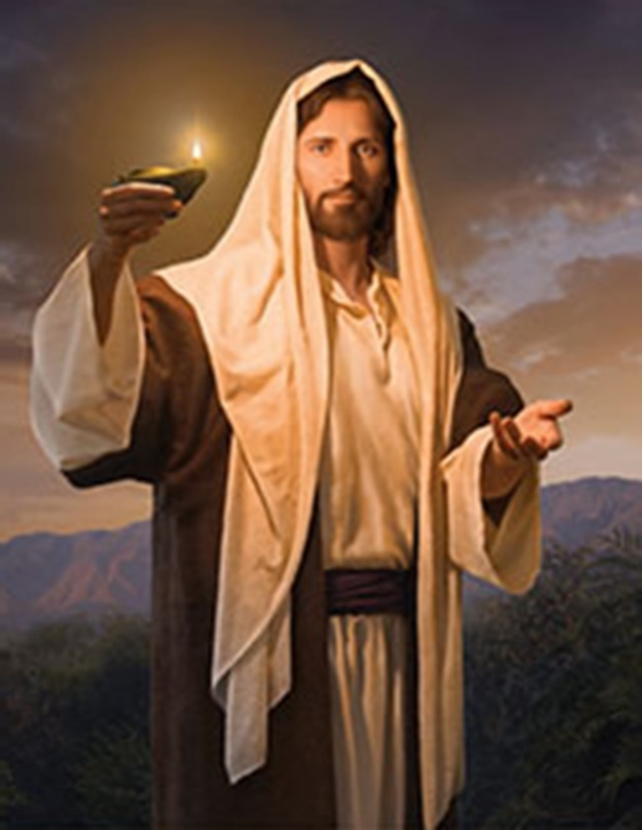
“It is a light thing”
A light unto the Gentiles
Showing obedience and righteousness of both the Savior and the faithful followers of God.
If we are to become true servants of the Lord, becoming ‘glorious” in His “eye,” we must act as a light to the Gentiles, bringing forth the gospel in this final dispensation.
Isaiah 49:6
(3)

Slide 26
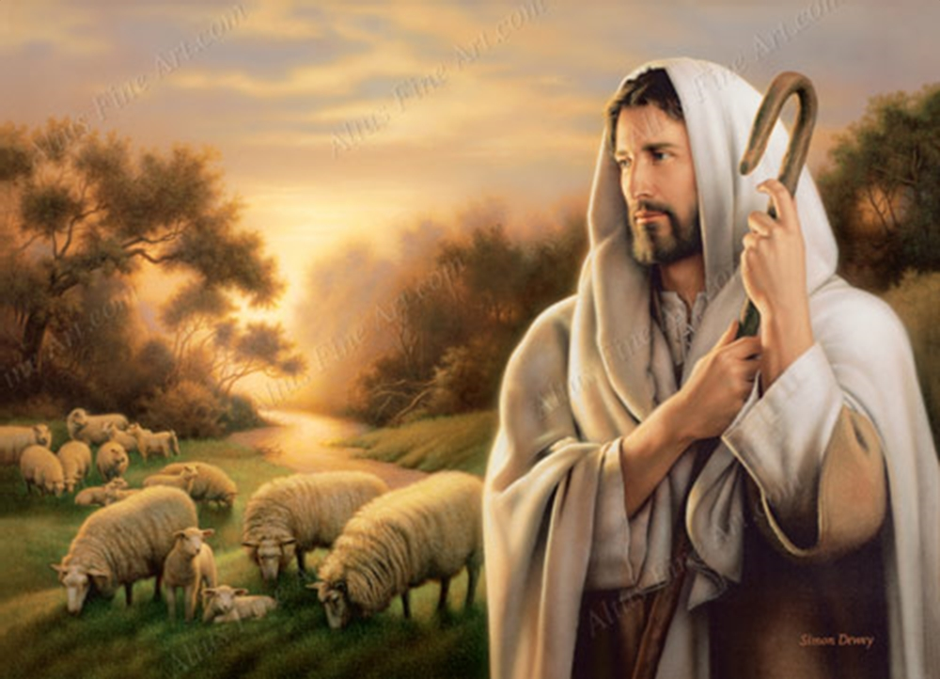
Obligations and Promises--Covenant
The Great Servant—the Mediator
Isaiah wants Israel to know that the Savior is a good provider and faithful keeper of His covenant, and He is very aware of His promises to His children.
“Feed in the ways” and “their pastures…in high places”
The Savior as the shepherd
Simon Dewey
Isaiah 49:7-13
(3)

Slide 27
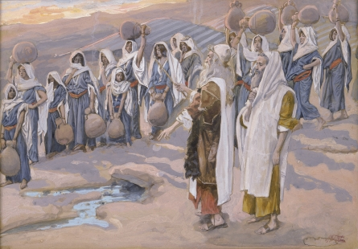
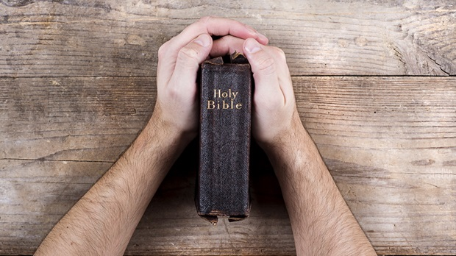
No Pain From Hunger and Thirst
“scorched from heat”…and led them to the fountain of living waters
How do we drink from the living waters?
While the children of Israel were wandering in the desert, the Lord provide a way for them to feed themselves and obtain water
But whosoever drinketh of the water that I shall give him shall never thirst; but the water that I shall give him shall be in him a well of water springing up into everlasting life.
John 4:14
Isaiah 49:10
(3)

Slide 28
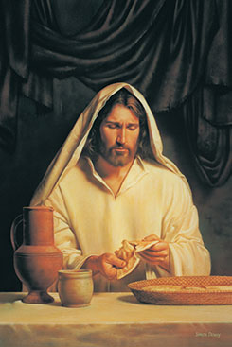
Can We Forget?
O remember, remember that these things are true; for the Lord God hath spoken it. Mosiah 2:41
God’s love is always constant
The word remember and remembrance are in the sacrament prayers of promises and covenants
O God, the Eternal Father, we ask thee in the name of thy Son, Jesus Christ, to bless and sanctify this bread to the souls of all those who partake of it, that they may eat in remembrance of the body of thy Son, and witness unto thee, O God, the Eternal Father, that they are willing to take upon them the name of thy Son, and always remember him and keep his commandments which he has given them; that they may always have his Spirit to be with them. Amen. D&C 20:79
Do We Remember The Savior in All That He did and All that He does and All that He will do?
Isaiah 49:14-15

Slide 29
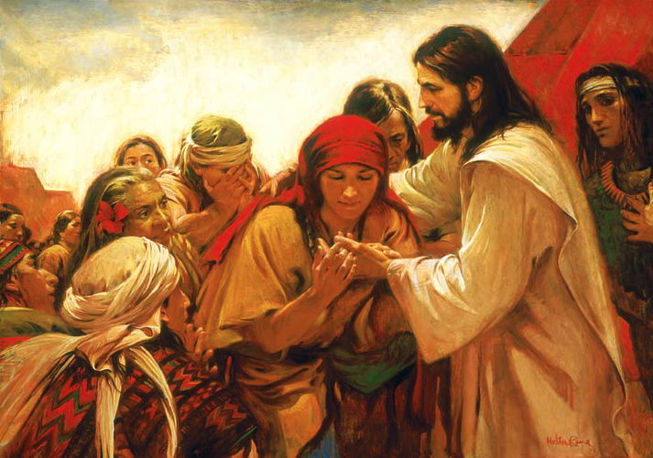
“Graven Upon”—A Constant Reminder
Upon the palms of His hands:
“This imagery of the hand is significant, referring to both the crucifixion of the Savior as well as symbolic temple ordinances and sacred promises. The marks in the palms of His hand would distinguish Christ’ supreme calling as He later visited the Nephites.”
Arise and come forth unto me, that ye may thrust your hands into my side, and also that ye may feel the prints of the nails in my hands and in my feet, that ye may know that I am the God of Israel, and the God of the whole earth, and have been slain for the sins of the world.
3 Nephi 11:14
Isaiah 49:16
(3)

Slide 30
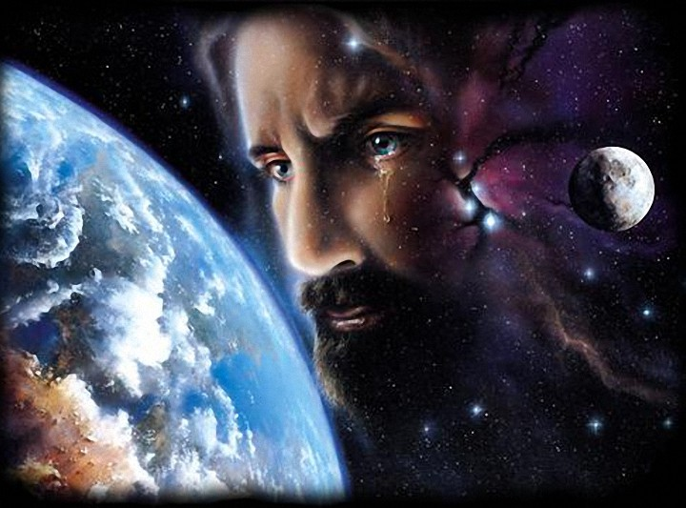
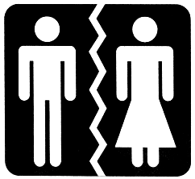
“Have I Put You Away?”
A Marriage imagery between God and Israel
Divorce was accomplished simply by the husband casting off his wife. (Det. 24:1)
However, it was not the husband (Christ) who turned away, it was the wife (Israel)
Mother—Israel or Zion
Children—Sons and Daughters of the covenant
Isaiah 50:1
(6)

Slide 31
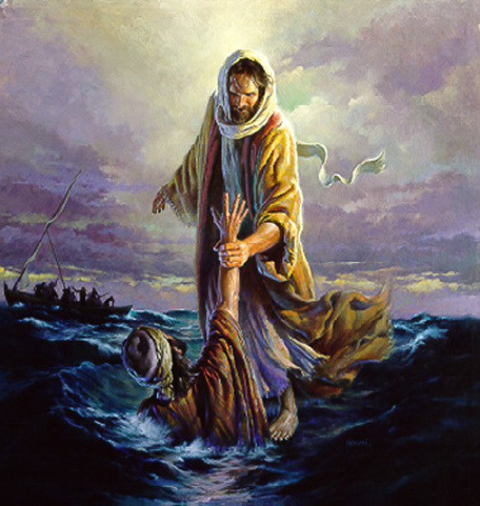
“Is my hand shortened at all, that it cannot redeem?
His hand is stretched out still
When the Lord’s Apostles were in a ship, they were tossed in the midst of the sea. Jesus went to them, walking on the water; but not recognizing Him, they cried out in fear.
When Jesus said, “Come” Then Peter walked on the water to Jesus
“But when he saw the wind boisterous, he was afraid,” began to sink, and cried out, “Lord, save me.
“And immediately Jesus stretched forth his hand, and caught him, and said unto him, O thou of little faith, wherefore didst thou doubt?” Matthew 14:25-31
Isaiah 50:2

Slide 32
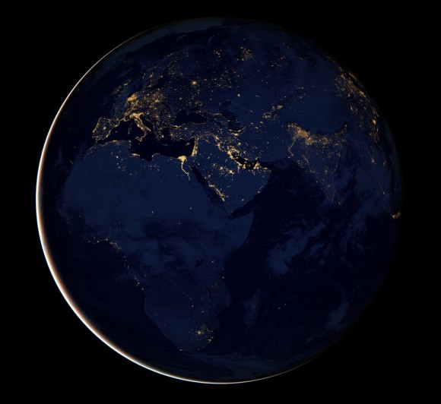
Blackness—No More Revelation
“Before the Second Coming, darkness will again cover the earth.” (Moses 7:61)
“The Lord’s power over the waters and the heavens provides periods of darkness in preparation for the light of a new day.”
(2 Nephi 19:2)
Isaiah 50:3
(3)

Slide 33
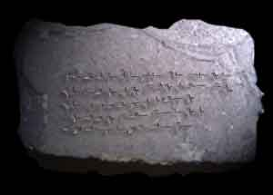
Face Like Flint
Set in stone
It is to learn what the Lord expects of you, make a plan to do it, act on your plan with diligence, and then share with others how your experience changed you and blessed others.
We are to learn our duty from the Lord, and then we are to act in all diligence, never being lazy or slothful. The pattern is simple but not easy to follow. We are so easily distracted.
You will become more diligent as you feel the magnitude of the trust God has placed in you.
Isaiah 50:7
(9)

Slide 34
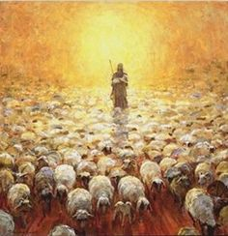
When The Messiah Comes
We know he is coming To gather his sheep And lead them to Zion in love, For why in the valley Of death should they weep Or in the lone wilderness rove?
How long we have wandered As strangers in sin And cried in the desert for thee! Our foes have rejoiced When our sorrows they've seen, But Israel will shortly be free.
(10)

Slide 35
Sources:
Suggested Hymn: # 108 The Lord is My Shepherd
Videos:
Steadfast in Our Covenants(1:15)
Redemption (1:45)
Old Testament Institute Manual The Gathering of Israel and the Coming of the Messiah Chapter 17
Bible Topics (Apostasy)
Victor L. Ludlow Unlocking Isaiah in the Book of Mormon p. 39-40, 55, 64
James E. Talmage Jesus the Christ pp. 40-41
John Bytheway Isaiah for Air Heads p. 43
Poway Institute Handout Becky Davies and Lesley Meacham
Joseph Smith Teachings 304
Quentin L. Cook(“Personal Peace: The Reward of Righteousness,” Ensign or Liahona, May 2013, 33, 35).
President Henry B. Eyring Act In All Diligence April 2010
Redeemer of Israel Hymnal #6
Presentation by ©http://fashionsbylynda.com/blog/

Slide 36
A sample of how the Bible varies from the Book of Mormon
Every verse in the Book of Mormon reads differently from the way it reads in the King James text, and many of the differences are significant. It can be assumed that the Book of Mormon text is more correct than the King James Version because Nephi lived just a little more than one hundred years after Isaiah’s time and most likely possessed a purer text than the one the King James translators worked from. (1)
Isaiah 48 | 1 Nephi 20
1 Hear ye this, O house of Jacob, which are called by the name of Israel, and are come forth out of the waters of Judah, which swear by the name of the Lord, and make mention of the God of Israel, but not in truth, nor in righteousness. | 1 Hearken and hear this, O house of Jacob, who are called by the name of Israel, and are come forth out of the waters of Judah, or out of the waters of baptism, who swear by the name of the Lord, and make mention of the God of Israel, yet they swear not in truth nor in righteousness.
2 For they call themselves of the holy city, and stay themselves upon the God of Israel; The Lord of hosts is his name. | 2 Nevertheless, they call themselves of the holy city, but they do not stay themselves upon the God of Israel, who is the Lord of Hosts; yea, the Lord of Hosts is his name.
6 Thou hast heard, see all this; and will not ye declare it? I have shewed thee new things from this time, even hidden things, and thou didst not know them. | 6 Thou hast seen and heard all this; and will ye not declare them? And that I have showed thee new things from this time, even hidden things, and thou didst not know them.
7 They are created now, and not from the beginning; even before the day when thou heardest them not; lest thou shouldest say, Behold, I knew them. | 7 They are created now, and not from the beginning, even before the day when thou heardest them not they were declared unto thee, lest thou shouldst say—Behold I knew them.
14 All ye, assemble yourselves, and hear; which among them hath declared these things? The Lord hath loved him: he will do his pleasure on Babylon, and his arm shall be on the Chaldeans. | 14 All ye, assemble yourselves, and hear; who among them hath declared these things unto them? The Lord hath loved him; yea, and he will fulfil his word which he hath declared by them; and he will do his pleasure on Babylon, and his arm shall come upon the Chaldeans.
16 ¶Come ye near unto me, hear ye this; I have not spoken in secret from the beginning; from the time that it was, there am I: and now the Lord God, and his Spirit, hath sent me. | 16 Come ye near unto me; I have not spoken in secret; from the beginning, from the time that it was declared have I spoken; and the Lord God, and his Spirit, hath sent me.
17 Thus saith the Lord, thy Redeemer, the Holy One of Israel; I am the Lord thy God which teacheth thee to profit, which leadeth thee by the way that thou shouldest go. | 17 And thus saith the Lord, thy Redeemer, the Holy One of Israel; I have sent him, the Lord thy God who teacheth thee to profit, who leadeth thee by the way thou shouldst go, hath done it.
22 There is no peace, saith the Lord, unto the wicked. | 22 And notwithstanding he hath done all this, and greater also, there is no peace, saith the Lord, unto the wicked.

Slide 37
“Isaiah 48 is the first chapter of Isaiah quoted in the Book of Mormon and is found there as 1 Nephi 20. Every verse in the Book of Mormon reads differently from the way it reads in the King James text, and many of the differences are significant. It can be assumed that the Book of Mormon text is more correct than the King James Version because Nephi lived just a little more than one hundred years after Isaiah’s time and most likely possessed a purer text than the one the King James translators worked from. Carefully compare verses 1–2, 6–7, 11, 14, 16–17, and 22 in both versions to see the significant changes” (Old Testament Student Manual: 1 Kings–Malachi, 3rd ed. [Church Educational System manual, 2003], 191).
“I have graven thee upon the palms of my hands” Isaiah 49:16
“Even though the power of the Resurrection could have—and undoubtedly one day will have—completely restored and made new the wounds from the crucifixion, nevertheless Christ chose to retain those wounds for a purpose, including for his appearance in the last days when he will show those marks and reveal that he was wounded ‘in the house of [his] friends’ [Zechariah 13:6; see also D&C 45:52].
“The wounds in his hands, feet, and side are signs that in mortality painful things happen even to the pure and the perfect, signs that tribulation is not evidence that God does not love us. It is a significant and hopeful fact that it is the wounded Christ who comes to our rescue. He who bears the scars of sacrifice, the lesions of love, the emblems of humility and forgiveness is the Captain of our Soul. That evidence of pain in mortality is undoubtedly intended to give courage to others who are also hurt and wounded by life, perhaps even in the house of their friends” Elder Jeffrey R. Holland (Christ and the New Covenant: The Messianic Message of the Book of Mormon [1997], 258–59).
My Right Hand:
“Isaiah’s imagery of the hand may also allude to the covenant state of the children of Israel. Traditionally, the right hand was used in the making and sealing of sacred covenants (like modern-day handshake used to “seal a deal”. Thus, in calling to the children of Israel with His right hand, God is referring to the sacred covenants that He enters into with us if we are righteous. God is “shaking hands” or raising His hand “to the spare” with us, promising to keep His end of the bargain if we keep ours?
(3) p. 43
Isaiah 49:
Monte S. Nyman observed that “chapter 49 is one of the most important chapters in the whole book of Isaiah, because it also clearly foretells the mission of the Latter-day Saints and the destiny of the land of America in connection with the house of Israel. Nephi interpreted the chapter as foretelling that the land of America would receive some of scattered Israel, while his brother Jacob applied it both to the Jews in Jerusalem and to the Gentiles. Chapter 49 is of such importance that it ought to be studied diligently by every member of the Church.” (“Great Are the Words of Isaiah,” pp. 173–74.)
Isaiah 49:
The entire chapter of Isaiah 49 is quoted in 1 Nephi 21 . Half of verse one is missing from the King James text. What was lost from the Bible is the statement that the scattering of Israel was a direct result of the wickedness of the religious leaders. Those on the isles who are invited to hearken are the broken-off or scattered branches of the house of Israel. Nephi wrote that by his time “the more part of all the tribes” of Israel had been “scattered to and fro upon the isles of the sea” (1 Nephi 22:4). Moreover it is made clear that the person speaking in these verses, the “me” of Isaiah 49:1–2, was Israel herself. Her mouth was “like a sharp sword” (v. 2) because she possessed the word of God to give to the nations. In many places God’s message is likened to a sword with a keen edge (see Ephesians 6:17; Revelation 1:16; 2:12; D&C 6:2; 33:1). It is double-edged because it cuts regardless of the direction it is moved.

