Slide 1
Lesson 131
Commandments
Part 1
Presentation by ©http://fashionsbylynda.com/blog/

Slide 2
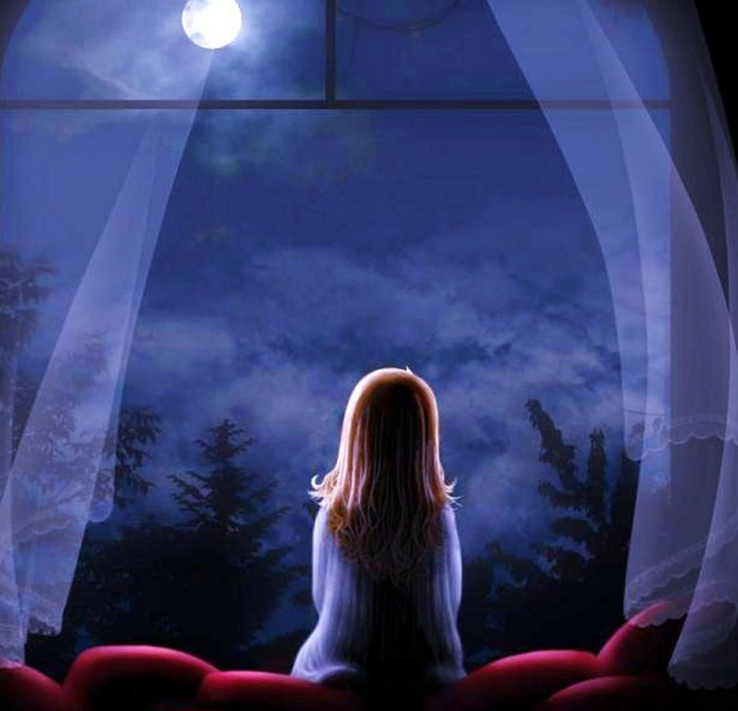
Commandments are the laws and requirements that God gives to help us progress and become like Him.
The commandments are a manifestation of God’s love for us.
We manifest our love for Him by keeping His commandments
If ye love me, keep my commandments
John 14:15

Slide 3
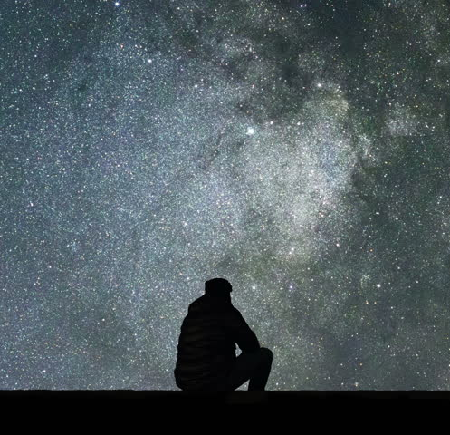
And moreover, I would desire that ye should consider on the blessed and happy state of those that keep the commandments of God.
For behold, they are blessed in all things, both temporal and spiritual; and if they hold out faithful to the end they are received into heaven, that thereby they may dwell with God in a state of never-ending happiness.
O remember, remember that these things are true; for the Lord God hath spoken it.
Mosiah 2:41
Keeping the commandments will always bring happiness and blessings from the Lord
Do not suppose, because it has been spoken concerning restoration, that ye shall be restored from sin to happiness. Behold, I say unto you, wickedness never was happiness.
Alma 41:10

Slide 4
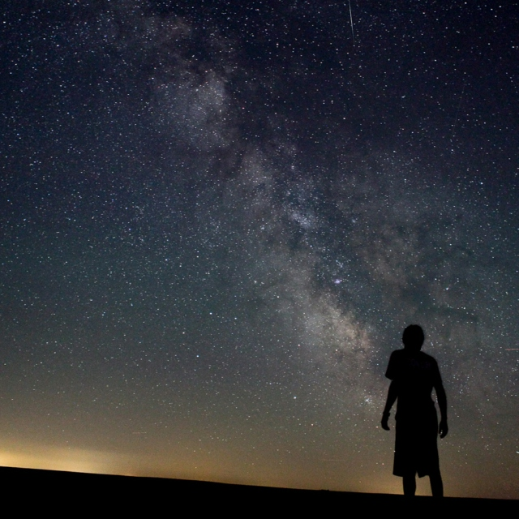
God will not give us a commandment without preparing a way for us to obey it.
And it came to pass that I, Nephi, said unto my father: I will go and do the things which the Lord hath commanded, for I know that the Lord giveth no commandments unto the children of men, save he shall prepare a way for them that they may accomplish the thing which he commandeth them.
1 Nephi 3:7

Slide 5
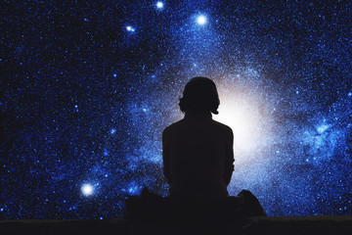
Jesus said unto him, Thou shalt love the Lord thy God with all thy heart, and with all thy soul, and with all thy mind.
This is the first and great commandment.
And the second is like unto it, Thou shalt love thy neighbour as thyself.
Matthew 22:37-39
The
two greatest and most fundamental commandments are “love the Lord thy God with all thy heart, and with all thy soul, and with all thy mind. … And … love thy neighbour as thyself”.

Slide 6
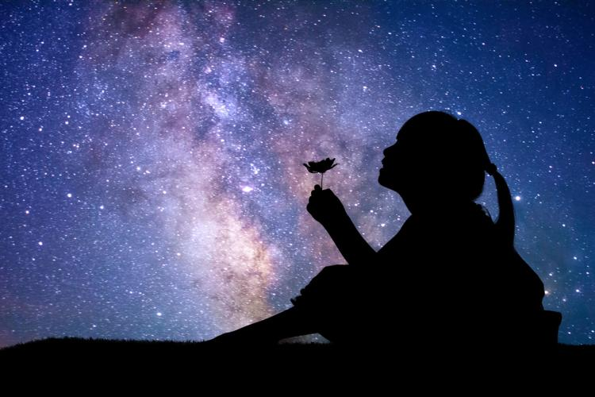
We can love and serve God by choosing to love and serve others.
And behold, I tell you these things that ye may learn wisdom; that ye may learn that when ye are in the service of your fellow beings ye are only in the service of your God.
Mosiah 2:17

Slide 7
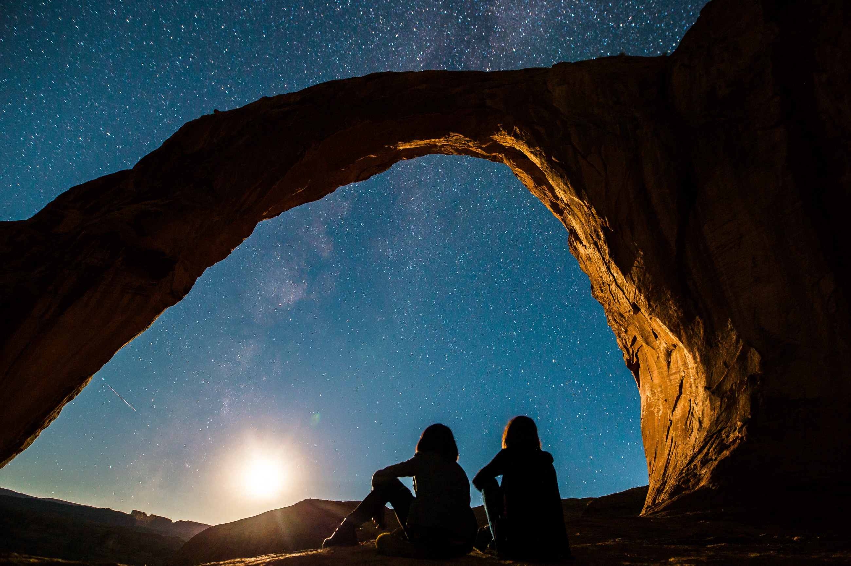
If thou turn away thy foot from the sabbath, from doing thy pleasure on my holy day; and call the sabbath a delight, the holy of the Lord, honourable; and shalt honour him, not doing thine own ways, nor finding thine own pleasure, nor speaking thine own words:
Then shalt thou delight thyself in the Lord; and I will cause thee to ride upon the high places of the earth, and feed thee with the heritage of Jacob thy father: for the mouth of the Lord hath spoken it.
Isaiah 58:13-14
God commands His children to honor Him by doing His will rather than our own on the Sabbath, and He promises great blessings to those who keep His day holy.
One of the earliest commandments given to man was to keep the Sabbath day holy.

Slide 8
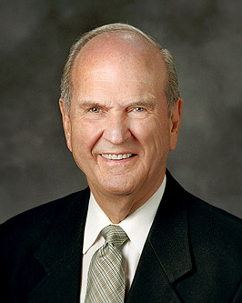
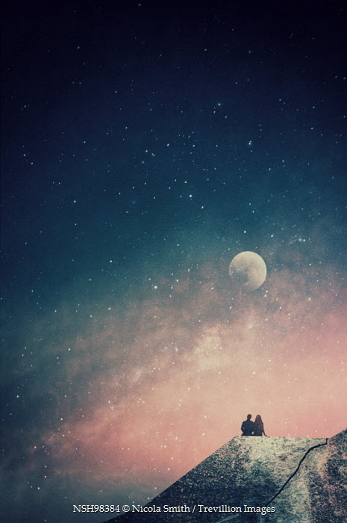
“Not pursuing your ‘own pleasure’ on the Sabbath requires self-discipline.
You may have to deny yourself of something you might like.
If you choose to delight yourself in the Lord, you will not permit yourself to treat it as any other day” (1)
Isaiah 58:13

Slide 9
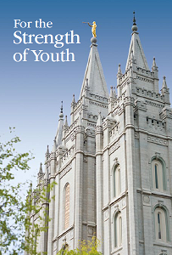
“Honoring the Sabbath day includes attending all your Church meetings. …
“Prepare during the week so that you can reserve Sunday for the many uplifting activities that are appropriate for the Sabbath day.
Such activities include spending quiet time with your family, studying the gospel, fulfilling your Church callings and responsibilities, serving others, writing letters, writing in your journal, and doing family history work.
Your behavior and dress on the Sabbath should show respect for the Lord and His holy day.” (2)

Slide 10
Sources:
Suggested Hymn: #303 Keep the Commandments
Russell M. Nelson, “The Sabbath Is a Delight,” Ensign or Liahona, May 2015, 132).
For the Strength of Youth[booklet, 2011], 30
Presentation by ©http://fashionsbylynda.com/blog/

