Slide 1
Lesson 133
Latter-day Gathering Of Israel
Isaiah 54-57
Come, my brethren, every one that thirsteth, come ye to the waters; and he that hath no money, come buy and eat; yea, come buy wine and milk without money and without price…
…Hearken diligently unto me, and remember the words which I have spoken; and come unto the Holy One of Israel, and feast upon that which perisheth not, neither can be corrupted, and let your soul delight in fatness.
2 Nephi 9:50

Slide 2
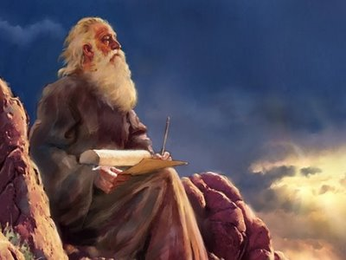
Recap
He also prophesied that because of the wickedness of the kingdom of Judah, it too would be conquered.
The Lord spoke of the growth of the house of Israel that would occur in the last days after being gathered from its scattered condition.
During Isaiah’s life, he witnessed the scattering of the Northern Kingdom of Israel because of the wickedness of its people.

Slide 3
Relationship Between the Lord and The People
A marriage image between the woman and the Husband—The Lord
Sing O Barren = Scattered Israel who hasn’t fulfilled her foreordained destiny because of her inability or unwillingness to produce spiritually strong offspring for the Lord.
Born to the “desolate” woman = Gentiles will be adopted into Israel.
“Forlorn woman”= Israel that had been scattered and remained in the Holy Land and will bring forth many children (physically and spiritually) outside the land of her original inheritance.
Isaiah 54:1
(2)

Slide 4
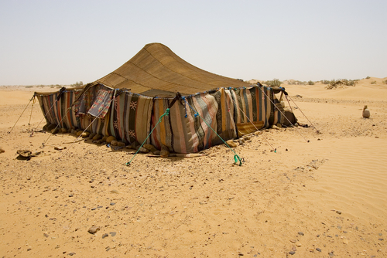
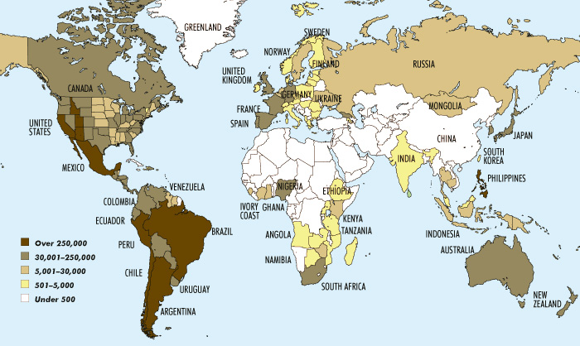
Enlarge The Place of Your Tents
Zion can be expanded to accommodate them all (Jews and Gentiles).
When one wishes to make a small tent larger, one must pull up the stakes and move to a further distance from the center pole = “lengthening the cords and strengthening the stakes”
Israel’s latter-day growth through conversion and gathering is represented as breaking “forth on the right hand and on the left.”
As of 2005
15,372,337 Members as of 2014 (4)
(3)
Isaiah 54:2-3

Slide 5
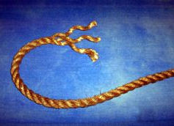
What would gathered Israel forget?
Its shame and reproach, or disgrace, caused by unfaithfulness to the Lord.
How did the Lord describe His relationship with Israel?
As a marriage in which He is the husband and Israel is the wife
“the shame of thy youth” and “the reproach of thy widowhood” = Israel’s condition of separation from her close covenant relationship with the Lord.
Israel’s forsaken years will gradually fade from her memory and become apostate
“With great mercies will I gather thee” =
The Lord will forgive and gather in great mercy (3 Nephi 22:9)
Isaiah 54:4-5

Slide 6
Reunite with Jehovah
Husband
“Although the wife left her husband (broken covenants and apostasy) The Lord will forgive.
If we return to the Lord, then He will have mercy on us
Come now, and let us reason together, saith the Lord: though your sins be as scarlet, they shall be as white as snow; though they be red like crimson, they shall be as wool. Isaiah 1:18
The gospel teaches us that relief from torment and guilt can be earned through repentance. Save for those few who defect to perdition after having known a fulness, there is no habit, no addiction, no rebellion, no transgression, no offense exempted from the promise of complete forgiveness…
So many live with accusing guilt when relief is ever at hand. (5)
Isaiah 54:5-7
Sheet Bend Tying

Slide 7
“Never Rebuke You Again”
A time will come when Israel will become righteous enough that she will need no chastisement from the Lord
When God makes promises, He keeps them.
He vowed to send a flood to cleanse the earth in Noah’s day and then covenanted with Noah that He would never again destroy the earth in that manner.
His promise to restore Israel in the latter days is “as the waters of Noah unto me”, that is, His promise to restore Israel is just as sure as His promise to Noah.
Mountains may depart and “hills be removed”, but God’s promise will still see fulfillment.
Is Noah mentioned in the Book of Mormon?
3 Nephi 22:7-8
Isaiah 54:7-10 Genesis 9:11-17

Slide 8
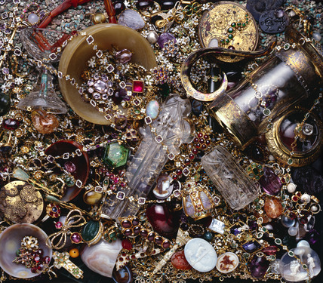
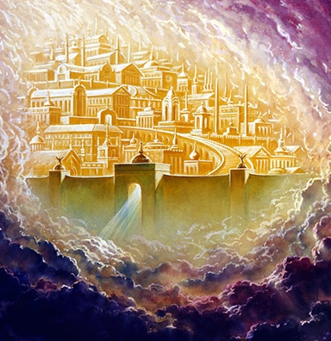
A Gathered Condition—the Millennium
Lay stones with fair colors
“Even in the midst and aftermath of great affliction, the Lord will shower material and spiritual blessings on Israel, including those jewels and precious metals that will be used to build the New Jerusalem. (7)
Represent the material and spiritual blessings that redeemed Israel will enjoy (3)
And the foundations of the wall of the city were garnished with all manner of precious stones. The first foundation was jasper; the second, sapphire; the third, a chalcedony; the fourth, an emerald;
The fifth, sardonyx; the sixth, sardius; the seventh, chrysolite; the eighth, beryl; the ninth, a topaz; the tenth, a chrysoprasus; the eleventh, a jacinth; the twelfth, an amethyst.
And the twelve gates were twelve pearls; every several gate was of one pearl: and the street of the city was pure gold, as it were transparent glass. Revelation 21:19-21
Isaiah 54:11-12

Slide 9
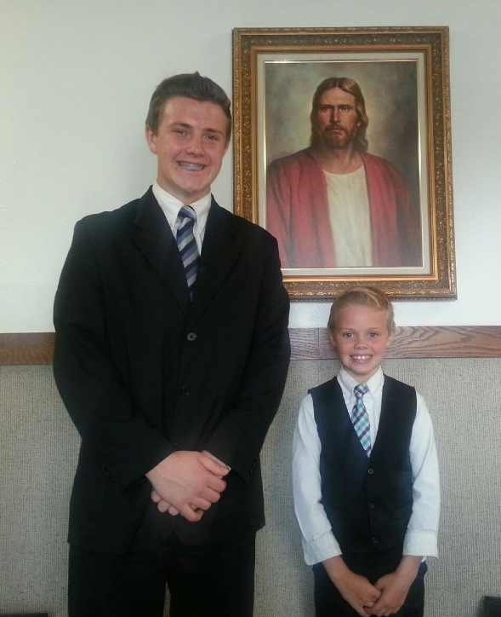
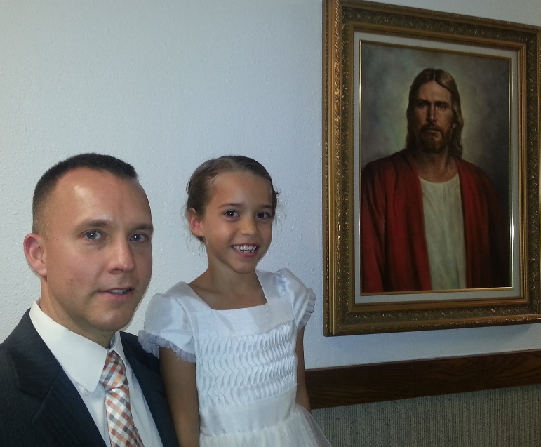
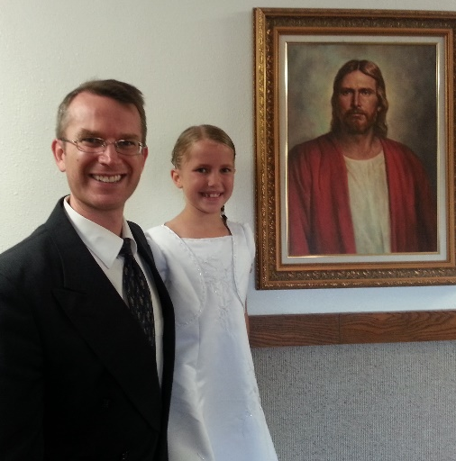
Peace
“Isaiah addresses those who are not yet comforted by the Lord’s assurance of mercy and protection.” (2)
The latter days will be a time of great turmoil, and both the righteous and the wicked will be afflicted.
Isaiah promises the magnificent glory of a millennial earth. (2)
John Bytheway said:
“I’d rather have my children be good and be at peace than have them be popular, good-looking or accomplished—and miserable.”
Isaiah 54:11-12

Slide 10
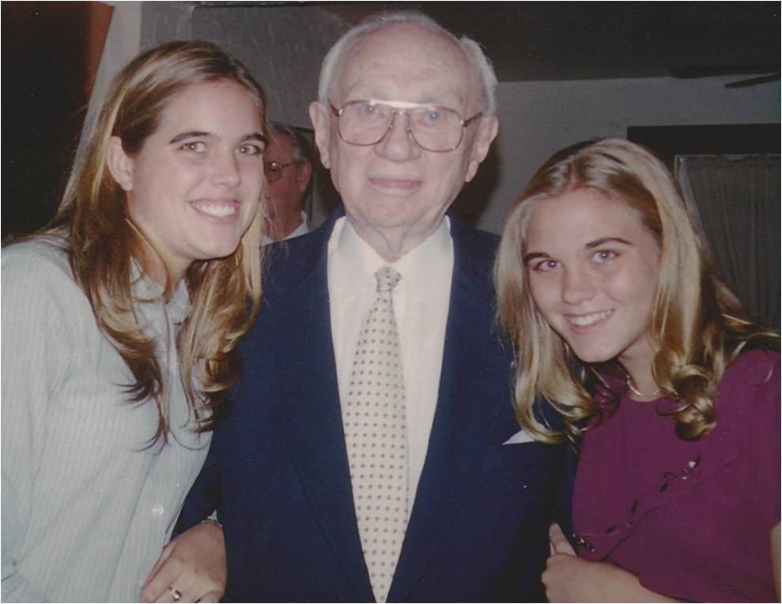
All the Children Shall Be Taught
“How much more beautiful would be the world and the societies in which we live if every father and mother looked upon their children as the most precious of their assets, if they led them by the power of their example in kindness and love, and if in times of stress blessed them by the authority of the holy priesthood; and if they regarded their children as the jewels of their lives, as gifts from the God of heaven who is their Eternal Father, and brought them up with true affection in the wisdom and admonition of the Lord.”
(8)
Isaiah 54:13

Slide 11
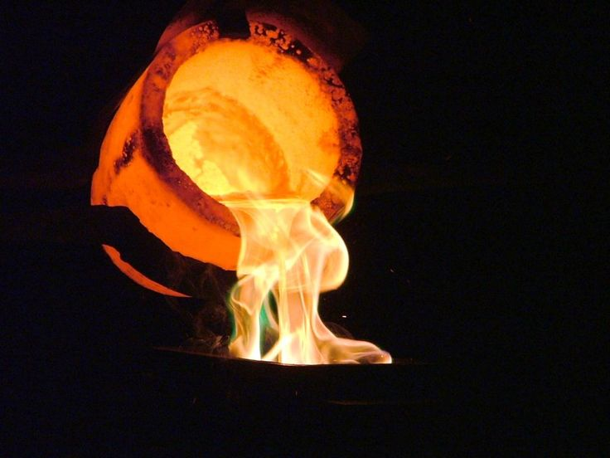
Continually Peace and Protection
Isaiah promises the blessings of righteousness with continual protection and peace, and freedom from oppression and fear.
Coal = Refiner’s Fire = Purify in the last days
For he is like a refiner’s fire, and like fuller’s soap; and he shall sit as a refiner and purifier of silver, and he shall purify the sons of Levi, and purge them as gold and silver, that they may offer unto the Lord an offering in righteousness. D&C 128:24
“The Lord does not condone the devil’s work, but He sometimes allows Satan’s evil actions to fulfill His own plan.
“Although bad things may occur because of Lucifer’s temptations and dealing with humanity, all things will eventually be for our good.”
Isaiah 54:14-17
(2)

Slide 12
No Power Will Prevail
Which causeth silence to reign, and all eternity is pained, and the angels are waiting the great command to reap down the earth, to gather the tares that they may be burned; and, behold, the enemy is combined. D&C 38:12
Yes, “the enemy is combined,” but when we are combined with the Lord’s “chariots of fire,” then “they that be with us are more than they that be with them”!
Furthermore, the divine promise is that no weapon formed against the Lord’s work shall finally prosper; this “is the heritage of the servants of the Lord.” (8)
Isaiah 54:17 2 Kings 6:16-17 D&C 71:9
(1)

Slide 13
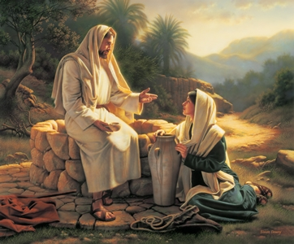
An invitation to Come to the Living Waters
Ho = Hey!
The Blessings Of Redemption
Christ invited them to come unto Him to enjoy the eternal blessings He freely offers rather than waste their effort in worldly pursuits that do not provide true satisfaction.
But whosoever drinketh of the water that I shall give him shall never thirst; but the water that I shall give him shall be in him a well of water springing up into everlasting life.
John 4:14
Simon Dewey
His gracious gifts to men are free
Isaiah 55:1-2

Slide 14
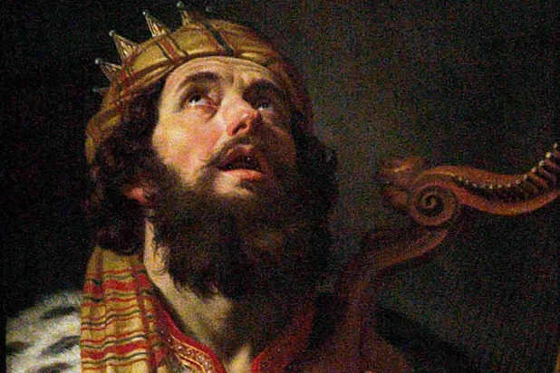
Things of the World Are Not Lasting
The things of the world can not satisfy our deepest and most vital needs
We tend to listen only in our time of need, or our times of trials.
Fatness = Spiritual Food
David = Even David will be resurrected though he partook in adultery and murder. (Acts 13:30-34)
Isaiah 55:2-3

Slide 15
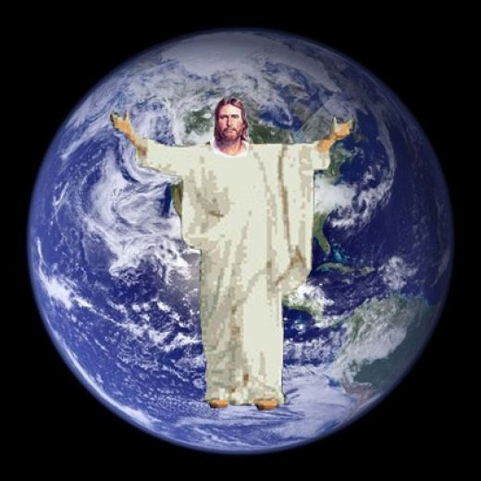
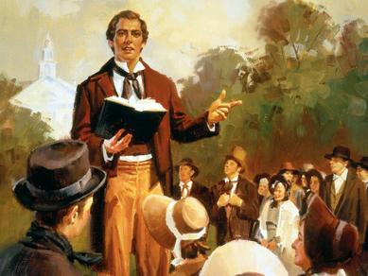
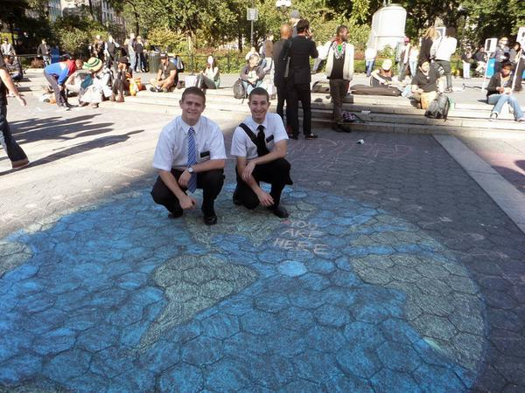
Witness
Leadership and commander--Christ
Christ represents himself on the earth
The Gentiles (the latter-day covenant people) will restore the gospel to the posterity of ancient Israel
“Call a nation that thou knowest not” = The Covenant people will take the gospel to the Gentiles, who will also help take the word to the world.
Isaiah 55:4-5
Elder Aaron Potter, left, and Elder Brad Witbeck
(9)

Slide 16
Seek--Ask
Seek and ye shall find
Ask and it shall be given you
Matthew 7:7-8
There is an allotted time during which mankind can repent and call upon the Lord.
If they wait it will be too late.
Tomorrow
…therefore, I beseech of you that ye do not procrastinate the day of your repentance until the end; for after this day of life, which is given us to prepare for eternity, behold, if we do not improve our time while in this life, then cometh the night of darkness wherein there can be no labor performed. Alma 34:33
Isaiah 55:6
(9)

Slide 17
Watching Our Words, Actions, and Thoughts
For our words will condemn us, yea, all our works will condemn us; we shall not be found spotless; and our thoughts will also condemn us; and in this awful state we shall not dare to look up to our God;
Alma 12:14
Let him return and He will abundantly pardon = fully forgive
If we return to the Lord, then He will have mercy on us
Isaiah 55:7-9

Slide 18
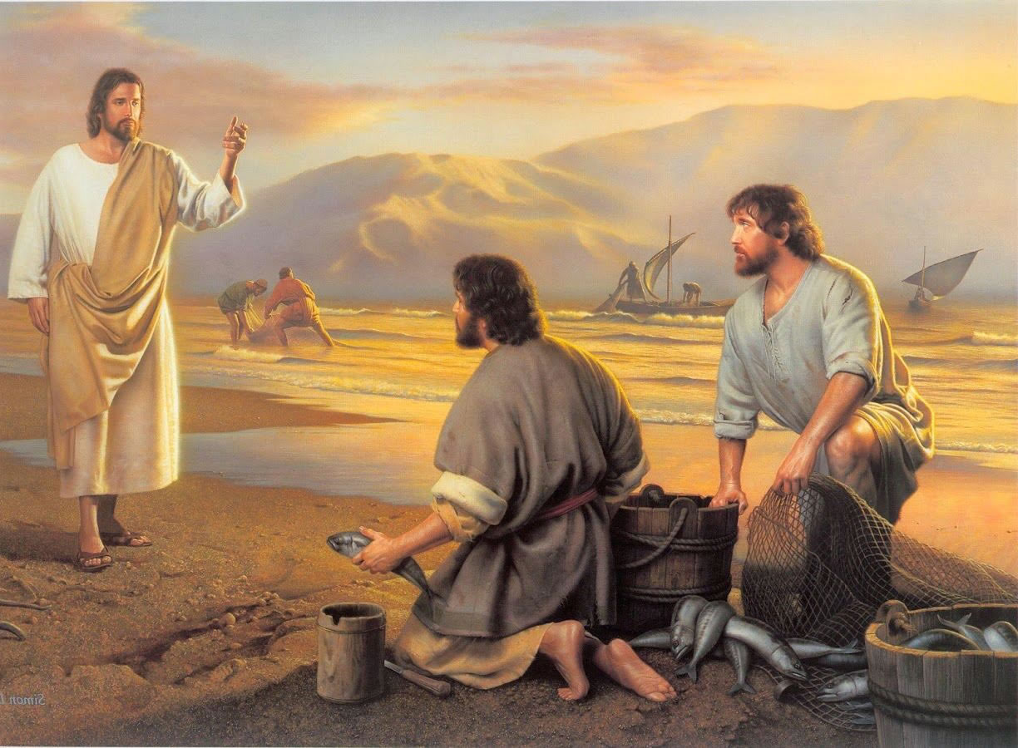
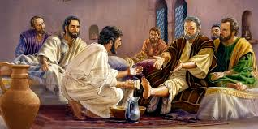
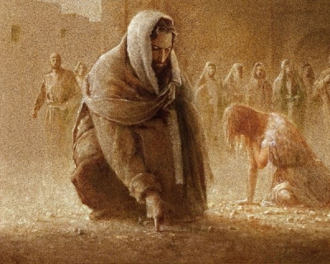
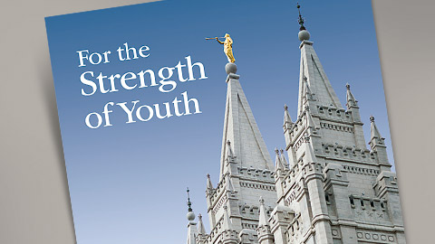
The Lord is all-knowing and His ways are perfect
Simon Dewey
God’s ways, words, and thoughts are not like ours: they are higher and greater.
As the rain comes down from heaven to help crops grow and provide food for us, so will the words of God feed and prosper our souls if we incline our ears to hear His word.
Often we are tempted to forget God and trust in our own wisdom or reject God’s way of doing things because they are not done as we think they should be done. (3)
Where can we find information on how to act, what to say, or where our thoughts should be?
Isaiah 55:8-13

Slide 19
Chiasm of Isaiah 56: 1-8
A. The Lord Will Rescue
B. Blessed people (Heb.- happy)
C. Sabbath keepers (keeping whole covenants)
D. Blessings for Gentiles
E. Eunuchs accepted by the Lord (those who feel they are 2nd class citizens)
F. Blessing conditional upon following the Lord
E. Blessings greater than children (an everlasting name
D. Invitation to Gentiles
C. Sabbath Keepers (those who don’t desecrate the Sabbath)
B. Joyful people
A. The Lord Will Gather

Slide 20
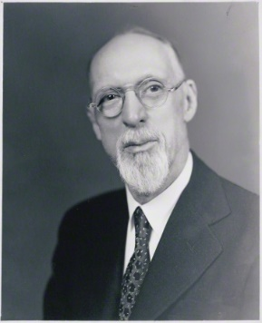
Do Justice
We are held accountable for our actions and our thoughts
“When your life is complete in mortality, it will be the sum of your thoughts.”
Isaiah 56:1
(10)

Slide 21
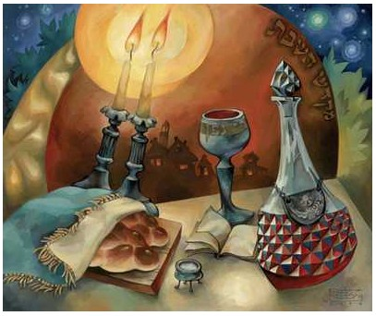
Sabbath
Only Sunday? Or Only the Lord’s Day?
The weekly sabbath was only one of several days called the Sabbath.
All of the feast days, including Passover, Pentecost, Tabernacles, and the day of Atonement, were also called Sabbaths.
Thus, to “keep my sabbaths [plural]” (v. 4) implied a keeping of the whole law of Moses, since the various feasts covered many aspects of the Israelites’ commitment to God. Also, by revelation, the Lord told Moses that keeping the Sabbath was a sign of the covenant between Israel and God.
When Isaiah talked about polluting the Sabbath, he meant far more than simply working or playing on Sunday (Saturday for the Jews).
Isaiah 56:2, 4
(3)

Slide 22
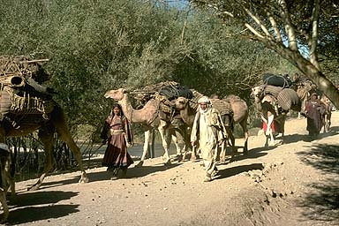
Strangers
“A stranger in the Mosaic law, and in the Old Testament generally, means one not of Israelitish descent dwelling with the Hebrews, as distinguished from a foreigner temporarily visiting the land.
The stranger was not a full citizen, yet he had recognized rights and duties. He was under the protection of God, and the Israelites were charged to treat him kindly.
Isaiah 56:3, 6 Exodus 20:10 Leviticus 16:29; 17:8 2 Samuel 1:13 Ezekiel 14:7
(3)

Slide 23
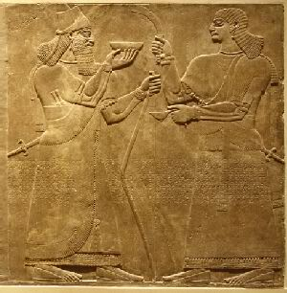
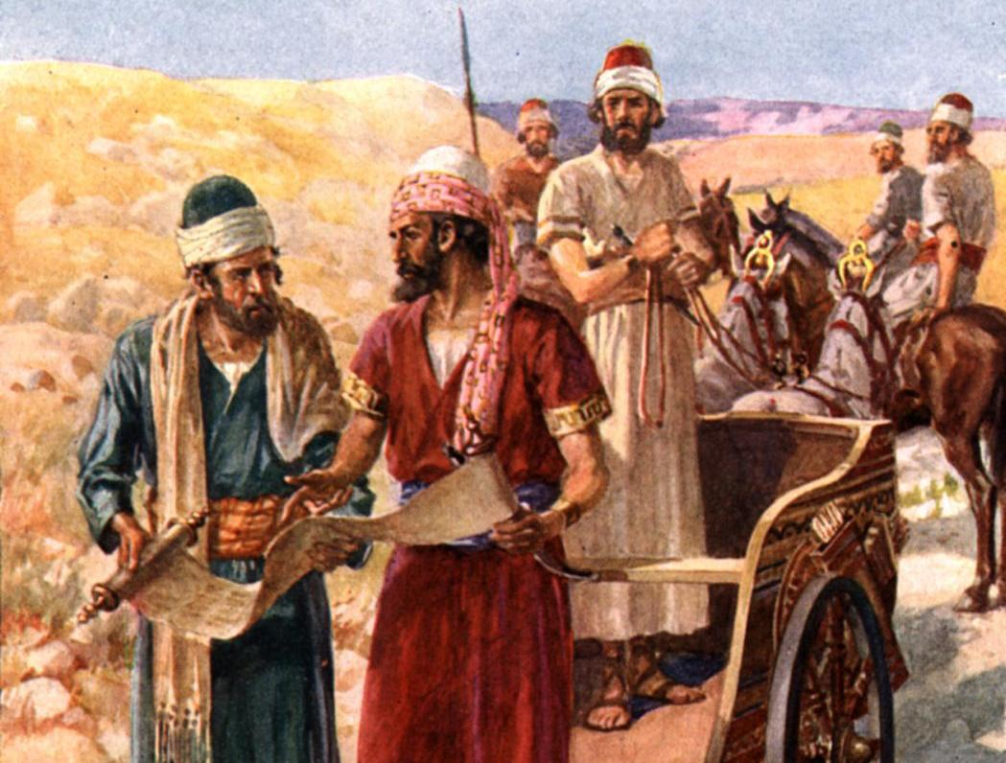
Eunuchs
Under the Mosaic law, anyone who had been sexually mutilated was not allowed into full fellowship in the house of Israel.
The law was likely written because wholeness of body typified or symbolized spiritual wholeness.
A priest or Levite who was a eunuch could not function in the priesthood offices.
Stone Relief of Ashurnasirpal II and his Attendant
Isaiah 56:4 Deuteronomy 23:1-2 Leviticus 21:17-23
(3)

Slide 24
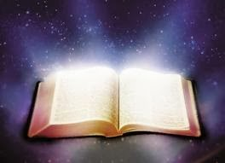
A Place For All
Even unto them will I give in mine house and within my walls a place and a name better than of sons and of daughters: I will give them an everlasting name, that shall not be cut off.
Isaiah was saying that those outcasts could now find the full blessings of God extended to them if they kept the sabbaths (epitomizing the law of God).
Not only will the “outcasts of Israel” (those who were scattered) be gathered in the last days, but so will “others.”
Whether one is a literal descendant of Israel will not matter as much as whether one will make and keep the covenant with God. In the age of restoration, the house of God will be “an house of prayer for all people.”
Isaiah 56:5-8
(3)

Slide 25
Christian World in the Last Days
The beasts devour, the watchmen are blind, the dogs are mute and greedy, and the shepherds are without understanding.
In a latter-day context, which this seems to be, these figures may point to the Gentiles who reject the gospel when it is presented to them and seek to have others do the same.
This passage may also refer to those who have the gospel (watch over the flock) but do not make it available to others.
And they shall contend one with another; and their priests shall contend one with another, and they shall teach with their learning, and deny the Holy Ghost, which giveth utterance. 2 Nephi 28:4
REJECT
Isaiah 56:9-12
(3)

Slide 26
There is no peace, saith my God, to the wicked.
When the righteous die, they go to paradise, a state of peace and rest.
The wicked, on the other hand, know no peace.
Isaiah refers to the general wickedness and uses Israel’s faithlessness to God.
“I will declare thy righteousness, and thy works,” the Lord said, “for they shall not profit thee.”
Treasures of wickedness profit nothing: but righteousness delivereth from death.
Proverbs 10:2
Isaiah 57
(3)

Slide 27
Sources:
Suggested Hymn: #7 Israel, Israel God is Calling
Videos:
Trial of Your Faith (2:04)
The Savior Wants to Forgive (5:50)
John Bytheway Isaiah for Airheads p. 173-175
Victor L. Ludlow Unlocking Isaiah in the Book of Mormon p. 246-251
Old Testament Institute Manual The Gathering of Israel and the Coming of the Messiah Chapter 17 and The Last Days and the Millennium Chapter 18
Mormon Newsroom and Church Membership (Wikipedia) 2014 Statistic Report at 2015 April Gen. Conf.
Elder Boyd K. Packer The Brilliant Morning of Forgiveness Nov. 1995 Gen. Conf.
Jeffery R. Holland Christ and the New Covenant p. 290
President Gordon B. Hinckley Behold Your Little Ones March 2001 (First Presidency Message)
Elder Neal A. Maxwell Yes, the Enemy is Combined Ensign May 1993
Poway Institute Handout Becky Davies and Lesley Meacham
George Albert Smith Collection, Univ. of Utah, ms 36, Scrapbook 1, p. 256; Church News, 16 Feb. 1946, p. 1).
Presentation by ©http://fashionsbylynda.com/blog/

Slide 29
Forgiveness:
The Lord provides ways to pay our debts to Him. In one sense we ourselves may participate in an atonement. When we are willing to restore to others that which we have not taken, or heal wounds that we did not inflict, or pay a debt that we did not incur, we are emulating His part in the Atonement.
That great morning of forgiveness may not come at once. Do not give up if at first you fail. Often the most difficult part of repentance is to forgive yourself. Discouragement is part of that test. Do not give up. That brilliant morning will come.
The Beasts, the watchmen, and the flocks:
“Kimchi observes, ‘The flock is intrusted to the care of these watchmen. The wild beasts come; these dogs bark not; and the wild beasts devour the flock. Thus they do not profit the flock. Yea, they injure it; for the owner trusts in them, that they will watch and be faithful; but they are not. These are the false teachers and careless shepherds.’” (Adam Clarke, The Holy Bible … with a Commentary and Critical Notes, 4:212.)
The Greedy Dogs:
"Yea, they are greedy dogs which can never have enough, and they are shepherds that cannot understand: they all look to their own way, every one for his gain, from his quarter." (Isa. 56:11.) Greed can make a person both dishonest and gullible. Such are spoken of in Doctrine and Covenants 68:31-32: "Their eyes are full of greediness. These things ought not to be, and must be done away from among them." Good advice for those who would avoid deceitful propositions is found in Doctrine and Covenants 9:13: "Be faithful, and yield to no temptation."
A friend recently confided that he had lost heavily in a get-rich-quick scheme because he couldn't turn off his greed valve. Wanting more and more-living beyond one's income-makes many of us susceptible to the dishonest promoter. The plan that offers exorbitant rewards or gives you and only you a once-in-a-lifetime deal is to be avoided.
Use of important, well-recognized names or undue reference to special community or religious affiliations are often used to gain confidence and open the door to sales deceptions.
Avoid those who want immediate decisions or cash right now. All worthwhile investment opportunities can bear deliberation and scrutiny. We must get all the available facts and consider them well, and then make decisions that are in the best interest of all. When marginal cases and situations arise, personal integrity must be an important element in any decision. When right actions are not clearly evident, personal honesty will lead us to discern and reveal relevant points or facts of which others may not be aware. A person of integrity will assist others to be honest. A person of integrity will ask questions and give answers that are accurate. Integrity makes it possible for us to chart a course of righteous personal conduct long before the time for action arrives. Marvin J. Ashton ("This Is No Harm," Ensign, May 1982, 10)
Turning From God:
“When we sin, we turn away from God. When we repent, we turn back toward God.
“The invitation to repent is rarely a voice of chastisement but rather a loving appeal to turn around and to ‘re-turn’ toward God” Elder Neil L. Andersen (“Repent … That I May Heal You” Ensign or Liahona, Nov. 2009, 40).
Peace in the Family:
“Surely every good parent would like this peace for his offspring. It comes from the simple life of the true Latter-day Saint as he makes his home and family supreme.” He assures us that this is not too much to ask of any parent.” Spence W. Kimball The Family Influence” Ensign Nov. 1995
Sure Mercies of David:
“Since it takes a first and a second coming to fulfill many Messianic prophecies, we of necessity must consider them here, and in the case of the Davidic-Messianic utterances show also how they apply to our Lord’s Second Coming. Christ is the Son of David, the Seed of David, the inheritor, through Mary his mother, of the blood of the great king. He is also called the Stem of Jesse and the Branch, meaning Branch of David. Messianic prophecies under these headings deal with the power and dominion he shall wield as he sits on David’s throne, and have reference almost exclusively to his second sojourn on planet earth.
Old Testament Institute Manual The Establishment of Zion Chapter 13 see 11-1

Slide 30
MANHATTAN, N.Y. — It wasn't their first project in Union Square, but for Elder Brad Witbeck of Cottonwood Heights, Utah, and Elder Aaron Potter of Idaho Falls, Idaho, last Friday was a completely new experience.
Both Elder Witbeck and Elder Potter are serving as missionaries for The Church of Jesus Christ of Latter-day Saints in the New York New York North Mission under President Tom Morgan. Both are close to the end of their two-year service and are in leadership positions. After they received a suggestion from a member of their local congregation assigned to help the missionaries, they invited several other missionaries to join them in preaching in a unique way.
"We came together for a brainstorm session, and we talked about different ideas that we could do," Elder Potter said about their meeting with the ward member. "He brought up that on his mission in Russia, they painted the plan of salvation on giant pieces of paper. And then from that, we decided we could do something similar, and that’s where the chalk-art idea came from."
The elders drew up their plans and distributed the idea to the other missionaries, deciding to illustrate each step in the plan of salvation. Days before the project was to take place, Elder Witbeck and Elder Potter scouted out different areas and concluded Union Square would work best.
"We made sure to talk to cops and make sure it was something we could do before we did it," Elder Witbeck said. "We were just looking forward to sharing the gospel in a way that people in New York probably hadn't seen too often. We thought it would be pretty refreshing."
A few days before, the two elders felt impressed to attend an institute class and encourage the young single adult members to participate in the chalk event. Lara Mayfield was one of many who decided to attend, and because of her idea to film the event with her iPhone, Elder Witbeck and Elder Potter have been able to share their activity with thousands.
"It was actually while I was on my way there, in the subway, when I had this thought, 'You know what would be cool ...' because I've put together little videos like that before," Mayfield said. "I just started filming. It still blows my mind, the way technology has progressed to the point that I could just have this random idea and throw together a video that has ended up being seen by thousands of people with what I had on hand."
After helping to draw some of the artwork, Mayfield began filming. Elder and sister missionaries spoke with those who passed by and showed interest in the project.
"There were a lot of people stopping and staring, and that brought up an opportunity for us to go up to them," Elder Potter said. "I think anyone walking through or around that area definitely noticed it because it was really large, especially the drawing of the Earth. ... We just had a lot of really great opportunities to teach people."
From Mayfield's perspective, it was an easy way to attract interest from a large number of people, and because there were several missionaries present, they were able to talk to anyone who was interested.
"It was a good way for the missionaries to casually strike up a conversation, and the people walking across Union Square aren't exactly in a hurry. ... I saw some really awesome discussions about the Book of Mormon and the plan of salvation," Mayfield said.
Although they hadn't planned to document the experience, the video has turned out to be the most effective missionary tool of all. It was posted to YouTube on Oct. 19 and has had more than 33,000 views as of Thursday afternoon, along with more than 14,000 views on Elder Potter and Elder Witbeck's blog,reachmygospel.blogspot.com
"Not only was there the influence of their message and of their individual offering as a missionary there at Union Square, but now the idea and the excitement and enthusiasm will be taken from their efforts by those who watch the video," President Morgan said.
"This idea that social media can influence people across the world is so awesome, and it's just our little zone in South Manhattan. ... Now thousands, literally thousands, of people have seen it, felt the Spirit from it and maybe taken some courage from it, maybe even go copy that idea — why not? It's incredible!"
As the video continues to gain momentum, the missionaries in South Manhattan have felt a growing sense of excitement.
"We definitely think it's more successful than we ever thought it would be," Elder Witbeck said. "It's been amazing the number of views we've been able to have."
The New York New York North Mission recently became an online proselytizing mission, allowing missionaries to engage with investigators online. In fact, it was only about a week ago that Elder Witbeck and Elder Potter created their blog. Although they have reached thousands of people with their video already, the elders agreed that they have a lot to learn about how to share the gospel online…
"The hand of God really does a lot more than we can," Elder Witbeck said. "If we can do everything we can on our own, God will help us magnify the things that we've done. I don't think there's ever really a way that we saw this coming.“ Desert News Oct 29, 2013
.
:
Chalk Drawing Artists
Chalk Drawing in New York: One Way to Share the Gospel
http://www.deseretnews.com/article/865589068/The-story-behind-New-York-Mormon-missionaries-viral-chalk-art-video.html?pg=all

Slide 31
Isaiah 54/3 Nephi 22
Chiasm of Isaiah 55:1
A. Ho, every one that thirsteth...he that hath no money;
B. come ye, buy, and eat;
B’. yea, come, buy wine and milk
A’. without money and without price.
Verses | Husband Provide Wife | The Lord Provides Israel
1-3 | Children | Great numbers of posterity
4-8 | Love | Reconciliation
9-10 | Commitment | Covenant Relationship
11-12 | Material comfort | Prosperity
13-17 | Protection | Peace
Chiasm of Isaiah 56: 1-8
A. The Lord Will Rescue
B. Blessed people (Heb.- happy)
C. Sabbath keepers (keeping whole covenants)
D. Blessings for Gentiles
E. Eunuchs accepted by the Lord (those who feel they are 2nd class citizens)
F. Blessing conditional upon following the Lord
E. Blessings greater than children (an everlasting name
D. Invitation to Gentiles
C. Sabbath Keepers (those who don’t desecrate the Sabbath)
B. Joyful people
A. The Lord Will Gather

Slide 32
 | The Lord’s Ways | Man’s Way
Choosing entertainment and Media
Dating
Language
 | The Lord’s Ways | Man’s Way
Choosing entertainment and Media
Dating
Language
 | The Lord’s Ways | Man’s Way
Choosing entertainment and Media
Dating
Language
 | The Lord’s Ways | Man’s Way
Choosing entertainment and Media
Dating
Language

