Slide 1
Lesson 130
Fasting and the Sabbath
Isaiah 58
And he said unto them, The sabbath was made for man, and not man for the sabbath:
Mark 2:27
Presentation by ©http://fashionsbylynda.com/blog/

Slide 2
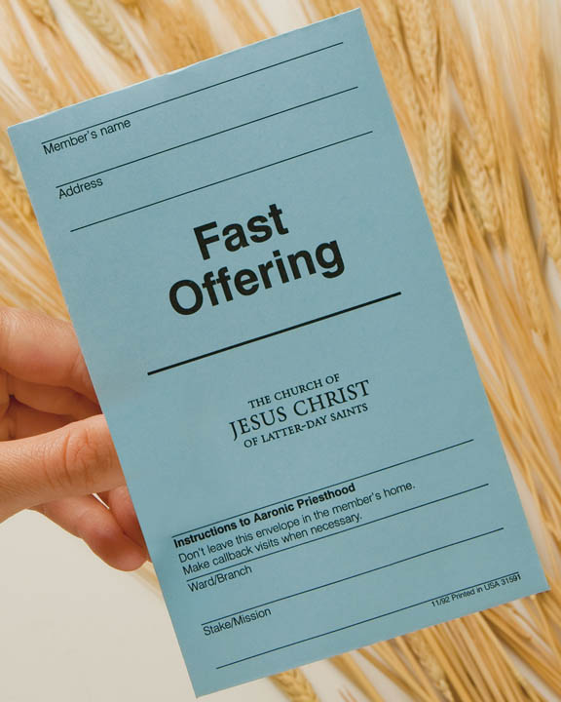
The True Law of the Fast
Fasting is more than abstaining from two meals.
The intent of the fast is not personal depravation but seeking to help and bless others.
What amount should we give for a fast offering?
Generally, at least the value of the two meals not eaten. Prophets have encouraged us to be generous when possible

Slide 3
What is fasting?
When members of the Church “fast,” they voluntarily go without food and drink for about 24 hours in order to draw closer to the Lord and seek His blessings.

Slide 4
When do Church members usually fast?
We can fast at any time, but “the Church designates one Sunday each month, usually the first Sunday, as a day of fasting” (1)

Slide 5
Cry Aloud
Voice and Trumpet
Prophets are to cry out against the people concerning their sins.
Alma Cries Repentance:
O that I were an angel, and could have the wish of mine heart, that I might go forth and speak with the trump of God, with a voice to shake the earth, and cry repentance unto every people!
Alma 29:1
Isaiah 58:1

Slide 6
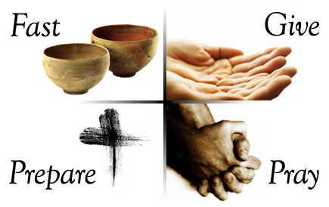
Wherefore Have We Fasted?
Why didn’t the Lord recognize their fast?
Their day of fasting was to be a holy day and they made it a holiday
During Lent, many Christians commit to fasting or giving up certain types of luxuries as a form of penitence. Many Christians also add a Lenten spiritual discipline, such as reading a daily devotional, to draw themselves near to God.
Isaiah 58:3

Slide 7
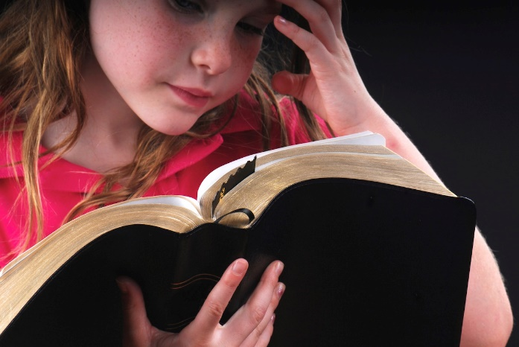
Fast For Strife and Debate
Fasting for the wrong reason just made them miserable and irritable
The Lord directed Isaiah to boldly declare to the house of Jacob (or Israel) their sins. These sins included outwardly performing religious practices without sincere intent and thus acting as if they were a righteous nation that had not forsaken the Lord
He taught that rather than seeking to be repentant and draw closer to Him while they fasted, they sought worldly pleasures and engaged in worldly activities.
Instead of showing compassion to others, they forced others to work, and they were irritable and contentious.
The Lord said that because their intentions and actions were improper while they fasted, He would not acknowledge their prayers.
Isaiah 58:3-4

Slide 8
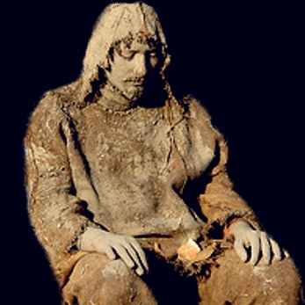
Sackcloth and Ashes
bulrush = a tall, thin grass that droops
sackcloth = a coarse material sometimes made from goat’s hair.
In biblical times people often wore sackcloth or sat on sackcloth and ashes to symbolize their humility or sorrow.
The Lord questioned whether the outward appearances of fasting reflected the proper spirit of the fast that He intended
The point of fasting was not to show an outward sign of their misery but to bypass the needs of our body and find connections between our spirit and the Holy Ghost. (3)
Isaiah 58:5

Slide 9
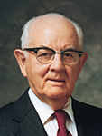
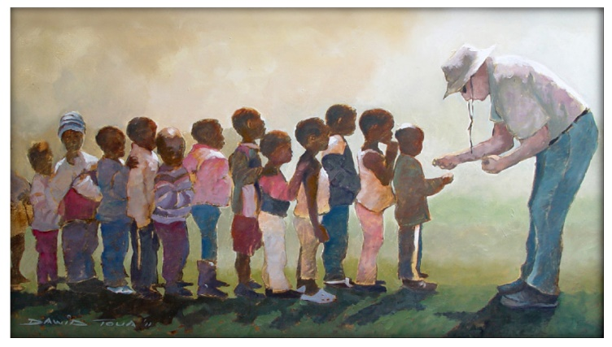
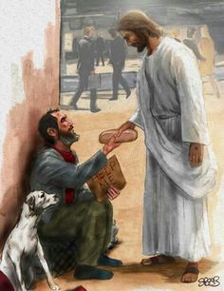
The Fast of the Lord
We need to learn to fast the way God requires with humility, repentance of our willfulness and selfishness. (3)
Loose the Bands of Wickedness = chains of sin
“sin is like handcuffs on the wrists, a ring in the nose, and slave bands around the neck.” (4)
Let the oppressed go free/ break every yoke =
A practice in ancient times was to take the property of the poor as collateral for debt. With no property, including clothing, the poor had no option but to stay in servitude. The practice of using and controlling other human beings must be broken…fasting can help break the yoke and burden of sin. (2)
Isaiah 58:6

Slide 10
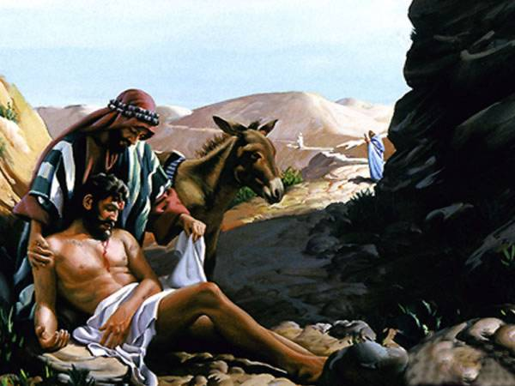
The Hungry and the Poor
Our fast should be extremely generous
Hide not thyself = Don’t avoid opportunities to help others
Cover Them!
Isaiah 58:7

Slide 11
Doctrinal Mastery
Is not this the fast that I have chosen? to loose the bands of wickedness, to undo the heavy burdens, and to let the oppressed go free, and that ye break every yoke?
Is it not to deal thy bread to the hungry, and that thou bring the poor that are cast out to thy house? when thou seest the naked, that thou cover him; and that thou hide not thyself from thine own flesh?
Isaiah
58:6-7
Isaiah 58:6-7

Slide 12
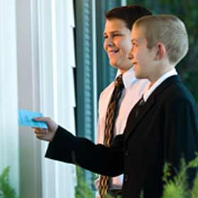
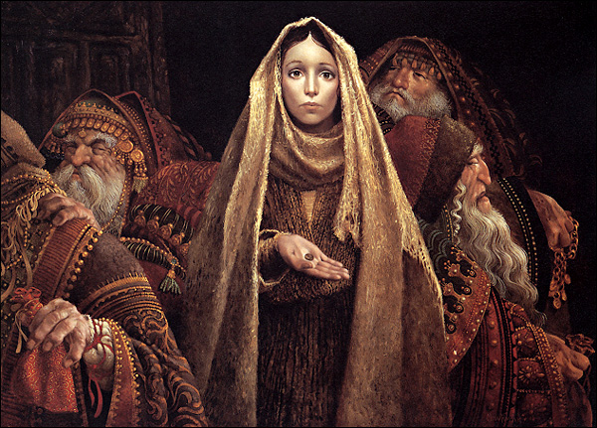
Fasting, a Spiritual Purpose
Men who truly love the Lord seek to overcome their sins and to draw nearer to the Lord in fasting and prayer.
Fasting has genuine spiritual purpose: it breaks the bands of wickedness, sets free the spiritually oppressed, and provides bread for the hungry and covering for the naked.
“Fast offerings are used for one purpose only: to bless the lives of those in need. Every dollar given to the bishop as a fast offering goes to assist the poor. When donations exceed local needs, they are passed along to fulfill the needs elsewhere” (7)
Isaiah 58:1-7
(2)

Slide 13
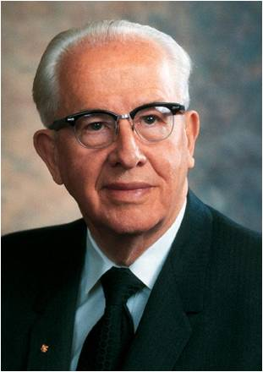
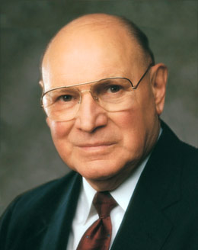
A Proper Fast
“Periodic fasting can help clear up the mind and strengthen the body and the spirit. … To make a fast most fruitful, it should be coupled with prayer and meditation; physical work should be held to a minimum, and it’s a blessing if one can ponder on the scriptures and the reason for the fast” (8)
“We observe that in the scriptures, fasting almost always is linked with prayer. Without prayer, fasting is not complete fasting; it’s simply going hungry. If we want our fasting to be more than just going without eating, we must lift our hearts, our minds, and our voices in communion with our Heavenly Father. Fasting, coupled with mighty prayer, is powerful. It can fill our minds with the revelations of the Spirit. It can strengthen us against times of temptation” (7)
Isaiah 58:1-7

Slide 14
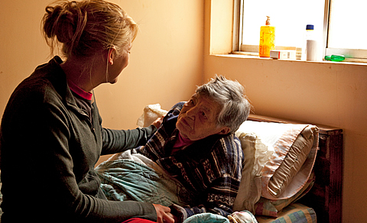
If we fast as the Lord intends, then we can help relieve others’ burdens and receive relief from our own burdens
If we fast as the Lord intends, then we will care for the poor and needy
If we fast as the Lord intends, then He can bless us with light, health, righteousness, protection, revelation, and guidance
Isaiah 58:1-7
(2)

Slide 15
The Light—A Blessing
One of the blessings of a true fast is the spiritual light that comes as we break away from darkness (3)
Rereward = an older word meaning “rear guard.”
Hebrew word asaph = “to gather”
“it is applied to the gathering up of the scattered rear of an army, or the keeping it from straggling, and defending it from the attacks of an enemy” (5)
Leave No One Behind
A better translation would be “the glory of Jehovah will gather thee, or keep thee together, i.e.be thy rear-guard” (6)
Isaiah 58:8

Slide 16
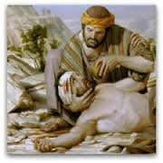
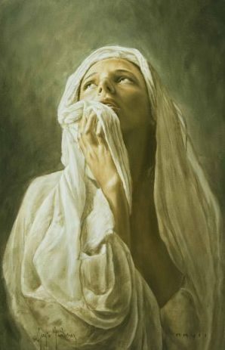
Thine Health—A Blessing
A growth of new flesh in the place of the old wound
Fasting properly helps in the healing of spiritual wounds
Isaiah 58:8

Slide 17
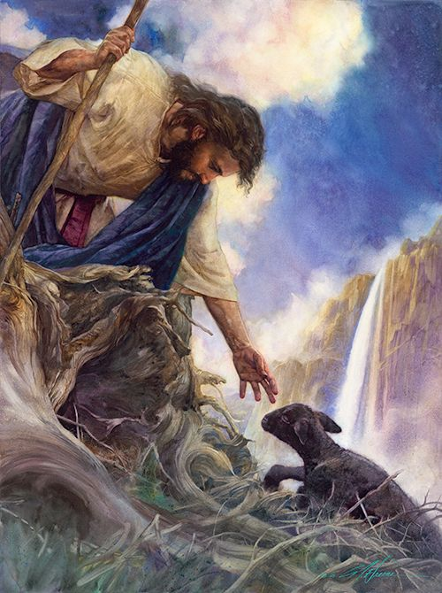
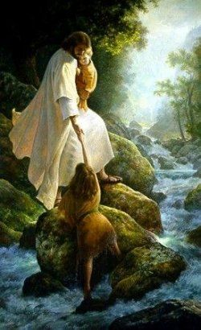
A Guide and Protection—A Blessing
Isaiah promises that we will be surrounded by the glory of the Lord
And if thou draw out thy soul to the hungry, and satisfy the afflicted soul; then shall thy light rise in obscurity, and thy darkness be as the noonday:
Isaiah 58:8-10

Slide 18
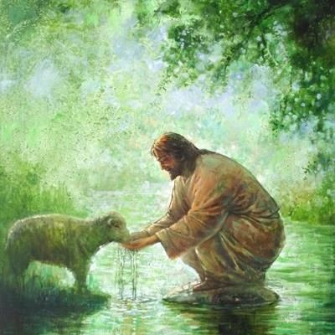
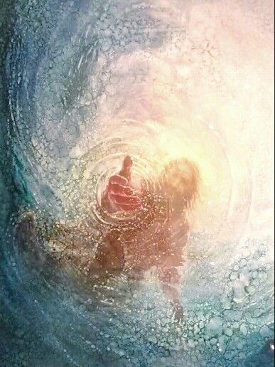
Safety of Thy Soul—A Blessing
Jehovah is like a shepherd who provides living water to his thirsting sheep
Fat thy bones = Bones are the gauge of vitality
Dry brittle = sickness and old age (ouch)
Fat Bones = young and vital, not easily broken
Watered garden =
But unto him that keepeth my commandments I will give the mysteries of my kingdom, and the same shall be in him a well of living water, springing up unto everlasting life.
D&C 63:23
Isaiah 58:11
Yongkim Kim

Slide 19
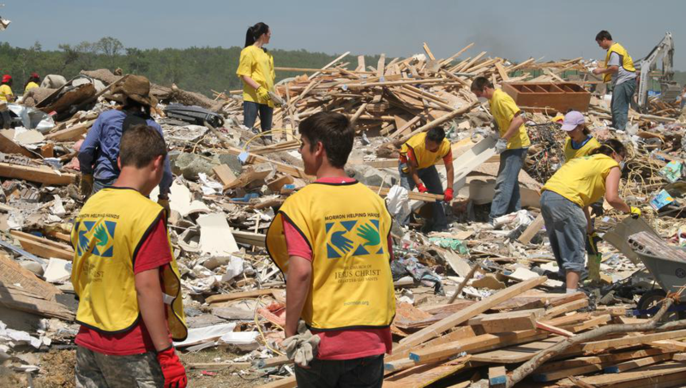
The Rebuilders—A Blessing
Those filled with light become rebuilders of broken walls, and restorers of houses in ruins.
Fasting helps us to repair our broken relationship with the Savior and we then join Him in the greatest work of restoring others to Christ
Isaiah 58:12

Slide 20
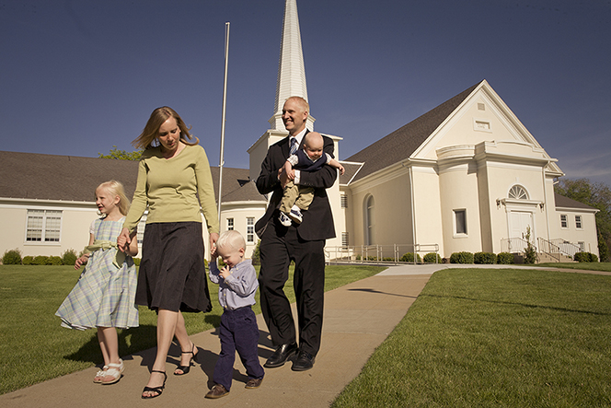
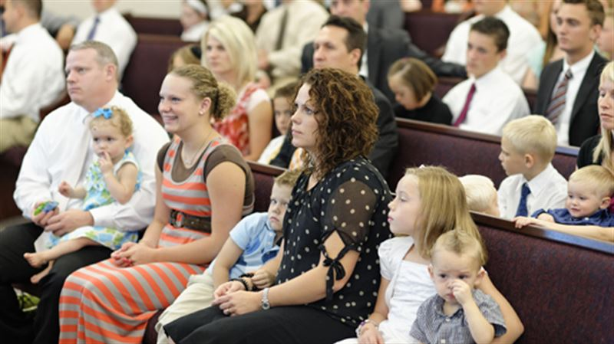
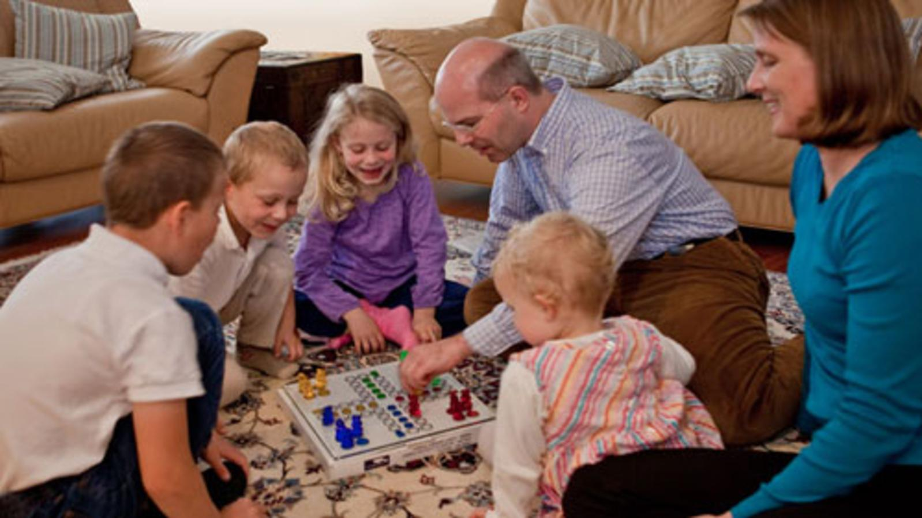
The Law of the Sabbath
One of the greatest challenges of the Sabbath is in giving up our desire for a “day off”.
If we obey the Sabbath and consecrate it to the Lord with pure hearts we will find joy in our obedience and in the Lord
Isaiah 58:13-14

Slide 21
Doctrinal Mastery
If thou turn away thy foot from the sabbath, from doing thy pleasure on my holy day; and call the sabbath a delight, the holy of the Lord, honourable; and shalt honour him, not doing thine own ways, nor finding thine own pleasure, nor speaking thine own words:
Then shalt thou delight thyself in the Lord; and I will cause thee to ride upon the high places of the earth, and feed thee with the heritage of Jacob thy father: for the mouth of the Lord hath spoken it.
Isaiah 58:13-14

Slide 22
If we honor the Lord by keeping the Sabbath day holy, then we will have joy in our relationship with the Lord and obtain both temporal and spiritual blessings

Slide 23
“The Sabbath is a holy day in which to do worthy and holy things. Abstinence from work and recreation is important but insufficient. The Sabbath calls for constructive thoughts and acts, and if one merely lounges about doing nothing on the Sabbath, he is breaking it.
“To observe it, one will be on his knees in prayer, preparing lessons, studying the gospel, meditating, visiting the ill and distressed, sleeping, reading wholesome material, and attending all the meetings of that day to which he is expected. To fail to do these proper things is a transgression on the omission side.”
Isaiah 58:13-14
(4)

Slide 24
Sources:
Suggested Hymn: #280 Welcome, Welcome, Sabbath Morning
Videos:
“Is Not This the Fast That I Have Chosen?” (3:15)
Wherefore Have We Fasted(7:22)
True to the Faith: A Gospel Reference(2004), 67
Old Testament Institute Manual The Last Days and the Millennium Chapter 18
Poway Institute Handout Becky Davies and Lesley Meacham
Spencer W. Kimball Miracle of Forgiveness
President Spencer W. Kimball(The Miracle of Forgiveness [1969], 96–97)
William Wilson, Old Testament Word Studies, s.v. “rereward.”
C. F. Keil and F. Delitzsch, Commentary on the Old Testament, 7:2:390
Elder Joseph B. Wirthlin (“The Law of the Fast,” Ensign, May 2001, 73-74).
President Ezra Taft Benson (“Do Not Despair,” Ensign, Nov. 1974, 66–67).
Presentation by ©http://fashionsbylynda.com/blog/

Slide 25
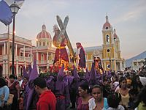
Lent is a solemn religious observance in the liturgical calendar of many Christian denominations that begins on Ash Wednesday and covers a period of approximately six weeks before Easter Sunday. The traditional purpose of Lent is the preparation of the believer through prayer, penance, repentance of sins, almsgiving, atonement, and self-denial. This event is observed by Christians in the Anglican, Eastern Orthodox, Lutheran, Methodist, and Roman Catholic. Recently, some Anabaptist and evangelical churches also observe the Lenten season. Its institutional purpose is heightened in the annual commemoration of Holy Week, marking the death, burial, and resurrection of Jesus, which recalls the tradition and events of the New Testament beginning on Friday of Sorrows, further climaxing on Jesus' crucifixion on Good Friday, which ultimately culminates in the joyful celebration on Easter Sunday of the Resurrection of Jesus Christ.
Lent is traditionally described as lasting for 40 days, in commemoration of the 40 days Jesus spent fasting in the desert, according to the Gospels of Matthew, Mark and Luke, before beginning his public ministry, after which he endured temptation by the Devil.
Lent celebrants carrying out a street procession during Holy Week, in Granada, Nicaragua. The violet color is often associated with penance and detachment. Similar Christian penitential practice is seen in other Catholic countries, sometimes associated with mortification of the flesh.
What Has Fasting Turned Into?
The number 40 has many Biblical references: *Moses spent 40 days on Mount Sinai with God (Exodus 24:18)
Elijah spent 40 days and nights walking to Mount Horeb (1 Kings 19:8)
God sent 40 days and nights of rain in the great flood of Noah (Genesis 7:4)
the Hebrew people wandered 40 years in the desert while traveling to the Promised Land (Numbers 14:33)
Jonah's prophecy of judgment gave 40 days to the city of Nineveh in which to repent or be destroyed (Jonah 3:4).
Jesus retreated into the wilderness, where He fasted for 40 days, and was tempted by the devil (Matthew 4:1–2, Mark 1:12–13, Luke 4:1–2). He overcame all three of Satan's temptations by citing scripture to the devil, at which point the devil left him, angels ministered to Jesus, and He began His ministry. Jesus further said that His disciples should fast "when the bridegroom shall be taken from them" (Matthew 9:15), a reference to his Passion.
Since, presumably, the Apostles fasted as they mourned the death of Jesus, Christians have traditionally fasted during the annual commemoration of his burial.
It is the traditional belief that Jesus lay for 40 hours in the tomb, which led to the 40 hours of total fasting that preceded the Easter celebration in the early Church (the biblical reference to 'three days in the tomb' is understood by them as spanning three days, from Friday afternoon to early Sunday morning, rather than three 24-hour periods of time). Some Christian denominations, such as The Way International and Logos Apostolic Church of God, as well as Anglican scholar E. W. Bullinger in The Companion Bible, believe Christ was in the grave for a total of 72 hours, reflecting the type of Jonah in the belly of the whale.
One of the most important ceremonies at Easter is the baptism of the initiates on Easter Eve. The fast was initially undertaken by the catechumens to prepare them for the reception of this sacrament. Later, the period of fasting from Good Friday until Easter Day was extended to six days, to correspond with the six weeks of training necessary to give the final instruction to those converts who were to be baptized.
Converts to Catholicism followed a strict catechumenate or period of instruction and discipline prior to baptism. In Jerusalem near the close of the fourth century, classes were held throughout Lent for three hours each day. With the legalization of Christianity (by the Edict of Milan) and its later imposition as the state religion of the Roman Empire, its character was endangered by the great influx of new members. In response, the Lenten fast and practices of self-renunciation were required annually of all Christians, both to show solidarity with the catechumens, and for their own spiritual benefit. Wikipedia

Slide 26
Pre-Lent days have turned into Carnivals:
The carnival celebrations which in many cultures traditionally precede Lent are seen as a last opportunity for excess before Lent begins. Some of the most famous are the Carnival of Barranquilla, the Carnival of Santa Cruz de Tenerife, the Carnival of Venice, Cologne Carnival, the New Orleans Mardi Gras, the Rio Carnival, and the Trinidad and Tobago Carnival.
The day immediately preceding Lent is called Mardi Gras ("Fat Tuesday"), Pancake Tuesday, or Shrove Tuesday.
Originally, in Lebanon and Syria, the last Thursday preceding Lent was called "Khamis el zakara". For Catholics, it was meant to be a day of remembrance of the dead ones. However, zakara (which means "remembrance", in Arabic) was gradually replaced by sakara" (meaning "getting drunk" in Arabic) , and so the occasion came to be known as Khamis el sakara, wherein celebrants indulge themselves with alcoholic beverages.
Wikipedia
Delight thyself in the Lord:
Our part is to turn away our foot (the symbol of following or obeying) from doing our own pleasure on the Sabbath, to call the Sabbath a delight (that is, to take delight in it), to call it the “holy of the Lord” (holy means set apart or sanctified for the work of God), to call it honorable (that is, capable of being honored), and to honor God by not doing our own ways, finding our own pleasures, or even speaking our own words (see v. 13). If we do this, then we will be able to delight our self in the Lord (a promise similar to “then shall thy confidence wax strong in the presence of God” [D&C 121:45]). We will be able to ride upon the “high places of the earth” (Isaiah 58:14; mountains, or the high places of the earth, have long been the site of revelation and communion with God; see Mose 1:1; 7:2; 1 Nephi 11:1;Ether 3:1; Isaiah 2:2). And we will feed on the heritage of Jacob (eat or consume it so that it becomes part of us). The word heritage comes from the same root as heir and inherit. Latter-day revelation teaches that Jacob’s inheritance is exaltation and godhood (see D&C 132:37). Old Testament Institute Manual The Last Days and the Millennium Chapter 18
Loosing the bands of wickedness:
“I suppose when he speaks of ‘loosing the bands of wickedness’ of ‘undoing the heavy burdens,’ and the ‘breaking of every yoke’ that he is referring to the wickedness of people who think only of themselves in selfishness, vanity, pride, and having hearts so set upon the things of this world that the two great commandments of loving God and loving neighbor are entirely forgotten. The principles of loving thy neighbor and of loving God are encompassed in the true purpose of the fast.
“Certainly, it takes no imagination to understand what is meant when he says, ‘… that thou bring the poor that are cast out to thy house? when thou seest the naked, that thou cover him; and that thou hide not thyself from thine own flesh?’
“He meant that in addition to taking care of the poor, that we should watch over our own kin and be responsible for our father, mother, brother, and sister when they are in need.
“It is here that I would like to state that the Lord has caused a day of fasting and prayer to be set up in this day so that collectively the Church might join together to fulfil the purposes of fasting.” Bishop John H. Vandenberg (In Conference Report, Apr. 1963, p. 28.)
The Sabbath is a day of rest.
• It is a day of worship to pay our devotions to the Most High.
• It is a day to offer up our vows in righteousness.
• It is a day to confess our sins.
• It is a day to partake of the sacrament.
• It is a day to prepare our food with singleness of heart.
• It is a day to perfect our fasting.
Earl C. Tingey The Law of the Sabbath BYU speeches Aug. 6, 1995

Slide 27
In our exacting lives, we are either growing spiritually or we are losing ground. We either feed the spirit or it withers and dies. There is no neutral course. If we have not grown spiritually' during the Sabbath day, of what value has it been to us? We may have obtained much-needed physical relaxation, but we would be foolish in- deed to overlook the fact that the finest care of the physical self is no substitute for the neglect of the soul.
Theodore Roosevelt was once asked by a soldier if he could not worship God while in the mountains as well as in church on Sunday. Roosevelt promptly replied, "You could, but you don't." It is true that Moses found God on a mountain, and Joseph Smith found him in a grove of trees, but, as has been pointed out, neither of them had a golf club or was carrying a fishing pole in his hand at the time. William E. Berrett writes, "It takes proper environment to induce deep thinking and deep feeling. It requires the harmony of soul that is accomplished in prayer or song. It needs the assuring presence of others reaching for the same things in order to quicken the spirit within us. It requires the spirit of God to reach out and kindle the flame of our own spirit. Jesus said, 'Where two or three are gathered together in my name, there I will be in the midst of them.' " You may remember the story of the two
ministers who were mulling over some of the time- worn excuses for not attending church. They decided to apply these excuses for not attending church to something people like to do, such as going to the movies. They came up with this list:
I don't attend the movies because the man- ager of the theater has never visited me.
I did go a few times, but no one spoke to me. Those who go there aren't very friendly.
Every time I go they ask me for money.
Not all folks who go to the movies live up to the high standards of the film.
I went to the movies so much as a child I've decided I have had all the entertainment I need.
The performance lasts too long; I can't sit still for an hour and a half.
I don't always agree with what I hear and see there.
I don't think they have very good music.
The shows are held in the evening, and that's the only time I have to be home with family.
Keep the Sabbath Day Holy
Page 1

Slide 28
We can see how ridiculous these excuses seem when they are used in this manner. In June 1959 Presidents David 0. McKay, J. Reuben Clark, Jr., and Henry D. Moyle of the First Presidency issued the following in a statement concerning the Sabbath : "The Sabbath is not just another day on which we merely rest from work, free to spend it as our light-mindedness may suggest. It is a holy day, the Lord's day, to be spent as a day of worship and reverence. All matters extraneous thereto should be shunned. "This is a Holy Day of the Lord, on which we are commanded to pour out our souls in gratitude for the many blessings of health, strength, physical comfort, and spiritual joy which come from the Lord's bounteous hand." President McKay has further commented on our conduct when we do come to Church on Sun- day. He states: "When you enter a church build- ing, you are coming into the presence of our Father in heaven; and that thought should be sufficient incentive for you to prepare your hearts, your minds, and even your attire, that you might appropriately and properly sit in his presence. . . ." In conclusion, William E. Berrett suggests five questions to ask ourselves each Sabbath day :
Have I this day learned one new spiritual truth?
Have I come one whit closer to understanding and loving my fellowman?
Have I resolved anew to become in my words and actions more like Jesus Christ?
Have I renewed my solemn covenants with God?
Have I kept my mind unhampered by thoughts of violence, financial schemes, petty jealousies, or sordid desires?
If we can answer "yes" to all of these, we may be sure that we have indeed kept the Sabbath day holy.
By Steve Sorensen Era on Youth page 42
https://archive.org/stream/improvementera7102unse/improvementera7102unse_djvu.txt
Page 2

