Slide 1
Lesson 136
Commandments
Part 2
Presentation by ©http://fashionsbylynda.com/blog/

Slide 2
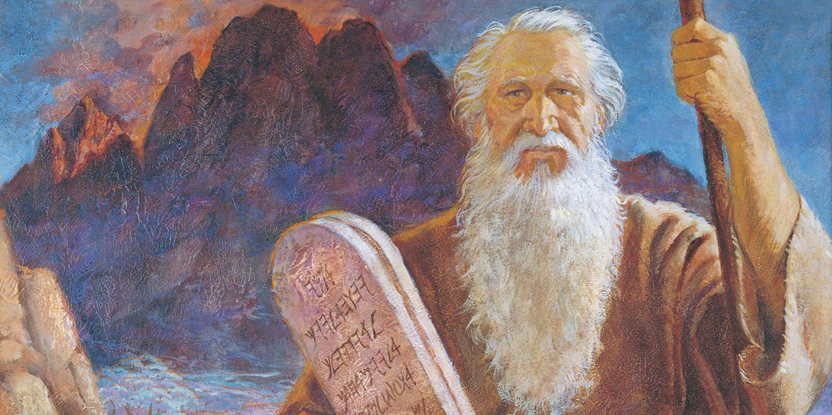
Why do we need the Ten Commandments?
The Ten Commandments are a vital part of the gospel and are eternal principles that are necessary for our exaltation.
Read Exodus 20:3-17

Slide 3
The Lord revealed them to Moses in ancient times, and He has restated them in latter-day revelations.
Yoram Raanan

Slide 4
How Are the Ten Commandments Relevant Today?
The Ten Commandments are a vital part of the gospel and are eternal principles that are necessary for our exaltation

Slide 5
How is this commandment a vital part of the gospel of Jesus Christ?
How can obeying this commandment help us to prepare for exaltation?
What are some ways we can keep this commandment?
How has obeying this commandment blessed your life and helped you become more like the Savior?

Slide 6
Sources:
Suggested Hymn: Keep the Commandments
Video: Obedience to the Ten Commandments (3:09)
Old Testament Seminary Teachers Manual Lesson 136
Presentation by ©http://fashionsbylynda.com/blog/

