Slide 1
Lesson 137
Jeremiah Preaches During Reign of Josiah
Jeremiah 1-6

Slide 2
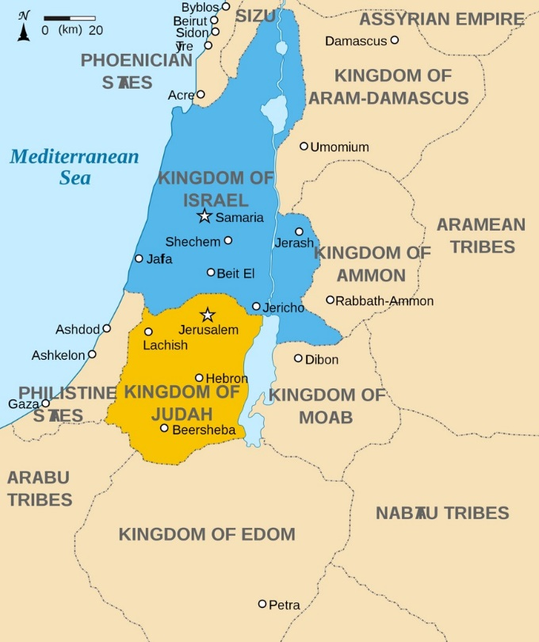
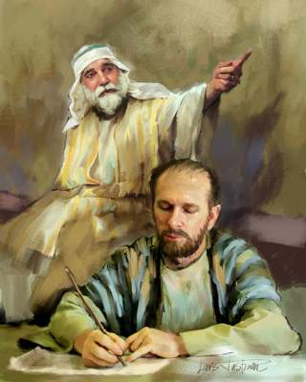
The Book of Jeremiah
Jeremiah
The book of Jeremiah contains the prophecies, warnings, and teachings that were part of the prophet Jeremiah’s ministry to the Southern Kingdom of Judah.
Jeremiah is responsible for much of the content of this book, but he likely used scribes to record his words as he dictated them (Jeremiah 36:4).
1 Nephi 1:4; 18:20 Zephaniah 1:1, Jeremiah 26:20-24; 36:32.

Slide 3
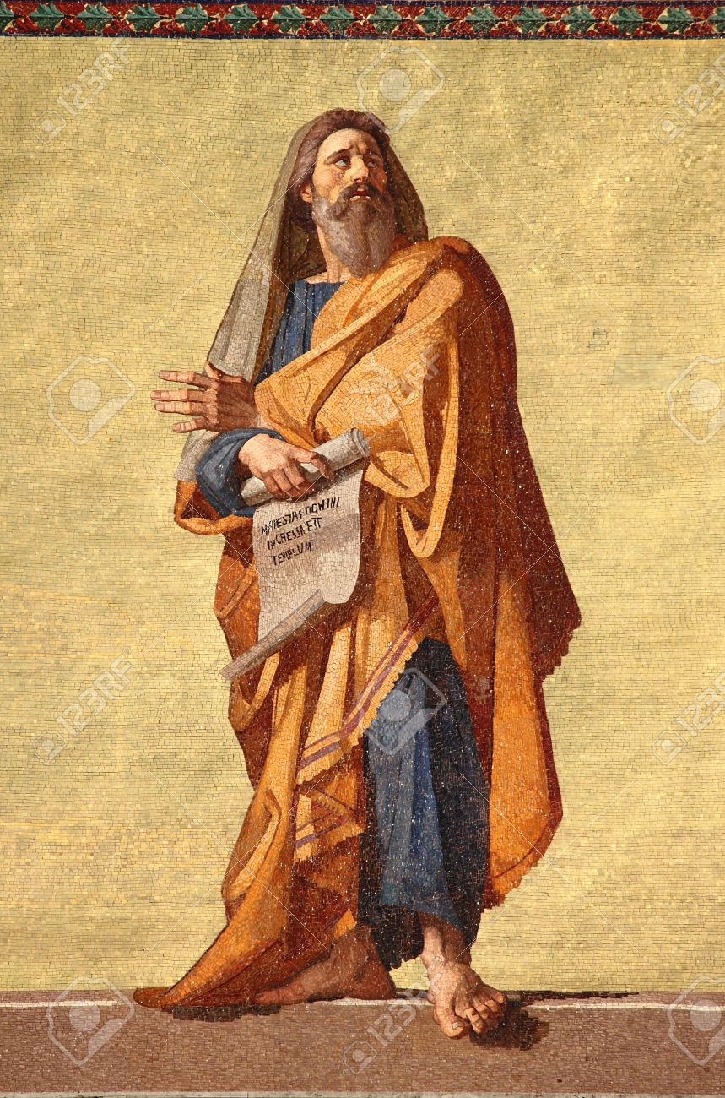
Jeremiah Preaches
Jeremiah
He labored in his prophetic calling during the reign of at least four kings of Judah: Josiah, Jehoahaz, Jehoiachin, and Zedekiah.
Jeremiah began his ministry in 626 B.C., the thirteenth year of the reign of King Josiah, and continued to preach until after the downfall of Jerusalem in approximately 586 B.C.
His preaching overlapped with the ministries of other prophets, including Lehi, Habakkuk, and Zephaniah. Some of Jeremiah’s words were recorded before the destruction of Jerusalem .
1 Nephi 1:4; 18:20 Zephaniah 1:1, Jeremiah 26:20-24; 36:32.

Slide 4
Jeremiah
He was born of a priestly family in Anathoth, son of Hilkiah
He was a prophet of the Lord during the days of Lehi and Daniel
He prophesied during a 40 year periods, from around 626 to 585 BC, including the 70 year captivity of Judah
He declared with power and authority the central governing principles of the gospel—that peace and happiness depend on obedience and honoring the covenants of the Lord
He witnessed the fall of Jerusalem
His writings are included in the brass plates of Laban (1 Nephi 5:10-13) and also mentioned two other times in the Book of Mormon (1 Ne. 7:14; Hel. 8:20)
He prophesied of a ‘new and everlasting covenant’ that would be fulfilled in the return of the kingdom of God to earth prior to the Second Coming (Jeremiah 31:31-34)
After the fall of Jerusalem the Jews who escaped into Egypt took Jeremiah with them as a kind of fetish (Jeremiah 43:6), and at last, according to tradition, stoned him to death
(1, 2)

Slide 5
Doctrinal Mastery
Jeremiah 1:4-5
Then the word of the Lord came unto me, saying,
Before I formed thee in the belly I knew thee; and before thou camest forth out of the womb I sanctified thee, and I ordained thee a prophet unto the nations.
Jeremiah 1:5

Slide 6
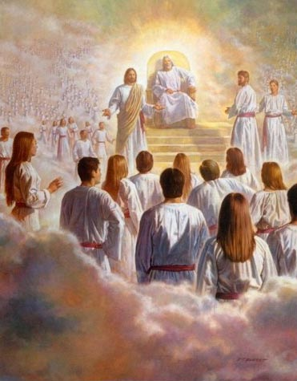
Foreordination
Before we were born, our Heavenly Father knew us and we existed as His spirit children
“The doctrine of foreordination applies to all members of the Church, not just to the Savior and His prophets. Before the creation of the earth, faithful women were given certain responsibilities and faithful men were foreordained to certain priesthood duties.
Although you do not remember that time, you surely agreed to fulfill significant tasks in the service of your Father. As you prove yourself worthy, you will be given opportunities to fulfill the assignments you then received” (3)
Jeremiah 1:5

Slide 7
Responsibilities Given…
Before we were born, we were given specific responsibilities and duties to perform during mortality
What are some of the responsibilities and duties that the Lord may have ordained His children to do in this life?
In what ways can we identify the specific duties or responsibilities we are to perform during mortality?
Jeremiah 1:5

Slide 8
Patriarchal Blessings
What is a patriarchal blessing?
“Every worthy, baptized member is entitled to and should receive a patriarchal blessing, which provides inspired direction from the Lord”.
Patriarchal blessings include a declaration of a person’s lineage in the house of Israel and contain personal counsel from the Lord. As a person studies his or her patriarchal blessing and follows the counsel it contains, it will provide guidance, comfort, and protection.
(4,5)

Slide 9
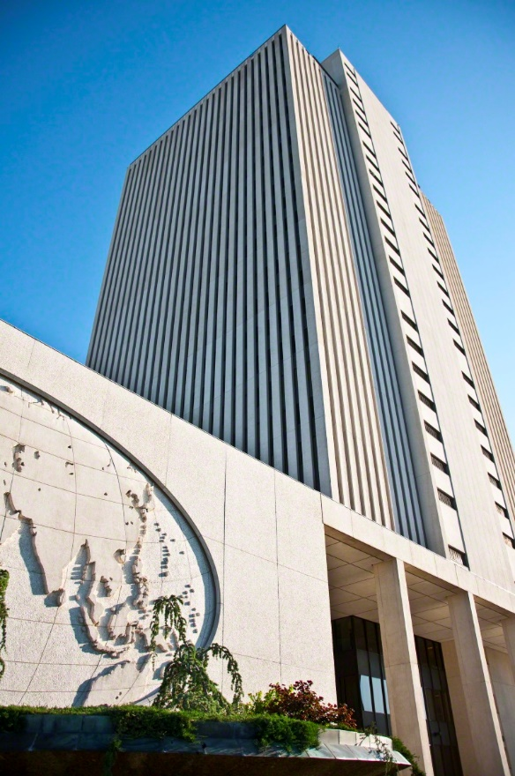
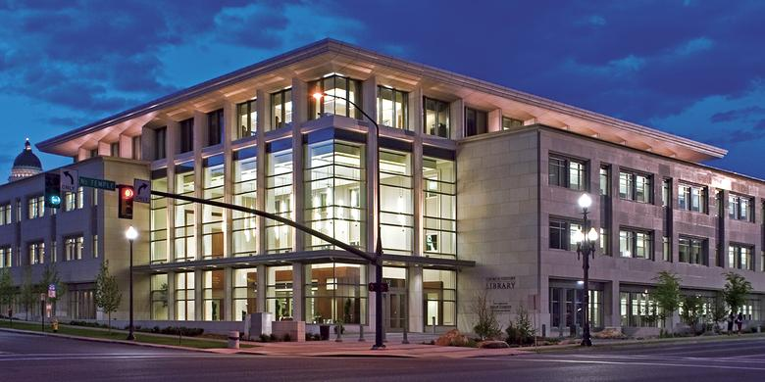
Patriarchal Blessings
How can I obtain a copy of my patriarchal blessing?
A person who has received a patriarchal blessing should carefully safeguard the copy he or she receives. However, if this copy is lost or destroyed, another one may be obtained from the patriarch if he still has the original in his binder of blessings. If the original has been sent to Church headquarters, a copy may be obtained”
The Church History Library can provide a copy of a patriarchal blessing that has been submitted by your patriarch.
(4)

Slide 10
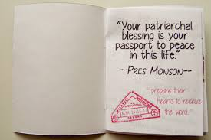
Patriarchal Blessings
May I share my blessing with others?
“Each patriarchal blessing is sacred, confidential, and personal.” Further, “Church members should not compare blessings and should not share them except with close family members. Patriarchal blessings should not be read in Church meetings or other public gatherings”.
They should not be distributed or shared through electronic means such as FamilySearch, social media, websites, or blogs.
(4)

Slide 11
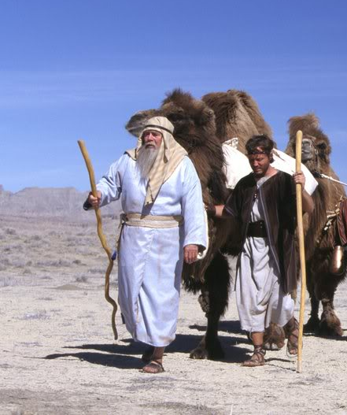
Jeremiah is Called
Jeremiah labored in his prophetic calling during the reign of at least four kings of Judah: Josiah, Jehoahaz, Jehoiachin, and Zedekiah.
He began his labors as a youth in approximately 627 B.C. and was the leading prophet in Jerusalem, serving with Habakkuk, Zephaniah, Lehi, and others (1 Nephi 1:4.)
Since Lehi and Nephi refer to Jeremiah’s prophecies, it is safe to assume that some of them were recorded on the brass plates.
(6)

Slide 12
Uncertainty—I Am A Child
Enoch
Moses
Gideon
And he said unto him, Oh my Lord, wherewith shall I save Israel? behold, my family is poor in Manasseh, and Iam the least in my father’s house.
Judges 6:15
And when Enoch had heard these words, he bowed himself to the earth, before the Lord, and spake before the Lord, saying: Why is it that I have found favor in thy sight, and am but a lad,
and all the people hate
me; for I am slow of
speech; wherefore am
I thy servant?
Moses 6:31
And Moses said unto the Lord, O my Lord, I am not eloquent, neither heretofore, nor since thou hast spoken unto thy servant: but I am slow of speech, and of a slow tongue.
Exodus 4:10
Jeremiah 1:6-10

Slide 13
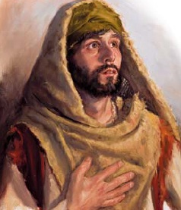
The Call
The role of a prophet is succinctly set forth. A prophet does not necessarily say what he wants to say, for the Lord puts His own words into the mouth of the prophet. That is why it does not matter whether the word comes direct from God or through His servant: “it is the same”
What I the Lord have spoken, I have spoken, and I excuse not myself; and though the heavens and the earth pass away, my word shall not pass away, but shall all be fulfilled, whether by mine own voice or by the voice of my servants, it is the same.
D&C 1:38
When God calls us to do His work, He will help us do what He has asked
(6)

Slide 14
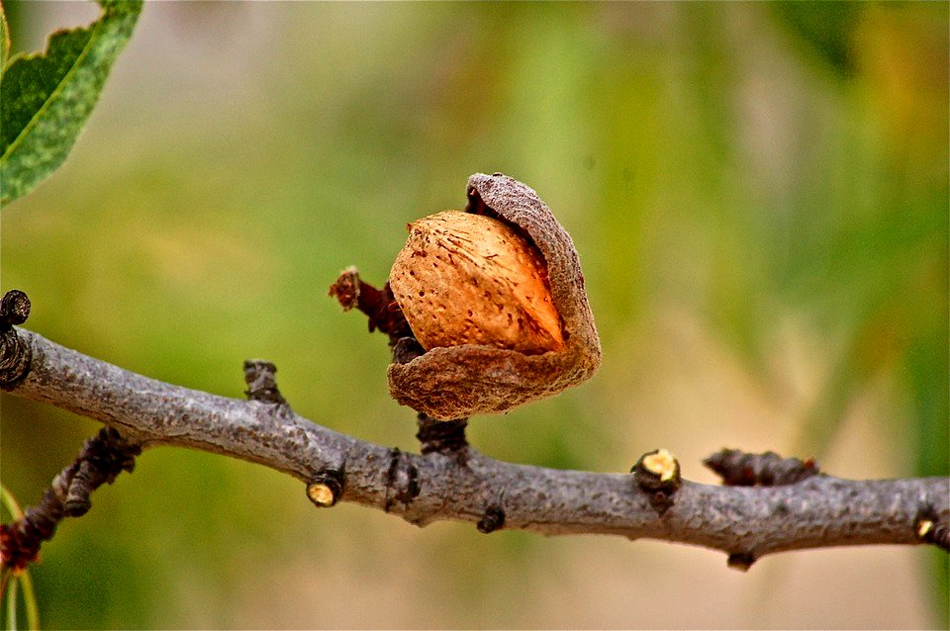
The Almond Branch
Aaron’s rod was an almond branch.
An almond branch was evidently chosen because it is the first tree to bud in spring.
As the almond tree hastens to come into blossom, so would the word of the Lord through Jeremiah hasten to fulfillment.
Jeremiah 1:11-12
(6)

Slide 15
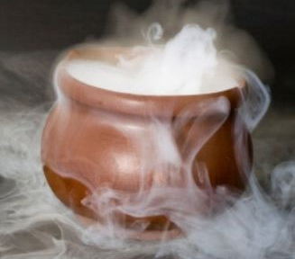
A Seething Pot
“seething pot” = symbolizing the disaster and pain which, like the contents of a boiling cauldron, would spill over and run down the kingdoms of the north to overwhelm Judah (7)
Jeremiah 1:13-15
(6)

Slide 16
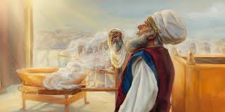
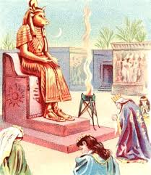
The Burning of Incense
The burning of incense = a symbol of prayer.
Far more is implied in the Lord’s accusation than just a ritual of burning incense to false gods.
The people were seeking help and guidance from the false gods rather than from the Lord..
And another angel came and stood at the altar, having a golden censer; and there was given unto him much incense, that he should offer it with the prayers of all saints upon the golden altar which was before the throne.
Revelation 8:3
Jeremiah 1:16
(6)

Slide 17
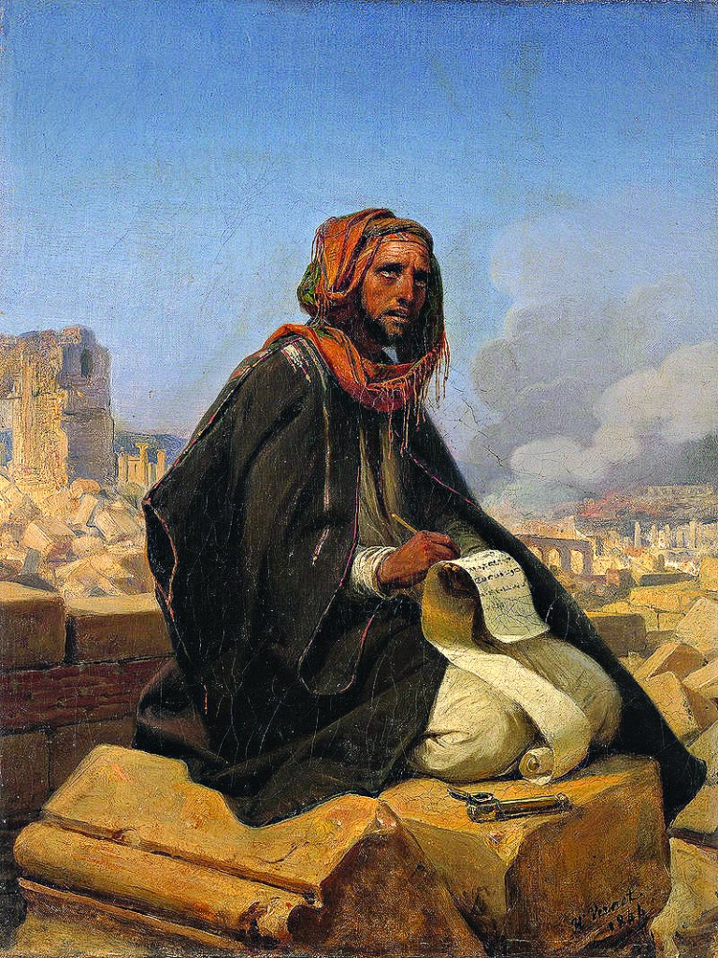
Arise and Speak
Jeremiah was told to stand stout and strong, to brace himself, and to declare the Lord’s word without fear of man.
The Lord likened him to an invincible city, preparing Jeremiah to stand firm against the onslaught that would pour out on him on every hand once he started his ministry and condemned the people’s sins.
Horace Vernet
Jeremiah 1:17-19
(6)

Slide 18
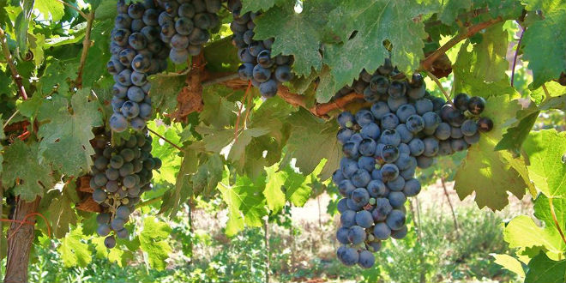
Waters of Life
Israel was once holy and fruitful and devoted
Jeremiah 2:1-4
(6)

Slide 19
Turned Away From the Waters of Life
“gone far from me”
Where is the Lord?
The Lord asked what fault the people found in Him that justified their turning away from Him.
Jeremiah 2:5-8
(6)

Slide 20
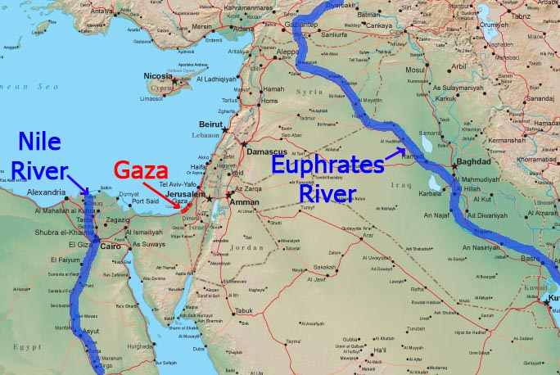
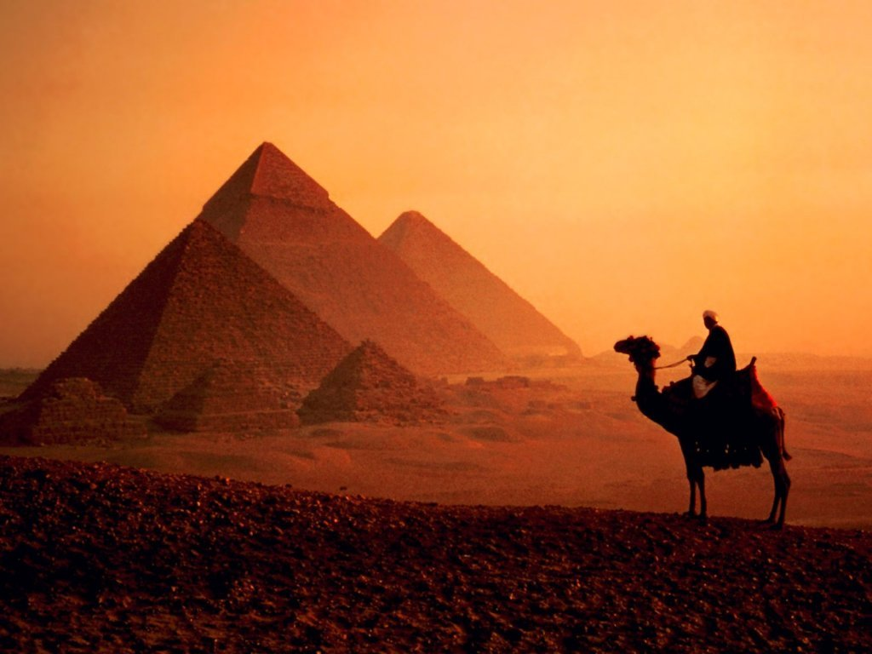
Waters of Life Forsaken
Apostasy
They have forsaken the fountain (Jehovah) of living water (life)
They have hewn out broken cisterns (gods) which can hold no water (life).
Waters of “Sihor” = (the Nile) and of “the river” = the Euphrates).
They drank the spiritual waters of Egypt and Babylon and were filled with the lifeless water of idolatry.
Jeremiah 2:9-18
(6)

Slide 21
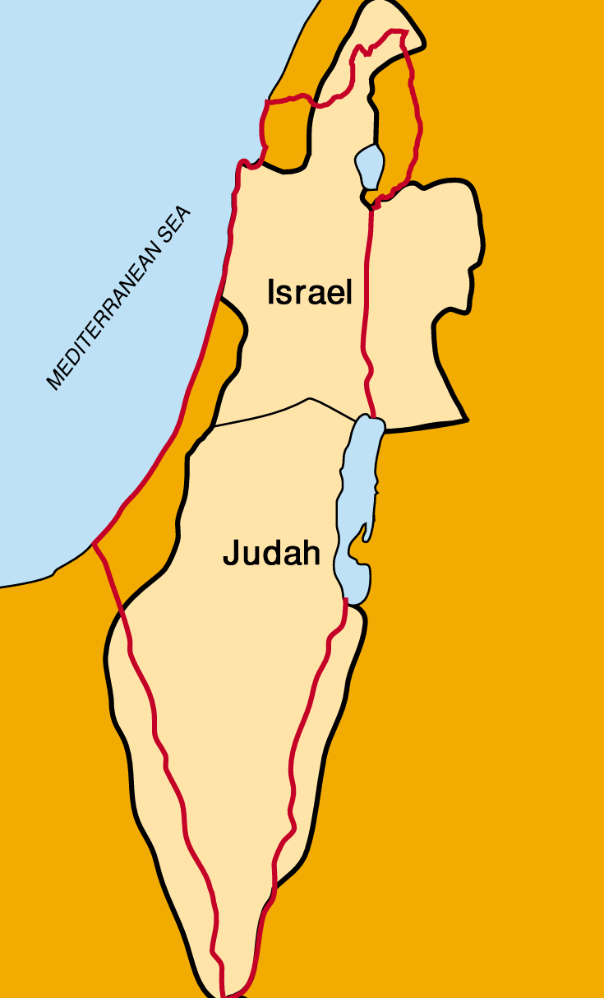
“Played the Harlot”
The Lord compared the kingdoms of Israel and Judah to two sisters.
One sister (Judah) watched the other sister (Israel) refuse to listen to the prophets and saw her ultimately reject the Lord. The Lord had given her a bill of divorcement.
As a result of this rejection, the Northern Kingdom
of Israel had been destroyed by the Assyrians in the century before Jeremiah was born, and the Southern Kingdom of Judah had witnessed it.
Jeremiah 3:1-11
(6)

Slide 22
The Latter-day Prophecy
Jeremiah 3 | Prophecy
14 | Missionary work and gathering to Zion
15 | Knowledge and understanding taught by faithful pastors (church leaders)
16 | The fulfillment of the old covenant and the establishment of a new covenant
17 | The restoration of Jerusalem to righteousness
18-19 See also Isaiah 11:16; 35:8-10; 51:9-11; D&C 133:26-35 | The gathering of Israel, including the return of the lost tribes from the north and the reuniting of the children of Judah in the lands of their inheritance
Jeremiah 3:12-19
(6)

Slide 23
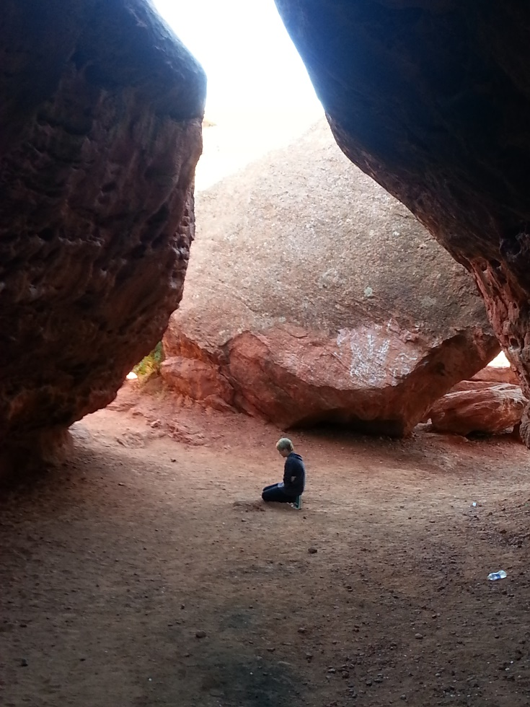
Return
If we repent and come unto the Lord with our whole hearts, He will heal our waywardness.
How does the Lord heal us and help us resist temptations?
As we turn to the Lord with our whole hearts, He will help us to change and not repeat sins of the past.
Jeremiah 3:22

Slide 24
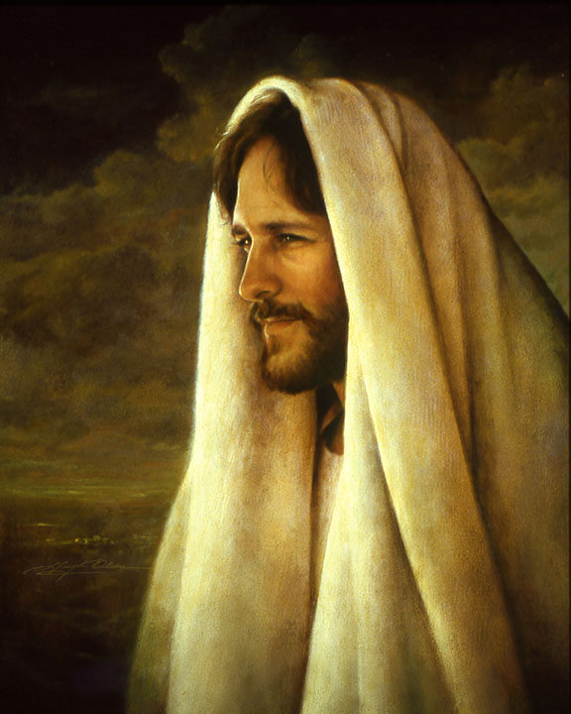
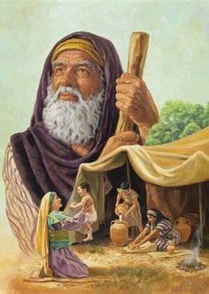
“Circumcise Yourselves to the Lord”
Circumcision was a token given to Abraham as a sign that a child was born into the covenant and was not accountable for sin until he was eight years old
The Lord taught in numerous places in the scriptures that the true circumcision after a person is accountable is that of the heart
One must accept the covenant in his heart and become sinless through faith, repentance, and baptism.
Jeremiah 4:1-4 Deuteronomy 10:16; 30:6; Jeremiah 9:25–26; Romans 2:25–29
(6)

Slide 25
Approaching Disasters
“The lion” = Renowned for its destructive killing power, the lion, Babylon, was about to come out of the thicket where it stayed hidden until it sallied forth on the hunt.
Jeremiah 4:5-31
(6)

Slide 26
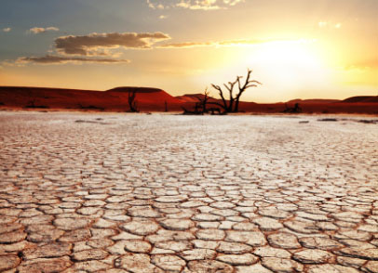
Dry Wind
The scorching desert winds were devastating in the Holy Land if they blew very long or hard, for they sucked the moisture from plants, animals, and people with terrible effect. This wind was not the gentle breeze used to fan away the chaff while winnowing grain, but a full, hard wind.
Jeremiah 4:11-13
(6)

Slide 27
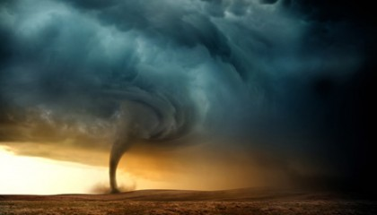
Clouds and Whirlwinds
“ Babylon’s troops would be like a huge thundercloud covering the sky, and its effect would be that of a tornado.
Jeremiah 4:15
(6)

Slide 28
Earth Without Form and Void
So great would be the destruction that it would be as if the Creation had been undone.
Jeremiah 4:23 Genesis 1:2
(6)

Slide 29
Hard As A Rock
They showed no repentance or compassion
The Lord promised to spare Judah if anyone could be found who lived justly or sought the truth
The prophets prophesy falsely, and the priests bear rule by their means; and my people love to have it so: and what will ye do in the end thereof?
Jeremiah 5
(6)

Slide 30
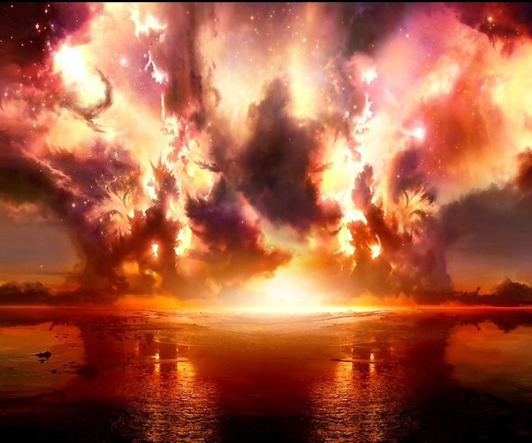
Peace, Peace
Where is the Peace?
Jeremiah knows that Jerusalem will be destroyed because of her iniquity and She will be overrun by a great and cruel nation. (Babylon)
Babylon represents the world, and Zion represents the pure in heart.
The Babylon I have described seems to have encouraged each individual to walk in his own way, to trust in and be rewarded by the strength of his own arm. It allows one to set up his own image and worship that image through the vitality of his body and the power of his own hand. Indeed, the attainment of power, whether through wealth, priestcraft, or political intrigue, appears to be the mainspring of Babylonian life.
Jeremiah 6
(8)

Slide 31
“Everything in the gospel teaches us that we can change if we need to, that we can be helped if we truly want it, that we can be made whole, whatever the problems of the past.”
(9)

Slide 32
Sources
Suggested Hymn: #284 If You Could Hie To Kolob (verse 1-3)
Video:
Until We Meet Again (2:08)
Who’s Who in the Old Testament by Ed J. Pinegar and Richard J. Allen pp. 57-58
Bible Dictionary
True to the Faith: A Gospel Reference [2004], 70.
Handbook 2: Administering the Church [2010], 20.12.1; 20.12.3
LDS Gospel Topics
Old Testament Institute Manual As ye Sow, So Shall Ye Reap Chapter 23
C. F. Keil and F. Delitzsch, Commentary on the Old Testament, 8:1:43–44.
BYU Speeches April 2003 by Dennis Tolley “Doing Business in Babylon”
Elder Jeffrey R. Holland (“He Hath Filled the Hungry with Good Things,” Ensign, Nov. 1997, 66).
Presentation by ©http://fashionsbylynda.com/blog/

Slide 33
Jeremiah At A Glance – Bible Dictionary
Jeremiah 1-6 | Prophecies of reign of Josiah | Jeremiah 1:4-5 Jeremiah 3:12-19 | Premortal Condition and Jeremiah’s Calling Prophecy of the return of Israel from the scattered condition, gathering one of a city and two of a family to Zion, a pleasant land where Israel and Judah can dwell in safety and peace
Jeremiah 7-20 | Prophecies under Jehoiakim
Jeremiah 21-38 | Prophecies under Zedekiah | Jeremiah 21-23 | On pastors or rulers of people, with promise of king Messiah
 |  | Jeremiah 24 | Exiles carried away with Jehoiachin
 |  | Jeremiah 26-29 | False prophets and containing the prophet’s letter to the exiles in Babylon, warning against the prophets there
 |  | Jeremiah 30-33 | Prophecies of the latter-day restoration of Israel and the gospel covenant, containing the story of the prophet’s buying a field, showing the firmness of his faith in the people’s restitution
 |  | Jeremiah 34-38 | Narratives of the treatment of the prophet and other events during the last times of the siege
Jeremiah 39-44 | The prophet’s history and other events after the fall of the city
Jeremiah 46-51 | Prophecies against foreign nations | Jeremiah 50-51 | In their present form are later than Jeremiah
Jeremiah 52 | Historical conclusion

Slide 34
For information about Patriarchal Blessings--handout
To obtain copies of patriarchal blessings for yourself or for deceased direct-line ancestors, you will need:
Your Church membership record number.
The blessing recipient’s current name.
The blessing recipient’s name at the time the blessing was given.
Names of the blessing recipient’s parents, including the mother’s maiden name.
The birth date of the blessing recipient.
The approximate year the blessing was given, if known.
The patriarch’s name, if known.
Your relationship to the recipient (for ancestor blessing requests).
Your mailing address, including apartment number or PO Box number.
Your email address.
You may request copies of patriarchal blessings in three ways:
Online: Go to LDS.org In the top right corner of the screen, click My Account and Ward, and then select Patriarchal Blessing. In the new window, click Get Started and then sign in to your LDS Account or friend account. Follow the instructions on the left to verify personal information. Please ensure that your Membership Record Number (MRN) field is filled out. To request a blessing, click the personal request icon or the ancestral request icon, and provide all of the required information. Upon verification by library staff, personal blessings will be delivered online via your LDS Account, and ancestral blessings will be sent via postal mail. Internet Explorer and Edge are not supported web browsers.
By Mail: Mail your request containing the above information to the Church History Library. Responses will be mailed through the postal service to the return address provided.
Church History Library ATTN: Patriarchal Blessings 15 East North Temple Street Salt Lake City, Utah 84150-1600
In Person: Individuals may request a copy of their personal blessing at the Church History Library during regular hours Monday through Friday. A valid photo ID is required.
For information, please call 1-801-240-3500.
Whose blessing may I request?
A: You may request a copy of your own blessing or that of a deceased direct-line ancestor, deceased child, or deceased spouse.
To obtain copies of patriarchal blessings for yourself or for deceased direct-line ancestors, you will need:
Your Church membership record number.
The blessing recipient’s current name.
The blessing recipient’s name at the time the blessing was given.
Names of the blessing recipient’s parents, including the mother’s maiden name.
The birth date of the blessing recipient.
The approximate year the blessing was given, if known.
The patriarch’s name, if known.
Your relationship to the recipient (for ancestor blessing requests).
Your mailing address, including apartment number or PO Box number.
Your email address.
You may request copies of patriarchal blessings in three ways:
Online: Go to LDS.org In the top right corner of the screen, click My Account and Ward, and then select Patriarchal Blessing. In the new window, click Get Started and then sign in to your LDS Account or friend account. Follow the instructions on the left to verify personal information. Please ensure that your Membership Record Number (MRN) field is filled out. To request a blessing, click the personal request icon or the ancestral request icon, and provide all of the required information. Upon verification by library staff, personal blessings will be delivered online via your LDS Account, and ancestral blessings will be sent via postal mail. Internet Explorer and Edge are not supported web browsers.
By Mail: Mail your request containing the above information to the Church History Library. Responses will be mailed through the postal service to the return address provided.
Church History Library ATTN: Patriarchal Blessings 15 East North Temple Street Salt Lake City, Utah 84150-1600
In Person: Individuals may request a copy of their personal blessing at the Church History Library during regular hours Monday through Friday. A valid photo ID is required.
For information, please call 1-801-240-3500.
Whose blessing may I request?
A: You may request a copy of your own blessing or that of a deceased direct-line ancestor, deceased child, or deceased spouse.

Slide 35
Jeremiah:
“With the exception of Josiah, all of the kings of Judah during Jeremiah’s ministry were unworthy men under whom the country suffered severely. Even during the reign of an earlier king, the wicked Manasseh, the Baal cult was restored among the Jews, and there was introduced the worship of the heavenly planets in accordance with the dictates of the Assyro-Babylonian religion. Jeremiah therefore found idolatry, hill-worship, and heathen religious practices rampant among his people. Heathen idols stood in the temple [Jeremiah 32:34], children were sacrificed to Baal-Moloch (7:31; 19:5; 32:35), and Baal was especially invoked as the usual heathen deity. The worship of the ‘queen of Heaven’ ought also to be mentioned. (7:18; 44:19) The corruption of the nation’s religious worship was, of course, accompanied by all manner of immorality and unrighteousness, against which the prophet had continually to testify. The poor were forgotten. Jeremiah was surrounded on all sides by almost total apostasy. But professional prophets there were aplenty. Says Dr. H. L. Willett:
“‘He was surrounded by plenty of prophets, but they were the smooth, easy-going, popular, professional preachers whose words awakened no conscience, and who assured the people that the nation was safe in the protecting care of God. This was a true message in Isaiah’s day, but that time was long since past, and Jerusalem was destined for captivity. Thus Jeremiah was doomed to preach an unwelcome message, while the false prophets persuaded the people that he was unpatriotic, uninspired, and pessimistic. (14:13, 14).’” (Sidney B. Sperry, The Voice of Israel’s Prophets, p. 153.)
Return, even when we have been disobedient:
: “Everything in the gospel teaches us that we can change if we need to, that we can be helped if we truly want it, that we can be made whole, whatever the problems of the past” Elder Jeffrey R. Holland (“He Hath Filled the Hungry with Good Things,” Ensign, Nov. 1997, 66).
Jeremiah 6:14-15:
Speaking of Jeremiah’s time, one scholar said: “The prophets and priests of the day dressed the nation’s wounds, but skin-deep only. Nor did they have any sense of shame for the loathsome deeds they perpetrated. They neither felt shame nor did they know how to blush. They had become completely insensitive to the evils in which they and their nation were immersed. But continued active involvement in evil has a way of dulling the conscience until a point is reached when all awareness of evil is lost. Thereafter leaders fall with the rest of those who fall. In the day of divine reckoning they too would go down, for it would be the day of their own doom.” (Thompson, Book of Jeremiah, p. 258.)
Jeremiah 3:14-19 | Prophecy Of Latter-days
14 | Missionary work and gathering to Zion
15 | Knowledge and understanding taught by faithful pastors (church leaders)
16 | The fulfillment of the old covenant and the establishment of a new covenant
17 | The restoration of Jerusalem to righteousness
18-19 See also Isaiah 11:16; 35:8-10; 51:9-11; D&C 133:26-35 | The gathering of Israel, including the return of the lost tribes from the north and the reuniting of the children of Judah in the lands of their inheritance

Slide 36
Verse | “Israel’s condition” | What the Lord Asks
20 | “Broken thy yoke and burst thy bands” | The Lord had delivered them from the bondage of Egypt
20 | “Playing the harlot” | Judah had committed idolatry, or spiritual adultery, with false gods as well as actually engaging in unchaste practices
21 | “The degenerate plant of a strange vine” | This wild vine brought forth poisonous berries, or evil works.
22 | “Wash thee with nitre [lye], and take thee much soap, yet thine iniquity is marked” | The most powerful means of purification could not cleanse Judah’s sins. “In the valley”
23 | “In the valley” | Probably this valley was the Hinnom Valley, where children were sacrificed to Molech (Jeremiah 7:31)
23-24 | “A swift dromedary traversing her ways; a wild ass … that snuffeth up the wind at her pleasure” | The imagery indicates that as a camel or a wild ass in heat runs back and forth during the mating season, so did Israel run after false gods.
25 | “Withhold thy foot from being shod and thy throat from thirst” | In their anxiety to follow after the peoples of the world and worship false gods, they ran out of the house barefoot and would not even stop to slake their thirst.
27 | “Saying to a stock, Thou art my father; and to a stone, Thou hast brought me forth” | ). Israel worshiped images of wood and stone as the gods to whom they owed life and being.
28 | Where are thy gods?” | The Lord challenged Judah to find help from the false idols now that destruction threatened her.
30 | “In vain have I smitten your children” | Even the judgments of the past, such as the fall of the Northern Kingdom and the siege of Judah by Assyria, were not enough to bring the people to repentance.
30 | “Your own sword hath devoured your prophets” | The people killed the prophets sent by God to warn them.
32-34 | “Can a maid forget her ornaments?” | Unlike the bride who adorns herself with chastity and faithfulness to her husband, this bride of Judah was found with soiled skirts, which were so obvious that a search was not required to find them. Israel had become so skilled in doing evil that she could teach even the experienced harlots of idolatry
Jeremiah 2 (6)

Slide 37
How did Babylon become the name for the archetypal rival to Zion?
The city of Babylon predates Abraham. Located in modern-day southern Iraq, it was a thriving commercial center for more than 17 centuries. At its height it was the capital of a vast empire covering much of the Middle East. In about the fourth century B.C., the splendor and wealth of the city began to fade until, in about the second century A.D., Babylon ceased to exist. By ceased to exist, I mean it disappeared. Only piles of rubble and ruin remained. Until the last century, knowledge of the actual city was preserved only in the Bible and in a few references made by ancient historians.
Several years ago I visited an isolated oasis deep in the Gobi Desert in China. Some 80 miles from the nearest town, the oasis was in a small canyon that had been occupied by a handful of Buddhist monks for hundreds of years. In this incredibly isolated spot, the monks could avoid the temptations of the world and focus only on Buddhist teachings. In Latter-day Saint terms, these monks were trying to flee Babylon.
Most of us have elected not to dwell in total isolation but to live in the civilized world. This decision requires us to interact daily with the world and to face the challenge of doing business in Babylon even as we attempt to follow the Lord’s command to “go . . . out . . . from Babylon, from the midst of wickedness” (D&C 133:14).
Babylon the Great
In the scriptures the Lord uses the words Babylon and Zion to refer to two archetypes of our temporal existence.¹ Babylon represents the world, and Zion represents the pure in heart. But how did Babylon become the name for the archetypal rival to Zion?
The city of Babylon predates Abraham. Located in modern-day southern Iraq, it was a thriving commercial center for more than 17 centuries. At its height it was the capital of a vast empire covering much of the Middle East. In about the fourth century B.C., the splendor and wealth of the city began to fade until, in about the second century A.D., Babylon ceased to exist. By ceased to exist, I mean it disappeared. Only piles of rubble and ruin remained. Until the last century, knowledge of the actual city was preserved only in the Bible and in a few references made by ancient historians.
In its prime, Babylon had two features that were, at different times, counted among the Seven Wonders of the Ancient World—the Hanging Gardens and the city’s great exterior walls.² The Hanging Gardens of Babylon were described as a series of arches arranged in a theater-like manner and ascending to the height of a seven-story building. This construction included 16-foot-long stone beams to bear the weight of the different tiers and a hydraulic system to pump water to the top of the structure, from whence it coursed through the gardens. The stone beams and parts of what scholars believe to be the hydraulic pump system were discovered about 100 years ago.³
The ancient historian Herodotus noted that the walls of Babylon were 335 feet high and 85 feet wide. The walls surrounded an approximately square city with a circumference of about 56 miles, according to Herodotus.⁴ One could fit BYU, Mapleton, Benjamin, Pleasant Grove, Geneva Steel, and everything in between within the walls described by Herodotus. One could drive two full-sized Hummers side-by-side atop the wall.
Scholars today believe that the Babylon of Nebuchadnezzar was a walled city the size of New York⁵ with a population of 250,000 or more.⁶ Scaling down Herodotus’ dimensions, modern archaeologists say the walls were actually about five stories tall (about 50 feet)⁷ and about 90 feet thick at the base,⁸ while the inner city covered an area of about 2,100 acres.⁹
Herodotus also described the great temple Etemenanki, translated as “The House of the Foundations of Heaven and Earth,” which many feel was the Tower of Babel.¹⁰ “The sanctuary of the deity, on the top floor, had doors inlaid with ivory and beams lined with gold.”¹¹ From the rubble heap representing the probable site of this great tower, the local residents have been removing the best brick for several centuries to build dams and more modern buildings. Even so, the rubble heap currently is a mound of broken brick and debris approximately seven stories high.¹² Evidence suggests that the tower was approximately 30 stories tall and could be seen from 60 miles away.
More information:
https://speeches.byu.edu/talks/h-dennis-tolley_business-babylon/

