Slide 1
Lesson 138 Part 1
Jeremiah Prophecies Under Jehoiakim
Jeremiah 7-16

Slide 2
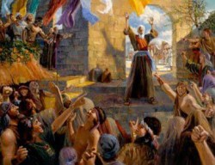
At the Temple Gate
Josiah had made it the sole place of sacrificial worship of Jehovah for all Jews in an attempt to stamp out idol worship.
The temple and its priests thus had acquired by this time greater importance than ever before. Then, in the name of Jehovah, Jeremiah issued a challenge that struck at the very existence of the temple.
He plainly told the Jews that if they would mend their ways and become righteous, they would be spared; otherwise, not even the temple would save them, because they had made the temple a “den of robbers”.
Because of the great reverence the people had for the temple, though it was a false reverence, it is not surprising that Jeremiah was quickly arrested and imprisoned.
Jeremiah 7:1-11; Jeremiah 26
(1)

Slide 3
A House of Prayer
Is this house, which is called by my name, become a den of robbers in your eyes? Behold, even I have seen it, saith the Lord..
Even them will I bring to my holy mountain, and make them joyful in my house of prayer: their burnt offerings and their sacrifices shall be accepted upon mine altar; for mine house shall be called an house of prayer for all people. Isaiah 56:7
And said unto them, It is written, My house shall be called the house of prayer; but ye have made it a den of thieves. Matthew 21:13
Many of the Jews in Jeremiah’s day behaved as though worshipping at the temple made them righteous, regardless of whatever else they did.
Jeremiah 7:11

Slide 4
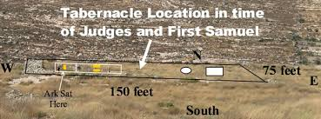
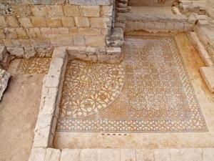
Go To Shiloh
A reminder of what happened to the temple in Shiloh—the temple would not protect them
After the Israelites under Joshua conquered the land of Canaan, the tabernacle, the equivalent of the temple, was set up at Shiloh
Eventually Israel became so wicked that they set up graven images and worshiped them in direct competition with the tabernacle.
A short time later the Philistines
attacked the Israelites and defeated
them. They overran Shiloh and
took the ark of the covenant in
the battle.
Jeremiah 7:12-20; Judges 18:30-31; 1 Samuel 4:10-12

Slide 5
Religious worship and practices alone cannot save us if we do not keep God’s commandments; if we repent and obey God’s voice, then He will be our God and we will be His people; if we strive to walk in all of God’s ways, then it will be well with us.

Slide 6
“Beginning in the days of Adam, and in every gospel dispensation since, the Lord has warned the inhabitants of the earth that their continued violation of the laws of righteousness, which He has revealed, would bring on their destruction. …
“In America two great civilizations, the Jaredite and the Nephite, were completely annihilated because of their rejection of the laws of righteousness which God revealed unto them.
“‘And God said unto Noah: The end of all flesh is come before me, for the earth is filled with violence, and behold I will destroy all flesh from off the earth’ [Moses 8:30].
“And this He did. Noah and his family were the sole survivors.
The Tragic Cycle
“Jerusalem was destroyed and its inhabitants were scattered throughout the earth because of their rejection of God’s laws of righteous living. …
“The people of Sodom and Gomorrah went through a similar cycle. They were warned and heeded not. For their iniquities ‘the Lord rained upon [them] brimstone and fire’ [Genesis 19:24].
Moses 8:30; Genesis 19:24; Jeremiah, Isaiah, Moroni
(2)

Slide 7
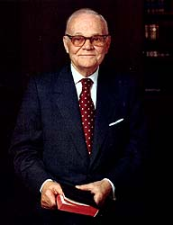
“…the Lord, through His prophets, pointed out their iniquities, warned them, and predicted their destruction if they did not repent. This they did not do. Consequently they were totally destroyed.
“We today are approaching the close of a similar cycle. We have been warned that we are ripening in iniquity and that we will be destroyed if we do not repent. …
“There is but one way these impending calamities can be avoided, and that way is repentance” (2)

Slide 8
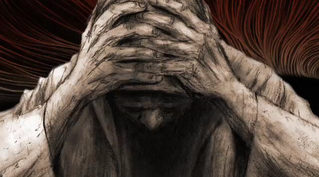
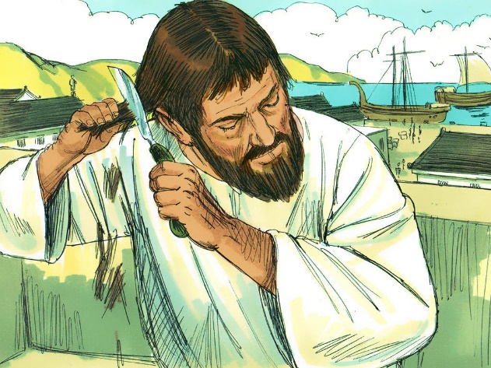
Cut Off Thine Hair
A symbol of grief
Then Job arose, and rent his mantle, and shaved his head, and fell down upon the ground, and worshipped,
Job 1:20
Make thee bald, and poll thee for thy delicate children; enlarge thy baldness as the eagle; for they are gone into captivity from thee.
Micah 1:16
To cut off the hair was to bring down Israel’s pride.
In Jeremiah’s view, Israel, now represented only by Judah and Jerusalem, had abandoned her consecration to Yahweh and was not worthy to wear the crown of her long hair.” (3)
Jeremiah 7:29

Slide 9
Israelites Choose to Disobey
Jeremiah 7:24-26, 30-31 | Jeremiah 8:5-6, 12 | Jeremiah 9:3-6 | Jeremiah 11:9-10 | Jeremiah 12:10–11; 13:27
Took counsel from sorcerers, built graven images instead of temples, and sacrificed humans. | Everyone lived according to their own devises and wills | They lied and was deceitful and slanderous | They refused to hear the word of the Lord and the prophets and also broke their covenants | Pastors false prophets and “layeth it to heart” “pays attention”
Jeremiah 7:29

Slide 10
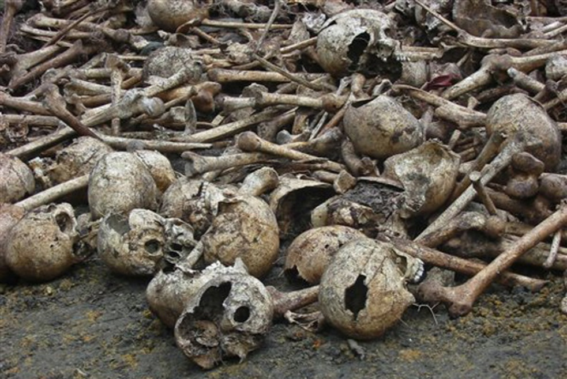
Bring Out the Bones
Scattering bones of kings, princes, prophets, priests, etc. ...an expression of hatred
“In order to pour the utmost contempt upon the land, the victorious enemies dragged out of their graves, caves, and sepulchers, the bones of kings, princes, prophets, priests, and the principal inhabitants, and exposed them in the open air; so that they became, in the order of God’s judgments, a reproach to them in the vain confidence they had in the sun, moon, and the host of heaven…
—all the planets and stars, whose worship they had set up in opposition to that of Jehovah. This custom of raising the bodies of the dead, and scattering their bones about, seems to have been general. It was the highest expression of hatred and contempt.”
Jeremiah 8:1-3
(4)

Slide 11
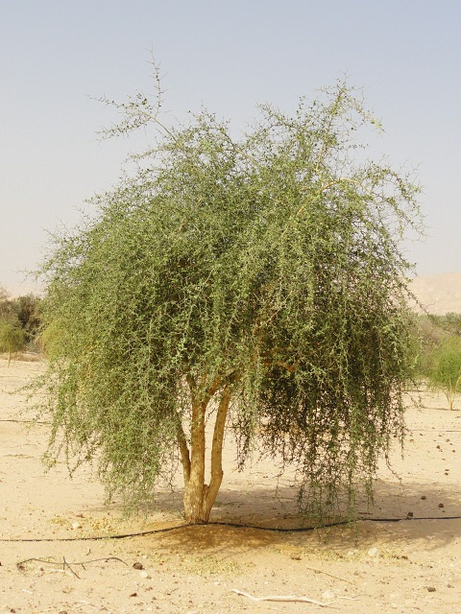
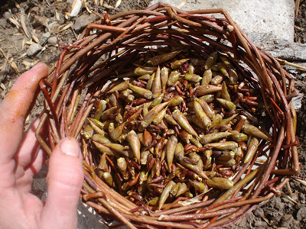
There Is No Balm in Gilead
Gilead was famous for its healing ointment
Jeremiah’s cry for balm of Gilead was an imagery: to soothe Judah and other nations.
No healing ointment, or medication, was available for rebellious Israel.
The balm of salvation could be administered only through Israel’s Savior, Jehovah, whom they had rejected.
Jeremiah 8:22, 46, 51
(1)

Slide 12
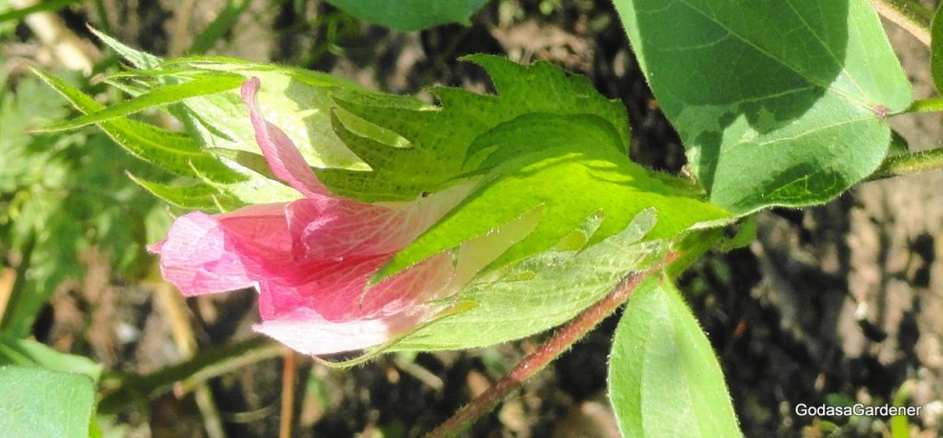
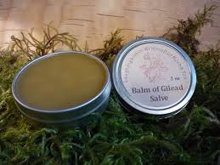
Healing in Three Prophecies
Jeremiah used the plant “balm of Gilead” to describe healing in three of his prophecies.
The first time Jeremiah foretold the destruction and exile of Judah.
The second time Jeremiah prophesied against Egypt. Jeremiah advised Egypt to go to Gilead and get balm, yet there would be no healing for them.
The third time, Jeremiah used the exemplar of balm for healing was to predict Babylon’s fall. Jeremiah suggested obtaining balm to heal Babylon; yet, Babylon could not be healed because her sins reached to the skies.
Even though God used Babylon to exact judgment against Judah, in God’s time Babylon would be destroyed.
Jeremiah 8:22, 46:11, 51:8-9
(1)

Slide 13
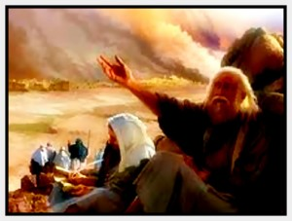
Jeremiah’s Lament
For the mountains will I take up a weeping and wailing, and for the habitations of the wilderness a lamentation, because they are burned up, so that none can pass through them; neither can men hear the voice of the cattle; both the fowl of the heavens and the beast are fled; they are gone.
call for the mourning women,
The Lord referred to the custom in ancient Israel of hiring professional mourners, women who were paid to wail and lament for long periods of time at someone’s death.
Jeremiah was told to hire professional mourners to lament over Judah.
Jeremiah 9:10, 17-22
(1)

Slide 14
Utterly Destroyed
To be consumed does not mean to become extinct. Being consumed and destroyed, in the context of the prophecies of the scattering of Israel, meant to be utterly disorganized and disbanded so that Israel’s power, influence, and cohesiveness as a nation was gone.
I call heaven and earth to witness against you this day, that ye shall soon utterly perish from off the land whereunto ye go over Jordan to possess it; ye shall not prolong your days upon it, but shall utterly be destroyed.
Deuteronomy 4:26
Moses told all Israel that they would “utterly be destroyed.” Yet the verses following show that Israel still existed as homeless individuals.
And the Lord shall scatter you among the nations, and ye shall be left few in number among the heathen, whither the Lord shall lead you.
Deuteronomy 4:27
Jeremiah 9:16
(1)

Slide 15
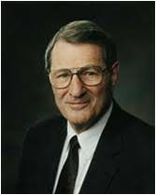
“Glory In”
Instead of worldly wisdom, strength, or riches, what did the Lord want His people to glory in?
Understanding and knowing the Lord and His attributes.
It is more valuable to know the Lord and understand His attributes than to pursue worldly interests.
“The more we know of Jesus, the more we will love Him. The more we know of Jesus, the more we will trust Him. The more we know of Jesus, the more we will want to be like Him and to be with Him by becoming the manner of men and women that He wishes us to be.” (5)
Jeremiah 9:23-24

Slide 16
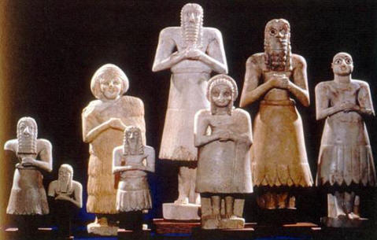
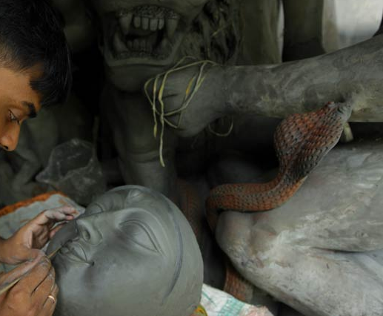
Idols
Jeremiah knew the stupidity and sheer illogic of worshiping an idol.
People take such materials as wood and precious metals which they work and shape at their own will, making all kinds of objects of service.
Then they take those same materials, make them into an idol by the work of their own hands, and suddenly expect the idol to be filled with supernatural power and be able to provide miraculous aid for the person who made it.
Jeremiah 10:1-16
(1)

Slide 17
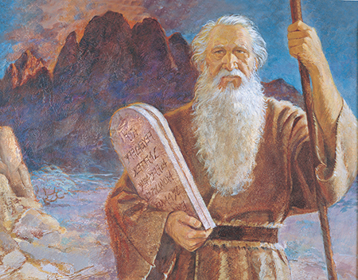
None Shall Escape
Jeremiah refers to the covenant the Lord made with the house of Israel at the time of the Exodus.
“I will take you to me for a people, and I will be to you a God” Exodus 6:7
Even as the Jews’ forefathers broke the covenant, so had their children in Judah.
Therefore, none would escape the punishment decreed, nor would the prayers of Jeremiah or those of the people help.
Jeremiah 11:1-14
(1)

Slide 18
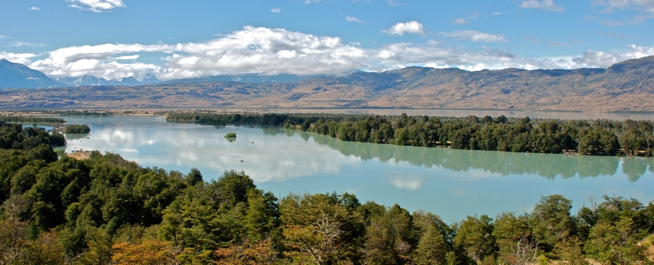
Why Do Wicked Prosper?
“If the smallest evils to which thou art exposed cause thee to make so many bitter complaints, how wilt thou feel when, in the course of thy prophetic ministry, thou shalt be exposed to much greater, from enemies much more powerful?
Footmen may here be the symbol of common evil events; horsemen, of evils much more terrible. If thou have sunk under small difficulties, what wilt thou do when great ones come?
…If in a country now enjoying peace thou scarcely thinkest thyself in safety, what wilt thou do in the swellings of Jordan? in the time when the enemy, like an overflowing torrent, shall deluge every part of the land?’
“The overflowing of Jordan, which generally happened in harvest, drove the lions and other beasts of prey from their coverts among the bushes that lined its banks; who, spreading themselves through the country, made terrible havoc, slaying men, and carrying off the cattle.”
Jeremiah 12:5
(6)

Slide 19
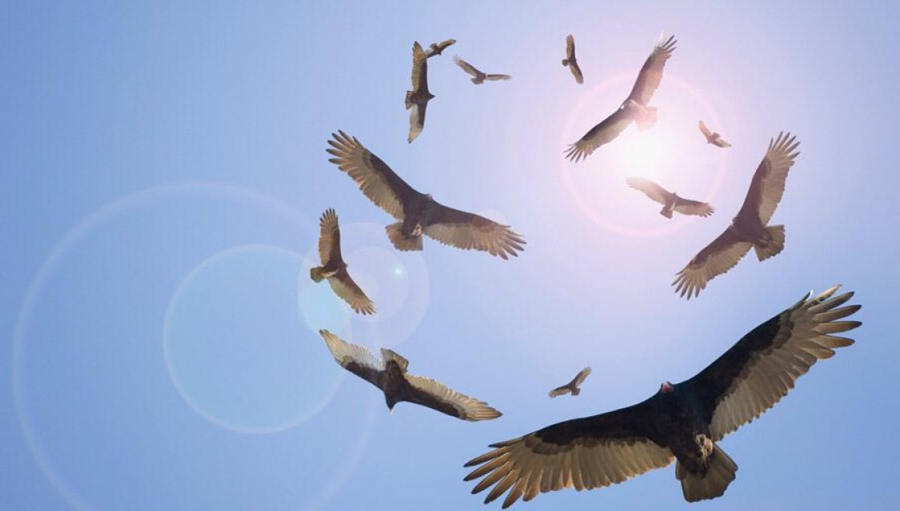
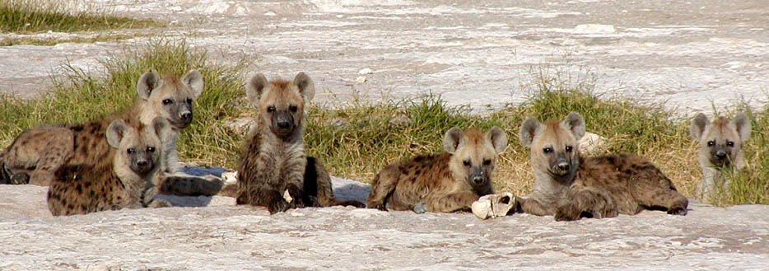
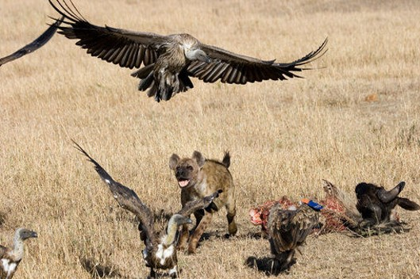
The Speckled Bird
I will pass through all thy flock to day, removing from thence all the speckled and spotted cattle, and all the brown cattle among the sheep, and the spotted and speckled among the goats: and of such shall be my hire. Genesis 30:32
“Israel with her proud plumage has attracted the attention of birds of prey (enemies) who move in to attack her (Israel).
An alternative translation arises from rendering sabua as a noun, ‘hyena,’ which is possible. This understanding of the word combined with the [Septuagint] substitution of the word ‘cave’ for ‘bird of prey’ leads to the translation:
“‘Is this land of mine a hyena’s lair
“‘With birds of prey hovering all around it?
“…a hyena’s lair with vultures hovering around waiting to swoop down on what is left of a carcass after the hyena has eaten.
…The people and land are under attack from foes. There is a feast prepared for all the wild beasts (lit. ‘beasts of the field’). The destruction of Judah will provide pickings for all.”
Jeremiah 12:9-12
(7)

Slide 20
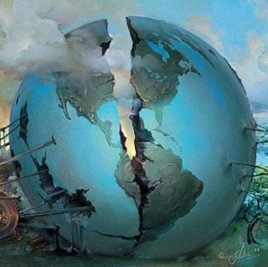
The Spoilers
The spoilers of the Lord’s heritage are also to be carried off out of their land; but after they, like Judah, have been punished, the Lord will have pity on them, and will bring them back one and all into their own land.
And if the heathen, who now seduce the people of God to idolatry, learn the ways of God’s people and be converted to the Lord, they shall receive citizenship amongst God’s people and be built up amongst them; but if they will not do so, they shall be extirpated [pulled out by the roots; wiped out].
Thus will the Lord manifest Himself before the whole earth as righteous judge, and through judgment secure the weal [health or prosperity] not only of Israel, but of the heathen peoples too.”
Jeremiah 12:14-17
(8)

Slide 21
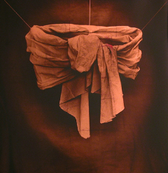
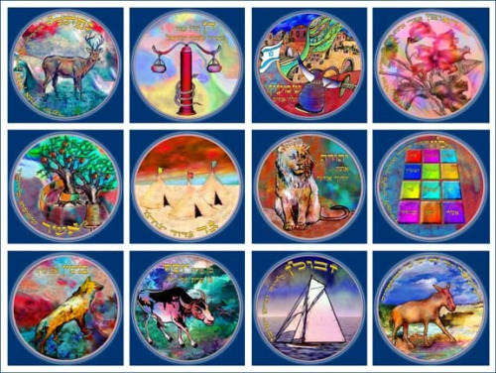
Parable of the Loin Cloth
The linen girdle = the priestly nation of Judea, since linen was used for priestly garments (see Leviticus 16:4).
Sperry wrote: The girdle represents the whole house of Israel, including Judah.
By reason of the iniquities of the Lord’s people (in this case the Jews), they will become separated from Him.
The coming Captivity into Babylon could well be represented by the hiding of the girdle near the Euphrates.
The fact that the girdle was ‘marred’ in its hiding place simply indicates that the close relationship between God and the Jews had been strained to the breaking point.”
Jeremiah 13:1-11
(9)

Slide 22
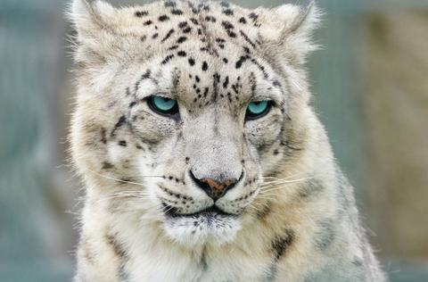
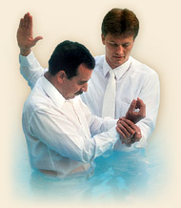
Can Spots Be Changed?
Skin color, like a leopard’s spots, cannot be changed.
“…whether totally black or only spotted the perspective of evil in the people is so fixed that they will do nothing about it.
The cause of it is the foundation cause: they have forgotten the Lord. Therefore the disasters come.” (10)
The wickedness of the Jews was so entrenched that they were past repenting. They had rejected that God who could wash away their spots. They had turned their backs on the only source of redemption. Can an evil fountain produce that which is good? (11)
By baptism, our blemishes can be washed clean again.
Jeremiah 13:23

Slide 23
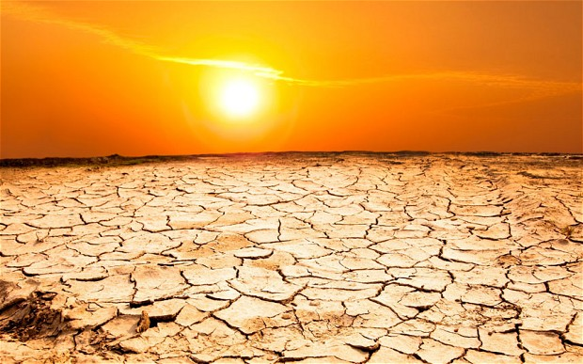
The Drought
Dearth = scarcity or lack of something
Everyone, even the wealthy, was affected by the drought, a calamity to which Judah was often subject.
Ordinarily Judah’s summers are dry, for little rain falls from April to the middle of October.
This scanty rainfall leaves the rivers low, or even dry, and grass is scarce.
Jeremiah 14:1-6

Slide 24
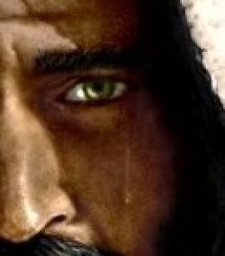
A Wayfaring Man
A traveler on his journey
That turneth aside to tarry for a night? - Who stays the shortest time he can; and takes up his lodging in a tent or caravanserai, for the dead of the night, that he may pursue his journey by break of day.
Instead of dwelling among us, thou hast scarcely paid the most transient visit to thy land. O come once more, and dwell among us. (6)
The Lord is waiting for the people to repent…however he can not dwell with those who reject Him and who have cast aside their covenants.
Jesus is the traveler and waiting for us to make the decision for Him to dwell with us.
Jeremiah 14:8

Slide 25
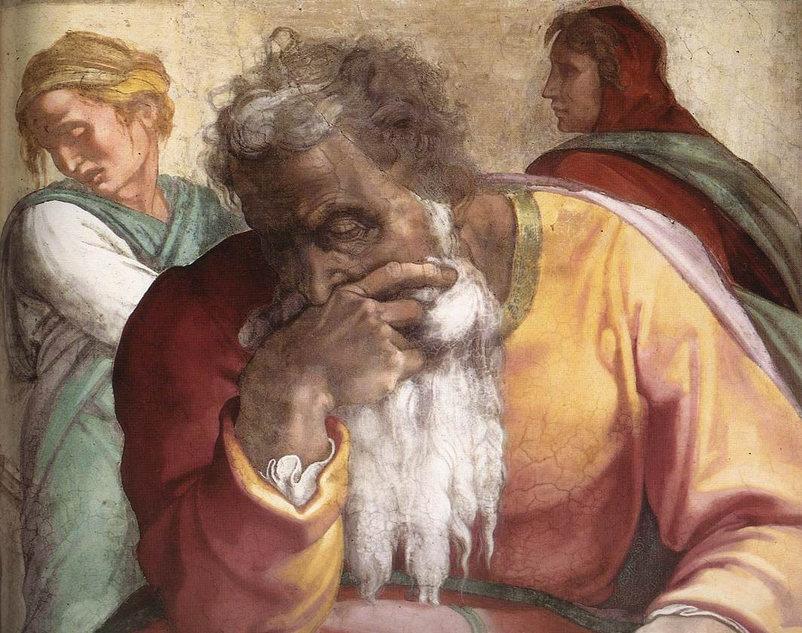
The Weary Man
Judah had reached the point at which the Lord would no longer forgive them.
Jeremiah repeatedly relented and gave Israel another chance.
However:
Nothing God did had worked; further delay was useless.
Jeremiah 15:1-14
(1)

Slide 26
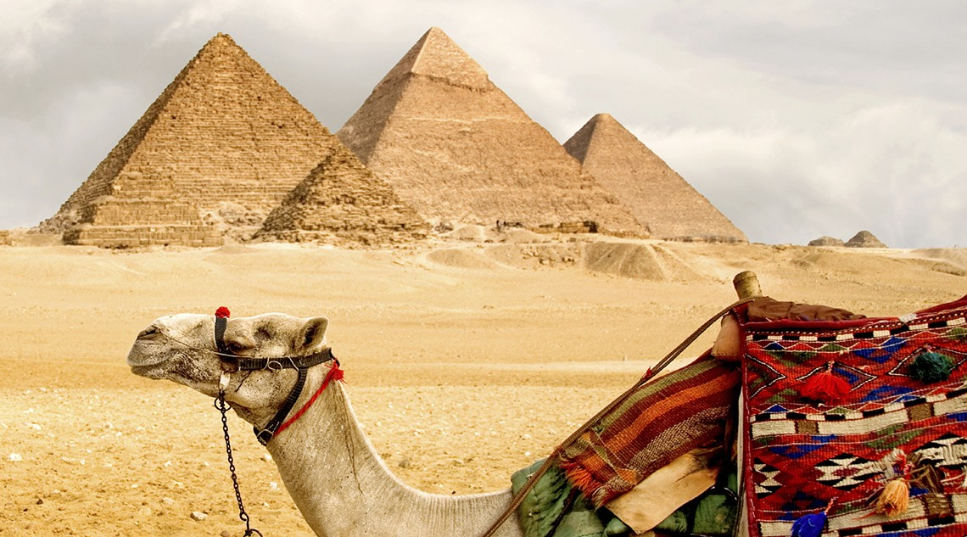
The Lord Sustained Jeremiah
As it happened, Jeremiah was not taken into Babylon but went into Egypt and probably died there a few years later.
The Lord’s promise, however, was more likely a promise of spiritual deliverance, a promise of an eternal reward for his faithfulness, since Jeremiah was taken into Egypt against his will..
Jeremiah 15:15-21
(1)

Slide 27
Jeremiah was not allowed…
He was not to marry or father children
16:2
He was not to lament those who had died in Judah
16:5
He was not to feast or eat with friends in Jerusalem
16:8
So universal was the calamity bearing down upon the people that God did not want children to suffer its outrage.
This commandment, like the one to Hosea to take a wife of whoredoms, may not have been a literal one. Perhaps the meaning is that Jeremiah was not to expect that his people would marry themselves to the covenant again, nor was he to expect to get spiritual children (converts) from his ministry.
(Hosea 10)
By the sword or famine, since they brought these judgments upon themselves.
Since feasting was a sign of celebration and eating together a symbol of fellowship.
Jeremiah was commanded to explain clearly to the people the reasons for his actions as well as the reasons for their coming punishment.
Jeremiah 16:2-8
(1)

Slide 28
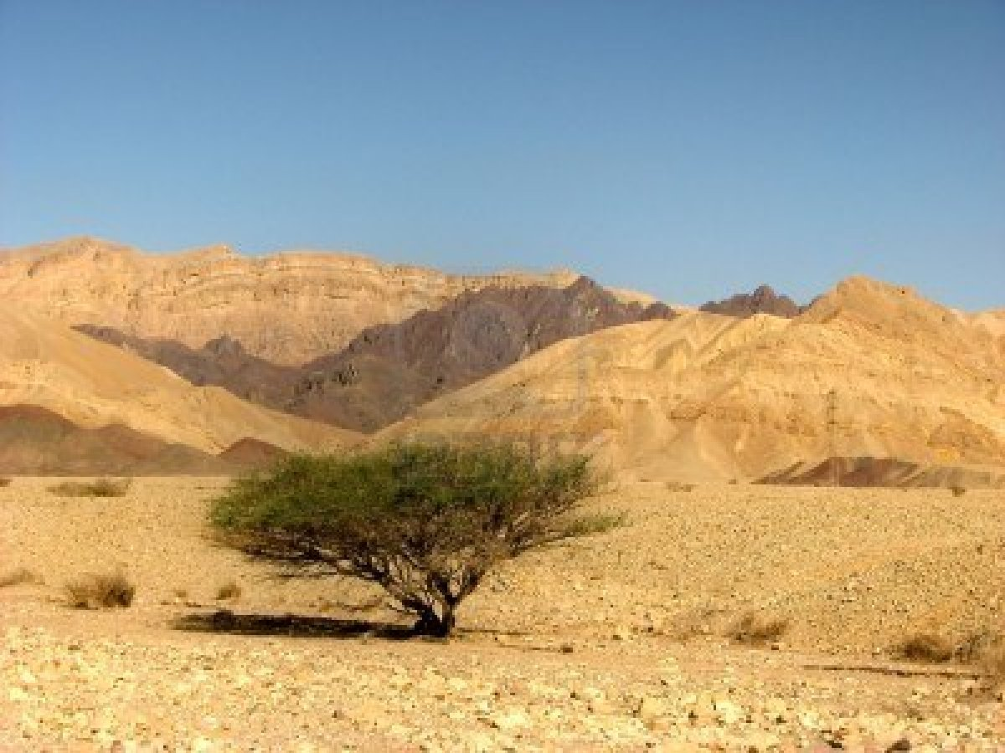
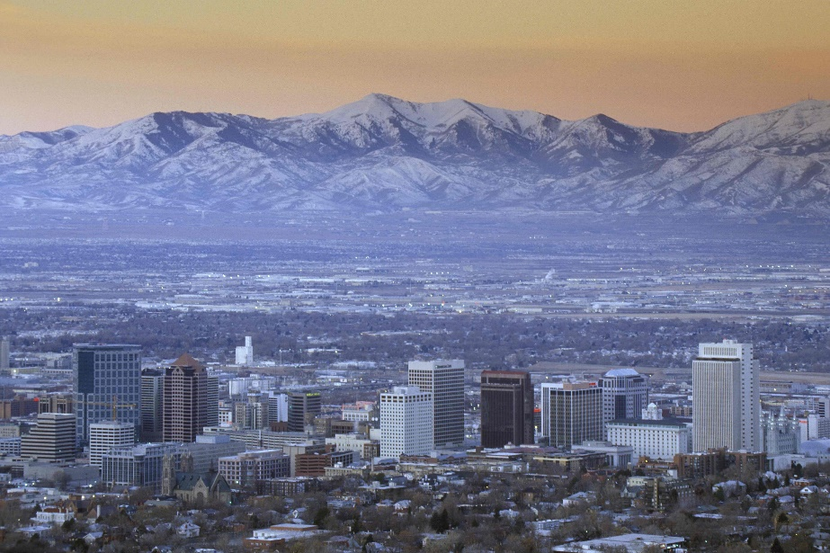
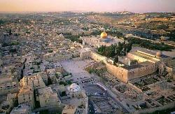
What did Jeremiah prophesy that the Lord would do in the latter days?
Bringing up the children of Israel from the north and from other lands means that the Lord will gather the descendants of Israel, bringing them to the knowledge of the gospel of Jesus Christ and to membership in His Church.
Jeremiah also prophesied that in the last days the Gentiles would seek to know the truth about God and would be gathered along with the descendants of Israel.
Jeremiah 16:14-21

Slide 29
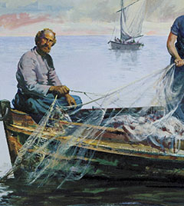
Fishers and Hunters
Those who help gather Israel through missionary work.
As we labor diligently to share the gospel with others, we can help them come to know the power of the true and living God
As we perform missionary work, these words can refer to us.
Jeremiah 16:16
(1)

Slide 30
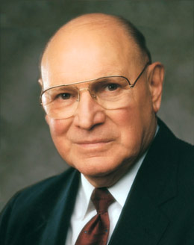
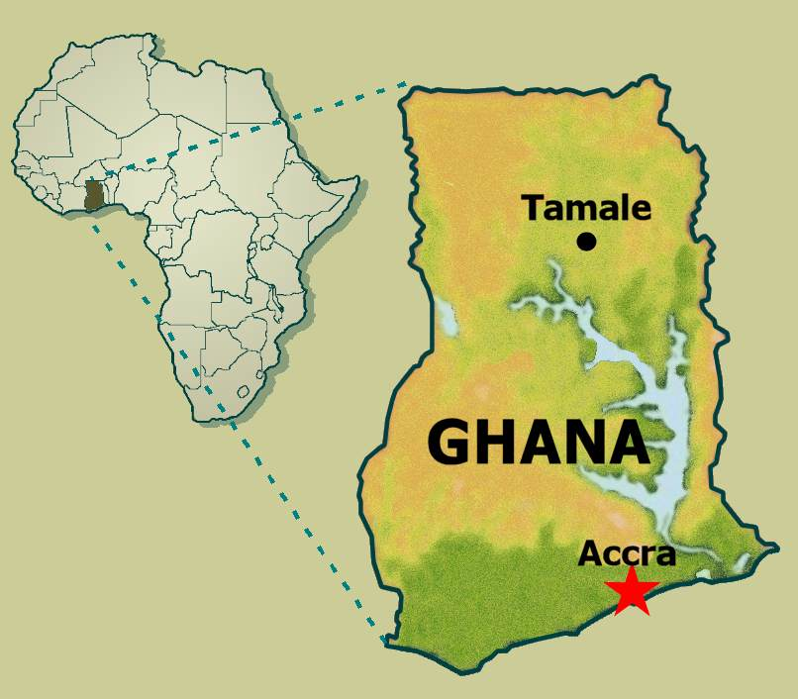
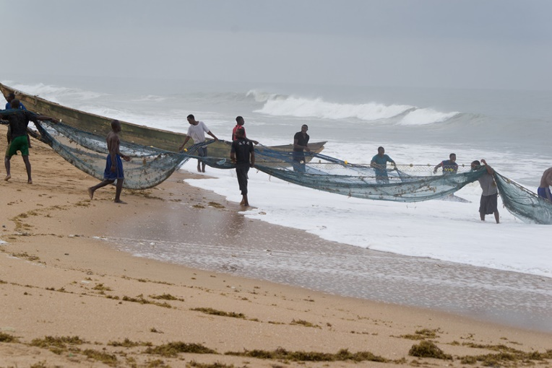
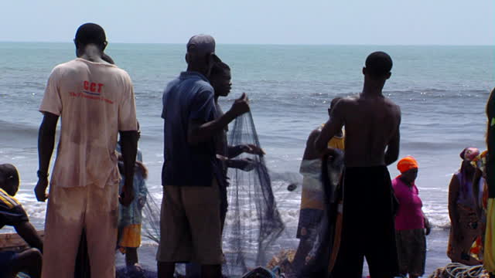
Visit to Ghana in West Africa
“We traveled to Ghana in West Africa. There the Church is growing rapidly and is on very solid footing. …
“As the sun was setting, we saw a large crowd of villagers. Young, old, and middle-aged all were pulling on a huge net and drawing it out of the water.
We stopped and inquired about what they were doing. They were pulling in the fish caught that day. In the net were large and small fish of many kinds. Each villager put his hands to the net to help bring in the catch.
Jeremiah 16:16
(12)

Slide 31
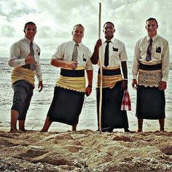
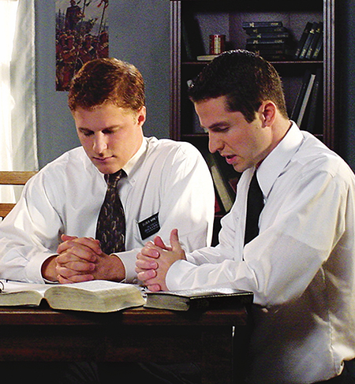
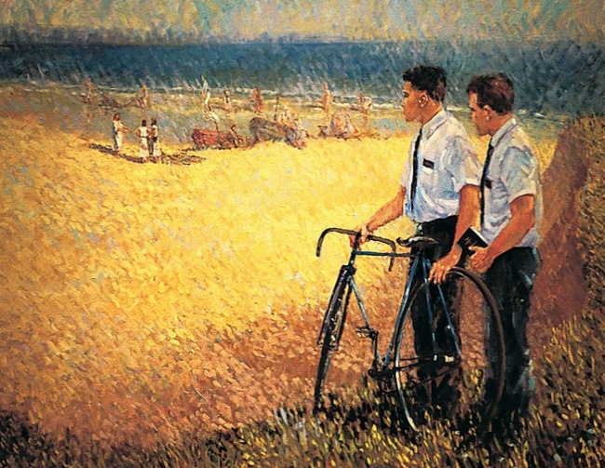
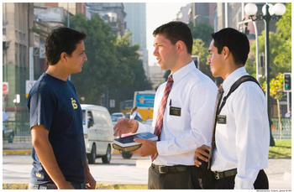
Fishers of Men
The thought ran through my mind of the gathering of Israel in the last days as referred to in Jeremiah. The Lord said, ‘I will send for many fishers … and they shall fish them’.
“That, brethren and sisters, is the mission of all of us as members of the Church: to put our hands on the net and pull in thousands of fine men and women who are searching for the truth.”
Mary Ann Wright
Jeremiah 16:16
(12)

Slide 32
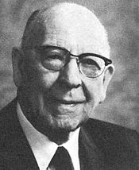
Seeing the day
“And Jeremiah saw the day when the Lord would do this very thing, when he would call for many fishers and many hunters, ‘and they shall hunt them from every mountain, and from every hill, and out of the holes of the rocks.’
Where do you find those fishers and hunters that we read about in this great prophecy of Jeremiah?
They are these [74,079] missionaries of this church, and those who have preceded them from the time that the Prophet Joseph Smith received the truth and sent the messengers out to share it with the world.
Thus have they gone out, fishing and hunting, and gathering them from the hills and the mountains, and the holes in the rocks. I think that is more literal than some of us think!”
Mormon news room 2016
Jeremiah 16:16
(13)
Statistical Report 2018 released April 2019 Gen.Conf.

Slide 33
Sources:
Suggested Hymn: #319 Ye Elders of Israel
Video:
No Regrets (5:38)
Old Testament Institute Manual As ye Sow, So Shall Ye Reap Chapter 23
President Marion G. Romney (“The Tragic Cycle,”) Ensign, Nov. 1977, 14–16).
Thompson, Book of Jeremiah, p. 293. found in Old Testament Institute Manual
Adam Clarke, The Holy Bible … with a Commentary and Critical Notes, 4:276.
Elder Neal A. Maxwell (“Plow in Hope,” Ensign, May 2001, 60).
Adam Clarke Commentary, 4:287; 244
Thompson, (Book of Jeremiah, p. 358.
Keil and Delitzsch,Commentary, 8:1:228.
Sperry, Voice of Israel’s Prophets, p. 167.
Moffatt The Interpreter’s Bible,5:928.
gospeldoctrine.com (Jeremiah 13:23)
Elder Joseph B. Wirthlin (“Pulling in the Gospel Net,” Ensign, Nov. 1986, 61).
Elder LeGrand Richards (In Conference Report, Apr. 1971, p. 143; or Ensign, June 1971, pp. 98–99.)
The Speckled Bird Song:
https://www.youtube.com/watch?v=IOnD72zIMU0
Presentation by ©http://fashionsbylynda.com/blog/

Slide 34
Jeremiah At A Glance – Bible Dictionary
Jeremiah 1-6 | Prophecies of reign of Josiah | Jeremiah 1:4-5 Jeremiah 3:12-19 | Premortal Condition and Jeremiah’s Calling Prophecy of the return of Israel from the scattered condition, gathering one of a city and two of a family to Zion, a pleasant land where Israel and Judah can dwell in safety and peace
Jeremiah 7-20 | Prophecies under Jehoiakim
Jeremiah 21-38 | Prophecies under Zedekiah | Jeremiah 21-23 | On pastors or rulers of people, with promise of king Messiah
 |  | Jeremiah 24 | Exiles carried away with Jehoiachin
 |  | Jeremiah 26-29 | False prophets and containing the prophet’s letter to the exiles in Babylon, warning against the prophets there
 |  | Jeremiah 30-33 | Prophecies of the latter-day restoration of Israel and the gospel covenant, containing the story of the prophet’s buying a field, showing the firmness of his faith in the people’s restitution
 |  | Jeremiah 34-38 | Narratives of the treatment of the prophet and other events during the last times of the siege
Jeremiah 39-44 | The prophet’s history and other events after the fall of the city
Jeremiah 46-51 | Prophecies against foreign nations | Jeremiah 50-51 | In their present form are later than Jeremiah
Jeremiah 52 | Historical conclusion

Slide 35
Activity in the church:
“Some have come to think of activity in the Church as the ultimate goal. Therein lies a danger. It is possible to be active in the Church and less active in the gospel. Let me stress: activity in the Church is a highly desirable goal; however, it is insufficient. Activity in the Church is an outward indication of our spiritual desire. If we attend our meetings, hold and fulfill Church responsibilities, and serve others, it is publicly observed.
“By contrast, the things of the gospel are usually less visible and more difficult to measure, but they are of greater eternal importance. For example, how much faith do we really have? How repentant are we? How meaningful are the ordinances in our lives? How focused are we on our covenants?” Elder Donald L. Hallstrom (“Converted to His Gospel through His Church,” Ensign or Liahona, May 2012, 14).
Jeremiah’s balm of Gilead Jeremiah 8:22 was probably the Balanites aegyptiaca, a small multi-branched spiny tree. The plant is also called the Ximenia aegyptiaca L, Jericho balsam, and desert date. Although widely distributed around the globe,B. aegyptiaca is thought to be native to Africa, India, and parts of the Middle East to include Israel. In Israel, it grows in in valleys, on river banks, and in depressions. Hasselquist who completed pioneering work on Holy Land plants described the gum of the B. aegyptiaca as yellow and light reflecting. Leaf stems and possibly roots produce a glutinous and tenacious resin. Sticking to the fingers, it can be drawn into long threads. Turkish surgeons used the gum to treat wounds. Supposedly, a few drops are applied to a fresh wound will cure it. Possibly wound edges could be connected by the glue-like property of the gum. Using Balm of Gilead to treat wounds is consistent with Jeremiah question of where was the balm of Gilead to heal the wounds of his people Judah (Jeremiah 8:22).
Medically, balms are healing or soothing substance, e.g., ointment, salve or cream. Balms can be analgesic and give pain relief. Figuratively, balms have the effects of calming, soothing and comforting, and providing solace and consolation. Jeremiah asked for pain relief for Judah which involved comfort and solace for their spirits as well as analgesia for their physical bodies.
http://godasagardener.com/2012/10/24/jeremiah-balm-of-gilead/
Long Hair: Jeremiah 7:29:
The long hair of the Nazarite was a sign of his consecration to Yahweh [Jehovah] (Num. 6:2–8). The removal of the hair signified an abandonment of his consecration. See (Judg. 16:15–22)
Jeremiah’s warning in vain: 11:1-14
“The Lord pointed out to him that there was a conspiracy among the Jews and that they had turned back to the iniquities of their forefathers. Their gods were as numerous as their cities, and the number of altars set up to Baal was according to the number of streets in Jerusalem. But, warned the Lord, their gods would not save them in the time of their trouble. In view of their spiritual condition the prophet was commanded not to pray for the people. Nor would the Lord hear their cries unto Him.” (11:9–14).” Sperry (Voice of Israel’s Prophets, pp. 165–66; emphasis added.)
Amend Your Ways Jeremiah 7:1-23
“Some have come to think of activity in the Church as the ultimate goal. Therein lies a danger. It is possible to be active in the Church and less active in the gospel. Let me stress: activity in the Church is a highly desirable goal; however, it is insufficient. Activity in the Church is an outward indication of our spiritual desire. If we attend our meetings, hold and fulfill Church responsibilities, and serve others, it is publicly observed.
“By contrast, the things of the gospel are usually less visible and more difficult to measure, but they are of greater eternal importance. For example, how much faith do we really have? How repentant are we? How meaningful are the ordinances in our lives? How focused are we on our covenants?” Elder Donald L. Hallstrom (“Converted to His Gospel through His Church,” Ensign or Liahona, May 2012, 14).

Slide 36
Who do the wicked Prosper? Jeremiah 12:1
“The enmity experienced by Jeremiah at the hands of his countrymen at Anathoth excites his displeasure at the prosperity of the wicked, who thrive and live with immunity. He therefore begins to expostulate with God, and demands from God’s righteousness that they be cut off out of the land (vers. 1–4); whereupon the Lord reproves him for this outburst of ill-nature and impatience by telling him that he must patiently endure still worse.—This section, the connection of which with the preceding is unmistakable, shows by a concrete instance the utter corruptness of the people; and it has been included in the prophecies because it sets before us the greatness of God’s long-suffering towards a people ripe for destruction.” (Keil and Delitzsch, Commentary, 8:1:219.)
Distress and Drought 14:1-6:
Distress into which the land and its inhabitants have fallen for lack of rain. Judah is the kingdom or the country with its inhabitants; the gates as used poetically for the cities with the citizens. Not mankind only, but the land itself mourns and pines away, with all the creatures that live on it; cf. v. 4, where the ground is said to be dismayed along with the tillers of it.” (Commentary, 8:1:244.)

Slide 37
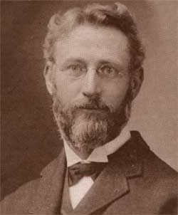
Something of Interest: Theology and Astrology in the Bible
In Biblical Theology: Old and New Testaments, Geerhardus Vos engages criticism of Jacob and retells a very interesting recapulation of the story of Jacob where the Patriarchs are interpreted as referencing to Ancient Astrological gods.
…it has also been attempted to explain these names from Babylonian antecedents. Sarah was teh goddess of Haran, Abraham a god of the same place: Laban, the moon-god. The four wives of Jacob are the four phases of the moon. The twelve sons of Jacob are the twelve months of the year; the seven sons of Leah are the seven days of the week; the number of men with which Abraham defeated the invaders, 318, constitutes the nubmer of days in a lunar year. (pg 67, Chapter 7, Biblical Theology, Geerhardus Vos).
There are many astrological references throughout the bible, and some are particularly interesting. The Magi were likely Persian Astrologers that were influenced by Jews during the Exile period, and somehow were able to determine the location of the birth of Jesus through an astrological sign. The bible is full of references to the sun, star and moons.
Then he dreamed another dream and told it to his brothers and said, “Behold, I have dreamed another dream. Behold, the sun, the moon, and eleven stars were bowing down to me.” (Genesis 37:9 ESV)
“And there will be signs in sun and moon and stars, and on the earth distress of nations in perplexity because of the roaring of the sea and the waves, people fainting with fear and with foreboding of what is coming on the world. For the powers of the heavens will be shaken. (Luke 21:25-26 ESV)
The Dead Sea Scrolls contains many Astrological fragments such as the Brontologion (4Q318) "thunder discourse" that contains a list of days of the month corresponding to the signs of the Zodiac. The Aramaic Horoscope (4Q561) equates physiognomy to astrological destiny, so that a person's future may be determined by their facial features, and in the same theme the Horoscope Written In Code (4Q186) that also considers facial features as revealing character. Most of these fragmented texts are available in English translations such as the Wise Abegg, Cook edition that I've read.
http://postbarthian.com/2012/04/13/geerhardus-vos-and-biblical-astrology/
Geerhardus Johannes Vos (1862–1949)

